Slide 1
Assistive Technologies to Support Individuals with Disabilities in Job Corps and the Workplace
Therese Willkomm, PhD, ATP
theresew@unh.edu
603-491-6555

Slide 2
Description and Learning Objectives:
This webinar will demonstrate technologies that can be used to support individuals with disabilities in various career paths, and explore innovative solutions to increase independence and productivity in the workplace. Participants will be able to identify and describe at least:
5 different assistive technologies to support students in different career technical paths
5 different everyday tools and materials for creating employability-related accommodations for students attending Job Corps.
3 different resources to obtain needed tools, materials, and technologies to support students’ independence and employability skills.

Slide 3
Assistive Technology Solutions for Various Career Paths
Office Work – Receptionist, Office support
Production Assembly
Agriculture and Outdoor careers
Maintenance and Repair
Food Service

Slide 4
Agriculture
Landscaping
Greenhouse work
Livestock handling and feeding
Gardening

Slide 5
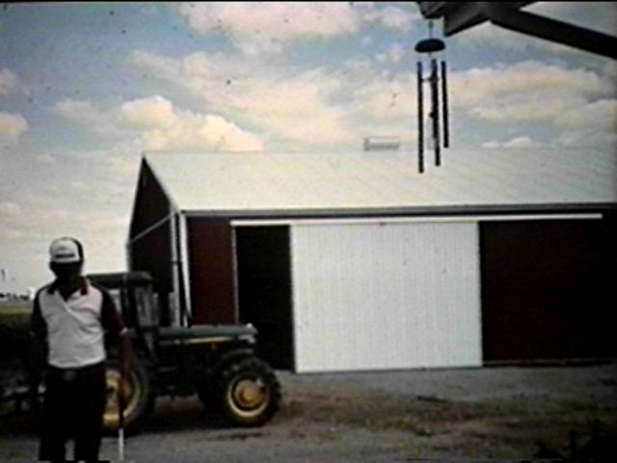

Slide 6
Livestock Handling

Slide 7
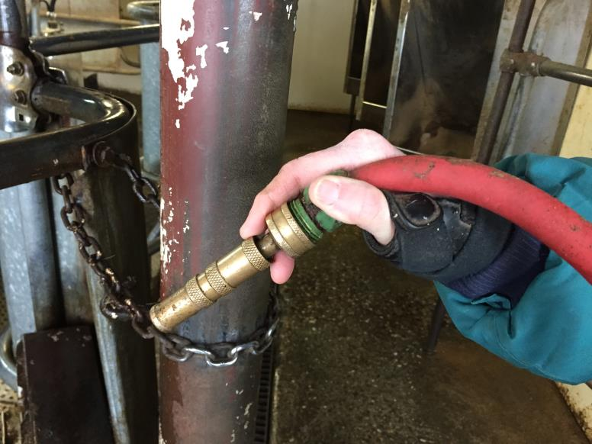
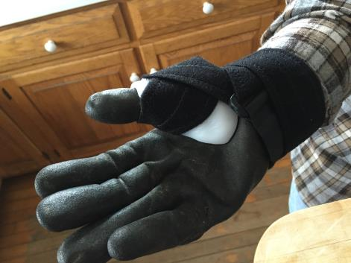

Slide 8
Lawn care Worksite Modifications

Slide 10
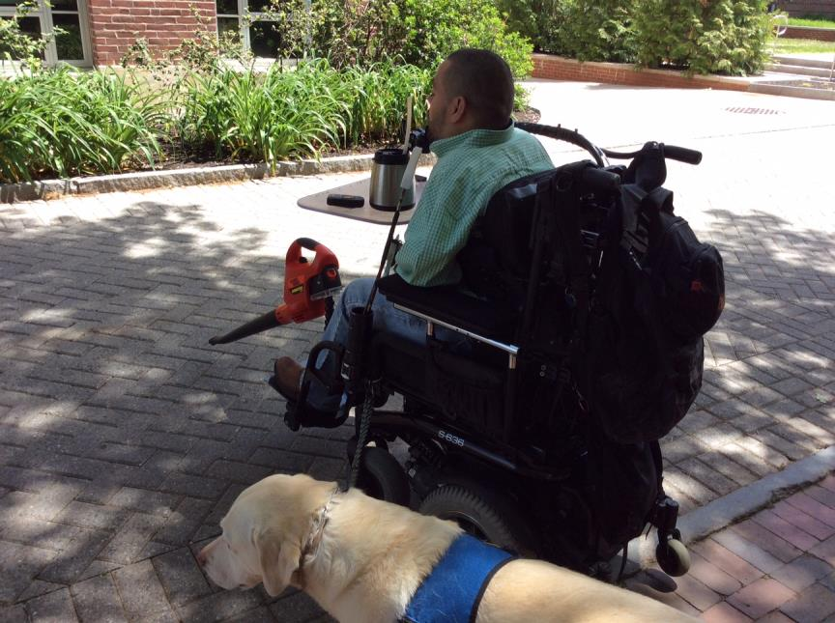

Slide 11
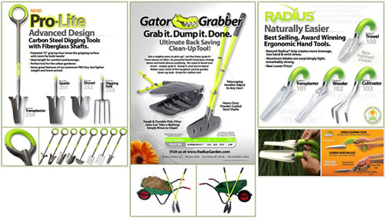
Back saving tools

Slide 12
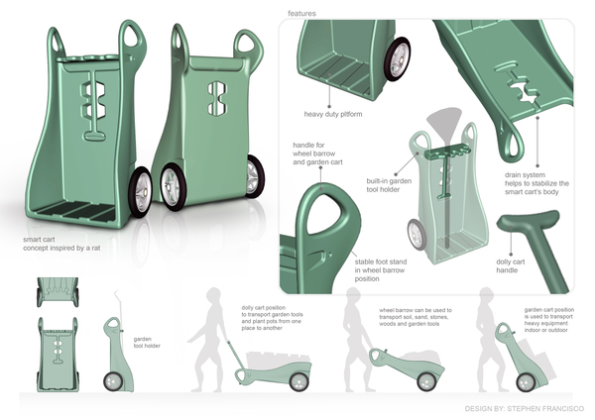
Smart Garden Cart with Ergonomic Handles

Slide 13
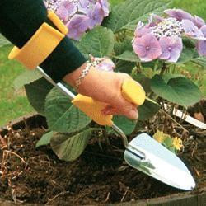

Slide 14
Trimmer Toad

Slide 15
Back Buddy

Slide 16
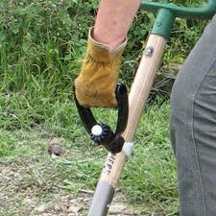
Back Saving Solutions Ergonomic Grips

Slide 17
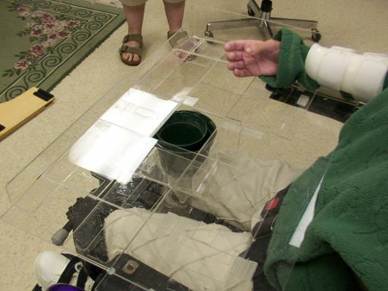
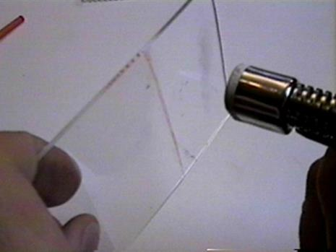
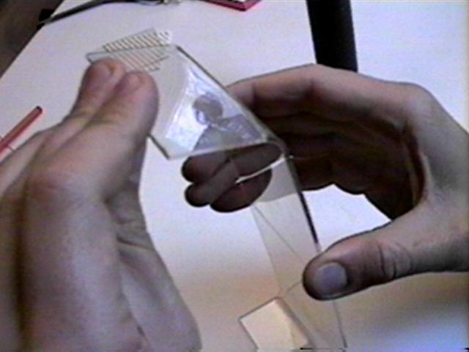
Working with acrylic

Slide 18
A.T. for Office Work

Slide 23
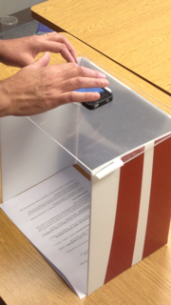

Slide 25
Workplace accommodations using colors for task completion prompts

Slide 26
A.T. for Production Work Careers

Slide 27
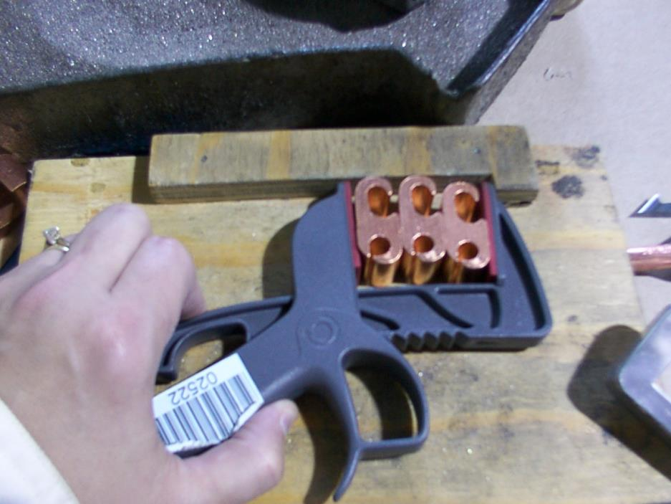

Slide 28
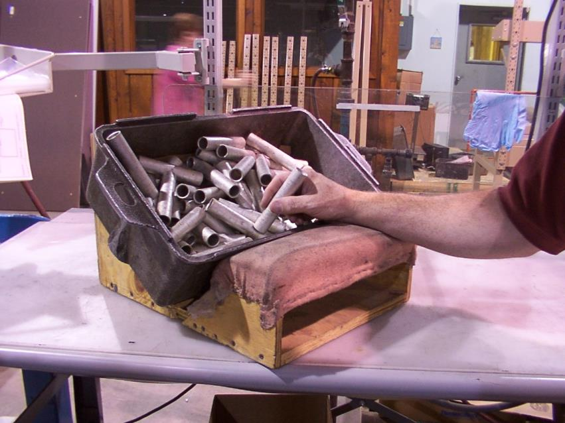

Slide 29
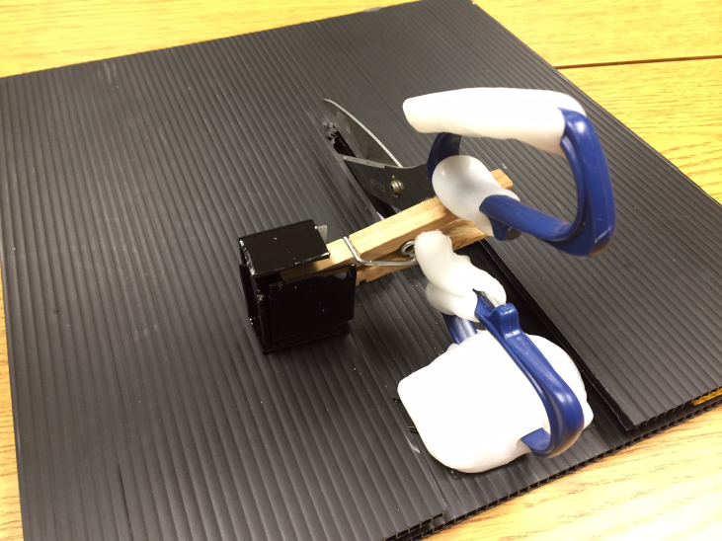
Spring Loaded Cutting Jig for Grasping Impairments

Slide 30
Use a multi-sensory approach for Assembly of Med Kits
Visual
Tactile
Auditory

Slide 31
Task Analysis & Chunk it Down

Slide 32
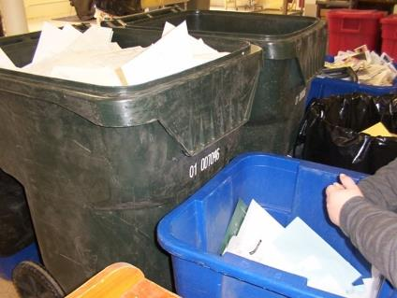
Strategies For Reducing Cognitive Demands for Paper Recycling Careers
Paper sorting can be cognitively demanding due to decision making process that occurs when paper is selected
Chunk tasks down – through a task analysis
Look at current industrial sorting jobs
Jigs, fixtures, scales

Slide 33
Labeling Jig

Slide 34
One handed Napkin silverware rolling Jig

Slide 35
Worksite assembly jig to reduce visual and cognitive demands

Slide 36
One Handed Jig for Mail Sorting in Post office

Slide 37
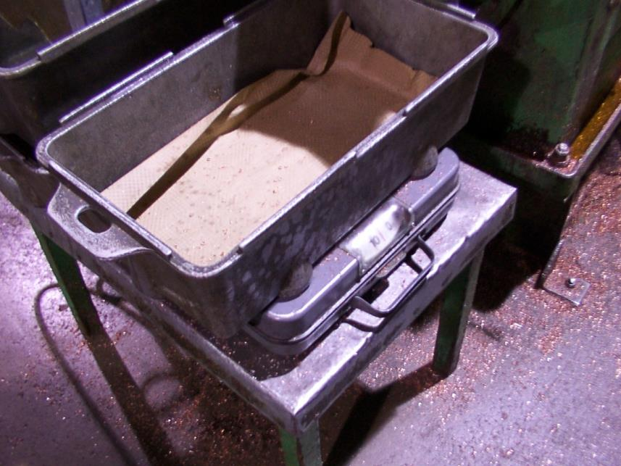

Slide 38
Rapid Prototyping

Slide 39
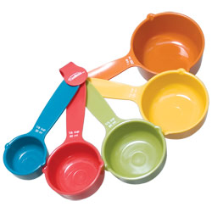
Color Coding Bins and Measuring

Slide 40
Maintenance and Repair Careers

Slide 41
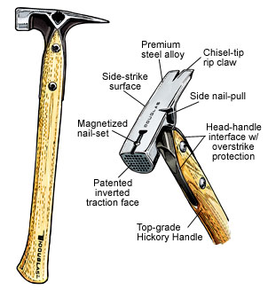
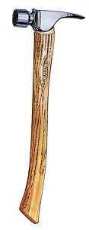

Slide 42
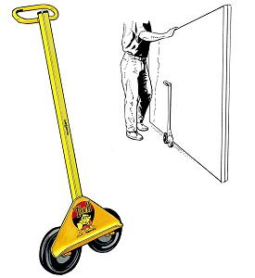

Slide 43
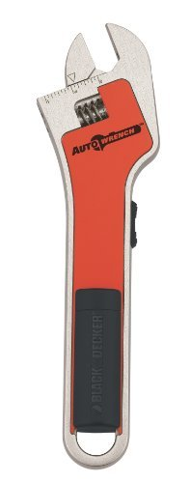
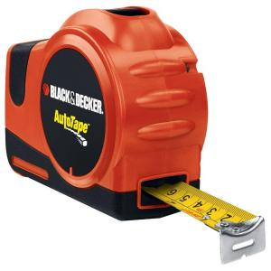
BLACK & DECKER Auto Tape Measure – One handed
Black and Decker Auto Wrench

Slide 44
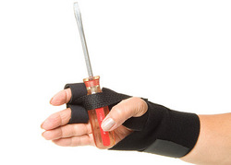
The Helpful Hand™

Slide 45
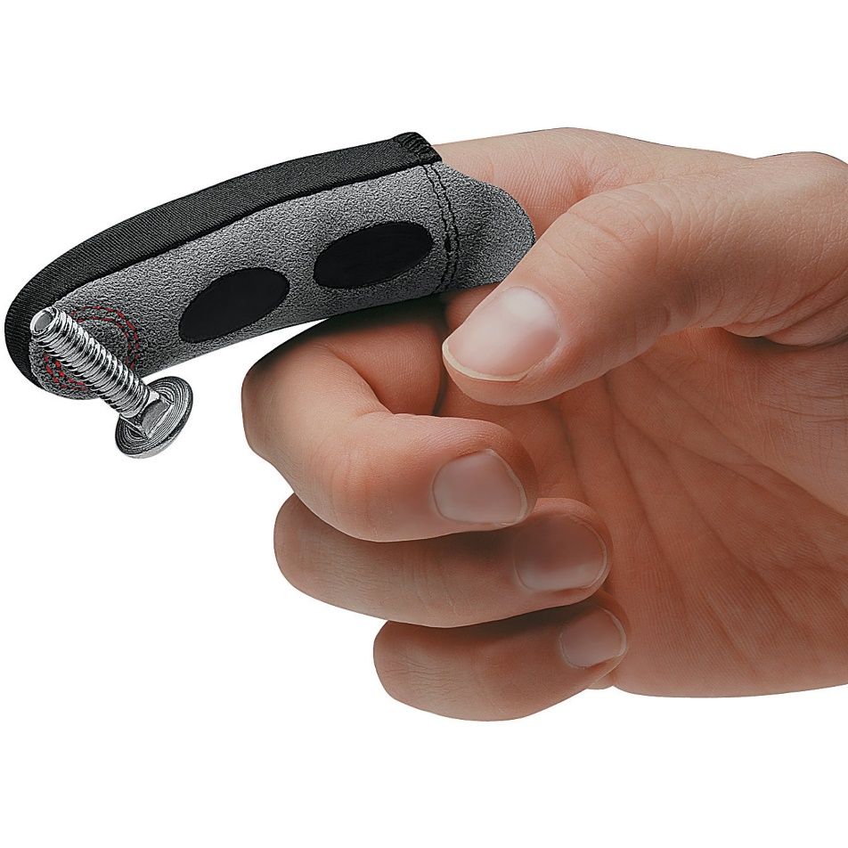
Magnetic Magic Finger

Slide 46
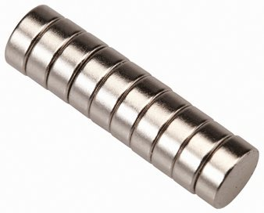
Rare Earth Magnets and JB Weld

Slide 47
Level 4: Fabricate New Solutions

Slide 48
Cam Assisted Pliers

Slide 49
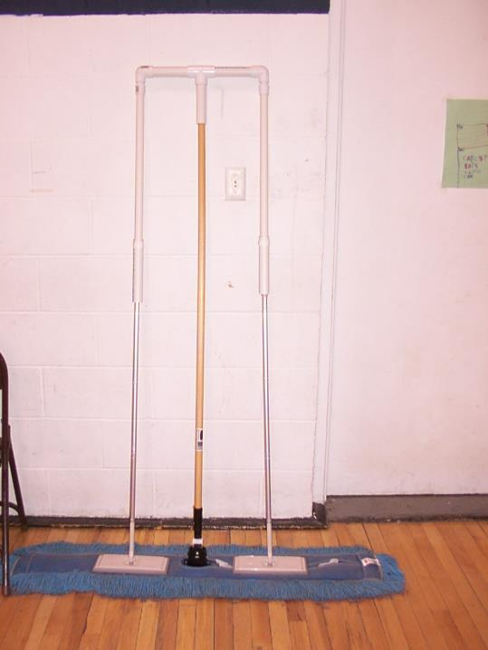

Slide 50
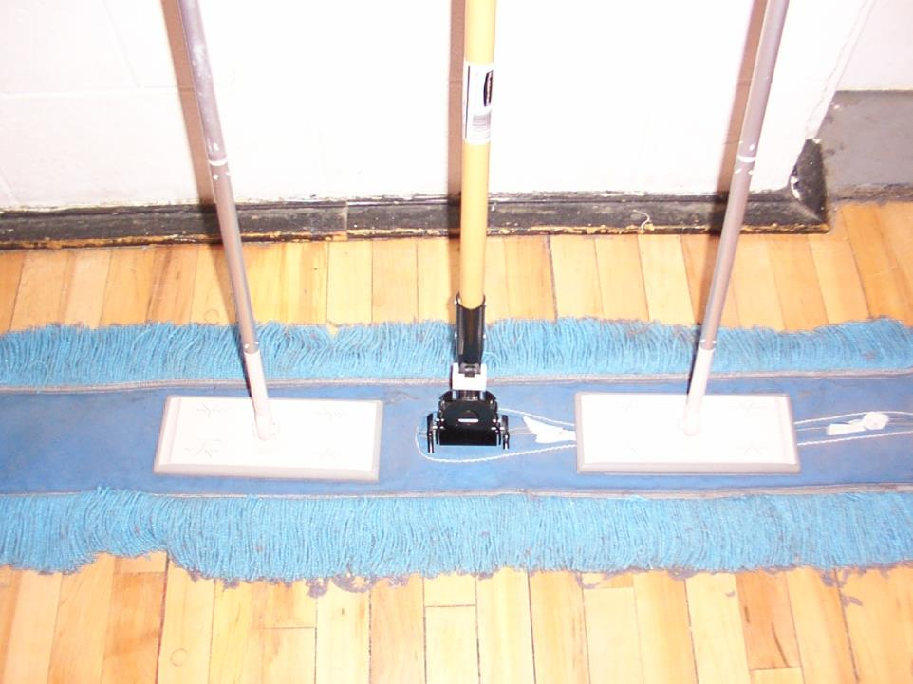

Slide 51
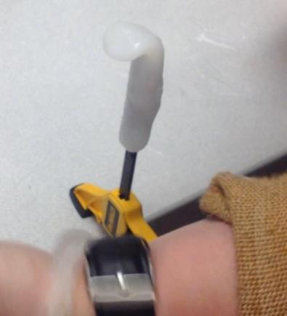
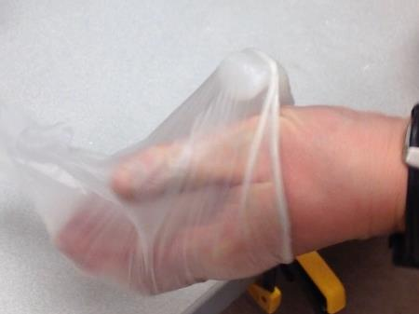
Putting Work Gloves on with One Hand

Slide 52
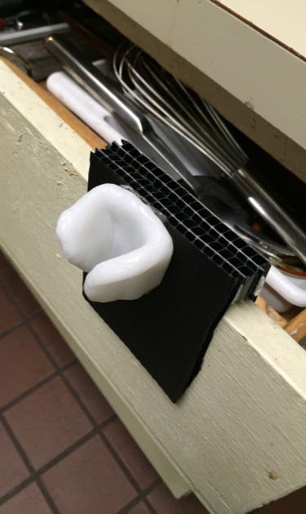
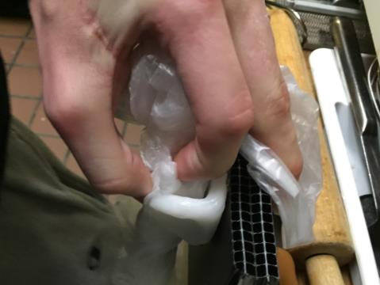
Tying Garbage Bags with One Hand

Slide 53
Assistive Technology and Food Service Careers

Slide 54
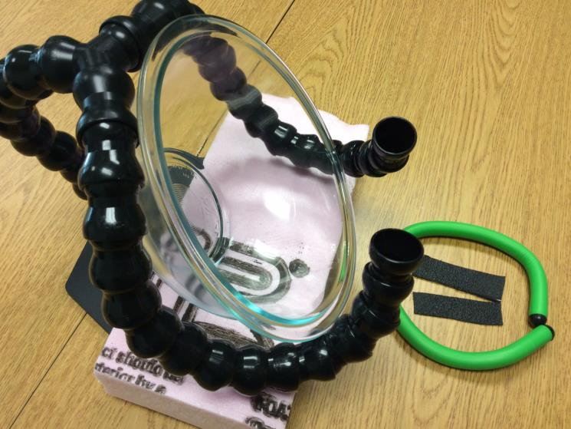
Assistive Technology for Food Preparation

Slide 55
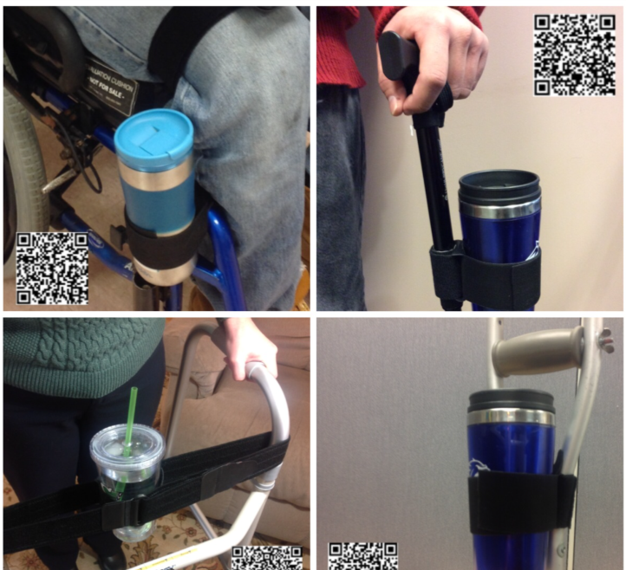

Slide 58
Assistive Technology for Work Task Reminding
Vibrating Watches and assorted reminding devices

Slide 59
Up to 37 Daily LOUD Alarms

Slide 60
Motion Sensor Prompts and Alerts

Slide 61
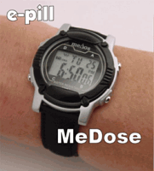
Tactile prompts
Vibrating pager
Vibrating watch reminder
Vibrating Cellphone

Slide 62
iPAD and iPhone Apps, Adaptations, Accessories for Employment Success
Smart Phones and apps – GPS and Scan and Read Stations
Wearable Technologies – Google Glass
Smart Watches – Pebbles
Reminders, Prompts, Work Task Training

Slide 63
iPADs and Service Trades -

Slide 64
Employees who are deaf and using iPAD to perform work tasks
Shoe store
Mail Delivery and postal work who is deaf
AAC Flip Writter for communication using Voice Recognitions
Using Photo Album

Slide 65
iPADs and Employees Who Are Blind
Tap Tap see
Textgrabber
Vision Assist
Point and Measure

Slide 66
iPADs and Employees with Intellectual Disabilities
Say&Go
Adia
Photo Album with Video Clips
Pictella for job task sequencing
Scene Speak for work task completion
Coach Me Video – job coaching
Priority Matrix

Slide 67
iPADs and Employees with Intellectual Disabilities
Mytile app for finding misplaced tools
Pebbles Watch for work task prompting and finding iPhone

Slide 68
Everyday Tools and Materials for Creating Worksite Accommodations in Minutes

Slide 71
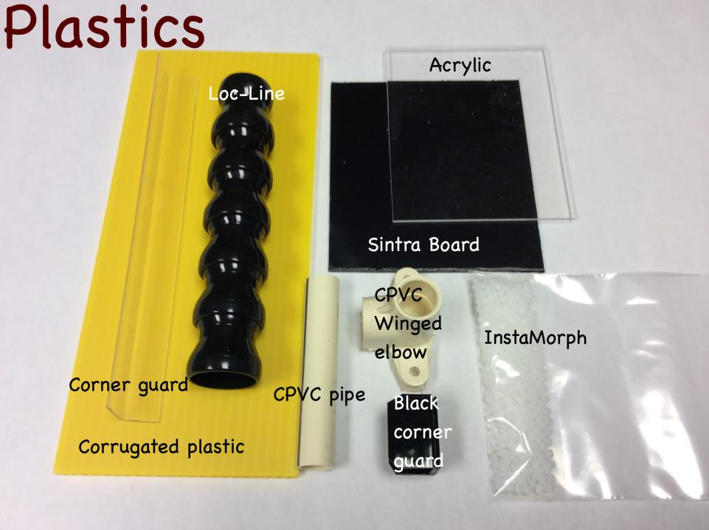

Slide 72
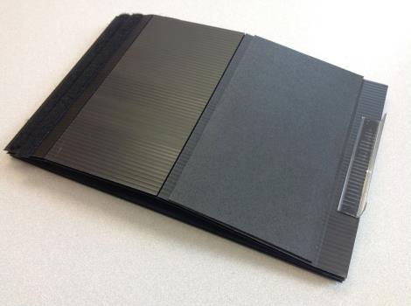
The Eileen Lightweight, Affordable,& Portable, Adjustable iPAD Holder

Slide 73
Traveling Eileen Benefits Everyone

Slide 74
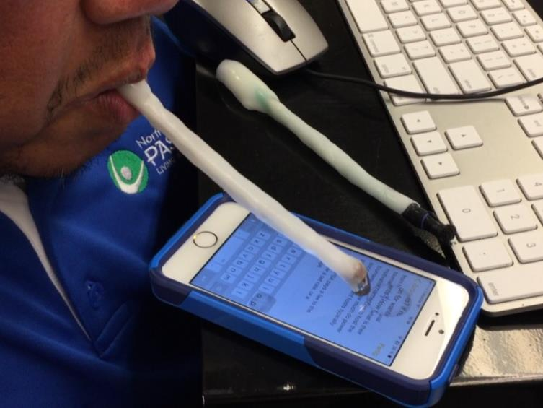
Adaptive Stylus for Employees with Disabilities

Slide 75
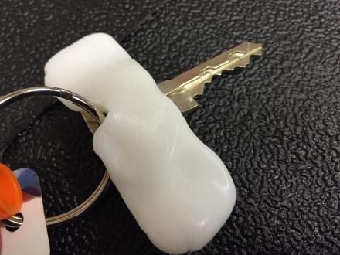
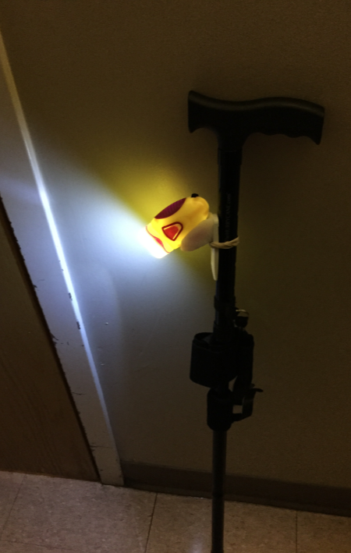
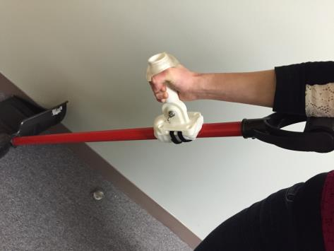

Slide 76
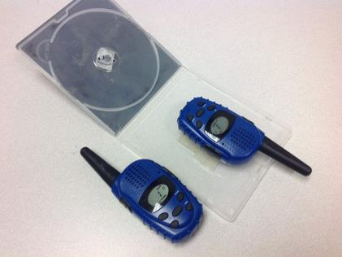
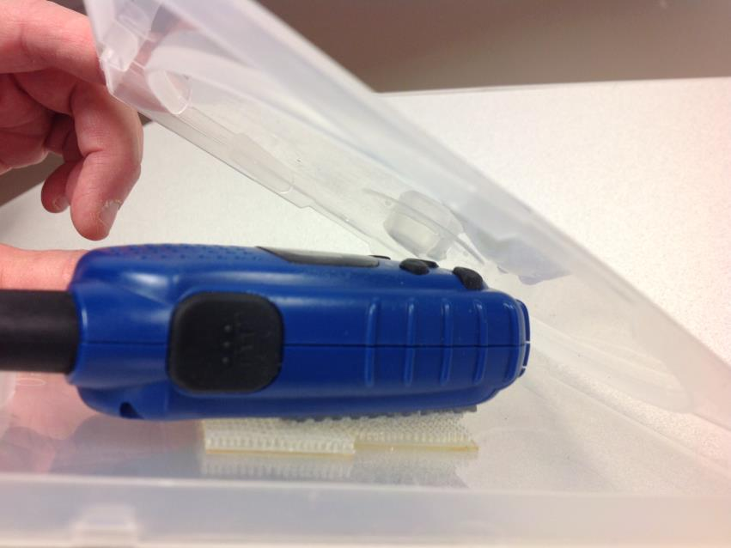

Slide 77
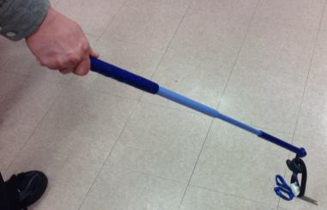
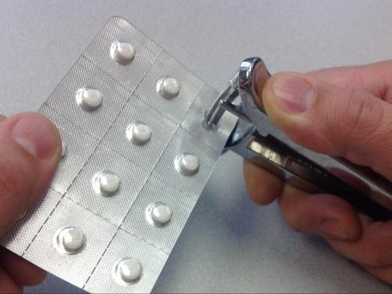
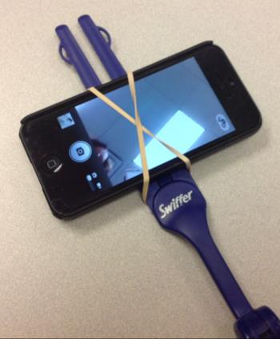
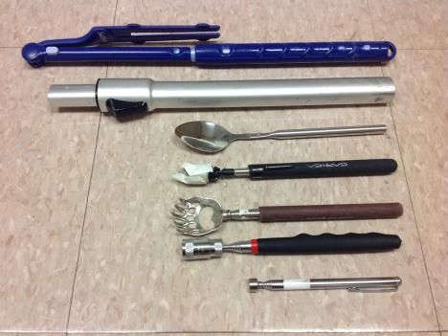

Slide 78
Resources
Job Accommodation Network:
http://askjan.org/
A.T. for Employers:
http://atconnects.com/resources/at-for-employers
Agrability:
http://agrability.org/

Slide 79
State assistive technology resources
Key Services Provided by Assistive Technology Projects in each State:
http://resnaprojects.org/nattap/at/stateprograms.html
Device Loan Programs
Device Reutilization Programs
Device Demonstration Programs
State Financing Activities

Slide 80
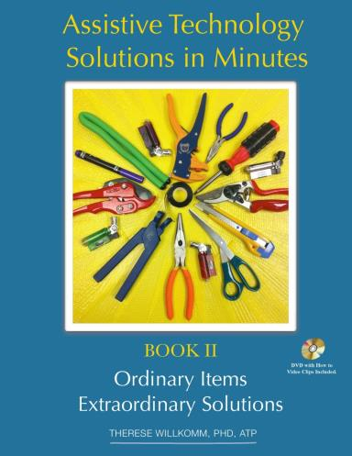
Assistive Technology Solutions in Minutes – Book II
AT in Minutes Book 2: http://www.iodbookstore.org/products/Assistive-Technology-Solutions-in-Minutes-II%3A-Ordinary-Items,-Extraordinary-Solutions.html

