Slide 1
Assistive Technology Tools Accommodating Students with Learning and Math Disabilities
Lisa Kosh, Regional Disability Coordinator
Maria Acevedo Correa, Mental Health Specialist, Puerto Rico Centers

Slide 2
Overview
What is a Learning Disability?
Assistive Technology Overview
Assistive Technology
Writing Disabilities – Dysgraphia
Math Disabilities – Dyscalculia
Sample Scenarios
Resources
Questions

Slide 3
What is a Learning Disability?
A LD is a neurological condition that affects the way individuals of average to above average intelligence receive, process, or express information.
A LD negatively impacts the ability to acquire basic skills of listening, speaking, thinking, reading, spelling, writing, and/or mathematics.

Slide 4
Common Types of Learning Disabilities
Dyslexia | Difficulty reading | Problems reading, writing, spelling, speaking
Dyscalculia | Difficulty with math | Problems doing math problems, understanding time, using money
Dysgraphia | Difficulty with writing | Problems with handwriting, spelling, organizing ideas
Dyspraxia (Sensory Integration Disorder) | Difficulty with fine motor skills | Problems with hand–eye coordination, balance, manual dexterity
Dysphasia/Aphasia | Difficulty with language | Problems understanding spoken language, poor reading comprehension
Auditory Processing Disorder | Difficulty hearing differences between sounds | Problems with reading, comprehension, language
Visual Processing Disorder | Difficulty interpreting visual information | Problems with reading, math, maps, charts, symbols, pictures
*resource - http://www.helpguide.org/mental/learning_disabilities.htm

Slide 5
What is NOT Considered a Learning Disability
Anxiety
Depression
Emotional trauma
Stressful events
ADHD
Autism

Slide 6
Assistive Technology Service
Assistive Technology service is defined as:
Directly assisting an individual with a disability in the selection, acquisition, or use of an assistive technology device.

Slide 7
Assistive Technology Device
An assistive technology device is defined as:
Any item, piece of equipment, or product system, whether acquired commercially off the shelf, modified, or customized, that is used to increase, maintain, or improve functional capabilities of individuals with disabilities.

Slide 8
Types of Assistive Technology
No-tech/Low-tech assistive technology devices are typically low cost and do not require the use of a computer or computer software to provide a benefit to an individual with a disability.
Mid-tech assistive technology usually offers the same advantages of low-tech devices. They are often more lightweight and portable, allowing them to be used anywhere and are relatively inexpensive.
Hi-tech assistive technology devices are costly and more complex electronic devices, such as computers and specialized software. High-tech devices often incorporate multiple features and may be used to meet a variety of needs.

Slide 9
Assistive Technology
Writing Disabilities

Slide 10
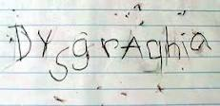
Signs of Dysgraphia
Generally illegible writing
Unfinished words or letters
Inconsistent spaces between words and letters
Misuse of lines and margins
Mixed upper case and lower case letters

Slide 11
Types of Dysgraphia
Dyslexic Dysgraphia – written work is illegible, spelling is bad.
Motor Dysgraphia – insufficient fine motor skills, poor muscle tone and poor dexterity.
Spatial Dysgraphia – lack of understanding of space. Illegible work, but may have normal spelling.

Slide 12
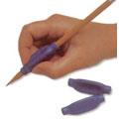
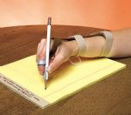
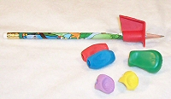
Pencil Grips
Rubber allows student to easily grip pen/pencil
allowing for better positioning
Provides stable grip
Increase coordination and accuracy when writing

Slide 13
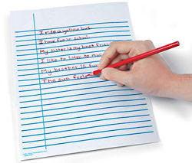
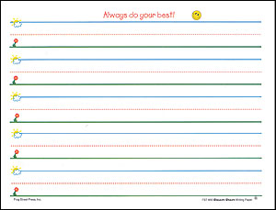
Raised Lined Paper
Raised lines allow for the student to feel his/her pen/pencil touch the boundaries of space they are writing in
Comes in a variety of colors
color contrasting

Slide 14
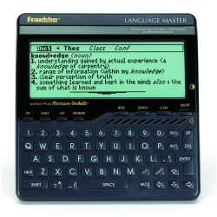
Talking Dictionary
Speaks/pronounces words and definitions
Adjustable type size and screen contrast

Slide 15
Removable Highlighter Tape
Temporarily highlight a sentence, a word, or part of a word in a book

Slide 16
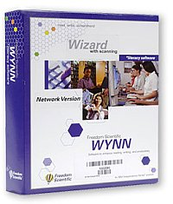
Wynn Wizard (Scanning and Reading Software)
Reads text aloud
Color coding
Web masking
Highlighting
Dictionary

Slide 17
Visual Graphic Organizers: Inspiration
Helps to guide thinking
Facilitates students’ learning by helping them to identify area of focus with a broad topic
Allows students to organize their thinking and writing process

Slide 18
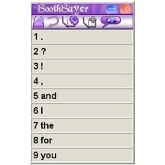
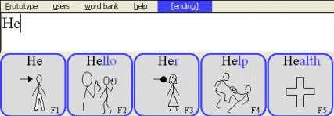
Word Prediction Software Programs
Helps the student during word “predicting” a word for the user to type
Sentence completion
Built in speech dictionary
Synthesized speech engines
Enhances typing speed minimizes key strokes for students that struggle with typing

Slide 19
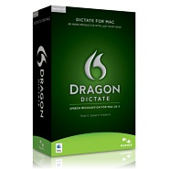
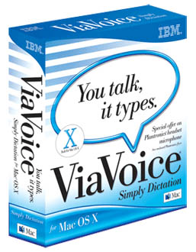
Voice Recognition Technology
Improves access to computer
Increase in writing production
Improvements in writing mechanics
Decreases anxiety around writing

Slide 20
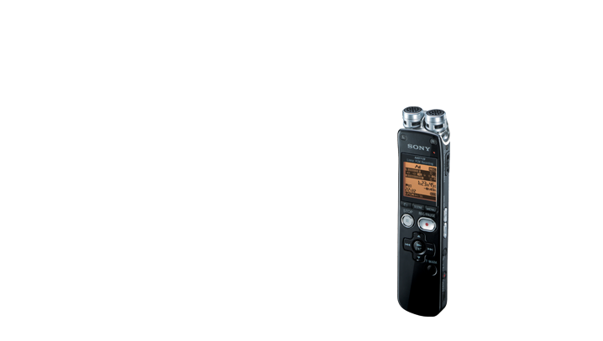
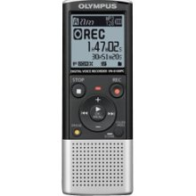
Digital Voice Recorders
Record lectures and notes that can be printed out using the Dragon Naturally Speaking voice-to-print software

Slide 21
DANA
Wireless hand held device
Full sized keyboard with a wide screen
Full featured word processor
Spell check and dictionary

Slide 22
Smartpen: LiveScribe Echo Smartpen
Record and playback feature
Written notes become searchable when uploaded onto computer
Links to written notes to audio
Can be used to “draw” onto computer screen

Slide 23
Rapid Typing Zone
Rapid Typing is a free software program (http://rapidtyping.com) to help students improve their typing skills through a series of lessons

Slide 24
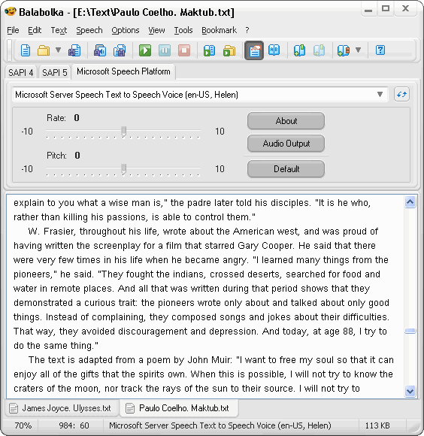
Balabolka
Balabolka
(http://cross-plus-a.com/balabolka.htm) is a free text-to-speech (TTS) software program
Uses various versions of Microsoft speech (API) and allows users to alter a voice’s parameters (including rate and pitch)

Slide 25
Assistive Technology
Math Disabilities

Slide 26
Dyscalculia
A specific developmental disability affecting a person's ability to conceptualize and perform mathematics.
Notes:
.

Slide 27
Signs of Dyscalculia
Difficulty learning math concepts beyond basic math
Trouble with mental math calculations
Difficulty with finding different approaches to one problem
Confuses similar numbers; reads numbers out of sequence
Inability to measure—telling time, using money

Slide 28
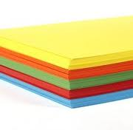
Specialty Paper
Colored Paper
Provides a better visual perception for information processing
Graph Paper
Assists with keeping numbers aligned and math problems are kept in organized rows and columns

Slide 29
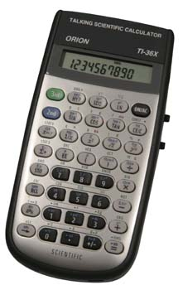
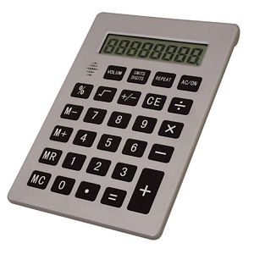
Talking Calculators
Talking calculators can assist students that experience difficulties with calculating math problems

Slide 30
Talking Tape Measurer
Announces the measured length
Memory mode
Can be used to measure consecutive distances
Automatically turns off when it is not used for 15 seconds

Slide 31
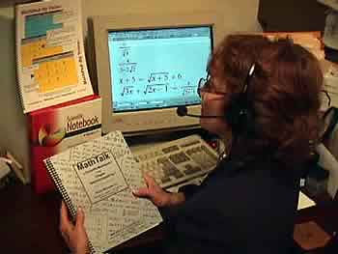
MathPad ™ & MathTalk ™ Software
*MathPad ™ By Voice
Allows students to do basic addition, subtraction, multiplication, and division
Reads back to student
MathTalk ™ By Voice
Allows students to voice any math from pre-algebra , algebra, trigonometry, and calculus (also includes voicing graphs)
Over 60,000 voice commands

Slide 32
Merit Solutions for Learning Disabilities Software
Basic Algebra Shape-Up and Word Prediction Shape-Up
Breaks questions down into multiple steps
Self paced
Students receive immediate feedback as they work

Slide 33
GeoGebra
GeoGebra (http://www.geogebra.org) is a FREE program that joins geometry, algebra, tables, graphing, statistics, and calculus.
Easy to use interface
Authoring tool to create interactive learning materials as web pages

Slide 34
Scenario–Meet Amber
Amber – 19 years old
Diagnosis: Dysgraphia
Experiences issues with:
Staying within the margins/lines when writing on paper
Has illegible handwriting
Insufficient speed when copying notes that causes her to fall behind in class
What are some assistive technology solutions to consider?

Slide 35
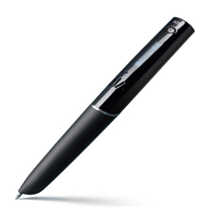
Possible AT Solutions for Amber

Slide 36
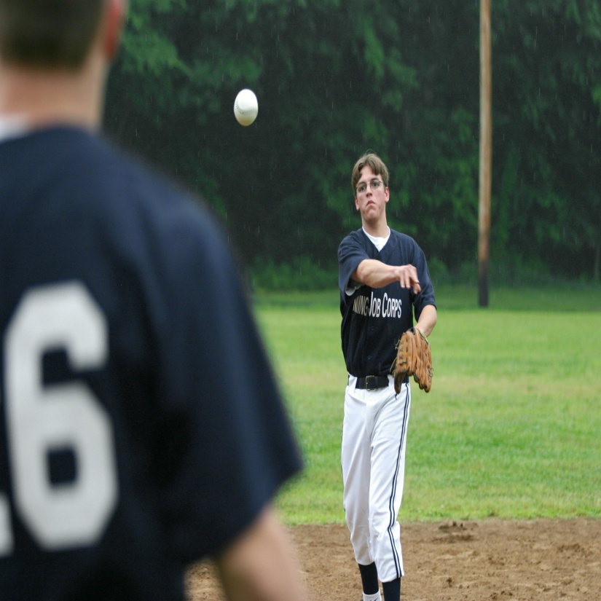
Scenario–Meet Jeff
Jeff – 21 years old
Diagnosis: Dyscalculia
Experiences issues with:
Mental calculations
Balancing a checkbook
Uses numbers out of sequence
What are some assistive technology solutions to consider?

Slide 37
Possible AT Solutions for Jeff

Slide 38
Where Can I Order these Products?
Therapro: www.therapro.com
Pencil grips
eNasco: www.enasco.com
Raised line paper
Independent Living: www.independentliving.com
Talking dictionary
Talking tape measurer

Slide 39
Where Can I Order these Products?
Resources for Reading: http://www.abcstuff.com
Removable highlighter tape
Learning, Sight & Sound: http://www.lssproducts.com
Talking calculators

Slide 40
Where can I Order These Products?
Software programs for Dysgraphia
Wynn Wizard: http://freedomscientific.com/
Inspiration: http://www.inspiration.com/
Word prediction software programs: http://www.enablemart.com
Soothsayer
WordQ
Prototype

Slide 41
Where can I Order These Products?
Software programs for Dysgraphia
Voice Recognition Technology: http://www.enablemart.com
Rapid Typing Zone (Typing Tutor): http://rapidtyping.com
Balabolka: http://cross-plus-a.com/balabolka.htm
Digital Voice Recorders: http://store.sony.com/
Smartpen: http://www.livescribe.com
DANA: http://www.neo-direct.com/Dana/default.aspx

Slide 42
Where can I Order These Products?
Software programs for Dyscaculia
MathPad™ & MathTalk™: http://www.mathtalk.com/
Merit Solutions for Learning Disabilities: http://www.meritsoftware.com/
GeoGebra: http://www.geogebra.org/cms/

Slide 43
Resources

Slide 44
Regional Disability Coordinators
Boston Region–Lisa Kosh
lisa.kosh@humanitas.com
Philadelphia and Atlanta Regions–Nikki Jackson
nikki.jackson@humantias.com
Dallas Region–Laura Kuhn
laura.kuhn@humanitas.com
Chicago and San Francisco Regions–Kim Jones
kim.jones@humanitas.com

Slide 45
Job Corps Disability Website

Slide 46
Job Corps Learning Disability Website

Slide 47
Learning Disabilities Association of America (http://www.ldnatl.org)

Slide 48
National Center for Learning Disabilities (http://www.ncld.org)

Slide 49
LD Online (http://www.ldonline.org)

Slide 50
Job Accommodation Network (JAN) (http://askjan.org)

Slide 51
Questions?

