Slide 1
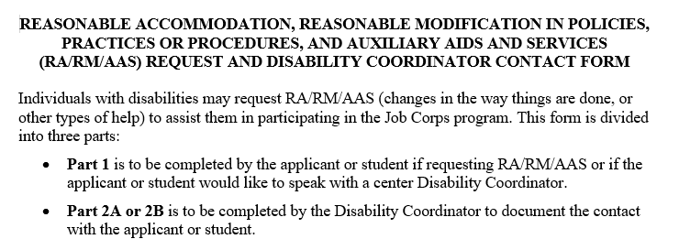
1
RA/RM/AAS Request and DC Contact Form
Completed by the applicant or student if requesting RA/RM/AAS or if the individual would like to speak with a center Disability Coordinator.
There are 2 parts to the Disability Accommodation (RA/RM/AAS) Request and Disability Coordinator (DC) Contact Form.
Part 2 is broken down into Parts 2A and 2B.
2A
Completed by the DC to document contact with an applicant or student who has requested accommodations (Part 1).
2B
Completed by the DC to document contact with an applicant or student who has disclosed a disability via the 653, documentation of a disability, or via any other communication method but made no formal disability accommodation request.
1

Slide 2
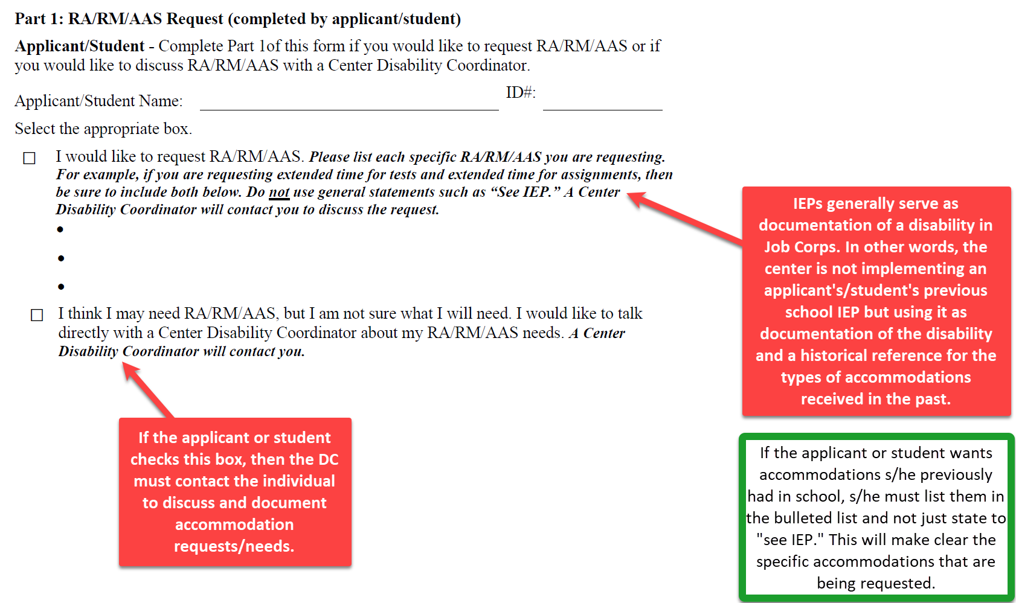
Part 1: RA/RM/AAS Request
2

Slide 3
Part 2: Disability Coordinator Contact
Who Completes Part 2?
Why is Part 2 Required?
A Disability Coordinator must contact an applicant/student to discuss potential disability accommodation (DA) needs if the applicant/student requests DA and/or discloses a disability.
Completed by the Disability Coordinator
Part 2A
Part 2B
A DC must contact an applicant/student to discuss potential DA needs if the applicant/student requests or indicates a DA “may” be needed.
A DC must contact an applicant/student to discuss potential DA needs if the applicant/student did not make a formal DA request but instead disclosed their disability via the 653, documentation of disability, or via any other communication method.
3

Slide 4
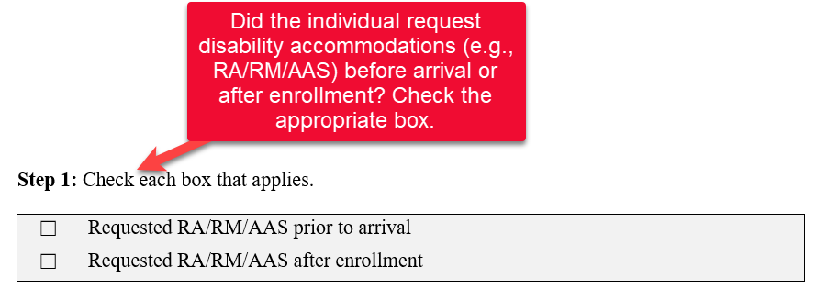
Part 2A – Documenting Request for RA/RM/AAS
Step 1
Part 2A
4

Slide 5
Part 1 Must Be Completed Before Moving Forward
Ensure that PART 1 has been completed in its entirety.
If the first box was checked without listing specific accommodations (i.e., says “See IEP,” for example), then contact the applicant to define the specific RA/RM/AAS(s) being requested and document in Part 1 of the form.
Step 2
Part 2A
5

Slide 6
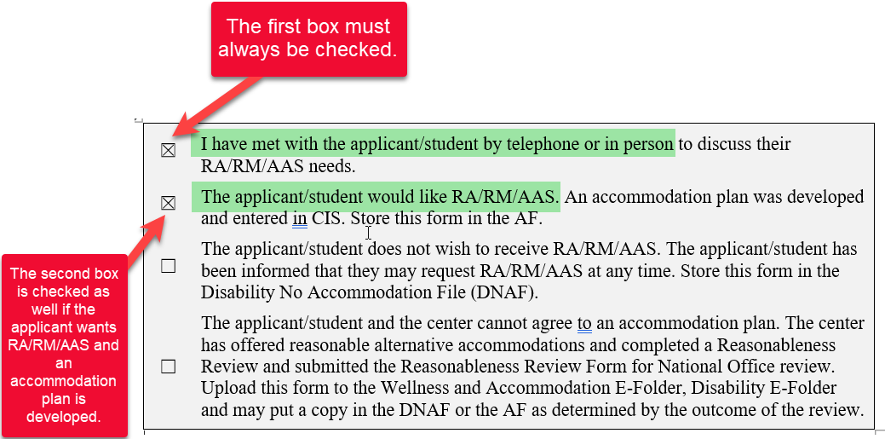
Document the outcome(s) of the RA/RM/AAS process
Individual wants RA/RM/AAS and AP is Developed
Step 3
Part 2A
6

Slide 7
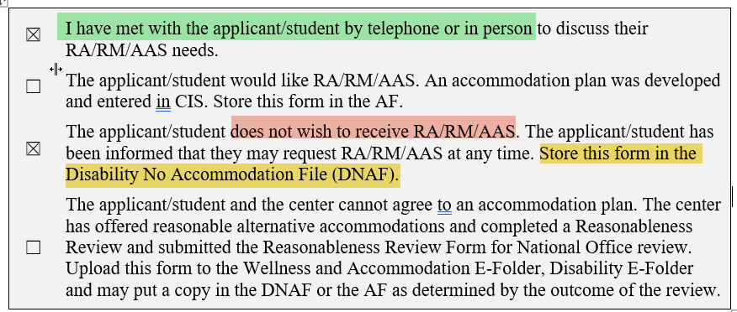
Document the outcome(s) of the interactive RA/RM/AAS process Individual does not want RA/RM/AAS
Step 3 (cont.)
Part 2A
7

Slide 8
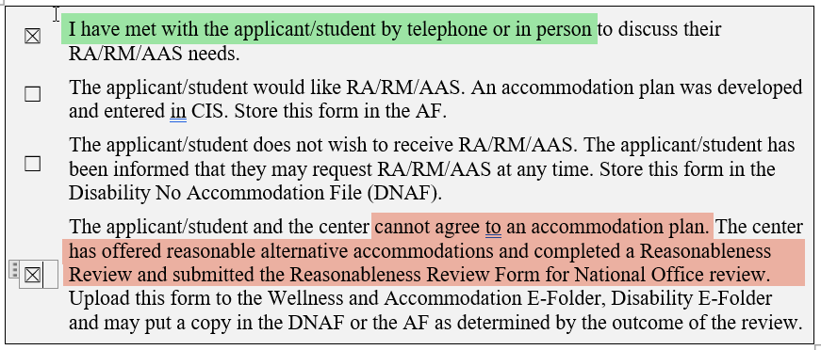
Document the outcome(s) of the interactive RA/RM/AAS process Center and Individual Cannot Agree – Reasonableness Determination
Step 3 (cont.)
Part 2A
8

Slide 9
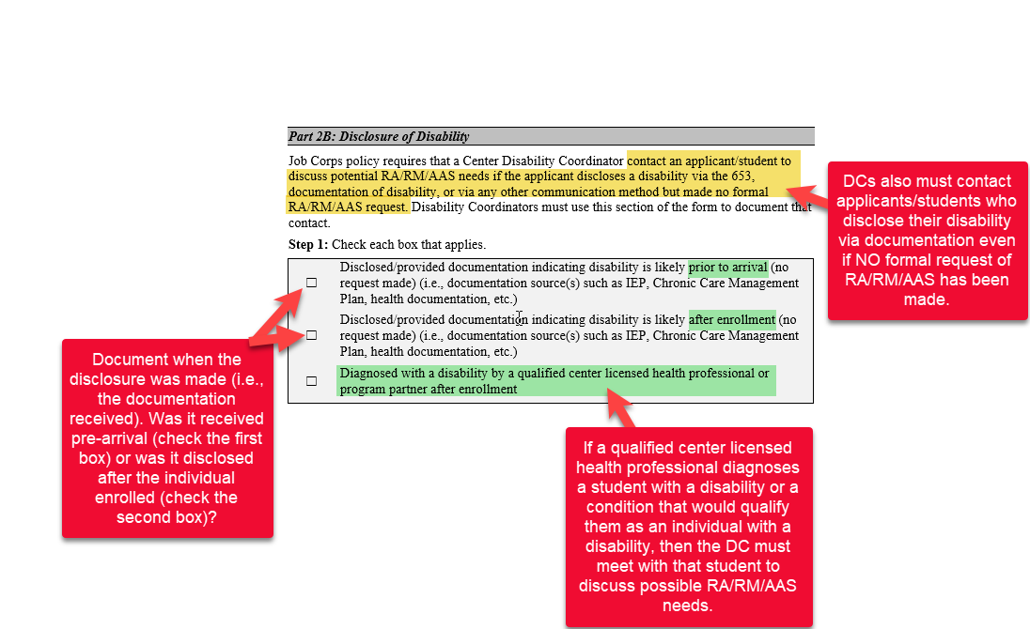
Part 2B – Disclosure of Disability
Step 1
Part 2B
9

Slide 10
Documenting Contact
Individual wants RA/RM/AAS and AP is Developed
Step 2
Part 2B
10

Slide 11
Document the outcome(s) of the interactive RA/RM/AAS process Individual does not want RA/RM/AAS
Step 2 (cont.)
Part 2B
11

Slide 12
Document the outcome(s) of the interactive RA/RM/AAS process Center and Individual Cannot Agree – Reasonableness Determination
Step 2 (cont.)
Part 2B
12

Slide 13
Reminder About Declinations
If a student declines accommodation initially but then decides s/he does wishes to have accommodations, then s/he should complete Part 1 of a new RA/RM/AAS Request and DC Contact Form.
13

Slide 14
Storage of the RA/RM/AAS Request/Contact Form and Related Documentation
Upload RA/RM/AAS Request and Disability Coordinator Contact Form to the Wellness and Accommodation E-Folders in CIS (e.g., Disability E-Folder).
01
If an AP is developed, update the notes in the Accommodation Plan Notes section of CIS.
02
Store a hard copy of this form in the Accommodation File (AF) or Disability No Accommodation File (DNAF), as applicable.
03
14

