Slide 1

Health and Wellness Director’s
Applicant File Review Coordinator Responsibilities
Notes:
Welcome to the Health and Wellness Director’s Applicant File Review Coordinator Responsibilities webinar! Although the applicant file review policy requirements and procedural elements are reviewed as part of the Applicant File Review Orientation Series, this webinar is targeted solely to the roles and responsibilities of Health and Wellness Directors and their responsibilities as File Review Coordinators.
I encourage you to actively participate today – take notes, ask questions and beyond today, commit to reviewing this presentation again along with the resources I am going to share with you at the end of this presentation.
Lastly, as most of you know, applicant file review is a very legally driven process. There are regulations about individual rights that must be adhered to, order of operations in which processes must occur, etc. It is a given that we must continue to strive to adhere to the regulations, any resulting Job Corps policies due to those regulations and to Civil Rights agreements that have driven policy changes in the past. However, the goal today is not only to ensure that you have the information you need to fulfill your duties as the center File Review Coordinator but also to provide you with ideas and suggestions as to where you have some flexibility in choosing procedures that may be more functional for how you process applicant files at your center.

Slide 2

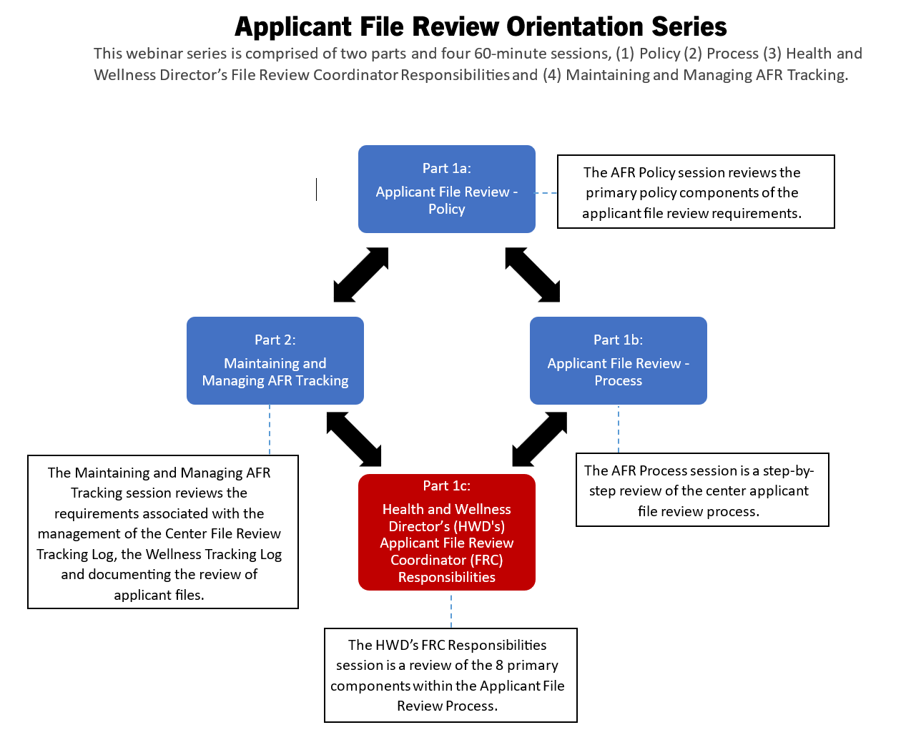
Applicant File Review Orientation
Series
Each part of the webinar series is held live via WebEx several times throughout the year. The individual webinars can be attended in ANY order and routine attendance is strongly encouraged as content is updated on a regular basis.
Resources and tools available to assist Health and Wellness Directors/File Review Coordinators in meeting applicant file review-related requirements will be shared.
2
Notes:
Applicant File Review Orientation Series
The original Disability Coordinator Orientation Series has been restructured into TWO different Orientation Series. The first one is the Applicant File Review Orientation Series which is comprised of two parts and four 60-minute sessions. The target audience for this series is primarily Health and Wellness Managers but center Qualified Health Professionals and Disability Coordinators would benefit as well. Today is Part 1c: Health and Wellness Director's (HWDs) Applicant File Review Coordinator (FRC) Responsibilities.
The second series is the Disability Coordinator Orientation Series and includes 3-parts comprised of 4 individual webinars.
The individual webinars can be attended in ANY order and routine attendance is strongly encouraged as content is updated on a regular basis. Resources and tools available to assist Health and Wellness Directors/File Review Coordinators in meeting applicant file review-related requirements will be shared.

Slide 3
08
01
Other
Responsibilities
Preliminary Review of Applicant Files
02
Documenting Preliminary Review
07
Wellness Tracking Log
Applicant File Review
06
03
Clearing for Enrollment
Recommendations
of Denial
05
04
Reviewing
Assessments for Completeness
Possible Health Care Needs or Direct Threat
3
Notes:
File Review Coordinators have oversight responsibility for 8 primary components within the Applicant File Review Process. We are going to review each of these components in today’s webinar.

Slide 4



What are the roles
and responsibilities
of a File Review Coordinator?
4
Notes:
Audience question: What are the roles and responsibilities of a File Review Coordinator?

Slide 5

Who is the center’s
File Review Coordinator?
Health and Wellness Directors (HWDs) are the File Review Coordinators (FRCs) at each center.
  The FRC has oversight for the center applicant file review process.
5
Notes:
Who is the center’s File Review Coordinator?
Health and Wellness Directors (HWDs) are the File Review Coordinators (FRCs) at each center.
The FRC has oversight for the ENTIRE center applicant file review process.

Slide 6


01
Preliminary Review of Applicant Files
HWDs must complete the preliminary review of all applicant files.
  What is included in the preliminary review?
6
Notes:
Component #1 – Preliminary Review of Applicant Files
HWDs must complete the preliminary review of all applicant files.
What is included in the preliminary review?

Slide 7



Preliminary Review Considerations
Look for affirmative responses on the 653 Health Questionnaire and corresponding explanations for information about current or historical services
Complete a review of documents in CIS to include: ​
Chronic Care Management Plans​
Other Health Records, Emergency Room visit documents, etc.
Non-health documents such as IEPs and 504 plans​
If an applicant discloses documents such as the examples in column 2, the HWD’s review of all health and medical documents including non-health ones (e.g., IEPs and 504 plans) generally must result in assignment of the file to the respective QHP.
7
Notes:
Preliminary Review Considerations
First, look for affirmative responses on the 653 Health Questionnaire and corresponding explanations for information about current or historical services
Next, complete a review of documents in CIS to include: ​
Chronic Care Management Plans​
Other Health Records, Emergency Room visit documents, etc. uploaded to CIS​
Non-health documents such as IEPs and 504 plans​
BTW, all documents within the applicant file review process should be reviewed and considered in the same manner regardless of source. In other words, the IEP and the 504 plan are not more or less important than a CCMP or other medical record.
If an applicant discloses documents such as the examples in column 2, the HWD’s review of all health and medical documents including non-health ones (e.g., IEPs and 504 plans) generally must result in assignment of the file to the respective QHP.

Slide 8

Preliminary Review Considerations (cont.)
After assignment, there must be either
a subsequent discussion with the QHP which whereby the HWD is able to clear applicants with some medically related health care needs in consultation with or under the umbrella of the QHP’s oversight, or
the QHP completes a clinical review (and interview if warranted) and makes a decision on enrollment.
There are some very limited circumstances when an HWD can clear an applicant without consultation with or being under the umbrella of the QHP’s oversight.
8
Notes:
Preliminary Review Considerations (cont.)
After assignment, there must be either
a subsequent discussion with the QHP which whereby the HWD is able to clear applicants with some medically related health care needs in consultation with or under the umbrella of the QHP’s oversight, or
the QHP completes a clinical interview and decision on enrollment.
There are some very limited circumstances when an HWD can clear an applicant without consultation with or being under the umbrella of the QHP’s oversight.

Slide 9
Review of Non-health Documents
Options
Non-health DC Feedback
The HWD may (1) assign the file to the non-health DC for review if they wish or (2) to streamline the process, they may review the documents themselves.
If the non-health DC reviews, they must provide written feedback to the HWD in a timely manner so that the information can be provided to the respective QHP to enable the completion of the file review process within the 30-day review period.
Notes:
Review of Non-health Documents
Options
The HWD may (1) assign the file to the non-health DC for review if they wish or (2) to streamline the process, they may review the documents themselves.
Non-health DC Feedback
If the non-health DC reviews, they must provide written feedback to the HWD in a timely manner so that the information can be provided to the QHP to enable the completion of the file review process within the 30-day review period.

Slide 10

HWDs Making Clinical Calls
Generally speaking, the HWD should not be calling the applicant to conduct a clinical interview.
WHY?
10
Notes:
HWDs Making Clinical Calls
Generally speaking, the HWD should not be calling the applicant to conduct a clinical interview.
WHY?

Slide 11
Let’s Review Policy!
Form 2-05 – Health Care Needs Assessment
The clinical assessment of health care needs falls under health services on each center.
  As such, these clinical assessment are conducted only by qualified health professionals who have current, documented expertise in the medical condition(s) or disability or disabilities involved in a particular case.
  General medical expertise, without expertise in the specific medical condition(s) or disabilities at issue, is insufficient.
One of the main purposes of the 653, Health Questionnaire is to enable the center to
determine the health care needs of the applicant or student and
assist in the assessment of whether those needs fall outside the Job Corps basic healthcare responsibilities as described in PRH Exhibit 2-4 and
if these needs significantly interfere with or preclude further training in Job Corps.
11
Notes:
Let’s Review Policy!
…starting with Form 2-05, Health Care Needs Assessment. One of the main purposes of the 653, Health Questionnaire is to enable the center to
determine the health care needs of the applicant or student and
assist in the assessment of whether those needs fall outside the Job Corps basic healthcare responsibilities as described in PRH Exhibit 2-4 and
if these needs significantly interfere with or preclude further training in Job Corps.
The clinical assessment of health care needs falls under health services on each center.
As such, these clinical assessments are conducted only by qualified health professionals who have current, documented expertise in the medical condition(s) or disability or disabilities involved in a particular case.
General medical expertise, without expertise in the specific medical condition(s) or disabilities at issue, is insufficient.

Slide 12

Policy (cont.)
Form 2-04 – Individualized Assessment of a Possible Direct Threat
Applicants may not be assessed for a direct threat to others unless the HWD:
  has a reasonable belief, based on objective evidence, that an individual applicant or student has a medical condition or disability that may pose a significant risk of substantial harm to the health or safety of others.
12
Notes:
Policy (cont.)
Then Form 2-04 which is the Individualized Assessment of a Possible Direct Threat Policy says that:
Applicants may not be assessed for a direct threat to others unless the HWD:
has a reasonable belief, based on objective evidence, that an individual applicant or student has a medical condition or disability that may pose a significant risk of substantial harm to the health or safety of others.

Slide 13



Key Points from Policy (2-04 and 2-05)
Job Corps cannot routinely call applicants to discuss their health care needs without a proper reason to do so and only when in alignment with Job Corps policy.
Doing so potentially can be construed as “fishing” for protected health information, which only may be reviewed/discussed when voluntarily disclosed.
The assessment of whether health care needs exceed those of basic health responsibilities must only be conducted by qualified health professionals who have current, documented expertise in the medical condition(s) or disability or disabilities involved in a particular case.
Job Corps cannot assess applicant for direct threat to others unless there is a reasonable belief, based on objective evidence of the need to do so.
The Regional Health Specialists guide that it is critically important for each licensed health professional to practice within the scope of their own expertise.
13
Notes:
Key Points from Policy (2-04 and 2-05)
Job Corps cannot routinely call applicants to discuss their health care needs without a proper reason to do so and only when in alignment with Job Corps policy. Doing so potentially can be construed as “fishing” for protected health information, which only may be reviewed/discussed when voluntarily disclosed.
The assessment of whether health care needs exceed those of basic health responsibilities must only be conducted by qualified health professionals who have current, documented expertise in the medical condition(s) or disability or disabilities involved in a particular case.
Job Corps cannot assess applicant for direct threat to others unless there is a reasonable belief, based on objective evidence of the need to do so.
The Regional Health Specialists guide that it is critically important for each licensed health professional to practice within the scope of their own expertise.

Slide 14

When HWDs Can Call During the Preliminary Applicant File Review
There are affirmative responses on the 653 Health Questionnaire, but no documentation was provided related to those affirmative responses.
The HWD may call the applicant during the preliminary review to ask about/gather information IF…
14
Notes:
When HWDs Can Call During the Preliminary Applicant File Review
The HWD may call the applicant during the preliminary review to ask about/gather information IF…
There are affirmative responses on the 653 Health Questionnaire, but no documentation was provided related to those affirmative responses.

Slide 15
What Happens After This Call?
If the HWD must call the applicant because there were disclosures on the 653, Health Questionnaire, but no supporting documentation was added, then ONE of TWO things must happen after the call is completed:
The HWD may clear the applicant for enrollment in limited circumstances.
The HWD may assign the file to a QHP or QHPs because of concerns that health care needs may exceed those of basic health responsibilities or because of concerns that there is a direct threat to others.
OR
What must not occur?
The applicant file may NOT be returned to Admissions Services due to lack of receipt of health or medical information. Disclosure of such documents and information is voluntary.
15
Notes:
What Happens After This Call?
If the HWD must call the applicant because there were disclosures on the 653, Health Questionnaire, but no supporting documentation added, then ONE of TWO things must happen after the call is completed:
The HWD may clear the applicant for enrollment in limited circumstances.
OR
The HWD may assign the file to a QHP or QHPs because of concerns that health care needs may exceed those of basic health responsibilities or because of concerns that there is a direct threat to others.
What must not occur?
The applicant file may NOT be returned to Admissions Services due to lack of receipt of health or medical information. Disclosure of such documents and information is voluntary.

Slide 16

Examples of Limited Circumstances!
Applicant checks 6-53 item for
Visual impairment/trouble seeing
  Applicant reports wearing glasses - HWD clears
Hearing impairment/trouble hearing
  Applicant reports wearing a hearing aid in left ear - HWD clears
Food-related Sensitivities
  Applicant reports that they have allergies to gluten and require a gluten free diet – HWD clears
Allergies
  Applicant reports anaphylactic reaction to bee stings and must always carry an epi pen – HWD clears
Other Health Concerns
  Applicant reports having GERD and either uses over the counter meds or daily proton pump inhibitor – HWD clears
To remain within scope of practice, HWDs should not clear an applicant that discloses a medical, mental health, substance use, or oral health condition without consulting/conversation with the QHP (i.e., assigning the file to a QHP for review).
If questions about the types of limited circumstances that are acceptable, please contact your respective Regional Health Specialist for assistance.
16
Notes:
Examples of Limited Circumstances!
To remain within scope of practice, HWDs should not clear an applicant that discloses a medical, mental health, substance use, or oral health condition without consulting/conversation with the QHP (i.e., assigning the file to a QHP for review).
[Presenter note: Revisit slides 6 and 10 briefly to remind why HWDs should not clear an applicant that discloses a medical, mental health, substance use, or oral health condition without consulting/conversation with the QHP/assigning the file to a QHP for review.]
Assignment to a QHP could be for a discussion and then clearance by the HWD or move on for a clinical interview to complete a HCNA or DTA by the QHP. If the CP, for example, has determined that there are certain areas that the HWD may clear, then the file is still FIRST assigned to the CP and then the HWD can do the process for the CP under the CP’s oversight.
There are some instances where the HWD may clear the applicant for disclosures on the 653 Health Questionnaire:
Visual impairment/trouble seeing
Applicant reports wearing glasses - HWD clears
Hearing impairment/trouble hearing
Applicant reports wearing a hearing aid in left ear - HWD clears
Food-related Sensitivities
Applicant reports that they have allergies to gluten and require a gluten free diet – HWD clears
Allergies
Applicant reports anaphylactic reaction to bee stings and must always carry an epi pen – HWD clears
Other Health Concerns
Applicant reports having GERD and either uses over the counter meds or daily proton pump inhibitor – HWD clears
If questions about the types of limited circumstances that are acceptable, please contact your respective Regional Health Specialist for assistance.

Slide 17



02
Documenting the Preliminary AFR Review
The HWD must complete the Center Applicant File Review (CAFR) Form (Form 1-06, page 1) for all file reviews unless the HWD believes the applicant may pose a potential direct threat to others. Then the Center Applicant/Student File Review (CA/SFR) Form (Form 2-04, page 8) must be completed.
17
Notes:
Component #2 – Documenting the Preliminary AFR Review
Now that the HWD has completed the Preliminary Review, it must be documented on the appropriate form.
The HWD must complete the Center Applicant File Review (CAFR) Form (Form 1-06, page 1) for all file reviews unless the HWD believes the applicant may pose a potential direct threat to others. Then the Center Applicant/Student File Review (CA/SFR) Form (Form 2-04, page 8) must be completed.

Slide 18
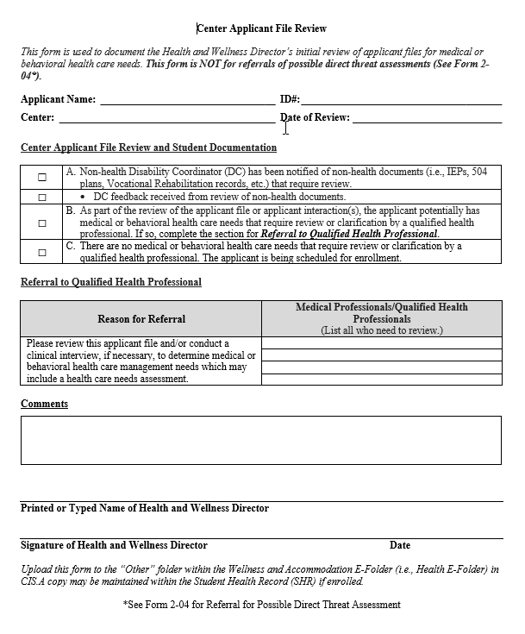
Center Applicant
File Review (CAFR) form
Form 1-06 (page 1)
The HWD must complete this form with each file review.
If there is reasonable belief, based on objective evidence, that the individual has a medical condition or disability that may pose a significant risk of substantial harm to the health or safety of others, then the HWD must complete a similar form in Form 2-04 instead.
18
Notes:
Center Applicant File Review (CAFR) form – Form 1-06 (page 1)
The Center Applicant File Review form is used to document the initial applicant file review of the HWD. This form will be completed for all applicant file reviews UNLESS there is reasonable belief, based on objective evidence, that the individual has a medical condition or disability that may pose a significant risk of substantial harm to the health or safety of others; in the case of a potential direct threat, the HWD must instead complete the Center Applicant/Student File Review Form – HWD’s Initial Review of Applicant Files or Review of Student Documentation for Assignment of Possible Direct Threat Assessment in Form 2-04 (page 8).

Slide 19
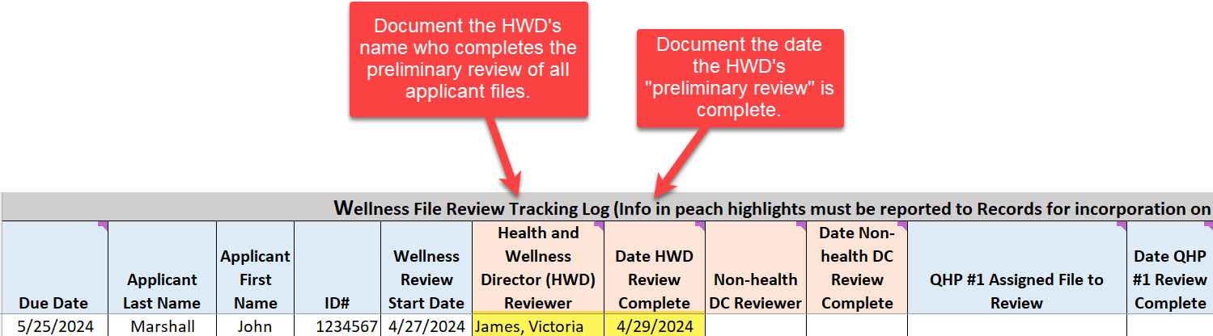
Completion of the HWD’s Preliminary Review
Wellness Tracking Log
19
Notes:
The HWD must also document the completion of each step of the file review process on the Wellness Tracking Log. In the example in the screenshot on this slide, the HWD has completed their preliminary review which is documented by filling out the “Health and Wellness Director (HWD) Reviewer” column which identifies the HWD as Victoria James and the “Date HWD Review Complete” column which documents 4/29/24 as the date of the completion of the preliminary review.

Slide 20

03
Clearing for
Enrollment
If there are no disclosures of health conditions, concerns about health care needs exceeding those of basic healthcare responsibilities (Exhibit 2-4) or of the applicant posing a direct threat to others, then the HWD documents the decision to enroll.
20
Notes:
Component #3 – Clearing for Enrollment
If there are no disclosures of health conditions, concerns about health care needs exceeding those of basic healthcare responsibilities (Exhibit 2-4) or of the applicant posing a direct threat to others, then the HWD documents the decision to enroll.

Slide 21
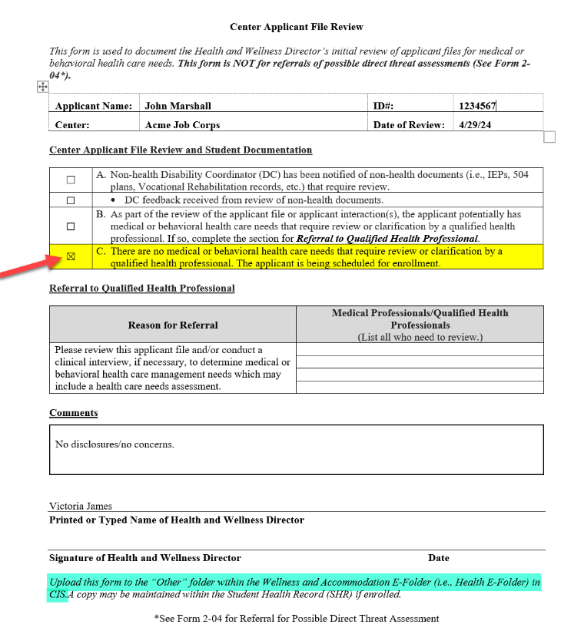
HWD Clears for Enrollment
CAFR form in Form 1-06 (page 1)
Notes:
HWD Clears for Enrollment – Center Applicant File Review form
If there are no disclosures of health conditions, concerns about health care needs, or concerns about direct threat to others, then the HWD documents the decision to enroll by checking the box here, which is item C.
Upload the completed form to the “Other” folder in the Health E-Folder in CIS (and a copy may be maintained within the Student Health Record (SHR) if enrolled).

Slide 22
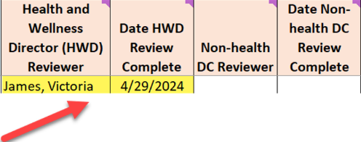
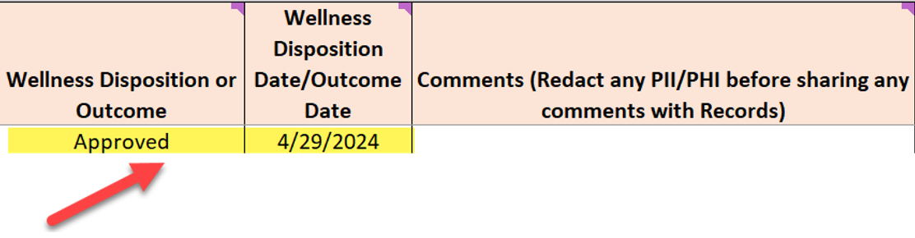
HWD Clears for Enrollment
Wellness Tracking Log
22
Notes:
HWD Clears for Enrollment - Wellness Tracking Log
If the HWD clears the file for enrollment, then two other columns need to be completed on the Wellness Tracking Log: (1) The Wellness Disposition or Outcome column and (2) the Wellness Disposition Date/Outcome Date Column. In our example above (see the yellow highlights to the right side of the screen), “approval” is selected as the disposition and the approval date is 4/29/24. Very straightforward entries and clearly document what occurred with the applicant file review.

Slide 23


04
Possible Health Care Needs or Direct Threat
If the HWD has a reasonable belief based upon objective evidence that an applicant’s health care needs may exceed those of basic health responsibilities (Exhibit 2-4) or may pose a direct threat to others, then the HWD must assign the applicant file documents to the respective QHPs for review.
23
Notes:
Component #4 – Possible Health Care Needs or Direct Threat
If the HWD has a reasonable belief based upon objective evidence that an applicant’s health care needs may exceed those of basic health responsibilities (Exhibit 2-4) or may pose a direct threat to others, then the HWD must assign the applicant file documents to the respective QHPs for review.

Slide 24
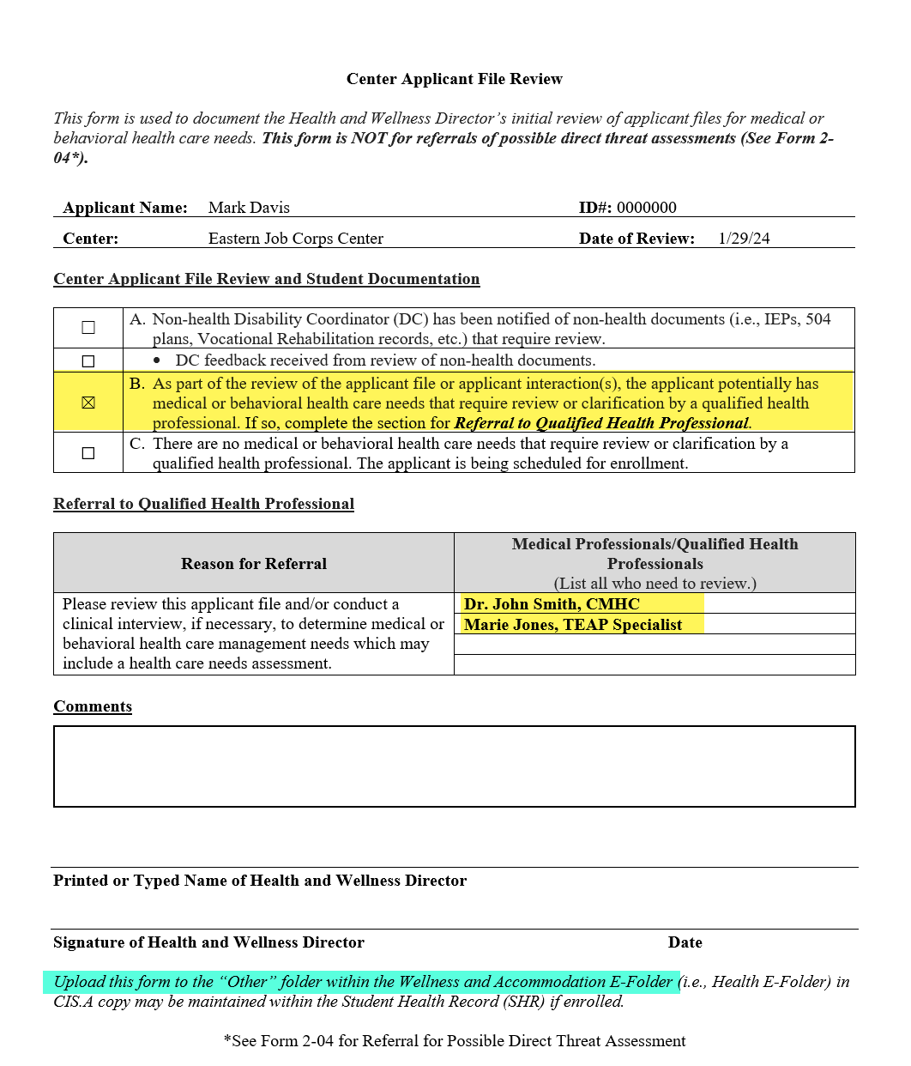
HWD Assigns File to Qualified Health Professional (QHP) for Review
Center Applicant File Review Form
Please ensure that the Qualified Health Professional(s) being assigned review of the file are listed by both their name and by their title.
Ensure that all reviewers are listed if there are multiple disciplinary areas of review needed.
24
Notes:
HWD Assigns File to Qualified Health Professional (QHP) for Review - Center Applicant File Review Form
When the HWD assigns a file to a QHP or QHPs for review, check the box for item B on the Center Applicant File Review form. Then go to the Referral to Qualified Health Professional section and list the name of each QHP assigned to complete a review. In this case, the HWD assigned the file to both the CMHC, Dr. John Smith, and to the TEAP Specialist, Marie Jones.
Please ensure that the Qualified Health Professional(s) being assigned review of the file are listed by both their name and by their title.
Ensure that all reviewers are listed if there are multiple disciplinary areas of review needed.

Slide 25
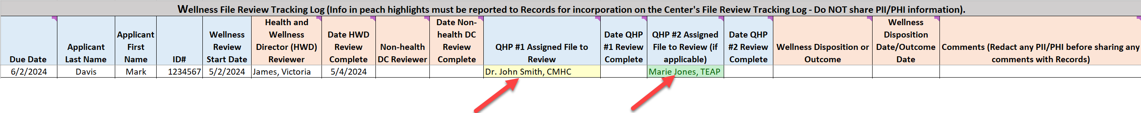
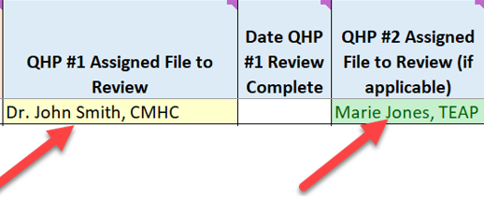
HWD Assigns File to QHPs for Review
Wellness Tracking Log
Document each QHP who is assigned to review the file in the Wellness Tracking Log.
25
Notes:
HWD Assigns File to QHPs for Review - Wellness Tracking Log
Each QHP who is assigned to review a particular file must be listed in the Wellness Tracking log as having reviewed the file along with the date of the completion of their review. Dr. John Smith, CMHC, and Marie Jones, TEAP Specialist were both assigned to review this file so they both are listed in the Wellness Tracking Log entry (i.e., Dr. John Smith, CMHC is highlighted in yellow and Marie Jones, TEAP is highlighted in green/teal).

Slide 26

When HWDs Can Call After Assigning a File to a QHP for Review
Once an applicant file is assigned to a QHP or QHPs for review, the HWD may call and collect background information for the QHP’s review if the QHP wishes for the HWD to do so.
26
Notes:
When HWDs Can Call After Assigning a File to a QHP for Review
Once an applicant file is assigned to a QHP or QHPs for review, the HWD may call and collect background information for the QHP’s review if the QHP wishes for the HWD to do so.

Slide 27
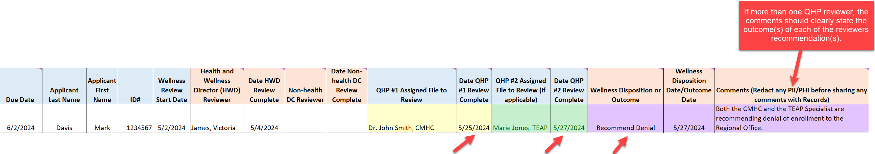
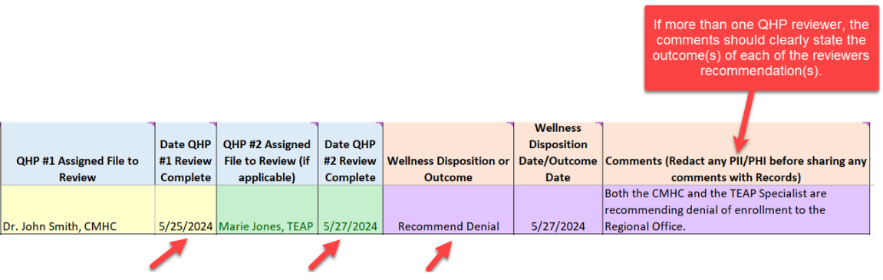
QHPs Complete Review and Make a Recommendation About Enrollment
Wellness Tracking Log
27
Notes:
QHPs Complete Review and Make a Recommendation About Enrollment - Wellness Tracking Log
Once each of the QHPs has completed their review of the applicant file and made a decision on enrollment, the Wellness Tracking Log must be updated with this information.
In the example above, Dr. John Smith, the CMHC completed his review on 5/25/24 and Marie Jones, TEAP Specialist completed her review on 5/27/24. Now note the disposition and the comments highlighted in purple. The applicant is being recommended for denial and because there was more than one reviewer, the outcomes of each reviewer should be explained in the comments which was done in the example above – “Both the CMHC and the TEAP Specialist are recommending denial of enrollment to the Regional Office.”

Slide 28



05
Reviewing Assessments for Completeness
HWDs must ensure that Health Care Needs and Direct Threat Assessments are completed as required before submitting to the Regional Office for review.
Are the assessments signed by the appropriate Qualified Health Professionals?
Are all documents including the assessment and the CAFR form uploaded to the Health and Disability E-Folders?
Are the updates/corrections requested during regional review completed in a timely manner and was the Regional Reviewer notified of their completion?
28
Notes:
Component #5 – Reviewing Assessments for Completeness
At the beginning of the presentation, we talked about the File Review Coordinator having responsibilities for overseeing the entire applicant file review process. That includes making sure that Health Care Needs or Direct Threat Assessments are completed as required before submitting to the Regional Office for review.
Ensure that the assessment is signed by the appropriate Qualified Health Professionals.
Ensure that all documents related to the applicant file review, including either the HCNA or DTA and the CAFR form are uploaded to the Health and Disability E-Folders.
Ensure that updates/corrections requested during regional review (if any are requested) are completed in a timely manner and that the Regional Reviewer is notified of their completion.

Slide 29



06
Recommendations of Denial
HWDs must know the types of recommendations of denial that are allowable, which documents must be completed, and the process for properly submitting the recommendation of denial for Regional Review.
29
Notes:
Component #6 – Recommendations of Denial
HWDs must know the types of recommendations of denial that are allowable, which documents must be completed, and the process for properly submitting the recommendation of denial for Regional Review.

Slide 30

Review: Types of Recommendations of Denial
30
Notes:
Review: Types of Recommendations of Denial
This information is reviewed in detail during the Applicant File Review Orientation webinars on applicant file review and we encourage HWDs to attend both the Applicant File Review Policy and Applicant File Review Process Orientation webinars.

Slide 31
Types of Recommendations of Denial
The overwhelming majority of Recommendations of Denial (RODs) are going to be related to health care needs.
However, there are two other types of RODs that may arise:
  Eligibility Review Due to New Information
  Eligibility Review Due to Disability Status
Health Care Needs
Health Care Needs – Alternate Center
Direct Threat
to Others
31
Notes:
Types of Recommendations of Denial
We have already mentioned that Health Care Needs and Direct Threat to Others are both types of recommendations of denials that can and do occur. The overwhelming majority of recommendations of denial are going to be related to health care needs. Direct Threat to Others occurs a handful or so times a year because the legal standard for being considered a direct threat to others is relatively stringent so most scenarios will be considered under the umbrella of health care needs that exceed those of basic health responsibilities.
However, there are two other types of RODs that may arise:
Eligibility Review Due to New Information
Eligibility Review Due to Disability Status

Slide 32
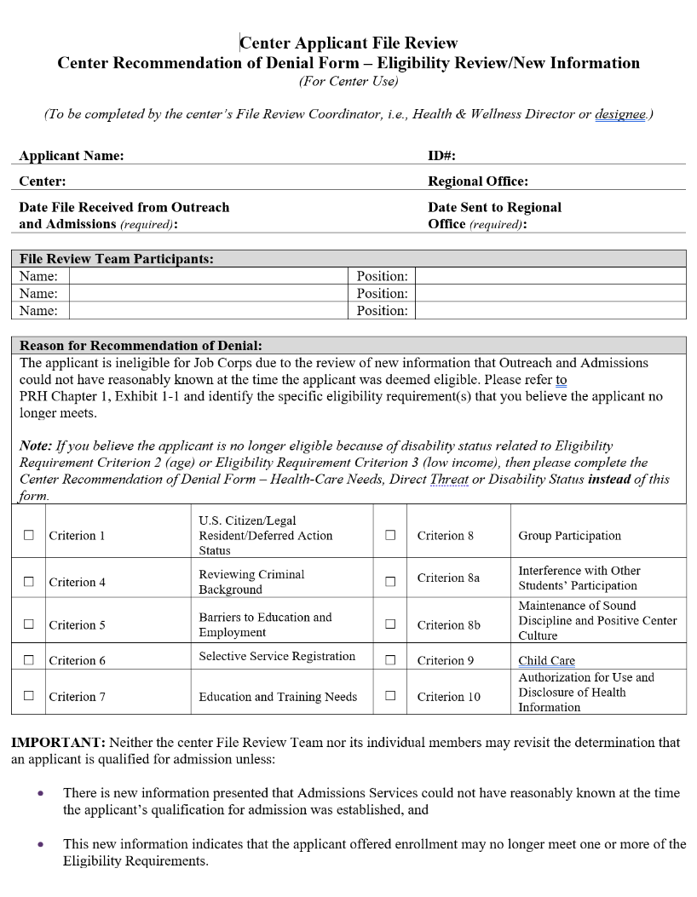
Eligibility Review Due to New Information
Form 1-06; pages 2-3
Center Applicant File Review
Center Recommendation of Denial Form – Eligibility Review/New Information
32
Notes:
Eligibility Review Due to New Information
Form 1-06; pages 2-3
Center Applicant File Review
Center Recommendation of Denial Form – Eligibility Review/New Information
If there is: new information presented that Admissions Services staff could not have reasonably known at the time the applicant’s qualification for admission was established; and the new information indicates that the applicant offered enrollment may no longer meet an eligibility requirement, then it is possible the applicant may NO longer be eligible for enrollment. One of the most common examples is an applicant who Admissions Services found to be eligible and during the center applicant file review process, they get incarcerated or perhaps arrested for a charge that may need to be adjudicated before a decision is made, etc. In this case, the center would complete the Center Recommendation of Denial Form – Eligibility Review/New Information Form and upload it to the OTHER folder within Health E-Folder.
So if the facts and details of your review lead you to believe that the applicant is potentially no longer eligible for Job Corps, then the center must complete the Center Recommendation of Denial Form – Eligibility Review/New Information. This form can be found in PRH Chapter 1 within Form 1-06 and there is a screenshot on the right-hand side of the screen of the first page. It is a 2-page document and is relatively straightforward to complete.
We will talk about the full process for submitting the actual denial in a couple of slides.

Slide 33

Eligibility Due to Disability Status
If the applicant is or will be older than 24 years old on the date of enrollment, the maximum age limit may be waived if the applicant is a person with a disability.
If the applicant would not meet the low-income requirement unless the applicant is considered a “family of one” because of a disability.
33
Notes:
Eligibility Due to Disability Status
Age and income are eligibility essential requirements (ER) in Exhibit 1-1 of the PRH and cannot be certified by Admissions Services because Admissions Services staff may not review medical documentation, only collect it. By medical documentation, we mean documentation that supports the individual’s disability status.
An applicant may exceed the upper age limit restriction and/or the applicant may be considered a “family of one” for income purposes and enroll in Job Corps if they have a disability.

Slide 34
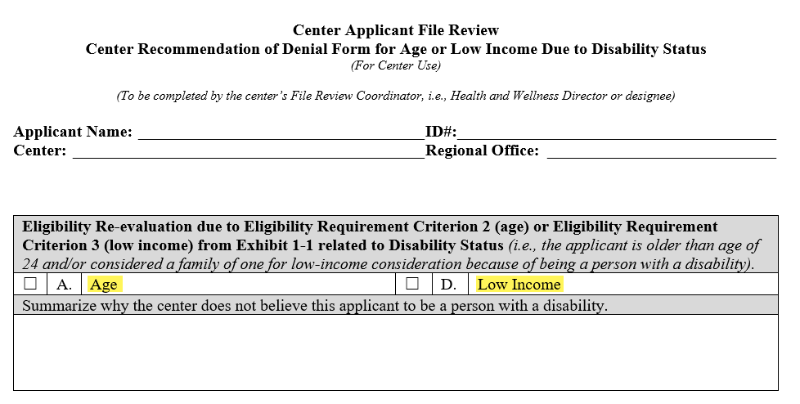
Documentation Supports Disability Status?
The file review process continues.
Documentation Does Not Support Disability Status?
Ask the applicant if they wish to secure documentation that would support their disability status.
If they do not or the documentation does not support the disability status, the center must recommend denial for age or low income due to disability status.
  Complete the Center Recommendation of Denial Form for Age or Low Income Due to Disability Status found in Form 1-06; page 4.
  Upload the form and supporting documentation to the OTHER folder within the Health E-Folder.
  Select the Notify Regional Review in the Health E-Folder.
34
Notes:
Documentation Supports Disability Status?
If the documentation supports that the individual is a person with a disability, the file review process continues.
Documentation Does Not Support Disability Status?
If there is no documentation or the documentation does not support that the individual is a person with a disability, give the applicant an opportunity to provide the documentation within the center’s file review timeframes. If the applicant does not provide documentation of disability, then the center must complete and upload the Center Recommendation of Denial Form for Age or Low Income Due to Disability Status which is found in Form 1-06 on page 4 along with any supporting documentation if the disability is not obvious and submit the file for regional review.
As you can see from the screenshot on the slide, the form is very simple. Basically, you select the category such as “age” and then explain they the applicant is not a person with a disability (i.e., the disability is not obvious, and the applicant did not provide documentation of their disability despite being given opportunities to do so).

Slide 35

Submitting
Recommendations of Denial
For Regional Office Review
35
Notes:
Submitting Recommendations of Denial For Regional Office Review
Now we are going to talk about how to submit a recommendation of denial to the respective regional office.

Slide 36
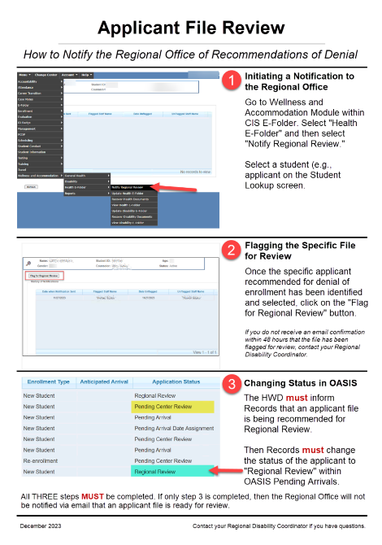
How to Notify the
Regional Office of
Recommendations of Denial
There are 3 basic steps that must be completed to submit a recommendation of denial of enrollment for Regional Review.
This resource may be found on the
Job Corps Disability Website.
https://supportservices.jobcorps.gov/disability/Documents/Submitting%20AFR%20RODs%20for%20Regional%20Review.pdf
36
Notes:
How to Notify the Regional Office of Recommendations of Denial
There are 3 basic steps that must be completed to submit a recommendation of denial of enrollment for Regional Review.
Step 1 – Note – there are screenshots on the right hand of the screen to provide you visual guidance and this graphic may be found on the Job Corps Disability Website (the link is at the bottom of the slide). Go to the Wellness and Accommodation Module within CIS E-Folder and select “Health E-Folder.” Then select “Notify Regional Review” and a student lookup screen will pop up. Select the applicant being recommended for denial on the student lookup screen.
Step 2 – Once the specific applicant recommended for denial of enrollment has been identified and selected, click on the “Flag for Regional Review” button.
Step 3 – Then the HWD MUST inform Records that an applicant is being recommended for Regional Review. Records must then change the status of the applicant to “Regional Review” within OASIS Pending Arrivals.
Key Points!
All THREE steps must be completed. If only step 3 is completed, then the Regional Office will not be notified via email that an applicant file is ready for review. In other words, step 2 triggers the notification to Humanitas and to the Regional Office. Step 3 must be completed to change the applicant’s file review status to the correct one (i.e., from pending center review to regional review).

Slide 37
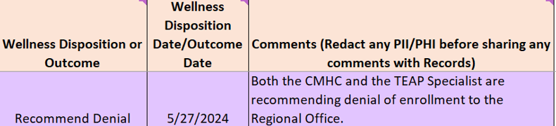
What Information Must Be Provided to Records to Include on the Center File Review Tracking Log?
  Answer: File review outcome information without any PHI.
  Any Protected Health Information (PHI) (e.g., CMHC/TEAP) within the purple highlighted cells MUST be redacted. For example, the HWD would only report the following to Records for the applicant above:
  “Davis, Mark (1234567) – recommending denial of enrollment to the Regional Office.”
37
Notes:
What Information Must Be Provided to Records to Include on the Center File Review Tracking Log?
Answer: File review outcome information without any PHI.
Any Protected Health Information (PHI) (e.g., CMHC/TEAP) within the comments section (see the purple highlighted cells in this example) MUST be redacted. For example, the HWD would only report the following to Records for the applicant above:
“Davis, Mark (1234567) – recommending denial of enrollment to the Regional Office.”

Slide 38
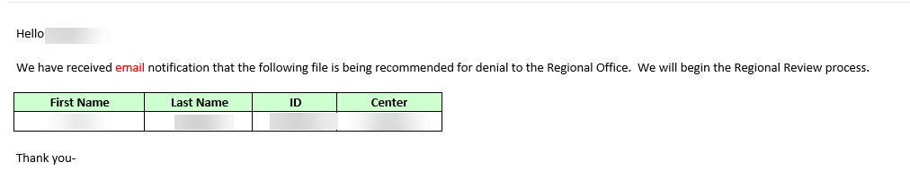
Email Notification of RECEIPT of the Denial Submission
You will always receive an email confirmation from Humanitas within 24-48 hours of flagging the file for review.
38
Notes:
How do you know if your recommendation of denial file submission was received?
You will always receive an email confirmation from Humanitas within 24-48 hours of flagging the file for review. Here is a screenshot of the email confirmation that is sent to centers when a file is received for regional review.
What do you do if you do not receive the confirmation email?
Contact your Regional Disability Coordinator to inquire!

Slide 39



07
Wellness Tracking Log
As we touched upon in Sections 3 and 4, Wellness must maintain its own internal tracking log.
39
Notes:
Component #7 – Wellness Tracking Log
As we touched upon in Sections 3 and 4, Wellness must maintain its own internal tracking log.

Slide 40
Wellness Tracking Log (WTL)
PRH Chapter 1: 1.5(R2)(b)
Each applicant file review must be logged on the Wellness Tracking Log and every file must have a final disposition (i.e., the conclusion or outcome of the applicant file review) documented.
The HWD must report the information recorded in the “peach” columns to Records for inclusion in the Center’s File Review Tracking log.
Protected Health Information, such as titles of QHPs, medical or special education document references, etc. must be redacted and only documented on the Wellness Tracking Log.
Wellness Tracking Log Components
HWD Reviewer | QHP #2 Assigned File to Review
Date HWD Review Complete | Date QHP #2 Review Complete
Non-health DC Reviewer (if the HWD does not review the non-health documents) | Wellness Disposition or Outcome
Date Non-health DC Review Complete (if the HWD does not review the non health documents) | Wellness Disposition or Outcome Date
QHP #1 Assigned File to Review | Comments (PHI Redacted)
Date QHP #1 Review Complete
https://supportservices.jobcorps.gov/disability/Documents/AFR%20Docs/Sample%20Wellness%20Tracking%20Log.xlsx
40
Notes:
Wellness Tracking Log (WTL) - PRH Chapter 1: 1.5(R2)(b)
Each applicant file review must be logged on the Wellness Tracking Log and every file must have a final disposition (i.e., the conclusion or outcome of the applicant file review) documented. The items listed in this table are the ones that are necessary to adequately track the AFR process.
The HWD must report the information recorded in the “peach” columns (i.e., HWD Reviewer, Date HWD Review Complete, etc.) to Records for inclusion in the Center’s File Review Tracking log.
Protected Health Information, such as titles of QHPs, medical or special education document references, etc. must be redacted and only documented on the Wellness Tracking Log.

Slide 41

Other WTL Maintenance Considerations
DO ensure the WTL comments clearly explain the outcome of the applicant review to include the:
  # of attempts to contact an applicant (which must at least be 2 attempts)
    the dates of those attempts to contact
  collaboration with Admissions Services
  the outcome of the efforts to contact*
  *This information also should be provided to Records for inclusion on the Center File Review Tracking Log. Remember to redact any Protected Health Information.
41
Notes:
Other WTL Maintenance Considerations
DO ensure the WTL comments clearly explain the outcome of the applicant review to include the:
# of attempts to contact an applicant (which must at least be 2 attempts)
the dates of those attempts to contact
collaboration with Admissions Services
the outcome of the efforts to contact*
*This information also should be provided to Records for inclusion on the Center File Review Tracking Log. Remember to redact any Protected Health Information.

Slide 42



08
Other Responsibilities
of the FRC
Ensure that there is a process for requesting extensions of time when needed for extenuating circumstances. Reminder, extensions of time are not permitted for expedited applicant file reviews.
Ensure that files are not returned to Admissions improperly (i.e., outside the scope of Job Corps’ policies)
42
Notes:
Component #8 – Other Responsibilities of the FRC
Ensure that there is a process for requesting extensions of time when needed for extenuating circumstances
Reminder, extensions of time are not permitted for expedited applicant file reviews.
Ensure that files are not returned to Admissions improperly (i.e., outside the scope of Job Corps’ policies)

Slide 43
08
01
Other
Responsibilities
Preliminary Review of Applicant Files
02
Documenting Preliminary Review
07
Wellness Tracking Log
Wrap
Up
06
03
Clearing for Enrollment
Submitting Recommendations
of Denial
05
04
Reviewing
Assessments for Completeness
Possible Health Care Needs or Direct Threat
43
Notes:
Wrap Up

Slide 44



Notify the Non-health DC
if the approved applicant has a disability, requested accommodations, or wants to speak with a DC.
Complete the DAP Process if a Person with a Disability
(i.e., either DC/both DCs/Full time DC review the disability-related documentation and make the required post approval contact to complete the Disability Accommodation Process before enrollment).
Notify Records
so that they may assign a start date.
Post Approval Actions
44
Notes:
Post Approval Actions
Once an applicant has been approved for enrollment, the following actions must occur.
Notify the Non-health DC
if the approved applicant has a disability, requested accommodations, or wants to speak with a DC.
Complete the DAP Process if a Person with a Disability
(i.e., either DC/both DCs/Full time DC review the disability-related documentation and make the required post approval contact to complete the Disability Accommodation Process before enrollment).
Notify Records
so that they may assign a start date.

Slide 45

45
Notes:
Resources

Slide 46
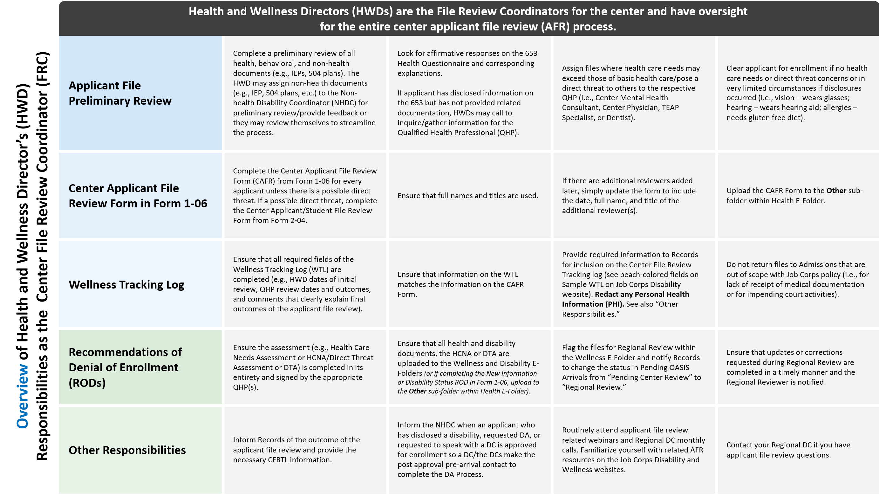
Notes:
Overview of Health and Wellness Director’s (HWD) Responsibilities as the Center File Review Coordinator
Given that Health and Wellness Directors (HWDs) are the File Review Coordinators for the center and have oversight for the entire center applicant file review process, we have developed a chart that outlines the major responsibilities/considerations for each of the primary areas of oversight (i.e., Applicant File Preliminary Review, Center Applicant File Review Form in Form 1-06, Wellness Tracking Log, Recommendations of Denial of Enrollment and Other Responsibilities).
This resource will be on the Job Corps Disability Website under New Items.

Slide 47
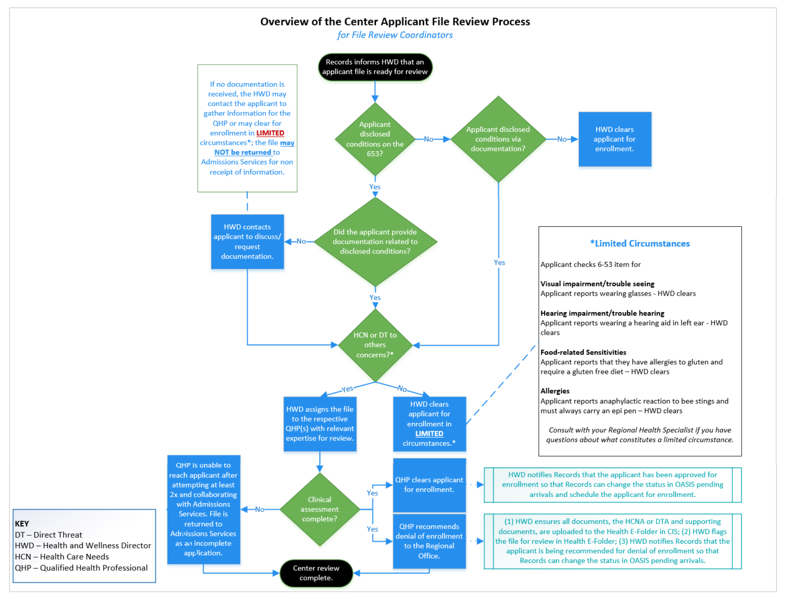
Overview of the Center Applicant File Review Process
Notes:
Overview of the Center Applicant File Review Process
We have also developed a Flowchart that provides an overview or the framework, if you will, for the Center Applicant File Review Process. This should be especially useful if you are a newer Health and Wellness Director.
This resource will be on the Job Corps Disability Website under New Items.

Slide 48
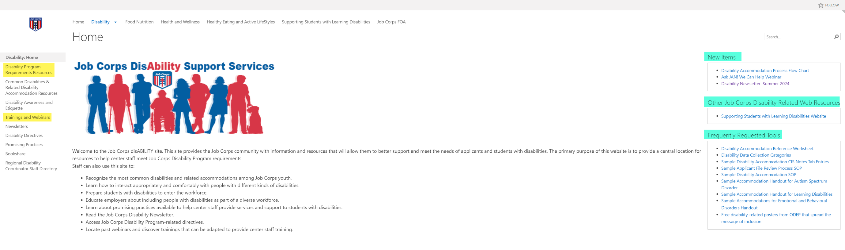
Job Corps Disability Support Services Website https://supportservices.jobcorps.gov/disability/Pages/default.aspx
Notes:
Job Corps Disability Website
The Job Corps Disability Support Services Website contains numerous resources and tools on applicant file review and disability accommodation requirements, processes and procedures.
As new resources and tools are developed, they are listed under the New Items heading to the right side of the website page.
Resources that are more commonly used and/or requested are listed under the Frequently Requested Tools section also highlighted in teal.
The categories of resources are listed on the left-hand side of the website and are highlighted in yellow.
The Job Corps Disability website link is located at the top of the slide.

