Slide 1
Maintaining and Managing Applicant File Review (AFR) Tracking
Final Dispositions
FRT Reviewers
30 days
Applicant File Review Orientation Series Part 2
Notes:
Welcome to Maintaining and Managing Applicant File (AFR) Tracking webinar! This webinar is targeted to center Records Managers, File Review Coordinators (Health and Wellness Directors) and Disability Coordinators but certainly all members of the applicant file review team can benefit from learning the requirements of AFR tracking including a review of the Wellness Tracking Log.

Slide 2
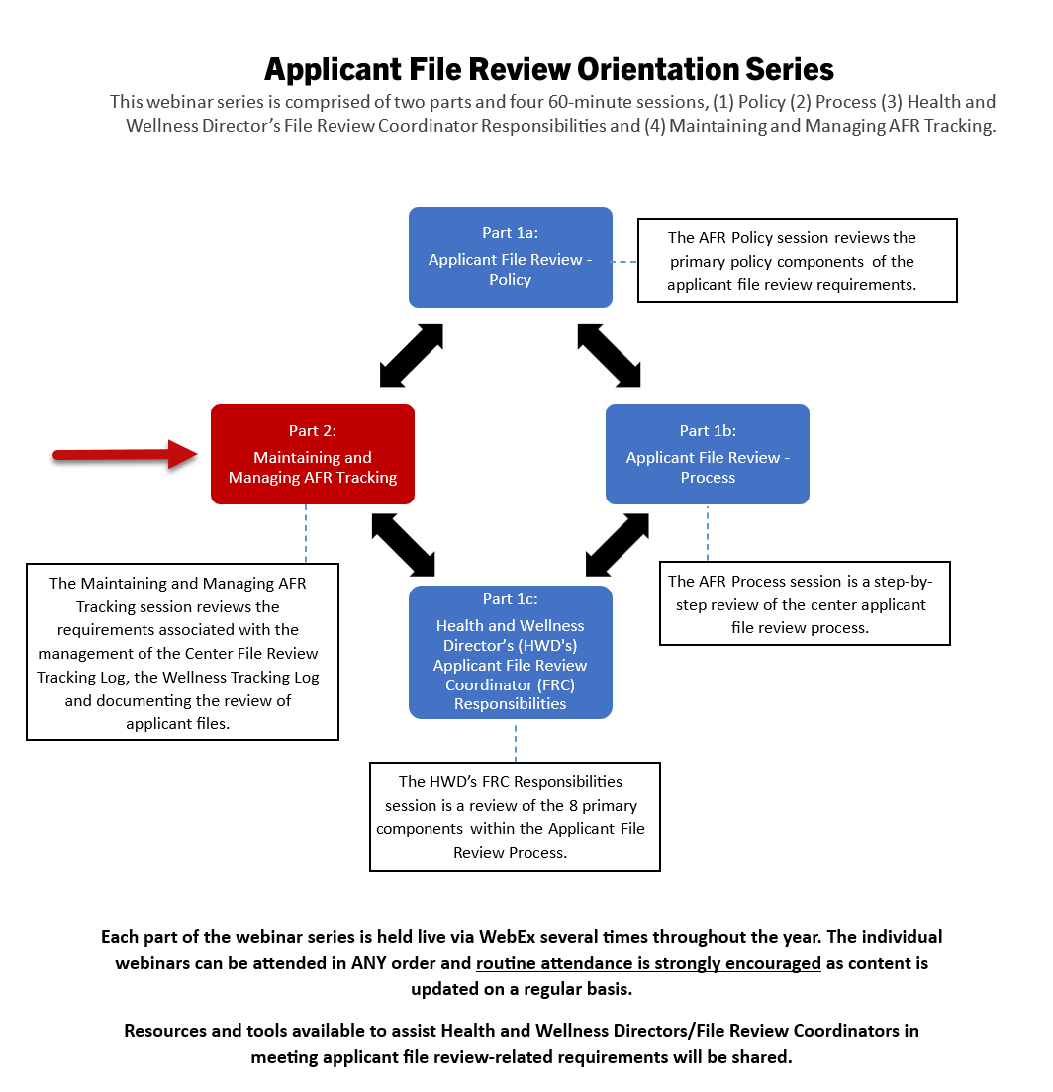
NOTE: TO CHANGE OUT THIS ICON OUT WITH YOUR OWN YOU MAY HAVE TO CLICK ON THE ICON A FEW TIMES TO HIGHLIGHT IT (SINCE IT IS IN A GROUP). ONCE HIGHLIGHTED… 1*RIGHT CLICK ON TOP OF THE ICON.
2*CHOOSE “CHANGE GRAPHIC”
3* CHOOSE WHERE TO FIND YOUR NEW ICON OR PICTURE AND PLACE IT.
Disability
Coordinator
Orientation
Webinar Series
2
Notes:
Applicant File Review Orientation Series
The original Disability Coordinator Orientation Series has been restructured into TWO different Orientation Series. The first one is the Applicant File Review Orientation Series, which is comprised of two parts and four 60-minute sessions. The target audience for this series is primarily Health and Wellness Managers but center Qualified Health Professionals and Disability Coordinators would benefit as well. The second series is the Disability Coordinator Orientation Series and includes 3-parts comprised of 4 individual webinars.
The individual webinars can be attended in ANY order and routine attendance is strongly encouraged as content is updated on a regular basis. For the AFR Orientation Series, resources and tools available to assist Health and Wellness Directors/File Review Coordinators in meeting applicant file review-related requirements will be shared.
Today, we will be reviewing Part 2 of the Applicant File Review Orientation Series: Maintaining and Managing AFR Tracking and it is highlighted in red on the graphic above.

Slide 3
Center File Review Tracking Log (CFRTL)
3
Notes:
Center File Review Tracking Log (CFRTL)
It is critically important to understand the policy requirements related to maintaining and managing the tracking of the applicant file review process for several reasons:
To ensure that the process is documented consistently and accurately.
To ensure that all components of the process are documented should there be a civil rights complaint.
To ensure that all applications are reviewed to a final disposition except for those electronically returned to Admissions Services for allowable policy reasons.

Slide 4
Center File Review Tracking Log
PRH Chapter 1: 1.5(R3)
A
Center File Review Tracking Log Requirements
File Receipt Date | Date Other Review Completed
File Review Due Date (30 days) | Extension Requested
Priority Applicant (Veteran’s and Veteran Spouses) | Final Disposition
Expedited Applicant | Disposition Date
Expedited Applicant File Review Due Date (21 days) | Days File in Review
Applicant ID# | Date of Assignment
Applicant Last and First Name | Date of Enrollment
Health and Wellness Director (HWD) Reviewer | Comments
Date HWD Preliminary Review Completed
Other Reviewer
Records MUST maintain a single ongoing center file review log which documents ALL applicant files received for review.
B
A new log should be started each Program Year and entries MUST NOT be deleted.
C
Wellness MUST maintain its own internal tracking log. (PRH Chapter 1:1.5(R2)(b).
4
Notes:
Center File Review Tracking Log - PRH Chapter 1: 1.5(R3)
The requirements of the Center File Review Tracking Log are listed in the table and we will discuss those further shortly but first let’s review some of the overarching requirements you need to be aware of in maintaining your center’s tracking log.
Records MUST maintain a single ongoing center file review log which documents ALL files received for review.
A new log should be started each Program Year and entries MUST NOT be deleted.
Wellness MUST maintain its own internal tracking log. (PRH Chapter 1:1.5(R2)(b).

Slide 5
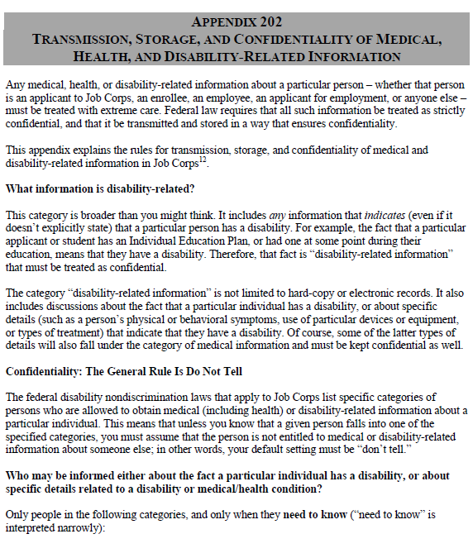
Confidential Information Within the Log
Specifically, on the Center File Review Tracking Log,
Avoid using such terms as IEP, names of conditions, etc.
If awaiting receipt of an IEP, for example, simply state "awaiting documentation" or "awaiting Wellness documentation.“
Use generic phrases that tell the story but do not inadvertently disclose protected health information or disability status.
5
Notes:
Confidential Information Within the Log
We cannot over emphasize the need for discretion and appropriate maintenance of protected health and disability information. It is serious business, and we must treat it as such.
Let’s talk about some things that we can do to minimize sharing/disclosure of protected health and disability information.
Avoid using such terms as IEP, names of conditions, etc. If awaiting receipt of an IEP, for example, simply state "awaiting documentation" or "awaiting Wellness documentation.“
Ultimately, try and use generic terms that tell the story but do not inadvertently disclose protected health information or disability status.
Appendix 202, Transmission, Storage, and Confidentiality of Medical, Health, and Disability-Related Information is your go to policy resource for understanding the maintenance of protected health and disability information.

Slide 6
Responsibilities of Records Staff
The records department is the gatekeeper of all applicant files.
The Records Manager (or designated Records staff) is accountable for ensuring the Center File Review Tracking Log tracks all required components and contains complete and accurate information.
Regular quality audits of the log are recommended to identify and correct missing or inaccurate information.
6
Notes:
Responsibilities of Records Staff
Job Corps policy requires that the Records department serve as the “gatekeeper” for tracking all applicant files and must manage/oversee the tracking of all applicant files from the time the center receives the applicant file until there is a final disposition. Regular audits of the log are recommended to identify and correct missing or inaccurate information.

Slide 7
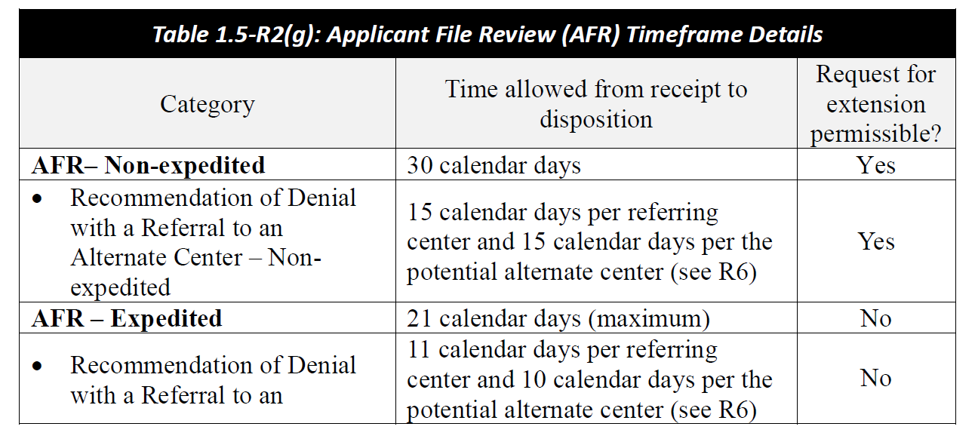
Timelines for Applicant and Expedited Applicant File Review
7
Notes:
Timelines for Applicant and Expedited Applicant File Review
AFR- Non-expedited
The center still has 30 calendar days from electronic receipt of the file by the center to complete the review of a standard applicant file. In other words, to decide to enroll or to recommend denial of enrollment. With standard applicant file reviews, centers may request extensions of time to complete the review of an application if the center reasonably can substantiate needing the file longer than 30 calendar days to complete the file review process. The extension request must be requested from your DOL Program Manager and it should be documented in the center’s File Review Tracking Log. Your extension request must be submitted to the Regional Office no later than 25 calendar days into your 30-day review timeframe.
Caution – extensions are to give the center time to secure a needed accommodation to participate in the file review process, to schedule a tour if that is logistically possible and needed, or to receive anticipated documentation. Extensions to complete file reviews should not function as delays in enrollment.
AFR – Expedited
The center has 21 calendar days maximum to complete the applicant file review. If possible, these files should be completed sooner than 21 days. No extensions of time may be requested or received for expedited applicant file reviews or for appeals of denial of enrollment for expedited applicant file reviews.

Slide 8
Center File Review Tracking Log
Review of Log Requirements
8
8
Notes:
Center File Review Tracking Log – Review of Log Requirements
Now let’s review the Sample Center File Review Tracking Log from the Job Corps Disability website and discuss the log requirements.

Slide 9
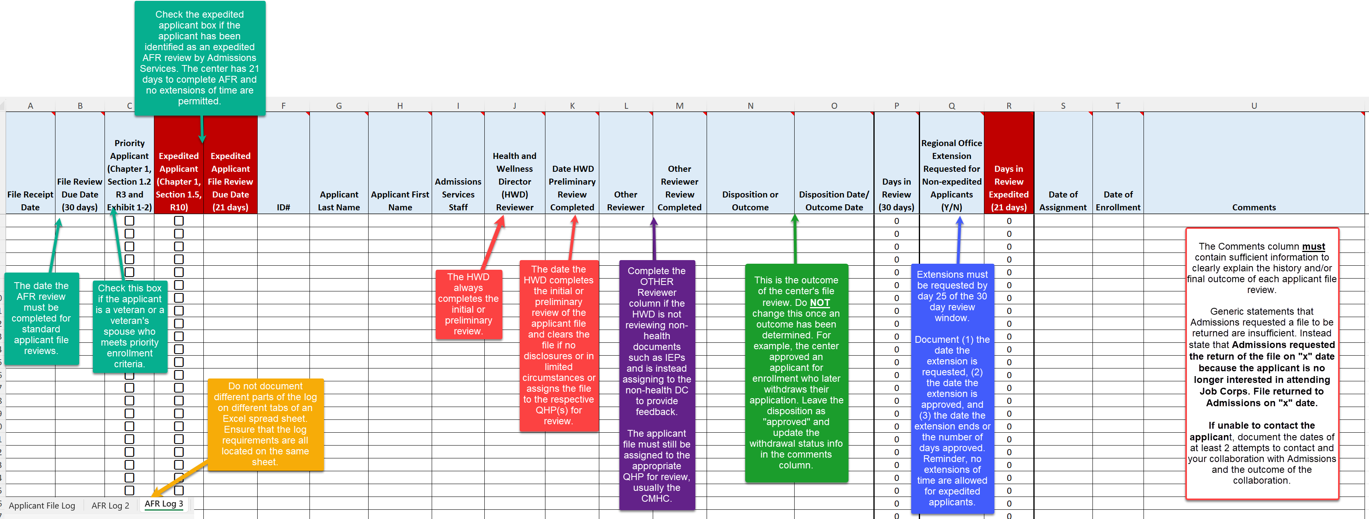
Sample Center File Review Tracking Log
Attend the Maintaining and Managing AFR Tracking webinar for a detailed discussion of each of the log requirements.
Notes:
Sample Center File Review Tracking Log
We have updated the Sample Center File Review Tracking Log to include the new requirements in Section 1.5 of the PRH. This graphic can be used as a reference sheet if you are unsure of what information to put in each of the primary columns of the log. This graphic may be found on the Job Corps Disability website in the same location as the Sample Center File Review Tracking Log template.

Slide 10
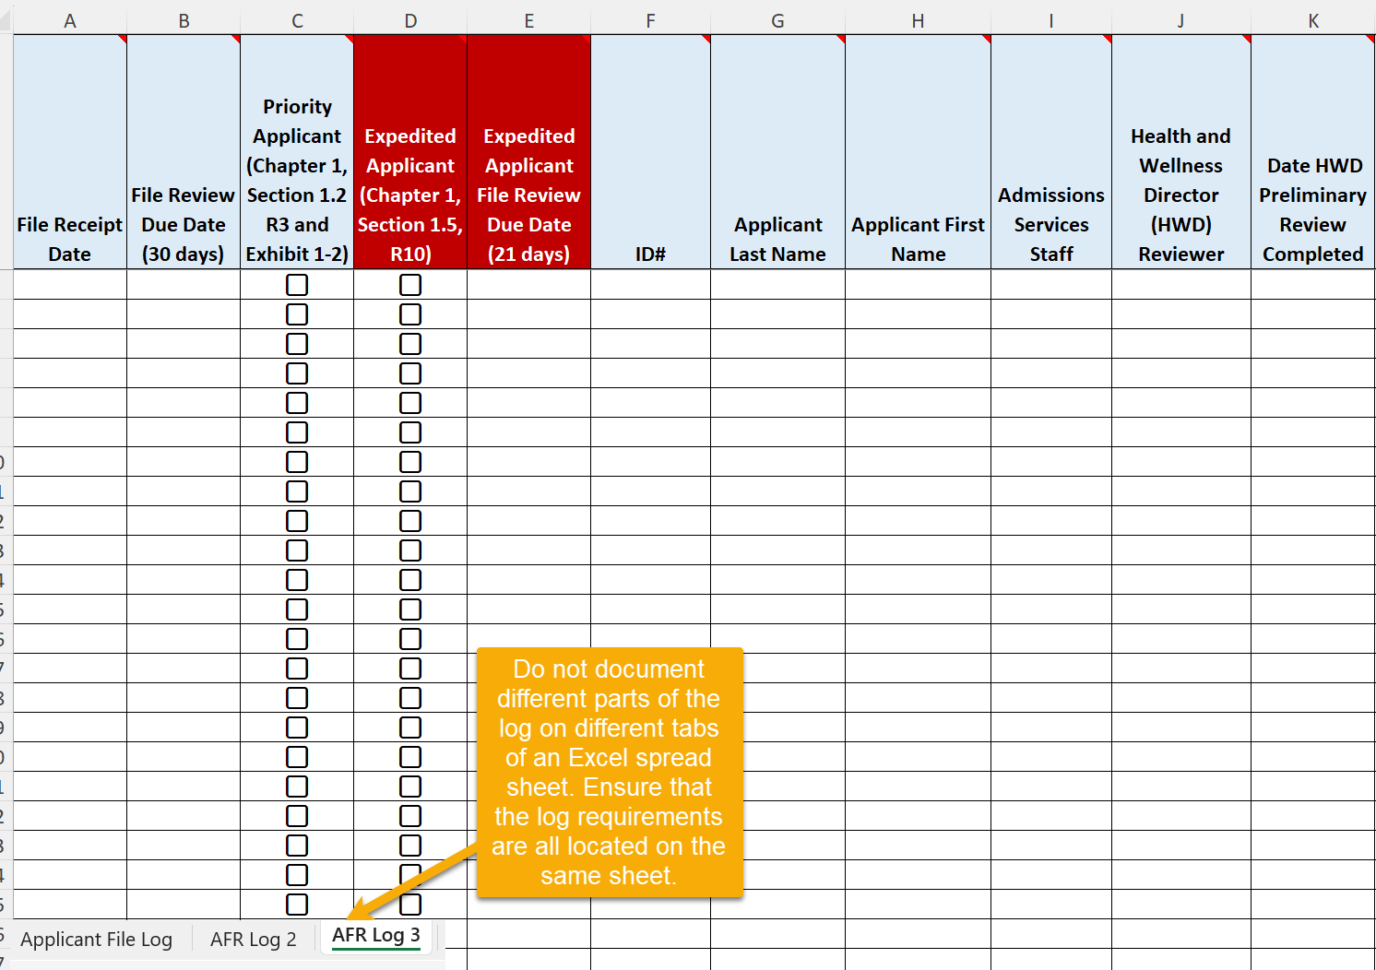
Center File Review Tracking Log
Multiple Logs
10
Notes:
Center File Review Tracking Log Review – Multiple Logs
First, look at the lower left-hand side of the screen where you seen the 3 tabs: AFR Log, AFR Log Pg 2 and AFR Log Page 3. Maintaining certain parts of the log on differing tabs is not maintaining a single log. Some centers, however, will complete a Program Year’s worth on entries on one tab say for 2024 and then start a new one in 2025 which is fine to do. However, the tracking log must not have requirements split up and tracked on different tabs even if on the same spreadsheet.
So please start using the new updated Sample log ASAP with any new applicant files received moving forward, to capture the new requirements in Section 1.5 of the PRH. If your Records Manager is not on this webinar, please relay this important information to them. The updated Sample log can be found on the Disability website.

Slide 11
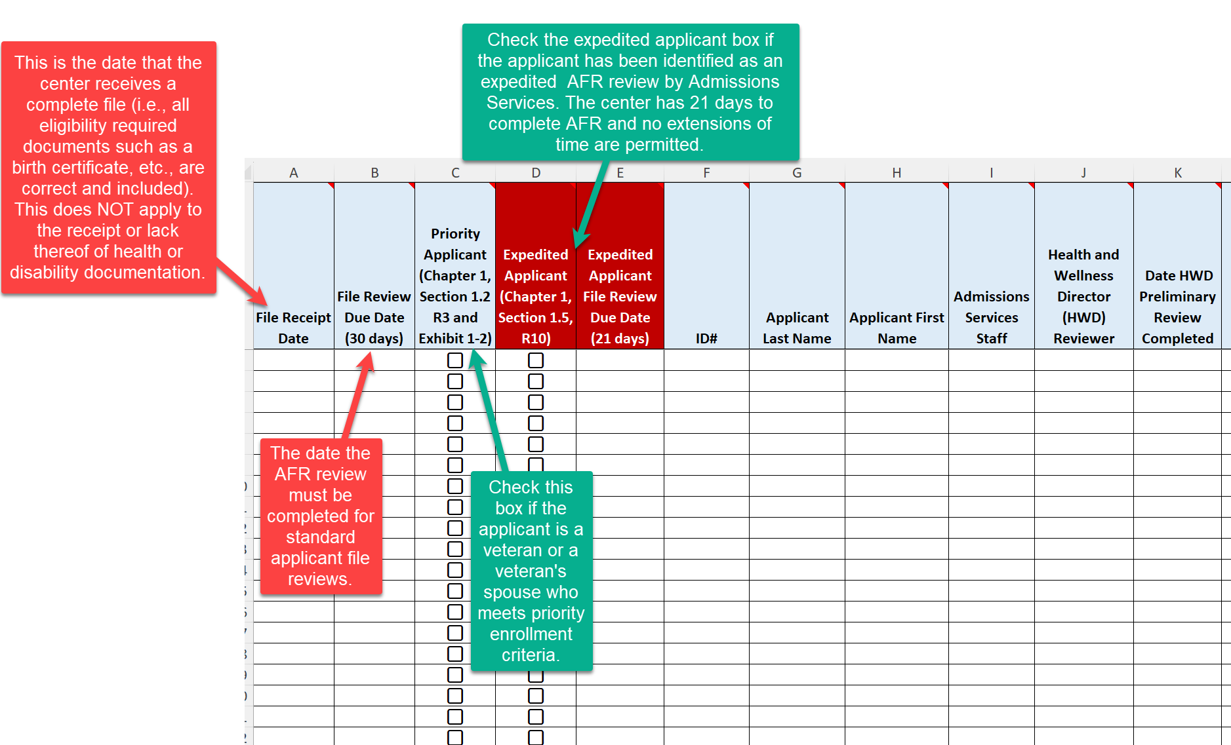
Center File Review Tracking Log
File Receipt and File Review Due Dates; Priority and Expedited Applicants
11
Notes:
Center File Review Tracking Log Review
The first column is the File Receipt Date. This is the date that the center receives a complete file (i.e., all eligibility required documents such as birth certificate, etc. are correct and included.) This does NOT apply to the receipt or lack thereof of health or disability documentation. Why? The disclosure of protected health and disability documentation is voluntary and if no documents are forthcoming (due to time constraints, not available, etc.), the center file review team must proceed with the completion of the applicant file review. Files may not be returned to Admissions due to the lack of receipt of Health and/or Disability information.
File Review Due Date (30 days)
This is the date the AFR review mut be completed for standard applicant file reviews.
Priority Applicant
Check this box if the applicant is a veteran or a veteran’s spouse who meets priority enrollment criteria as per Exhibit 1-2.
Expedited Applicant and Expedited Applicant File Review Due Date
Check the expedited applicant box if the applicant has been identified as an expedited AFR review by Admissions Services. The center has 21 days to complete AFR and no extensions of time are permitted.

Slide 12
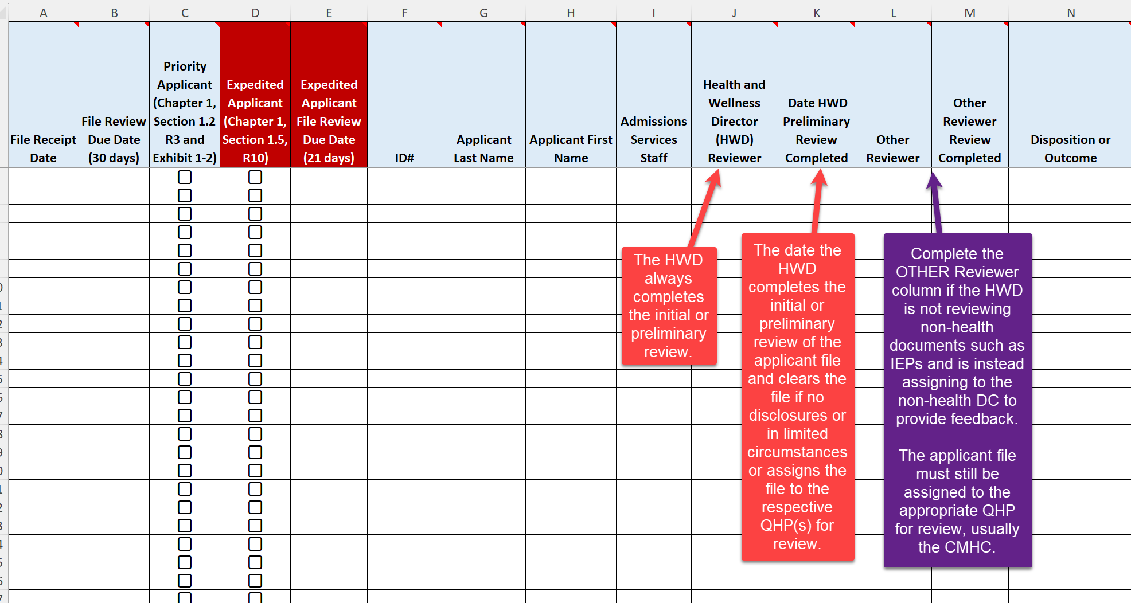
Center File Review Tracking Log
Health and Wellness Director (HWD) Reviewer and Date HWD Preliminary Review Completed
12
Notes:
Center File Review Tracking Log Review - Health and Wellness Director (HWD) Reviewer and Date HWD Preliminary Review Completed
Health and Wellness Director (HWD) Reviewer. The HWD is the File Review Coordinator for the center and is the person identified in Job Corps policy to complete the preliminary review of all “complete” applicant files and manage the applicant file review process. Given this, the Health and Wellness Director (HWD) Reviewer column should consistently list the name of the HWD as the initial reviewer of the applicant file.
Date HWD Review Completed
The date the HWD completes the initial or preliminary review of the applicant file and clears the file if no disclosures or in limited circumstances or assigns the file to the respective QHP(s) for review. There should always be a date in this column unless the applicant file has been returned to Admissions Services for an allowable reason within Job Corps policy and before the 30-day file review window had expired (or maximum of 21 days for expedited) and/or before the Health and Wellness Director completed their preliminary review. This typically occurs when there has been a withdrawal of application early in the center’s file review process.
Other Reviewer/Other Reviewer Review Completed
Complete the OTHER Reviewer column if the HWD is not reviewing non-health documents such as IEPs and is instead assigning to the non-health DC to provide feedback. The applicant file must still be assigned to the appropriate QHP for review, usually the CMHC.

Slide 13
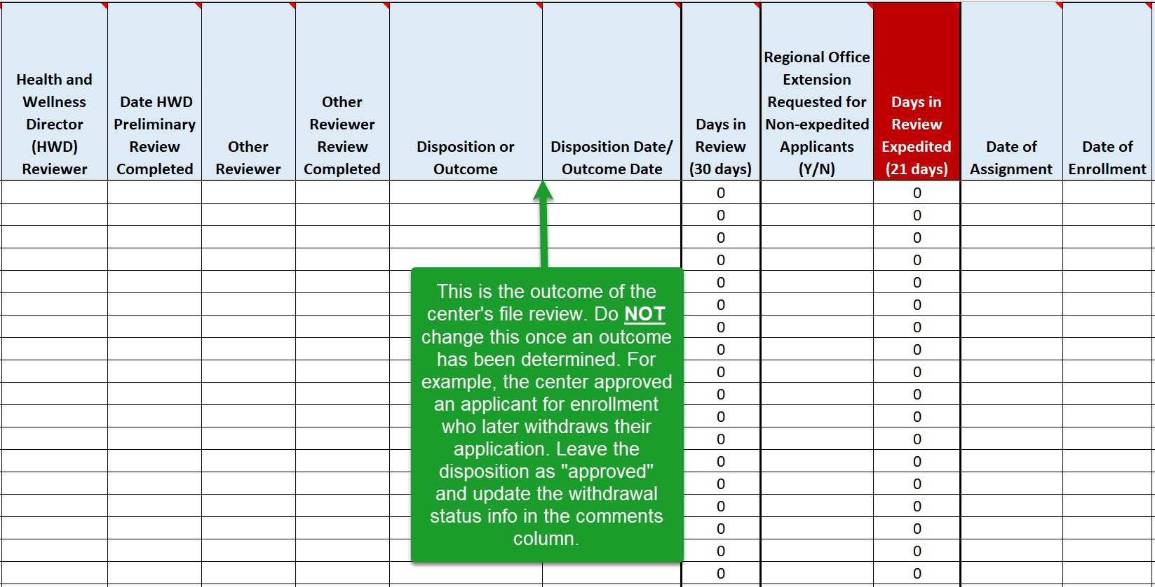
Center File Review Tracking Log
Disposition or Outcome and Disposition Date/Outcome Date
13
Notes:
Center File Review Tracking Log Review - Disposition or Outcome and Disposition Date/Outcome Date
Disposition or Outcome
This is a very important column as it documents the center’s outcome of the file review. Do NOT change the disposition/outcome once an initial one has been determined. For example, the center approved an applicant who later withdrew their application. Leave the disposition/outcome as approved here and update the withdrawal status info in the comments column.
The Disposition or Outcome is a critical column and should NEVER be blank. Every application has some type of outcome. There is a dropdown box that includes the following fields:
Approved
Recommend Denial
Return to Admissions – Withdrawal (Explain in comments)
Return to Admissions – Incomplete (Explain in comments)
Return to Admissions – Other (Explain in comments)
Error in Eligibility
When there is a return to admissions, there should always be an explanation in the comments box to include adding any additional dates that may apply. Generic statements that do not provide sufficient explanation do result in concerns during your center assessments. For example, stating that Admissions Services requested it back but including no other clarifying information is insufficient. Why did Admissions Services request it back and is the return allowable under Job Corps policy? If it is not allowable under Job Corps policy, then the file may not be returned to Admissions Services and the center must complete the applicant file review process.

Slide 14
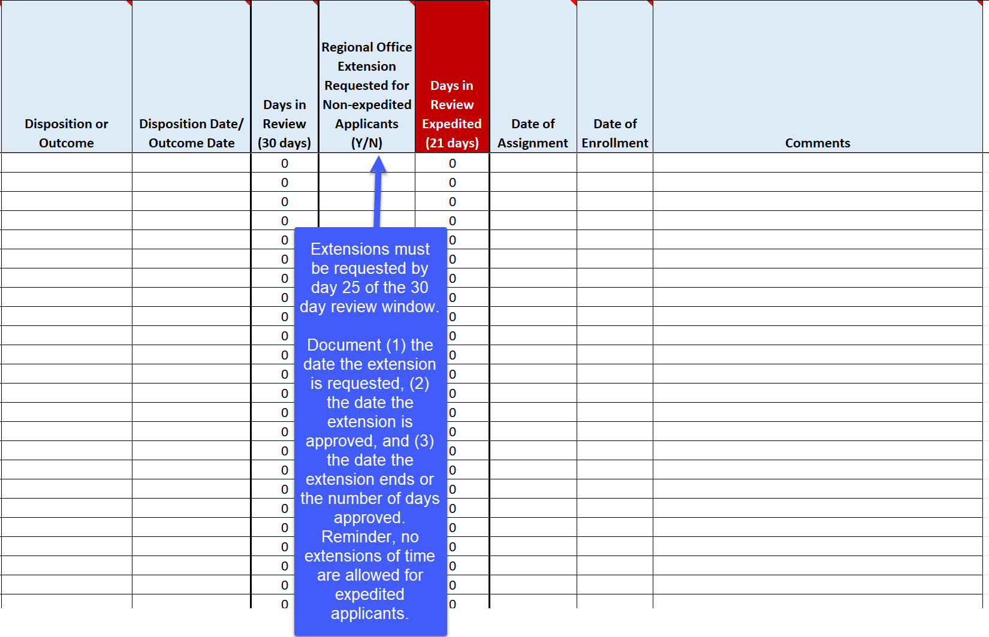
Center File Review Tracking Log
Days in Review (30 days), Regional Office Extension Requested for Non-expedited Applicants, and
Days in Review Expedited (21 days)
14
Notes:
Center File Review Tracking Log Review - Days in Review (30 days), Regional Office Extension Requested for Non-expedited Applicants, and Days in Review Expedited (21 days)
Regional Office Extension Requested
Extensions must be requested by day 25 of the 30-day review window. Document (1) the date the extension is requested, (2) the date the extension is approved, and (3) the date the extension ends or the number of days approved. Reminder, no extensions of time are allowed for expedited applicants.

Slide 15
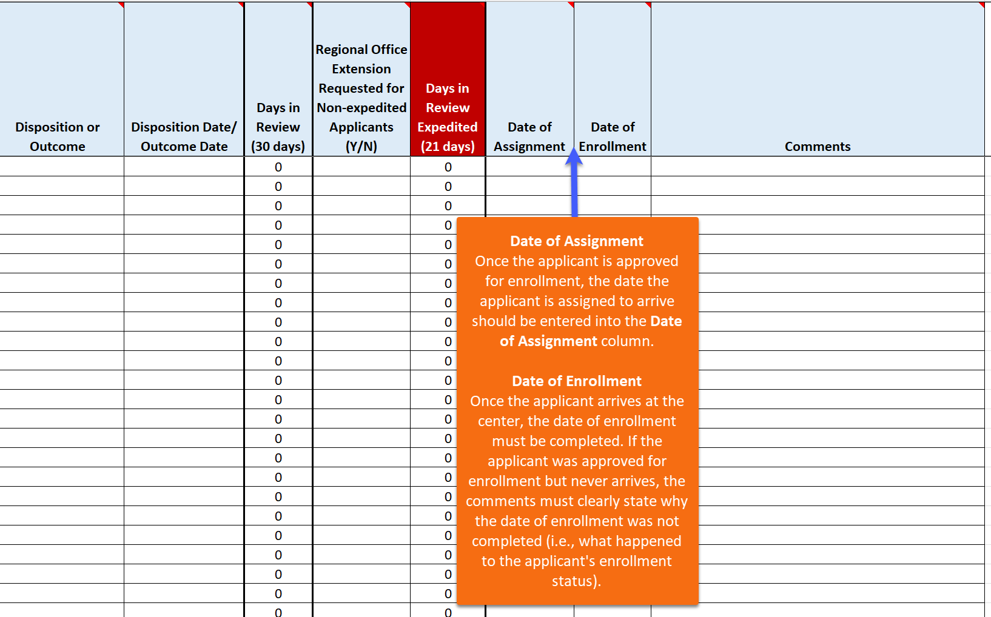
Center File Review Tracking Log
Date of Assignment and Date of Enrollment
15
Notes:
Center File Review Tracking Log Review – Date of Assignment and Date of Enrollment
Date of Assignment
Once the applicant is approved for enrollment, the date the applicant is assigned to arrive must be entered into the Date of Assignment column.
Date of Enrollment
Once the applicant arrives at the center, the date of enrollment must be completed. If the applicant was approved for enrollment but never arrives, the comments must clearly state why the date of enrollment column was not completed (i.e., what happened to the applicant's enrollment status).

Slide 16
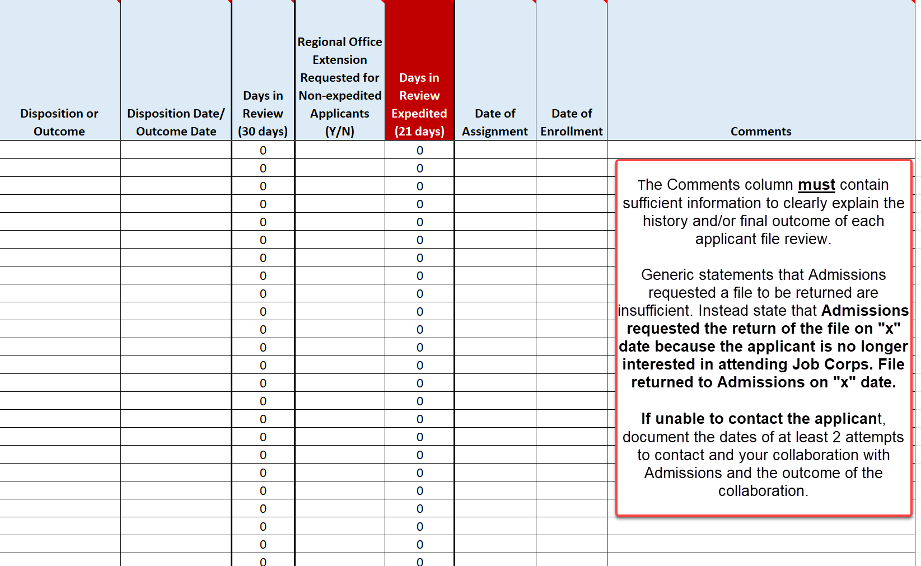
Center File Review Tracking Log
Comments
16
Notes:
Center File Review Tracking Log Review – Comments
Comments
The Comments column must contain sufficient information to clearly explain the history and/or final outcome of each applicant file review. Again, generic statements that Admissions requested a file to be returned are insufficient. Instead state that Admissions requested the return of the file on "x" date because the applicant is no longer interested in attending Job Corps. File returned to Admissions on "x" date.
If unable to contact the applicant, document the dates of at least 2 attempts to contact and your collaboration with Admissions and the outcome of the collaboration.

Slide 17
Center File Review Tracking Log
Days in Review Calculations/Extensions Examples
17
Notes:
Center File Review Tracking Log Review – Days in Review Calculations/Extensions Examples
Quick Review: If a non-expedited applicant file review is going to take longer than 30 days due to extenuating circumstances, then the center must request a brief extension of time from the center’s Regional DOL Program Manager.
Documenting File Review Extensions
The center must select a “Y” for yes in the Regional Office Extensions Requested for Non-expedited Applicant column and the center should be documenting the date the extension is requested, and the date the extension ends in the comments section. Looked at the bottom line of the log above. Note that the applicant file review took 34 days, a Y is in the extension requested column and the comment states (and read the comment).
Expedited Applicants
If the center has an expedited applicant, select the check box for expedited applicants (see the yellow highlighted checkbox) and ensure that the review is completed by a maximum of 21 days, sooner if at all possible. In the example on the table, the file review took 25 days and the center would be out of compliance because no extensions of time are allowed.
The Days in Review columns will auto calculate as long as the File Receipt Date and the Disposition/Outcome Dates are filled in on the table (and the calculation formulas in the Days in Review columns are not removed). Note: Both columns will calculate days in review simultaneously. The days in review in the expedited column should never exceed a maximum of 21 days.

Slide 18
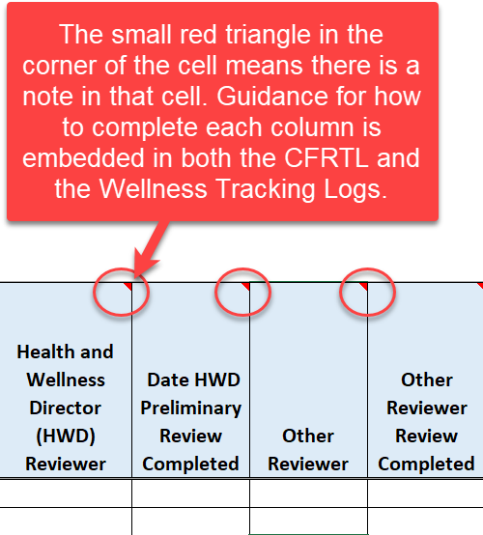
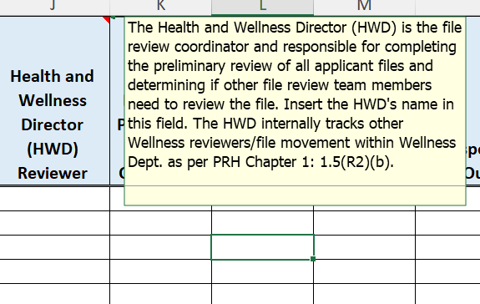
Instructions and Guidance Embedded in Log
Notes:
Instructions and Guidance – Embedded in Log
Each column has a red triangle in the upper right corner. If you place your cursor on the triangle, there is a dropdown that includes an explanation of what type of information goes in that column.
For example, in the Health and Wellness Director (HWD) Reviewer column, it states: “The HWD is the file review coordinator and responsible for completing the preliminary review of all applicant files and determining if other file review team members need to review the file. Insert the HWD’s name in this field.”

Slide 19
Center File Review Tracking Log Comments Acceptable or Unacceptable?
Awaiting receipt of IEP. (No final disposition noted.)
CMHC requested additional documentation and did not receive it. File returned to Admissions Services.
Applicant stated they got a job, so the file was returned to Admissions Services as a withdrawal of application on August 15, 2024.
File returned to Admissions Services as per Admissions Services staff request.
Applicant’s case worker called and informed center that applicant is incarcerated. File was returned to Admissions Services.
19
Notes:
Center File Review Tracking Log Comments – Acceptable or Unacceptable?
In the chat box, type whether you think the comment is an acceptable or an unacceptable one to be on the center File Review Tracking Log.
Awaiting receipt of IEP. (No final disposition noted.) Unacceptable – the center must make a decision based upon the clinical interview and any information received if the additional documentation is not forthcoming within the 30-day window or the timeframe of the extension granted by the RO. Also, the CFRTL should not disclose disability or medical information so documenting awaiting on an IEP is a breach of confidentiality.
CMHC requested additional documentation and did not receive it. File returned to Admissions Services. Unacceptable – just as in the last example, the center must make a decision based upon the clinical interview and any information previously received. The file may not be returned to Admissions Services.
Applicant stated they got a job, so the file was returned to Admissions Services as a withdrawal of application on August 15, 2024. Acceptable.
File returned to Admissions Services as per Admissions Services staff request. Unacceptable – it is not clear why the file was returned to Admissions staff and must not be returned unless the basis is a valid one as per JC policy.
Applicant’s case worker called and informed center applicant is incarcerated. File was returned to Admissions Services. Unacceptable. The center must complete a Recommendation of Denial for New Information and submit to the Regional Office for review.

Slide 20
Recommending Denial of Enrollment
20
20
20
Notes:
Recommending Denial of Enrollment
Let’s stop here and discuss the possible dispositions for recommending denial of enrollment. This will be a very high-level review of the specific types of recommendations of denial. For more detailed discussion, please ensure you attend the Applicant File Review webinars when they are scheduled and/or visit the Disability website to review the PPT presentations from the AFR Orientation Series.

Slide 21
Eligibility Review Due to New Information
Center applicant file review teams may only revisit the determination that an applicant is qualified for admission (i.e., an applicant’s eligibility status) if:
There is new information presented that Admissions Services staff could not have reasonably known at the time the applicant’s qualification for admission was established.
The new information (e.g., incarceration after certification of eligibility, court action pending, etc.) indicates that the applicant offered enrollment may no longer meet an eligibility requirement.
PRH 1:1.5(R1)(a)
21
Notes:
Eligibility Review Due to New Information
Let’s start with Eligibility Reviews that occur at the center level meaning after Admissions Services has conditionally enrolled the applicant because they were found to be eligible for the Job Corps program. An Eligibility Review Due to New Information should not occur often and is limited to very specific situations because the Program cannot arbitrarily revisit an enrollee’s eligibility status.
However, if there is: new information presented that Admissions Services staff could not have reasonably known at the time the applicant’s qualification for admission was established; and the new information (e.g., incarceration after certification of eligibility, court action pending, etc.) indicates that the applicant offered enrollment may no longer meet an eligibility requirement, then it is possible the applicant may NO longer be eligible for enrollment.

Slide 22
Eligibility Due to Disability Status
If the applicant is or will be older than 24 years old on the date of enrollment, the maximum age limit may be waived if the applicant is a person with a disability.
If the applicant would not meet the low-income requirement unless the applicant is considered a “family of one” because of a disability.
PRH 1: 1.2 (R3)(b)(1)
PRH 1: 1.5 (R8)
22
Notes:
Eligibility Due to Disability Status
Age and income are eligibility essential requirements (ER) in Exhibit 1-1 of the PRH and cannot be certified by Admissions Services because Admissions Services staff may not review medical documentation, only collect it. By medical documentation, we mean documentation that supports the individual’s disability status.
An applicant may exceed the upper age limit restriction and/or the applicant may be considered a “family of one” for income purposes and enroll in Job Corps if they have a disability.

Slide 23
Health Care Needs
A Health Care Needs Assessment (HCNA) is conducted for an applicant if the qualified health professional on the File Review Team determines that:
The applicant’s health care needs may not be manageable through the basic healthcare services provided for in Exhibit 2-4, Job Corps Basic Health Responsibilities.
PRH 1: 1.5 (R6)(a)
Exhibit 2-4
Form 2-05
23
Notes:
Health Care Needs
A Health Care Needs Assessment (HCNA) is conducted for an applicant if the qualified health professional on the FRT determines that: the applicant’s health care needs may not be manageable through the basic healthcare services provided for in Exhibit 2-4, Job Corps Basic Health Responsibilities. This is Form 2-05 in the PRH.
We will be talking more about the Health Care Needs Process during the Process section which will be on [insert day/date/time].

Slide 24
Direct Threat to Others
A Direct Threat Assessment (DTA) is conducted for an applicant if the qualified health professional on the File Review Team determines that:
An applicant or student may pose a significant risk of substantial harm to the health or safety of others that cannot be eliminated or reduced sufficiently by disability accommodations.
PRH 1: 1.5 (R6)(c)
Form 2-04
24
Notes:
Direct Threat to Others
The Individualized Assessment of Possible Direct Threat (Form 2-04) is completed if the qualified health professional on the File Review Team determines that an applicant or student may pose a significant risk of substantial harm to the health or safety of others that cannot be eliminated or reduced sufficiently by disability accommodations.

Slide 25
Other Possible Applicant File Review Outcomes
25
25
25
Notes:
Now let’s review the Other Possible Applicant File Review Outcomes.

Slide 26
Withdrawal of Application
If an applicant is no longer interested in attending Job Corps and withdraws their application, the applicant file should be electronically returned to Admissions Services.
If the withdrawal request was made in writing, hard copy or electronically, copies of the withdrawal request must be maintained.
PRH 1: 1.5 (R5)(a)
26
Notes:
Withdrawal of Application
A withdrawal of application is relatively straightforward in that if an applicant is no longer interested in attending Job Corps and withdraws their application, the applicant file should be electronically returned to Admissions Services. If the withdrawal request was made in writing, hard copy or electronically, copies of the withdrawal request must be maintained.

Slide 27
…even with Admissions Services assistance
Incomplete Application
If the center is unable to reach the applicant to complete a needed clinical interview or to complete barrier removal considerations (i.e., disability accommodations when recommending denial based on health care needs or direct threat), the FRT or DAC must:
Have attempted to contact the applicant at least twice
Document each attempted contact in an applicant contact log
Maintain a copy of the applicant contact log
PRH 1: 1.5 (R5)(b)
Provide the contact log information to the center Records Department to include in the Center File Review Tracking Log
27
Notes:
Incomplete Application
What is the difference between an incomplete application and a withdrawal of application. As we just discussed, a withdrawal of application occurs when an applicant has withdrawn their interest in attending Job Corps. An incomplete application is when the center File Review Team is unable to complete a required component of the applicant file review process, meaning either an inability to reach the applicant to complete the clinical interview or to complete barrier removal considerations (i.e., disability accommodations when recommending denial based on health care needs or direct threat). One important note – the center FRT must collaborate with Admissions Services to determine whether they can reach the applicant or not as well.
If neither the FRT nor Admissions Services staff is able to reach the applicant, then the FRT must:
Have attempted to contact the applicant at least twice
Document each attempted contact in an applicant contact log
Maintain a copy of the applicant contact log
Provide the contact log information to the center Records Department to include in the Center File Review Tracking Log
If the application is in regional review, the center must NOT return the file electronically to Admissions Services because the outcome of the application review is now in the purview of the Regional Office. The center must notify the regional reviewer via email and upload any supporting documentation including the applicant contact log into the Wellness and Accommodation E-Folder labeled “Other.”

Slide 28
Rare!
Error in Initial Eligibility Process
If the center FRT identifies a potential eligibility concern that occurred as a potential error in the initial eligibility review process, then the center should contact the DOL Program Manager for guidance.
If the initial eligibility determination was made in error as determined by the respective Regional Office, then the file may be returned to Admissions Services.
PRH 1: 1.5 (R5)(c)
Exhibit 1-1
What is the difference between “new information” that may make an individual now ineligible for the program and an error in the initial eligibility process?
28
Notes:
Error in the Initial Eligibility Process. This has been an informal category in the past and not included in the PRH. This outcome should only occur very rarely and is different than a “new information” recommendation of denial. If the center FRT identifies a potential eligibility concern that occurred as a potential error in the initial eligibility review process, then the center should contact the Program Manager for guidance. If the initial eligibility determination was made in error as determined by the respective Regional Office, then the file may be returned to Admissions Services.
What is the difference between “new information” that may make an individual now ineligible for the program and an error in the initial eligibility process?

Slide 29
Review!
New Information
Error in Eligibility
New information that makes the applicant “newly” ineligible; information Admissions Services staff could not have known at the time of the original certification (e.g., incarceration occurs during center file review).
Center reviews information KNOWN by Admissions Services at the time of the initial eligibility certification and believes the applicant was never eligible.
New Information
vs
Error in Eligibility
Center contacts (calls or emails) the DOL Program Manager for discussion/review.
Center recommends denial of enrollment via Notify Regional Review in CIS.
29
Notes:
Review – New Information vs Error in Eligibility
Let’s Review the differences between a new information recommendation of denial and a determination of a possible error in eligibility.
New Information
There are some key words that distinguish the differences between these two categories:
New information that makes the applicant “newly” ineligible; information Admissions Services staff could not have known at the time of the original certification (e.g., incarceration occurs during center file review).
Center recommends denial of enrollment via Notify Regional Review in CIS.
Error in Eligibility
Center reviews information KNOWN by Admissions Services at the time of the initial eligibility certification and believes the applicant was never eligible.
Center contacts (calls or emails) the DOL Program Manager for discussion/review.

Slide 30
Residential Settings or Hospitalization
If an applicant is in a treatment facility, residential program, or is currently hospitalized, the center FRT and/or Disability Accommodation Committee (DAC) must make at least two attempts to contact the applicant using contact information provided in the applicant file.
Made contact?
Complete the applicant file review process.
Unable to make contact?
Document the attempts to contact and electronically return the file to Admissions Services as an incomplete application.
What does the center do if the file is in Regional Review?
PRH 1: 1.5 (R5)(d)
30
Notes:
Residential Settings or Hospitalization
First, an applicant being in a residential setting or hospitalized does not mean that their file is automatically returned to Admissions Services! These applicants must be treated the same as all applicants.
If an applicant is in a treatment facility, residential program, or is currently hospitalized, the center FRT and/or Disability Accommodation Committee (DAC) must make at least two attempts to contact the applicant using contact information provided in the applicant file in order to complete the applicant file review process and either make a determination of enrollment or recommend denial.
If the center can reach the applicant, the center may not return the applicant file to Admissions Services but must process the recommendation of enrollment or denial unless the applicant states that they wish to withdraw their application.
If the center is unable to reach the applicant, then the center must document the attempts to contact and then may electronically return the file to Admissions Services due to the inability to complete the application process.
What if the center is unable to reach the applicant but the file is in Regional Review?
Contact the Regional Reviewer and let them know that the center has been unable to reach the applicant to complete a required contact (usually a clinical interview or the disability accommodation process) and the Regional Reviewer will manage the next steps.

Slide 31
Other
Centers may not arbitrarily return an applicant file to Admissions Services if outside the scope of or in conflict with Job Corps policy.
Examples:
Returning a file requested by Admissions Services without knowing why it is being requested.
Returning a file to Admissions Services that has a new legal action pending instead of submitting as a recommendation of denial to the Regional Office.
Reasons for returning an application to Admissions Services must be clearly documented in the Center File Review Tracking Log.
PRH 1: 1.5 (R5)(e)
31
Notes:
Other
The “OTHER” category serves as a valuable reminder that applicant files may not be returned to Admissions Services if outside the scope of or in conflict with Job Corps policy.
Examples:
Returning a file requested by Admissions Services without knowing why it is being requested.
Returning a file to Admissions Services that has a new legal action pending instead of submitting as a recommendation of denial to the Regional Office.
Reasons for returning an application to Admissions Services must be clearly documented in the Center File Review Tracking Log.

Slide 32
Center Applicant File Review Form (CAFR) and the Wellness Tracking Log (WTL)
PRH 1: 1.5, R1(b) and Form 1-06; R2(b)
32
32
32
Notes:
Center Applicant File Review Form (CAFR) and the Wellness Tracking Log (WTL)
PRH 1: 1.5, R1(b) (Health and Disability Review) and Form 1-06 (Center Applicant File Review form)
PRH 1: 1.5, R2(b) (Standard Operating Procedure)

Slide 33
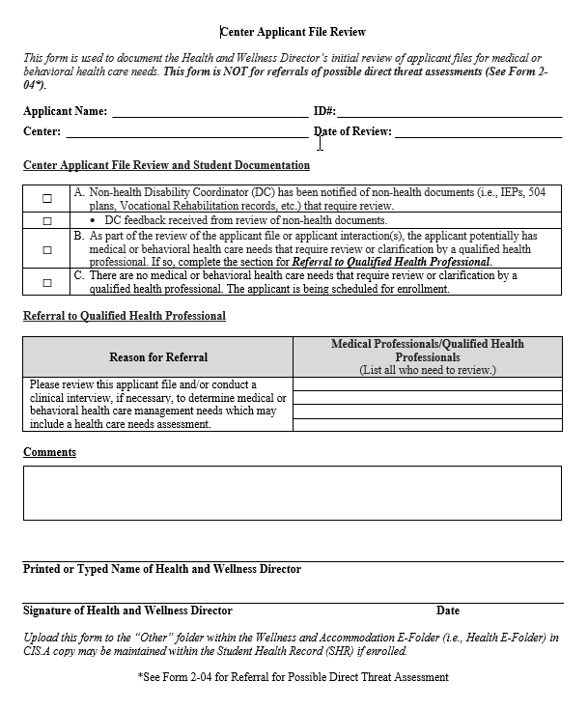
Center Applicant File Review (CAFR) Form Form 1-06
The HWD must complete this form with each file review.
If there is reasonable belief, based on objective evidence, that the individual has a medical condition or disability that may pose a significant risk of substantial harm to the health or safety of others, then the HWD must complete a similar form in Form 2-04 instead.
Notes:
Center Applicant File Review (CAFR) Form - Form 1-06
The Center Applicant File Review Form is where the HWD documents:
Their clearance of an applicant file where no disclosures were made via the 653, Health Questionnaire or via documentation
The assignment of the Disability Coordinator to review non-health documents and provide feedback to the HWD. (Remember that even if the Non-health DC reviews, the applicant file must still be assigned to the appropriate QHP for review, usually the CMHC.)
The assignment of Qualified Health Professionals when the applicant has disclosed conditions outside of the limited circumstances list included in the HWD’s File Review Coordinator’s PPT which may be found on the Job Corps Disability website.
For Presenter’s reference – the Limited Circumstances List includes:
Visual impairment/trouble seeing ​
Applicant reports wearing glasses - HWD clears​
Hearing impairment/trouble hearing​
Applicant reports wearing a hearing aid in left ear - HWD clears​
Food-related Sensitivities ​
Applicant reports that they have allergies to gluten and require a gluten free diet – HWD clears​
Allergies​
Applicant reports anaphylactic reaction to bee stings and must always carry an epi pen – HWD clears​
Other Health Concerns​
Applicant reports having GERD and either uses over the counter meds or daily proton pump inhibitor – HWD clears​
The HWD must complete the Center Applicant File Review (CAFR) Form (Form 1-06, page 1) for all file reviews unless the HWD believes the applicant may pose a potential direct threat to others; in cases of potential direct threat, the HWD must instead complete Center Applicant/Student File Review (CA/SFR) Form (Form 2-04, page 8).

Slide 34
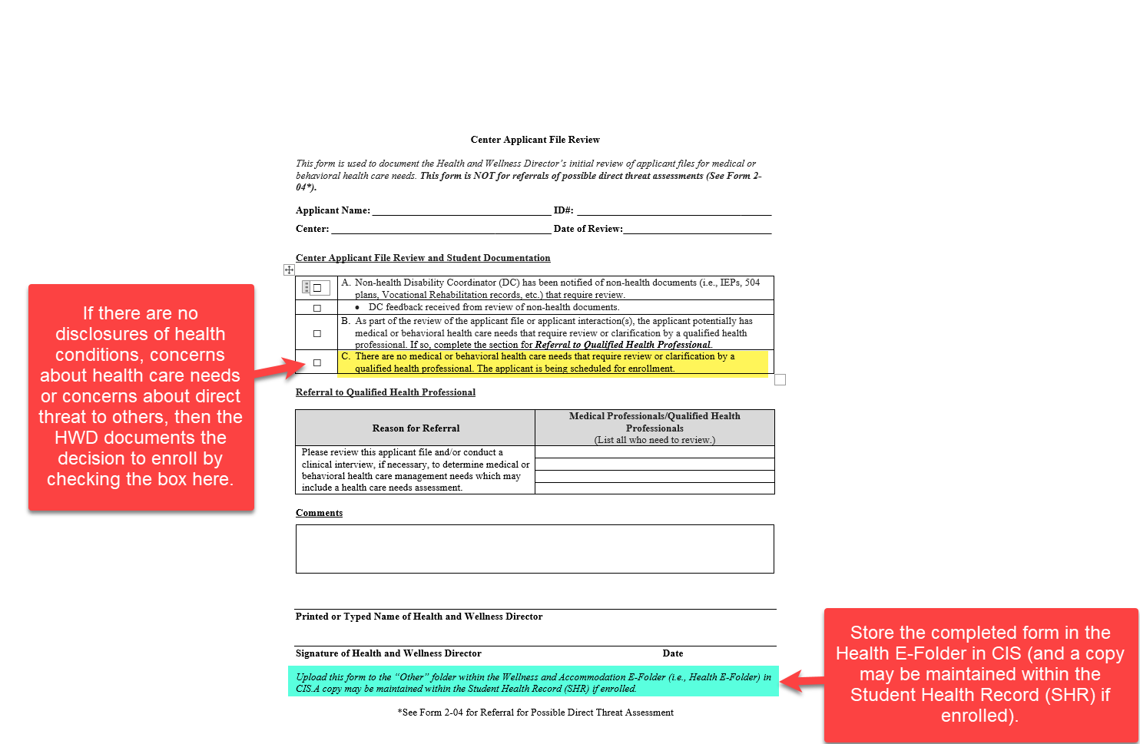
Notes:
Center Applicant File Review Form – Item C
If there are no disclosures of health conditions, concerns about health care needs or concerns about direct threat to others, then the HWD documents the decision to enroll by checking Item C on the CAFR Form.
Store the completed form in the Health E-Folder in CIS (and a copy may be maintained within the Student Health Record (SHR) if enrolled).

Slide 35
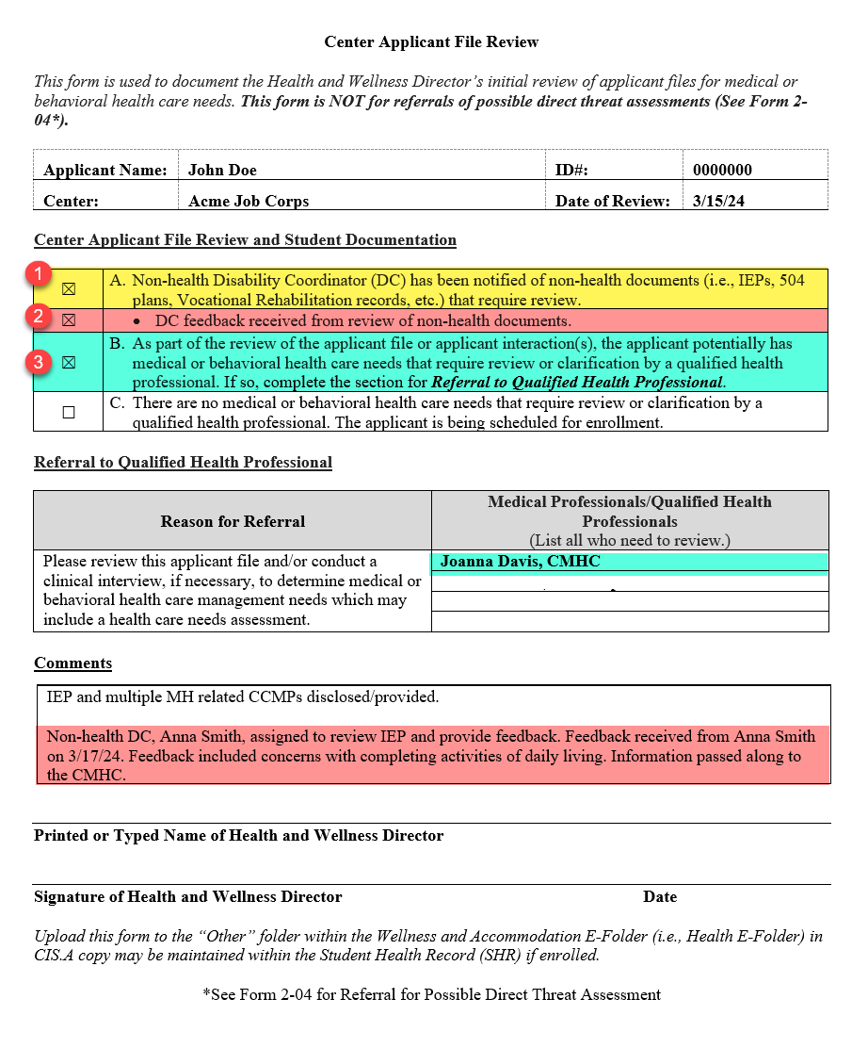
If the non-health DC is reviewing IEPs/504 plans, then the sub-bullet under Item A must be checked when the non-health DC’s written feedback has been received.
Please ensure that the Qualified Health Professional(s) being assigned review of the file are listed by both their name and by their title.
Ensure that all reviewers are listed if there are multiple disciplinary areas of review needed.
The non-health DC’s feedback can be captured in the comments section of the CAFR form. (See coral highlight.)
Notes:
CAFR Form
The yellow highlighted section shown as #1 in the Center Applicant File Review and Student Documentation section documents that the Non-health Disability Coordinator was assigned to review non-health documents such as an IEP. If the non-health DC is reviewing IEPs/504 plans, then the sub-bullet under Item A (shown as #2) must also be checked when the non-health DC’s written feedback has been received. See the coral highlight in this same section.
When the HWD assigned the IEP to the Non-health DC Anna Smith to review, they noted this in the comments section, which is the 2nd yellow highlight: “IEP and multiple MH related CCMPs disclosed/provided. Non-health DC, Anna Smith, assigned to review IEP and provide feedback.” The non-health DC’s feedback can also be captured in the comments section of the CAFR Form. The HWD documented the date the feedback was received and summarized in the comments box (i.e., Feedback included concerns with completing activities of daily living).
HWD Also Assigns File to Qualified Health Professional (QHP) for Review and to make a decision on enrollment because the applicant disclosed mental health conditions along with an IEP and Chronic Care Management Plans.
When the HWD assigns a file to a QHP or QHPs for review, check the box for item B on the Center Applicant File Review form. Then go to the Referral to Qualified Health Professional section and list the name of each QHP assigned to complete a review. In this case, the HWD assigned the file to CMHC, Dr. Joanna Davis.
Please ensure that the Qualified Health Professional(s) being assigned review of the file are listed by both their name and by their title.
Ensure that all reviewers are listed if there are multiple disciplinary areas of review needed.

Slide 36
Wellness File Review
Tracking Log
PRH Chapter 1: 1.5(R2)(b)
A
Wellness MUST maintain its own internal tracking log. (PRH Chapter 1:1.5(R2)(b).
Wellness File Review Tracking Log Components
HWD Reviewer | QHP #2 Assigned File to Review
Date HWD Review Complete | Date QHP #2 Review Complete
Non-health DC Reviewer | Wellness Disposition or Outcome
Non-health DC Review Complete | Wellness Disposition or Outcome Date
QHP #1 Assigned File to Review | Comments (PHI Redacted)
Date QHP #1 Review Complete
B
Specific QHPs (i.e., the Center Physician, Center Mental Health Consultant (CMHC), Trainee Employment Assistance Program (TEAP) Specialist, or other qualified health professionals and/or the Disability Coordinator) must not be listed on the center File Review Tracking Log by title for confidentiality reasons.
Information highlighted in Peach must be reported to Records for inclusion in the Center’s Applicant File Review Tracking Log.
36
Notes:
Wellness File Review Tracking Log – PRH Chapter 1: 1.5(R2)(b)
The PRH does not provide a detailed list of what is required to be tracked on the Wellness Log unlike the Center File Review Tracking Log. The information that is provided is in PRH 1.5 R2b: “Specific qualified health professionals (i.e., the Center Physician, Center Mental Health Consultant (CMHC), Trainee Employment Assistance Program (TEAP) Specialist, or other qualified health professionals) must not be listed on the center File Review Tracking Log by title for confidentiality reasons. Wellness must maintain its own internal tracking log.“ Given these statements, we know that the individual QHP reviews are not documented on the log maintained by records and is why Wellness must maintain their own internal tracking log.
The Wellness log is required to track the movement of the applicant file through the review by the QHPs that were identified by the HWD. The table on this slide contains QHP review information and other key tracking components of the WTL. If the non-health DC has been assigned non-health documents to review, the non-health DC review may either be tracked on the Wellness Tracking log or the Center File Review Tracking Log. Do not list the DC by title if included on the Center File Review Tracking Log. Please note that the information highlighted in peach must be reported to Records for inclusion in the Center’s Applicant File Review Tracking Log.
How do we know which QHPs should be noted on the Wellness tracking log as reviewing a specific file? They would be the same QHPs identified by the HWD on the Center Applicant File Review form.
This WTL’s information must match the basic non-health information documented on the CFRTL!

Slide 37
Sample Wellness Tracking Log
https://supportservices.jobcorps.gov/disability/Documents/AFR%20Docs/Sample%20Wellness%20Tracking%20Log.xlsx
Notes:
Sample Wellness Tracking Log
There is also a sample Wellness Tracking Log on the Disability Website. This log is not a duplicate of the Center FR Tracking Log because it serves a different purpose. For example, there is not a column that tracks the number of days in review. The tracking log managed by Records is required to track that information. Some of the information tracked on the Wellness log also needs to be added to the Records log and those columns are in the peach color. There is a statement at the top explaining that the information in peach must be provided to Records with a reminder to not send any PII/PHI. [REVIEW some of the columns.] Access should be limited because this log will contain PHI.

Slide 38
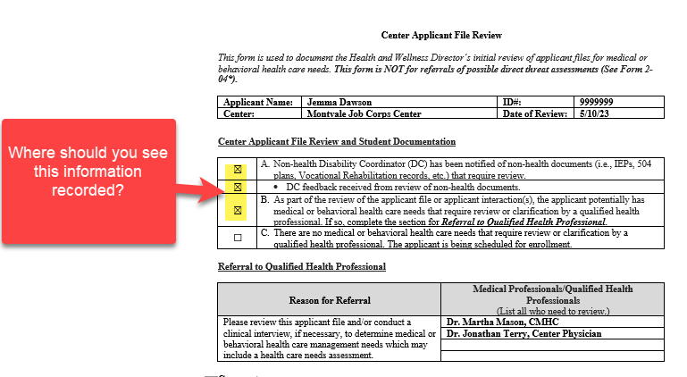
What Do You Think? Connecting the Center Applicant File Review Form Information to the Information on the Tracking Logs
The HWD’s first and last name must be listed on the Center File Review Tracking log and “should” be on the Wellness Tracking Log as well.
The non-health DC and their dates of review must be on the Center File Review Tracking Log IF they reviewed non-health documents.
The CMHC and the CP should be listed as reviewers on the Wellness Tracking Log.
38
Notes:
What Do You Think?
Items A and B of the Center Applicant File Review Form have been checked. Where should we see this information recorded?
First, since the HWD must complete the preliminary review of every applicant file, we would expect to see their name listed on the Center File Review Tracking Log and on the Wellness Tracking log along with the completion date of the preliminary review.
Then we would anticipate that the non-health DC and the completion date of their review must be on the Center File Review Tracking log (and may be on the Wellness Tracking log).
Finally, we would expect to the see the names and titles of the Center Mental Health Consultant and the Center Physician as reviewers on the Wellness Tracking log.

Slide 39
Documenting Outcomes
What information must be provided to Records for inclusion on the Center File Review Tracking Log?
Wellness Review Start Date | Health and Wellness Director (HWD) Reviewer | Date HWD Review Complete | Non-health DC Reviewer | Date Non-health DC Review Complete | QHP #1 Assigned File to Review | Date QHP #1 Review Complete | QHP #2 Assigned File to Review (if applicable) | Date QHP #2 Review Complete
4/27/2023 | Smith, S. | 4/29/2023 | Morgan, R. | 5/01/2023 | Davis, J., CMHC | 5/20/2023 | Martin, M., TEAP | 5/17/2023
4/27/2023 | Smith, S. | 5/01/2023
4/28/23 | Smith, S. | 5/01/2023 | Morgan, R. | 5/01/2023 | Davis, J., CMHC | 5/20/2023
Since the Wellness Tracking Log is a secure document maintained in Wellness only, centers may document the outcomes within the comments instead of using a separate sheet or form.
Wellness Disposition or Outcome | Wellness Disposition Date/Outcome Date | Comments (Redact any PII/PHI before sharing any comments with Records)
Approved | 5/20/2023 | CMHC and TEAP Specialist approved the applicant for enrollment.
Approved | 5/11/2023 | No disclosures on 653 or via health or disability documentation. HWD approved for enrollment.
Approved | 5/20/2023 | Non-health DC Review: Applicant has an IEP. There is some mention of challenges with ADLs. HWD Note: adding CMHC to review. CMHC approved applicant for enrollment.
What comments should be provided to records in these three scenarios?
39
Notes:
Documenting Outcomes
What information on the Wellness Tracking Log must be shared with Records?
The information in Peach on the example slides would be provided to Records. The center MUST redact any protected health or disability information (typically in the comments) before sharing this information.
Since the Wellness Tracking Log is a secure document maintained in Wellness only, centers may document the outcomes within the comments instead of using a separate sheet or form.
What comments should be provided to records in these three scenarios?
The first comment states: CMHC and TEAP Specialist approved the applicant for enrollment. Does this comment need to be reported to Records? No, it does not need to be reported to Records nor can it be reported due to the PHI disclosed. It is sufficient for Records to be informed the applicant is approved and the date approved.
The second comment states: No disclosures on 653 or via health or disability documentation. HWD approved for enrollment. No, it does not need to be reported to Records nor can it be reported due to PHI disclosed. It is sufficient for Records to be informed the applicant is approved and the date approved.
What about that third comment? Non-health DC Review: Applicant has an IEP. There is some mention of challenges with ADLs. HWD Note: adding CMHC to review. CMHC approved applicant for enrollment.
Is there anything in that comment that would need to be reported to Records?
No. It would be the same as the first 2 examples. It is sufficient for Records to be informed the applicant is approved and the date approved.

Slide 40
More Review of Comments on Wellness Tracking Log
Determine whether each comment needs to be reported to Records and if so, can it be reported to Records as is or does it require redacting of information.
Wellness attempted to contact the applicant 2x (5/5/24 and 5/10/24) with no response. Left voicemails and instructions to call back within 5 days. Contacted admissions on 5/15/24 and admissions staff confirmed inability to reach the applicant. Returning the file to admissions on 5/28/24, notified Records Manager to return file to Admissions staff as an incomplete application.
This is what your comments should look like when sending a file back as an incomplete application: (1) # of attempts to contact, (2) outcome of efforts to contact, (3) collaboration with Admissions Services staff, and (4) final action taken.
40
Notes:
More Review of Comments on Wellness Tracking Log
What about this example? Does the comment need to be reported to Records and if so, can it be reported to Records as is or does it require redacting of information?
Wellness attempted to contact the applicant 2x (5/5/24 and 5/10/24) with no response. Left voicemails and instructions to call back within 5 days. Contacted admissions on 5/15/24 and admissions staff confirmed inability to reach the applicant. Returning the file to admissions on 5/28/24, notified Records Manager to return file to Admissions staff as an incomplete application.
The history of the contacts with the applicant and the outcomes of those contacts must be included on the Center File Review Tracking Log. This example can be provided to Records as it is and in its entirety as it contains: (1) # of attempts to contact, (2) outcome of efforts to contact, (3) collaboration with Admissions Services staff, and (4) final action taken.

Slide 41
CFRTL Review
41
41
41
41
Notes:
CFRTL Review - Let’s Discuss

Slide 42
CFRTL Examples
42
Notes:
CFRTL Examples
Review as many as time permits and make as interactive as time allows.
Example #1:
This is an example of an applicant who is approved for enrollment and the file review was completed within the appropriate timeframe.
No issues with this entry.
Example #2:
In this example, the center is attempting to contact to the applicant to complete the required components of the applicant file review process and unable to do so. So, the center documents at least 2x to contact, collaboration with Admissions Services and the date the file was returned to Admissions.
No issues with this entry.
Example #3:
In this example, the applicant is an expedited applicant so the expedited applicant checkbox is selected. The comments state that Admissions requested the file back.
Unfortunately, the center did not document why Admissions requested the file back so it is not possible to know if it was returned for appropriate reasons and could result in a concern on the center’s Disability Program Center Assessment. Also, look at the yellow highlighted cells. The Disposition and Disposition dates are missing and should be completed.
Example #4:
In this example, this is also an expedited applicant.
No issues with this entry.
Example #5:
In this example, the applicant file was returned to Admissions Services because applicant has a court date pending.
If this is new information not known by Admissions Services and this potentially makes the applicant ineligible for the Job Corps Program, the center must complete a New Information recommendation of denial and submit it to the Regional Office for review. The file must not be returned to Admissions Services due to court-related reasons.
Example #6:
In this example, this is another expedited applicant and the center took 24 days to complete the review and requested an extension of time from the Regional Office.
The center only has 21 days maximum to complete this applicant’s review and there are no extensions of time allowed.
Example #7:
In this example, the applicant file review was going to exceed 30 days and the center requested an extension of time.
No issues with this entry. The center requested the extension by day 25 of the review, documented the date of the extension request and the end date of the extension.

Slide 43
Resources
43
43

Slide 44
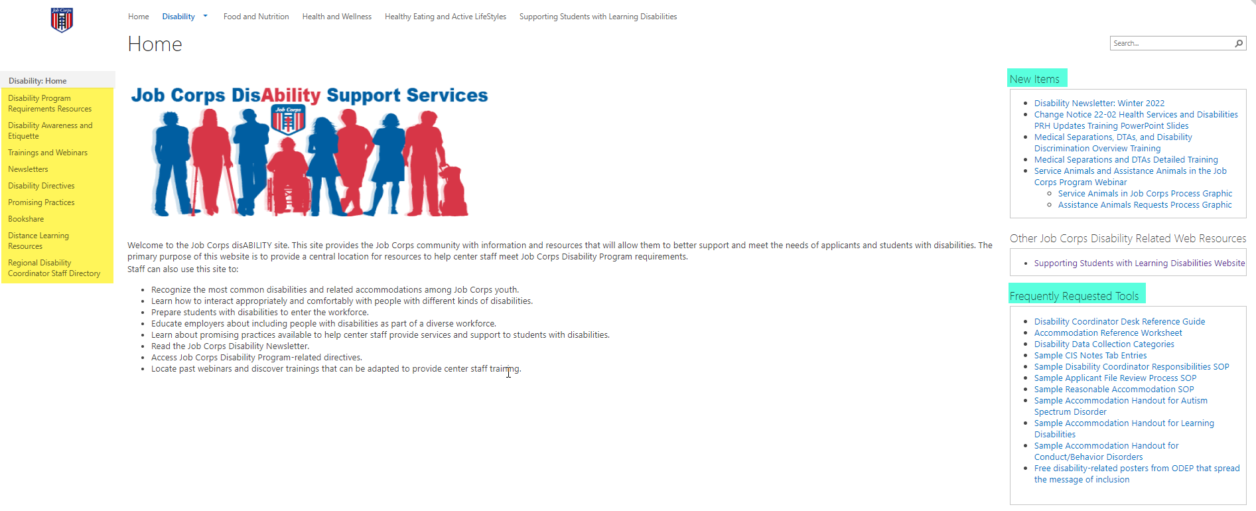
Job Corps Disability Support Services Website https://supportservices.jobcorps.gov/disability/Pages/default.aspx
44
Notes:
Job Corps Disability Website
The Job Corps Disability Support Services website contains numerous resources and tools on applicant file review and disability accommodation requirements, processes and procedures.
As new resources and tools are developed, they are listed under the New Items heading to the right side of the website page. See teal highlighted area. Resources that are more commonly used and/or requested are listed under the Frequently Requested Tools section also highlighted in teal.
The categories of resources are listed on the left-hand side of the website and are highlighted in yellow.
The Job Corps Disability website link is located at the top of the slide.

Slide 45
Questions?
45

