Slide 1
Applicant
FILE REVIEW
Center Process
Applicant File Review Orientation Series
Part 1a - Policy
Notes:
Welcome to Applicant File Review Orientation Series – Part 1a which is a comprehensive review of a center’s applicant file review policy considerations.

Slide 2
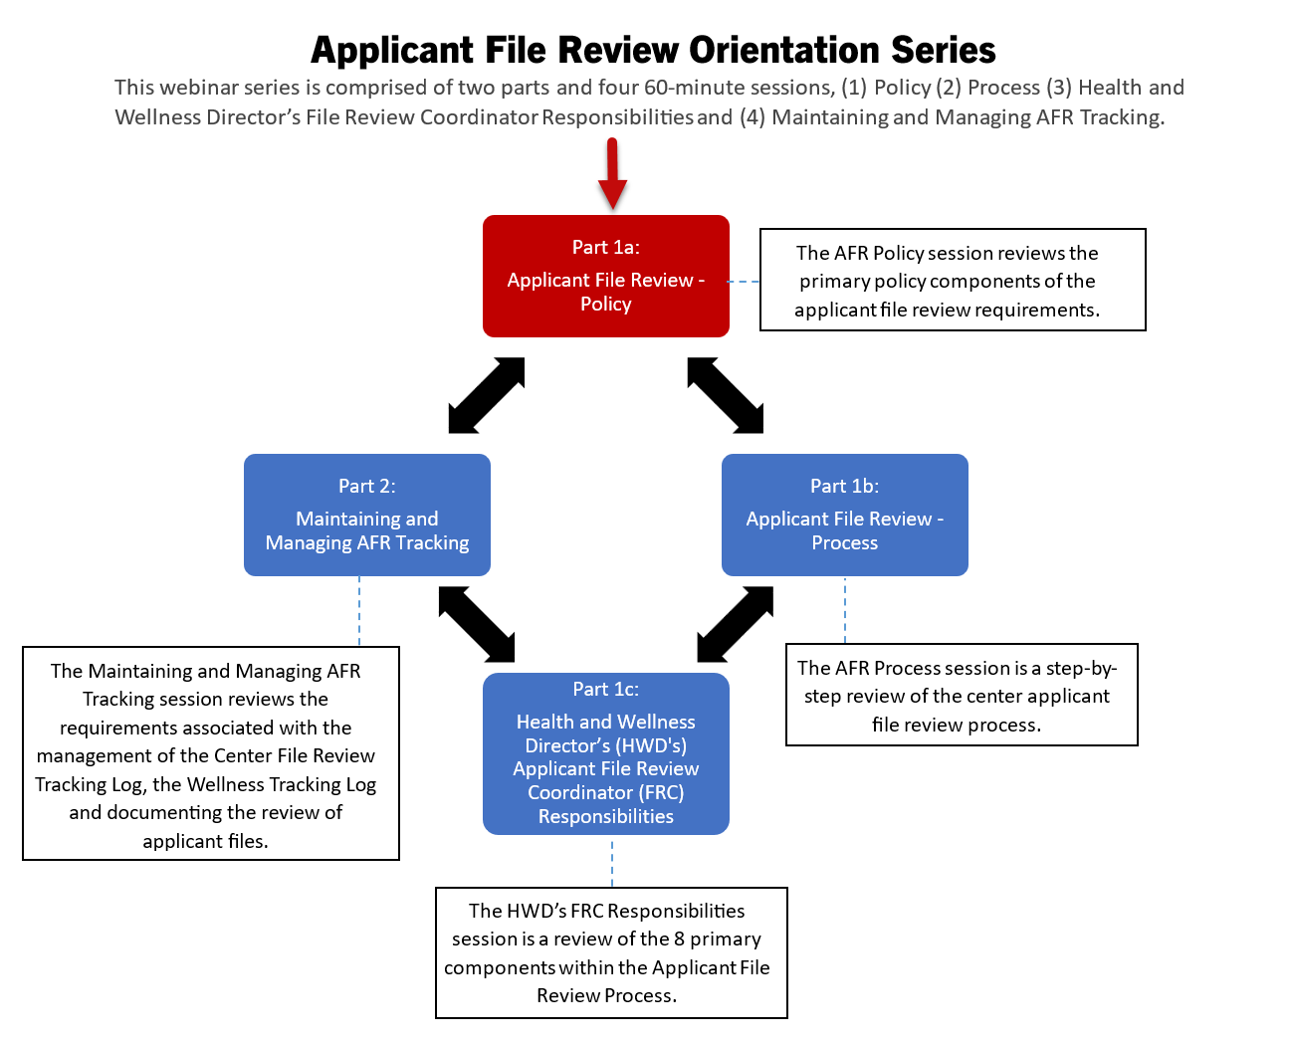
Applicant File Review Orientation
Series
Each part of the webinar series is held live via WebEx several times throughout the year. The individual webinars can be attended in ANY order and routine attendance is strongly encouraged as content is updated on a regular basis.
Resources and tools available to assist Health and Wellness Directors/File Review Coordinators in meeting applicant file review-related requirements will be shared.
2
Notes:
Applicant File Review Orientation Series
The original Disability Coordinator Orientation Series has been restructured into TWO different Orientation Series. The first one is the Applicant File Review Orientation Series which is comprised of two parts and four 60-minute sessions. The target audience for this series is primarily Health and Wellness Managers but center Qualified Health Professionals and Disability Coordinators would benefit as well. The second series is the Disability Coordinator Orientation Series and includes 3-parts comprised of 4 individual webinars.
The individual webinars can be attended in ANY order and routine attendance is strongly encouraged as content is updated on a regular basis. Resources and tools available to assist Health and Wellness Directors/File Review Coordinators in meeting applicant file review-related requirements will be shared.

Slide 3
Objectives
General Policy Review
Timelines
AFR Tracking
List and implement applicant file review-related requirements.
List the timeline requirements for completing applicant and appeal file reviews.
Describe the required entries for maintaining the center’s File Review Tracking Log.
Recommending Denial
Returning Files to Admissions
Identify the allowable reasons for recommending denial of an applicant.
List the allowable reasons for returning an applicant file to Admissions Services.
3
Notes:
We have 5 primary objectives today so our goal is that by the end of this webinar, you will be able to:
General Policy Review. List and implement applicant file review-related requirements. Applicant file review is a very legally driven process, so it is very important that the center be well versed in applicant file review policy to ensure compliance with Job Corps’ related applicant file review policy.
Timelines. List the timeline requirements for completing applicant and appeal file reviews.
AFR Tracking. Describe the required entries for maintaining the center’s File Review Tracking Log.
Recommending Denial/Returning Files to Admissions. List the allowable reasons for recommending denial of an applicant and listing the allowable reasons for returning an applicant file to Admissions Services. It is critically important that the program uses the same applicant file review process for each applicant including how the center recommends denial of enrollment and when the center is returning applicant files to Admissions Services.

Slide 4
Policy
Application
Outcomes
Center Applicant File Review
Policy
4
Notes:
So, let’s start by reviewing the potential outcomes for an applicant when they apply to the Job Corps Program. Understanding the types of allowable outcomes for an applicant will help frame many of the later policy discussions in this presentation.

Slide 5
Application Outcomes
Eligibility Review Due to New Information
Withdrawal of Application
Health Care Needs
Eligibility Review Due to Disability Status
Health Care Needs – Alternate Center
Incomplete Application
Direct Threat
to Others
Residential Settings or Hospitalization
Error in Initial
Eligibility Review
5
Notes:
Here is a summary slide of all the types of Application Outcomes which is included here for you as a reference slide. Of course, the primary outcome is enrollment but we need to understand how to process files where enrollment is not or may not be the outcome.

Slide 6
Eligibility Review Due to New Information
Center applicant file review teams may only revisit the determination that an applicant is qualified for admission (i.e., an applicant’s eligibility status) if:
There is new information presented that Admissions Services staff could not have reasonably known at the time the applicant’s qualification for admission was established.
The new information indicates that the applicant offered enrollment may no longer meet an eligibility requirement.
PRH 1:1.5(R1)(a)
6
Notes:
Let’s start with Eligibility Reviews that occur at the center level meaning after Admissions Services has conditionally enrolled the applicant because they were found to be eligible for the Job Corps program. An Eligibility Review Due to New Information should not occur often and is limited to very specific situations because the Program cannot arbitrarily revisit an enrollee’s eligibility status.
However, if there is: new information presented that Admissions Services staff could not have reasonably known at the time the applicant’s qualification for admission was established; and the new information indicates that the applicant offered enrollment may no longer meet an eligibility requirement, then it is possible the applicant may NO longer be eligible for enrollment. We will review a couple of examples in just a moment of the types of new information that may trigger the center completing and submitting a new information recommendation of denial to the respective Regional Office.

Slide 7
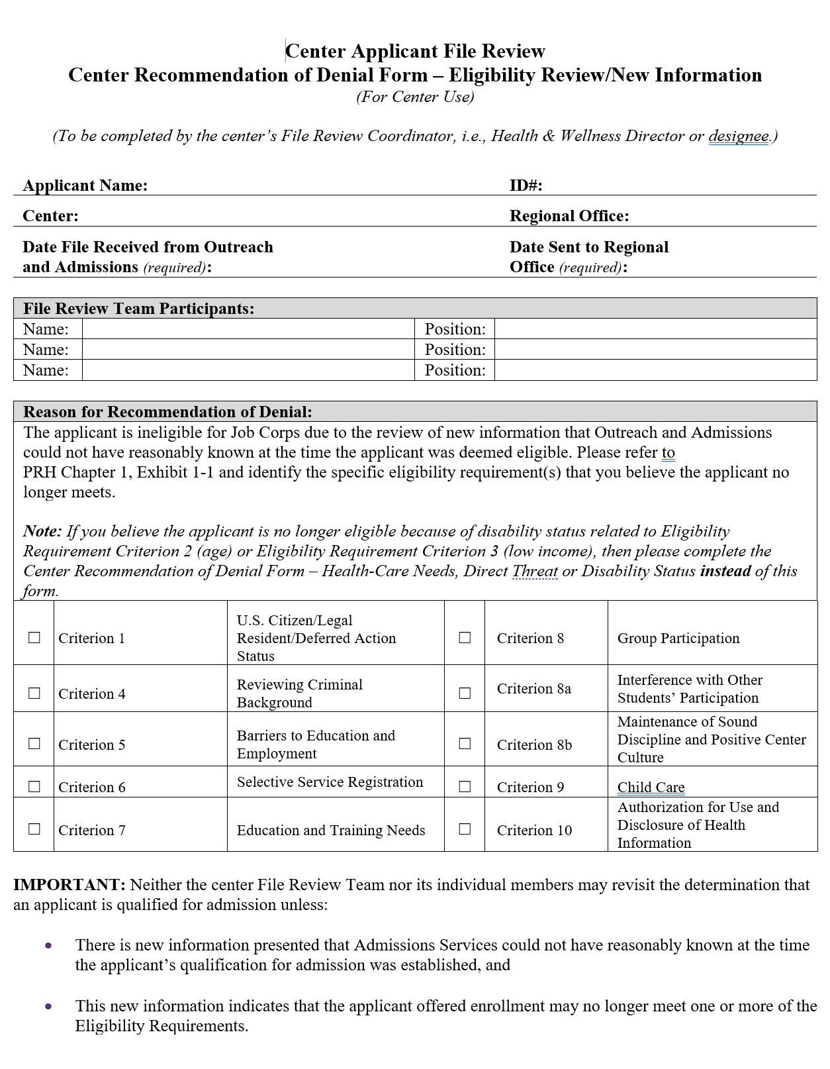
Eligibility Review Due to New Information
PRH 1: Form 1-06
Center Applicant File Review
Center Recommendation of Denial Form – Eligibility Review/New Information
Notes:
If the facts and details of your review lead you to believe that the applicant is potentially no longer eligible for Job Corps, then the center must complete the Center Recommendation of Denial Form – Eligibility Review/New Information. This form can be found in PRH Chapter 1 within Form 1-06 and there is a screenshot on the right-hand side of the screen of the first page. It is a 2-page document and is relatively straightforward to complete. If the center is recommending denial because there is a belief the applicant is no longer eligible due to new information, then the center will upload this form and all corresponding information to the Health E-Folder in CIS and the Health and Wellness Director will select the Notify Regional Review in that same Health E-Folder module.

Slide 8
What is and is NOT New Information
IS New Information
IS NOT New Information
Incarceration after certification of eligibility
Conviction of a crime such as sexual assault after certification of eligibility
Disclosure of medical or mental health condition(s)
Medical or mental health stability or non-compliance with treatment provider regimen including medication non-compliance
What do you do with an applicant file you are reviewing when you learn that
the applicant has just become incarcerated?
8
Notes:
Now let’s talk for a few minutes about What is and is NOT new information. Eligibility is based upon Exhibit 1-1 of the PRH. You cannot expand the criteria in Exhibit 1-1.
New information sometimes is disclosed during clinical interviews or embedded in medical records or IEP documents. Whatever the new information is, it must be related to the criteria in Exhibit 1-1 and because of this new information the individual is now likely no longer eligible for enrollment. For example, an applicant gets arrested and is incarcerated after Admissions Services certified they are eligible for Job Corps or a medical document contains information about conviction of a crime such as a sexual assault, etc. These are types of new information that may relate to the eligibility criteria in Exhibit 1-1 of the PRH.
Equally important is understanding what is Not “NEW” Information
If the basis of the new information review is due to a disclosure of a medical condition or medically-related, it is not likely that you have a “new information” situation at least as it relates to eligibility. If the applicant File Review Team (FRT) determines that the applicant’s health care needs exceed those of basic health care or that the applicant poses a direct threat, then the center can complete either the Health Care Needs or the Direct Threat Assessment Forms (i.e., Form 2-05 and Form 2-04, respectively), whichever is appropriate, and submit as a recommendation of denial to the Regional Office.
Audience Participation: What do you do with an applicant file you are reviewing when you learn that the applicant has just become incarcerated?
Review the facts of the situation and if it is determined that the applicant is likely no longer eligible, then the center would complete the Center Recommendation of Denial Form – Eligibility Review/New Information Form in 1-06 and submit to the Regional Office for review by uploading the form and selecting the Notify Regional Review within Health E-Folder in CIS.

Slide 9
Eligibility Due to Disability Status
If the applicant is or will be older than 24 years old on the date of enrollment, the maximum age limit may be waived if the applicant is a person with a disability.
If the applicant would not meet the low-income requirement unless the applicant is considered a “family of one” because of a disability.
PRH 1: 1.2 (R3)(b)(1)
PRH 1: 1.5 (R8)
9
Notes:
Age and income are eligibility essential requirements (ER) in Exhibit 1-1 of the PRH and cannot be certified by Admissions Services because Admissions Services staff may not review medical documentation, only collect it. By medical documentation, we mean documentation that supports the individual’s disability status.
An applicant may exceed the upper age limit restriction and/or the applicant may be considered a “family of one” for income purposes and enroll in Job Corps if they have a disability.

Slide 10
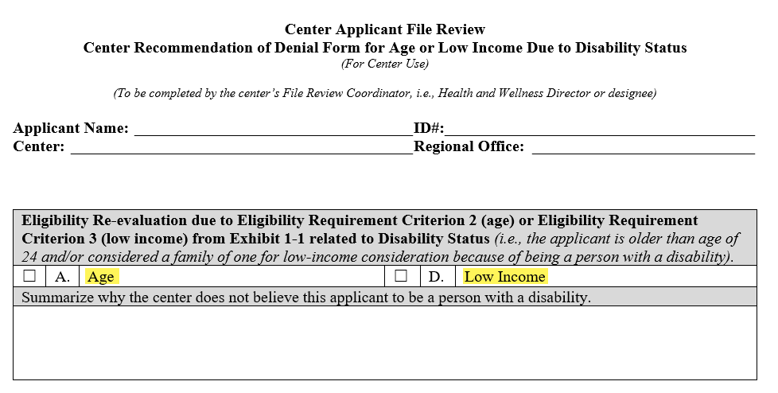
Documentation Supports Disability Status?
The file review process continues.
Documentation Does Not Support Disability Status?
Ask the applicant if they wish to secure documentation that would support their disability status.
If they do not or the documentation does not support the disability status, the center must recommend denial for age or low income due to disability status.
Complete the Center Recommendation of Denial Form for Age or Low Income Due to Disability Status found in Form 1-06.
Upload the form and supporting documentation to the Health/Disability E-Folder.
Select the Notify Regional Review in the Health E-Folder.
Notes:
If the documentation supports that the individual is a person with a disability, the file review process continues.
If there is no documentation or the documentation does not support that the individual is a person with a disability, give the applicant an opportunity to provide the documentation within the center’s file review timeframes. If the applicant does not provide documentation of disability, then the center must upload the Center Recommendation of Denial Form for Age or Low Income Due to Disability Status found in Form 1-06 and select the Notify Regional Review in CIS within the Health E-Folder. There is a screenshot of this document in the upper right-hand corner of the slide.

Slide 11
Health Care Needs
A Health Care Needs Assessment (HCNA) is conducted for an applicant if the qualified health professional on the File Review Team determines that:
The applicant’s health care needs may not be manageable through the basic healthcare services provided for in Exhibit 2-4, Job Corps Basic Health Responsibilities.
PRH 1: 1.5 (R6)(a)
Exhibit 2-4
Form 2-05
11
Notes:
A Health Care Needs Assessment (HCNA) is conducted for an applicant if the qualified health professional on the FRT determines that: the applicant’s health care needs may not be manageable through the basic healthcare services provided for in Exhibit 2-4, Job Corps Basic Health Responsibilities. This is Form 2-05 in the PRH.
We will be talking more about the Health Care Needs Process during the Process section which will be on [insert day/date/time].

Slide 12
Direct Threat to Others
A Direct Threat Assessment (DTA) is conducted for an applicant if the qualified health professional on the File Review Team determines that:
An applicant or student may pose a significant risk of substantial harm to the health or safety of others that cannot be eliminated or reduced sufficiently by disability accommodations.
PRH 1: 1.5 (R6)(c)
Form 2-04
12
Notes:
As a reminder, in 2017, there was a change to the legal definition of direct threat that removed threat to self. Direct threat is now only for direct threat to others. The Individualized Assessment of Possible Direct Threat (Form 2-04) is completed if the qualified health professional on the File Review Team determines that an applicant or student may pose a significant risk of substantial harm to the health or safety of others that cannot be eliminated or reduced sufficiently by disability accommodations.

Slide 13
Withdrawal of Application
If an applicant is no longer interested in attending Job Corps and withdraws their application, the applicant file should be electronically returned to Admissions Services.
If the withdrawal request was made in writing, hard copy or electronically, copies of the withdrawal request must be maintained.
PRH 1: 1.5 (R5)(a)
13
Notes:
A withdrawal of application is relatively straightforward in that if an applicant is no longer interested in attending Job Corps and withdraws their application, the applicant file should be electronically returned to Admissions Services. If the withdrawal request was made in writing, hard copy or electronically, copies of the withdrawal request must be maintained.

Slide 14
Incomplete Application
If the center is unable to reach the applicant to complete the clinical review interview or the interactive disability accommodation process, the File Review Team (FRT) must:
Have attempted to contact the applicant at least twice.
Contact Admissions Services to see if they can reach the applicant if unable to reach the applicant after 2 attempts.
Document each attempted contact in an applicant contact log or the Center File Review Tracking Log (CFRTL).
Maintain a copy of the applicant contact log if not documented in the CFRTL.
PRH 1: 1.5 (R5)(b)
14
Notes:
What is the difference between an incomplete application and a withdrawal of application? As we just discussed, a withdrawal of application occurs when an applicant has withdrawn their interest in attending Job Corps. An incomplete application is when the center FRT is unable to complete a required component of the applicant file review process, meaning either an inability to reach the applicant to complete the clinical interview or the interactive disability accommodation process.
If the center is unable to reach the applicant to complete the clinical review interview or the interactive disability accommodation process, the File Review Team (FRT) must:
Have attempted to contact the applicant at least twice.
Contact Admissions Services to see if they can reach the applicant if unable to reach the applicant after 2 attempts.
Document each attempted contact in an applicant contact log or the Center File Review Tracking Log (CFRTL).
Maintain a copy of the applicant contact log if not documented in the CFRTL.
If the center FRT in collaboration with Admissions Services staff is unable to contact the applicant, the applicant file is returned electronically to Admissions Services.
If the application is in regional review, the center must NOT return the file electronically to Admissions Services because the outcome of the application review is now in the purview of the Regional Office. The center must notify the regional reviewer via email and upload any supporting documentation including the applicant contact log into the Wellness and Accommodation E-Folder labeled “Other.”

Slide 15
Error in Initial Eligibility Process
If the center FRT identifies a potential eligibility concern that occurred as a potential error in the initial eligibility review process, then the center should contact the DOL Program Manager for guidance.
If the initial eligibility determination was made in error as determined by the respective Regional Office, then the file may be returned to Admissions Services.
PRH 1: 1.5 (R5)(c)
Exhibit 1-1
What is the difference between “new information” that may make an individual now ineligible for the program and an error in the initial eligibility process?
15
Notes:
Error in the Initial Eligibility Process. This has been an informal category in the past and not included in the PRH. This outcome should only occur very rarely and is different than a “new information” recommendation of denial. If the center FRT identifies a potential eligibility concern that occurred as a potential error in the initial eligibility review process, then the center should contact the Program Manager for guidance. If the initial eligibility determination was made in error as determined by the respective Regional Office, then the file may be returned to Admissions Services.
What is the difference between “new information” that may make an individual now ineligible for the program and an error in the initial eligibility process?
Let’s compare these outcome types further.

Slide 16
Review!
New Information
Error in Eligibility
New information that makes the applicant “newly” ineligible; information Admissions Services staff could not have known at the time of the original certification (e.g., incarceration occurs during center file review).
Center reviews information KNOWN by Admissions Services at the time of the initial eligibility certification and believes the applicant was never eligible.
New Information
vs
Error in Eligibility
Center contacts (calls or emails) the DOL Program Manager for discussion/review.
Center recommends denial of enrollment via Notify Regional Review in CIS.
Notes:
Let’s Review the differences between a new information recommendation of denial and a determination of a possible error in eligibility.
New Information
There are some key words that distinguish the differences between these two categories:
New information that makes the applicant “newly” ineligible; information Admissions Services staff could not have known at the time of the original certification (e.g., incarceration occurs during center file review).
Center recommends denial of enrollment via Notify Regional Review in CIS.
Error in Eligibility
Center reviews information KNOWN by Admissions Services at the time of the initial eligibility certification and believes the applicant was never eligible.
Center contacts (calls or emails) the DOL Program Manager for discussion/review.

Slide 17
Residential Settings or Hospitalization
If an applicant is in a treatment facility, residential program, or is currently hospitalized, the center FRT and/or Disability Accommodation Committee (DAC) must make at least two attempts to contact the applicant using contact information provided in the applicant file.
Made contact?
Complete the applicant file review process.
Unable to make contact?
Document the attempts to contact and electronically return the file to Admissions Services as an incomplete application.
What does the center do if the file is in Regional Review?
PRH 1: 1.5 (R5)(d)
17
Notes:
First, an applicant being in a residential setting or hospitalized does not mean that their file is automatically returned to Admissions Services! These applicants must be treated the same as all applicants.
If an applicant is in a treatment facility, residential program, or is currently hospitalized, the center FRT and/or Disability Accommodation Committee (DAC) must make at least two attempts to contact the applicant using contact information provided in the applicant file in order to complete the applicant file review process and either make a determination of enrollment or recommend denial.
If the center can reach the applicant, the center may not return the applicant file to Admissions Services but must process the recommendation of enrollment or denial unless the applicant states that they wish to withdraw their application.
If the center is unable to reach the applicant, then the center must document the attempts to contact and then may electronically return the file to Admissions Services due to the inability to complete the application process.
What if the center is unable to reach the applicant but the file is in Regional Review?
Contact the Regional Reviewer and let them know that the center has been unable to reach the applicant to complete a required contact (usually a clinical interview or the disability accommodation process) and the Regional Reviewer will manage the next steps.

Slide 18
Other
Centers may not arbitrarily return an applicant file to Admissions Services if outside the scope of or in conflict with Job Corps policy.
Examples:
Returning a file requested by Admissions Services without knowing why it is being requested.
Returning a file to Admissions Services because applicant is incarcerated instead of submitting as a recommendation of denial to the Regional Office.
Reasons for returning an application to Admissions Services must be clearly documented in the Center File Review Tracking Log.
PRH 1: 1.5 (R5)(e)
18
Notes:
The “OTHER” category serves as a valuable reminder that applicant files may not be returned to Admissions Services if outside the scope of or in conflict with Job Corps policy.
Examples:
Returning a file requested by Admissions Services without knowing why it is being requested.
Returning a file to Admissions Services that because applicant is incarcerated instead of submitting as a recommendation of denial to the Regional Office.
Reasons for returning an application to Admissions must be clearly documented in the center’s File Review Tracking Log.

Slide 19
Application Outcomes for Expedited Applicants
If Admissions Services receives information within the first 90 days of enrollment that indicates that the expedited applicant who initially self-attested to the allowable eligibility factors within Exhibit 1-3 and/or Appendix 102, is no longer eligible, then the applicant file is returned to Admissions Services.
“Initial” Ineligibility Determined/Confirmed
During First 90 Days of Enrollment
Expedited applicant file reviews are conducted and processed in the same manner as all other applicant file reviews except for completing the applicant file review process within 21 calendar days maximum instead of 30 calendar days. Admission Services should continue to gather any available health documentation at the time of application for centers to review.
Applicant File Review
19
Notes:
Application Outcomes for Expedited Applicants
“Initial” Ineligibility Determined/Confirmed During First 90 Days of Enrollment
If Admissions Services receives information within the first 90 days of enrollment that indicates that the expedited applicant who initially self-attested to the allowable eligibility factors within Exhibit 1-3 and/or Appendix 102, is no longer eligible, then the applicant file is returned to Admissions Services.
Applicant File Review
Expedited applicant file reviews are conducted and processed in the same manner as all other applicant file reviews except for completing the applicant file review process within 21 calendar days maximum instead of 30 calendar days. The center should strive to complete expedited applicant files as quickly as reasonably feasible not to exceed 21 calendar days.
Admission Services should continue to gather any available health documentation at the time of application for centers to review.

Slide 20
Application Outcomes for Expedited Applicants (cont.)
If the applicant’s health care needs exceed those of basic health care or the applicant poses a direct threat to others, the center recommends denial of enrollment to the respective Regional Office by flagging the applicant file in the Wellness and Accommodation Health E-Folder; otherwise, the applicant is scheduled for enrollment in the same manner as all other applicants.
Health Care Needs/Direct Threat
If health records received during the first 90 days of enrollment for an expedited applicant indicate that the expedited individual’s health care needs may exceed those of basic health care or that the individual poses a direct threat to others, the center follows the medical separation procedures as outlined in Chapter 6, Section 6.2, R5.
Health Care Needs/Direct Threat and Health and Medical Documentation Received During First 90 Days of Enrollment
Reminder: “New Information” recommendations are processed as outlined in PRH 1.5 and are treated differently than “initial” ineligibility determinations for an expedited applicant. See slides 6-8.
20
Notes:
Application Outcomes for Expedited Applicants (cont.)
Health Care Needs/Direct Threat
If the applicant’s health care needs exceed those of basic health care or the applicant poses a direct threat to others, the center recommends denial of enrollment to the respective Regional Office by flagging the applicant file in the Wellness and Accommodation Health E-Folder; otherwise, the applicant is scheduled for enrollment in the same manner as all other applicants.
Health Care Needs/Direct Threat and Health and Medical Documentation Received During First 90 Days of Enrollment
If health records received during the first 90 days of enrollment for an expedited applicant indicate that the expedited individual’s health care needs may exceed those of basic health care or that the individual poses a direct threat to others, the center follows the medical separation procedures as outlined in Chapter 6, Section 6.2, R5.
Contact your Regional Nurse or Regional Health Specialist for assistance, if needed.
Reminder - “New Information” recommendations are processed as outlined in PRH 1.5 and are treated differently than “initial” ineligibility determinations for an expedited applicant. See slides 6-8.

Slide 21
Policy
Timelines
Applicant File Review, Referral to Alternate Center and
Appeal of Denials of Enrollment
Policy
21
Notes:
Now let’s move on to discussing timelines for completing applicant file reviews and appeals of denials of enrollment.

Slide 22
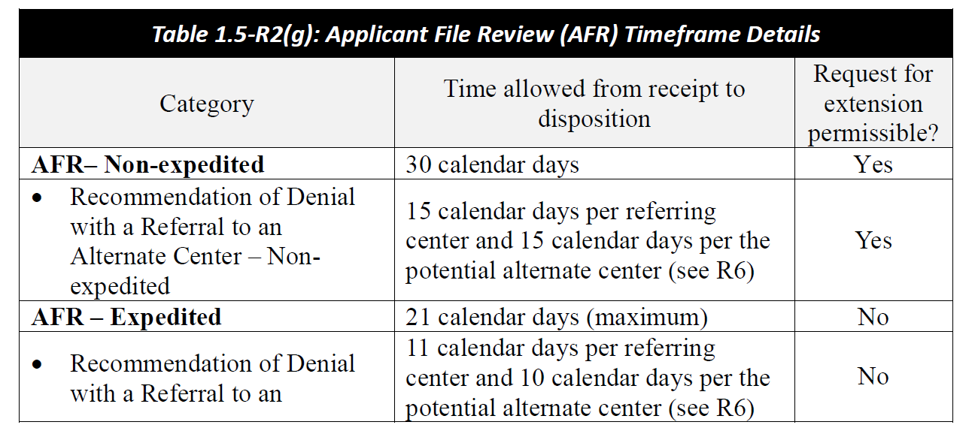
Timelines for Applicant and Expedited Applicant File Review
22
Notes:
Timelines for Applicant and Expedited Applicant File Review
AFR- Non-expedited
The center still has 30 calendar days from electronic receipt of the file by the center to complete the review of a standard priority applicant file. In other words, to decide to enroll or to recommend denial of enrollment. With standard priority applicant file reviews, centers may request extensions of time to complete the review of an application if the center reasonably can substantiate needing the file longer than 30 calendar days to complete the file review process. The extension request must be requested from your DOL Program Manager and it should be documented in the center’s File Review Tracking Log. Your extension request must be submitted to the Regional Office no later than 25 calendar days into your 30-day review timeframe.
Caution – extensions are to give the center time to secure a needed accommodation to participate in the file review process, to schedule a tour if that is logistically possible and needed, or to receive anticipated documentation. Extensions to complete file reviews should not function as delays in enrollment.
AFR – Expedited
The center has 21 calendar days maximum to complete the applicant file review. If possible, these files should be completed sooner than 21 days. No extensions of time may be requested or received for expedited applicant file reviews or for appeals of denial of enrollment for expedited applicant file reviews.

Slide 23
Policy
Standard Operating Procedure
Center Applicant File Review
Policy
23
Notes:
Next is a review of the Center Applicant File Review Standard Operating Procedure.

Slide 24
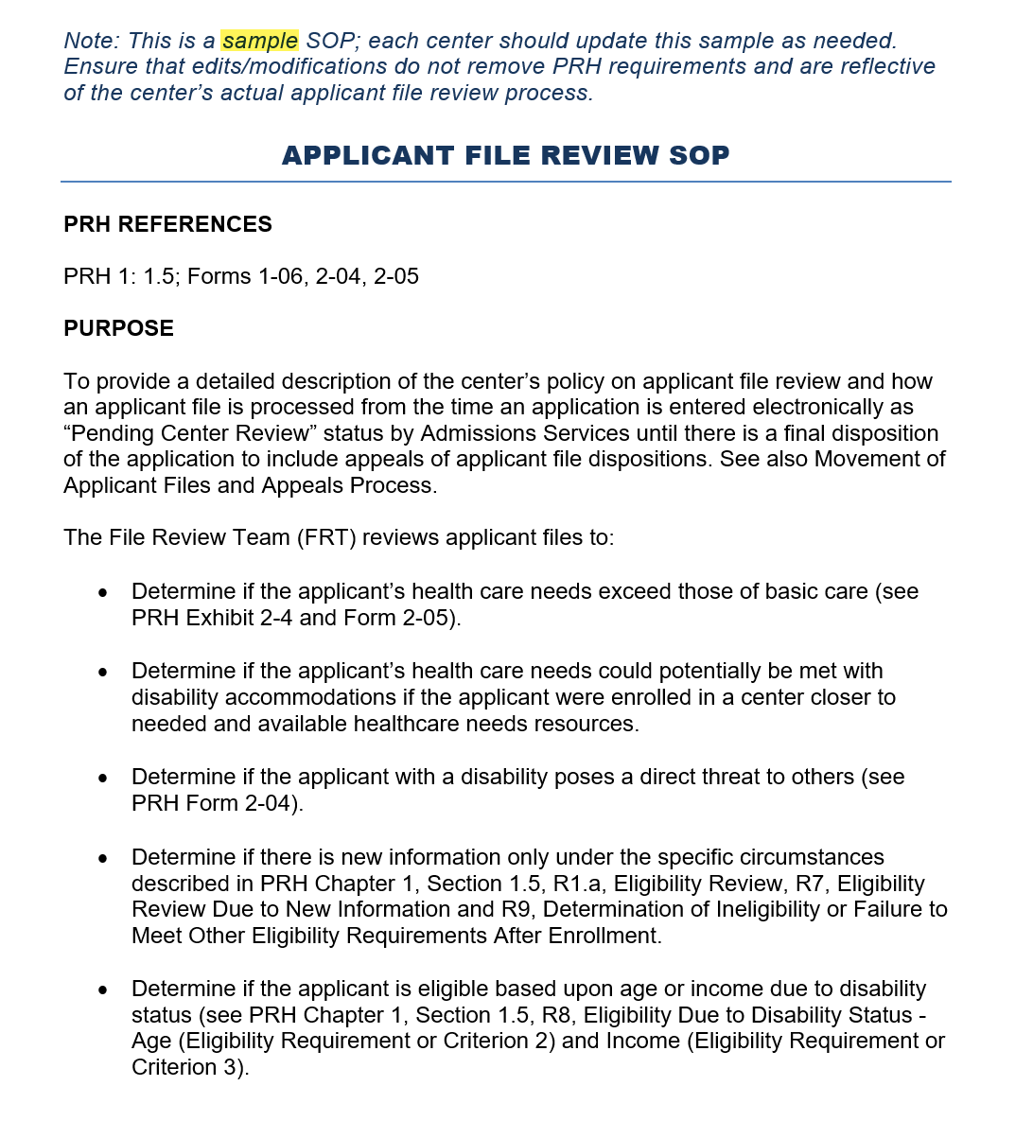
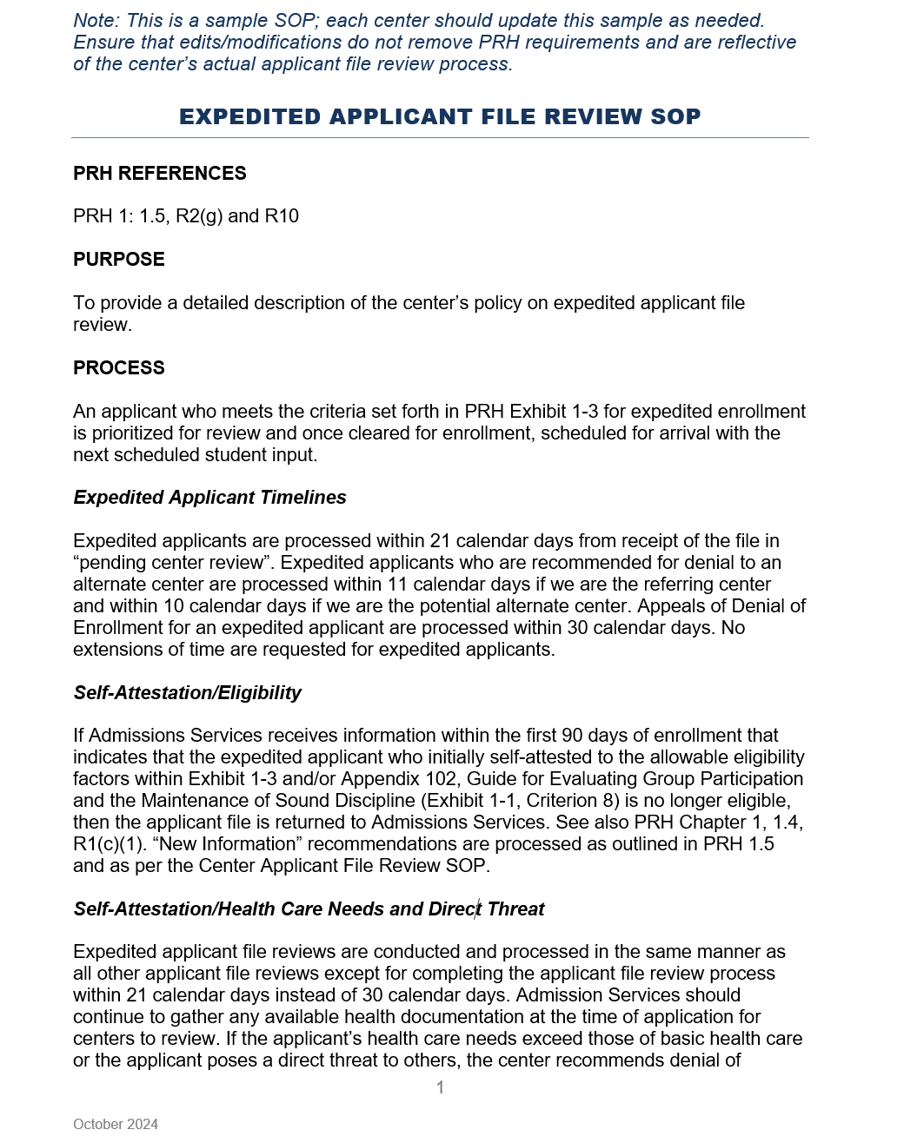
AFR Standing Operating Procedure (SOP)
PRH Chapter 1: 1.5(R2) and Exhibit 5-1
Requires DOL Program Manager Approval
The standard priority AFR SOP must describe in detail how an applicant file is processed from the receipt of the electronic file/application until there is final disposition!
24
Notes:
AFR Standing Operating Procedure (SOP) - PRH Chapter 1: 1.5(R2) and Exhibit 5-1
There are now two applicant file review SOPs that are required: (1) A SOP that outlines the standard priority applicant file review process and (2) A SOP that outlines the expedited priority applicant file review process.
As you know, an SOP outlines how the center is going to implement and execute policy. Both SOPs must be approved by the DOL Regional Office, typically by your respective DOL Program Manager. The standard priority AFR SOP must contain all the required procedures as outlined in PRH-1: 1.5 (R2) and Exhibit 5-1 and the expedited priority AFR SOP must contain all the required procedures as outlined in PRH 1: 1.5, R2(g) and R10.
The standard priority AFR SOP must describe how an applicant file is processed from the time it is received by the center until there is some final decision or adjudication of the application. For example, there has been a decision that the applicant has been accepted into the program, assigned a start date or the center has determined that there is a need to recommend denial of enrollment to the respective Regional Office.

Slide 25
AFR SOP Requirements
Electronic Management Procedures for uploading required documents into E-Folder and notifying the RO that an applicant file is being recommended for denial.
Identification of FRT
Responsibilities and roles of the center FRT members to include the HWD, the qualified health professionals, and the center’s DCs.
Applicant File Review
Procedures for reviewing an applicant file/recommending denial.
Tracking and Monitoring
Procedures for logging and tracking center file reviews (Center log and Wellness log) upon notification that an applicant file is pending review.
Disability Accommodation
Procedures for reviewing and making determinations on requests for RA/RM/AAS.
25
Notes:
The PRH requires that the center’s SOP include a number of specific requirements, which will be discussed in greater detail in the respective requirement areas of this presentation. As an overview, the Applicant File Review SOP must include:
The electronic management of the file review process such as procedures for uploading required documents into E-Folder and notifying the Regional Office that an applicant file is being recommended for denial.
The tracking and monitoring of the applicant file review process, which includes procedures for logging and tracking center file reviews (Center log and Wellness log) upon notification that an applicant file is pending review.
Delineating and assigning the roles and responsibilities of the center FRT members to include the HWD, the QHPs, and the center’s DCs.
Outlining the procedures for reviewing an applicant file/recommending denial.
Likewise, outlining the procedures for reviewing and making determinations on requests for RA/RM/AAS.

Slide 26
AFR SOP Requirements (cont.)
Movement of Applicant Files
Procedures for processing application withdrawals and incomplete application process.
Storage and Transmission
Storage, transmission, and maintenance of the applicant file information.
Timelines
Timeline detailing how center will complete AFR process within 30 calendar days.
Appeals
Procedures for processing applicant appeal of denial determination.
Does it matter if the center’s actual AFR practice
matches the AFR SOP?
26
Notes:
SOP Requirements (cont.)
The Applicant File Review SOP should also contain explanations for
How the center moves files like processing application withdrawals and incomplete application process.
The timelines detailing how center will complete AFR process within 30 calendar days, requesting extensions of time, etc.
How the center will store, transmit, and maintain applicant file information.
Procedures for processing applicant appeal of denial determination.
Audience Participation
Does it matter if the center’s actual AFR practice matches the AFR SOP?
Yes! The center should be implementing and using the process outlined in the respective AFR SOP.

Slide 27
Expedited AFR SOP Requirements
Timelines
Timeline detailing how center will complete AFR process within 21 calendar days and that no extensions of time are allowed.
Self-Attestation/Health Care Needs and Direct Threat
Affirmation that the center will follow the typical AFR process to include procedures for reviewing an applicant file/recommending denial unless health/ medical documentation is not received until after arrival and during the first 90 days of enrollment.
If health/medical documentation is received during the first 90 days of enrollment and indicates that the expedited individual’s health care needs may exceed those of basic health care or that the individual poses a direct threat to others, the center follows the medical separation procedures as outlined in Chapter 6, Section 6.2, R5.
Self-Attestation/Eligibility
Procedures for how the center will collaborate with Admissions Services to verify eligibility within the first 90 days of enrollment, if applicable.
27
Notes:
Expedited AFR SOP Requirements
The expedited priority AFR SOP only needs to contain the specific procedures and considerations related to completing an expedited applicant file review and should reference that the standard priority AFR process must be followed for all non-expedited applicants.
Components of the expedited priority AFR SOP must include:
Timelines
Timeline detailing how center will complete AFR process within 21 calendar days and that no extensions of time are allowed.
Self-Attestation/Eligibility
Procedures for how the center will collaborate with Admissions Services to verify eligibility within the first 90 days of enrollment, if applicable.
Self-Attestation/Health Care Needs and Direct Threat
Affirmation that the center will follow the typical AFR process to include procedures for reviewing an applicant file/recommending denial unless health/medical documentation is not received until after arrival and during the first 90 days of enrollment.
If health/medical documentation is received during the first 90 days of enrollment and indicates that the expedited individual’s health care needs may exceed those of basic health care or that the individual poses a direct threat to others, the center follows the medical separation procedures as outlined in Chapter 6, Section 6.2, R5.

Slide 28
Policy
File Review/ Wellness Tracking Logs
Center Tracking of Applicant File Review
Policy
28
Notes:
Next, we are going to review the File Review Tracking Log requirements. This is how the center tracks the applicant file review process and is an area of critical importance. The tracking log can become of central importance if there is a complaint filed, for example. Failing to maintain a proper tracking system for the management and completion of applicant file review can result in multiple concerns during your Disability Program Compliance Assessment so we want you to be clear about these requirements so that you can ensure that you are maintaining a proper applicant file review tracking process.

Slide 29
Center File Review Tracking Log
PRH Chapter 1: 1.5(R3)
A
Center File Review Tracking Log Requirements
File Receipt Date | Date Other Review Completed
File Review Due Date (30 days) | Extension Requested
Priority Applicant (Veteran’s and Veteran Spouses) | Final Disposition
Expedited Applicant | Disposition Date
Expedited Applicant File Review Due Date (21 days) | Days File in Review
Applicant ID# | Date of Assignment
Applicant Last and First Name | Date of Enrollment
Health and Wellness Director (HWD) Reviewer | Comments
Date HWD Preliminary Review Completed
Other Reviewer
Records MUST maintain a single ongoing center file review log which documents ALL applicant files received for review.
B
A new log should be started each Program Year and entries MUST NOT be deleted.
C
Wellness MUST maintain its own internal tracking log. (PRH Chapter 1:1.5(R2)(b).
29
Notes:
Center File Review Tracking Log - PRH Chapter 1: 1.5(R3)
The requirements of the Center File Review Tracking Log are listed in the table and we will discuss those further in the next slide but first let’s review some of the overarching requirements you need to be aware of in maintaining your center’s tracking log.
Records MUST maintain a single ongoing center file review log which documents ALL files received for review.
A new log should be started each Program Year and entries MUST NOT be deleted.
Wellness MUST maintain its own internal tracking log. (PRH Chapter 1:1.5(R2)(b).

Slide 30
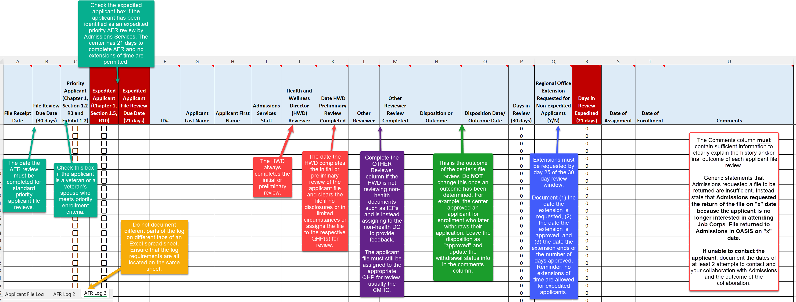
Sample Center File Review Tracking Log
Attend the Maintaining and Managing AFR Tracking webinar for a detailed discussion of each of the log requirements.
Notes:
Sample Center File Review Tracking Log
We have updated the Sample Center File Review Tracking Log to include the new requirements in Section 1.5 of the PRH.
First, look at the lower left-hand side of the screen where you seen the 3 tabs: AFR Log, AFR Log Pg 2 and AFR Log Page 3. Maintaining certain parts of the log on differing tabs is not maintaining a single log. Some centers, however, will complete a Program Year’s worth on entries on one tab say for 2024 and then start a new one in 2025 which is fine to do. However, the tracking log must not have requirements split up and tracked on different tabs even if on the same spreadsheet.
File Review Due Date (30 days)
This is the date the AFR review mut be completed for standard priority applicant file reviews.
Priority Applicant
Check this box if the applicant is a veteran or a veteran’s spouse who meets priority enrollment criteria as per Exhibit 1-2.
Expedited Applicant and Expedited Applicant File Review Due Date
Check the expedited applicant box if the applicant has been identified as an expedited priority AFR review by Admissions Services. The center has 21 days to complete AFR and no extensions of time are permitted.
Health and Wellness Director Reviewer
The Health and Wellness Director must complete a review of each complete file received by the center. A complete file is one that has all the required eligibility documents such as birth certificate and such. This does NOT include health or disability information, which is totally voluntary. Dependent upon staff turnover, this should be the same person listed all the way down the column.
Date HWD Review Completed
The date the HWD completes the initial or preliminary review of the applicant file and clears the file if no disclosures or in limited circumstances or assigns the file to the respective QHP(s) for reivew.
Other Reviewer/Other Reviewer Review Completed
Complete the OTHER Reviewer column if the HWD is not reviewing non-health documents such as IEPs and is instead assigning to the non-health DC to provide feedback. The applicant file must still be assigned to the appropriate QHP for review, usually the CMHC.
Disposition or Outcome
This is a very important column as it documents the center’s outcome of the file review. Do NOT change the disposition/outcome once an initial one has been determined. For example, the center approved an applicant who later withdrew their application. Leave the disposition/outcome as approved here and update the withdrawal status info in the comments column.
Regional Office Extension Requested
Extensions must be requested by day 25 of the 30-day review window. Document (1) the date the extension is requested, (2) the date the extension is approved, and (3) the date the extension ends or the number of days approved. Reminder, no extensions of time are allowed for expedited applicants.
Comments
The Comments column must contain sufficient information to clearly explain the history and/or final outcome of each applicant file review. Generic statements that Admissions requested a file to be returned are insufficient. Instead state that Admissions requested the return of the file on "x" date because the applicant is no longer interested in attending Job Corps. File returned to Admissions in OASIS on "x" date.
If unable to contact the applicant, document the dates of at least 2 attempts to contact and your collaboration with Admissions and the outcome of the collaboration.
Attend the Maintaining and Managing AFR Tracking webinar for a detailed discussion of each of the log requirements.

Slide 31
Wellness File Review
Tracking Log
PRH Chapter 1: 1.5(R2)(b)
A
Wellness MUST maintain its own internal tracking log. (PRH Chapter 1:1.5(R2)(b).
Wellness File Review Tracking Log Components
HWD Reviewer | QHP #2 Assigned File to Review
Date HWD Review Complete | Date QHP #2 Review Complete
Non-health DC Reviewer | Wellness Disposition or Outcome
Non-health DC Review Complete | Wellness Disposition or Outcome Date
QHP #1 Assigned File to Review | Comments (PHI Redacted)
Date QHP #1 Review Complete
B
Specific QHPs (i.e., the Center Physician, Center Mental Health Consultant (CMHC), Trainee Employment Assistance Program (TEAP) Specialist, or other qualified health professionals and/or the Disability Coordinator) must not be listed on the center File Review Tracking Log by title for confidentiality reasons.
Information highlighted in Peach must be reported to Records for inclusion in the Center’s Applicant File Review Tracking Log.
31
Notes:
The PRH does not provide a detailed list of what is required to be tracked on the Wellness Log unlike the Center File Review Tracking Log. What information that is provided is in PRH 1.5 R2b which we reviewed at the beginning. READ highlighted area. Per this statement, we know that the individual QHP reviews are not documented on the log maintained by records, so Wellness must maintain their own internal tracking log. The Wellness log is required to track the movement of the applicant file through the review by the QHPs that were identified by the HWD. If the non-health DC has been assigned non-health documents to review, the non-health DC review may either be tracked on the Wellness Tracking log or the Center File Review Tracking Log. Do not list the DC by title if included on the Center File Review Tracking Log.
How do we know which QHPs should be noted on the Wellness tracking log as reviewing a specific file? They would be the same QHPs identified by the HWD on the Center Applicant File Review form.

Slide 32
Sample Wellness Tracking Log
https://supportservices.jobcorps.gov/disability/Documents/Sample%20Wellness%20File%20Review%20Tracking%20Log.xlsx
Notes:
There is also a sample Wellness Tracking Log on the Disability Website. This log is not a duplicate of the Center FR Tracking Log because it serves a different purpose. For example, there is not a column that tracks the number of days in review. The tracking log managed by Records is required to track that information. Some of the information tracked on the Wellness log also needs to be added to the Records log and those columns are in the peach color. There is a statement at the top explaining that the information in peach must be provided to Records with a reminder to not send any PII/PHI. REVIEW some of the columns. Access should be limited because this log will contain PHI.

Slide 33
Instructions and Guidance Embedded in Log
Both the Center AFR and Wellness Tracking Logs contain embedded guidance.
Notes:
A closer look: each column has a red triangle in the upper right corner. If you place your cursor on the triangle, there is a dropdown that includes an explanation of what type of information goes in that column.

Slide 34
File Review Tracking Log Comments Acceptable or Unacceptable?
Awaiting receipt of IEP.
CMHC requested additional documentation and did not receive it.
Applicant stated they got a job, so the file was returned to Admissions Services as a withdrawal of application on December 15, 2023.
File returned to Admissions Services as per Admissions Services staff request.
Applicant’s case worker called and informed center applicant is incarcerated. File was returned to Admissions Services.
Notes:
Let’s Review!
In the chat box, type whether you think the comment is an acceptable or an unacceptable one to be on the center File Review Tracking Log.
Awaiting receipt of IEP. (No final disposition noted.) Unacceptable – the center must make a decision based upon the clinical interview and any information received if the additional documentation is not forthcoming within the 30-day window or the timeframe of the extension granted by the RO.
CMHC requested additional documentation and did not receive it. File returned to Admissions Services. Unacceptable – just as in the last example, the center must make a decision based upon the clinical interview and any information previously received. The file may not be returned to Admissions Services.
Applicant stated they got a job, so the file was returned to Admissions Services as a withdrawal of application on March 15, 2023. Acceptable.
File returned to Admissions Services as per Admissions Services staff request. Unacceptable – it is not clear why the file was returned to Admissions staff and must not be returned unless the basis is a valid one as per JC policy.
Applicant’s case worker called and informed center applicant is incarcerated. File was returned to Admissions Services. Unacceptable. The center must complete a Recommendation of Denial for New Information and submit to the Regional Office for review.

Slide 35
Policy
File Review Team
Composition and Member Responsibilities
Policy
35
Notes:
File Review Team – Composition and Member Responsibilities

Slide 36
Initial Reviewer
Health and Wellness Director
Completes initial/preliminary review and assigns files to QHP, as appropriate
QHP
TEAP Specialist
Reviews substance-use information
File Review Team (FRT) Composition
QHP
Center Mental Health Consultant (CMHC)
Reviews mental health-related information
QHP
Center Dentist
Reviews oral health information
Other Reviewer
Non-health Disability Coordinator
Reviews non-health documents (e.g., IEPs/504 plans) to provide feedback if the HWD does not routinely review.
QHP
Center Physician/Nurse Practitioner/Physician’s Assistant
Reviews medical information
Notes:
The composition of the FRT is very important for a couple of reasons:
Only those individuals who have a need to know are allowed to review an applicant’s health and disability information.
Of those how have a need to know, only those individuals with the proper qualifications should review applicant’s health and disability information.
As we have previously discussed, the Initial Reviewer must be the HWD. Sometimes, when there are disclosures of medical conditions such as asthma, diabetes, etc., then the HWD may complete the medical review for the Center Physician, run the history by the CP, and document “discussed with CP.” However, if the applicant is being recommended for denial, the HWD will have to collaborate with the Center Physician who ultimately must sign the Health Care Needs Assessment.
QHPs include:
CMHC who reviews mental health-related information
CP/NP/PA reviews medical information
TEAP Specialist reviews substance-use information
Center Dentist reviews oral health information
Other Reviewers
The Other Reviewer is generally the Non-health DC who reviews non-health documents (e.g., IEPs/504 plans) to provide feedback if the HWD does not routinely review.

Slide 37
Policy
Accessibility
Access to Participate in the Job Corps Program
Policy
37
Notes:
Accessibility
Accessibility means affording access to individuals with a disability such that they can participate in the Job Corps Program. We have had multiple accessibility scenarios arise this past year and there has been some confusion surrounding how accessibility considerations interface with applicant file review.

Slide 38
Accessibility to Participate in the Job Corps Program
Accessibility needs are NOT part of the center applicant file review process.
Access Examples
Mobility access concerns for an applicant in a wheelchair are not part of the enrollment decision.
Visual impairments are not factors in the enrollment decision.
Trade selection, especially related to a disability, is NOT a factor in the center’s enrollment decision.
What should you do if you have an applicant who has specialized access needs, and you are unsure of how to proceed?
38
Notes:
So, how do accessibility considerations interface with applicant file review? The short answer is that they don’t! Accessibility needs are NOT part of the center applicant file review process. A center must make enrollment decisions based upon the center’s ability to meet a person’s health care needs or whether they pose a direct threat to others.
Mobility access concerns for an applicant in a wheelchair are not part of the enrollment decision. Visual impairments are not factors in the enrollment decision. Trade selection, especially related to a disability, is NOT a factor in the center’s enrollment decision.
So when do you consider access needs? AFTER you have made a decision to enroll the applicant. Do not delay the enrollment decision based upon access. Do not attempt to locate a center you think is more accessible for the applicant.
Audience Participation
What should you do if you have an applicant who has specialized access needs, and you are unsure of how to proceed?
Contact your Regional Disability Coordinator for assistance. The overwhelming majority of the time, we can figure out disability accommodations that are necessary to allowing that individual to arrive at your center. IF accommodation considerations have been exhausted and access barriers cannot be mitigated sufficiently, then we will work with your center to contact the Regional Office to request/discuss the possibility of assigning the enrollee to another center where the access needs can be met.

Slide 39
True or False?
It is acceptable to return a file to Admissions Services if the center does not receive medical documentation the center feels is essential to deciding on enrollment.
If there are accessibility concerns (i.e., the center is not accessible to an individual in a wheelchair), the center can delay a decision on enrollment.
If an applicant is blind or has a mobility impairment (e.g., uses a wheelchair), the center can refer the applicant file to another center that is more accessible.
Notes:
It is acceptable to return a file to Admissions Services if the center does not receive medical documentation the center feels is essential to deciding on enrollment. False. The disclosure of health/medical documentation is voluntary and if the applicant does not provide documentation or requested health information is not received within the 30-day window or within the window of any Regional Office approved extensions of time, the center must make a decision based upon the information it has to include the completion of a clinical interview.
If there are accessibility concerns (i.e., the center is not accessible to an individual in a wheelchair), the center can delay a decision on enrollment. False. Accessibility has no bearing on decisions related to health care needs and/or direct threat to others. The center must make a decision to enroll or recommend denial based upon the same factors applied to all other applicants. If enrolling, then the center begins to work through any accessibility considerations and should contact their Regional Disability Coordinators for assistance.
If an applicant is blind or has a mobility impairment (e.g., uses a wheelchair), the center can refer the applicant file to another center that is more accessible. False. Centers first must attempt to work through any accessibility concerns (with the Regional Disability Coordinator’s assistance) and if those cannot be resolved, the Regional Office will determine which center the applicant will be assigned for arrival.

Slide 40
Policy
Reapplications
Applicants who have been denied enrollment previously by a Regional Office
Policy
40
Notes:
Reapplication
Applicants who have been denied enrollment previously by a Regional Office must reapply to be considered for admission to Job Corps. Let’s review the requirements for reapplication.

Slide 41
Reapplication of Previously Denied Applicants (PRH Chapter 1: 1.5, R12)
Applicants who have been denied admission by a Regional Office due to health care needs exceeding those of basic health care (see Exhibit 2-4) or because the individual poses a direct threat to others may reapply if they provide new or updated health- and/or behavior-related documentation.
Notes:
Reapplication of Previously Denied Applicants policy is in PRH Chapter 1: 1.5, R12.
Applicants who have been denied admission by a Regional Office due to health care needs exceeding those of basic health care (see Exhibit 2-4) or because the individual poses a direct threat to others may reapply if they provide new or updated health- and/or behavior-related documentation. This responsibility is part of the center file review responsibility and falls to the Wellness Department.
We will review the reapplication process during the DC 1 part b on Thursday.

Slide 42
Policy
Resources
Job Corps Disability and Health Websites
Policy
42
Notes:
Resources
Let’s review a couple of crucial resources that you will need in understanding and completing applicant file reviews.

Slide 43
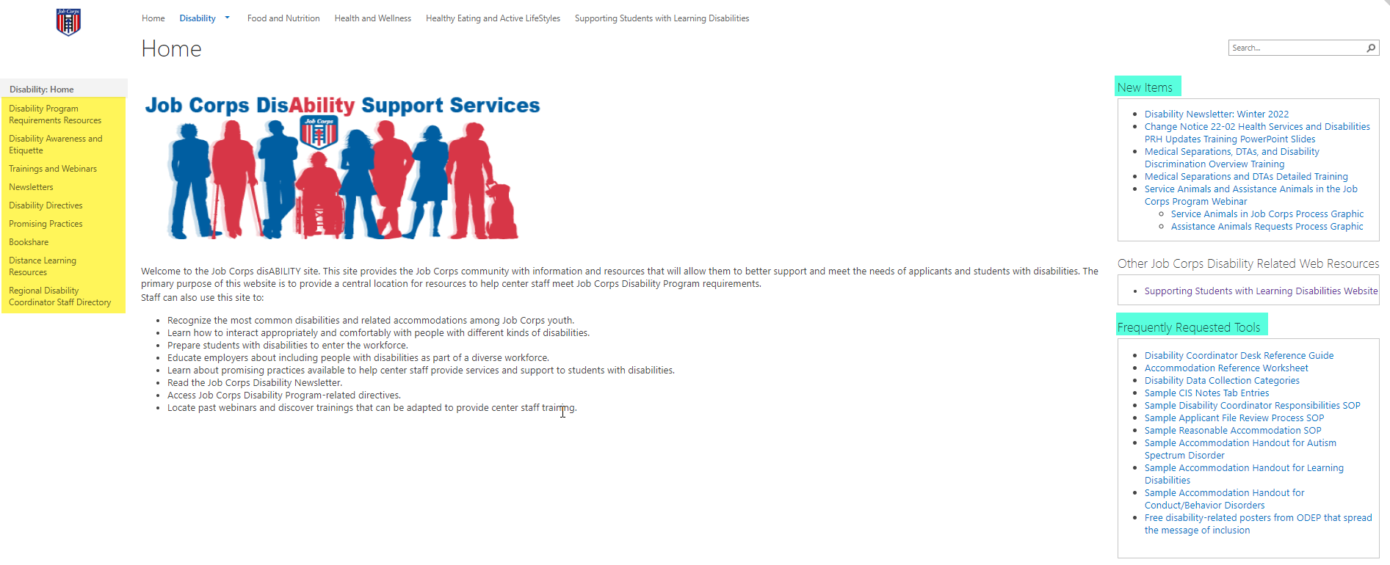
Job Corps Disability Support Services Website https://supportservices.jobcorps.gov/disability/Pages/default.aspx
Notes:
Job Corps Disability Website
The Job Corps Disability Support Services website contains numerous resources and tools on applicant file review and disability accommodation requirements, processes and procedures.
As new resources and tools are developed, they are listed under the New Items heading to the right side of the website page. See teal highlighted area. Resources that are more commonly used and/or requested are listed under the Frequently Requested Tools section also highlighted in teal.
The categories of resources are listed on the left-hand side of the website and are highlighted in yellow.
The Job Corps Disability website link is located at the top of the slide.

Slide 44
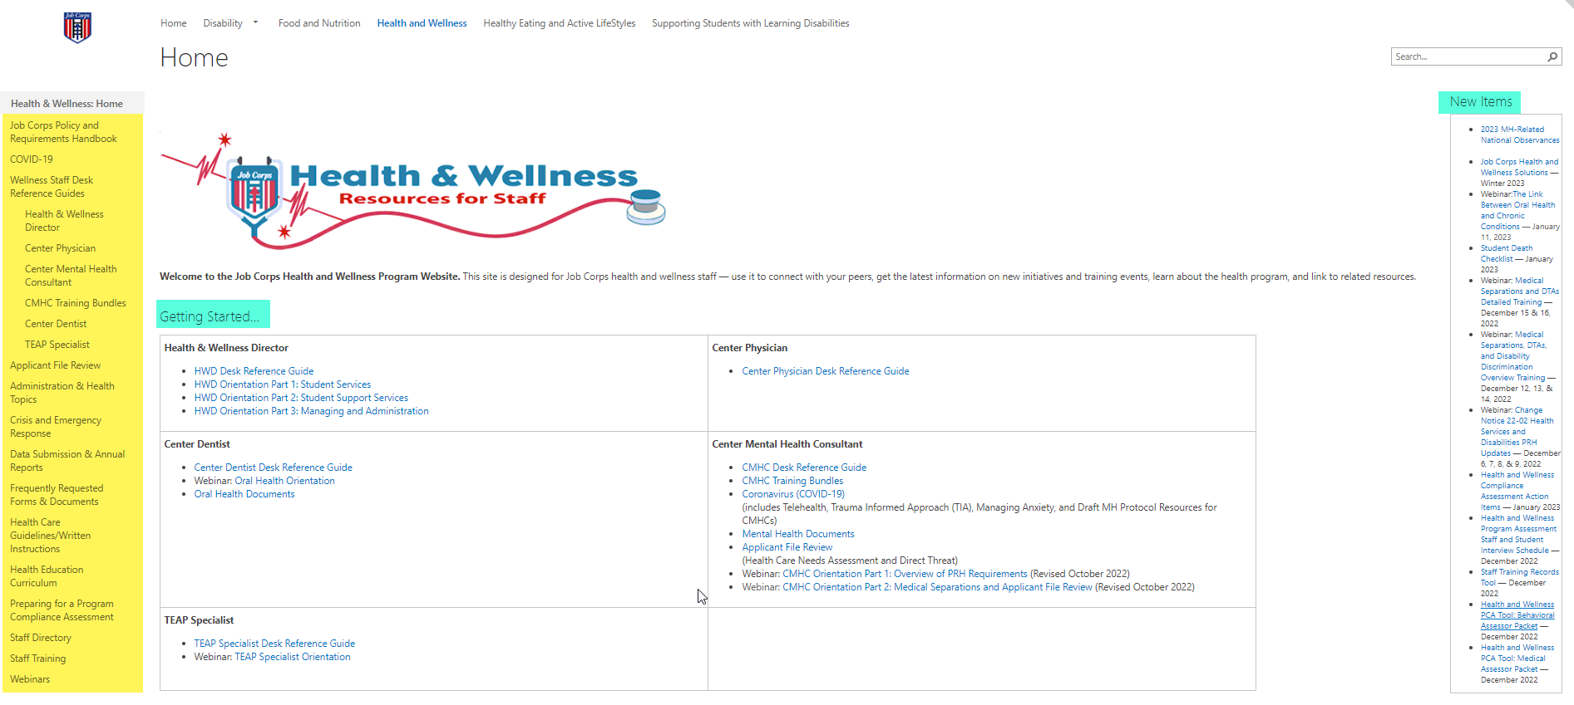
Job Corps Health and Wellness Website https://supportservices.jobcorps.gov/health/Pages/default.aspx
Notes:
Job Corps Health and Wellness Website
In addition to the Job Corps Disability website, the Job Corps Health and Wellness website provides numerous tools and resources to support center staff with health and wellness-related topics such as AFR, H&W-related policy/requirements health care guidelines and more! Specific webpages are designed to support clinical staff.
Please visit the Job Corps Health and Wellness website often. As new tools are developed to assist with understanding and implementing PRH requirements, they are located under the New Items section on the right side of the Home Page.
Your Regional Mental Health Specialists and Regional Disability Coordinators are here to help you navigate the PRH requirements – reach out as needed.

Slide 45
Questions?

