Slide 1
Assistive Technology 101 for Supporting Students with Disabilities at Job Corps
Presenter:
Diana Petschauer, M.Ed., ATP, Consultant
Assistive Technology Professional; RESNA certified

Slide 2
Assistive Technology in the Workplace
A link to this presentation:
http://bit.ly/ATJobCorps

Slide 3
Your Presenter
ATforED.com
Diana Petschauer, M.Ed, ATP
Previously the AT Specialist at Disability Services, UNH
Founder, ATforED.com & Access4Employment.com
Assistive Technology Professional, RESNA Certified
Consultant, Trainer, ATforED.com,Access4Employment.com
Faculty Trainer at CTDInstitute.org, Center on Technology and Disability & ATinNH

Slide 4
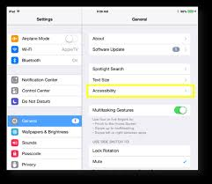
iOS Accessibility Features
Built-In to iPhone/ iPad
Text To Speech, Magnification & Zoom, High Contrast, Speech to Text, 3rd Party Keyboards, Keyboard Shortcuts
Notes:
Stacy

Slide 5
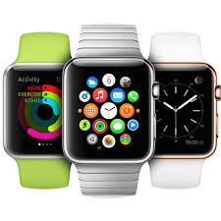
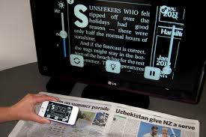
iOS Apps-iPhone, iPad, Apple Watch
OCR, Accessible Work Documents, Magnification, Text to Speech, Speech Input, Scheduling & Reminders
ClaroPDF, PDF Expert
TextGrabber, KNFB Reader, Prizmo
Better Vision
CanPlan, Due
Notes:
Stacy

Slide 6
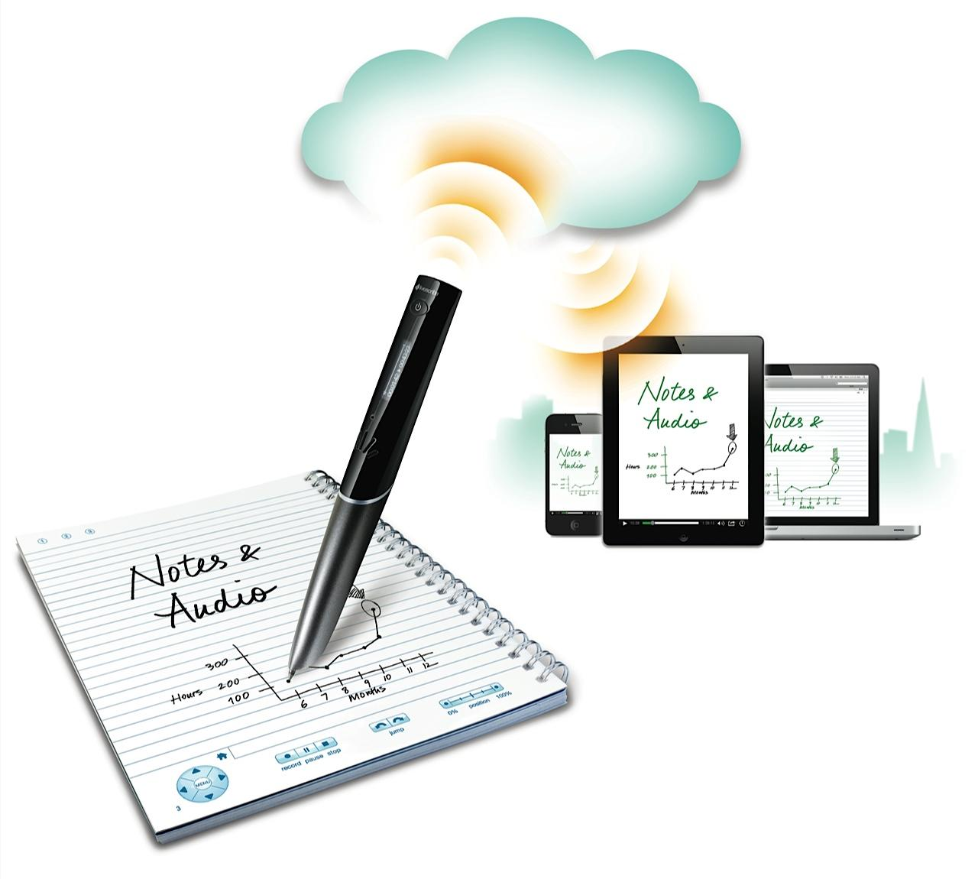
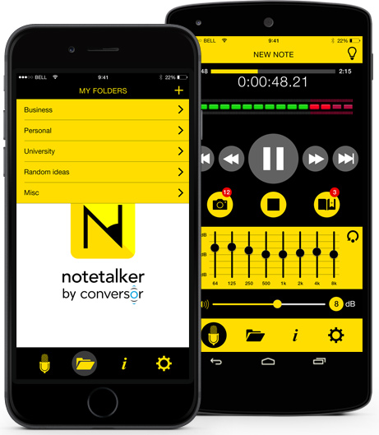
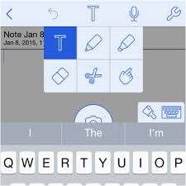
Note taking Options
Record Meetings/ Lectures, take notes, handwrite, embed photos
Apps, Notability, Notetalker
SmartPen, Livescribe

Slide 7
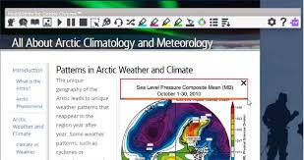
Google Chrome Apps, Extensions, Add-Ons
Google Docs, Drive, Add-Ons- Easy Bib, Charts
Visor, Screen Masking
High Contrast, Zoom
Stay Focused
Session Buddy
Google Keep
Read and Write

Slide 8
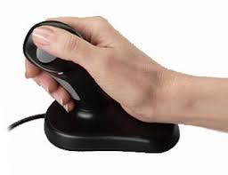
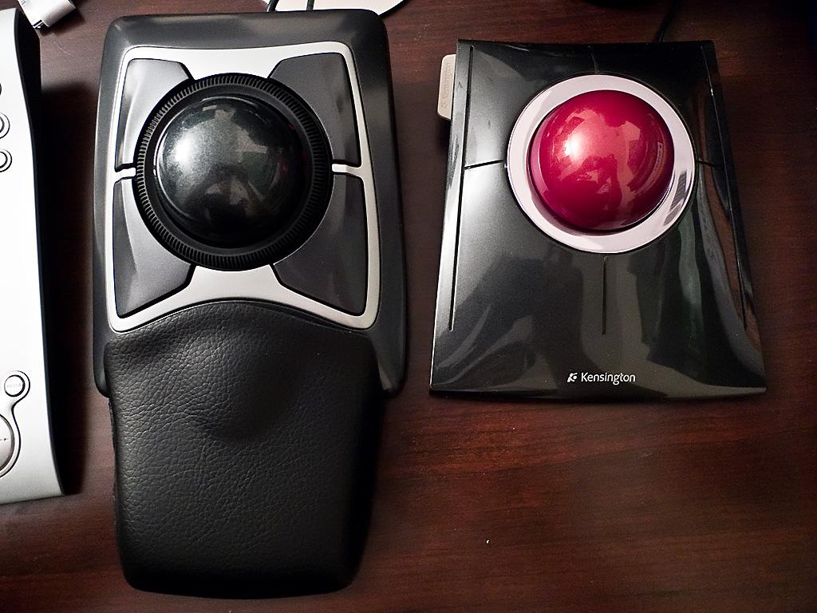
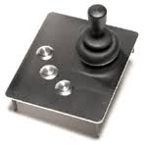
Adaptive Workstation Equipment
Adaptive Mice, Trackball Mouse, Joystick

Slide 9
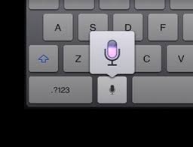
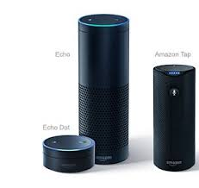
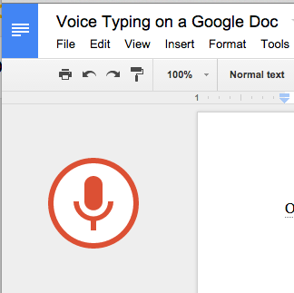
Speech to Text, Speech Input, Voice Recognition Options
Dragon Software Not Just Typing!
Google Voice Typing Lights, Heat
iOS Built-In Microphone Reminders, Banking
Built-In Mac Dictation
Built-In Dictation Windows
Google Assistant, Amazon Alexa, Cortana, Siri
Voice Control, Echo, Dot, Environmental Controls
Notes:
Stacy

Slide 10
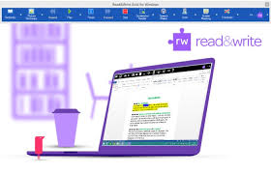
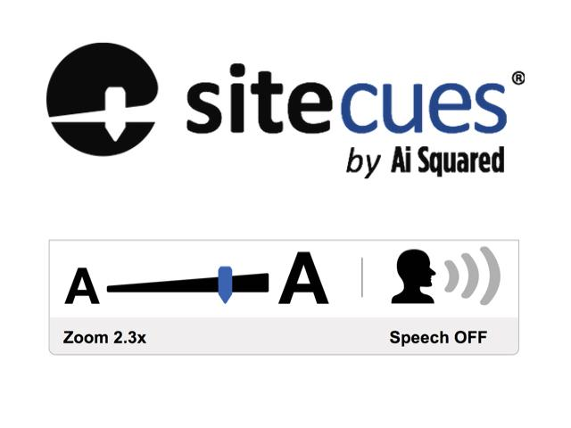
Literacy Software
Support Individuals with Learning/ Cognitive Disabilities
Text to Speech, Accessible work docs & websites, emails, organization tools, word prediction
Read and Write for Work, Texthelp
Browse aloud
SiteCues, Ai Squared

Slide 11
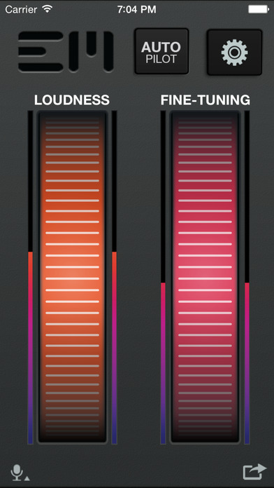
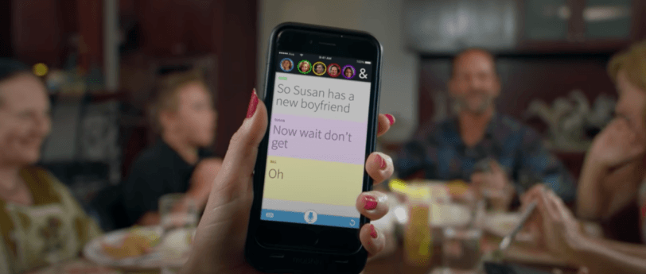
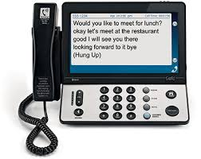
Amplification & Captioning, Alerts
Caption Meetings or Amplify Voices, Apps, Software
Captioning Phones
Interact-AS Speech Gear
Ear Machine amplification iPhone App, Ava for Captioning conversations

Slide 12
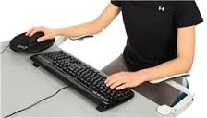
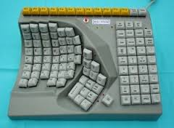
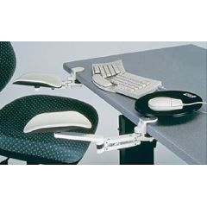
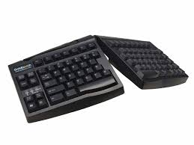
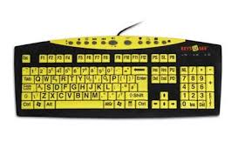
Adaptive Workstation Equipment
Adaptive Keyboards, Arm/Wrist Supports and Rests

Slide 13
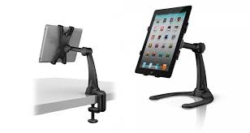
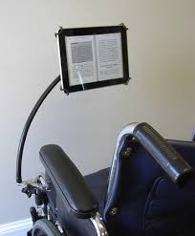
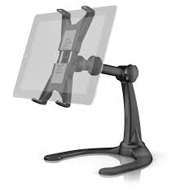
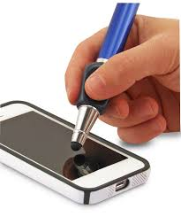
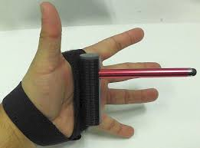
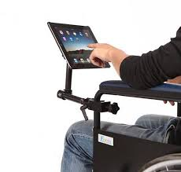
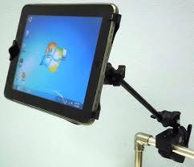
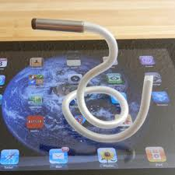
iPad Stands, Mounting, Styluses

Slide 14
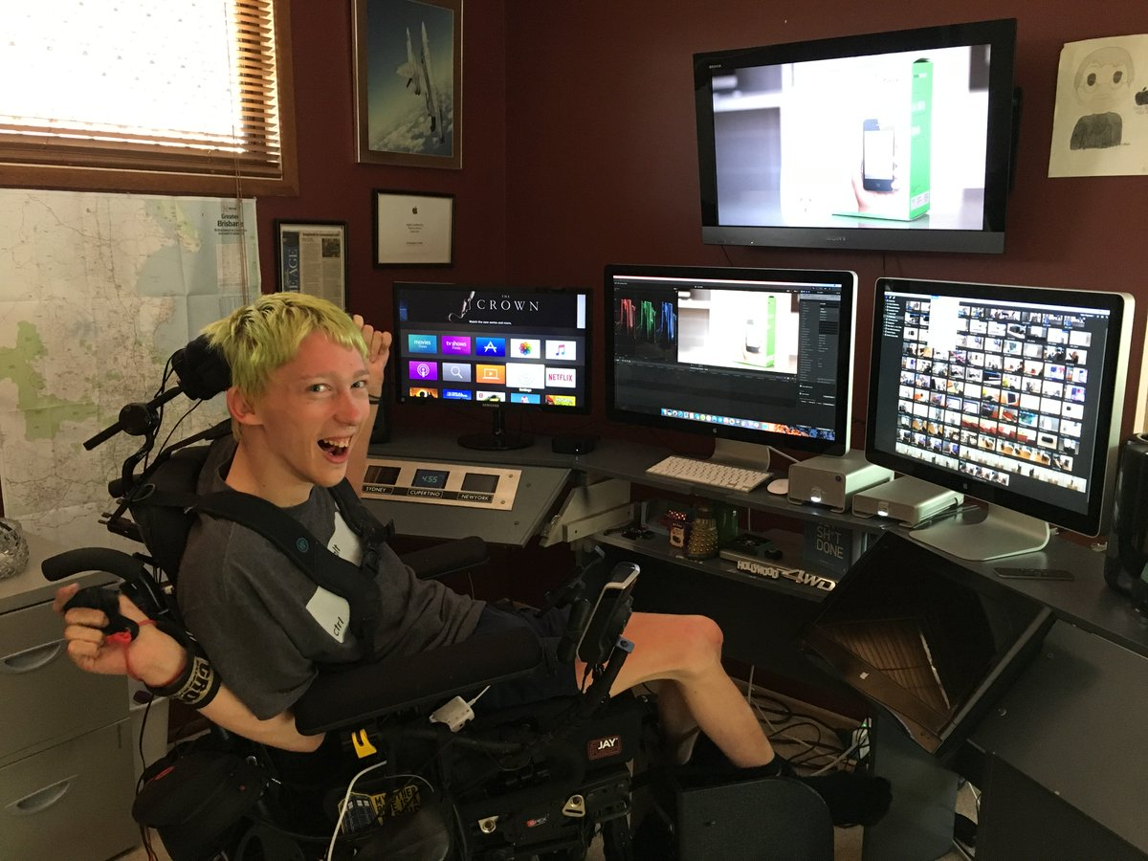
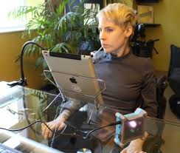
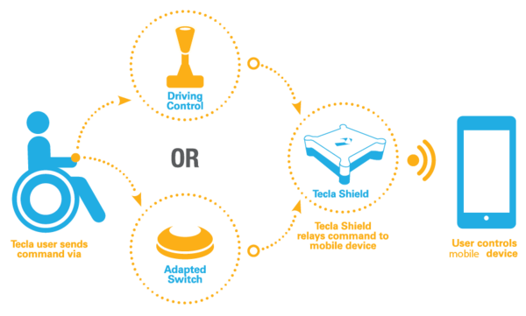
Switch Access
Support Access for Individuals with physical disabilities
Switch Access iOS and Mac
Tecla Shield, Tecla Video Carolyn
Switch Control Chris Video

Slide 15
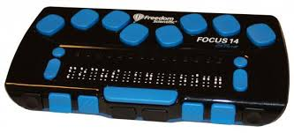
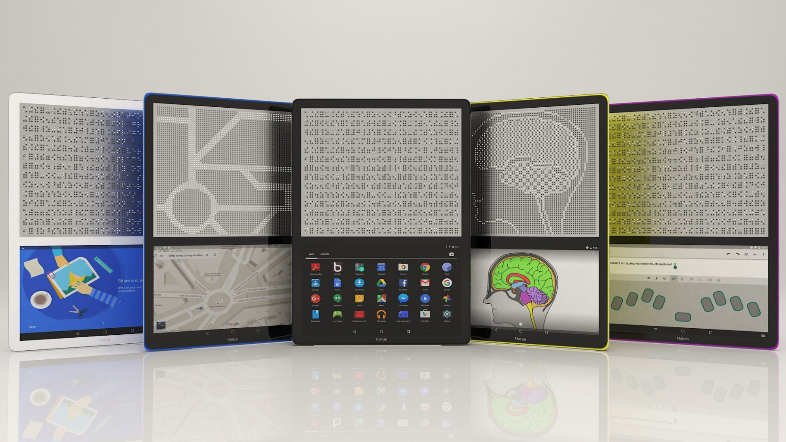
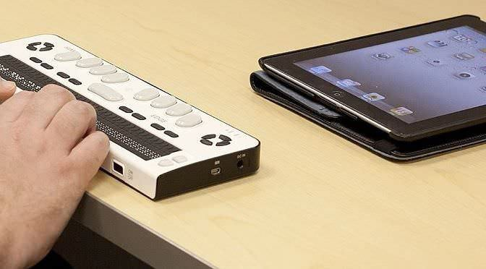
Braille Displays, Digital Braille Options
Use with iPad or laptop/ desktop
Braille options and Voice Over on iPad
Blitab-Innovative tactile Tablets coming!

Slide 16
Resources
16

Slide 17
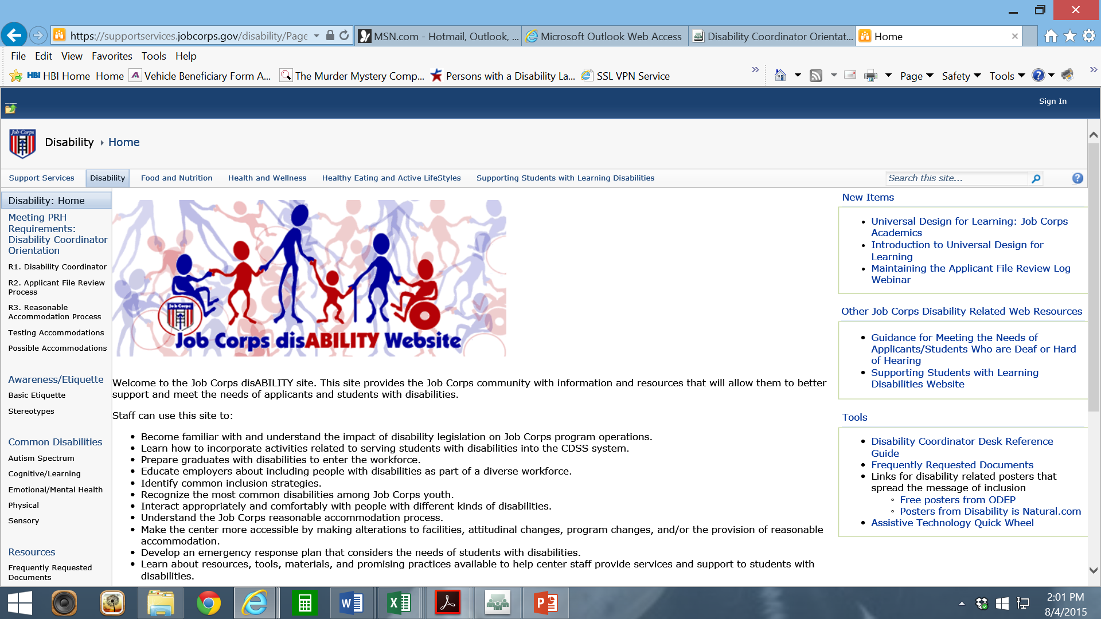
Job Corps Disability Website https://supportservices.jobcorps.gov/disability/Pages/default.aspx

Slide 18
RESNA http://www.resna.org/
Notes:
RESNA is a national society engaged in the work of connecting those in need of AT to potential funding sources. Almost every state has a federally funded AT Program that offer device loans, funding sources, and further resources for AT.

Slide 19
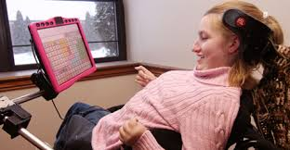
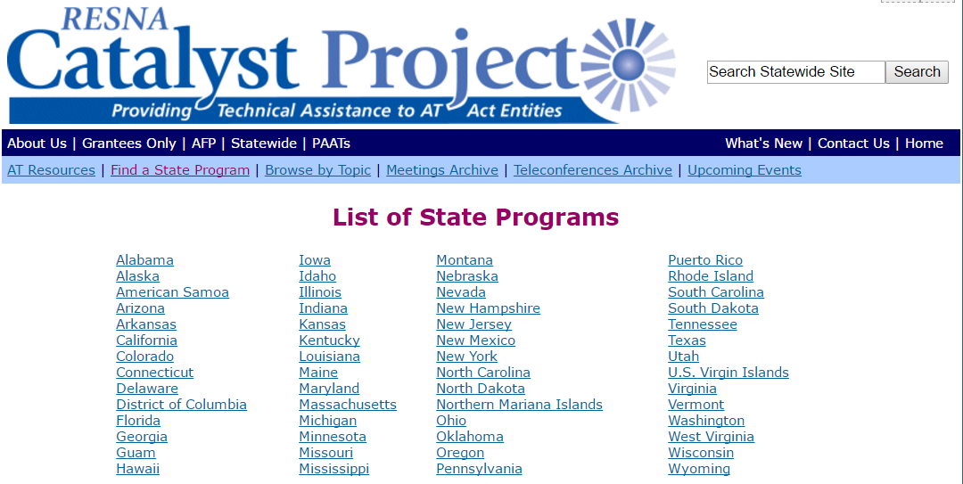
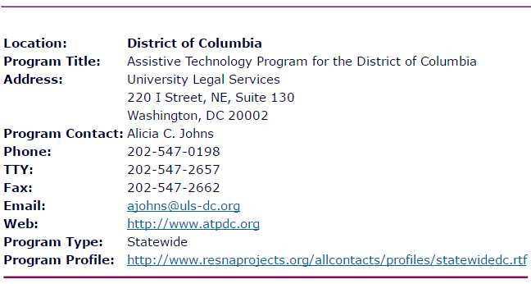
State AT Programs http://www.resnaprojects.org/allcontacts/statewidecontacts.html
Notes:
This slide is a snapshot of the actual list of state AT programs on the RESNA website. The right hand side of the slide has another snap shot of when you click on an individual state. In this case, it shows the contact info for the AT Program in DC.

Slide 20
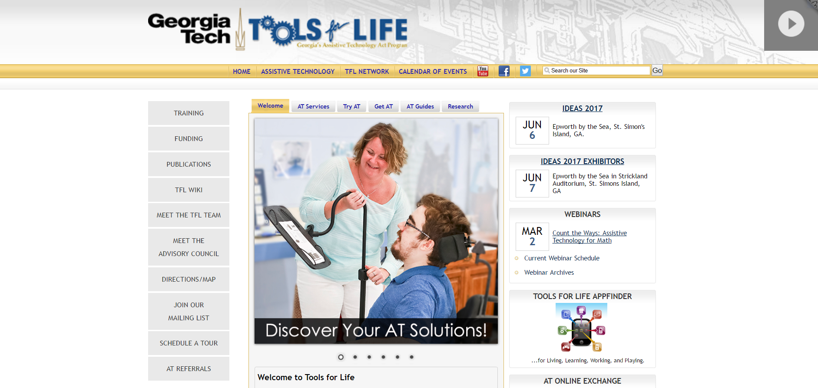
Tools for Life http://www.gatfl.org/

Slide 21
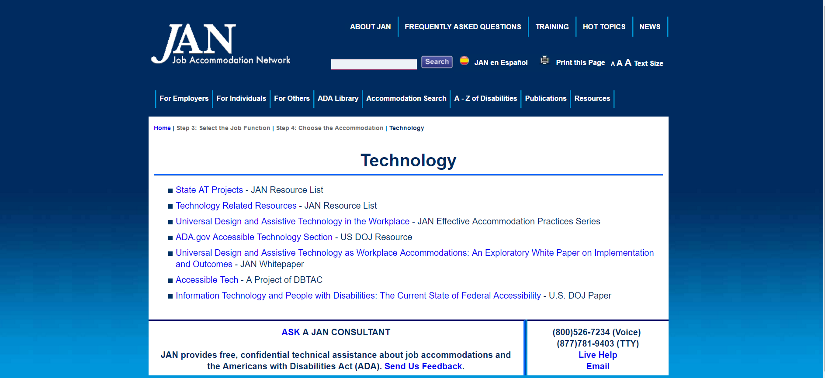
Job Accommodation Network http://askjan.org/topics/tech.htm
Notes:
Website tour: May use SOAR to demo LD (Case Study-Pat)…choose reading, math, and organization to show how AT can accommodate

Slide 22
Questions? Comments? CONTACT US!
ATforEd.com
Access4Employment.com
603-998-4980
dp.ATspecialist@gmail.com or diana@atfored.com

Slide 23
Access to Education & The Workplace using Assistive Technology

