Slide 1
Admissions Services (AS)
Center Applicant File Review and
Disability Accommodation Considerations
Notes:
Welcome! Today’s presentation is about Center Applicant File Review and Disability Accommodation Considerations as they apply to Admissions Services and/or the collaboration or interaction of the center File Review Team with Admissions Services staff.

Slide 2
Agenda
Effective Communication
Eligibility Process Considerations
Disability Accommodations within the Admissions Process
Collection of Health and Disability Documentation
Center File Review Considerations/ Admissions Services Collaboration
Reapplications
Notes:
We will be reviewing 5 topic areas today.
Effective Communication and Eligibility Process Considerations
Disability Accommodations within the Admissions Process
Collection of Health and Disability Documentation
Center File Review Considerations/Admissions Services Collaboration
Reapplications

Slide 3
Warm-up Activity
Attention Activity
Notes:
Before we get started, let’s take a few minutes and do a warm-up activity. Let’s see how well you can pay attention right after lunch!
Count how many times the individuals who are wearing white t-shirts only pass the ball from one to another. Just the individuals wearing the white shirt and let’s see if any of you can get the right number!

Slide 4
Effective
Communication
Communicating with Individuals with Disabilities
Appendix 201
4
Notes:
Let’s start by discussing a critically important area – Effective Communication, Communicating with Individuals with Disabilities which is PRH Appendix 201.

Slide 5
A.
Communication must be as effective as communication with others.
B.
Applies to all stages of the Job Corps process.
C.
The obligation to communicate effectively with people with disabilities is separate from the obligation to provide reasonable accommodation or reasonable modification in policies, practices, or procedures for qualified individuals with disabilities.
Communicating with Individuals with Disabilities
Appendix 201
5
Notes:
What are our legal obligations when communicating with individuals with disabilities enrolled in or related to the Job Corps program?
Communication with people with disabilities (whether those people are students, staff, applicants for admission/employment, parents, guardians, or members of the public) must be as effective as communication with others and we don’t always actively think about whether our communication exchanges are effective.
This obligation applies to all stages of the Job Corps process.
The obligation to communicate effectively with people with disabilities is separate from the obligation to provide reasonable accommodation or reasonable modification in policies, practices, or procedures for qualified individuals with disabilities. Let’s talk more about why so much emphasis is placed on the need for effective communication.
Appendix 201 – Communicating with Individuals with Disabilities

Slide 6
Auxiliary Aids
and
Services
If a request for auxiliary aids and services is received (communication aids to include sign language interpreter services), Admissions Services:
Must address the request immediately
Must not begin, or continue with, any part of the admissions process until some sort of communication aid has been provided that is acceptable to the person for whom the auxiliary aid and services is being requested
6
Notes:
Auxiliary Aids and Services
If a request for auxiliary aids and services is received (communication aids to include sign language interpreter services), Admissions Services:
Must address the request immediately
(Critically important) - Must not begin, or continue with, any part of the admissions process until some sort of communication aid has been provided that is acceptable to the person for whom the auxiliary aid and services is being requested

Slide 7
Why is Effective Communication so Important?
Without clear, accurate, effective communication, any encounter between a person with a disability and a program from which that person is seeking services, such as Job Corps, will be literally meaningless.
7
Notes:
The Workforce Innovation and Opportunity Act (WIOA) nondiscrimination regulations distinguish between these two obligations for a very simple reason: Without clear, accurate, effective communication, any encounter between a person with a disability and a program from which that person is seeking services, such as Job Corps, will be literally meaningless.
In other words, it is NOT left up to our interpretation without ensuring that we have effectively communicated with an applicant/student.

Slide 8
Who is Responsible to Ensure Effective Communication?
Under the law, the burden is on Job Corps to provide the auxiliary aids and services (communication aids) that are needed for equally effective communication with a particular person with a disability.
8
Notes:
Who is responsible to ensure effective communication?
Under the law, the burden is on Job Corps to provide the auxiliary aids and services (communication aids) that are needed for equally effective communication with a person with a disability.
Job Corps is not necessarily required to provide the precise communication aid/services requested by a person with a disability when an EQUALLY EFFECTIVE, less costly alternative is available. The law places on us the clear obligation to provide some method of communication that is effective for that particular person with a disability.

Slide 9
Identifying or Determining What is Effective?
How Do You Know if Communication Accommodations are needed?
First – Determine HOW to communicate effectively with the individual with a disability.
Is a disability obvious?
Individual is deaf, visually impaired, etc.?
Individual requests auxiliary aids and services (e.g., communication accommodations or modifications).
The individual does not appear to understand what they are being asked or what is being communicated.
Primary consideration should be given to the requests of the person with a disability.
Why do you think the law does this?
9
Notes:
How Do You Know if Communication Accommodations are needed?
Is a disability obvious?
Individual is deaf, visually impaired, etc.?
Individual requests auxiliary aids and services (e.g., communication accommodations or modifications).
The individual does not appear to understand what they are being asked or what is being communicated.
Identifying or Determining what is Effective?
When a person who has a specific disability that affects his/her ability to communicate approaches Job Corps, the first thing we should do is find out how to communicate as effectively with that person as we would with people without disabilities. This essentially means we must engage the applicant/student in an interactive process to find out what communication methods/strategies the person can genuinely understand. Interactive does not mean we solely interact with paperwork/documentation, and not involve the applicant/student.
When considering how best to communicate with an applicant/student with a disability, primary consideration should be given to the requests of the person with a disability.
Audience Participation:
Why do you think the law requires this? (Use the text box to respond)
The individual with a disability is the best source of information about their own needs. Individuals who have the “same” diagnosis or disability may not be able to use and understand the same communication method. For example, individuals who have hearing impairments may use differing methods to communicate. Some individuals may use American Sign Language (ASL), others communicate using Signed English, while still others do not understand sign language at all and need a different method such as Computer Assisted Real-Time Transcription (CART).
Some communication methods/needs are more obvious than others. If a person is blind or visually impaired, written communication will be difficult and the individual may require an alternate form of communication. We need to be mindful of the different communication preferences and approaches, and not attempt to apply a “one type fits all” strategy. Again, individualizing the approach with an interactive meeting with the applicant/student is the best way to discover effective communication methods/strategies/accommodations.

Slide 10
Cont.
Eligibility Process Considerations
Exhibit 1-1
10
Notes:
Eligibility Process Considerations and our policy references for this section are PRH Chapter 1, Section 1.2 and Exhibit 1-1.

Slide 11
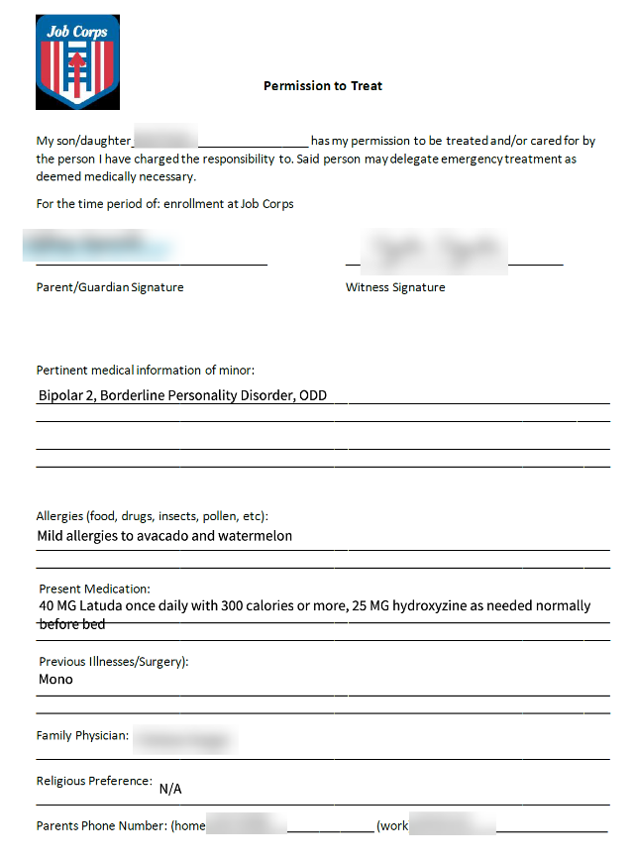
Use of Unauthorized Forms and Collection of Information
Collection of unauthorized health information and use of unauthorized forms to do so is outside the scope of Job Corps policy.
Notes:
Let’s start with a couple of What NOT to do’s!
Use of Unauthorized Forms and Collection of Information
Collection of unauthorized health information and use of unauthorized forms to do so is outside the scope of Job Corps policy. Look at the form on the right-hand side of the slide entitled, “Permission to Treat.” As we review this form, we note that it has health conditions listed, allergies, medications, and health history.
What authorized form already captures most of this type of information? The ETA 6-53, Health Questionnaire.
Issues:
It is unclear at what point in the process this information was collected which does matter and we will discuss that shortly.
The form is not an authorized form for collection of this type of information.
It is unclear WHY this form is being completed. How is this information being used and why is it necessary?
The form is asking and collecting health and potential disability-related information that may or may not have been captured on the ETA 6-53.
It is unclear if the applicant has been informed that the information solicited is voluntary.

Slide 12
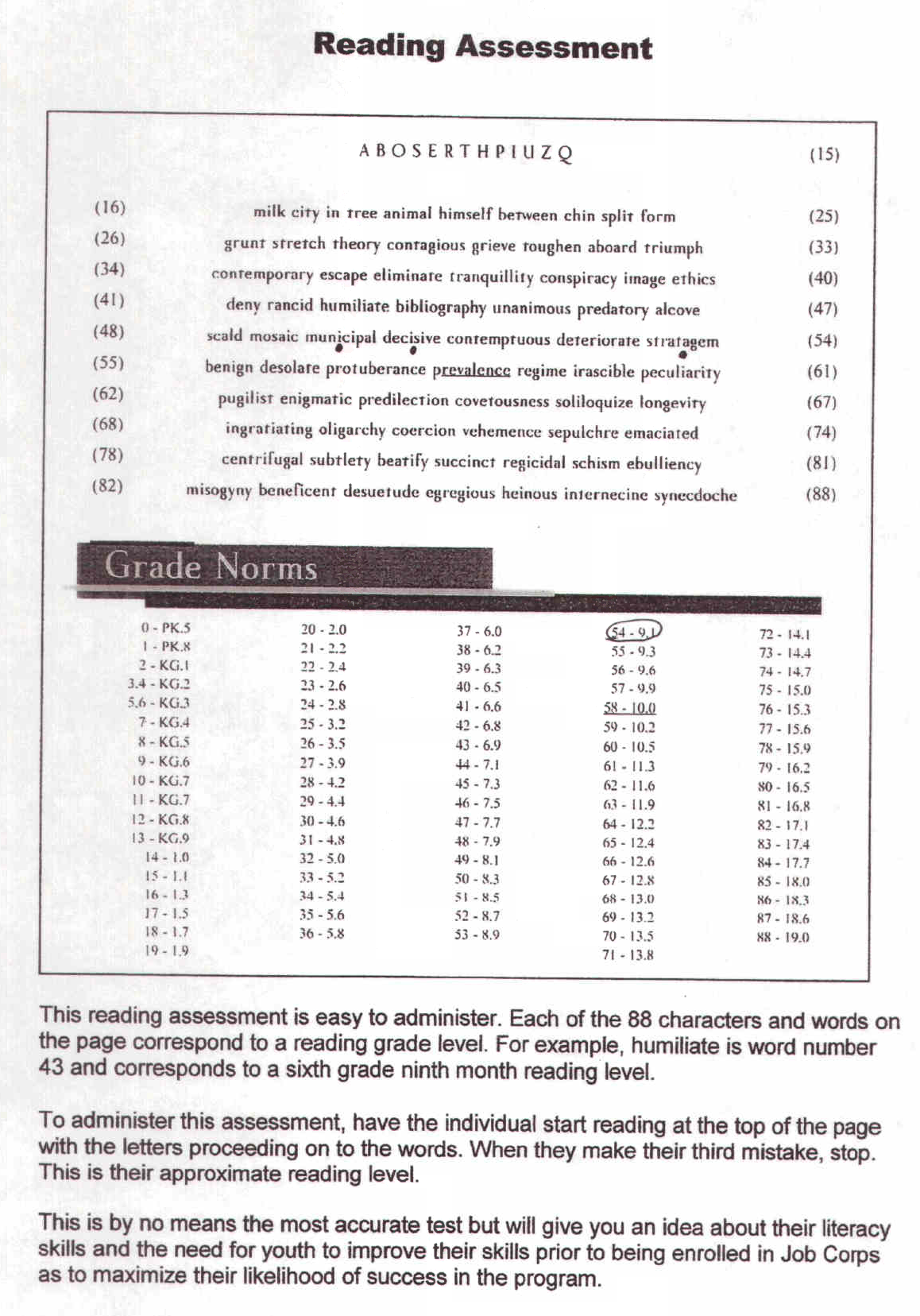
Applying Additional Criteria Outside of Policy
Additional eligibility criteria may not be applied to applicants outside the scope of PRH policy.
Reading screeners, for example
Notes:
Applying Additional Criteria Outside of Policy
Additional eligibility criteria may not be applied to applicants outside the scope of PRH policy. Reading screeners are one example of a tool that places additional admissions criteria upon the applicants subjected to its completion. The screen shot to the right of the slide is one example of a reading screener uses to assess reading abilities of applicants.

Slide 13
Possible Disclosure
PRH 1: 1.2, R3(a,b)
Before beginning the eligibility requirements process, Admissions Services must explain to every applicant, and their parent, guardian if a minor, or other representative, that two of the eligibility requirements questions (those related to age and low-income status) may result in answers disclosing that the applicant has a disability.
Asking About Disability
Notes:
Asking About Disability
Possible Disclosure
PRH 1: 1.2, R3(a,b)
Before beginning the eligibility requirements process, Admissions Services must explain to every applicant, and their parent, guardian if a minor, or other representative, that two of the eligibility requirements questions (those related to age and low-income status) may result in answers disclosing that the applicant has a disability.

Slide 14
Conditionally Enrolled
At Two Points…
At two points in the process of determining eligibility; however, Admissions Services may invite an applicant to disclose whether they have a disability:
If the applicant is or will be older than 24 years old on the date of enrollment, the maximum age limit may be waived if the applicant is a person with a disability.
If the applicant would not meet the low-income requirement unless the applicant is considered a “family of one” because of a disability.
In general, Admissions Services may not ask whether an applicant is an individual with a disability or about the nature and severity of a disability prior to conditional enrollment in Job Corps except at two points in the process.
Notes:
Conditionally Enrolled
In general, Admissions Services may not ask whether an applicant is an individual with a disability or about the nature and severity of a disability prior to conditional enrollment in Job Corps except at two points in the process. (An applicant is conditionally enrolled in Job Corps when Admissions Services determines that the applicant has met the eligibility requirements of Exhibit 1-1).
At two points in the process of determining eligibility; however, Admissions Services may invite an applicant to disclose whether they have a disability:
If the applicant is or will be older than 24 years old on the date of enrollment, the maximum age limit may be waived if the applicant is a person with a disability.
If the applicant would not meet the low-income requirement unless the applicant is considered a “family of one” because of a disability.

Slide 15
Response Options to Disability Status-related Questions
The Admissions Services staff should explain to the applicant that when they are asked whether they fall into the category of an individual with a disability, the applicant should select only one of three possible answers:
Yes
No
Do not wish to answer
Notes:
Response Options to Disability Status-related Questions
The applicant has options when responding to disability status-related questions. The Admissions Counselor should explain to the applicant that when they are asked whether they fall into the category of “an individual with a disability,” the applicant should select only one of three possible answers:
Yes
No
Do not wish to answer
If the applicant’s response is “yes,” the Admission Counselor must not use this information to determine the applicant’s admissibility under any factors other than age or low-income status.

Slide 16
Providing disability-related information is voluntary.
The information will be kept confidential as required by law.
Declining to disclose whether they have a disability will not cause the applicant to receive unfavorable treatment (except that if the applicant decides not to disclose, there is a possibility that they will not be found to meet the age requirements and/or qualify as low income).
The information will be used only in accordance with the law.
Four
Principles
The Admissions Services staff must also explain the four principles that apply to all medical and disability-related questions in Job Corps. See Section 1.2, R3.b.
Notes:
Four Principles
The Admissions Services staff must also explain the four principles that apply to all medical and disability-related questions in Job Corps. See Section 1.2, R3.b.
Providing disability-related information is voluntary – in other words, the applicant is not required to disclose whether they have a disability.
The information will be kept confidential as required by law.
Declining to disclose whether they have a disability will not cause the applicant to receive unfavorable treatment (except that if the applicant decides not to disclose, there is a possibility that they will not be found to meet the age requirements and/or qualify as low income).
The information will be used only in accordance with the law.

Slide 17
If the response is “yes,” the center determines if the disability status is valid.
Admissions Services staff must presume the applicant is eligible and proceed to completing the remainder of the eligibility review.
No other information regarding the disability may be requested or collected until the applicant is notified that they have been determined to be eligible.
Notes:
If the response is “yes,” I am a person with a disability, the center determines if the disability status is valid. First admissions staff must presume that the applicant is eligible and proceed to completing the remainder of the eligibility review.
Important!!! NO other information regarding the disability may be requested or collected until the applicant is notified that they have been determined to be eligible.

Slide 18
Recap of Steps When Asking About Disability
01
02
03
04
05
Explain to EVERY applicant that two of the eligibility requirements questions (those related to age and low-income status) may result in answers disclosing that the applicant has a disability.
Admissions Services may invite an applicant to disclose whether they have a disability if the applicant:
is or will be older than 24 years old on the date of enrollment or
would not meet the low-income requirement unless the applicant is considered a “family of one” because of a disability.
Explain the four principles that apply to all medical and disability-related questions in Job Corps.
Explain to the applicant that they have the option to respond in 1 of 3 ways:
Yes, No, or Do Not Wish to Answer.
If yes to disability for age or income eligibility, presume the applicant is eligible.
No other information related to the disability can be collected until the individual is conditionally enrolled.
Note:
Notes:
Recap of Steps When Asking About Disability
Step 1: Explain to EVERY applicant that two of the eligibility requirements questions (those related to age and low-income status) may result in answers disclosing that the applicant has a disability.
Step 2: Admissions Services may invite an applicant to disclose whether they have a disability if the applicant is or will be older than 24 years old on the date of enrollment or if the applicant would not meet the low-income requirement unless the applicant is considered a “family of one” because of a disability.
Step 3: Explain the four principles that apply to all medical and disability-related questions in Job Corps.
Step 4: Explain to the applicant that they have the option to respond in 1 of 3 ways: Yes, No, or Do Not Wish to Answer.
Step 5: If yes to disability for age or income eligibility, presume the applicant is eligible.
Note: No other information related to the disability can be collected until the individual is conditional enrolled.

Slide 19
Disability Accommodations within the Admissions Process
Forms 1-05 and 2-03
Notes:
Disability Accommodations within the Admissions Process – Forms 1-05 and 2-03

Slide 20
Terminology Change with PRH Change 22-02:
Changed RA to RA/RM/AAS: Reasonable Accommodation is no longer a stand-alone term.
When considering accommodation needs, the program must consider reasonable accommodation, reasonable modification in policies, practices or procedures, and auxiliary aids and services (RA/RM/AAS).
RA to RA/RM/AAS
“Disability Accommodations” (DA) in Short
20
Notes:
Terminology Change with PRH Change 22-02
PRH Change 22-02 was released in November of 2022 and included a change in terminology for how we reference reasonable accommodation. Reasonable Accommodation is no longer a stand-alone term because the term reasonable accommodation does not cover all the areas Job Corps is required to consider when meeting an applicant or student’s accommodation needs. There are actually 3 areas –
reasonable accommodation,
reasonable modification in policies, practices or procedures, and
auxiliary aids and services.
When considering accommodation needs, the program must consider reasonable accommodation, reasonable modification in policies, practices or procedures, and auxiliary aids and services (RA/RM/AAS). We can use an umbrella term such as “disability accommodations” in short.

Slide 21
Applicants with Disabilities Who Request Disability Accommodations
An applicant may request disability accommodations at any time during the Admissions Process or while enrolled in the Job Corps program. A request may be communicated in any form (i.e., verbally, in writing, etc.).
Disability Accommodations Request - Admissions
Notes:
Applicants with Disabilities Who Request Disability Accommodations
An applicant may request disability accommodations at any time during the Admissions Process or while enrolled in the Job Corps program. A request may be communicated in any form (i.e., verbally, in writing, etc.); however, it must be documented on the request form found in Form 1-05 and we will review that form on the next slide.
This request is different from establishing effective communication as we discussed at the beginning of this presentation.

Slide 22
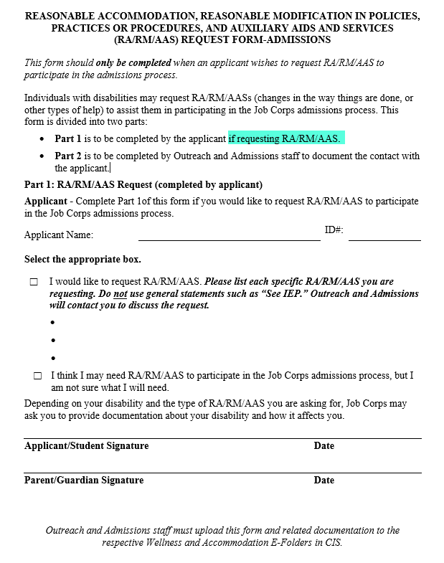
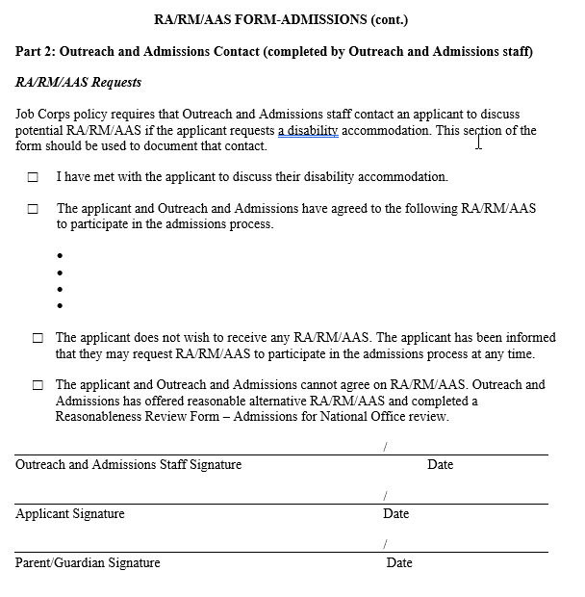
Form 1-05
An applicant not completing this form does NOT relieve Job Corps of its obligation to provide disability accommodations if the individual is a person with a disability.
Notes:
Form 1-05
If an applicant wants to request RA/RM/AAS, as we stated at the previous slide, the request may be communicated in any form but the request must be documented on Form 1-05 and Admissions Services may assist with the completion of the request form, as necessary. An applicant’s failure to complete the form does NOT relieve Job Corps of its obligation to provide disability accommodations if the individual is a person with a disability.
This form must NOT be given to every applicant. It is to be completed when an applicant is requesting disability accommodations and to document Admissions Services staff contact with the applicant to discuss the requested accommodations. This form is only for individuals who are requesting accommodations to participate in the ADMISSIONS process, not for participation at the center.
What are some types of disability accommodations that an individual might request to participate in the admissions process?
Sign language interpreter
Text to speech or admissions documents read aloud
Scribe to document information on the required forms
Accessible location or to meet virtually instead
Upload completed Form 1-05 to Disability E-Folder.

Slide 23
Requesting Accommodations in the Admissions Process
Must address the applicant’s DA needs immediately.
Must not begin, or continue with, any part of the admissions process for which the applicant has requested DA until the DA has been provided.
Must not ask for any disability-related information except at the times, and under the circumstances, that are described elsewhere in Chapter 1.
Must not take the applicant’s disability into consideration in determining whether they meet the eligibility requirements or other factors for enrollment in Job Corps, except as described in Chapter 1, Section 1.2, R3.b.
Must document the request for DA in accordance with Job Corps DA guidelines as described in Form 1-05.
Notes:
Requesting Accommodations in the Admissions Process
IF an applicant requests accommodations to participate in the admissions process, Admissions Services staff:
Must address the applicant’s DA needs immediately.
Must not begin, or continue with, any part of the admissions process for which the applicant has requested DA until the DA has been provided.
Must not ask for any disability-related information except at the times, and under the circumstances, that are described elsewhere in Chapter 1.
Must not take the applicant’s disability into consideration in determining whether they meet the eligibility requirements or other factors for enrollment in Job Corps, except as described in Chapter 1, Section 1.2, R3.b.
Must document the request for DA in accordance with Job Corps DA guidelines as described in Form 1-05.

Slide 24
Form 2-03
Applicants may request disability accommodations to participate in the Job Corps program.
The request may be communicated in any format (i.e., orally, in writing, etc.).
The request must be documented on Form 2-03.
Disability Accommodations Request for Participation in the Program
Notes:
Disability Accommodation Request for Participation in the Program - Form 2-03
Applicants may request disability accommodations to participate in the Job Corps program.
The request may be communicated in any format (i.e., orally, in writing, etc.).
The request must be documented on Form 2-03 just as it was required to be documented on Form 1-05 for participation in the admissions process.

Slide 25
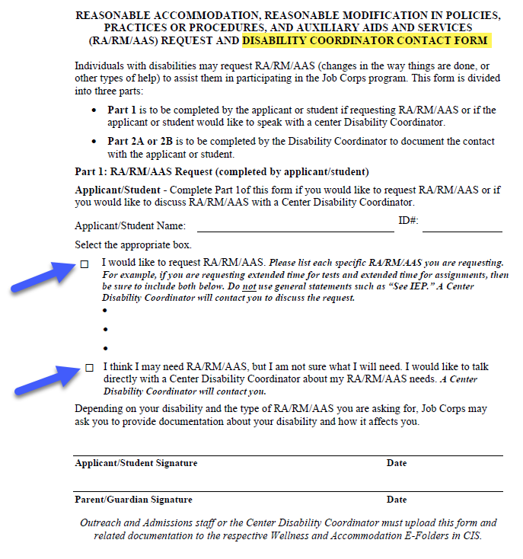
Form 2-03
Do not ask every applicant to complete Form 2-03.
Do ask and/or assist those who request disability accommodations or who indicate they may need accommodations to participate in the Job Corps program to complete the request form.
Do not use other forms, memos, etc. to document disability accommodation requests.
Do not use this form, other forms, memos, etc. to document declines of accommodation.
Notes:
Within Form 2-03 is the RA/RM/AAS Request and Disability Coordinator Contact Form where an applicant’s request for accommodation to participate in the Job Corps program is documented. The same as with Form 1-05, do not ask every applicant to complete this request form.
Do ask and/or assist those who request disability accommodations or who indicate they may need accommodations to participate in the Job Corps program to complete the request form.
Do not use other forms, memos, etc. to document disability accommodation requests.
Do not use this form, other forms, memos, etc. to document declines of accommodation. There should never be a need for you to have document a decline of accommodations for center participation. Does anyone know why? Because you won’t be asking them if they want accommodations to participate at the center level and if the applicant does not request accommodations, there is no need to be using this form at all. The center Disability Coordinators will engage applicants who disclose documentation of disability.

Slide 26
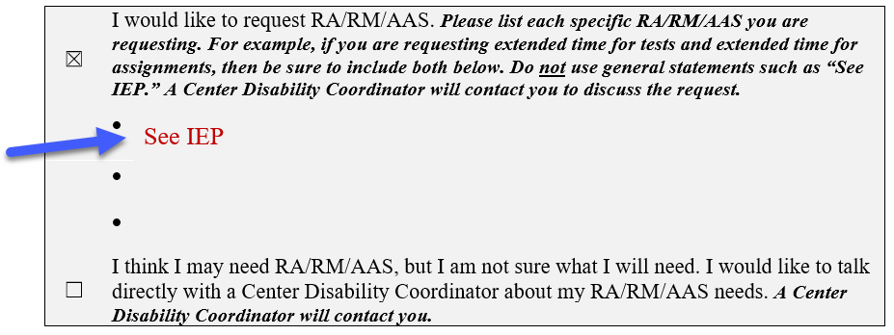
General Do’s and Don’ts for Completing for Documenting DA Requests on Forms 1-05 and 2-03
Do not write “see IEP.”
If unsure of accommodations needed, do have them check the box, “I think I may need…”
Notes:
General Do’s and Don’ts for Completing for Documenting DA Requests on Forms 1-05 and 2-03
Do not write, see “IEP” when the individual provides an IEP as their documentation of disability. Instead, ask the applicant what accommodations from their IEP that they would like to request and have considered. To the extent possible, do all that you can to have the applicant document concrete and specific accommodations. If they do not know what accommodations they need, then just have them check the box that says, “I may need…” and the center disability coordinator can work with them further to flesh out their accommodation needs based upon current functional limitations.
Simply writing “see IEP” is not clear.

Slide 27
Collection of Health and Disability Documentation
Notes:
Collection of Health and Disability Documentation

Slide 28
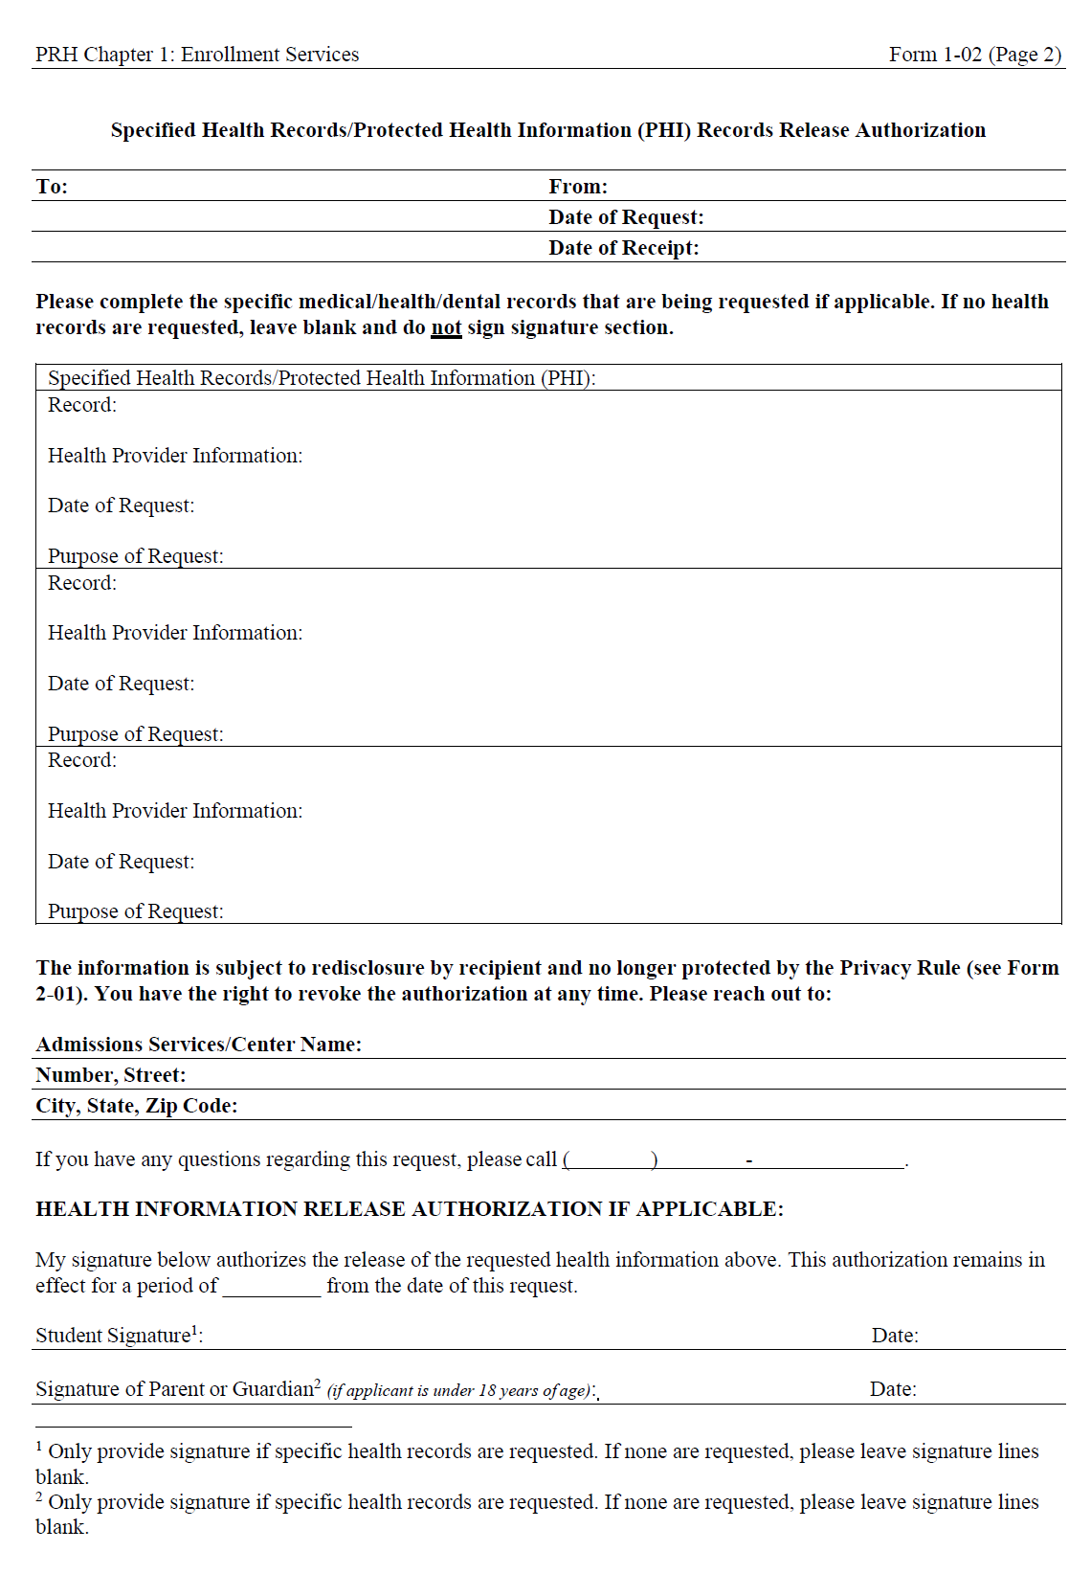
Form 1-02
Specified Health Records/Protected Health Information (PHI) Records Release Authorization ( Page 2)
Notes:
Let’s start by discussing one of the Records Release Authorization Forms, specifically page 2 of the Specified Health Records/Protected Health Information (PHI) Records Release Authorization Form. On the right-hand slide of the slide, there is a screenshot of page 2 of this form.

Slide 29
Form 1-02, Page 2
To be compliant with the Health Insurance Portability and Accountability Act (HIPAA), a release of medical information from Admission Services staff must:
Never have applicants and/or guardians sign or place their Adobe signature(s) on blanket releases for health records.
Always get permission from applicants and/or guardians to place their Adobe signature(s) on the release form for EACH request.
Only provide signature(s) if specific health records are requested. If none are requested, please leave signature lines blank.
Read and follow the HIPAA instructions on page 4 of Form 1-02.
Note: There may be times when a provider, facility, or hospital requires an applicant to use their specific records of release authorizations form. If so, secure that form and use to request health information.
Notes:
Form 1-02, Page 2
To be compliant with the Health Insurance Portability and Accountability Act (HIPAA), a release of medical information from Admission Services staff must:
Never have applicants and/or guardians sign or place their Adobe signature(s) on blanket releases for health records.
Always get permission from applicants and/or guardians to place their Adobe signature(s) on the release form for EACH request.
Only provide signature(s) if specific health records are requested. If none are requested, please leave signature lines blank.
Read and follow the HIPAA instructions on page 4 of Form 1-02.
Note: There may be times when a provider, facility, or hospital requires an applicant to use their specific records of release authorizations form. If so, secure that form and use to request health information.

Slide 30
ETA 6-53 Health Questionnaire
Who Collects?
Health/ Disability
When to Collect?
Who Reviews?
Resources
Notes:
ETA 6-53 Health Questionnaire
We are going to review When to Collect related documentation for disclosed conditions and events, who collects the information, who reviews the collected information and then share a related resource with you.

Slide 31
When to Collect?
The ETA 6-53 is completed after a conditional offer of enrollment has been made.
Any needed disability documentation for disability accommodation requests are also secured after the conditional offer of enrollment has been made.
Notes:
When to Collect
The ETA 6-53 is completed after a conditional offer of enrollment has been made. Any needed disability documentation for disability accommodation requests are also secured after the conditional offer of enrollment has been made.
Let’s review that again because this is legally significant! The ETA 6-53, Health Questionnaire is not provided to applicants or completed until there is a conditional offer of enrollment. This also means that health and/or disability documentation is not secured until AFTER the conditional offer of enrollment as well.

Slide 32
Who Collects?
If an affirmative (yes) response is made on the ETA 6-53, Health Questionnaire, Admission Services staff should make a dedicated effort to secure related health information and upload it to CIS.
It is a best practice for Admission Services to provide centers with a memo or some documentation that an effort was made to gather health documents. Especially when there are multiple health items checked on the ETA 6-53 and no health records uploaded in CIS.
Notes:
Who Collects?
If an affirmative (yes) response is made on the ETA 6-53, Health Questionnaire, Admission Services staff should make a dedicated effort to secure related health information and upload it to CIS.
It is a best practice for Admission Services to provide centers with a memo or some documentation that an effort was made to gather health documents. Especially when there are multiple health items checked on the ETA 6-53 and no health records uploaded in CIS.

Slide 33
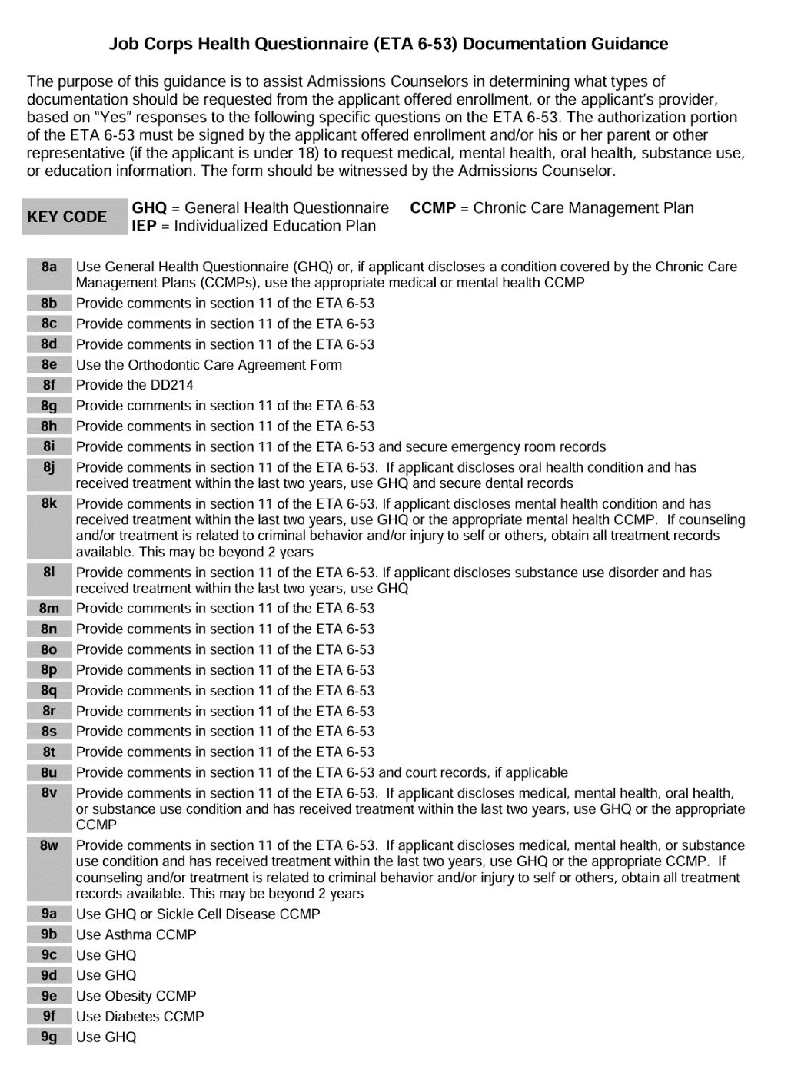
What to Collect?
Job Corps Health Questionnaire, ETA 6-53 Documentation Guidance was released via Information Notice 17-04 (c). Job Corps Health Questionnaire (ETA 6-53) Documentation Guidance.
Information Notice 17-04 Attachment C - Job Corps Health Questionnaire (ETA 6-53) Documentation Guidance (1).pdf(Review) - Adobe cloud storage
Notes:
What to Collect?
Job Corps Health Questionnaire, ETA 6-53 Documentation Guidance was released via Information Notice 17-04 (c). Job Corps Health Questionnaire (ETA 6-53) Documentation Guidance. There is a screenshot of the first page of the ETA 6-53 Documentation Guidance document on the right hand of the slide. For any item marked as an affirmative on the 6-53, look at that item on the guidance document to determine what corresponding documentation should be requested.

Slide 34
Who Reviews?
Admissions Services staff do not/must not review the content of health and/or disability documentation and may only collect it.
The center Health and Wellness Director, Qualified Health Professionals and Disability Coordinators, as appropriate, review health and/or disability documentation.
Notes:
Who Reviews
Admissions Services staff do not/must not review the content of health and/or disability documentation and may only collect it.
The center Health and Wellness Director, Qualified Health Professionals and Disability Coordinators, as appropriate, review health and/or disability documentation.

Slide 35
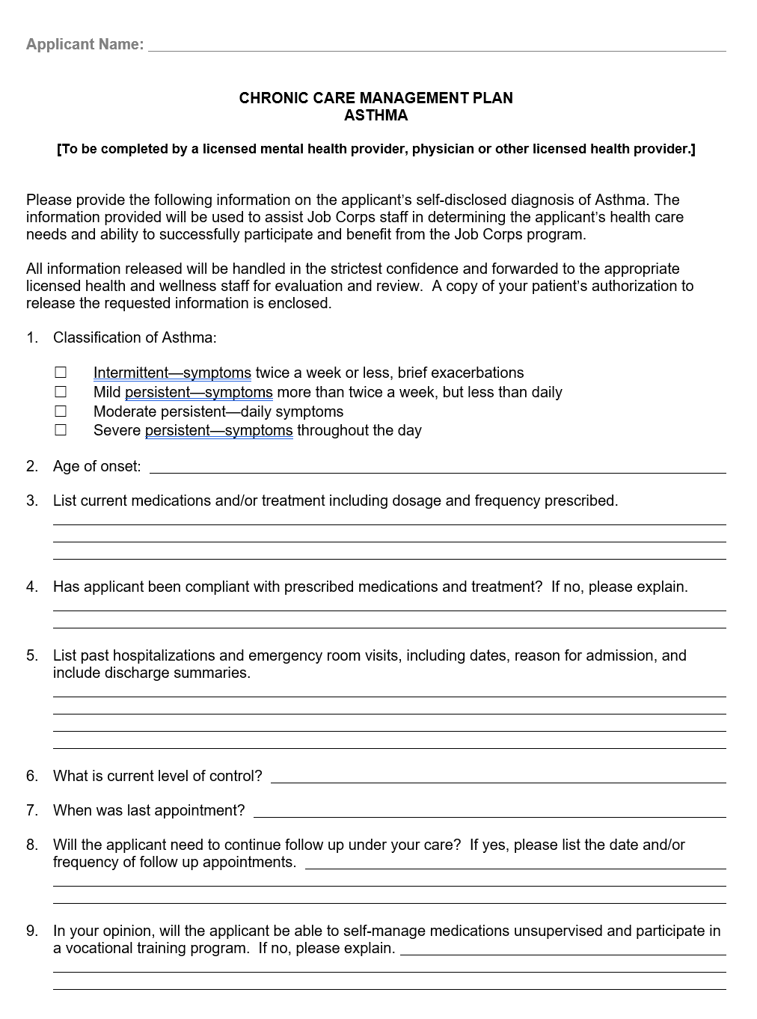
CCMPs
Chronic Care Management Plans and Health Records
Notes:
CCMPs or Chronic Care Management Plans and Health Records

Slide 36
CCMPs
CCMPs are the disease/disorder-specific questionnaires in OASIS that Admission Services staff forward to the applicant’s physician or treating provider to answer questions related to medical, substance use, and mental-health services provided.
The most recent Medical and Mental Health CCMP Provider Health Questionnaires are dated February 2021.
These should be completed by licensed health providers.
Remember that securing a CCMP does not take the place of gathering other health records and vice versa. It is helpful to have BOTH CCMPs and other health records when available.
Notes:
CCMPs
CCMPs are the disease/disorder-specific questionnaires in OASIS that Admission Services staff forward to the applicant’s physician or treating provider to answer questions related to medical, substance use, and mental-health services provided.
The most recent Medical and Mental Health CCMP Provider Health Questionnaires are dated February 2021.
These should be completed by licensed health providers.
Remember that securing a CCMP does not take the place of gathering other health records and vice versa. It is helpful to have BOTH CCMPs and other health records when available.

Slide 37
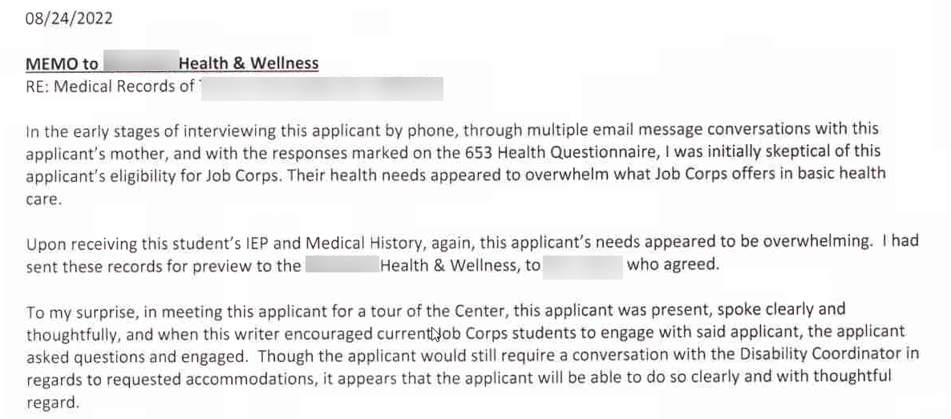
What Do You Think? Memo from Admissions Services staff to the Center HWD
Notes:
What Do You Think?
This is a memo that was sent from Admissions Services staff to the Center HWD about an applicant file. In this memo, the Admissions Service staff documents their skepticism of the applicant’s eligibility for Job Corps after conversations and reviewing the ETA 6-53, Health Questionnaire. They reference possible health care needs that exceed basic health care. They reviewed the student’s IEP and medical history but then when they met the applicant for a tour of the center, they were surprised to see how well they spoke and other positive attributes of the applicant.
Do you see any issues or problems with this memo and if so, what are they?

Slide 38
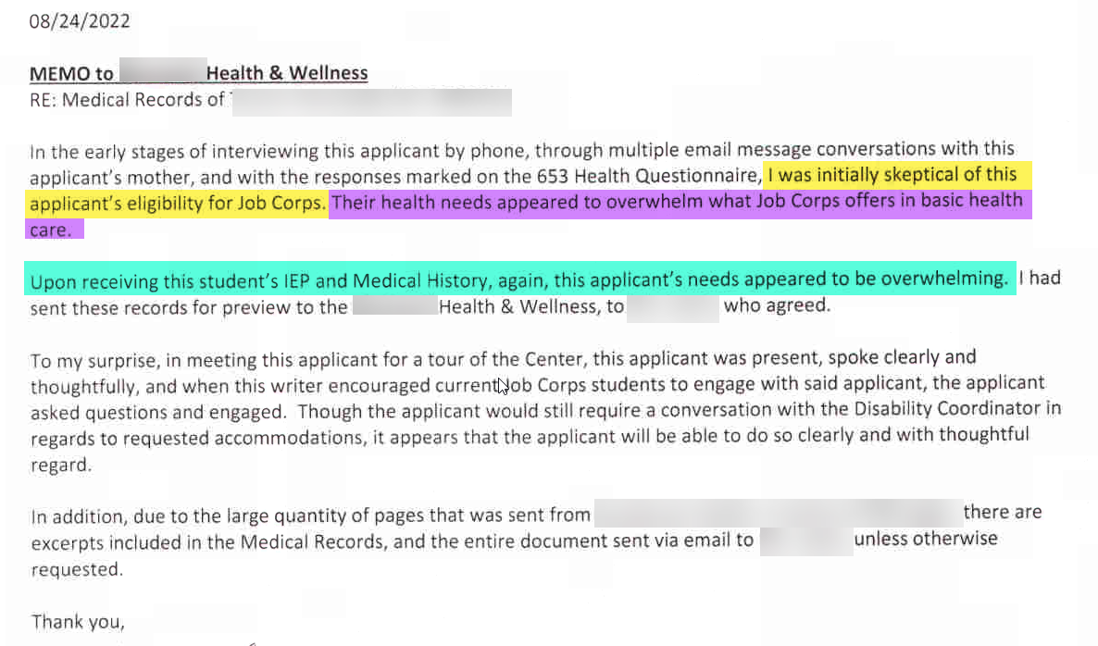
What Do You Think? (Example #1) Memo from Admissions Services staff to the Center HWD
Notes:
What Do You Think? Example #1
Memo from Admissions Services staff to the Center HWD
First, look at the yellow highlighted information. “I was initially skeptical of this applicant’s eligibility for Job Corps.” Then in purple, they state that their “health care needs appeared to overwhelm what Job Corps offered in basic health care.” Finally, in teal, they state, “upon receiving this student’s IEP and Medical History, again, this applicant’s needs appeared to be overwhelming.”
Issues:
Combining eligibility with health related needs
Reviewed protected health and disability information
Formulated an opinion based upon the review of the protected health and disability information.
Eligibility is not tied to health care needs. Health care needs are ONLY determined by qualified health professionals (e.g., licensed center clinical staff).

Slide 39
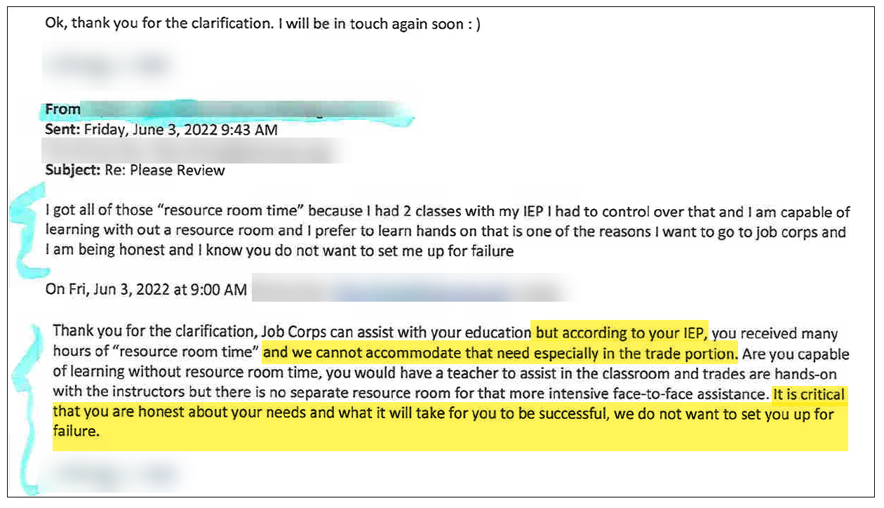
What Do You Think? (Example #2) Email Exchange with an Applicant with a Disability
Concerns:
Evidence of reviewing protected health and disability information.
Alluding to the use of a resource room as a possible "eligibility" barrier to enrollment so adding criteria outside the scope of JC policy.
Notes:
What Do You Think? Example #2
Read the Admissions Services staff email dated 6/3/22 at 9:00 a.m. (para 2).
Do you have any concerns about this email exchange?

Slide 40
Center File Review Considerations/ Admissions Services Collaboration
Notes:
Center File Review Considerations/Admissions Services Collaboration
In this section, we are going to discuss some of the center applicant file review process components that overlap with admissions services responsibilities and what issues might arise during these collaborations.

Slide 41
Movement of Applicant Files
Admissions Services Requesting Files in Center File Review to be Returned
What are some acceptable reasons (i.e., within the scope of Job Corps policy) that Admissions Services may request an applicant file to be returned when the file is in center file review?
Withdrawals of application
Requesting reassignment of application due to trade interest, etc.
41
Notes:
Movement of Applicant Files
Admissions Services Requesting Files in Center File Review to be Returned
What are some acceptable reasons (i.e., within the scope of Job Corps policy) that Admissions Services may request an applicant file to be returned when the file is in center file review? There are not a lot of reasons that files may be returned to Admissions Services during center applicant file review and the most common one is
Withdrawals of application
Another one we see with less frequency but still often is admissions services staff requesting files to be returned because the applicant has changed their mind about the trade they wish to pursue or some other reason they wish to be considered for a different center.
Requesting reassignment of application due to trade interest, etc.

Slide 42
What Do You Think?
Admissions Services Receiving Files from Centers Outside the Scope of Policy
For medical documentation?*
No
*Additional medical records may be requested, if warranted, without the application being returned.
For court related events/actions?
No
For being in the hospital or residential settings?
Only if unable to contact the applicant.
42
Notes:
What Do You Think?
Admissions Services Receiving Files from Centers Outside the Scope of Policy
I am going to show you a reason that the center electronically returned a file to Admissions Services. Tell me if you think the reason is an acceptable one as per Job Corps policy.
For medical documentation?*
*Additional medical records may be requested, if warranted, without the application being returned.
For court related events/actions?
No
For being in the hospital or residential settings?
Only if unable to contact the applicant.

Slide 43
What Do You Think? (cont.)
Admissions Services Receiving Files from Centers Outside the Scope of Policy
For incomplete applications (i.e., center is unable to reach the applicant to complete clinical interview or disability accommodation process)?
Yes
For lack of documentation to substantiate disability status?
No
43
Notes:
What Do You Think?
Admissions Services Receiving Files from Centers Outside the Scope of Policy
Continuing from the previous slide, tell me if you think the reason is an acceptable one as per Job Corps policy.
For incomplete applications (i.e., center is unable to reach the applicant to complete clinical interview or disability accommodation process)?
Yes
For lack of documentation to substantiate disability status?
No

Slide 44
Files in Regional Review
Centers may not return files to Admissions Services if the file is currently in Regional Review status.
Admissions Services staff may not remove files from Regional Review status in Pending OASIS Arrivals under any circumstances!
Why would this be problematic?
Once a file is in Regional Review, ONLY the Regional Office may take that file out of Regional Review status.
Applicants being recommended for denial potentially have health care needs that exceed those of basic health care or may pose a direct threat to others. Removing these files from Regional Review status and reassigning them to another center creates serious safety concerns and increases the risk of legal complaints and actions.
Notes:
Files in Regional Review
Centers may not return files to Admissions Services if the file is currently in Regional Review status.
Admissions Services staff may not remove files from Regional Review status in Pending OASIS Arrivals under any circumstances!
Why would this be problematic?
Once a file is in Regional Review, ONLY the Regional Office may take that file out of Regional Review status.
Applicants being recommended for denial potentially have health care needs that exceed those of basic health care or may pose a direct threat to others. Removing these files from Regional Review status and reassigning them to another center creates serious safety concerns and increases the risk of legal complaints and actions.

Slide 45
Question! Future discussion…
When files are in “Pending Center Review” or “Regional Review” and 120 days has passed, the file “drops out” of OASIS.
Is there any process or procedure to ensure that the file is reinstated in the status it was previously in when it dropped out of OASIS.
Are there plans for notifications to be made to the center, Humanitas (if in Regional Review), etc. to ensure that these applications are processed to a final determination?
Note some applicants have been approved for enrollment and are waiting for an assignment date when this occurs.

Slide 46
Reapplications of Applicants Previously Denied Admission
For Health Care Needs or Direct Threat
Notes:
Reapplications of Applicants Previously Denied Admission for Health Care Needs or Direct Threat

Slide 47
New/Updated Information
AS staff ask for new or updated health documentation.
Remember, collect but do not review.
Reapplication Requirements and Considerations
AS Does Not Receive Documentation
If you do not receive new or updated health documentation, the file review process continues, and the center will discuss the need for the new and updated information with the applicant and give them an opportunity to secure.
Center Does Not Receive Documentation
If the new or updated health documentation is not forthcoming, the file will be electronically returned to Admissions as an incomplete application.
Notes:
Reapplication Requirements and Considerations
New/Updated Information
AS staff ask for new or updated health documentation.
Remember, collect but do not review.
AS Does Not Receive Documentation
If you do not receive new or updated health documentation, the file review process continues, and the center will discuss the need for the new and updated information with the applicant and give them an opportunity to secure.
Center Does Not Receive Documentation
If the new or updated health documentation is not forthcoming, the file will be electronically returned to Admissions as an incomplete application.

Slide 48
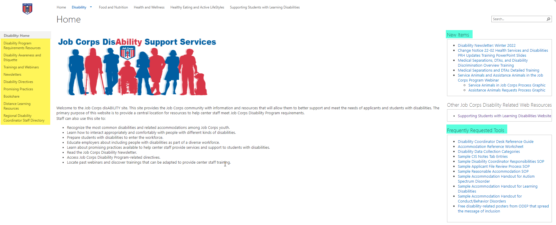
Job Corps Disability Support Services Website https://supportservices.jobcorps.gov/disability/Pages/default.aspx
Notes:
Job Corps Disability Website
The Job Corps Disability Support Services website contains numerous resources and tools on applicant file review and disability accommodation requirements, processes and procedures.
As new resources and tools are developed, they are listed under the New Items heading to the right side of the website page. See teal highlighted area. Resources that are more commonly used and/or requested are listed under the Frequently Requested Tools section also highlighted in teal.
The categories of resources are listed on the left-hand side of the website and are highlighted in yellow.
The Job Corps Disability website link is located at the top of the slide.

Slide 49
Regional Disability Coordinators
Boston
Kristen Philbrook
Philbrook.Kristen@jobcorps.org
Philadelphia
Angela Jenkins
Jenkins.AngelaK@jobcorps.org
Atlanta and San Francisco
Stephanie Karras
Karras.Stephanie@jobcorps.org
Dallas
Alyssa Purificacion Olivas
Purificacion.Alyssa@jobcorps.org
Chicago
Sharon Hong
Hong.Sharon@jobcorps.org
49

Slide 50
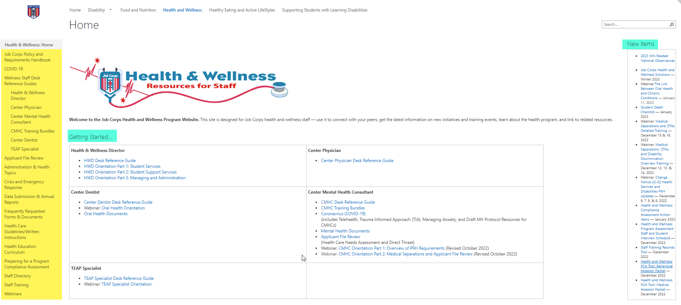
Job Corps Health and Wellness Website https://supportservices.jobcorps.gov/health/Pages/default.aspx
Notes:
Job Corps Health and Wellness Website
In addition to the Job Corps Disability website, the Job Corps Health and Wellness website provides numerous tools and resources to support center staff with health and wellness-related topics such as AFR, H&W-related policy/requirements health care guidelines and more!
Please visit the Job Corps Health and Wellness website often. As new tools are developed to assist with understanding and implementing PRH requirements, they are located under the New Items section on the right side of the Home Page.
Your Regional Mental Health Specialists and Regional Disability Coordinators are here to help you navigate the PRH requirements – reach out as needed.

Slide 51
Applicant File Review(AFR) Webinars
Applicant File Review – Disability Coordinator Orientation Series
Part 1a – AFR Policy
Part 1b – AFR Process

Slide 52
Questions?
52
Notes:
Questions?

