Slide 1
Ask JAN! We can help.
A Trusted Partner in the Accommodation Process
AskJAN.org
JAN is a service of the U.S. Department of Labor’s Office of Disability Employment Policy/ODEP.
Notes:
“Ask JAN! We can help.”
As the leading source of expert and trusted guidance on workplace accommodations and the Americans with Disabilities Act (ADA), the Job Accommodation Network (JAN) has the knowledge, resources, and tools to help employers recognize the valuable contributions that qualified workers with disabilities add to the workforce. Job accommodations are typically low in cost, positively impact the workplace in many ways, and play a vital role in creating inclusive workplaces. This presentation will introduce attendees to JAN services and resources and explain how JAN can be a partner in exploring accommodation solutions. Ask JAN! We can help.

Slide 2

About the Job Accommodation Network
JAN was established in 1983
National, free consulting service
Expert, trusted, confidential
guidance on job accommodations and disability employment issues
A service of the U.S. Department
of Labor’s Office of Disability Employment Policy (ODEP)

Slide 3
JAN is a Trusted Partner in the Accommodation Process
JAN consulting staff are highly qualified, experienced, and serve as a member of
a specialty team:
  ADA
  Cognitive/Neurological
  Motor
  Sensory
  Self-Employment
Practical guidance and technical assistance for employers, people with disabilities, and others on:
  Accommodation process strategies
  Job accommodation solutions
  Title I of the ADA & related legislation
  Self-employment & entrepreneurship options for people with disabilities

Slide 4

Services for Employers &
Professionals Assisting Employers (e.g., HR, Legal, Rehabilitation, etc.)
What does JAN do for employers?
Provides employers of all types and sizes free and confidential one-on-one consultation on workplace accommodations, accommodation process strategies, and Title I of the ADA and related legislation
JAN does not provide legal advice or legal advocacy and does not have authority to enforce the law
AskJAN.org for Employers

Slide 5

Services for Individuals with Disabilities &
Their Family Members & Advocates
What does JAN do for individuals?
Provides practical information about requesting and negotiating accommodations, accommodation solutions, and basic information about the employment provisions of the ADA
JAN does not provide legal advice or
legal advocacy and does not have authority to enforce the law
AskJAN.org for Individuals

Slide 6
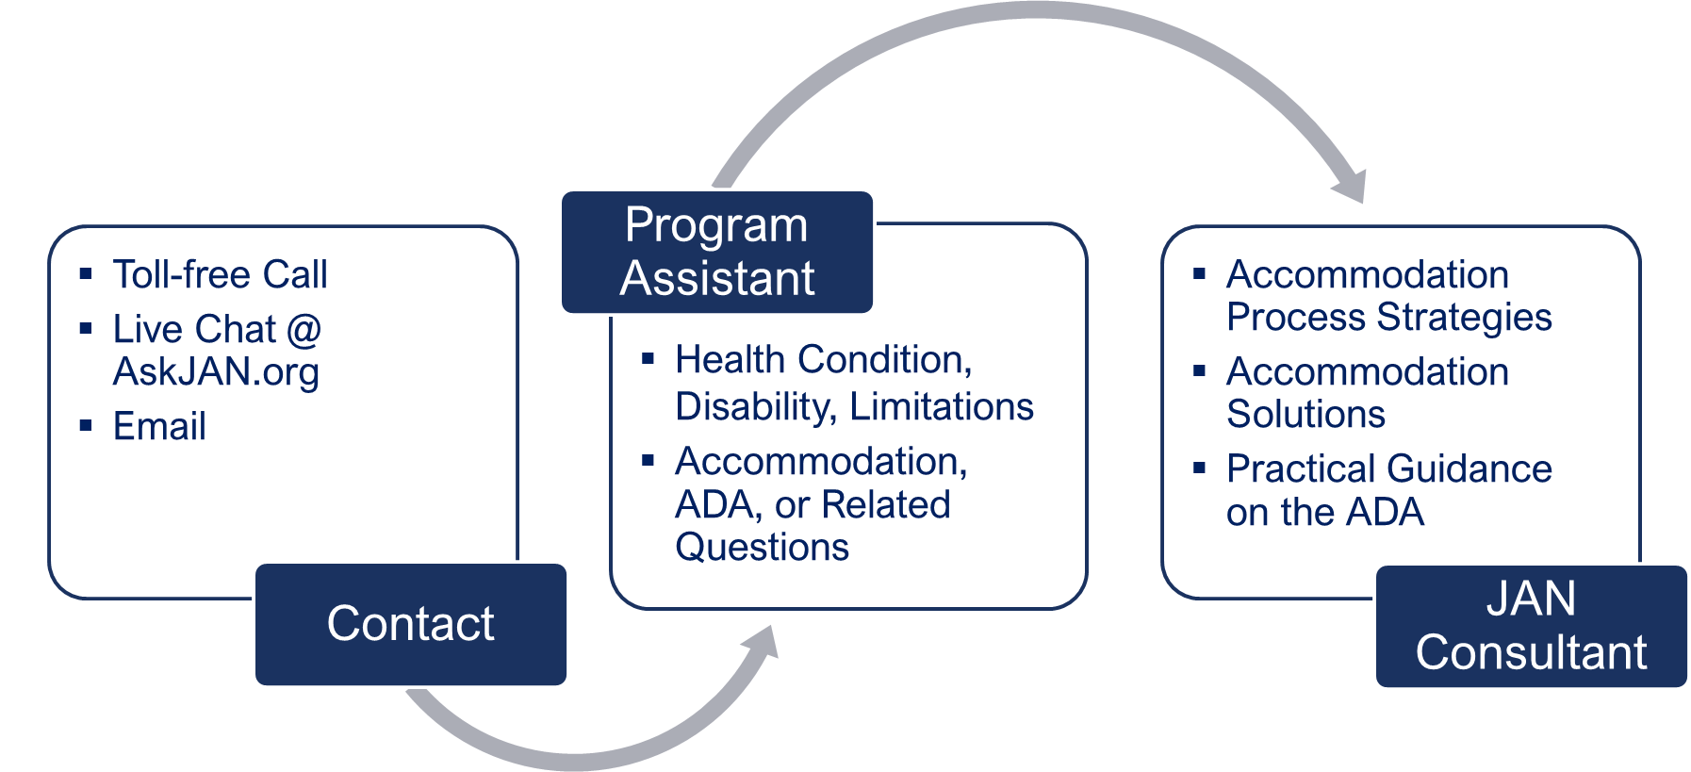
When You Contact JAN…

Slide 7

AskJAN.org—
By Audience, A to Z, ADA Library, Publications, Training

Slide 8

JAN Updates—
Featured Resources/Events @ AskJAN.org

Slide 9

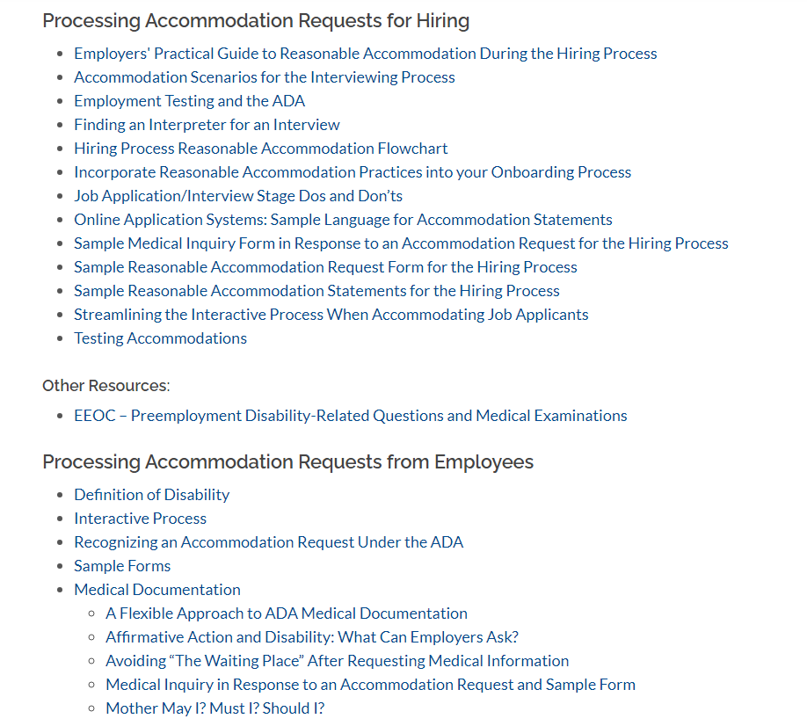
Information By Role: Employers
Five Practical Tips for Providing and Maintaining Effective Job Accommodations
Sample Forms
Employers' Practical Guide to Reasonable Accommodation During the Hiring Process
Why Communication Is Key to the Accommodation Process
Avoiding “The Waiting Place” After Requesting Medical Information
9

Slide 10

Workplace Accommodation Toolkit
Comprehensive online resource for employers seeking to move beyond basic ADA compliance.
Resources:
Accommodation Process
Best Practices
Training Videos
Sample Forms and Policies

Slide 11

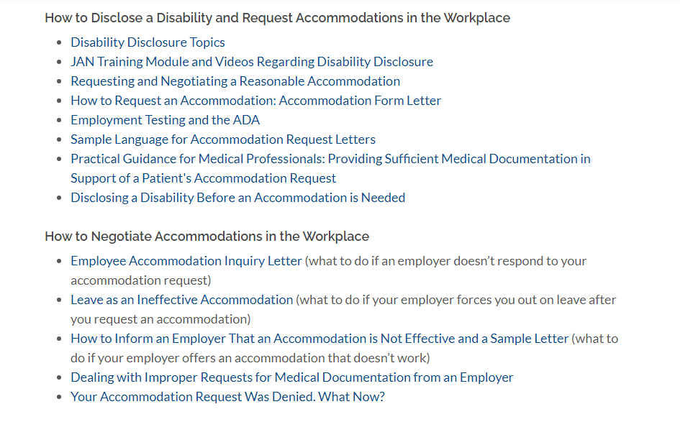
Information By Role: Individuals
Employee’s Practical Guide to Requesting and Negotiating Reasonable Accommodation Under the ADA
FAQ: Basic ADA and Accommodation Process Questions
Sample Language for Accommodation Request Letters
Practical Guidance for Medical Professionals: Providing Sufficient Medical Documentation in Support of a Patient’s Accommodation Request

Slide 12


A to Z of Disabilities & Accommodations
Click on the tabs to browse the index!
By Disability
By Limitation
By Work-Related Function
By Topic
By Accommodation

Slide 13


A to Z of Disabilities & Accommodations (2)
Click on the tabs to browse the index!
By Disability
By Limitation
By Work-Related Function
By Topic
By Accommodation

Slide 14
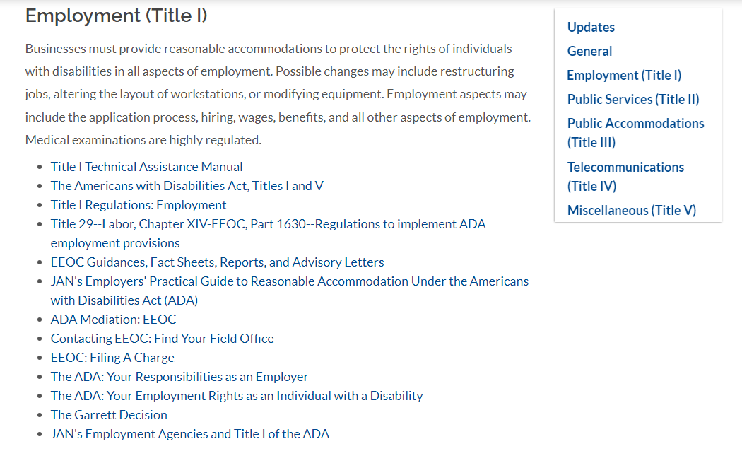
ADA Library
Primary topics:
ADA Amendments Act (ADAAA)
General ADA topics
Employment (Title I)
Title I Regulations
Equal Employment Opportunity Commission (EEOC) Guidance Documents, Fact Sheets, Reports, and Advisory Letters

Slide 15

MyJAN—A Personalized AskJAN.org Experience
Allows users to organize any JAN webpage available at AskJAN.org by category—
Accommodation, Legal, and Other
Offers easy access to most frequently
used JAN resources
Receive notice of newly released JAN resources
Choose and save JAN resources by color-coded category and order of importance to the user

Slide 16
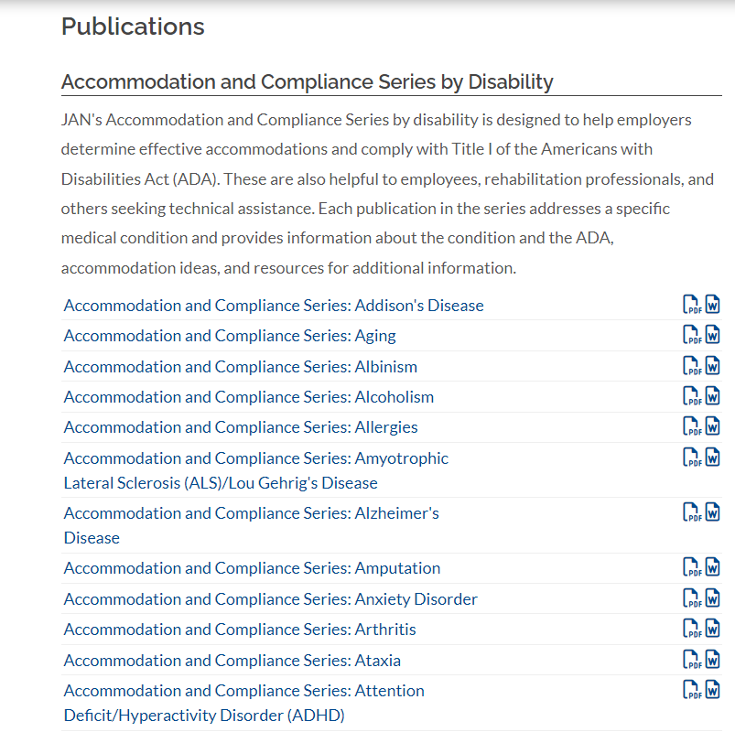
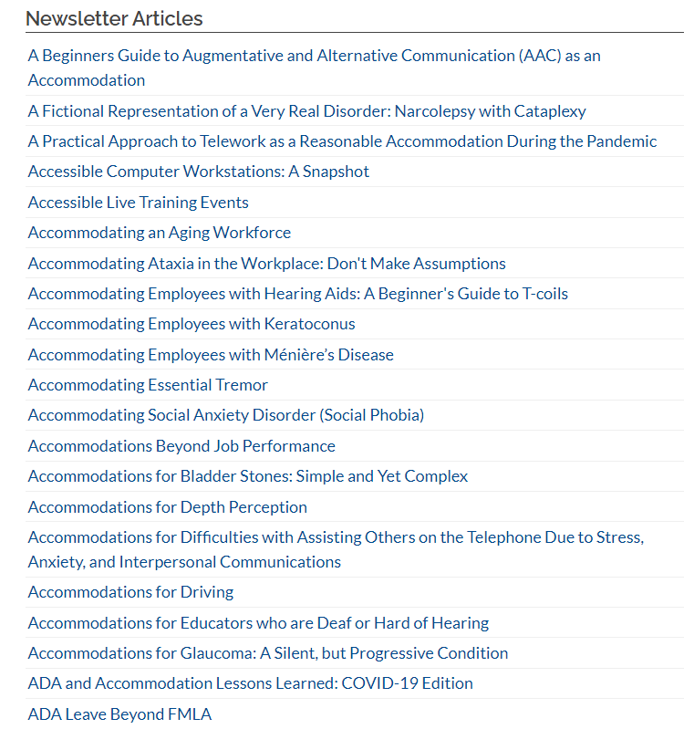
Publications and Articles
Accommodation and
Compliance Series
Consultants’ Corner
Case Studies
Newsletter Articles
Effective Accommodation
Practices Series

Slide 17

Training Solutions
JAN Webcast Series
Webcast Series Library
JAN eLearning
and Training Resources
Video Training Resources
Solution Showcase Videos

Slide 18



Accommodation Situations

Slide 19

Accommodations: Low Cost │ High Impact
Workplace Accommodations:
Low Cost, High Impact
Benefits of Accommodation
  Retained a valued employee
  Improved productivity
  Eliminated cost of training a new employee
  Improved attendance
  Improved diversity of the company
Cost of Accommodation
  Most employers report no or low cost
  Median one-time expenditure: $300

Slide 20
Common Accommodations
Making existing facilities accessible and useable
Job restructuring
Flexible or modified work schedules
Modifying policies
Acquiring or modifying equipment
Telework
Providing a qualified reader, interpreter, job coach
Access for service or emotional support animal
Reassignment to a vacant position
Leave

Slide 21

Telework Example
A business consultant with Long COVID and anxiety was concerned about contracting COVID again and having an exacerbation of their symptoms. Because their job duties involved face-to-face contact with clients, the employer allowed part-time telework and implemented safety protocols to limit the employee’s risk of exposure to COVID when working directly with clients onsite.
AskJAN.org A to Z: Anxiety
AskJAN.org A to Z: Long COVID
Accommodation Strategies for Returning
to the Workplace

Slide 22

Flexible Work Arrangement Example
A case manager with ADHD had difficulty completing documentation. They worked in a cubicle in a noisy, open area that affected the employee’s ability to focus and concentrate. Private workspace was not available. A modified work schedule was approved to enable the employee to work two hours earlier in the day, when fewer staff were in the office and the employee had the best mental acuity.
AskJAN.org A to Z: ADHD
AskJAN.org A to Z: Neurodiversity
Accommodation Solutions for Individuals with Executive Functioning Deficits

Slide 23

Job Restructuring Example
A nurse for a rehabilitation hospital was experiencing a pregnancy-related medical condition that caused limitations in lifting, pushing, and pulling. She was restricted from lifting more than 20 pounds. The job was restructured temporarily to assign the employee to care for patients who did not require transferring assistance and she was allowed to request assistance moving heavier items.
AskJAN.org A to Z: Pregnancy
Preparing for Pregnant Workers Fairness Act (PWFA) Accommodation Requests

Slide 24
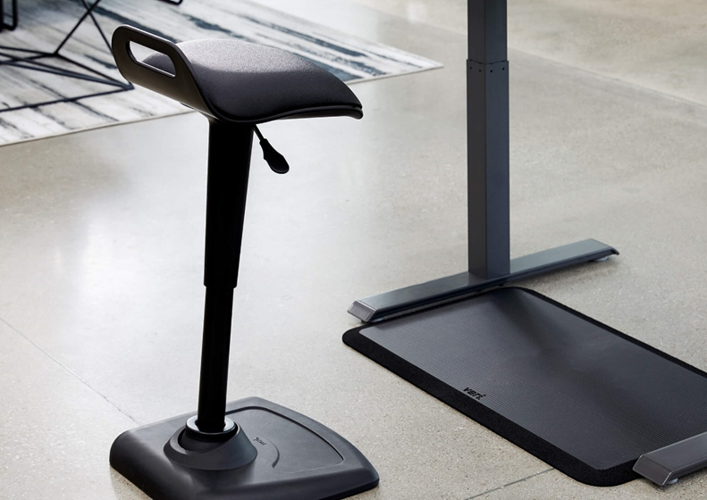
Equipment Example
An assembly line worker with chronic pain was having difficulty standing for long periods. He was accommodated with a stand-lean stool and anti-fatigue matting. Other possible solutions included job restructuring, reassignment to a sitting position, and a modified schedule/breaks during flare-ups.
AskJAN.org A to Z: Chronic Pain
Stand-Lean Stools
AskJAN.org A to Z: Job Restructuring

Slide 25

Reassignment Example
A customer service representative with COPD experienced respiratory issues, including frequent coughing. They had difficulty talking on the phone for long periods of time. As an accommodation, they were reassigned to a customer service position where they performed job duties using online chat instead of the phone.
AskJAN.org A to Z: Respiratory Distress
AskJAN.org A to Z: Reassignment

Slide 26





Ask JAN!
We can help.
AskJAN.org
800.526.7234
Live Chat @ AskJAN.org
Email JAN@AskJAN.org

Slide 27




Social Media
Job Accommodation Network
Job Accommodation Network
JANatJAN
JANinformation

Slide 28

Questions?

