Slide 1
Autism: Acceptance, Advocacy, and Support
Haley Moss, Esq.

Slide 2
A Note on Accessibility
This session strives to be as inclusive as possible!
No one person can grant or gatekeep access. Access is something we create together.
If you need to take a break, answer phone calls, stand up, twiddle your fingers, stim, or feel overwhelmed – this is a no judgment zone! Go for it!
Copies of these slides to follow along have alt text on images and should also be accessible for screen readers. ☺

Slide 3
What is Autism?
Autism is a complex neurological condition and developmental disability characterized by a spectrum of differences in social communication and interaction, heightened sensory processing and experiences, intense passions or interests, and repetitive behaviors
The CDC estimates 1 in 54 children are autistic.
Autistic adults make up about 2.2% of the population (about 5.4 million Americans).

Slide 4
Breaking Stereotypes
Science, Technology, Engineering, Math (STEM) genius stereotypes
Assumptions that all of us must be computer geniuses
Disabled people do not have to work in the field of disability
The calls and emails I get show this stereotype in full effect
(I am not a special education or disability rights attorney!)

Slide 5
What is Neurodiversity?
Neurodiversity is a concept where neurological differences are to be recognized and respected as any other human variation. Labels that fall under neurodiversity include autism, ADHD, dyslexia and other learning disabilities, Tourette Syndrome, and intellectual disabilities.

Slide 6
Benefits of Neurodiversity at Work
Neurodiverse teams at SAP created a fix that saved the company nearly $40 million
28% higher revenues than companies that do not employ people with disabilities (Accenture, 2019),
Favorable public opinion of a business
We benefit from working with all kinds of minds

Slide 7
Employment Disparity
Despite the benefits of neurodiversity at work…
Traditional hiring practices are biased against autistic candidates
Neurotypical people misinterpret autistic communication
Body language, eye contact
Gaps in employment
Disclosure and discrimination
Fear of the unknown

Slide 8
Disclosure on the Job
When is the right time to disclose autism or neurodivergence?
It depends on the person!
The cover letter
The interview
When the student has an offer
When the student needs an accommodation
Under the ADA, the general rule is individuals don’t have to disclose until an accommodation is needed.

Slide 9
Disclosure: How Can We Prepare Our Students?
Promote self-advocacy by discussing and providing self-advocacy and disclosure resources!
http://www.ncwd-youth.info/wp-content/uploads/2016/10/411_Disability_Disclosure_complete.pdf
Information about ODEP can be found at http://www.dol.gov/odep/
Notes:
We can prepare our students by promoting self-advocacy and by discussing and providing self-advocacy and disclosure resources such as “The 411 on Disability Disclosure” available through ODEP (Office of Disability Employment Policy).

Slide 10
Job Corps and Disclosure of Disabilit(ies)
PRH Requirement: During the Career Transition Readiness (CTR) phase of the Job Corps program, all students will receive information about workers’ rights and responsibilities including reasonable accommodations in the workplace [2.4, R3(c); 3.4, R23(k)]
ALL students should receive information about workers’ rights and responsibilities
Students should receive information about how and when to disclose a disability
Students should receive information on workplace accommodation resources
Job Corps Career Transition Resources and Readiness (CTR) Guide = https://supportservices.jobcorps.gov/disability/Pages/Transition%20Resources.aspx
Notes:
It is Job Corps policy (a PRH requirement) that during the Career Transition Readiness phase of the Job Corps program, all students will receive information about workers’ rights and responsibilities including reasonable accommodations in the workplace. The Job Corps policy references are on this slide. The requirements include:
ALL students should receive information about workers’ rights and responsibilities;
Students should receive information about how and when to disclose a disability;
Students should receive information on workplace accommodation resources
Note: Job Corps Transition Resources and the Career Transition Readiness Guide are available on the Job Corps Disability Website (see link on this slide)

Slide 11
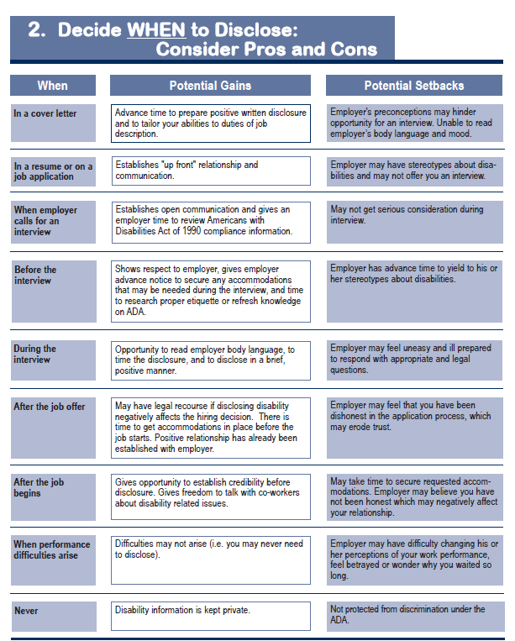
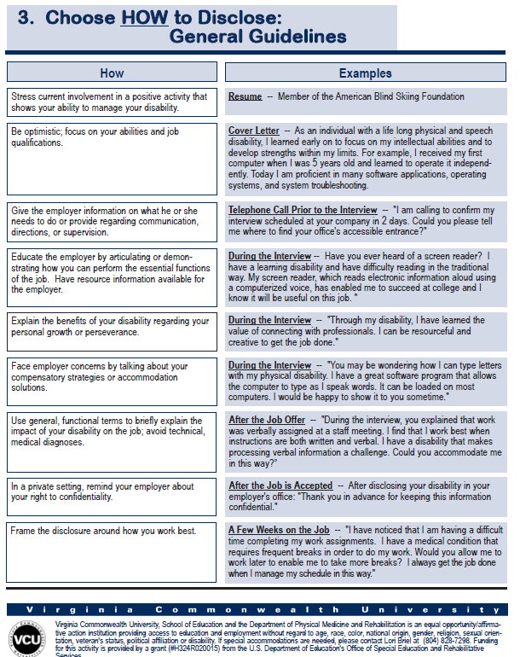
Disclosure Decisions to Get the Job Virginia Commonwealth University
http://www.worksupport.com/documents/disclosure_decisions.pdf
Notes:
Some of those resources could include examples such as these on “disclosure decisions to get the job.”

Slide 12
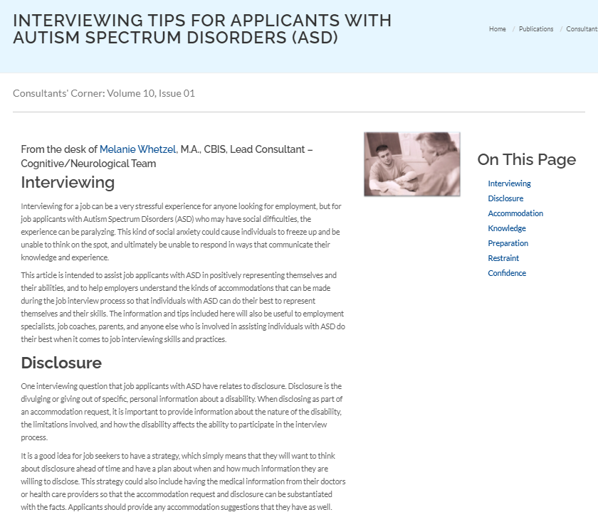
Do’s and Don’ts of Disclosure Job Accommodation Network
http://askjan.org
Notes:
These resources (Dos and Don’ts of Disclosure and Interviewing Tips for Applicants with Autism Spectrum) from Job Accommodation Network (JAN) can also be used to prepare students with disabilities for interviewing and possible disclosure.

Slide 13
Preparing Students with Autism for Job Interviews
Interviewers have a very specific set of things they look for and judge candidates on.
Autistic behaviors can be misinterpreted as not trustworthy or distracting
Open-ended questions are difficult to gauge
Skills-based interviews vs. question-based interviews

Slide 14
Preparing Students with Autism for Job Interviews
Job Accommodation Network Accommodation Ideas:
Requesting fewer interviewers
Requesting that the first interview be conducted by phone
Requesting a copy of the interview questions to be provided in advance
Requesting that the interview occur at a specific time of day can also be an accommodation.
https://askjan.org/publications/consultants-corner/vol10iss01.cfm?csSearch=2890279_1#spy-scroll-heading-1
Notes:
When preparing students with autism for job interviews, JAN offers these ideas:
Requesting fewer interviewers
Requesting that the first interview be conducted by phone
Requesting a copy of the interview questions to be provided in advance
Requesting that the interview occur at a specific time of day
Questions that applicants with ASD hear for the first time may produce anxiety that could limit their ability to think on the spot, and ultimately limit their ability to respond in a way commensurate with their knowledge and experience and providing interview questions in advance of an interview should not be a problem unless the applicants’ ability to think on their feet is a job qualification the employer is assessing.
If the disability involves limitations in concentration, focus, or energy and fatigue, the time of day the individuals are at their best may vary.

Slide 15
Unpacking “Openly Autistic”
“To me, being 'openly autistic’ means not having to hide or mask my autism; it is the freedom to be exactly who I am.”
Source: Haley Moss, I’m Florida’s First Openly Autistic Attorney: Here’s What That Means (HuffPost)

Slide 16
Accessibility and Accommodations
Employers think a lot of accommodations would cause undue hardship
Accommodations generally cost $500 or less (Job Accommodation Network)
What do accommodations look like for autistic people?
How to go about getting accommodations

Slide 17
The Workplace Shift Towards Self-Advocacy

Slide 18
What is Self-Advocacy?
Self-advocacy is both a set of skills and a movement
Self-advocacy skills empower people with disabilities to make choices that affect their daily lives and allow for greater independence
“Self-advocacy – as a personal and political philosophy – is a movement primarily of and by [people with disabilities] who are making their own decisions, speaking for themselves and for others with disabilities, and taking control over their lives.

Slide 19
I’m Not a Self-Advocate. What Can I Do?
Teachers, professionals, and employers can also encourage self-advocacy in respective settings
Can be as simple as a someone saying, “I don’t feel comfortable” and respecting boundaries
At work, it can be learning someone’s needs: “I need to take a break.”
In school, can apply to all students
“I Wish My Teacher Knew…” hashtag and conversation

Slide 20
Disclosing and Requesting Accommodations as Self-Advocacy
Frame accommodations as a conversation to empower both employers and employees
“I work best when…”
Deciding who needs to know
Pros and cons
Advocating for accommodation solutions and workplace policies

Slide 21
The Future of Neurodiversity at Work

Slide 22
What Does the Future Look Like?
Neurodiverse leadership
Further collaboration
Inclusive culture
Aligning people to strengths
All across the spectrum

Slide 23
Neurodiverse Leadership
Autistic people want careers, not just jobs
Provide mentorship and professional development opportunities to allow employees to grow
Should be part of executive teams and leadership
Paying it forward - what if we have neurodiverse hiring teams and interviewers?

Slide 24
A Culture of Acceptance and Inclusion
Starts from the top down with openness and vulnerability
Employee resource/interest groups
Aligning people to their strengths
Open communication
Shifting the autism training focuses from autistic employees to company-wide trainings
Best: having autistic people lead these conversations

Slide 25
Focus on the Strengths

Slide 26
Final Reflections
How can we do better, across all professions, to make sure autistic and neurodivergent people are being recruited, hired, accepted, and supported at work?
How can we make sure autistics succeeding in the workplace is a norm and not an exception?
How should we be making sure to encourage self-advocacy and teach those skills to people with disabilities?

Slide 27
Let’s Continue the Conversation
Facebook: facebook.com/haleymossart
Twitter: @haleymossart
Instagram: @haleymossart
Email: haley@haleymoss.net

