Slide 1

Supporting Students with Disabilities in the
Job Corps Program
Functional Limitations
Accommodations
Case
Management
Resources
Behavior

Slide 2
Overview
Disability and Functional Limitations and Behavioral Considerations
What is a Reasonable Accommodation?
Reasonable Accommodation vs. Case Management
RAC Process Need to Know
Resources

Slide 3
Your Role
Learn about the basic characteristics of a variety of types of disorders.
Review behavior manifestations in light of the disability and determine if adjustments in accommodations are needed.
Participate in the RAC, as appropriate.
Ensure that accommodations under your responsibility are implemented and effective.
Communicate regularly with the DC.

Slide 4
Disability and Functional Limitations, Behavioral Consideration
Definitions, Examples and More

Slide 5
Key Information for CSOs/SPOs/Residential Staff
Must understand the basics of various disorders and conditions
  Sensory Processing Disorder/Sensitivities
  Mental Health Conditions
  Spectrum Disorders
  Traumatic Brain Injuries
  And more…
  WHY?

Slide 6
Here’s Why…
Conditions and disabilities may impact the way an individual responds or is able to respond to various stimuli, frustrations, and so forth.
We want to assist the individual in being able to manage these situations successfully as this is critical to employability.
  Accommodations
  Case Management Supports
  Use of Strategies

Slide 7
What is the Definition of a Disability?
A physical or mental impairment that substantially limits one or more of the major life activities of such individual

Slide 8

Major Life Activities
Notes:
caring for oneself, performing manual tasks, seeing, hearing, eating, sleeping, walking, standing, lifting, bending, speaking, breathing, learning, reading, concentrating, thinking, communicating, and working

Slide 9
Examples of Physical and
Mental Disabilities
Orthopedic
Visual
Speech
Hearing
Intellectual disability
Specific learning disabilities
HIV
Cerebral palsy
Epilepsy
Muscular dystrophy
Multiple sclerosis
Cancer
Diabetes
Emotional illness
Drug addiction
Alcoholism

Slide 10
What is NOT Considered a Mental or Physical Impairment?
Lesbian, gay, bisexual, or transgender
Normal pregnancy
Environmental, cultural, and economic disadvantages (e.g., a prison record or a lack of education)
Limited English proficiency/English as a second language

Slide 11
Functional Limitations
Definition: The inability to perform an action or a set of actions, either physical or mental, because of physical or emotional restriction²
Time Management
Organization and Prioritization
Social Skills
Concentration
Memory
Communication
Stamina
Responding to Change
Screening Out Environmental Stimuli
Managing Stress
²Brodwin, M., Tellez, F., Brodwin, S. (1993). Medical, Psychosocial and Vocational Aspects of Disability. Athens, GA: Elliott and Fitzpatrick, Inc.

Slide 12
Remember!
Individuals with the same diagnosis may and often do have needs that are unique to them; the same disability may manifest itself in different ways in different people.
There is no list of accommodations appropriate for a particular condition. Accommodations are determined on a case-by-case basis.
  Functional limitations
  Strengths

Slide 13
Functional Limitations
Screening Out Environmental Stimuli
  An applicant with ADHD reports being easily distracted may not be able to work in a large group.
Concentration
  An applicant reports having depression and has trouble focusing on tasks for extended periods.
Stamina
  Student with a diagnosis of schizophrenia reports not having energy to do residential chores in the morning and combating drowsiness in the afternoon due to medications.

Slide 14
Functional Limitations
Change
  A student with anxiety disorder may take longer to learn new routines, or feel stressed when new students arrive in the dorm.
Managing Stress
  An applicant with a personality disorder indicates that when stressed by deadlines and workload has a hard time managing emotions and sometimes gets into verbal conflicts with peers.
Social Skills
  A student with Asperger’s does not talk much with other students during down time in the dorm and has trouble reading subtle social cues in a group setting.

Slide 15
Sensory Processing
Individuals with sensory processing disorder or sensory sensitivities may experience heightened responses to sensory stimuli
  Noise – loud noises might be painful to the individual
  Color – certain colors may make it difficult for the individual to pay attention
  Touch – may be hypersensitive to touch, particularly around head, face or during nail clipping
  Smell – may be hypersensitive to smells and may feel ill

Slide 16
Behavioral Considerations
Individuals with certain spectrum or mental health disorders can interpret rules literally and can be rigid about following them in a particular way.
  Teach the student cause/effect relationships for better understanding of center and rule requirements.
  Preferably write the rules down for them and review together.
  Provide clear concrete expectations and rules for behavior.
  Have them explain what the rules mean to them. Clarify as needed.

Slide 17
Behavioral Considerations
Avoid escalating power struggles as these individuals may not understand the situation or pick up on the anger until it is too late. They may become more rigid and stubborn if confronted in a forceful and rigid method.
  If the student is becoming more rigid, stubborn, or resistant to direction. Step back and give the individual time to cool down.
  Remain calm.

Slide 18
Behavioral Considerations
Take preventative action to avoid these situations whenever possible.
  Use humor to diffuse tension.
  Offer two choices as options (if possible).
  Redirect through diversion of attention to something else.
  Again, allow time for the individual to regroup and regain level of calmness.
Notes:
It is very easy to have a reaction to a situation then preventing it from happening in the first. That is why being flexible, trust worthy and calm can be the difference between writing a student up and deflecting an altercation. Remember everyone can have a bad day including ourselves. Its how we handle it that can become the teachable moments

Slide 19
Reasonable Accommodation
Definitions, Examples and More

Slide 20
What is Reasonable Accommodation?
Any changes to the environment or in the way things are customarily done, that gives a person with a disability an opportunity to participate in the application process, job, program or activity that is equal to the opportunity given to similarly situated people without disabilities.

Slide 21

Examples of Reasonable Accommodations
A modification to:
  Job
  Work/academic environment
  Policy, program, or procedure
Examples:
  Modifying a facility
  Modifying work or training schedules
  Acquiring or modifying equipment or devices
  Adjusting or modifying examinations, training materials, or policies
  Providing communication access

Slide 22

Accommodations:
Screening Out Environmental Stimuli
Help arrange the student's environment
  Redesign space
  Minimize auditory/visual distractions
  Reduce clutter

Slide 23

Accommodations:
Maintaining Concentration
Help arrange the student’s schedule
  Prioritize tasks/activities/assignments
    By day, week, month, etc.
  Identify student’s patterns in activity
    Example: “you do this 3 times each week”
  Emphasize due dates on calendars
  Develop a color-coded system (each color represents a task, or event, or level of importance)
  Ensure accuracy of entries on calendar or I-Phone

Slide 24
Accommodations –
Maintaining Stamina
Arrange for longer/more frequent breaks between activities
Help student pace their workload and social activities
Develop substitution strategies (for times when a student cannot keep their obligation to the event or activity)

Slide 25

Accommodations:
Managing Change (Transition)
Recognize that change can be difficult (physically/mentally)
Maintain special channels of communication during transition period (hotline, on-call personnel)
When appropriate, share your own experiences with transition
Re-fresh skills learned in orientation (such as directions through the building, doing laundry, etc.)
Offer peer mentorship

Slide 26

Accommodations:
Managing Stress
Reinforce time management techniques
Identify support personnel
Teach money management skills
Invite therapy animals organization onto site for visit
Notes:
As residential staff you are just as important as the instructor and supporting students manager their stress after a long day of training. Finding ways to decompress and/or get everything done in a day can be overwhelming to the best of us. But for a person that has an anxiety disorder it can be 10x’s more unaccomplishable.

Slide 27

Accommodations:
Exhibiting Appropriate Social Skills
Develop simple and appropriate code of conduct for environment:
  Acceptable verbal language or gestures
  Engaging in debate or discussion
  Acceptable student interaction
Environments might require different codes of conduct:
  Classroom/career technical
  Lunchroom
  Dorms or common areas
  Recreation
  Out in the community
Notes:
Behavior that is accepted through society may not have been taught in some of our students environments or their disability may require that we reinforce the social concepts because they do not easily manifest in their interactions with others.

Slide 28
Accommodations:
Exhibiting Appropriate Social Skills
Practice appropriate social skills
  Role play
  Video demonstration
Encourage all students to model appropriate social skills
Use a peer, tutor, and/or mentor to reinforce appropriate social skills
Reward/praise student engaging in appropriate behavior
Notes:
Some centers have cluster meetings in the dorms where role play activities could help them to handle social settings in a more traditionally appropriate way. The key here is that we don’t want to humiliate students. We want them to understand there could be a better way to handle situations than they have been.

Slide 29

Accommodations:
Exhibiting Appropriate Social Skills
Identify the “out” for those times when the student cannot demonstrate appropriate skills
  Hand gesture, word, or signal
  Where to go to regain composure
  How to return/re-engage in environment

Slide 30

Accommodations:
Communicating with Others
Adjust method of communication
  One-on-one
  Face-to-face
  In the presence of another
Teach/model appropriate communication skills
  Addressing person by name or title
  Waiting to speak (not interrupting others)
  How to enter another group’s conversation

Slide 31
Reasonable Accommodation vs. Case management

Slide 32
Health Case Management (CM)
Definition of case management:
“a collaborative process of assessment, planning, facilitation and advocacy for options and services to meet an individual’s health needs through communication and available resources to promote quality cost-effective outcomes.”
Case Management Society of America

Slide 33


Case Management Examples
A student who is diabetic is monitored for medication compliance, glucose levels, and knowledge of condition in the wellness center
A student with a depressive disorder is monitored for changes in behavior. If a concern, an appointment with the CMHC may occur.

Slide 34
Relationship Between CM & RA
Reasonable
Accommodation Plan
Health
Case Management Plan
Student must have a disability
Should be individualized and should not contain medical information
Used to inform staff of the specific accommodations the student must be provided
Accommodations afford access and are not intended to treat a condition
Includes information regarding the student’s condition and the condition will be managed

Slide 35
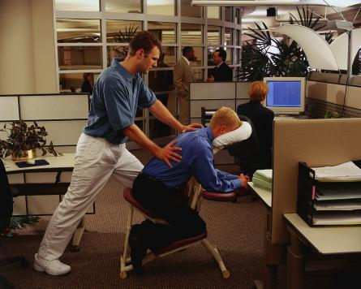

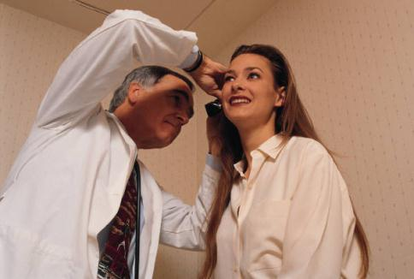
Reasonable Accommodation is NOT
Therapy
Medication
Treatment

Slide 36
Example: Asthma
Health Case Management
Reasonable Accommodation
Offer medical identification bracelet
Provide self-management education
Discuss trade selection
Discuss life style changes, smoking cessation
Educate student and staff about condition
May or may not include reasonable accommodations
Schedule adjustments for off center appointments
Use of additional safety equipment in certain conditions

Slide 37
Example: Diabetes
Health Case Management
Reasonable Accommodation
Monitor glucose testing
Annual vision exam
Dental exam
Offer medical identification bracelet
Regular follow up
Schedule adjustments to leave class to obtain snack or check levels
Refrigerator in dorm room for medications
Food or drink in areas otherwise prohibited but which do not pose a safety hazard

Slide 38
Example: Schizophrenia
Health Case Management
Reasonable Accommodation
Offer medical identification bracelet
Provide self-management education
Discuss trade selection
Discuss life style changes, smoking cessation
Educate student and staff about condition
Allow flexible training schedule–breaks when needed
Provide a quiet place to complete assignments/tests
Locate a quiet place in the dorm when student is stressed
Single room or fewer roommates when available

Slide 39
How will information be shared?
Health Case Management
Reasonable Accommodation
Shared individually with staff who have need to know by clinician, usually HWM
  Ex. watch for medication side effects, changes in behavior
  Ex. Information about a medical condition and/or manifestations
Shared via CIS accommodation plan icon, all staff who work with students have a need to know this information
  Ex. ensure student can read all dorm instructions
  Ex. Student may take a short break

Slide 40
Accommodations or Case Management Supports/Strategies?
Provide a place for down time and/or time to be alone each day.
Provide a peer buddy for support.
Educate other students about Asperger’s Syndrome.
Conduct role playing to teach the use of pragmatic language and social cues (i.e., when is it ok to interrupt, taking turns speaking).

Slide 41
Accommodations or Case Management Supports/Strategies?
Break down directions into simple steps.
Attend therapy session.
Provide visual or electronic organizers for daily routine. Review each day’s activities and if using a visual organizer, have student highlight any changes in routine.
Take medication as prescribed.

Slide 42
CM or RA Review?
Medication Management
Schedule Adjustments
Medication Compliance
Therapy or Counseling Sessions
Distraction Free Space
Large Print
Mental Health Stability

Slide 43
RAC Process Need to Know
CSO/SPO and Residential

Slide 44
Reasonable Accommodation Committee (RAC)
The RAC consists of center staff and community-based service providers. Participants will vary depending on the nature of the request, but may include:
  DCs
  Applicant/student (required)
  CMHC
  Career technical staff
  Career counselor/other CDSS staff

Slide 45
Who Else Can Participate
  CSO
  Safety officer
  Community-based service providers (e.g., VR counselor, high school/ charter representatives, etc.)
  Facilities manager
  Food services manager
  TEAP specialist
  Center director
  Residential manager
  Others as deemed appropriate and necessary

Slide 46
RAC’s Role in Developing Accommodation Plans
Review & discuss needed accommodations
  For an enrolled applicant
  For a student
Interview the applicant /student– interaction is required
Review previous documentation (e.g. IEPs, 504 plans, psychological & other evaluations)
Develop the accommodation plan

Slide 47
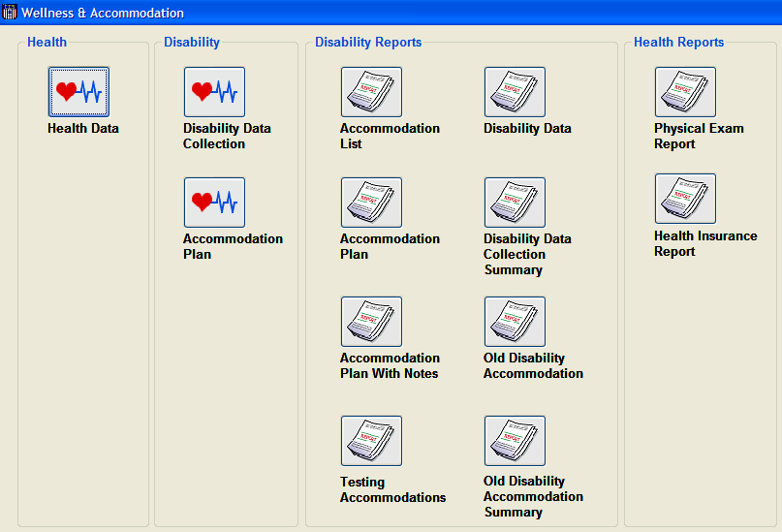

Where can I find the Accommodation Plans?
CIS
.

Slide 48
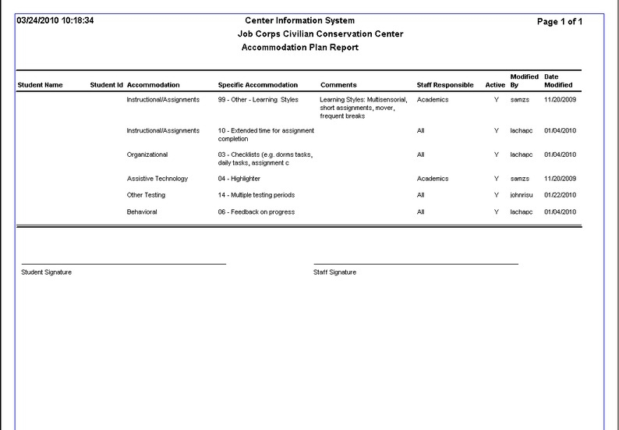

Slide 49

Notification
A weekly email notification should be sent to center staff informing them of students with new or updated accommodation plans that are available in CIS.
This weekly email should only be sent out to center staff who would be involved in the provision of accommodations to students.
  Create an accommodation plan notification distribution list. Avoid using the center’s “All staff” e-mail account as it may include non center staff or those that do not need this information.
  May also send notification to managers who can inform their staff

Slide 50

Determining Accommodation Effectiveness
Monitor accommodation plan
  All staff who interact with student have a responsibility
Review and modify plan
  As needed, but at least every 60 days as part of student performance panel
Counselor should:
  Check with student about effectiveness of plan at each meeting
  Gather information from appropriate staff about the effectiveness of accommodation prior to panel
  Forward information to DCs to update plan or resolve issues

Slide 51
Referral to the DC or Mental Health
If you suspect a student has a disability
Use the referral form
  Document what you noticed
    Lack of focus
    Cant read instructions
    Spaces out at odd times
    Is constantly depressed or emotional
Expect Feedback

Slide 52
Remember Your Role
Again, learn about the basic characteristics of a variety of types of disorders.
Review behavior manifestations in light of the disability and determine if adjustments in accommodations are needed.
Participate in the RAC, as appropriate.
Ensure that accommodations under your responsibility are implemented and effective.
Communicate regularly with the DC.

Slide 53
Resources
Websites & More

Slide 54
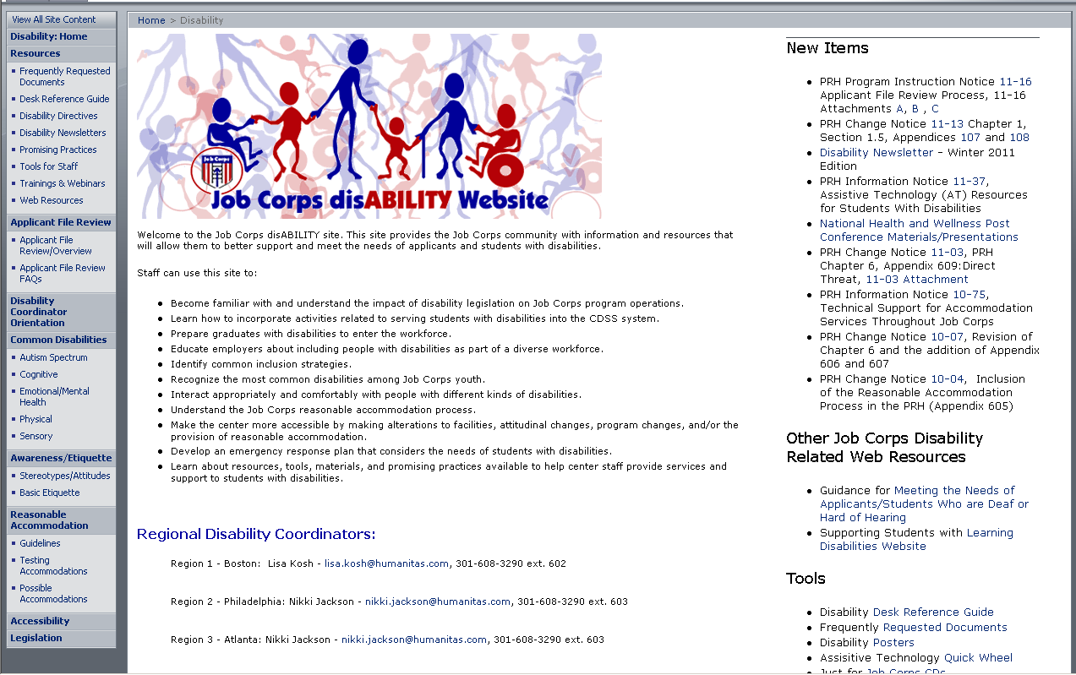

Slide 55
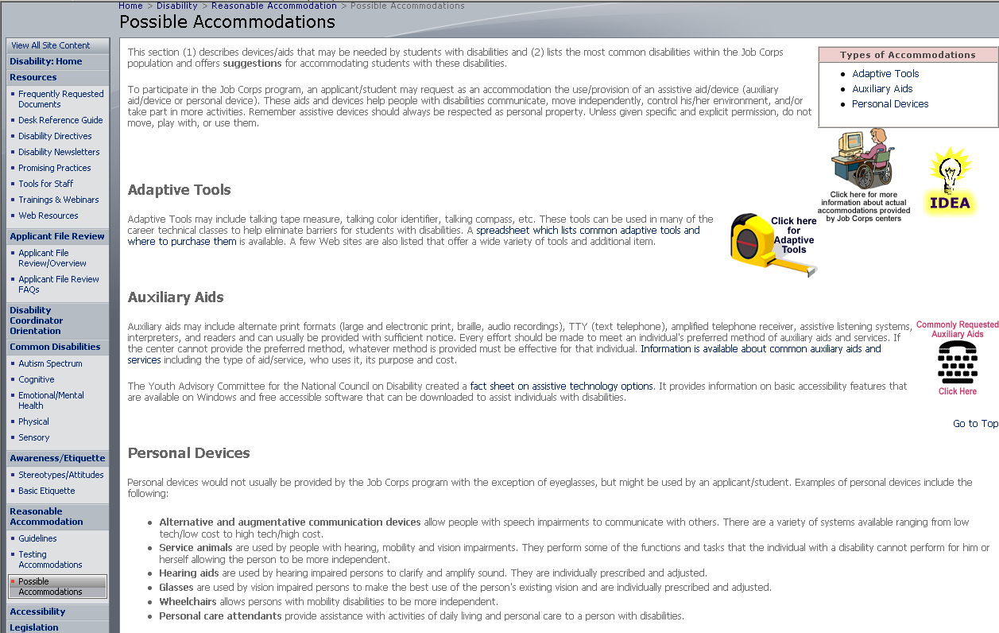

Slide 56
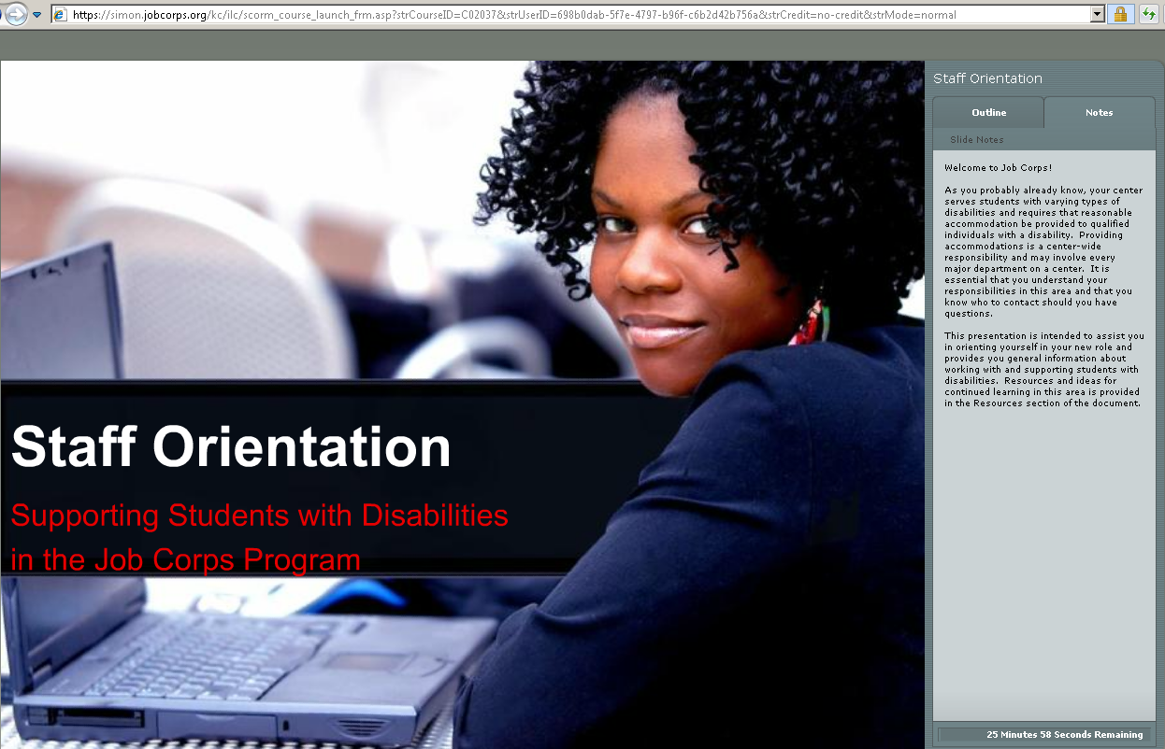
SIMON Training
https://simon.jobcorps.org

Slide 57
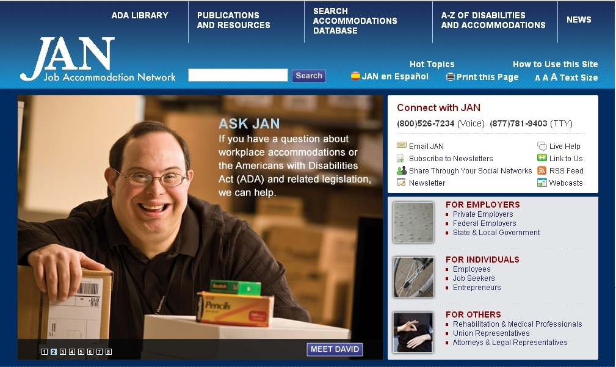
(800) 526-7234 (V)
(877) 781-9403 (TTY)
www.askjan.org

Slide 58
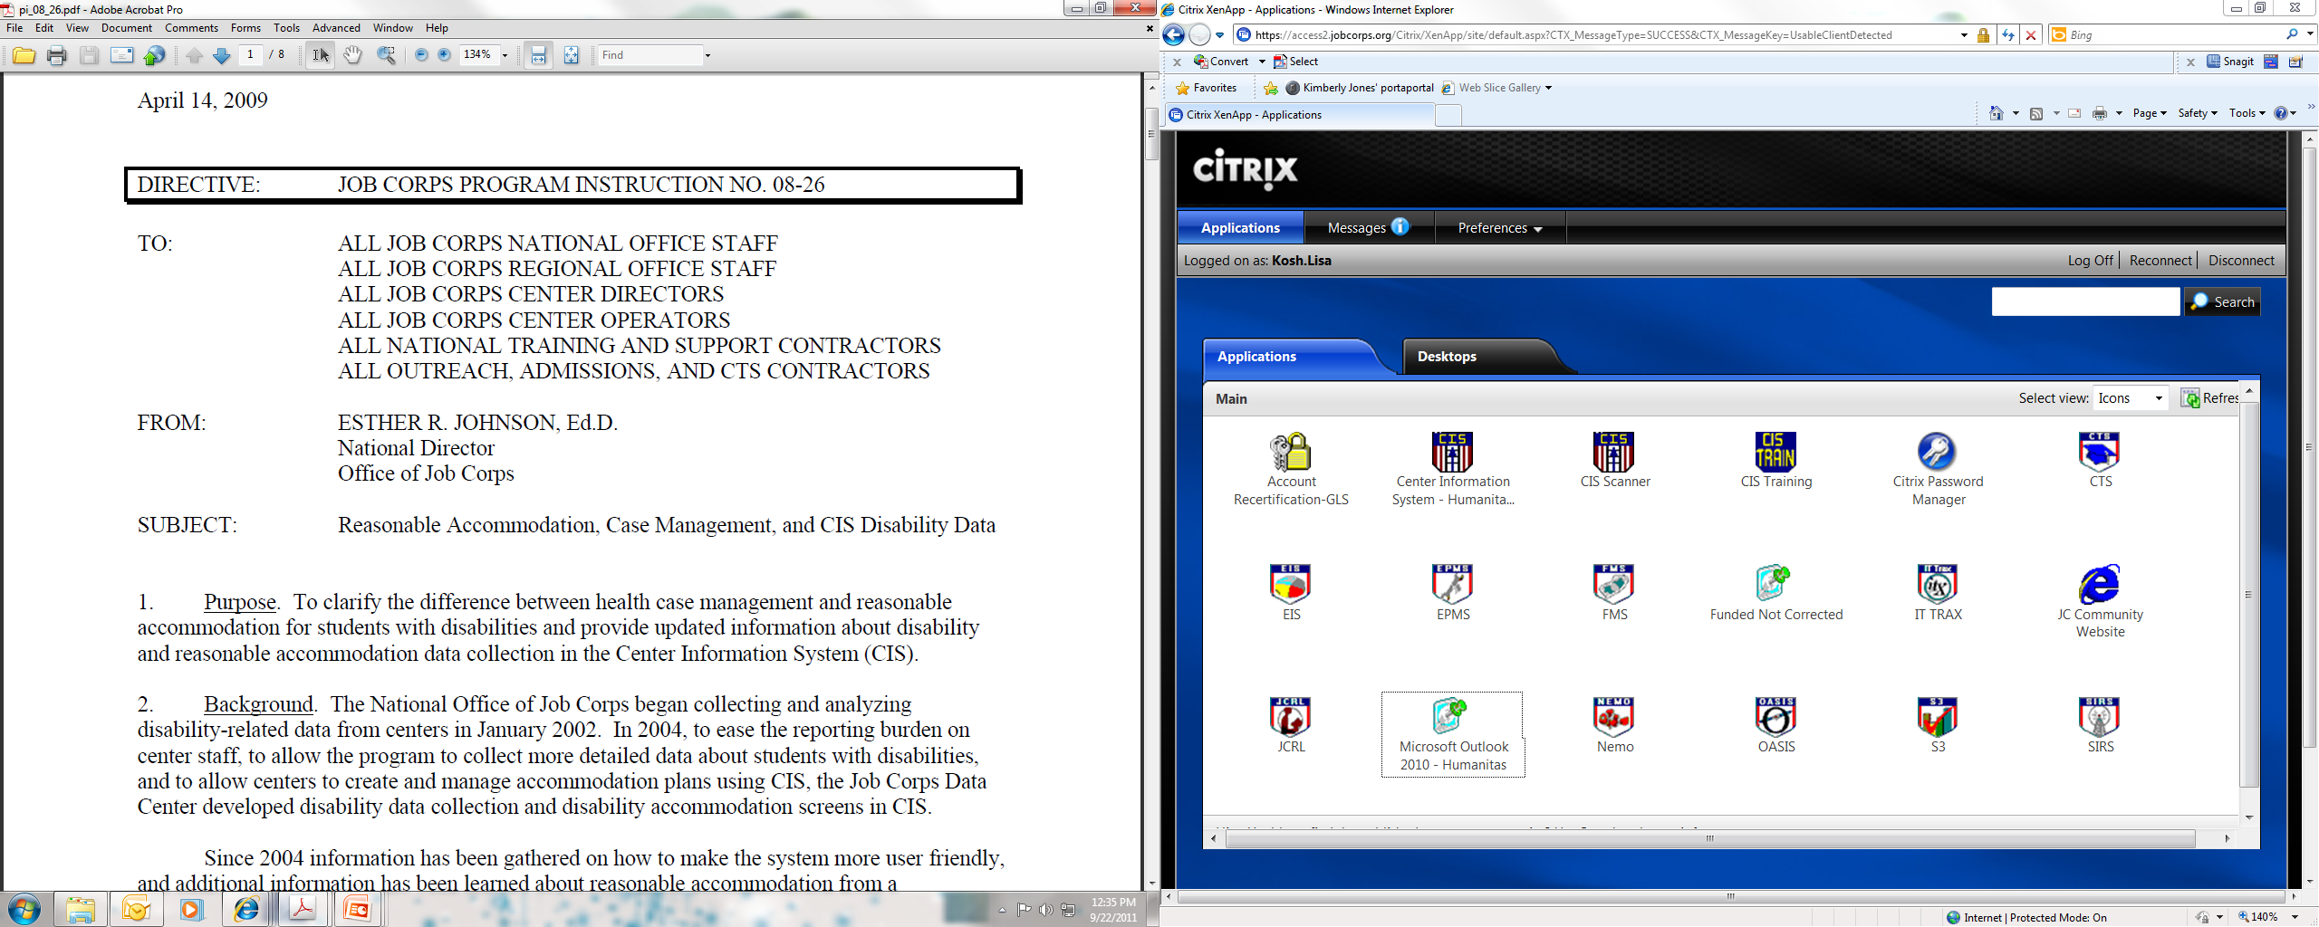
Program Instruction 08-26

