Slide 1

Disability
Accommodation
Policy
Disability Coordinator Orientation
Part 1a
Notes:
Welcome to Disability Coordinator Orientation – Part 1a webinar, Disability Accommodation – Policy. This webinar along with part 1b are overviews of the requirements contained within PRH Form 2-03, PROCEDURES FOR PROVIDING REASONABLE ACCOMMODATION, REASONABLE MODIFICATIONS IN POLICIES, PRACTICES, OR PROCEDURES, AND AUXILIARY AIDS AND SERVICES FOR PARTICIPATION IN THE JOB CORPS PROGRAM.
​

Slide 2
Objectives
Definitions
Communication
Documentation of Disability
Explain what is a disability and what constitutes disability accommodations?
Describe the responsibilities and key considerations for communicating with an applicant with a disability.
List at least 3 appropriate sources of documentation of disability.
DAC
List the primary roles and responsibilities of the Disability Accommodation Committee (DAC).
2
Notes:
We have 4 primary objectives today so our goal is that by the end of this webinar, you will be able to:​
Explain what is a disability and what constitutes disability accommodations?
Describe the responsibilities and key considerations for communicating with an applicant with a disability.
List at least 3 appropriate sources of documentation of disability.
List the primary roles and responsibilities of the Disability Accommodation Committee (DAC).

Slide 3

Effective Communication
Separate Obligation from RA and RM
3
3
Notes:
Effective Communication – Separate Obligation from Reasonable Accommodation and Reasonable Modification
Let’s begin with “Communicating with People with Disabilities”—What are our legal obligations? You can locate more on these obligations in Appendix 201 located in the PRH and also on the JC Disability Website (Program Requirements; DA; PRH; Appendix 201).

Slide 4

A.
Communication must be as effective as communication with others.
B.
Applies to all stages of the Job Corps process.
C.
The obligation to communicate effectively with people with disabilities is separate from the obligation to provide reasonable accommodation or reasonable modification in policies, practices, or procedures for qualified individuals with disabilities.
Communicating with Individuals with Disabilities
Appendix 201
4
Notes:
What are our legal obligations when communicating with individuals with disabilities enrolled in or related to the Job Corps program?
Communication with people with disabilities (whether those people are students, staff, applicants for admission/employment, parents, guardians, or members of the public) must be as effective as communication with others and we don’t always actively think about whether our communication exchanges are effective.
This obligation applies to all stages of the Job Corps process.
The obligation to communicate effectively with people with disabilities is separate from the obligation to provide reasonable accommodation or reasonable modification in policies, practices, or procedures for qualified individuals with disabilities. Let’s talk more about why so much emphasis is placed on the need for effective communication.

Slide 5

Why is Effective Communication so Important?
Without clear, accurate, effective communication, any encounter between a person with a disability and a program from which that person is seeking services, such as Job Corps, will be literally meaningless.
5
Notes:
The Workforce Innovation and Opportunity Act (WIOA) nondiscrimination regulations distinguish between these two obligations for a very simple reason: Without clear, accurate, effective communication, any encounter between a person with a disability and a program from which that person is seeking services, such as Job Corps, will be literally meaningless.
In other words, it is NOT left up to our interpretation without ensuring that we have effectively communicated with an applicant/student.

Slide 6

Who is Responsible to Ensure Effective Communication?
Under the law, the burden is on Job Corps to provide the auxiliary aids and services (communication aids) that are needed for equally effective communication with a particular person with a disability.
6
Notes:
Who is responsible to ensure effective communication?
Under the law, the burden is on Job Corps to provide the auxiliary aids and services (communication aids) that are needed for equally effective communication with a person with a disability.
Job Corps is not necessarily required to provide the precise communication aid/services requested by a person with a disability when an EQUALLY EFFECTIVE, less costly alternative is available. The law places on us the clear obligation to provide some method of communication that is effective for that particular person with a disability.

Slide 7
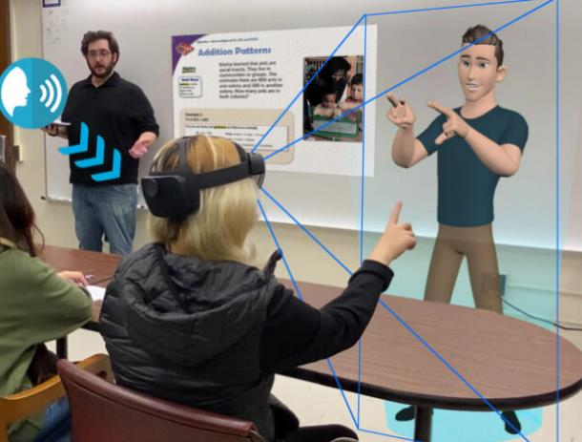

Identifying or Determining What is Effective?
Future Possibilities?
First – Determine HOW to communicate effectively with the individual with a disability.
Primary consideration should be given to the requests of the person with a disability.
https://blog.siggraph.org/2022/07/assistive-technology-enters-the-classroom-with-holographic-sign-language-interpreters.html/
Why do you think the law does this?
7
Notes:
Identifying or Determining what is Effective?
When a person who has a specific disability that affects his/her ability to communicate approaches Job Corps, the first thing we should do is find out how to communicate as effectively with that person as we would with people without disabilities. This essentially means we must engage the applicant/student in an interactive process to find out what communication methods/strategies the person can genuinely understand. Interactive does not mean we solely interact with paperwork/documentation, and not involve the applicant/student.
When considering how best to communicate with an applicant/student with a disability, primary consideration should be given to the requests of the person with a disability.
Audience Participation:
Why do you think the law requires this? (Use the text box to respond)
The individual with a disability is the best source of information about their own needs. Individuals who have the “same” diagnosis or disability may not be able to use and understand the same communication method. For example, individuals who have hearing impairments may use differing methods to communicate. Some individuals may use American Sign Language (ASL), others communicate using Signed English, while still others do not understand sign language at all and need a different method such as Computer Assisted Real-Time Transcription (CART).
Some communication methods/needs are more obvious than others. If a person is blind or visually impaired, written communication will be difficult and the individual may require an alternate form of communication. We need to be mindful of the different communication preferences and approaches, and not attempt to apply a “one type fits all” strategy. Again, individualizing the approach with an interactive meeting with the applicant/student is the best way to discover effective communication methods/strategies/accommodations.
Just as a point of interest – look at the picture on the right-hand side of the slide. There are initiatives underway to make holographic sign-language interpreters a possible option for individuals who rely on sign language interpretation services.

Slide 8
What are Communication-related Accommodations?
Any adjustment or modification, support, and so forth that enables the individual to be able to both receive and express information that is meaningful to them. Examples might include such things as:
Simplifying language to include rephrasing statements or questions and providing them in either oral or written formats as needed
Slowing the rate of speech and/or repeating phrases and giving extra time for processing
Interviewing face-to-face instead of by phone
Providing picture-related support/other symbols to convey meaning
Securing interpreters or using hearing-assisted devices/text-to-speech technology
Allowing written communication such as e-mails, texts, or other types of written responses
Asking the recipient to repeat back information to confirm understanding
Providing more specialized accommodations as needed, such as a sign-language interpreter or video remote interpreting (VRI)
Notes:
What are communication-related accommodations?
Any adjustment or modification, support, and so forth that enables the individual to be able to both receive and express information that is meaningful to them. Examples might include such things as:
Simplifying language to include rephrasing statements or questions and providing them in either oral or written formats as needed
Slowing the rate of speech and/or repeating phrases and giving extra time for processing
Interviewing face-to-face instead of by phone
Providing picture-related support/other symbols to convey meaning
Securing interpreters or using hearing-assisted devices/text-to-speech technology
Allowing written communication such as e-mails, texts, or other types of written responses
Asking the recipient to repeat back information to confirm understanding
Providing more specialized accommodations as needed, such as a sign-language interpreter or video remote interpreting (VRI)

Slide 9

Disability Accommodations (DA)
Policy Requirements
PRH 2: 2.4, (R2) and 3.4, (R23); Appendices 201, Form 2-03, and Exhibit 5-1
9
9
Notes:
Disability Accommodations (DA)
Policy Requirements
PRH 2: 2.4, (R2) and 3.4, (R23); Appendices 201, Form 2-03, and Exhibit 5-1
Disability Accommodations for individuals with disabilities provides access to participate in the Job Corps program. Let’s start by reviewing related Disability Accommodations policies.

Slide 10

DA Standard Operating Procedure
10
10
Notes:
There are two SOP requirements for the Disability Program, one on the center’s applicant file review process and this one which is on disability accommodation.

Slide 11
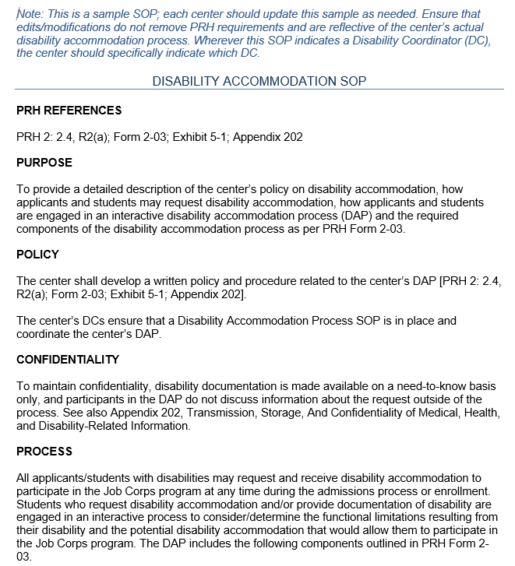
DA Standard Operating Procedure (SOP)
PRH 1: 1.5, Form 2-03, Exhibit 5-1
Requires DOL Regional Office approval!
All centers are required to have a Disability Accommodation Process (DAP) SOP.
DCs must ensure DA SOP is in place.
Must include all components of the Disability Accommodation Process (DAP) in Form 2-03
DCs coordinate the center’s DAP.
11
Notes:
DA Standard Operating Procedure
As you know, a SOP outlines how the center is going to implement and execute required policy. On the right-hand side of the screen, there is a partial snapshot of a sample DA Process SOP. Your center’s DA SOP must contain all the required procedures as outlined in PRH 1: 1.5, Form 2-03 and Exhibit 5-1. The center DCs coordinate the Disability Accommodation Process or DAP and must ensure that the DA SOP is in place and that the SOP is reflective of the center’s actual DA practice/process. This SOP must be approved by the DOL Regional Office.
The entire template can be downloaded from the Job Corps Disability Support Services Website in the DA resources section; however, we will provide you with a link to this template in the chat box.

Slide 12

Defining Disability
12
12
Notes:
Defining Disability
​
This section discusses the definition of a disability and impairments that are almost always considered a disability.

Slide 13

Disability Definition
“Disability” means, with respect to an individual:
A physical or mental impairment that substantially limits one or more of the major life activities of such individual.
13
13
Notes:
“Disability” means, with respect to an individual: A physical or mental impairment that substantially limits one or more of the major life activities of such individual. Major life activities include such things as walking, talking, eating, breathing, learning, bodily functions, etc. If a person has certain conditions that impact major body or system functions, even when stable, that individual may be considered as a person with a disability. For example, if a person has diabetes, they are almost always considered to have a disability because of the impact of the condition to the endocrine system.
The definition of “disability” shall be construed broadly in favor of expansive coverage, to the maximum extent permitted by federal disability nondiscrimination law.

Slide 14

BRAND SUBTEXT
Examples
Muscular dystrophy
Multiple sclerosis
Cancer
Diabetes
Psychological illness
Drug addiction
Alcoholism
ADHD
Orthopedic
Visual/Hearing
Speech
Intellectual
Learning disabilities
HIV
Cerebral palsy
Epilepsy
A physical or mental impairment
01
Disability Defined
An impairment is a disability if it substantially limits the ability of an individual to perform a major life activity as compared to most people in the general population
  Requires an individualized assessment
  Should not require extensive analysis
  Should be construed broadly in favor of expansive coverage
that
substantially limits
02
  Learning
  Reading
  Concentrating
  Thinking
  Communicating
  Interacting with others
  Caring for oneself
one or more
of a person’s major life activities
03
An activity that is “of central importance to daily life”
Notes:
As defined by the Americans with Disabilities Act as Amended (ADAAA) in 2008 , the definition of a disability is “a physical or mental impairment that substantially limits one or more of a person’s major life activities.”
Whether a particular person has an impairment that satisfies this definition, and whether a specific accommodation is appropriate for a particular person must be determined on a case-by-case basis by someone with expertise in the field. Let’s examine the sub parts of this definition one by one starting with What is a physical or mental impairment?
A physical impairment is any physiological disorder or condition, cosmetic disfigurement, or anatomical loss affecting one or more body systems such as: Neurological, musculoskeletal, special sense organs, respiratory (including speech organs), cardiovascular, reproductive, digestive, genitourinary, immune, circulatory, hemic, lymphatic, skin, and endocrine.
A mental impairment is any mental or psychological disorder such as intellectual disability, organic brain syndrome, emotional or mental illness, and specific learning disabilities.
Some examples of physical and mental disabilities include: Blindness, deafness, intellectual and learning disabilities, Diabetes, ADHD, Depression, Generalized Anxiety Disorders, etc.
What does it mean to substantially limit?
An impairment is a disability if it substantially limits the ability of an individual to perform a major life activity as compared to most people in the general population. An impairment need not prevent, or significantly or severely restrict the individual from performing a major life activity in order to be considered substantially limiting.
Determining substantial limitation requires an individualized assessment of the individual’s functioning which generally is done via a review of disclosed medical, health, or disability related documentation. This assessment “should NOT” require extensive analysis and the information must be construed broadly in favor of expansive coverage; “substantially limits” is not meant to be a demanding standard. In other words, Job Corps takes a broad sweep in reviewing and accepting a variety of forms of documentation to support an individual’s disability status.
Certain impairments will virtually always be found to result in substantial limitation in performing certain life activities and we will review some of those in the next few slides.
What are major life activities?
A major life activity is one that is of central important to daily life. For example, learning, concentrating, communicating, caring for oneself are all examples of major life activities.

Slide 15

Physical or mental impairment does not include Homosexuality and bisexuality
01
Transvestism, transsexualism, or gender identity disorders not resulting from physical impairments
02
Not A Disability
Pedophilia, exhibitionism, voyeurism, or other sexual behavior disorders; compulsive gambling, kleptomania, or pyromania
03
Psychoactive substance-use disorders resulting from current illegal use of drugs
04
Notes:
There are various conditions and/or behaviors and symptoms that are not considered to be a disability:
Physical or mental impairment does not include Homosexuality and bisexuality
Transvestism, transsexualism, or gender identity disorders not resulting from physical impairments
Pedophilia, exhibitionism, voyeurism, or other sexual behavior disorders; compulsive gambling, kleptomania, or pyromania
Psychoactive substance-use disorders resulting from current illegal use of drugs
A normal pregnancy is also not considered a disability. There are various conditions that may occur during pregnancy that could result in the individual being considered as a person with a temporary disability but pregnancy in and of itself is not a disability.
Students who are Limited English or for whom English is a second language are not considered individuals with disabilities simply because of having limitations in the use of the English language. They may be entitled to certain supports based upon their language status but not based upon disability status.

Slide 16

Impairments that virtually always impose a substantial limitation
Deafness substantially limits hearing;
Blindness substantially limits seeing;
Intellectual disability substantially limits brain function;
Partially or completely missing limbs or mobility impairments requiring the use of a wheelchair substantially limit musculoskeletal function;
Autism substantially limits brain function;
Cancer substantially limits normal cell growth;
Cerebral palsy substantially limits brain function;
Diabetes substantially limits endocrine function;
Epilepsy, muscular dystrophy, and multiple sclerosis each substantially limits neurological function;
Human Immunodeficiency Virus (HIV) infection substantially limits immune function; and
Major depressive disorder, bipolar disorder, post-traumatic stress disorder, obsessive compulsive disorder, and schizophrenia each substantially limits brain function.
16
Notes:
This list is not all inclusive.
Are there certain impairments that will virtually always be found to impose a substantial limitation on a major life activity?
The following impairments should be easily found to substantially limit a major life activity (and may substantially limit additional major life activities not explicitly listed).
Some conditions essentially are always considered a disability. Mitigating factors (like taking medication) generally were removed from the legislation with the last reauthorization of the Americans with Disability Act which means that we must think about how the disorder impacts the individual should they not be on medication, receive treatment, etc. What this means is that an individual who is stable does not automatically lose their disability status and it means that we still must consider accommodations for them.
Qualified Health Professionals (QHPs) and Disability Coordinators (DCs) should not spend a lot of time analyzing whether that applicant’s condition meets the definition of a disability or requesting extensive documentation. Instead, the focus should be on the accommodation and whether it is reasonable and whether there are other disability accommodation alternatives that can be considered.

Slide 17

Mitigating Measures
Mitigating measures include, but are not limited to:
Medication, medical supplies, equipment, or appliances, low-vision devices, prosthetics including limbs and devices, hearing aid(s) and cochlear implant(s) or other implantable hearing devices, mobility devices, and oxygen therapy equipment and supplies
Use of assistive technology
Reasonable modifications in policies, practices, or procedures, and auxiliary aids and services
Learned behavioral or adaptive neurological modifications
Psychotherapy, behavioral therapy, or physical therapy
Substantially limits a major life activity shall be made without regard to the ameliorative effects of mitigating measures
Consider evidence of limitations the person experienced prior to using a mitigating measure
Eyeglasses or contact lenses shall be considered
Notes:
Mitigating Measures
Mitigating measures include, but are not limited to Medication, medical supplies, equipment, or appliances, low-vision devices, prosthetics including limbs and devices, hearing aid(s) and cochlear implant(s) or other implantable hearing devices, mobility devices, and oxygen therapy equipment and supplies and may include the
Use of assistive technology;
Reasonable modifications in policies, practices, or procedures, and auxiliary aids and services;
Learned behavioral or adaptive neurological modifications; or
Psychotherapy, behavioral therapy, or physical therapy.
Just because a person is stable with the use of medication does not preclude them from being considered a person with a disability. A certain condition’s level of seriousness may vary in seriousness or impact over time. “Substantially limits” a major life activity shall be made without regard to the ameliorative effects of mitigating measures; in other words, taking medication and becoming stable on that medication, for example, does not remove the individual’s disability status. When thinking about how a condition impacts an individual, consider how the condition impacts them without the use of the mitigating measure.
Eyeglasses or contact lenses are two exceptions where the mitigating measure SHALL BE considered in determining ameliorative effects of a condition. For example, if a person needs glasses to see clearly and the use of the glasses enables them to see clearly, then no disability exists.

Slide 18

Episodic or Remission
An impairment that is episodic or in remission is a disability if it would substantially limit a major life activity when it is active.
This means that chronic impairments with symptoms or effects that are episodic rather than present all the time are disabilities even if the symptoms or effects substantially limit a major life activity only when the impairment is active.
Epilepsy
Hypertension
Asthma
Diabetes
Major depressive disorder
Bipolar disorder
Schizophrenia
Examples of impairments that may be episodic include:
Notes:
Episodic or Remission
An impairment that is episodic or in remission is a disability if it would substantially limit a major life activity when it is active.
An impairment that is episodic or in remission is a disability if it would substantially limit a major life activity when it is active. This means that chronic impairments with symptoms or effects that are episodic rather than present all the time are disabilities even if the symptoms or effects substantially limit a major life activity only when the impairment is active. Examples of impairments that may be episodic include epilepsy, hypertension, asthma, diabetes, major depressive disorder, bipolar disorder, and schizophrenia.

Slide 19

Temporary Disability
What are the considerations for someone to have a temporary disability?
The effects of an impairment lasts or is expected to last less than 6 months
Can be substantially limiting for purposes of establishing an actual disability or record of a disability
Concussions
Broken limbs
Surgery
Back or Neck Injuries
Notes:
Temporary Disability
What are the considerations for someone to have a temporary disability?
The effects of an impairment lasting or expected to last less than 6 months can be substantially limiting for purposes of establishing an actual disability or record of a disability.
Examples of temporary disabilities might include:
Concussions
Broken limbs
Surgery
Back or Neck Injuries

Slide 20
Drug Addiction Under the Americans with
Disabilities Amendments Act (ADAAA)
Protected:
Not Protected:
Addicted to drugs, no longer using drugs illegally and received/receiving treatment for drug addiction or who would have been otherwise rehabilitated
Current illegal users of drugs
Casually illegal user in the past, but did not become addicted
20
Notes:
Drug Addiction Under the Americans with Disabilities Amendments Act (ADAAA)
Addiction is an impairment that substantially limits the major life activity of the brain and neurological functions.
Who is Protected as a Person with a Disability Related to Substance Use
Individuals who have been diagnosed with a drug dependence diagnosis, and who have successfully completed a supervised drug rehabilitation program (e.g., inpatient, outpatient, or employee assistance program) and who are NO LONGER using drugs illegally.
Individuals who have been rehabilitated successfully in some other way (e.g., recognized self-help programs such as Narcotics Anonymous and who are NO LONGER using drugs illegally.
Individuals who are currently participating in a supervised rehabilitation program, and who are NO LONGER using drugs illegally.
Who is Not Protected as a Person with a Disability Related to Substance Use
Individuals who are current illegal users of drugs
Individuals who have been a casual illegal drug user in the past, but did not become addicted
This exclusion means that it is generally not against the law for Job Corps to take adverse action against an individual – to separate him or her from Job Corps, or otherwise give him or her less favorable treatment than others – because of current illegal drug use.

Slide 21

Alcoholism Under the ADAAA
Persons who are alcoholics may be protected under the ADAAA as individuals with disabilities.
Alcoholism is a physical or mental impairment.
Individuals who are currently using alcohol are still protected under the ADAAA.
Students with drug addiction or alcoholism disabilities are subject to the center’s disciplinary policies and measures regarding the use and abuse of alcohol, as well as to Job Corps’ Zero Tolerance policy.
21
Notes:
Alcoholism Under the ADAAA
Persons who are alcoholics may be protected under the ADAAA as individuals with disabilities.
Alcoholism or alcohol use disorder is a physical or mental impairment and if it substantially limits a major life activity (e.g., learning, concentrating, interacting with others, caring for oneself) it will constitute a disability.
Individuals who are currently using alcohol are still protected under the ADAAA.
Students with drug addiction or alcoholism disabilities are subject to the center’s disciplinary policies and measures regarding the use and abuse of alcohol, as well as to Job Corps’ Zero Tolerance policy.

Slide 22

What are Disability Accommodations (DA)?
PRH 2: 2.4, (R2) and Form 2-03
22
22
Notes:
What are Disability Accommodations (DA)?

Slide 23

Disability Accommodations
There are 3 prongs to consider:
Reasonable Accommodation
Reasonable Modification in Policies, Practices, and Procedures
Auxiliary Aids and Services
23
23
Notes:
Disability Accommodations
The term Disability Accommodation and the phrase Reasonable Accommodation, Reasonable Modification in Policies, Practices and Procedures, and Auxiliary Aids and Services can be used interchangeably. In other words, the use of the term disability accommodation means that you are considering all 3 sub-component areas and it is a legal requirement to do so. Let’s take a closer look at each of the sub-component areas.

Slide 24

Examples of Reasonable Accommodation and Reasonable Modification
Modified work or training schedules
Modification of equipment or devices
Adjustments or modifications to examinations, training materials or policies
Provision of interpreters
Use of assistive technology
Use of behavioral related supports
If your center has a policy against the use of headsets during the training day, can you allow a student with a noise related sensory functional limitation to use noise cancelling headsets?
24
Notes:
What are some examples of Reasonable Accommodation and Reasonable Modification?
Reasonable accommodation or reasonable modification might include such adjustments as modifying work or training schedules, modifying equipment or devices, modifying content or policies. Using assistive technology or providing behaviorally related supports or providing interpreter services all are examples of reasonable accommodation and reasonable modifications.
Audience Participation:
If your center has a policy against the use of headsets during the training day, can you allow a student with a noise related sensory functional limitation to use noise cancelling headsets?
Presenter Response:
Yes, the center may allow the use of headsets as an adjustment to the center policy. This request is generally found to be reasonable and only restricted in limited circumstances such as when wearing the headsets would pose a safety hazard or during instructional time or other such similar instances.

Slide 25
More Examples of Changes to Policies/Procedures
LEARNING DISABILITY
Extended Time
ANXIETY DISORDER
Breaks
SEIZURE DISORDER
Bottom Bunk
DIABETES
Schedule Adjustment
ADHD
Test in Private Setting
PHYSICAL
Elevator Pass
Notes:
More Examples of Changes to Policies/Procedures
Some disabilities may present functional limitations that require disability accommodations to eliminate barriers created by policies or procedures.
For example:
An individual with a learning disability “may” need more time to complete assignments or tests or may need extra support in remembering dorm duties or other center requirements.
An individual with an anxiety disorder may need breaks to regroup, calm down, use their mindfulness phone apps, etc.
An individual with a seizure disorder likely will need to be placed on a bottom bunk if the center has bunk beds.
An individual with diabetes may need schedule adjustments to take meds, get and eat snacks or something to drink, or passes to Wellness to check blood sugar levels.
An individual who has a type of ADHD with a functional limitation of distractibility may need to test in a private or secluded setting so that they can adequately focus and concentrate on the test.
An individual with a mobility or vision impairment may need a pass to use an elevator if one is located in the building.

Slide 26

Auxiliary Aids and Services
Form 2-03 and Appendix 201
Communication Access Realtime Translation (CART)
The instant translation of the spoken word into English text using a stenotype machine, laptop and real-time software
Auxiliary Aids and Services are devices or services that enable effective communication.
https://askjan.org/products/Communication-Access-Realtime-Translation-CART.cfm
26
Notes:
Auxiliary Aids and Services are devices or services that enable effective communication. This might include the use of sign language interpreters, language interpreters, or a variety of assistive technology devices. For example, the use of Communication Access Realtime Translation (CART), which is an instant translation of the spoken word into English text using a stenotype machine, laptop and real-time software.
“Computer-aided transcription services” has since become known as “real-time captioning”, a professional service that can be delivered on location or remotely. The text produced by the CART service can be displayed on an individual’s laptop monitor, projected onto a screen, combined with a video presentation to appear as captions, and more.

Slide 27

Documentation of Disability
Sources and Content
27
27
Notes:
Documentation of Disability
What types of documentation are required to substantiate an individual’s disability status?

Slide 28



Documentation of Disability Resources
Physicians
Psychiatrists
Psychologists
Medical Specialists
Therapists
Social Workers
Nurses
Physical, speech, and occupational therapists
28
Notes:
Documentation of Disability Resources
As you can see from the lists above, disability documentation generally should be generated by or from appropriately credentialed or licensed health professionals. Certain special education professionals generate relevant special education documentation, especially in the public school setting.

Slide 29

Documentation Types
Examples
IEPs
504 Plans
School Medical Plans
Vocational Rehabilitation Assessments
Medical Records
Chronic Care Management Plans
Social Security Records
29
Notes:
Documentation Types Examples
As you can see, there are many types of documentation that may contain documentation that affirms/supports a student’s disability status. Please note that IEPs and 504 plans serve as sources of documentation just as a Chronic Care Management Plan is documentation of a disability. They are not intended to be implemented in their exact form. Student accommodation plans must be developed based upon an individual's current functional limitations/needs; however, IEPs and 504 plans often provide valuable historical information, especially in the areas of behavioral needs and standardized testing accommodations.

Slide 30
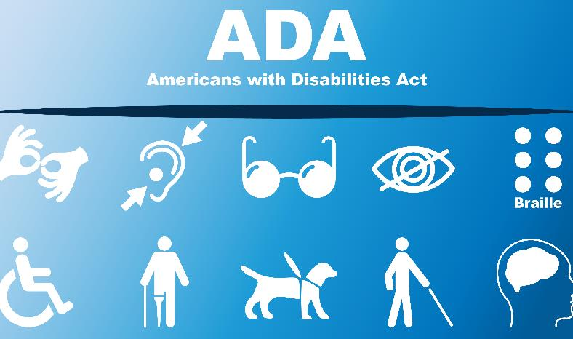
No Documentation Provided
What Disabilities are Obvious?
Factors to Consider
If an applicant’s or student’s disability or need for RA/RM/AAS is not obvious, and they do not provide documentation to support a request for accommodation, then they may not be entitled to RA/RM/AAS.
If an applicant/student suspects that they may have a disability that has not been diagnosed and is unable to pay for an evaluation, AS staff or a DC should provide the applicant/student with referral information.
Examples include:
Blindness
Deafness
Mobility Impairments
30
Notes:
No Documentation Provided
If the applicant/student fails or refuses to provide the reasonable documentation requested, and the disability is not obvious (i.e., not a person who is blind or deaf, has a mobility impairment, etc.), then the applicant/student may not be entitled to accommodations.
Factors to Consider
If an applicant/student suspects that they may have a disability that has not been diagnosed and is unable to pay for an evaluation, AS staff or a DC should provide the applicant/student with referral information.

Slide 31
Documentation to Support Accommodations for Standardized Testing
Use due diligence in granting testing accommodations!
Testing accommodations should be provided only after documentation of the disability containing information that supports the need for the testing accommodations has been provided, unless the disability is obvious.
Types of accommodations that are allowable in a standardized testing situation usually are more limited than in other environments because certain accommodations may significantly alter what the test is intended to measure.
See also Appendix 301 and the TABE 11/12 Student Testing System Administrator’s Guide.
31
Notes:
Types of accommodations that are allowable in a standardized testing situation such as the Test of Adult Basic Education (TABE) or high school curriculum competency assessments usually are more limited than in other environments such as the academic and career technical training classrooms because certain accommodations may significantly alter what the test is intended to measure.
Testing accommodations should be provided only after documentation of the disability containing information that supports the need for the testing accommodations has been provided, unless the disability is obvious. For example, a student is blind and needs either an oral administration or a Braille administration of the TABE, as appropriate.
Use due diligence in granting standardized testing accommodations. Ensure that the need and the documentation support the accommodations being approved for use.

Slide 32
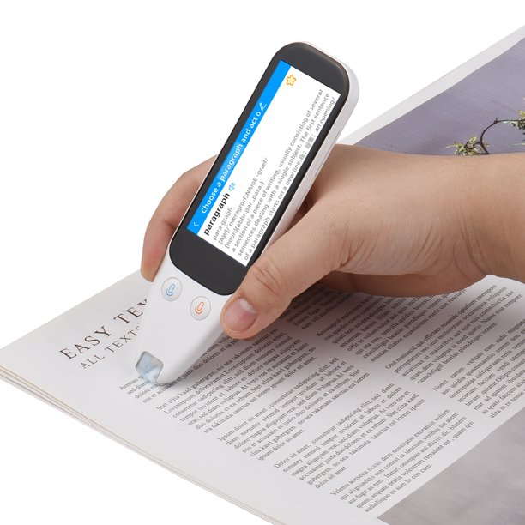
Identifying
Disability
Accommodation
DCs should not spend a lot of time analyzing whether an applicant’s/student’s condition meets the definition of a disability or requesting extensive documentation.
32
Notes:
Identifying Disability Accommodation
The law guides us that we should not spend a lot of time analyzing whether an applicant’s/student’s condition meets the definition of a disability or requesting extensive documentation meaning that we consider the determination of disability status in a broad sense.

Slide 33
Disability Accommodation Requests
Centers may not “deny” disability accommodations at the center level (i.e., determine that a request is unreasonable).
For example, if an applicant or student requests a private room, the center cannot tell the student that Job Corps does not provide private rooms.
  First, the center may offer equally effective alternative accommodations (e.g., fewer roommates, room dividers, noise machines, etc.).
  If the individual does not accept the alternative accommodations, then the center must determine if providing the private room is “reasonable” or not.
Important!
Notes:
Disability Accommodation Requests
Centers may not “deny” disability accommodations at the center level (i.e., determine that a request is unreasonable).
For example, if an applicant or student requests a private room, the center cannot tell the student that Job Corps does not provide private rooms.
First, the center may offer equally effective alternative accommodations (e.g., fewer roommates, room dividers, noise machines, etc.).
If the individual does not accept the alternative accommodations, then the center must determine if providing the private room is “reasonable” or not. If the center determines that the request is unreasonable, it must submit the proper Reasonableness Review documents from Form 2-03 of the PRH to their respective Regional Disability Coordinators.

Slide 34

Timelines
Entering Disability Accommodations into CIS
34
34
Notes:
Timelines
Let’s review the timelines for entering disability accommodations into CIS.

Slide 35



Timelines for Entering Accommodation Plans
Applicant Requests
Student Requests
TABE Accommodations
Disclosure:
Disclosure:
Disclosure:
Disclosure:
Occurs during the admissions process.
Occurs after enrollment/ arrival.
Occurs during the admissions process.
Occurs after first TABE.
AP Entered:
AP Entered:
AP Entered:
AP Entered:
Enter prior to or on the day of the student’s arrival.
Enter as soon as possible after disclosure of disability.
Enter prior to or on the day of the student’s arrival.
Enter as soon as possible after disclosure of disability.
35
Notes:
Timelines for Entering Accommodation Plans
When must accommodation plans be entered into CIS when an applicant requests disability accommodation, when a student requests disability accommodation or when an individual needs TABE accommodations.
For example, if an applicant discloses a disability and/or requests RA/RM/AAS to participate in the Job Corps program during the admissions process, the accommodation plan must be entered in CIS using the accommodation plan icon prior to or on the day of the student’s arrival.
If a student discloses a disability after enrollment/arrival, the accommodation plan must be entered as soon as possible after disclosure of disability.
If an individual discloses their disability prior to arrival and require TABE testing accommodations, this data must be entered prior to the administration of the first TABE test. If a student discloses a disability and requests testing accommodations after the administration of the first TABE test, the accommodation plan should be entered into CIS as soon as possible after disclosure of disability (and must be entered prior to the next TABE test administration).
All the necessary timelines are included on this slide for you to reference as needed.

Slide 36
Administrative Considerations
Protected Information/ Confidentiality
Signing the AP
Copy of Plan and AP Storage
APs must not include information about an individual student’s diagnosis, medication needs, or other health-related history.
A DC and student must sign the plan (soon after the student’s arrival if the disclosure occurred during the admissions process or after the DAC meeting if the disclosure occurred after arrival).
A copy of the plan must be provided to the student, and the original must be maintained in the student’s AF.
36
Notes:
Administrative Considerations
Protected Information/ Confidentiality
APs must not include information about an individual student’s diagnosis, medication needs, or other health-related history. For example, do not include references to IEP or 504 documents in the AP.
Signing the AP
A DC and student must sign the plan (soon after the student’s arrival if the disclosure occurred during the admissions process or after the DAC meeting if the disclosure occurred after arrival).
Copy of Plan and AP Storage
A copy of the plan must be provided to the student, and the original must be maintained in the student’s AF.

Slide 37

Disability Accommodation Committee (DAC)
Members and Responsibilities
37
37
Notes:
Disability Accommodation Committee (DAC)
Next, we will review who must and should be members of the DAC and what are the responsibilities of the DAC.

Slide 38

Members of DAC
Participants of the DAC varies depending on the nature of the request or disclosure.
Academic Manager and/or the HWD as DCs
Dedicated position for a DC
CMHC
Center Physician or equivalent
TEAP Specialist
Dentist
Career Technical Manager
Student’s Counselor
Rep of Center Depts. Affected by DA Request
Community Agency or Partner Rep
Advocate or Authorized Rep
Required!
It Depends!
It Depends!
38
Notes:
Members of DAC
Participants of the DAC vary depending on the nature of the request or disclosure.
For example, if the disability accommodation request is straightforward and does not involve significant expense, the interactive process can be a DAC meeting (phone or face-to-face) between a DC and the applicant/student (and parents, service providers, if applicable). Agreed upon disability accommodation can be determined at this meeting and approved by a DC. If the disability accommodation request is complex and/or may involve significant expense, a DAC meeting involving additional participants may be required.
Note: We are not talking about the DAC within the Health Care Needs Assessment or Direct Threat Assessment Process. This is for applicants who are enrolling and/or students already enrolled in the program.
Who are the required members for an applicant/student who is enrolling in the program?
Academic Manager and/or the HWD as DCs or a dedicated position for a DC (Note: Only one DC is required to conduct a DAC although both DCs may attend).
Applicant/student and their parents (if the applicant/student is a minor or if applicant/student requests their parents attend the meeting).
Who should attend if available?
Center licensed health professionals such as CMHCs
Who should attend if the accommodation needs are more complex and involve multiple areas of consideration throughout the center?
The DAC might include the Career Technical Manager or the Student’s Counselor and sometimes representatives from center disability partners or community agency representatives.
Who must attend if requested by the applicant/student?
Advocates or other authorized representatives

Slide 39
Disability Coordinator
Role in Preparing for Arrival of a Student with a Disability
What is the Role of a Disability Coordinator (DC) in Preparing for
Arrival of a Student with a Disability?
Actions in Preparing for
Arrival of a Student with a Disability
Responsibilities in
Preparation for Arrival
Once approval for enrollment has been confirmed by Wellness, then a DC (e.g., non-health DC, full-time DC, and/or the Health and Wellness Director DC) contacts the student with a disability to discuss the need for accommodations and develop an accommodation plan in preparation for arrival.
Discuss requested accommodations (from applicant, Chronic Care Management Plans, or others on behalf of the applicant)
Discuss other accommodation needs based upon identified functional limitations
!
Cautions!
Ensure RA/RM/AAS Request and DCC Form is completed.
Only discuss requested accommodations and functional limitations related to conditions and/or documentation disclosed by the incoming student.
Do not contact applicants to discuss accommodation needs BEFORE they have been approved for enrollment unless the accommodation considerations is a part of a Health Care Needs Assessment (HCNA) or a Direct Threat Assessment (DTA).
Draft accommodation plan, if agreed upon, and enter Disability Accommodation Committee (DAC) notes into CIS Accommodation Plan notes.
RA/RM/AAS Request and DCC Form: Reasonable Accommodation/ Reasonable Modification in Policies, Practices or Procedures, and Auxiliary Aids and Services Request and Disability Coordinator Contact Form
Notes:
Role in Preparing for Arrival of a Student with a Disability
The DC does not start preparing for arrival of an individual with a disability until the individual is cleared for enrollment.
Once approval for enrollment has been confirmed by Wellness, then a DC (e.g., non-health DC, full-time DC, and/or the Health and Wellness Director DC) contacts the student with a disability to discuss the need for accommodations and develop an accommodation plan in preparation for arrival.
REMEMBER -
Do not contact applicants to discuss accommodation needs BEFORE they have been approved for enrollment unless the accommodation considerations is a part of a Health Care Needs Assessment (HCNA) or a Direct Threat Assessment (DTA).
Only discuss requested accommodations and functional limitations related to conditions and/or documentation disclosed by the incoming student.
If the applicant is approved for enrollment,
Discuss requested accommodations (from applicant, Chronic Care Management Plans, or others on behalf of the applicant)
Discuss other accommodation needs based upon identified functional limitations
Ensure RA/RM/AAS Request and DCC Form is completed.
Draft accommodation plan, if agreed upon, and enter Disability Accommodation Committee (DAC) notes into CIS Accommodation Plan notes.

Slide 40
When Does DAP Occur?
Requests RA/RM/AAS
Note: Accommodation
requests may be made in any form (i.e., verbally, in writing, by other individuals, etc. but must be documented on the RA/RM/AAS Request DCC Form)
Provides documentation that they may be an individual with a disability who may need disability accommodation to participate in Job Corps
Applicant/
Student
Applicant/
Student
Indicates on the Request Form or the 653, Health Questionnaire, that they would like to discuss the need for accommodations with the DC
Applicant
Applicant/
Student
The disability is obvious
Notes:
When Does the Disability Accommodation Process or DAP Occur?
What triggers the DAP to occur?
The DAP is initiated if:
1. There is a request for RA/RM/AAS or disability accommodation.
As we just discussed and to emphasize the importance of when and how a request can be made, accommodation requests may be made in any form (i.e., verbally, in writing, by other individuals, etc. but must be documented on the RA/RM/AAS Request DCC Form)
2. If an applicant indicates on the Request Form or the 653, Health Questionnaire, that they “may” need accommodations or would like to discuss the need for accommodations with the DC.
3. If the applicant provides documentation that they may be an individual with a disability who may need disability accommodation to participate in Job Corps. For example, if there is a Chronic Care Management Plan in the Health E-Folder that documents that the applicant has Bipolar Disorder, the DC must begin the interactive process to discuss possible need for DA.
4. If the disability is obvious.

Slide 41

Primary Reasons DAC
Must Meet
Recommended Denial of Enrollment
Applicant Appealed Denial of Enrollment
Applicant or Student Requests DA to Participate in JC Program
Applicant or Student Provides Documentation of Disability
Concerns Identified During Effectiveness Review
DC Receives Referral of Possible Need for AP
Student Enters Work-based Learning or Career Transition Readiness
Student Needs Assistance Securing HSE or Certification DA
41
Notes:
The PRH (in Form 2-03) lists the primary reasons when the DAC must meet.
The DAC must meet when:
A center has recommended denial of an application of an individual with a disability.
An applicant who is an individual with a disability has appealed their denial from the Job Corps program.
An applicant or student requests disability accommodation in order to participate in the Job Corps program.
An applicant or student provides documentation that indicates they may be an individual with a disability who may need disability accommodation to participate in the Job Corps program.
Concerns are identified during the RA/RM/AAS effectiveness review process.
Referrals are made to the DCs that indicate an accommodation plan may be needed or the review of a current accommodation plan may be needed.
Students enter work-based learning or Career Transition Readiness. The DAC meets to review and discuss any disability accommodation the student may need to access and/or participate in the specific work environment or program they are entering.
Students need assistance in securing disability accommodation for the High School Equivalency and certification examinations administered on center, by partnering program and/or certification organization providers and for these examinations.
Visit Form 2-03 to review the full list of reasons when the DAC must meet.

Slide 42
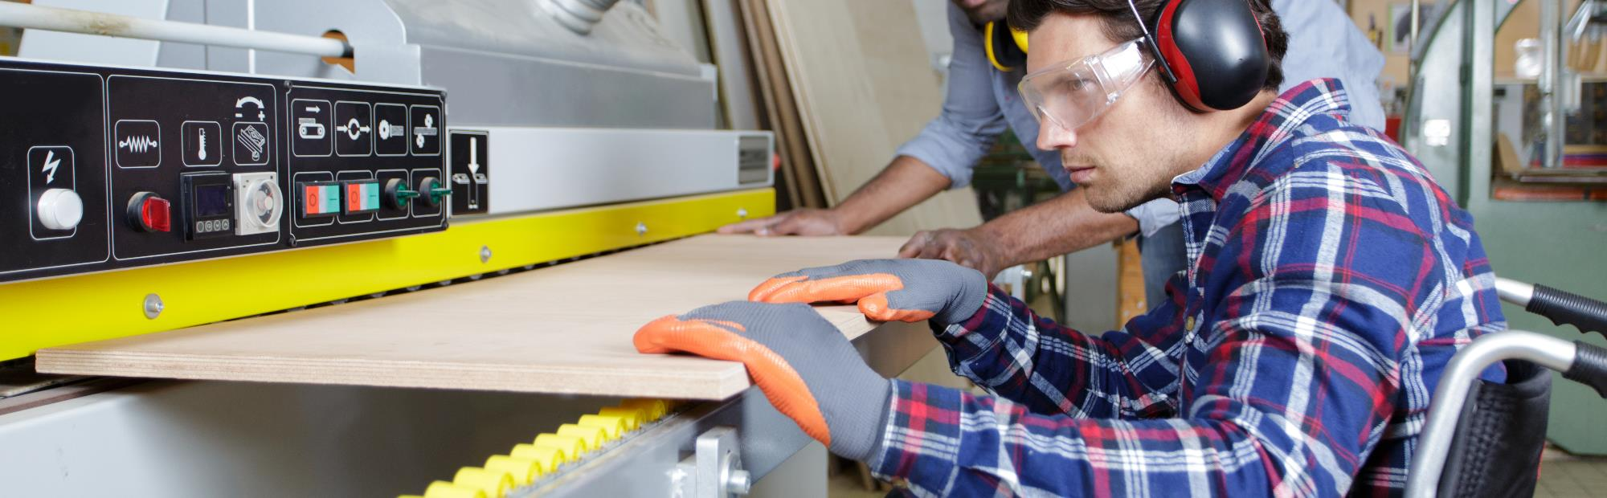
Transfer/Readmit/Advanced Training Students with Existing APs
Accommodation Files
42
42
Notes:
Transfer/Readmit/Advanced Training Students with Existing APs
What are the requirements for accommodation file access when a student is transferring from one center to another, is being readmitted to the Job Corps program, or is entering into Advanced Training within the Job Corps environment?

Slide 43

Accommodation Files for Transfer/Readmit/Advanced Training Students with Existing APs
If a student with an AP already in CIS transfers to another center, re-enrolls in the program, or is admitted to an advanced training program, the center must engage the individual in the DAP.
43
Notes:
Accommodation Files for Transfer/Readmit/Advanced Training Students with Existing APs
If a student with an AP already in CIS transfers to another center, re-enrolls in the program, or is admitted to an advanced training program, the center must engage the individual in the DAP and determine if the accommodation plan needs to be adjusted or updated.

Slide 44
Previous Documentation
Transfers, Readmission or Advanced Training
If the documentation cannot be obtained, then document in the AP notes within CIS that the student previously had an AP documented in CIS and the center’s efforts to obtain the documentation.
Documentation Available?
Documentation Not Received?
Has or had the previous center uploaded documentation of the disability to E-Folder?
Is there documentation of the disability in the Student Health Record (SHR)?
If not, DC must request that the sending center upload the existing documentation.
Then continue to provide the previously agreed upon accommodations.
44
Notes:
Previous Documentation – Transfers, Readmission or Advanced Training
Is there previous documentation available?
Check to see if the individual’s information is uploaded in CIS in the Health or Disability E-Folders and if not, check to see if there is documentation of the disability in the Student Health Record (SHR).
Documentation Not Received?
If no documentation was received but there is an accommodation plan in CIS, the DC must request that the sending center upload the existing documentation.
However, If the documentation cannot be obtained, then document in the AP notes within CIS that the student previously had an AP documented in CIS and the center’s efforts to obtain the documentation and continue to provide the previously agreed upon accommodations.

Slide 45

Resources
Websites
45
45

Slide 46
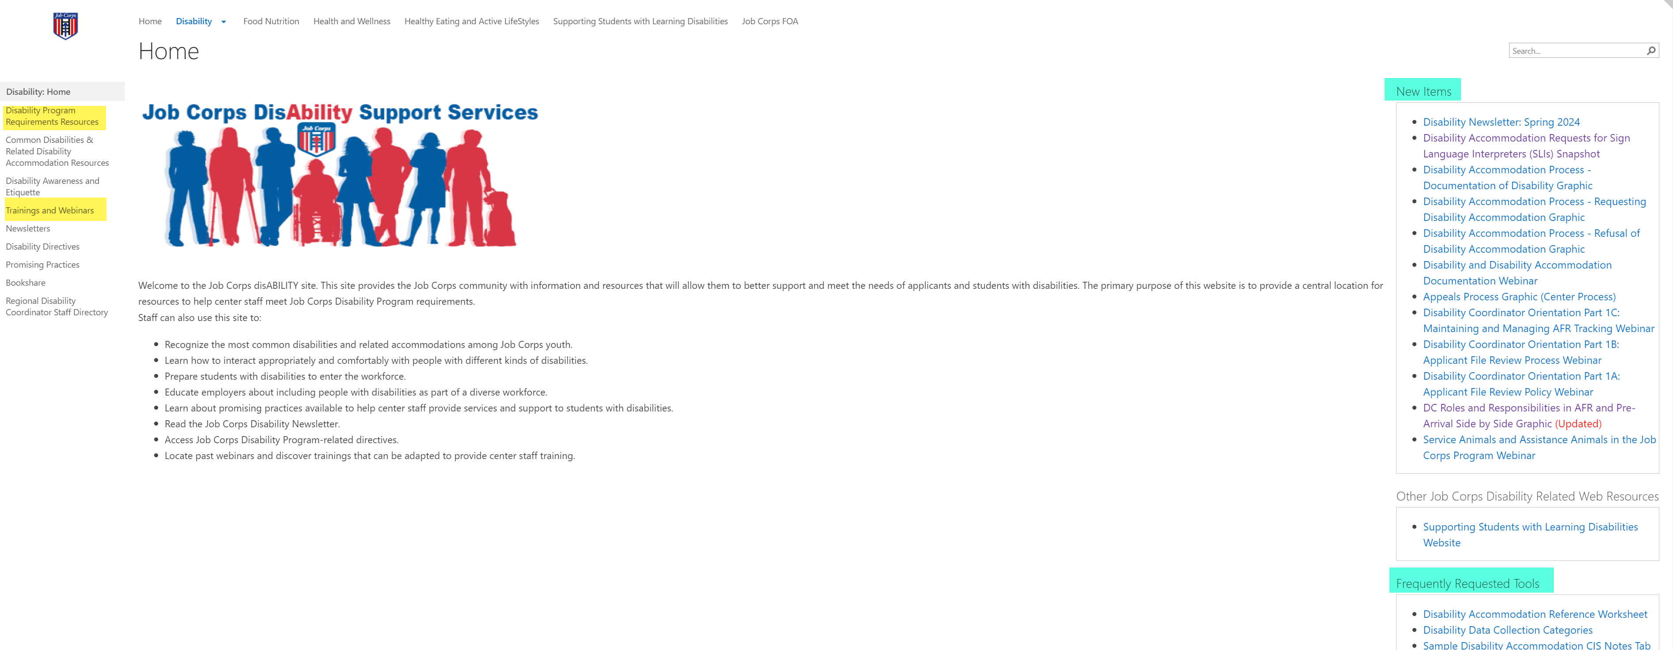
Job Corps Disability Support Services Website https://supportservices.jobcorps.gov/disability/Pages/default.aspx
Notes:
Job Corps Support Services Disability Website
The Job Corps Disability Support Services Website contains numerous resources and tools on applicant file review and disability accommodation requirements, processes and procedures.
As new resources and tools are developed, they are listed under the New Items heading to the right side of the website page. See teal highlighted area. Resources that are more commonly used and/or requested are listed under the Frequently Requested Tools section also highlighted in teal.
The categories of resources are listed on the left-hand side of the website and are highlighted in yellow.

Slide 47

Questions?
47
Notes:
Questions?

