Slide 1
Disability
Accommodation
Process
Disability Coordinator Orientation
Part 1b
Notes:
Welcome to Disability Coordinator Orientation – Part 1b webinar, Disability Accommodation – Process. This webinar along with part 1a which was conducted earlier this week are overviews of the requirements contained within PRH Form 2-03, PROCEDURES FOR PROVIDING REASONABLE ACCOMMODATION, REASONABLE MODIFICATIONS IN POLICIES, PRACTICES, OR PROCEDURES, AND AUXILIARY AIDS AND SERVICES FOR PARTICIPATION IN THE JOB CORPS PROGRAM.
​

Slide 2
Objectives
DAP
Documenting Process
Reasonableness
Articulate or list the disability accommodation process (DAP) steps outlined in Form 2-03/ required in the center’s Disability Accommodation SOP.
Identify when and where disability accommodation process information must be documented.
List the basic steps for determining reasonableness and what to do if a DA request is potentially unreasonable.
DA Resources
Identify at least 2 disability accommodation related resources.
2
Notes:
We have 5 primary objectives today so our goal is that by the end of this webinar, you will be able to:​
Articulate or list the disability accommodation process (DAP) steps outlined in Form 2-03/ required in the center’s Disability Accommodation SOP.
Identify when and where disability accommodation process information must be documented.
List the basic steps for determining reasonableness and what to do if a DA request is potentially unreasonable.
Identify at least 2 disability accommodation related resources.

Slide 3
Disability Accommodation Process (DAP)
3
3
Notes:
The Disability Accommodation Process (DAP), also known as RA/RM/AAS Process must include all the components outlined in Form 2-03.

Slide 4
Disability Accommodation Process (DAP)
Documenting the Disability Accommodation Process
Determining the Need for RA/RM/AAS
Gathering Documentation
Engaging in the Interactive Process
Determining Reasonableness
4
Notes:
There are 10 components of the Disability Accommodation Process. A graphic identifying the components are included on this slide and the next and each will be described in detail. Steps 1 – 5 are listed here and include:
Documenting the DAP.
Determining the need for RA/RM/AAS.
Gathering Documentation
Engaging in the Interactive Process
Determining Reasonableness

Slide 5
Disability Accommodation Process (DAP) (cont.)
Entering the Accommodation Plan in CIS
Notifying Staff
of the Accommodation Plan
Accessing/ Implementing/ Monitoring the Accommodation Plan
Maintaining/ Storing Files
Initiating a Disability/ Accommodation Referral
5
Notes:
6. Entering the Accommodation Plan in CIS.
7. Notifying Staff of the Accommodation Plan.
8. Accessing/Implementing/Monitoring the Accommodation Plan.
9. Maintaining/Storing Files.
10. Initiating a Disability/Accommodation Referral.

Slide 6
Step
Documenting the DAP
All interactions related to RA/RM/AAS must be documented!
Documenting the Disability Accommodation Process (DAP) is required by federal nondiscrimination law.
If an AP is developed, the interactions are documented in CIS Accommodation Notes tab.
This documentation can be very important if an applicant/student alleges discrimination.
6
Notes:
Step 1 is Documenting the Disability Accommodation Process.
Documentation of actions and decisions is required by federal disability nondiscrimination law and can be very important if an applicant/student alleges discrimination. All interactions related to the provision or denial of RA/RM/AAS (1) must be documented and (2) must be documented in the CIS Accommodation Notes tab.

Slide 7
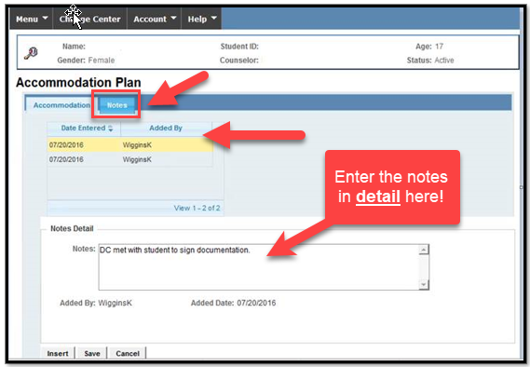
Accommodation Plan with Notes Tab in CIS
Sample notes are available on the Job Corps Disability Website, Frequently Requested Documents tab.
7
Notes:
Accommodation Plan with Notes TAB in CIS
The screen shot is of the CIS Disability Notes Tab where the center documents the accommodation process. Select the “Notes” tab and add to the Notes Detail section. As the heading suggests, enter the notes in detail here ensuring that relevant dates and descriptions of what occurred are documented.
There are sample notes available on Job Corps Disability Website, Frequently Requested Documents tab.

Slide 8
Step
Determining the Need for RA/RM/AAS
Must be documented on the RA/RM/AAS Request and Disability Coordinator Contact (DCC) Form
A DA request can be communicated in any form (e.g., oral, written, sign language).
A disability may also be disclosed via documentation.
Must be contact (phone or in person) between DC and applicant/student (and parent/guardian when appropriate)
Contact must be made prior to assigning the applicant a start date.
8
Notes:
Step 2 is Determining the Need for RA/RM/AAS or Disability Accommodation.
Key points to know!
A DA request can be communicated in any form (e.g., oral, written, sign language). A disability may also be disclosed via documentation.
The request MUST be documented on the RA/RM/AAS Request and Disability Coordinator Contact (DCC) Form.
There must be contact (phone or in person) between DC and applicant/student (and parent/guardian when appropriate) when a request is made or when there is disclosure of disability via documentation.
Policy wise, contact must be made prior to assigning the applicant a start date. What is essential is that this contact occurs pre-arrival.

Slide 9
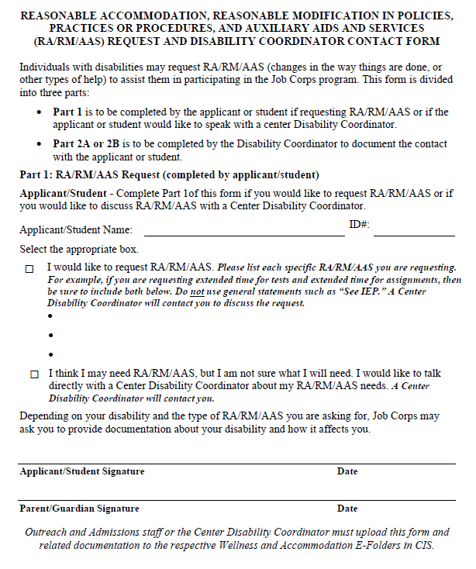
Are you using the
correct form? Discard
and delete forms prior
to 11/29/22 PRH
release!
RA/RM/AAS Request
and DC Contact Form
9
Notes:
Here is a screenshot of the RA/RM/AAS Request and DC Contact Form. Please ensure that you are using the most current form and that you discard and/or delete any forms released in the PRH prior to 11/29/22.

Slide 10
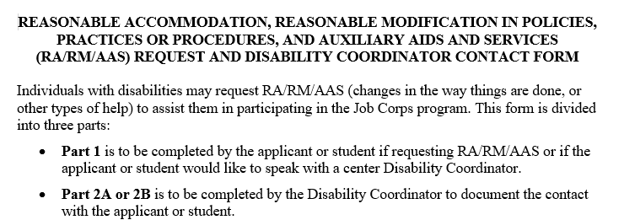
RA/RM/AAS Request and
DC Contact Form
1
Completed by the applicant or student if requesting RA/RM/AAS or if the individual would like to speak with a center Disability Coordinator.
There are 2 parts to the Disability Accommodation (RA/RM/AAS) Request and Disability Coordinator Contact Form.
Part 2 is broken down into Parts 2A and 2B.
2A
Completed by the DC to document contact with an applicant or student who has requested accommodations (Part 1).
2B
Completed by the DC to document contact with an applicant or student who has disclosed a disability via the 653, documentation of a disability, or via any other communication method but made no formal disability accommodation request.
10
Notes:
The new RA/RM/AAS Request and DCC Contact Form has two primary parts:
Part 1 - Completed by the applicant or student if requesting RA/RM/AAS or if the individual would like to speak with a center Disability Coordinator.
Part 2 – Part 2 is broken down into two sections:
Part 2A is completed by the DC to document contact with an applicant or student who has requested accommodations (Part 1).
Part 2B is completed by the DC to document contact with an applicant or student who has disclosed a disability via the 653, documentation of a disability, or via any other communication method but made no formal disability accommodation request.

Slide 11
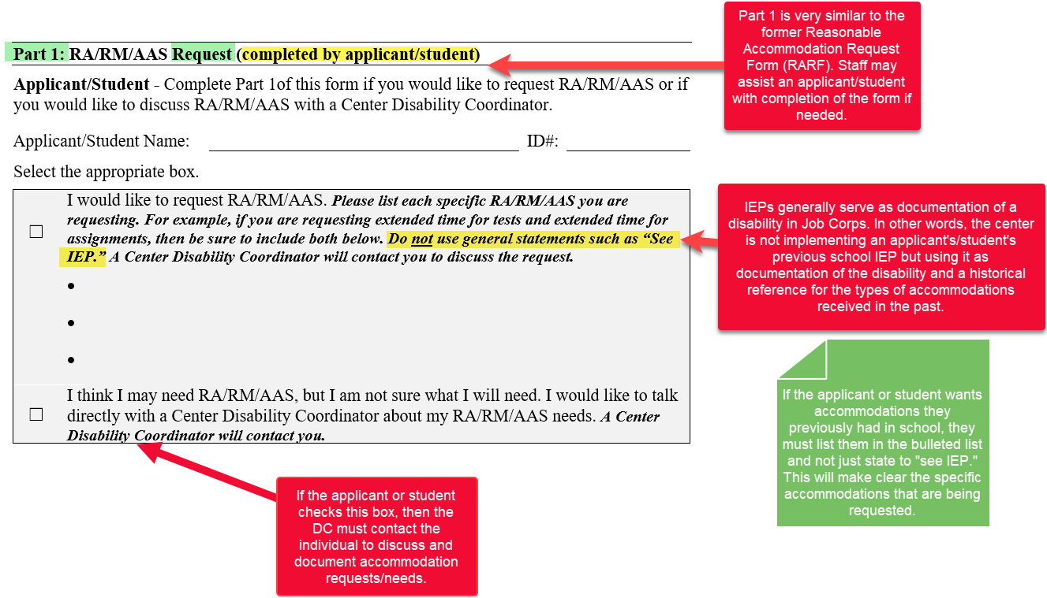
Part 1: RA/RM/AAS Request
11
Notes:
Part 1: RA/RM/AAS Request
The applicant or student has made a request for RA/RM/AAS to participate in the Job Corps program.
Part 1 is very similar to the former Reasonable Accommodation Request Form (RARF) and so this part may look familiar to you. Look at the yellow highlight at the top of the graphic (completed by applicant/student). Staff may assist an applicant or student with completion of the form if necessary.
Next to the first checkbox, the applicant or student is asked to check the box if they are requesting RA/RM/AAS and to list EACH specific accommodation they are requesting. It is important that individuals do not state “see IEP” as that does not document the specific requests of the individual. Remember that IEPs generally serve as documentation of a disability in Job Corps. In other words, the center is not implementing an applicant’s/student’s previous school IEP but using it as documentation of the disability and as a historical reference for the types of accommodations received in the past. This is helpful especially when considering and approving standardized testing accommodations. So, what does this mean?
If the applicant or student wants accommodations they previously had in school, they must list them in the bulleted list and not just state to “see IEP.” This will make clear the specific accommodations that are being requested.
If the applicant or student checks the second box, the one that states “I think I may need RA/RM/AAS…,” then the DC must contact the individual to discuss AND document accommodation requests/needs.

Slide 12
Part 2: Disability Coordinator Contact – Documenting Contact
Who Completes Part 2?
Why is Part 2 Required?
A Disability Coordinator must contact an applicant/student to discuss potential disability accommodation (DA) needs if the applicant requests DA and/or discloses a disability.
Completed by the Disability Coordinator
Part 2A
Part 2B
A DC must contact an applicant/student to discuss potential DA needs if the applicant requests DA or indicates they “may” need DA.
A DC must contact an applicant/student to discuss potential DA needs if the applicant/student did not make a formal DA request but instead disclosed their disability via the 653, documentation of disability, or via any other communication method.
12
Notes:
Now, let’s review Part 2 of the form which is the Disability Coordinator Contact - documentation of the contact with the applicant or student.
Who Completes Part 2?
As we started at the beginning of the training, Part 2 is completed by the DC.
Why is Part 2 Required?
A Disability Coordinator must contact an applicant/student to discuss potential disability accommodation (DA) needs if the applicant requests DA and/or discloses a disability.
Again, Part 2 is broken into 2 subparts:
Part 2A which documents the DC’s contact with the applicant/student to discuss potential DA needs if the applicant requests DA or indicates they “may” need DA.
Part 2B which documents the DC’s contact with the applicant/student to discuss potential DA needs if the applicant/student did not make a formal DA request but instead disclosed their disability via the 653, documentation of disability, or via any other communication method.
There is a detailed set of PowerPoint slides on the completion of both sections of this form which can be found on the Job Corps Disability Website.

Slide 13
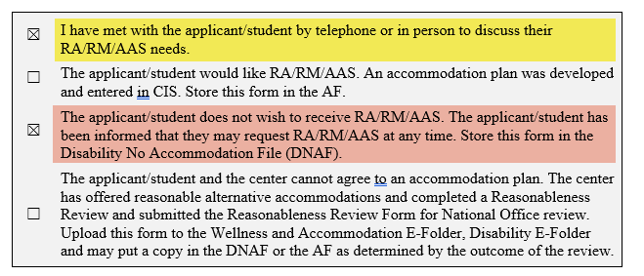
Declining Accommodation
If the applicant/student declines a disability accommodation, it must be documented on the RA/RM/AAS Request and DCC Form.
The applicant/student is instructed to contact a DC if they decide accommodation is necessary later.
The applicant/student and the center cannot agree to an accommodation plan. Contact your Regional Disability Coordinator to discuss!
13
Notes:
If the applicant/student declines an accommodation plan, it must be documented on the RA/RM/AAS Request and DCC Form. Look at the screenshot to the section that is highlighted in yellow and in pink. The yellow highlighted area must always be completed as it is verification that an interactive process took place. Then based upon the outcome of that conversation, one of the next 3 boxes would be checked. In this instance, since we are talking about declining accommodations, the third box (in pink) would be checked.
When a student declines an accommodation plan, they should be instructed to contact a DC if they decide accommodations are necessary later.
If there is a circumstance where the applicant/student and the center cannot agree to an accommodation plan or specific accommodations (i.e., meaning accommodations requested by the applicant/student), then contact your Regional Disability Coordinator to discuss! A reasonableness review may be required, and you will need assistance in navigating through that process.
If the applicant/student declines an accommodation plan, then the student can sign the Request/Documentation of Disability Coordinator Contact form when they arrive on center.

Slide 14
Storage of the RA/RM/AAS Request/ DCC Form and Related Documentation
Upload RA/RM/AAS Request and Disability Coordinator Contact Form to the Wellness and Accommodation E-Folders in CIS (e.g., Disability E-Folder).
01
If an AP is developed, update the notes in the Accommodation Plan Notes section of CIS.
02
Store a hard copy of this form in the Accommodation File (AF) or Disability No Accommodation File (DNAF), as applicable.
03
14
Notes:
Storage of the RA/RM/AAS Request/ DCC Form and Related Documentation
First, Upload RA/RM/AAS Request and Disability Coordinator Contact Form to the Wellness and Accommodation E-Folders in CIS (e.g., Disability E-Folder).
If an accommodation plan is developed, then ensure that the notes in the Accommodation Plan Notes section of CIS are updated.
Finally, store a hard copy of the form either in the Accommodation File if there is an active accommodation plan or in the Disability No Accommodation File if the individual declines accommodations.

Slide 15
Step
Gathering Documentation
During the Application Process
AS will attempt to secure supporting medical and/or educational documentation.
If an applicant has disclosed a condition on the 653, Health Questionnaire, then Admissions Services (AS) must attempt to secure supporting documentation.
AS must not review the contents of these documents.
AS must upload all medical and special education/disability documentation to the Wellness and Accommodation E-Folder.
15
Notes:
Step 3 – Gathering Documentation – During the Application Process
If an applicant has disclosed a condition on the 653, Health Questionnaire, then Admissions Services (SA) must attempt to secure supporting documentation.
Since Admissions Services staff do not have a need to know health and disability information related to center enrollment, they must not review the contents of the medical and/or educational documentation.
Once the information has been collected, AS must upload any medical and special education/disability documentation to the Wellness and Accommodation E-Folder (e.g., Health and Disability E-Folders).

Slide 16
Step
Gathering Documentation
After Enrollment
Only the documentation that is needed to establish that (1) the student has a disability, and (2) the disability necessitates a RA/RM/AAS may be requested.
The DC can ask the student for reasonable documentation of their disability and functional limitations unless both the disability and need for RA/RM/AAS are obvious.
It is important to obtain this type of information since the RA/RM/AAS needs of an individual with a disability will depend on the individual’s functional capacities and limitations rather than their diagnosis.
16
Notes:
Step 3 – Gathering Documentation – After Enrollment
The DC can ask the student for reasonable documentation of their disability and functional limitations unless both the disability and need for disability accommodation are obvious. However, it is very important to understand that only the documentation that is needed to establish that (1) the student has a disability, and (2) the disability necessitates a disability accommodation may be requested may be requested. In other words, once sufficient documentation of disability has been secured, you cannot continue requesting additional information. This does not apply to the management of health care needs and only applies to determining disability status.
It is important to obtain this type of information since the disability accommodation needs of an individual with a disability will depend on the individual’s functional capacities and limitations rather than their diagnosis.

Slide 17
Step
Engaging in the Interactive Process
Disability Accommodation Committee (DAC)
To determine the appropriate DA, the center’s DAC, led by the center DC(s), must initiate an informal, interactive process with the individual with a disability in need of DA.
When the DAC meets
Members of the DAC
DAC Considerations
17
Notes:
Engaging in the Interactive Process – Disability Accommodation Committee (DAC)
To determine the appropriate disability accommodation, the center’s Disability Accommodation Committee (DAC), led by the center DC(s), must initiate an informal, interactive process with the individual with a disability in need of Disability Accommodation.
In the next few slides, we are going to discuss:
When the DAC meets
Members of the DAC, and
DAC Considerations

Slide 18
DAC Considerations
Review DA Requested by Applicant/Student or Others on their Behalf
Review Provided Documentation
Consider DA Needs of Applicants/Students Who Disclose Disability via Documentation
Identify Functional Limitations and Potential DA to Support
Identify Staff Responsible for Providing DA
Document Declinations
Determining if Costs Associated with Providing DA
Develop an Accommodation Plan
18
Notes:
ΔΑΧ Χονσιδερατιονσ
Ρεϖιεω δοχυμεντατιον οφ δισαβιλιτψ τηατ ωασ προϖιδεδ.
Review any specific disability accommodations requested by the applicant/student or by others on the applicant/student’s behalf and review whether the documentation supports the need for the types of disability accommodation.
Consider disability accommodation needs of applicants/students who disclose their disability via documentation but who have made no specific disability accommodation request. The DAC will assist in identifying disability accommodation for consideration.
Identify all the functional limitations resulting from the applicant’s/student’s disability and the potential disability accommodation that could overcome those limitations.
Consider disability accommodations for all areas of the center, not just academics and testing (e.g., career technical, residential, common areas, transportation, etc.), in which the functional limitations of the applicant/student may impact access and participation.
Disability accommodations afforded to an applicant or student must be relevant to that individual’s impairment and functional limitations resulting from the impairment. For example, a student who has diabetes and who has been granted disability accommodation that include schedule adjustments and frequent breaks would not be entitled to the use of a calculator on the TABE unless there was also a corresponding disability in math calculations.
Document any declinations (e.g. decline or refusal) of disability accommodation including alternative but equally effective disability accommodation by the applicant/student in the CIS Accommodation Notes tab.
Identify the center staff responsible for ensuring approved disability accommodations are provided and the date by which the disability accommodation will be in place. Approved disability accommodation for applicants must be in place by the scheduled arrival date of the applicant.
Determine if there is a cost associated with providing the disability accommodation. If there are concerns about the center’s ability to provide the accommodation, contact your Regional Disability Coordinator for assistance.
Develop an accommodation plan.

Slide 19
Developing an Accommodation Plan
Review existing documentation, and with the applicant/student:
Functional Limitations
Using Resources
Determine the functional limitations the individual may have as a result of the disability.
Use expertise of staff and other resources.
Determine barriers to the program, if any, and accommodations needed to alleviate barriers.
Determine what accommodations are necessary and appropriate for the applicant/student in the Job Corps setting.
Barrier Removal
Developing the AP
19
Notes:
Developing an Accommodation Plan
So what is our focus?
Our focus should be on the disability accommodation that is needed to remove barriers to participation in the program or enable the individual to participate equally to those without disabilities.
Review Functional Limitations
Review the documentation to determine the functional limitations the individual may have as a result of the disability.
Barrier Removal and Using Resources
Determine barriers to the program, if any, and accommodations needed to alleviate barriers. Use your resources to assist in this process if necessary (i.e., expertise of your CMHC, Vocational Rehabilitation, the Job Accommodation Network, etc.).
Developing the AP
Ensure that the disability accommodations identified, requested and ultimately agreed upon are relevant to the functional limitations or manifestations of the disability. As we discussed earlier, the program would not grant the use of a calculator to a person who has a reading disability but no math disability.
Reminder
The center may not deny accommodations at the center level. If there are concerns about the reasonableness of the accommodation, FIRST offer alternative accommodations that are reasonable. For example, if the person requested a private room, you might first offer room dividers, reduced #’s of roommates, white noise devices, noise cancelling headsets, private space for short periods of down time, etc.). If the individual is still requesting a private room, contact your Regional Disability Coordinator for assistance.

Slide 20
Step
Determining Reasonableness
Reasonableness Reviews
Reasonableness – Undue hardship or fundamental alteration
There is no specific list of DAs that will or will not be provided. Each request for DA must be evaluated individually, and a determination made regarding whether it is reasonable.
Completing and documenting reasonableness reviews
Determining reasonableness
Contact your Regional Disability Coordinators (RDIC) for assistance!
20
Notes:
Step 5 – Determining Reasonableness – Reasonableness Reviews
There is no specific list of DAs that will or will not be provided. Each request for DA must be evaluated individually, and a determination made regarding whether it is reasonable.
Reasonableness reviews include an evaluation of whether providing disability accommodation results in an undue hardship or a fundamental alteration to the program. The Center Director is responsible for the completion of the reasonableness review although the DCs may assist in the completion of this process. The form for documenting a reasonableness review is in PRH Form 2-03.
If the center determines that an accommodation request is unreasonable, the reasonableness review forms are uploaded to the Disability E-Folder and the center should notify its Regional Disability Coordinator. The National Office will review the request and make a decision on whether the accommodation will be provided.
If the National Office determines that the request is reasonable, the accommodation must be provided.
If the National Office determines that the request is unreasonable (meaning that it would either pose an undue hardship or result in a fundamental alteration to the program), the applicant/student is provided a written statement from the National Office that includes the reason for the denial of the requested accommodation.

Slide 21
Funding High-Cost Accommodations
Generally, centers are responsible for any costs associated with providing RA/RM/AAS to students with disabilities.
If DA costs are more than $5,000, contact the center’s RDIC for assistance requesting National Office funding.
In rare cases, a high-cost DA (e.g., sign language interpreter) may be needed.
21
Notes:
Funding High-Cost Accommodations
Generally, centers are responsible for any costs associated with providing RA/RM/AAS to students with disabilities.
In rare cases, a high-cost DA (e.g., sign language interpreter) may be needed. If DA costs are more than $5,000, contact the center’s RDIC for assistance requesting National Office funding.

Slide 22
Step
Entering the AP in CIS
JCDC offers training on how to enter accommodation plans in CIS (see offerings in the LMS)
All Accommodation Plans must be entered into CIS via the Accommodation Entry plan screen.
Reminder! Ensure that disability data is entered for ALL students with a disability even if they decline accommodations/do not have an accommodation plan.
22
Notes:
Step 6 – Entering the Accommodation Plan in CIS
All Accommodation Plans must be entered into CIS via the Accommodation Entry plan screen.
It might be helpful to review the training offered by JCDC on how to enter accommodation plans in CIS. This training is located within LMS.
Reminder! Ensure that disability data is entered for ALL students with a disability even if they decline accommodations/do not have an accommodation plan.

Slide 23
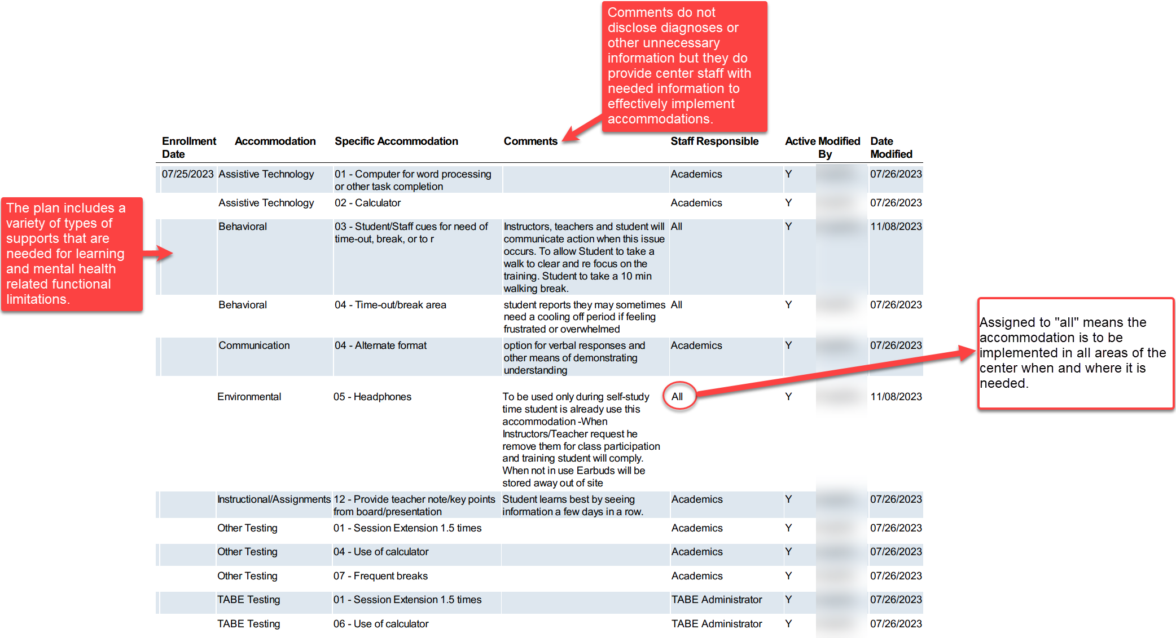
Sample Accommodation Plan
Notes:
Sample Accommodation Plan
Here is a screenshot of a student’s accommodation plan. This plan includes a variety of types of supports that are needed for learning and mental health related functional limitations to include assistive technology, behavioral, communication, environmental and testing.
The comments included in this plan do not disclose diagnoses or other unnecessary information but they do provide center staff with needed information to effectively implement accommodations.
Finally, look at the STAFF RESPONSIBLE column. If the responsibility is assigned to “All” staff, then that means the accommodation is to be implemented in all areas of the center when and where it is needed. For a student who has auditorily based sensory functional limitations, the student may need to wear the headphones or ear buds in the cafeteria or while in the gym where noise can be amplified in addition to during self-study or other approved times in academics or career technical.

Slide 24
Step
Notifying Staff of the AP
When APs are added or updated in CIS), but at least biweekly, a DC must e-mail staff members who interact with students a list of all students with accommodation plans available in the CIS.
The email list must specifically indicate any new or updated plans.
Examples: highlighting, placing an asterisk (*) next to, etc. the names of those with new or updated plans
Copies of the emails must be maintained by the DC and maintained in a secure location.
24
Notes:
Step 7 – Notifying Staff of the Accommodation Plan
When APs are added or updated in CIS), but at least biweekly, a DC must e-mail staff members who interact with students a list of all students with accommodation plans available in the CIS.
The email list must specifically indicate any new or updated plans. For example, the DC might highlight the names of students who have either a new or an updated accommodation plan.
Copies of the emails must be maintained by the DC and maintained in a secure location.

Slide 25
Step
Accessing/Implementing/Monitoring
the AP
Must access plans by using the CIS accommodation plan icon
All center staff responsible for providing accommodations must have access to the accommodation plan report in CIS.
Staff are responsible for providing accommodations as indicated in the accommodation plan.
Managers are responsible for ensuring that accommodation plans are implemented in their areas of supervision.
25
Notes:
Step 8 – Accessing/Implementing/Monitoring the AP
All center staff responsible for providing accommodations must have access to the accommodation plan report in CIS.
Staff must access accommodation plans by using the CIS accommodation plan icon.
Staff are responsible for providing accommodations as indicated in the accommodation plan wherever they are needed on center.
Ultimately, area managers are responsible for ensuring that accommodation plans are implemented in their areas of supervision.

Slide 26
Effectiveness Monitoring
As the student participates in the program, new needs may be identified or accommodation adjustments may be required.
Frequency
Documenting
The effectiveness of a student’s accommodation plan must be evaluated with the student at least every 60 days throughout the student’s enrollment in Job Corps.
Monitoring must be documented in the CIS Accommodation Notes tab.
26
Notes:
Effectiveness Monitoring
As the student participates in the program, new needs may be identified or accommodation adjustments may be required.
How often must effectiveness of accommodations be reviewed?
The effectiveness of a student’s accommodation plan must be evaluated with the student at least every 60 days throughout the student’s enrollment in Job Corps. The center may manage this process however you choose. The DC can meet with the student. The center can continue to use performance panels to monitor effectiveness and pass along the information to the DCs to enter into CIS AP Notes tab and/or to follow up with the student who may need an accommodation plan adjustment.
Documenting the Process
Monitoring must be documented in the CIS Accommodation Notes tab.

Slide 27
Step
Maintaining/Storing the AF or DNAF
Each student with a disability must have either an AF (if the student has an accommodation plan) or a DNAF (if the student has a disability but declined accommodation).
Disability documentation must only be shared as a “need to know.”
See Appendix 202, Transmission, Storage, and Confidentiality of Medical, Health, and Disability-Related Information for more information on access to and storage of disability-related information.
27
Notes:
Step 9 – Maintaining/Storing the Accommodation File or Disability No Accommodation File
Each student with a disability must have either an Accommodation File or AF (if the student has an accommodation plan) or a Disability No Accommodation File or DNAF (if the student has a disability but declined accommodation).
Disability documentation must only be shared as a “need to know.”
See Appendix 202, Transmission, Storage, and Confidentiality of Medical, Health, and Disability-Related Information for more information on access to and storage of disability-related information.

Slide 28
Accommodation Files (AFs)
Documentation of Disability
CIS AP Notes tab
Medical Records must remain in SHR with note in AF stating documentation is in SHR
01
04
Printout of the AP Notes tab (added at separation)
02
05
Referral Form
RA/RM/AAS Request and DCC Form
If applicable
Accommodation Plan
03
06
May contain:
Signed by student and DC
Accommodation Monitoring Forms (optional, monitoring must be documented in CIS Accommodation Notes tab)
28
Notes:
Accommodation Files (AFs)
What are the types of documentation/information that must be in the Accommodation File?
Documentation of Disability
Non health records should be kept in the Accommodation File. This typically includes such documents as IEPs and 504 plans. Medical Records must remain in SHR with note in AF stating documentation is in SHR.
RA/RM/AAS Request and DCC Form
Copy of Accommodation Plan
The AP must be signed by the student and the DC.
CIS AP Notes tab
This is only printed out and added when the student separates from the program.
There are other documents that may need to be included but that is dependent upon the individual situation. For example, if there was a referral for suspicion of disability, then the referral form/information should be included in the accommodation file.
The accommodation file also “may contain” accommodation monitoring forms. Again, remember that the monitoring must be documented in CIS Accommodation Notes tab.

Slide 29
Disability No Accommodation Files (DNAFs)
RA/RM/AAS Request and DCC Form
Completion of the form appropriately serves as documentation of contact with the applicant; however, DCs can store additional notes documenting contact in the DNAF.
Documentation of Disability
Medical Records must remain in SHR with note in AF stating documentation is in SHR.
01
02
29
Notes:
Disability No Accommodation Files (DNAFs)
What are the types of documentation/information that must be in the Disability No Accommodation File?
Documentation of Disability
The same as with the Accommodation File, non health records should be kept in the Disability No Accommodation File and again, medical records must remain in the student health record with a note in the AF stating that the documentation of a disability is in SHR.
RA/RM/AAS Request and DCC Form
Completion of the form appropriately serves as documentation of contact with the applicant; however, DCs can store additional notes documenting contact in the DNAF.

Slide 30
Storing Disability AFs and DNAFs
Each student who has one or more conditions entered into disability data must have a corresponding disability accommodation file (a SINGLE file).
The file is either going to be a Disability, No Accommodation File (DNAF) or an Accommodation File (AF)
Disability Accommodation Files need to be stored separate from all other student records and stored securely (i.e., separate drawer, file cabinet, or storage room, or on a separate server).
30
Notes:
Storing Disability AFs and DNAFs
Each student who has one or more conditions entered into disability data must have a corresponding disability accommodation file (a SINGLE file).
The file is either going to be a Disability, No Accommodation File (DNAF) or an Accommodation File (AF)
Disability Accommodation Files need to be stored separate from all other student records and stored securely (i.e., separate drawer, file cabinet, or storage room, or on a separate server).

Slide 31
Step
Initiating a Disability/
Accommodation Referral
When a student discloses a disability and may want DA
A written referral/feedback system must be established to document a referral to the DCs.
Staff suspects a student may have a disability that is impacting their success in the program
All documentation related to the referral/feedback must be stored in the student’s AF or in the SHR if no AF exists.
31
Notes:
Step 10 – Initiating a Disability/Accommodation Referral
A written referral/feedback system must be established to document a referral to the DCs when a student discloses a disability and may want disability accommodation or staff suspects a student may have a disability that is impacting their success in the program.
All documentation related to the referral including feedback to the referral source must be stored in the student’s AF or in the SHR if no AF exists.

Slide 32
What do you think?
A student requests extra time for TABE testing and they have a CCMP for generalized anxiety disorder. Can the center grant this accommodation request?
Likely so but it depends on how the anxiety impacts the student. Do they have difficulty with timed or high stakes testing activities or is their anxiety related to being in crowds and/or social situations? If the latter, providing secluded testing may be more appropriate and sufficient.
Remember accommodation consideration must be individualized for each person with a disability.
Check - in
Notes:
What if a student requests extra time for TABE testing and they have a CCMP for generalized anxiety disorder. Can the center grant this accommodation request? What do you think?
Likely so but it depends on how the anxiety impacts the student. Do they have difficulty with timed or high stakes testing activities or is their anxiety related to being in crowds and/or social situations? If the latter, providing secluded testing may be more appropriate and sufficient.
Remember accommodation consideration must be individualized for each person with a disability.
Contact your Regional Disability Coordinator for technical assistance if needed.

Slide 33
What do you think?
You receive a referral from a staff who suspects a student has a disability and may need accommodations. Where must you document the actions related to this referral?
Once you review the referral, you realize that this is a student who declined accommodations previously which is why there is no accommodation plan in CIS. What should you do next?
When you speak to the student who previously declined accommodations and they state they now wish to have accommodations, do you need to generate a new accommodation request form?
Check - in
Notes:
What do you think?
You receive a referral from a staff who suspects a student has a disability and may need accommodations. Where must you document the actions related to this referral?
IF a student with a disability who wants accommodations, all interactions with the student and actions taken related to this referral should be captured in the AP Notes within CIS.
IF not a student with a disability, the center can document the outcome on a referral form and store in the SHR.
Once you review the referral, you realize that this is a student who declined accommodations previously which is why there is no accommodation plan in CIS. What should you do next?
Convene a DAC and talk to the student about how things are going and whether they might need an accommodation plan. The DAC likely would only consist of a DC and the student.
When you speak to the student who previously declined accommodations and they state they now wish to have accommodations, do you need to generate a new accommodation request form?
Yes, you will need to generate a new request form to supersede the declination of accommodations documented previously.

Slide 34
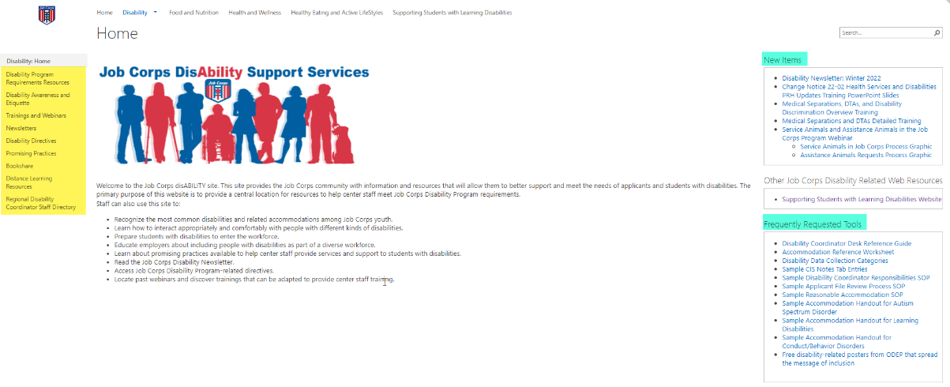
Job Corps Disability Support Services Website https://supportservices.jobcorps.gov/disability/Pages/default.aspx
Notes:
Job Corps Disability Website
The Job Corps Disability Support Services website contains numerous resources and tools on all areas of the disability program.
As new resources and tools are developed, they are listed under the New Items heading to the right side of the website page. See teal highlighted area. Resources that are more commonly used and/or requested are listed under the Frequently Requested Tools section also highlighted in teal.
The categories of resources are listed on the left-hand side of the website and are highlighted in yellow.
The Job Corps Disability website link is located at the top of the slide.

Slide 35
Job Accommodation Network askjan.org

Slide 36
Questions?
36
Notes:
Questions?

