Slide 1
Disability
Data and Accommodation Plan Entry/Notes
Disability Coordinator Orientation
Part 2
Notes:
Welcome to Disability Coordinator Orientation – Part 2 webinar, Disability Data and Accommodation Plan Entry and Notes. The Disability Program requires that center Disability Coordinators enter, implement, and monitor student disability data, Accommodation Plans and Accommodation Plan notes. This webinar reviews the CIS data-related components of the Disability Program and discusses quality control strategies.

Slide 2
Objectives
Timelines
CIS Access
List the timelines for entering disability data, accommodation plans, and accommodation plan notes in CIS.
Identify which staff may have access (within CIS) to disability data, accommodation plans, and accommodation plans with notes screens and reports.
Documentation
Quality Control
Articulate 3 basic considerations when determining if documentation is sufficient to support the disability status and/or relevant agreed upon disability accommodations.
Articulate 1-2 quality control strategies when reviewing Disability Data and Accommodation Reports.
2
Notes:
We have 4 primary objectives today so our goal is that by the end of this webinar, you will be able to:
Timelines
List the timelines for entering disability data, accommodation plans, and accommodation plan notes in CIS.
CIS Access Rights
Identify which staff may have access (within CIS) to disability data, accommodation plans, and accommodation plans with notes screens and reports.
Documentation
Articulate 3 basic considerations when determining if documentation is sufficient to support the disability status and/or relevant agreed upon disability accommodations.
Quality Control
Articulate 1-2 quality control strategies when reviewing Disability Data and Accommodation Reports.

Slide 3
Disability Data and Accommodation Plans
Policy Review
3
3

Slide 4
A DC must accurately enter the required data in the disability data collection and accommodation plan icons in CIS prior to or on the day of arrival for new students or soon after disclosure of disability whether the disclosure occurs via disability documentation, completion of a DA Request Form, or verbally for existing students.
PRH-2: 2.4, R3(a)
Notes:
A DC must accurately enter the required data in the disability data collection and accommodation plan icons in CIS prior to or on the day of arrival for new students or soon after disclosure of disability whether the disclosure occurs via disability documentation, completion of a DA Request Form, or verbally for existing students.

Slide 5
Review of Key Points
R3(a)
A DC must accurately enter disability data and accommodation plans prior to or on the day of arrival for new students or soon after disclosure of disability if disclosure occurs after arrival.
Disclosure may occur via disability documentation, completion of a DA Request Form, or verbally for existing students.
5
Notes:
Review of Key Points - PRH-2: 2.4, R3(a)
A DC must accurately enter the required data in the disability data and accommodation plan icons in CIS prior to or on the day of arrival for new students or soon after disclosure of disability whether the disclosure occurs via disability documentation, completion of a DA Request Form, or verbally for existing students. It is critically important that students who have disclosed and who need disability accommodations have them available to them upon arrival to a center.

Slide 6
For students who disclose their disability prior to arrival and require TABE testing accommodations, this data must be entered prior to the administration of the first TABE test.
PRH-2: 2.4, R3(b)
Notes:
For students who disclose their disability prior to arrival and require TABE testing accommodations, this data must be entered prior to the administration of the first TABE test.

Slide 7
Review of Key Points
R3(b)
If disability status was disclosed PRIOR to arrival and TABE testing accommodations are needed…
…this data must be entered prior to the administration of the first TABE test.
7
Notes:
Review of Key Points - PRH-2: 2.4, R3(b)
For students who disclose their disability prior to arrival and require TABE testing accommodations, disability status data and accommodations, including any TABE accommodations, must be entered prior to the administration of the first TABE test so that needed accommodations are available during the first testing session. There may be data integrity concerns if students are not accommodated on the first TABE test when disclosure occurred prior to arrival or even prior to the administration of the first TABE test.

Slide 8
If a student discloses a disability and requests testing accommodations after the administration of the first TABE test, the accommodation plan must be entered into CIS as soon as possible after disclosure of disability (see R3.a) and must be entered prior to the next TABE test administration.
PRH-2: 2.4, R3(b)
Notes:
If a student discloses a disability and requests testing accommodations after the administration of the first TABE test, the accommodation plan must be entered into CIS as soon as possible after disclosure of disability (see R3.a) and must be entered prior to the next TABE test administration.

Slide 9
Review of Key Points
R3(b) (cont.)
…this data must be entered as soon as possible and prior to the administration of the next TABE test.
If disability status was disclosed after the administration of the first TABE test…
9
Notes:
Review of Key Points - PRH-2: 2.4, R3(b) (cont.)
If a student discloses a disability and requests testing accommodations after the administration of the first TABE test, the accommodation plan must be entered into CIS as soon as possible after disclosure of disability (see R3.a) and must be entered prior to the next TABE test administration.

Slide 10
Only the DCs will have access to the Disability Data Entry Screen, Disability Data Report and the Accommodation Plan with Notes Report in CIS.
PRH-2: 2.4, R3(c)
Notes:
Only the DCs will have access to the Disability Data Entry Screen, Disability Data Report and the Accommodation Plan with Notes Report in CIS.

Slide 11
Review of Key Points
R3(c) (cont.)
Disability Data Entry Screen
Disability Data Report
Accommodation Plan with Notes Report
Only DCs will have access to:
11
Notes:
Review of Key Points - PRH-2: 2.4, R3(c)
Only the DCs will have access to the Disability Data Entry Screen, Disability Data Report and the Accommodation Plan with Notes Report in CIS. Appendix 202, Transmissions, Storage, and Confidentiality of Medical, Health, and Disability-Related Information discusses why disability and other protected health information can only be shared on a “need to know” basis and the general rule is “do not tell.”

Slide 12
Generally, only the DCs will have access to the Accommodation Plan Entry Screen; however, if a designee is appointed to enter accommodation plans, this staff person can have access.
PRH-2: 2.4, R3(d)
Notes:
Generally, only the DCs will have access to the accommodation plan entry screen; however, if a designee is appointed to enter accommodation plans, this staff person can have access.

Slide 13
Review of Key Points
R3(d)
The center may appoint a designee to enter accommodation plans.
The center may appoint a designee to enter accommodation plans.
This staff person can have access to Accommodation Plan Entry Screen.
13
Notes:
Review of Key Points - PRH-2: 2.4, R3(d)
Generally, only the DCs will have access to the accommodation plan entry screen; however, if a designee is appointed to enter accommodation plans, this staff person can have access.

Slide 14
All center staff responsible for providing accommodations will have access to the Accommodation Plan (without notes) Report in CIS.
PRH-2: 2.4, R3(e)
Notes:
All center staff responsible for providing accommodations will have access to the Accommodation Plan (without notes) Report in CIS.

Slide 15
Review of Key Points
R3(e)
All center staff responsible for implementing student accommodation plans…
…must have access to the Accommodation Plan (without notes) Report in CIS.
15
Notes:
Review of Key Points - PRH-2: 2.4, R3(e)
All center staff responsible for providing accommodations must have access to the Accommodation Plan (without notes) Report in CIS. Many disability accommodations are assigned to “ALL” staff; thus, staff throughout the center need to have access to student accommodation plans to ensure that they know what to implement in their respective areas of responsibility. Center-wide training may be necessary to ensure that staff understand their individual responsibilities for implementing disability accommodations within the student’s accommodation plan.

Slide 16
Accommodation plans must not contain any medical or diagnostic information.
PRH-2: 2.4, R3(f)
Notes:
Accommodation plans must not contain any medical or diagnostic information.

Slide 17
Review of Key Points
R3(f)
…must not contain any medical or diagnostic information including references to IEPs, 504 plans, etc.
Accommodation plans…
17
Notes:
Review of Key Points - PRH-2: 2.4, R3(f)
Accommodation plans must not contain any medical or diagnostic information. If the comments section is used appropriately (i.e., does not disclose disability or protected health information but explains the what and the how of the disability accommodation listed), then the staff who must implement accommodations have the information they need to do so. Telling “why” an accommodation is needed may lead to oversharing protected disability and health information and doing so is not necessary to explaining the support that needs to be implemented.

Slide 18
Conducting a Self-Audit of Staff Access
18
18
Notes:
We are going to break these requirements down into 3 parts; access to disability data and accommodation plan entry screens in CIS, the Disability Data Report, and the Accommodation Plan Report. Let’s start with staff access to disability data and accommodation plan entry screens in CIS.

Slide 19
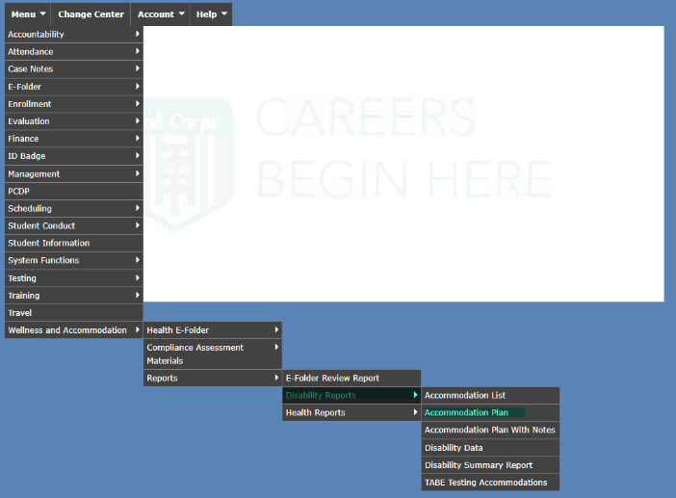
Staff Access to Disability Data and
Accommodation Plans
Is access to the Disability Data Entry Screen, Disability Data Report in CIS limited to only DCs?
Is access to the Accommodation Plan Entry Screen and the Accommodation Plan with Notes Report in CIS limited to only DCs or designee?
Do all center staff responsible for providing accommodations have access to the Accommodation Plan Report in CIS?
Notes:
Is access to the Disability Data Entry Screen, Disability Data Report in CIS limited to only DCs?
- Only the DCs should have access to the Disability Data Entry Screen and the Disability Data Report in CIS.
Is access to the Accommodation Plan Entry Screen and the Accommodation Plan with Notes Report in CIS limited to only DCs or designee?
- Access to the accommodation plan entry screen and the Accommodation Plan with Notes Report must be limited only to DCs and a possible designee.
Do all center staff responsible for providing accommodations have access to the Accommodation Plan Report in CIS?
- The Accommodation Plan Report should be accessible to all staff who implement accommodations on a center-wide basis. For example, if an accommodation is assigned to a responsibility of “all” staff, then all staff need access to that plan to be able to implement the specified accommodation. Please check with your IT/POC to help determine if access to these screens has been appropriately limited.

Slide 20
Screens/Reports | Who Should Have Access | System Functions Report to Verify Access
Disability Data Entry Screen | Only Disability Coordinators | Authorization: WelAcc - Disability Data Collection, Module
Disability Data Report | Only Disability Coordinators | Authorization: WelAcc-Rpt - Disability Data Report, Module
Accommodation Plan Entry Screen | Only Disability Coordinators or Designee | Authorization: WelAcc - Accommodation Plan, Module
Accommodation Plan with Notes Report | Only Disability Coordinator or Designee | Authorization: WelAcc-Rpt - Accommodation Plan Report, Module
Accommodation Plan Report | All Staff | Authorization: WelAcc-Rpt - Accommodation Plan Report, Module
Notes:
Pictured on this slide is a table that identifies who should have access to which screens and reports in CIS. This is also a great tool to share with your IT/POC so they appropriately limit or provide access to staff. The first column, “Screens/Reports” includes the name of the screen/report in CIS, the middle column identifies who should have access, and the column on the right provides the name of the “System Functions Report” in CIS. The System Function Report lists each staff that has access to that screen/report. The DCs or IT/POC can review the system function report to verify that appropriate staff have access.

Slide 21
Conducting a Self-Audit of the
Disability Data Report
21
21
Notes:
Now we are going to review the requirements related to accurately entering and maintaining information in the Disability Data Report.

Slide 22
Quality Control
Disability Data Report vs. AP Report
Look at the TOTAL number of students with accommodation plans on the Accommodation Plan Report and COMPARE it to the TOTAL number of students with accommodation plans in the Disability Data Report.
Do they match?
Notes:
Quality Control Tips - # of APs
Now let’s review some quality control tips that may help you better ensure compliance with disability data and accommodation plan notes requirements.
First, determine if all students with accommodation plans are entered in CIS. Remember, the accommodation plans screens in CIS are a function of the disability program. Only students with disability related accommodations should have accommodation plans entered in CIS. Therefore, every student with an accommodation plan in the accommodation plan report in CIS should have a confirmed disability and should be captured in the Disability Data Report.
Look at the TOTAL number of students with accommodation plans on the Accommodation Plan Report and COMPARE it to the TOTAL number of students with accommodation plans in the Disability Data Report.
Do they match?

Slide 23
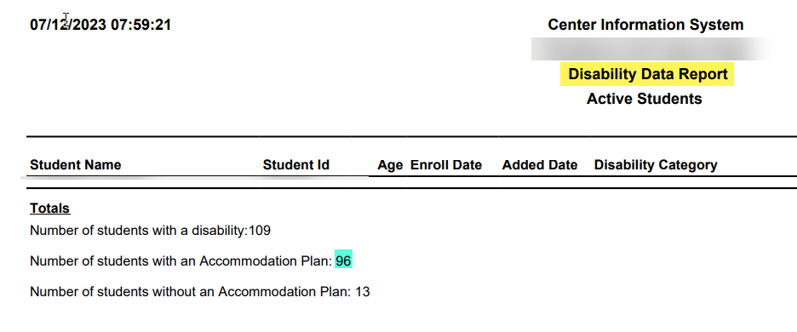
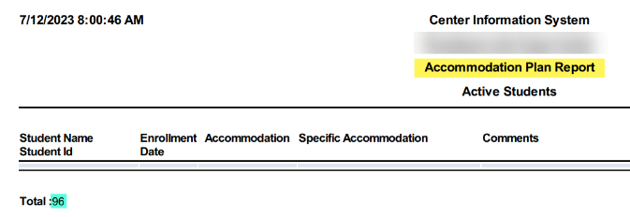
# of APs in the Disability Data Report versus the Accommodation Plan Report
Notes:
Here is an example of the final pages of both a Disability Data Report and an Accommodation Plan Report.
To check to ensure all students with accommodation plans are captured in the Disability Data Report, compare the total number of students listed on the Disability Data Report as having an accommodation plan (which is 96 in the top screenshot) to the total number of students with accommodation plans (which is also 96 in the bottom screenshot) listed on the Accommodation Plan Report. If the numbers do not match, what might be the issue? Answer: Some students might have an accommodation plan but were never entered into disability data.
To resolve, review student name by student name through both reports and identify which students have accommodation plans but have not been added to disability data.

Slide 24
Quality Control
All Conditions Entered
Ensure that all students with disabilities have been entered into disability data and engaged in the interactive accommodation process.
How can you be sure that you have included all students and captured all disabilities?
Notes:
Quality Control Tips – All Conditions Entered
Ensure that all students with disabilities have been entered into disability data and engaged in the interactive accommodation process.
How can you be sure that you have included all students and captured all disabilities?

Slide 25
Are all students with a disability and their corresponding conditions entered into Disability Data?
Review the Disability Data Report. Are only learning or cognitive conditions included?
Does the report list individuals who have mental health, medical, or other types of conditions? If not, why not?
Was all the documentation reviewed from both the accommodation file and the Student Health Record (SHR)?
Are medication records reviewed as some medications may be indicators of a disability?
NOTE! Non-health DCs may assist in reviewing SHRs to ID conditions/assist with ensuring that all students with disabilities have been identified.
Notes:
Are all students with a disability and their corresponding conditions entered into Disability Data?
Review the Disability Data Report. Are only learning or cognitive conditions included?
Does the report list individuals who have mental health, medical, or other types of conditions? If not, why not?
Was all the documentation reviewed from both the accommodation file and the student health record?
Are medication records reviewed as some medications may be indicators of a disability?
NOTE! Non-health DCs may assist in reviewing SHRs to ID conditions/assist with ensuring that all students with disabilities have been identified.

Slide 26
Age | Enroll Date | Added Date
20 | 11/17/22 | 09/07/23
17 | 11/08/23 | 11/08/23
20 | 07/26/23 | 10/02/23
18 | 04/19/23 | 06/03/23
Quality Control
Timely Entry
Compare the students “Enroll Date” with the “Added Date” in the Disability Data Report.
Are students with disabilities being added to this report prior to or on the day of the student’s arrival?
Age | Enroll Date | Added Date
18 | 04/08/23 | 04/01/23
21 | 08/08/23 | 08/08/23
16 | 05/26/23 | 05/16/23
17 | 10/04/23 | 10/03/23
Notes:
Next, review the date a student’s disability data was added to the Disability Data Report to determine if the center is in compliance with time entry requirements. If an applicant discloses a disability and/or requests DA to participate in the Job Corps program during the admissions process, the disability data and if applicable the accommodation plan must be entered in CIS prior to or on the day of the student’s enrollment. If a student does not disclose a disability prior to enrollment, then disability data and if applicable the accommodation plan should be entered soon after receipt of documentation to confirm disability status.
Remember, each document uploaded to CIS indicates the date it was uploaded and who uploaded the document. If documentation of a disability was uploaded by admissions and available prior to the “enroll date” listed in the data collection report, then the date the disability data was added to CIS should be prior to or the same as the enroll date.
Look at the first example and review the enroll dates versus the added dates. Are the entries entered timely?
No
Look at the second example. What about these entries? Were they entered timely?
Yes

Slide 27
Disability Category | Specific Disability
Cognitive | ADHD/ADD
Other Type of Disability (user would specify) | Other
Cognitive | ADHD/ADD
Cognitive | Learning
Quality Control
Disability Data Category
DCs must select a Disability Category even if the Specific Disability will be “Other.”
Disability Categories are meant to capture all types of disabilities so there is likely an appropriate category to choose.
Disability Category | Specific Disability
Mental Health | Other
Mental Health | Serious Emotional Disturbance
Cognitive | Other
Cognitive | ADHD/ADD
Notes:
DCs must select a Disability Category even if the Specific Disability will be “Other.” The disability category captures overarching areas such as medical, cognitive, mental health, etc. The specific disability drop down options are somewhat limited; however, we should be able to determine an overarching category of disability even when we may not be able to determine the specific disability and the specific disability is listed as other.
Look at the first example and the yellow highlighted entry, where “Other Type of Disability (user would specify)” is the Disability Category. The specific disability is listed as “other.” Is this acceptable?
No, update the student’s Disability Category by selecting a Disability Category from the drop-down boxes in the Disability Data Entry Screen.
Look at the second example. Are these “Other” entries acceptable?
Yes

Slide 28
Data Collection Category/ Specific Disability Key Guide
Notes:
Here is a screenshot of the Data Collection Category/Specific Disability Key Guide.
Use the specific disability conditions to help you determine an appropriate disability category.
This resource is available on the Job Corps Support Services Disability Website or through your RDIC.

Slide 29
Conducting a Self-Audit of the Accommodation Plan with Notes Report
29
29
Notes:
Next, we are going to review the requirements of the Accommodation Plan with Notes Report.

Slide 30
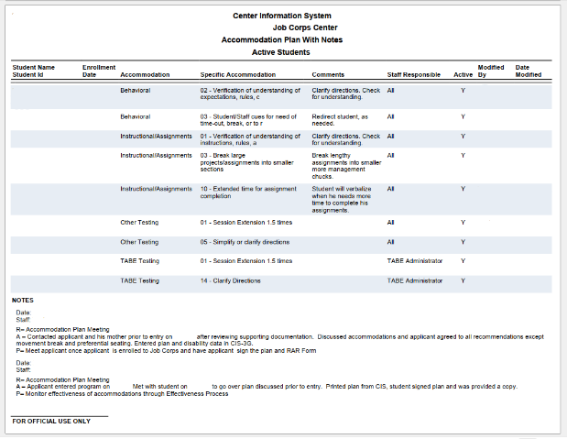
Accommodation and Specific Accommodation Selected From Drop-Down Boxes
Details on how to provide the DA in the comments section
Staff responsible for implementing the DA
Notes documenting the Disability Accommodation Process
Notes:
Let's first review the parts of the Accommodation Plan with Notes Report as it appears in CIS.
Starting at the top of the Accommodation Plan with Notes Report you have the accommodation and specific accommodation drop down options. To the right of that you have the comments box. The comments box should be used to add additional details about what accommodation is needed or how staff are expected to implement the accommodations. The comments box should not reveal any confidential information and we will discuss that in more detail on the next few slides.
Continuing clockwise to the right is the staff responsible drop down. The staff responsible indicates which staff is responsible for implementing the accommodation listed.
Finally at the bottom left is the accommodation notes tab.
It is important to note the difference between the comments box which is a part of the accommodation plan that all staff have access to and therefore should not contain confidential information and the accommodation notes tab, which is confidential and only the DCs and their designees should have access to view or enter information in the notes.

Slide 31
Confidential Information
31
31
Notes:
Maintaining the appropriate confidentiality of both personally identifiable information and protected health information is essential and required by law. Let’s review some areas where protected (confidential) information may be inadvertently disclosed.

Slide 32
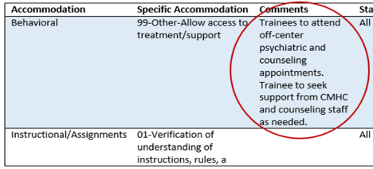
Quality Control
Confidential Information
Do the accommodation plan comments contain confidential or protected health information?
Do you see key words or phrases (or acronyms) that divulge protected health or disability specific information?
IEP, CMHC, anxiety, substance-use counseling
Notes:
Quality Control Tips – Confidential Information
Do the accommodation plan comments contain confidential or protected health information? Do you see key words or phrases (or acronyms) that divulge protected health or disability specific information?
IEP, CMHC, anxiety, substance-use counseling, access to snacks for diabetes, etc.
Confidential information must not be captured in the comments field. The comments box should be used to clarify the accommodation and specific accommodation the DC captured in the drop-down options so it is clear for staff implementing the accommodation what the accommodation is and how to implement it, but the comments box should not provide details about why the accommodation is needed. For example, stating that an accommodation is due to a seizure disorder would not be appropriate or acceptable.
Look at the first example on the slide. “Trainee to attend off-center psychiatric and counseling appointments. Trainee to seek support form the CMHC and counseling staff as needed.” What do you think?
The accommodation is for a schedule adjustment and/or for a pass to Wellness or Counseling. The comments should reflect when the student is allowed the schedule adjustment or pass and not WHY they were granted the accommodation. This example discloses protected health information.
Look at the second example on the slide. “Due to hearing loss.” What do you think?
Comments should focus on “what” accommodation is needed or “how” the accommodation should be implemented for the student rather than “why” the DA is needed which potentially divulges confidential, disability-related information as we just reviewed in the previous slide.
Ensure no confidential information or functional limitations is included in the comments. Again, confidential/protected information includes such things as
medical information
diagnoses
references to medication monitoring
references to specific QHPs
references to the types of disability documentation disclosed such as IEPs/504 plans
…and functional limitations may include such things as
angers easily
experiences anxiety in groups
has trouble recalling facts from recently read content

Slide 33
How do you ensure that accommodation plans do not contain confidential information?
Review the comments field within your Accommodation Plan with Notes Report and check to ensure that accommodation plans do not contain confidential information (i.e., medical information, diagnostic information, references to disability documentation such as an IEP or a CCMP).
The comments also must not include identification of specific functional limitations such as the student experiences anxiety or anger.
If any confidential information is noted, adjust/remove those comments so that NO confidential/protected health information is divulged.
Notes:
How do you ensure that accommodation plans do not contain confidential information?
Review the comments field within your Accommodation Plan with Notes Report and check to ensure that accommodation plans do not contain confidential information (i.e., medical information, diagnostic information, references to disability documentation such as an IEP or a CCMP). The comments also must not include identification of specific functional limitations such as the student experiences anxiety or anger. If any confidential information is noted, adjust/remove those comments so that NO confidential/protected health information is divulged.

Slide 34
Disability Accommodations
for Testing
34
34
Notes:
Let’s talk about testing accommodations.

Slide 35
Quality Control
DA Listed as “Other”
Are “Other” DA created when there are drop down selections available?
Are “Other” DA accompanied by additional details in the comments or description box that provide sufficient details about what support to implement?
Notes:
Quality Control - DA Listed as “Other”
Are “Other” DA created when there are drop down selections available?
Are “Other” DA accompanied by additional details in the comments or description box that provide sufficient details about what support to implement?
We have already established how critically important it is to ensure that accommodations are clearly stated so that all staff responsible for implementing the accommodation are clear as to what the accommodation is or includes.

Slide 36
DA Listed as “Other”
Quality Control
DA Listed as “Other”
Tips
Notes:
Look at the first example. It says, “OTHER” but there are no comments included. This accommodation cannot be implemented as entered.
Now look at the second example that states, “Remove one wrong answer (only 3 choices to choose from).” Now the staff have the necessary information to implement this accommodation.
If there isn’t a specific drop-down option for an agreed upon accommodation, please use the comments section to specify how staff can provide DA for the student.

Slide 37
Quality Control
Only DA for Testing
Does the need for testing DA also indicate a potential need for similar DA in other areas (not all inclusive)? For example
assignments
behavior
environmental
assistive technology
Notes:
Quality Control - Only DA for Testing
Does the need for testing DA also indicate a potential need for similar DA in other areas (not all inclusive)? For example
assignments
behavior
environmental
assistive technology
When reviewing accommodation plans, be mindful of whether accommodations reflect providing access center-wide. Given that Job Corps is a residential program with recreation programs, food services, etc., it would be uncommon to see accommodations for all students with disabilities focused only on academic or testing environments. The DC should determine how each functional limitation impacts the student in each area of the Job Corps program and assign responsibility for implementation of each accommodation accordingly.

Slide 38
Only DA for Testing
Quality Control
DA Listed as “Other”
Notes:
Look at the example. Does this accommodation plan reflect testing considerations in other areas of the program?
No

Slide 39
Only Testing DA
Are DA offered on tests also being offered in the instructional environment?
Are DA being considered for all areas on center (recreation, residential, trade, Work-based Learning)?
Are there notes indicating the student rejected previously used or other related DA that were offered?
Are all DA being provided to the student captured in the accommodation plan?
Notes:
A few questions to consider:
Are the DA offered on tests also being offered in the instructional environment?
Are DA being considered for all areas on center (recreation, residential, trade, Work-based Learning)?
Are there notes indicating the student rejected previously used or other related DA that were offered?
Are all DA being provided to the student captured in the accommodation plan?
Use the drop-down boxes in the accommodation plan entry screen in CIS to add accommodations (based on appropriate supporting documentation and interactive process with student) outside the testing environment or center-wide, as needed.
Look at the example at the bottom of the screen. What do you think about this sample AP? It reflects accommodations that are testing related being provided in other areas of the center such as extended time for both assignment completion and other testing.

Slide 40
Behavioral Supports
40
40
Notes:
Next, we are going to discuss behavioral supports within accommodation plans. Post Covid, there has been an increase in need for emotional and behavioral supports. It is critically important that DA are considered for all areas of functional limitation, including the need for behavior support.

Slide 41
Quality Control
Behavioral Supports
Are there few or no accommodation plans with behavior supports?
Do students with mental health disabilities appear to have adequate behavior supports?
Are there notes indicating behavior concerns?
If so, are there DA to support the behavior(s) in the accommodation plan?
Notes:
Some questions to consider:
Are there few or no accommodation plans with behavior supports?
Do students with mental health disabilities appear to have adequate behavior supports?
Are there notes indicating behavior concerns?
If so, are there DA to support the behavior(s) in the accommodation plan?
Use the drop-down boxes in the accommodation plan entry screen in CIS to select appropriate behavioral supports (based on appropriate supporting documentation and interactive process with student) and use the comments box to specific details about the DA as necessary.

Slide 42
Behavioral Supports
Quality Control
DA Listed as “Other”
Notes:
Let’s review a couple of examples of behavioral accommodations, specifically positive behavior supports and their associated comments.
In the first example, it states to “Please allow use of a quiet fidget item.” Do you think this comment sufficiently explains what staff need to do to implement the accommodation?
This accommodation is clarified by the additional comments provided so that all staff are clear as to what accommodation they must implement. We all know that the accommodation is the use of a quiet fidget item.
In the second example, it states to “Provide positive reinforcement. If student makes a mistake, provide encouragement to do better.” Do you think these comments sufficiently explain what staff need to do to implement the accommodation?
If the comment had only stated to “Provide positive reinforcement,” it still would not have been clear exactly what that means or when the positive reinforcement is needed. The second sentences provides the additional clarity that staff need, “If student makes a mistake, provide encouragement to do better.”

Slide 43
Accommodation Notes Tab
43
43
Notes:
The accommodation notes tab is where centers are responsible for capturing details of the interactive accommodation process for every student with an accommodation plan.

Slide 44
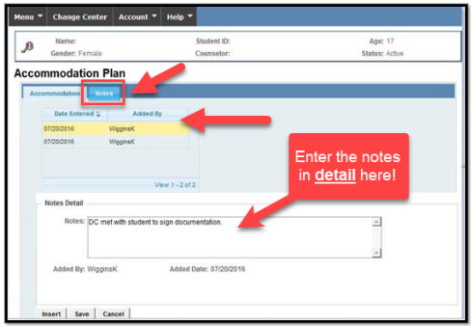
Quality Control
Accommodation Notes Tab
Do all students have an initial note that explains how/when the DA process started?
Do all students have notes indicating effectiveness reviews are occurring at least every 60 days?
Do notes provide enough detail for the reader to understand what has occurred in each step of the process?
Notes:
Quality Control Tips – Accommodation Notes Tab
Do all students have an initial note that explains how/when the DA process started?
Do all students have notes indicating effectiveness reviews are occurring at least every 60 days?
Do notes provide enough detail for the reader to understand what has occurred in each step of the process?
Accommodation notes should detail the disability accommodation process from initial contact until separation. The notes should provide the reader enough detail to understand what has occurred in each step of the process and should include such details as the following:
Disability Accommodation Committee (DAC) calls/meetings conducted, which might include calls/meeting for
Work-based Learning/off-center training accommodation needs
Accommodation effectiveness reviews
Referral for disability status/potential DA needs
Requests for DA for career technical certification examinations/HSE examinations
Coordination with community resources/partners to secure needed support resources
Appropriate maintenance of accommodation notes demonstrate evidence of compliance with PRH requirements.

Slide 45
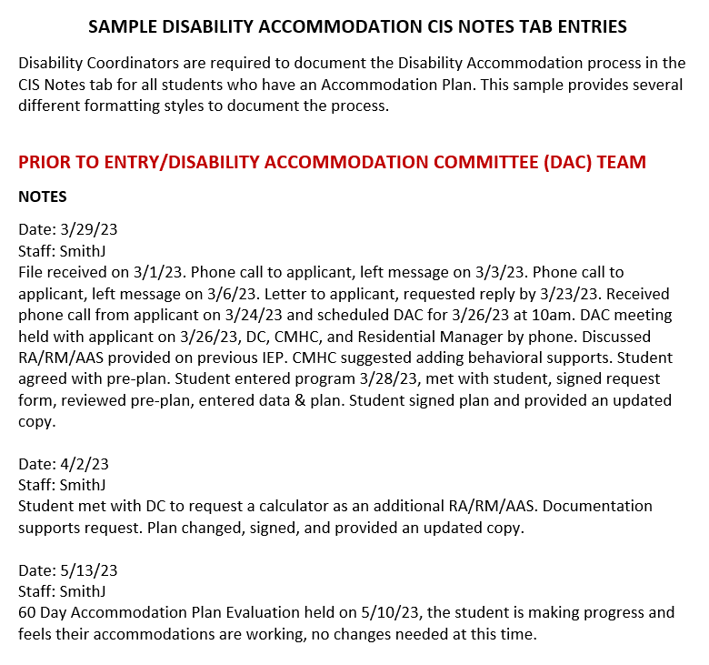
Sample Disability Accommodation CIS Notes Tab Entries
The “Sample Disability Accommodation CIS Notes Tab Entries” document is available in the Frequently Requested Tools section located on the Home Page of the Disability Website.
Notes:
There is a Sample Disability Accommodation CIS Notes Tab Entries document that can be found on the Job Corps Disability Website. The “Sample Disability Accommodation CIS Notes Tab Entries” document is available in the Frequently Requested Tools section located on the Home Page of the Job Corps Disability Website.

Slide 46
What Do You Think? AP Notes Review
Let’s review this scenario line by line…
E-Folder contains an IEP uploaded by Admissions on 2/1/23.
Student enrolls on 3/5/23.
Initial note is dated 4/5/23 and states that student has an IEP and met with student to discuss accommodation needs and plan developed and was entered on 3/31/23.
Notes:
What Do You Think? AP Notes Review
Let’s review this scenario line by line…
E-Folder contains an IEP uploaded by Admissions on 2/1/23.
What do we know by this statement? That Admissions uploaded the IEP and it is likely a document that has been made available pre-arrival; however, the center can confirm the dates of the upload and if a student, compare the dates of the upload to the date of arrival. If disclosure occurs pre-arrival, then the center must contact the individual to discuss/review accommodations before they arrive on center. PRH policy requires making this contact prior to assigning a start date but what is critically important is to ensure that any needed reasonable disability accommodations are in place and ready to implement upon arrival.
Student enrolls on 3/5/23.
Now the note confirms that the student enrolled on 3/5/23.
Initial note is dated 4/5/23 and states that student has an IEP and met with student to discuss accommodation needs and plan developed and was entered on 3/31/23.
Any concerns?
Concerns:
No pre-arrival call
Did not meet with student upon arrival and because no pre-arrival or meeting with DC upon arrival, an accommodation plan was not in place upon arrival.
If TABE accommodations were needed on the first test, the accommodations would not have been entered on time.
Initial note entry was late.

Slide 47
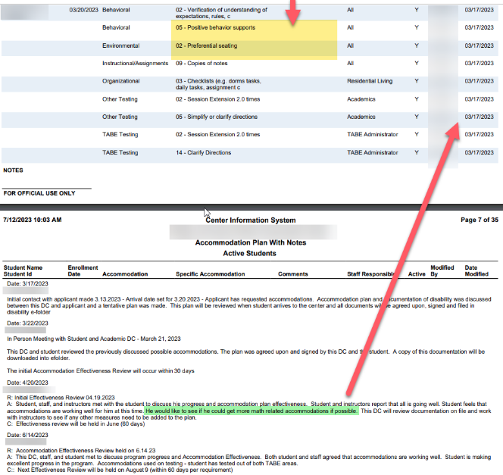
What Do You Think? AP Notes Review
As an aside, are comments needed to understand what specific accommodations are needed?
Was there follow up on the information noted in the April Effectiveness Review regarding student request for more math accommodations?
Notes:
What Do You Think? AP Notes Review
During an effectiveness review in April 2023, the student mentions that they would like to have more math related accommodations if possible. The note does not explain what math accommodations the individual wishes to have considered but does state that the DC will review the documentation and work with instructors.
Any concerns?
There should have been a follow-up note that specifically addressed the outcome of this request. Some other information/considerations - The student tested out of math and reading TABE testing but it is not clear whether math accommodations would be needed for high school or GED classes or even for the career technical training area. At a minimum, there should have been follow-up on the original request.
As an aside, look at the yellow highlighted accommodations. There are no comments so it would not be clear to staff as to what positive behavior supports needed to be implemented or what preferential seating was needed (e.g., seated near teacher/instructor, away from traffic flow within the space, away from windows, at the back of the room, etc.

Slide 48
Updating Vague/Incomplete Notes
When the center either conducts self-audits or receives feedback that there may be an issue with the center’s notes, then the center should add an additional note with the missing or clarifying details even though it is after the fact.
Contact your Regional Disability Coordinator if you have questions or need assistance with clarifying AP notes.
Notes:
When the center either conducts self-audits or receives feedback that there may be an issue with the center’s notes, then the center should add an additional note with the missing or clarifying details even though it is after the fact.
Contact your Regional Disability Coordinator if you have questions or need assistance with clarifying AP notes.

Slide 49
Other Considerations
49
49
Notes:
A few other important topics related to accommodation plan and notes requirements.

Slide 50
Documentation to Support DA
Do the notes indicate the student may not have documentation to support the accommodations being provided?
Do the notes indicate the accommodations are being provided for reasons other than having a disability (e.g., ELL, religious accommodations, transgender etc.)?
Are there accommodations that do not match the disability listed in the disability data report (e.g., student who has diabetes receiving a calculator on the TABE)?
Accommodation Notes Tab example from center: Entry to center 1/24/24. Student reports new disability of a Learning disability with trouble processing. No documentation on file. Will have release signed to obtain this. Email to Academic Manager for this. RAM/RM/AAS request completed Today. DA were added to CIS.
Accommodation Notes Tab example from center: Met with student on 8-10-23, sent records release to previous school, after arrival, received records on 11-9-23, gave to DC to write up DA, received paperwork back on 11-22-23, sent pass to meet with student on 12-5-23 to sign paperwork. Added agreed upon DA to CIS.
Notes:
Documentation to Support Disability Accommodations
Let’s look at the first example.
Do the notes indicate the student may not have documentation to support the accommodations being provided?
Do the notes indicate the accommodations are being provided for reasons other than having a disability (e.g., ELL, religious accommodations, transgender etc.)?
Are there accommodations that do not match the disability listed in the disability data report (e.g., student who has diabetes receiving a calculator on the TABE)?
Was the documentation of disability ever received? Maybe it was but we can’t tell from the notes whether it was or was not. If no documentation of disability was ever received, inform the student that documentation of the disability is required to continue to provide the accommodations and if not received, remove those accommodation plans from CIS. Additionally, since this only pertains to a request by the student thus far, a note should have not yet been entered and an AP should not have been created.
What about the second example? Yes, this example contains all the necessary info – when documentation requested, when received, when the DC met with the student and when the information was added to CIS.

Slide 51
Center Denying DA
Are there notes or comments indicating that DA were denied by the center?
Accommodation Notes Tab Example from center: 5/11/23 telephone call to applicant 5/2/23 discussed no resource room and cannot provide note taker. Cannot modify curriculum and no time outs. Student wants electrical.
Notes:
Are there notes that document that disability accommodations were denied by the center?
For example: “5/11/22 telephone call to applicant; 5/2/22 discussed no resource room and cannot provide note taker. Cannot modify curriculum and no time outs. Student wants electrical.”
No DA may be denied at the center level. Review PRH Form 2-03 for guidance on the process for submitting a reasonableness determination and contact your Regional Disability Coordinator for assistance!

Slide 52
Specific Staff Refusing to Provide DA
Are there notes or comments indicating that specific staff are refusing to provide DA?
Accommodation Notes Tab Example from center: 6/13/23 Effectiveness Review – student reported his math instructor does not allow him to use his calculator on assignments, even after the student reminded the instructor that a calculator is listed in his accommodation plan.
Notes:
Are there notes or comments indicating that specific staff are refusing to provide DA?
“6/13/22 Effectiveness Review – student reported his math instructor does not allow him to use his calculator on assignments, even after the student reminded the instructor that a calculator is listed in his accommodation plan.”
Provide DA as indicated in the accommodation plan. If the center feels a DA cannot be provided, please reach out to your Regional Disability Coordinator.

Slide 53
DA in the Notes Tab
Are DA listed in the CIS Accommodation Notes tab that should be captured using the accommodation drop down list?
Notes:
Are DA listed in the CIS Accommodation Notes tab that should be captured using the accommodation drop down list?
For example: “Organizational – Graphic organizers; Instructional/Assignment: Break large projects/assignments into smaller section; Behavior – Time-out/break area; Instructional/Assignment – Student/staff cues for need of time-out, break; Environmental – headphones; TABE Testing – Extended time 1.5 times, Read Directions, Use of calculator; Other Testing – Use of calculator.
We can see that the “Use of the calculator,” for example is not in the accommodation plan which only shows accommodations under Other Testing as small group setting and audio-taped administration.
Only the DCs have access to the CIS Accommodation Notes tab; therefore, any DA listed in the CIS Accommodation Notes tab and not in the accommodation plan would not be seen by staff responsible for providing the DA.

Slide 54
DA in the Notes Tab
Accommodation Notes Tab Example: The student requested DA for organizational, instructional/assignment, and testing environments. The DC reviewed the student’s disability documentation which supports the request. The DA were added to the accommodation plan. Staff were notified of the updated accommodation plan in CIS.
Notes:
Ensure that all accommodations are entered into the accommodation plan. In this example, the DC added all agreed upon DA to the accommodation plan by utilizing the appropriate drop-down boxes.

Slide 55
Inactivating DA
Are student DA listed as inactive?
If the student previously agreed to disability accommodations but no longer wants them the DA should be made inactive (N).
Review the “active” column in the accommodation plan (third from the left), to see if the DA the student no longer wishes to receive is listed as active (Y) or inactive (N).
Accommodation Notes Tab example from center: All TABE and instructional DA deactivated. ‘Other Testing’ active. Student reported is and has made good progress and in agreement with updated plan.
Notes:
Are student DA listed as inactive? If the student previously agreed to disability accommodations but no longer wants them the DA should be made inactive (N).
Review the “active” column in the accommodation plan to see if the disability accommodations the student no longer wishes to receive is listed as active (Y) or inactive (N).
If the student decides they no longer want any disability accommodations, inactivate them in the accommodation plan entry screen and document in the CIS Accommodation Notes tab why the plan is no longer required. The student's disability(ies) should continue to be reflected in data report.

Slide 56
Staff Entering Accommodation Plans
Access to Accommodation Plans Entry screens should be limited to DCs only. Are staff other than the DCs entering the accommodation plans/notes?
Notes:
Access to Accommodation Plans Entry Screens should be limited to DCs only.
Are staff other than the DCs entering the accommodation plans/notes?
Ensure the center’s CIS POC has limited access to the accommodation plan entry screen to the DCs only.

Slide 57
Resources
57
57
Notes:
Let’s review some Data and AP resources available on the Job Corps Disability Website.

Slide 58
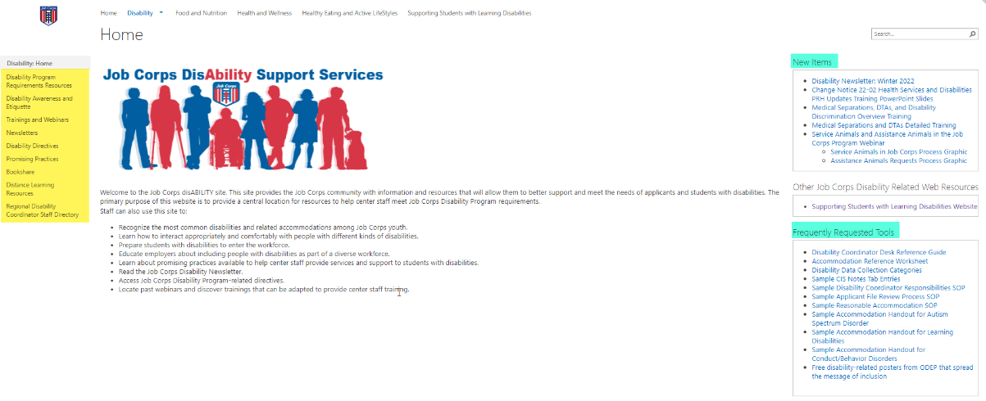
Job Corps Disability Support Services Website https://supportservices.jobcorps.gov/disability/Pages/default.aspx

Slide 59
Questions?
59
Notes:
Questions?

