Slide 1
General Disability and Other
Disability Program
Requirements
Disability Coordinator Orientation – Part 3
Notes:
Welcome to Disability Coordinator Orientation – Part 3 webinar, the Other Disability Program Requirements. Part 3 covers the remaining requirements of the Disability Program such as Disability Coordinators responsibilities, partnerships, barrier removal and staff training requirements.
​

Slide 2
Objectives
Requirements
Disability Coordinators
Tools/Resources
List the OTHER Disability Program requirements.
Articulate the roles and responsibilities of the Disability Coordinators.
Identify two tools available to assist in meeting Disability Program-related requirements.
Due Dates
List relevant date due requirements for specific components of the Disability Program such as for barrier removal and staff training.
2
Notes:
We have 5 primary objectives today so our goal is that by the end of this webinar, you will be able to:​
Requirements: List the OTHER Disability Program requirements (as we just discussed in the previous slide)
Disability Coordinators: Articulate the roles and responsibilities of the Disability Coordinators.
Tools/Resources: Identify two tools available to assist in meeting Disability Program-related requirements.
Due Dates: List relevant date due requirements for specific components of the Disability Program such as for barrier removal and staff training.

Slide 3
Introduction to Center Life
Disability Coordinators
PRH-2: 2.4, R1; PRH-3: 3.4, R1
3
3
Notes:
There are two components in this section to review and discuss. (1) The appointment of Disability Coordinators and oversight of the Disability Program, and (2) a general introduction of the Disability Program.

Slide 4
Disability Coordinators
The Health and Wellness Director (HWD) (or a health staff designee) and Academic Manager (or an academic staff designee) will function as Disability Coordinators (DC) to oversee the program.
Additional DCs may be appointed.
Centers may choose to hire a full or part time DC to oversee the program rather than or in addition to appointing an academic and health DC.
4
Notes:
The Health and Wellness Director (HWD) (or a health staff designee) and Academic Manager (or an academic staff designee) will function as Disability Coordinators (DC) to oversee the program. However, additional DCs may be appointed as needed and should be appointed to serve as back-ups if the primary DC(s) are out or the DC role becomes vacant.
Centers also may opt to hire a full or part-time DC to oversee the program rather than or in addition to appointing an academic and health DC.

Slide 5
Meeting with DCs
New students must have a variety of opportunities to meet and interact with Disability Coordinators.
5
5
Notes:
New students must have a variety of opportunities to meet and interact with Disability Coordinators. When we move into the Disability Program Introduction, we will talk about a number of ways that you can meet both the Meeting with DCs and the Disability Program Introduction requirements.

Slide 6
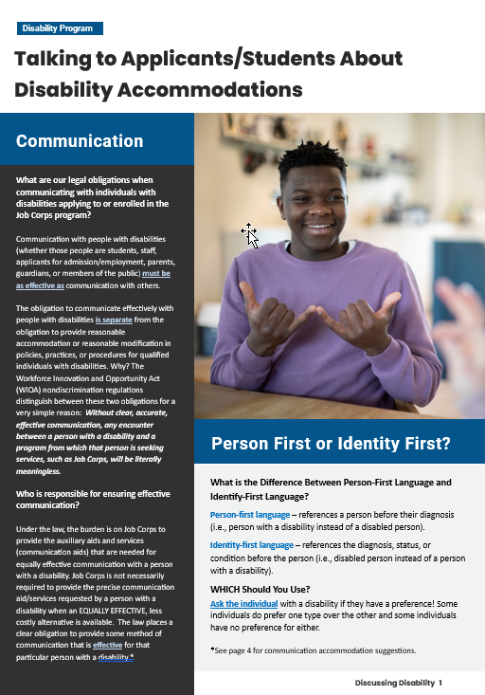
Talking to Applicants/Students About Disability Accommodations (DA)
Communication Requirements and Communication Accommodation Examples
Sample Scripts
Discussing Disability
Suspicion of Disability
Disclosures of Conditions on the 653
Checked “Yes” to Needing DA on the 653
This resource is located on the Job Corps Disability Website!
6
Notes:
We have recently updated the Talking to Applicants/Students About Disability Accommodations Guide. This document now covers:
general communication requirements for communicating or talking with an individual with a disability
sample communication accommodations
basic recommendations for deciding whether to use person first or identity first language when communicating with or about individuals with a disability
sample scripts for talking with students with a disability, with individuals who disclose a disability via the 653, Health Questionnaire, who check “yes” on the 653 for needing disability accommodations, or when the Disability Coordinator has received a referral of suspicion of a disability.
This resource is located on the Job Corps Disability Website!

Slide 7
Disability Program Introduction
PRH-3: 3.4, R2
7
Notes:
The next requirement is to ensure that all new students are provided information on the Disability Program. Let’s explore some options for meeting this requirement.

Slide 8
Provide Information!
Centers must provide new students with information that will lead to an understanding of the opportunities and benefits available as part of the center’s Disability Program.
https://jcmarketplace.com/product/reasonable-accommodation-flier/
8
Notes:
Centers must provide new students with information that will lead to an understanding of the opportunities and benefits available as part of the center’s Disability Program. MP&F produces a 2-page flyer that you can order and hand out to all new students and the screenshot of the first page is on the right-hand side of the slide.
The link to the flyer is at the bottom left-hand side of the slide.

Slide 9
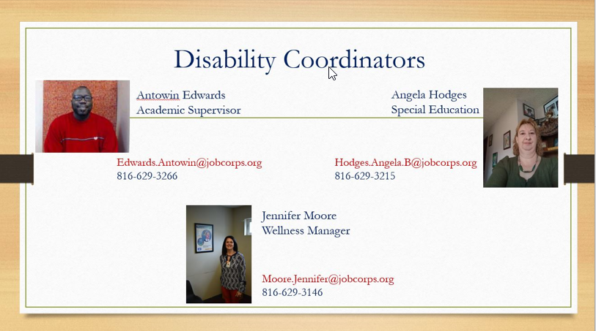
Provide Opportunities!
New Student
Orientation Sessions
Centers must provide a variety of opportunities for new students to meet and interact with the DCs.
9
Notes:
Provide opportunities for students to meet and interact with the center’s Disability Coordinators. In a nutshell, this about how you are disseminating information about the program to ensure students are getting the support they need. Are you handing out information related to the benefits of disclosing a disability and what accommodations are? Is it clear that you are the person to talk to in the case they may need accommodations?
Creating bulletin boards and flyers that have pictures of the Disability Coordinators, your contact information, and even in some cases where you are located can be very helpful to students.
Many thanks to all the centers who shared examples of their resources. On this slide is a bulletin board showcasing the center Disability Coordinators from Excelsior Springs Job Corps.

Slide 10
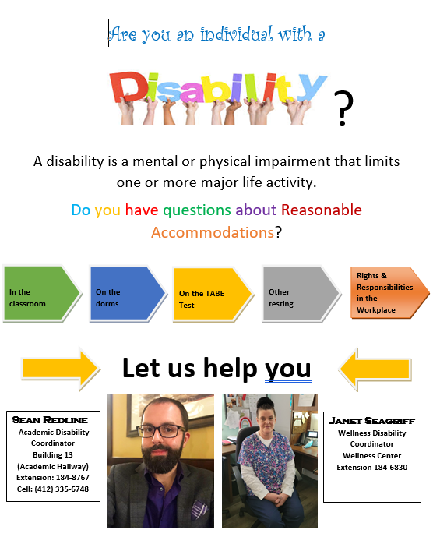
Posters Identifying Center Disability Coordinators
10
Notes:
Here are a couple of bright and catchy flyers being used by the Muhlenberg Job Corps Center on the left and the Pittsburgh Job Corps Center on the right.

Slide 11
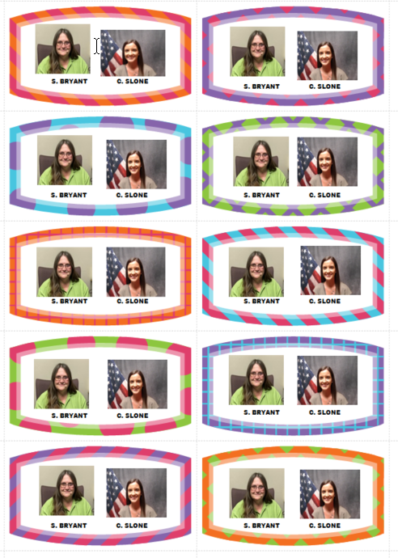
DC (Picture) Business Cards!
Carl D. Perkins Job Corps
11
Notes:
Carl D. Perkins had an innovative idea! Create business cards with pics of the DCs and their contact information!

Slide 12
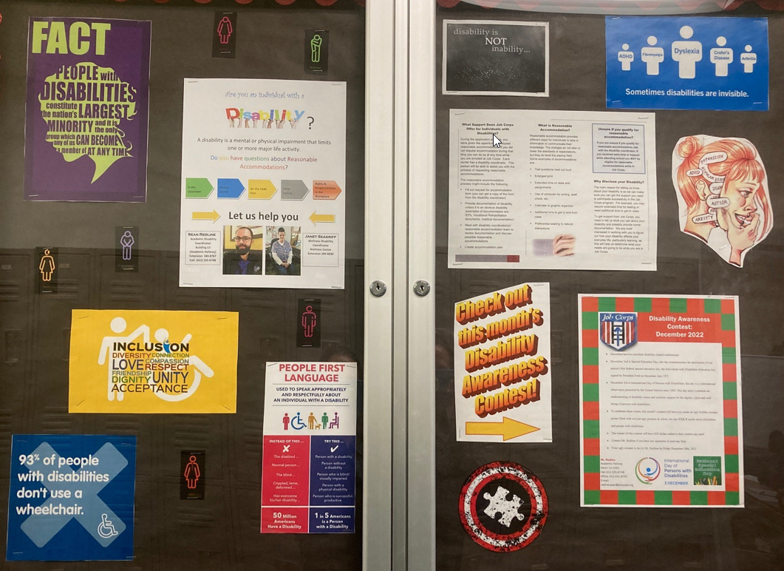
Bulletin Boards
Provide disability-related information
Promote inclusion
Inform students of disability-related supports and services
Announce essay and poster contests on related disability topics
Pittsburgh Job Corps Center
Notes:
Pittsburgh also developed this bulletin board loaded with great information showcasing information about disabilities, person first language, Disability Coordinator pictures and contact information and even advertised a center Disability Awareness contest. These awareness bulletin boards, posters, etc. do more than just advertise who the DCs are for your center. They provide a foundation for establishing a positive culture on your center for students who have disabilities.

Slide 13
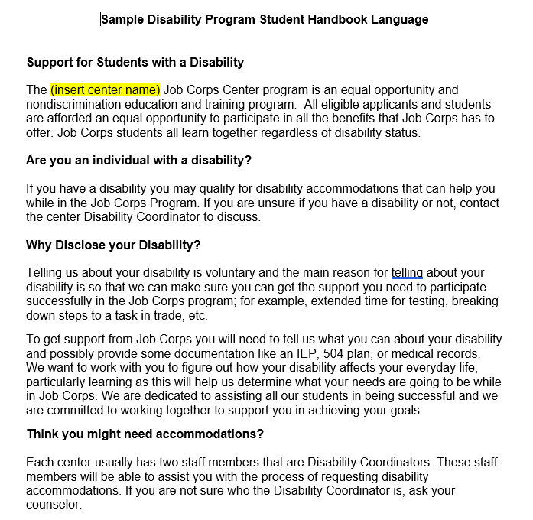
Student Handbook!
The student handbook must include information about the Disability Program.
13
13
Notes:
The student handbook must include information about the Disability Program. There is updated sample handbook language available on the Job Corps Disability Website.
Some students won’t disclose their needs right away. Is there information in the handbook so the student can reference it at a later time? A great tip is to make your handbook available in various formats like in larger print or electronically so that a screen reader can be used so that it is accessible to ALL students.
As you update your student handbooks, be sure to update the language you are using to match existing PRH language (e.g., disability accommodations instead of reasonable accommodations).

Slide 14
Partnerships/Resources for Individuals with Disabilities
PRH-5: 5.1, R34
14
14
Notes:
The next requirement is for the center to develop partnerships and resources to assist with supporting individuals with disabilities in the Job Corps program.

Slide 15
Partnerships/ Resources for Individuals with Disabilities
Each center must develop resources and partnerships with outside agencies and programs that will assist the center in serving students with disabilities.
Special focus should be given to developing resources and partnerships that can assist the center in identifying or providing accommodation support that promotes student independence and employability.
Policy Requirement and Focus
15
Notes:
Each center must develop resources and partnerships with outside agencies and programs that will assist the center in serving students with disabilities. In doing so, special focus should be given to developing resources and partnerships that can assist the center in identifying or providing accommodation support that promotes student independence and employability.
Partnerships can significantly enhance access for students with disabilities and enable greater participation in the Job Corps program. They also connect students with disabilities to valuable community resources that possibly can be used in transitioning to the workforce and thereafter. We will review some exciting examples of center partnerships shortly.

Slide 16
Other Center Staff’s Involvement
Your center’s Qualified Health Professionals (QHPs) such as CMHCs and TEAP Specialists may have community connections that would be helpful!
Other appropriate staff should be involved in the process
Involve Administration, Career Transition or other staff tasked with developing community support and/or relationships.
16
16
Notes:
Never forget that the Disability Program is a center-wide effort and responsibility. Policy requires that other appropriate staff should be involved in the process. Your center’s Qualified Health Professionals (QHPs) such as CMHCs and TEAP Specialists may have community connections that would be helpful!
Career Counselors may have community connections with a wide variety of potential partners that could assist the center in supporting students with disabilities. Involve Administration, Career Transition, or other staff tasked with developing community supports and/or relationships who could invite disability-related organizations to join community relations council or workforce council activities and more.
Just FYI in case it comes up (RE: BCL)
Technically the requirement says…
The Business Community Liaison (BCL) and Other appropriate staff should be involved in the process, but PRH Change Notice 15-07 released on 12/11/15 eliminated the requirement for a BCL position

Slide 17
Disability Partnership Tool
Each center will document efforts to develop resources/partners by completing the Disability Partnership Tool available on the Job Corps Disability Website or their customized Disability Partnership Tool available from their Regional Disability Coordinator.
17
17
Notes:
Each center will document efforts to develop resources/partners by completing the Disability Partnership Tool available on the Job Corps Disability Website or their customized Disability Partnership Tool available from their Regional Disability Coordinator. A new customized disability partnership tool is sent out to centers each fall. A new tool does not have to be created year to year, but the centers should use the tool as a working document to write down efforts to contact or meet, updates, and contact information related to developing and maintaining partnerships in the community.

Slide 18
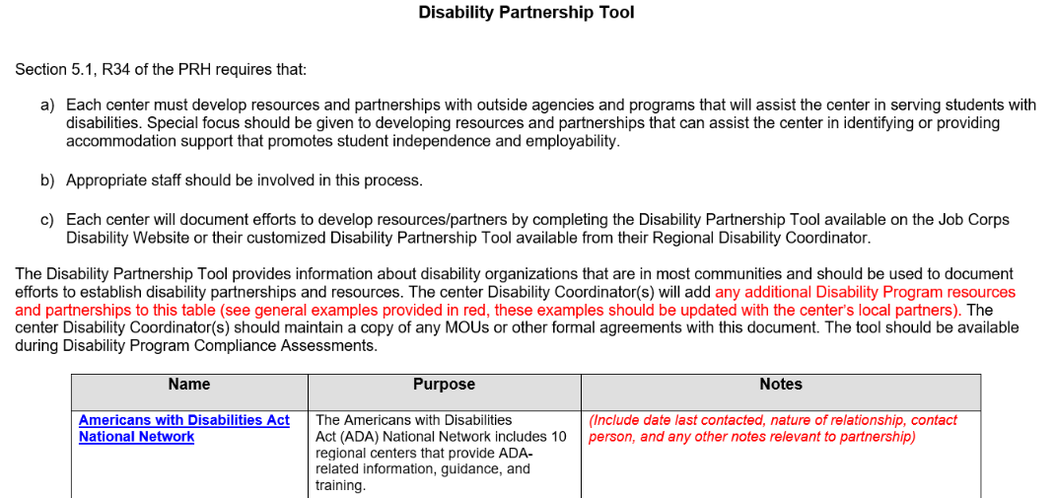
Ensure that your center’s tool includes updated contact information to includes dates of contact, outcomes of the contact, etc.
Notes:
Very important!
As we just discussed, you do not have to create a new tool every year but your tool should be reflective of current and active partnerships. Within the Notes section of the tool, ensure that updated contact information such as dates of contact, outcomes of the contact, etc. are included. On the screen, we have provided an example of the type of documentation that should be included within the tool. Presenter Note: Review the “Centers for Independent Living” example.
It is not expected that the center will be in active partnership with each of the organizations listed. The pre-populated resources are there to help you get started and are merely suggestions based on national availability. Many of them may have local chapters near you or a big online presence, like the Job Accommodation Network.
Partnerships should be made with organizations that are helpful and make sense for your center. As you develop your own partnerships, you can edit the tool as needed. Building partnerships is a process that occurs over time and where there is mutual benefit, those partnerships can last for years.

Slide 19
Disability Program Partnership Tool (Examples) Centers for Independent Living
Centers for Independent Living (CILs) work with individuals to promote leadership and independence as well with local communities to remove barriers to independence.
CILs can provide individuals advocacy, peer counseling, independent living skills training, information and referral, and transition services for youth.
Services to the community include systems change advocacy, disability awareness, community education, and technical assistance regarding accessibility and disability-related legislation.
http://www.virtualcil.net/cils/
Notes:
Centers for Independent Living are one example of possible disability partner that is included on the Disability Program Partnership Tool. Why is this type of relationship potentially valuable?
Centers for Independent Living (CILs) work with individuals to promote leadership and independence as well with local communities to remove barriers to independence.
CILs can provide individuals advocacy, peer counseling, independent living skills training, information and referral, and transition services for youth.
Services to the community include systems change advocacy, disability awareness, community education, and technical assistance regarding accessibility and disability-related legislation
As a fellow WIOA partner, CILs have partnership requirements of their own, so this is one partnership where both parties can benefit from each other. CILs are highly involved in the community and are often very knowledgeable of most if not all disability related resources in your area and we highly recommend reaching out to them when you are starting partnership building for your center!

Slide 20
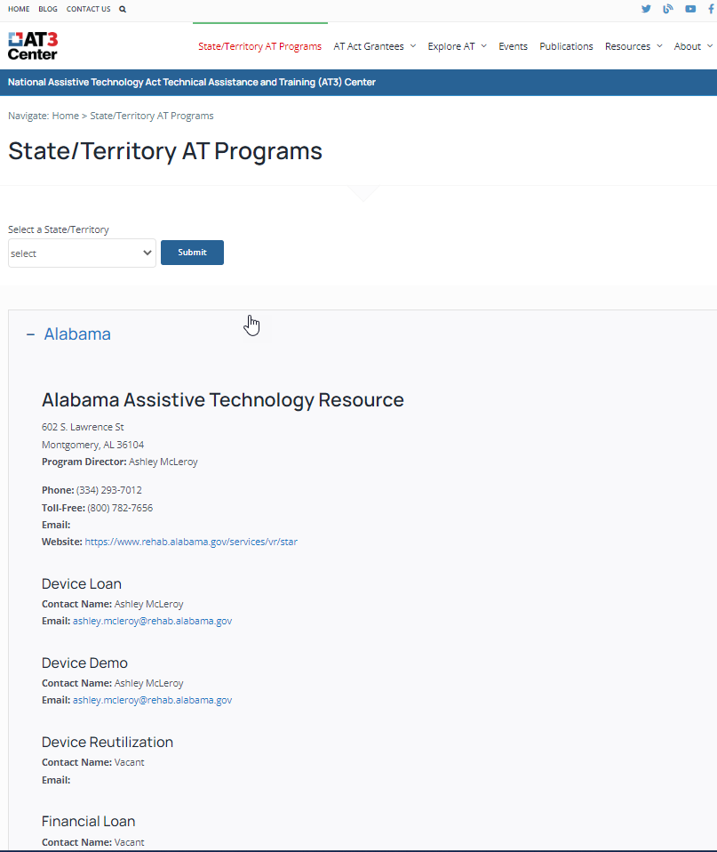
Disability Program Partnership Tool (Examples) State Assistive Technology Act Programs
Works to improve the provision of assistive technology to individuals with disabilities of all ages through comprehensive statewide programs of technology-related assistance
Provides training, technical assistance, loan programs, and other services
https://www.ataporg.org/about
https://www.at3center.net/stateprogram
Notes:
Another possible partner is State Assistive Technology Act Programs often referred to as State AT Programs. The State AT Program Works to improve the provision of assistive technology to individuals with disabilities of all ages through comprehensive statewide programs of technology-related assistance. They do this through AT loan programs and other services. State AT Programs are excellent resources to provide training and assistive technology technical assistance. If you go to the second link at the bottom of the page, it will take you to a list of all the State AT Programs and you can see a screenshot of that resource on the right hand of the slide.

Slide 21
Disability Program Partnership Tool (Examples) Job Accommodation Network
The Job Accommodation Network (JAN) is a free consulting service funded by the U.S. Department of Labor’s Office of Disability Employment Policy.
JAN provides practical guidance and technical assistance on job accommodation solutions and Title I of the Americans with Disabilities Act (ADA) and related legislation.
https://askjan.org/
Notes:
Another partner that we routinely encourage centers to engage with is the Job Accommodation Network (JAN).
The Job Accommodation Network (JAN) is a free consulting service funded by the U.S. Department of Labor’s Office of Disability Employment Policy.
JAN provides practical guidance and technical assistance on job accommodation solutions and Title I of the Americans with Disabilities Act (ADA) and related legislation.
JAN has experts in a variety of areas of conditions and may be contacted via phone or via the web. They also have a comprehensive search feature known as SOAR or Searchable Online Accommodation Resource where you can find many disability accommodation suggestions and related information.

Slide 22
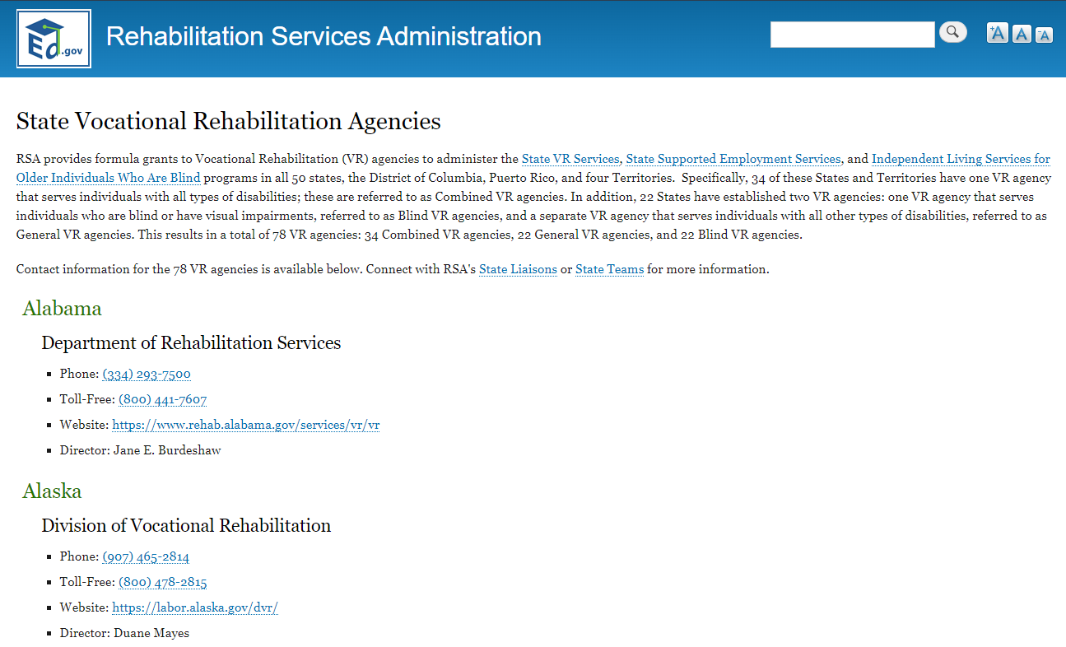
Disability Program Partnership Tool (Examples) Vocational Rehabilitation
Vocational Rehabilitation’s (VR) mission is to assist individuals with disabilities in securing employment and achieving self-sufficiency.
VR provides a variety of valuable job-related services such as interview and job coaching support, assistive technology assistance, disability evaluation/ assessments, student/staff training, and much more!
https://rsa.ed.gov/about/states
Notes:
Many centers have developed relationships with their local Vocational Rehabilitation office.
Vocational Rehabilitation’s (VR) mission is to assist individuals with disabilities in securing employment and achieving self-sufficiency.
VR provides a variety of valuable job-related services such as interview and job coaching support, assistive technology assistance, disability evaluation/ assessments, student/staff training, and much more!
Some centers have a VR representative visit the center routinely to participate in Disability Accommodation Committee (DAC) meetings of current clients and other centers have received staff training or have students who have been assessed by VR to obtain updated documentation of disability and/or needed assistive technology.
If you are not sure of how to contact your local VR representative, go to the web address on the slide and search for the VR agency for your state.

Slide 23
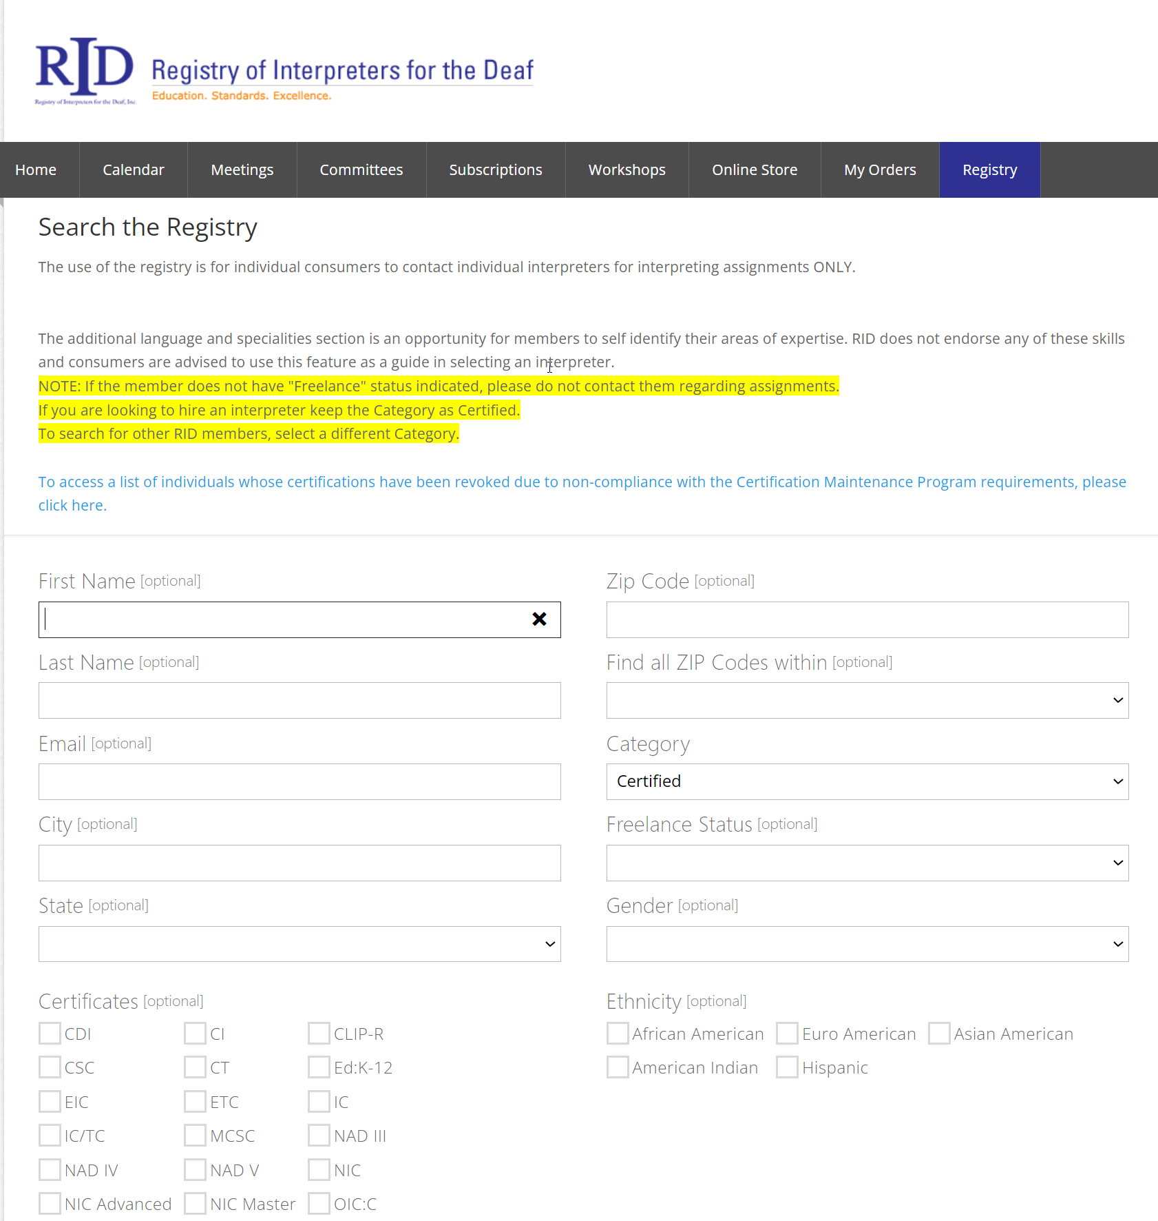
Disability Program Partnership Tool ( Local Example) Registry of Interpreters for the Deaf
Registry of Interpreters for the Deaf (RID) is the national certifying body of sign language interpreters
Search the registry for an interpreter or verify a RID member’s certifications
Interpreters are tested to ensure quality services and are required to complete professional development to maintain certification
https://rid.org/
https://myaccount.rid.org/Public/Search/Member.aspx
Notes:
All centers should know of a local Sign Language Interpreter agency should the center need to provide an interpreter for an applicant, student, or parent/guardian. You can add your local sign language interpreter resource to your Partnership Tool as a local partner. RID is a good place to start your search for a local interpreter.
Reminder: JC must provide sign language interpreters for applicant, students, parents/guardians. Contact your RDIC for assistance.
https://rid.org/
https://myaccount.rid.org/Public/Search/Member.aspx

Slide 24
Ways to Build Partnerships
Meet with local service agencies to discuss mutual benefits
Distribute flyers or brochures about Job Corps
Invite organizations to visit the center
Develop a reciprocity relationship with your local VR agency.
Educate local employers about hiring people with disabilities.
Have prospective partners take a tour of center and invite them to serve on the Community Relations Council or Workforce Council.
24
Notes:
What are some ways to build partnerships with disability-related organizations?
Meet with local service agencies to discuss mutual benefits. Some of the partners listed are national WIOA partners, who have partnership requirements of their own. Develop a reciprocity relationship with your local vocational rehabilitation agency meaning discuss not only how VR benefits students in Job Corps but how Job Corps students can assist VR in meeting their local employment goals (i.e., students completing Job Corps and becoming employed). It is a win-win for VR and for Job Corps!
Distribute flyers or brochures about Job Corps. Educate local employers about hiring people with disabilities. Distribute Job Corps Program information with local disability organizations (e.g., centers for independent living, one stops, school systems, colleges/universities).
Invite organizations to visit the center. Have prospective partners take a tour of center and invite them to serve on the Community Relations Council or Workforce Council.

Slide 25
Ways to Build Partnerships (cont.)
Connect with a variety of organizations who could provide a diverse array of supports/services.
Seek trained disability experts who can train staff and students.
Contact Assistive Technology based agencies/organizations
Ask about discounts, funding, items for loan, or staff training options.
Seek organizations who can provide a variety of needed services such as ones who conduct disability evaluations or testing, who can assist with job placement or securing workplace supports, or other support needs.
Invite organizations who have trained disability experts or staff to provide student/staff training or to assist with disability awareness activities.
25
Notes:
What are some ways to build partnerships with disability-related organizations?
Contact Assistive Technology based agencies/organizations. Organizations may offer discounts, funding assistance, grants, or have a library of Assistive Technology to loan. Staff training on the use of various assistive technology may also be an available resource.
Connect with a variety of organizations who could provide a diverse array of supports/services. Seek organizations who can provide a variety of needed services such as ones who conduct disability evaluations or testing, who can assist with job placement or workplace supports, or those who would assist the individual with housing and other support needs upon completion of the Job Corps program.
Seek trained disability experts who can train staff and students. Invite organizations who have trained disability experts or staff to provide student/staff training or to assist with disability awareness activities.

Slide 26
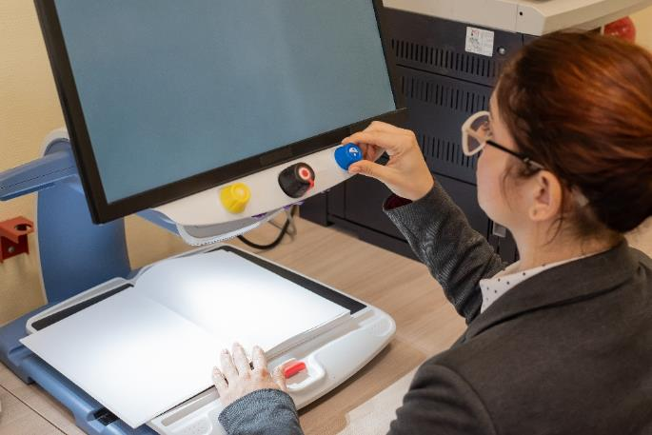
Center Partnership Successes!
Services for the Blind such as North Carolina Division of Services for the Blind, New England Low Vision and Blindness, Blind Rehabilitation Services, or Braille Institute
Provided students with a vision disability access to an accessible library.
Provided assistive technology such as magnifying devices, light attached to glasses, metal mittens to protect hands from injury.
Provided staff training on accessible features in Chrome Book.
Provided funding for medically corrective lenses.
Services for the Blind
26
Notes:
One of the best ways to demonstrate the benefit of disability partnerships is to review examples where center relationships with their local disability partners benefitted students with disabilities.
Center partnerships with Services for the Blind (e.g., North Carolina Division of Services for the Blind, New England Low Vision and Blindness, Blind Rehabilitation Services, or Braille Institute) have
Provided students with a vision disability access to an accessible library.
Provided assistive technology such as magnifying devices, light attached to glasses, metal mittens to protect hands from injury.
Provided staff training on accessible features in Chrome Book.
Provided funding for medically corrective lenses.

Slide 27
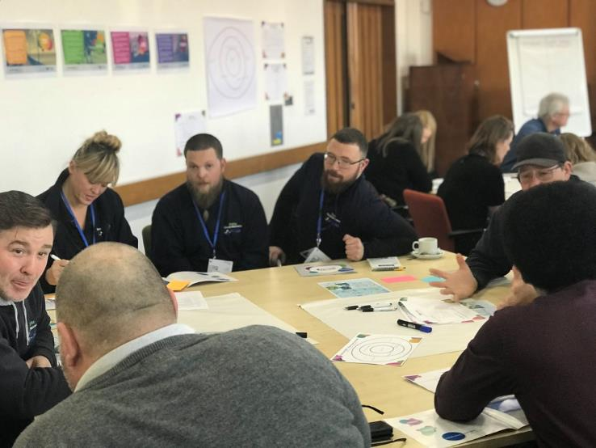
Center Partnership Successes! (cont.)
Career/Workforce Centers such as Kentucky Career Center, Eastern Main Development Corporation, Texas Workforce Solutions, or Ability Works
Provided DC guidance on purchasing clear face masks and dictation app for student with hearing impairment.
Assisted in securing Work-based Learning opportunities for students.
Serves on the center’s Workforce Council
Career/Workforce Centers
27
Notes:
Center partnerships with Career/Workforce Centers (e.g., Kentucky Career Center, Eastern Main Development Corporation, Texas Workforce Solutions, or Ability Works) have
Provided DC guidance on purchasing clear face masks and dictation app for student with hearing impairment.
Assisted in locating or securing Work-based Learning opportunities for students.
Serves on the center’s Workforce Council

Slide 28
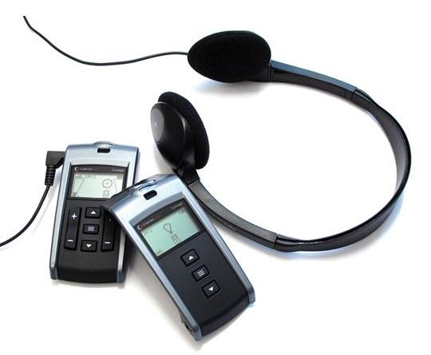
Center Partnership Successes! (cont.)
State Assistive Technology (AT) programs such as the Nevada Assistive Technology Collaborative, Montana Assistive Technology Program, Oregon Access Technologies
Obtained a magnifier for student with visual impairment.
Provided recommendations for appropriate AT and guidance for how to access.
Obtained discounted AT or provided AT on loan.
Provided center staff with training on AT.
State Assistive Technology (AT)
28
Notes:
Center partnerships with State Assistive Technology (AT) programs (e.g., Nevada Assistive Technology Collaborative, Montana Assistive Technology Program, Oregon Access Technologies) have
Obtained a magnifier for student with visual impairment.
Provided recommendations for appropriate AT and guidance for how to access.
Obtained discounted AT or provided AT on loan.
Provided center staff with training on AT.

Slide 29
Job Corps Disability “Partnership” Website Resources
Visit the Promising Practices section on the Job Corps Disability Website for ideas on ways to build partnerships.
Review partnership-related webinars:
Developing Partnerships
Job Accommodation Network (JAN) Overview
Using your Statewide AT Act Program as a Resource
Bookshare and Job Corps, Parts 1 and 2
Review the Job Accommodation Network and Vocational Rehabilitation brochures for additional information on services and supports offered by these two potential partners.
Notes:
Job Corps Disability Website Resources
There are numerous partnership related resources on the JC Disability Website to include:
Promising Practices for ideas on ways to build partnerships
Partnership-related webinars including such topics as Developing Partnerships, information about the Job Accommodation Network (JAN), how to use your Statewide AT ACT Program as a Resource, and Bookshare and its partnership with Job Corps.
Additionally, we encourage center staff to review informational brochures on both the Job Accommodation Network and Vocational Rehabilitation – both invaluable resources to the Job Corps program.

Slide 30
Readily Achievable Barrier Removal
PRH-5: 5.1, R36; Exhibit 5-2
30
Notes:
Our next to last requirement is on Readily Achievable Barrier Removal.

Slide 31
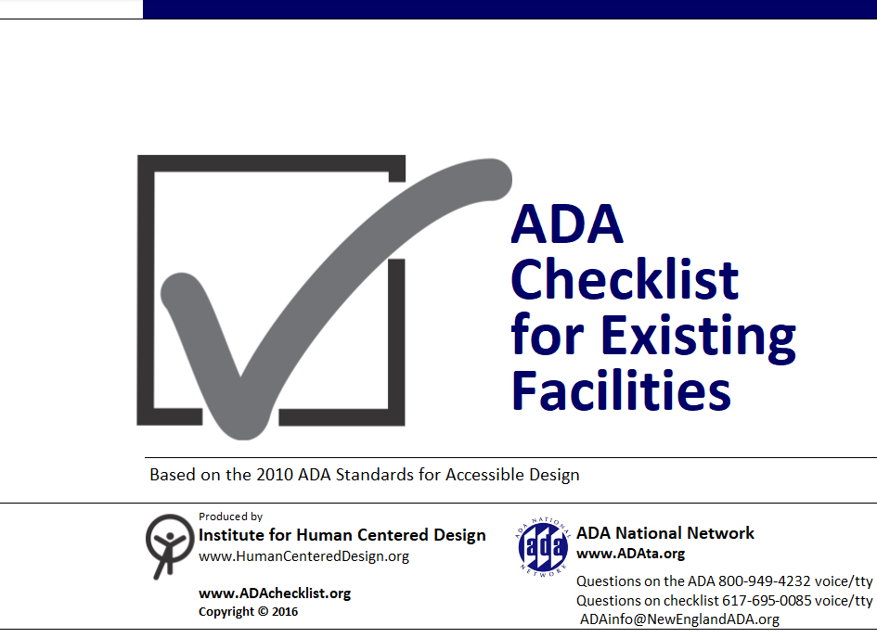
Accomplishing Achievable Barrier Removal - Physical
1
Determine potential improvements to the physical accessibility (e.g., ramps, elevators, adjustable workstations, restrooms, etc.) of the center, by completing the ADA Checklist for Readily Achievable Barrier Removal.
31
Notes:
Each center must consider readily achievable barrier removal—things center staff can do to make the center more accessible that are easily accomplishable and able to be carried out without much difficulty or expense. To accomplish this, centers must:
Determine architectural or physical accessibility. Using the ADA Checklist for Existing Facilities, staff will be able to determine any physical barriers or needed improvements. This checklist should be completed for each building on center. This checklist will include specific measurements of physical items on center such as rails, doorknobs, light switches, the slope of ramps, etc. Centers usually complete this item (ADA Checklist) once and update as needed when new buildings are erected or renovated.
PROMISING PRACTICE: Some centers make this into a learning activity! DCs should contact career technical instructors and the center’s math instructor, for example, to complete the questions that require measuring and calculating slope. It’s a great way to collaborate and spread awareness.

Slide 32
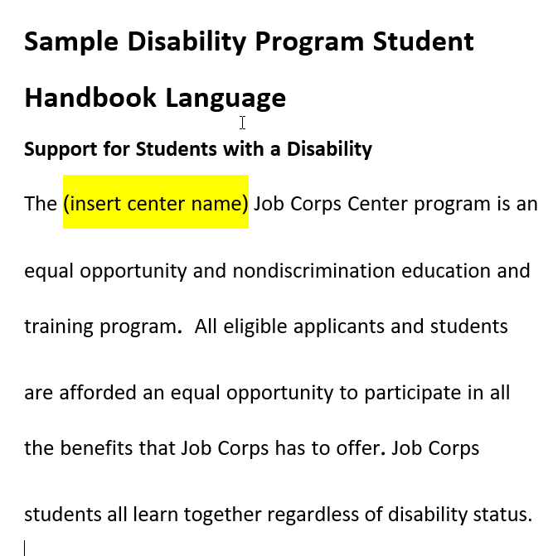
(
Accomplishing Achievable Barrier Removal - Programmatic
2
Determine potential improvements to the programmatic accessibility of the center, staff by completing the program Center Accessibility Tool.
Examples: communication options such as audio tapes, large print, etc.; center’s public materials contain a statement that reflects a commitment to providing disability accommodations for all their programs, etc.)
Large Print Disability Program Student Handbook Language
32
Notes:
Determine potential improvements to the programmatic accessibility of the center, staff by completing the program Center Accessibility Tool. Some examples of programmatic improvement considerations might include:
communication options such as audio tapes, large print, etc. See the example of having a Large Print version of the Disability Program Student Handbook information.
center’s public materials contain a statement that reflects a commitment to providing disability accommodations for all their programs, etc.

Slide 33
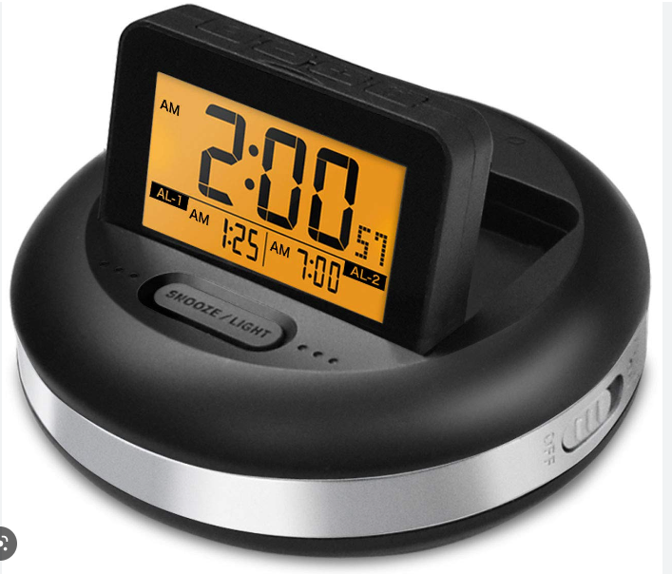
Programmatic Accessibility Tool Examples
Vibrating Alarm
(Has a stronger vibration than a phone/watch and can place under pillow to assist with waking up on time.)
Notes:
Examples of questions you might see in the Accessibility Tool:
Are accessible dormitory rooms offered to students with disabilities on a preferential basis, as needed, and as appropriate?
Are students with disabilities encouraged to take part in all recreational trips and programs?
Improving accessibility does not always mean expensive. There are many things that can be done that are no to low cost that will improve the center's overall accessibility. For example, perhaps the center purchases a heavy-duty vibrating alarm like the one pictured on the right. This alarm provides a more vigorous vibration than say a watch or phone alarm would and could be used for other students who struggle with getting up in the morning!

Slide 34
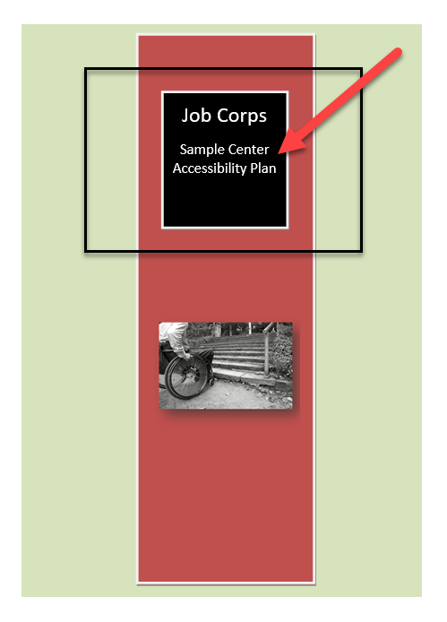
Accessibility Plan
3
Develop an accessibility plan with priorities and next steps based on the results of the ADA Checklist for Readily Achievable Barrier Removal and Center Accessibility Tool.
34
Notes:
Once your center staff has completed both the ADA Checklist and the Center Accessibility Tool, the center is required to develop an accessibility plan with priorities and next steps based on the results of the ADA Checklist for Readily Achievable Barrier Removal and Center Accessibility Tool completion.
Anything that has been checked “no” on either the ADA checklist or the Center Accessibility Tool should appear on this accessibility plan.
A sample plan is available on the JC Disability Website. If you elect to use it as a template, you must fill in your own center’s information from the checklists and tool—along with your goals, objectives, dates, and responsible parties, etc. Leaving the pre-populated information examples is not sufficient.
Examples of priorities and next steps based on the results of the ADA Checklist for Readily Achievable Barrier Removal and Center Accessibility Tool:
Academic and career technical training staff will be trained on the use of text to speech technology.
Recreation staff will invite Paralympic organizations (or other disability based recreational organizations in your community) to build awareness and assist students with disabilities in recreational activities.

Slide 35
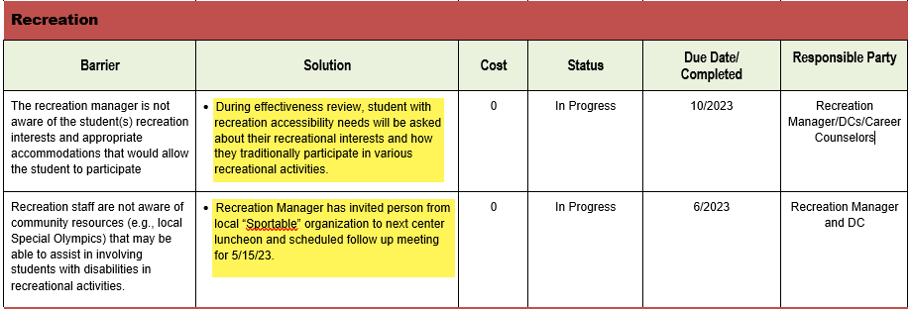
Accessibility Plan Examples
3
The accessibility plan will be reviewed and updated annually by June 30.
The safety and facilities maintenance staff should play a primary role in completing the plan with support from managers in all areas.
What are some actions your center can take to improve overall accessibility for students with disabilities?
35
Notes:
The Accessibility Plan will be formally assessed during DPCAs but the center should be reviewing and updating annually each year by 6/30. It is only the plan that requires annual updates. The other portions (the ADA Checklist and the Center Programmatic Tool) should be revisited as changes happen physically and programmatically. To show evidence of your annual updates, update the plan itself as well as keep meeting notes listing participants and the outcome of the meetings.
The safety and facilities maintenance staff should play a primary role in completing the plan with support from managers in all areas.

Slide 36
Disability-Related Staff Training
PRH-5: 5.2, R11; Exhibit 5-4
36
Notes:
Our final requirement today is Disability-Related Staff Training. Even though this is the last requirement, it is a critically important one. Job Corps' Disability Program is unique in many ways and staff require training to be able to implement and properly maintain all the requirements.

Slide 37
Staff Training Requirements Centers will provide disability-related staff training in accordance with PRH Chapter 5, Exhibit 5-4.
Yearly training for all center staff about the Disability Program or a disability-related topic
Disability Accommodation training for new staff within the 1st 90 days of employment
Disability Accommodation training for all staff yearly thereafter.
Staff must complete the Supporting Students with Disabilities in the Job Corps Program training available in the Learning Management System (LMS), located in CITRIX for requirements #2 and #3.
Notes:
Staff Training Requirements
Centers will provide disability-related staff training in accordance with PRH Chapter 5, Exhibit 5-4. There are 3 Disability Program Training Requirements that must be met.
Yearly training for all center staff about the Disability Program or a disability-related topic
Disability Accommodation training for new staff within the 1st 90 days of employment
Disability Accommodation training for all staff yearly thereafter.
To meet requirements 2 and 3, staff must complete the Supporting Students with Disabilities in the Job Corps Program training available in the Learning Management System (LMS), located in CITRIX.

Slide 38
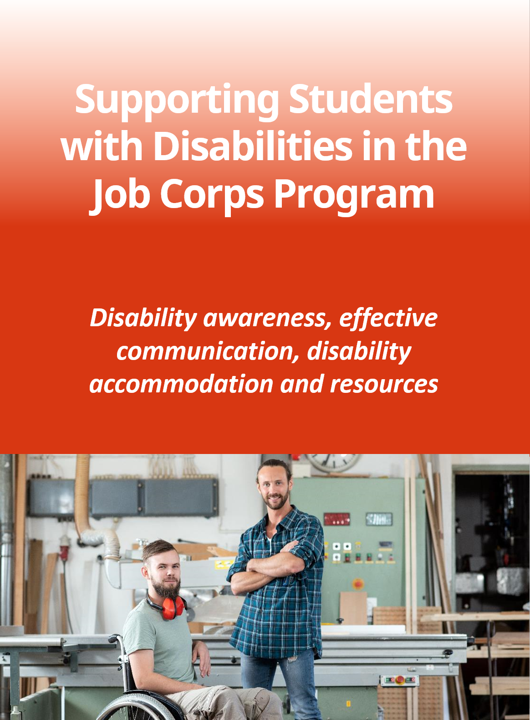
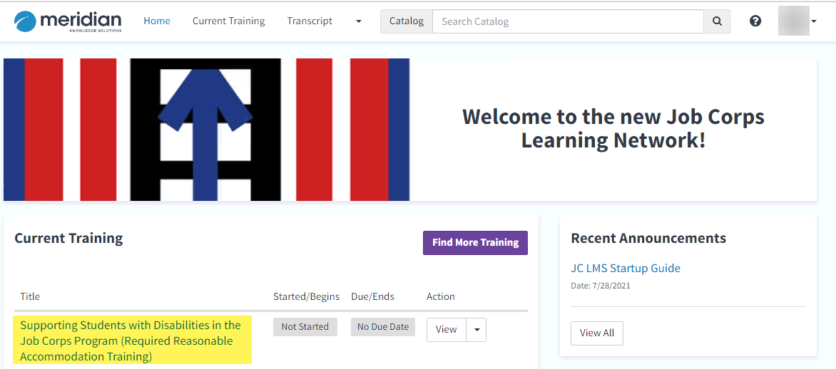
Learning Management System Supporting Students with Disabilities in the Job Corps Program
Notes:
Here is a screenshot of the Supporting Students with Disabilities training that is available in the Job Corps Learning Management System. Remember this training is required initially within the first 90 days of hire and then annually thereafter for all staff.

Slide 39
What Types of Training Qualify? Item #1 on Slide 38 - Disability Program or a disability-related topic
Annual training (for item #1 on slide 38) can be any type of training:
Webinars
Other online presentations by reputable sources
Disability conferences
An additional disability topic in LMS
Small group training by the DC or by an outside presenter
The training does not have to be an in-person training or done as a single all staff training by a DC.
Notes:
Annual training (for item #1 on slide 38) can be any type of training:
Webinars - If center staff have been attending any of our disability webinars these last few months, that could count as your annual disability related training. Make sure center staff is filling out the survey at the end of our webinars so that they can get a certificate of participation. Ask your Human Resource staff to log the training and maintain the certificates of participation as proof of training completion.
Online
Disability Conferences
An additional disability topic in LMS
Small group training by DC or an outside presenter
It does not have to be in person training or done as a single all staff training by a DC.
A disability related trivia game using an app like Kahoot (which we will be demonstrating in just a moment) could be a great way to test what staff have learned after a simple presentation they read through on their own.

Slide 40
Documenting Staff Training
Staff training documentation should be compiled and available to review during DPCAs (Disability Program Center Assessments).
Who is tracking and monitoring the completion of the three training requirements for the Disability Program?
Would the documentation identify the date of hire and the date the training was completed to determine if completed within 90 days of hire?
Is training being tracked for all current staff and compiled in such a way that it could be provided to your DPCA reviewer (i.e., not individual documents in each personnel file)?
Notes:
Staff training documentation should be compiled and available to review during DPCAs (Disability Program Center Assessments). Let’s review some considerations for your training documentation requirements.
Who is tracking and monitoring the completion of the three training requirements for the Disability Program? Is it Human Resources? If so, check in with them to see the types of documentation that is being maintained and ensure that it is adequate.
Would the documentation identify the date of hire and the date the training was completed? Since one of the training requirements is for new hires within 90 days of employment, the documentation will need to show that the training occurred within that timeframe.
Is training being tracked for all current staff and compiled in such a way that it could be provided to your DPCA reviewer (i.e., not individual documents in each personnel file)? Is the center maintaining a spreadsheet or some other type of list or only maintaining individual certificates.

Slide 41
Career Transition Readiness
Worker’s Rights and Responsibilities and
Workplace Accommodations
41
41
Notes:
Career Transition Readiness
We often are so focused on applicant file review and identifying and implementing accommodations for center participation that we forget that there are policy obligations that carry over into Career Transition Readiness including providing information on Worker’s Rights and Responsibilities and Workplace Accommodations.

Slide 42
Career Transition Readiness
During Career Transition Readiness all students must receive information about workers’ rights and responsibilities including RA/RM/AAS in the workplace.
Chapter 3, Section 3.4, R23, (k).
At least 45 days prior to projected graduation, centers must assess and counsel students to determine their capabilities and review job search skills and strategies to include assisting students develop an understanding of worker’s rights and responsibilities (e.g., including disability accommodation in the workplace).
42
Notes:
Career Transition Readiness
During Career Transition Readiness all students must receive information about workers’ rights and responsibilities including disability accommodations in the workplace.
The actual requirement states that at least 45 days prior to projected graduation, centers must assess and counsel students to determine their capabilities and review job search skills and strategies to include assisting students develop an understanding of worker’s rights and responsibilities (e.g., including disability accommodation in the workplace).

Slide 43
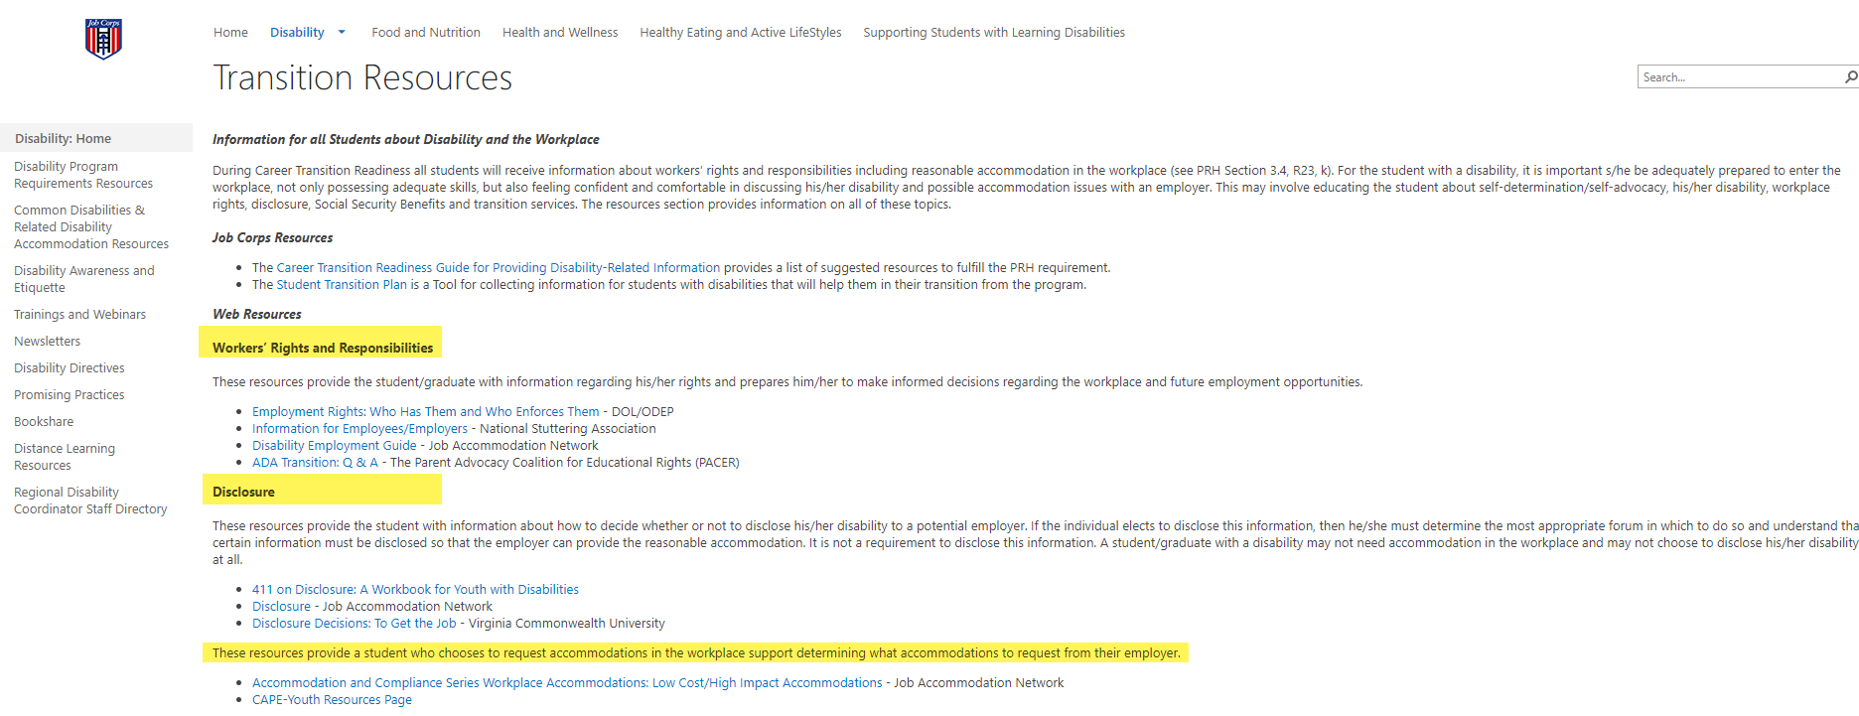
Career Transition Readiness Resources https://supportservices.jobcorps.gov/disability/Pages/Disability-Program-Requirements-Resources.aspx
Notes:
Career Transition Readiness Resources
There are multiple resources on the Job Corps Disability Support Services Website to assist you in meeting this requirement. We will visit the Job Corps Disability Support Services Website at the end of this presentation and visit some of these resources.

Slide 44
Kahoot Activity Answers
44
Notes:
Let’s see what you have learned! We are going to demo a game-based app, Kahoot, to test your knowledge of the Disability Program-related requirements we covered today. There are many similar apps to the one we’re using today, Kahoot is just an example of one of the apps you could use on your center.

Slide 45
https://kahoot.com
Game-based education app (free)
Can be played on smartphones, tablets, laptops, and desktops
Create, share and play learning games or trivia quizzes
READY?
Notes:
There is no pressure to use the app or website, you could play along using the chat box today. Either way you will all be able to see the questions on our shared screen.
So let's get started – you can follow along and participate using the chat box, but if you choose to play with your phone or browser using the Kahoot platform, head over to kahoot.com and enter the game PIN that is posted in the chat box and spin to pick your nickname.
The questions will appear through this shared screen and you will select the correct answer by selecting the corresponding color or shape on your phone or browser.
Again if you prefer not to use the Kahoot platform, you can participate by typing the corresponding color or shape into the chat box.
(PLAY KAHOOT – toggle screens)

Slide 46
Kahoot Quiz Answers
The Disability Program Introduction section requires that new students have opportunities to meet the Disability Program DCs.
The Disability Coordinators and other appropriate staff should be involved in creating and maintaining Disability Program related partnerships.
Disability Program related partnerships must be documented on the Partnership Tool.
A new Partnership Tool does not need to be created year to year.
Notes:
Thanks for playing!

Slide 47
Kahoot Quiz Answers
5. The Accessibility Plan is based on the results of the ADA Checklist and Accessibility Tool.
6. The “Barrier Removal” requirement includes:
Completion of the ADA Checklist for Readily Achievable Barrier Removal
Completion of the Center Accessibility Tool
Completion of a center Accessibility Plan
Notes:
Thanks for playing!

Slide 48
Kahoot Quiz Answers
7. Disability-Related Staff Training includes:
Training on a disability-related topic – annually – for all staff
Completion of the Supporting Students with Disabilities training in LMS – first 90 days of hire and annually thereafter.
8. The required training in LMS is titled Supporting Students with Disabilities in the Job Corps Program.
Notes:
Thanks for playing!

Slide 49
Job Corps Disability Support Services Website https://supportservices.jobcorps.gov/disability/Pages/default.aspx
Notes:
Job Corps Disability Website
The Job Corps Disability Support Services Website contains numerous resources and tools on all areas of the Disability Program.
The categories of resources are listed on the left-hand side of the Website. For example, Disability Program Requirements Resources lists all the Disability Program Requirement areas, associated policy links, related forms, and tools that include guides, graphics, Snapshot documents and more.
As new resources and tools are developed, they are listed under the New Items heading to the right side of the website page. See teal highlighted area. Resources that are more commonly used and/or requested are listed under the Frequently Requested Tools section also highlighted in teal.
The Job Corps Disability Website link is located at the top of the slide.

Slide 50
Questions?
50
Notes:
Questions?

