Slide 1
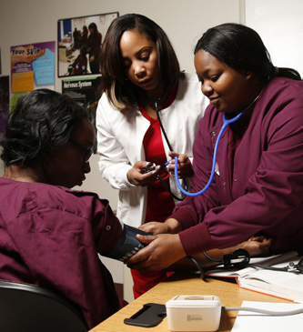


Part 2
Reasonable Accommodation in
Career Technical Training (CTT)
Easy and Practical Ways to Accommodate and Adapt the “Center Trades”
Notes:
Welcome to Easy and Practical Ways to Accommodate and Adapt the “Center-Based” Trades. This is Part 2 of a 2-part webinar series that will highlight assistive technology accommodations and other practical adaptations that support both independence and employability for students with disabilities enrolled in the medical, office, automotive or food service career technical training. The importance of developing supports that are portable and transferrable into the workplace also will be discussed.

Slide 2
Webinar Objectives
List at least 2-3 assistive technologies that are available in local stores and used in daily life that also can be used to accommodate students with disabilities in CTT on-center trades.
List at least 3 specific assistive technology resources that provide support and services for students with disabilities who are enrolled in CTT.
Describe at least 2 ways to modify instruction that would remove barriers and provide access for students with various disabilities in CTT on-center trades trades.
Notes:
During this webinar, we will be exploring a wide range of assistive technologies on a continuum of low to high tech, as well as free to a bit more costly. We will also explore how these accommodations can be used to provide more impudence for students with disabilities, as well as provide support in more than one area of life.
You will be provided with several resources today that can be used to search for just the right accommodation for specific functional limitations, and resources that can be used to explore funding for AT.
Let’s begin with a poll…

Slide 3


Poll Question #1
My primary role in Job Corps is
  Disability Coordinator
  Career Technical Instructor or Manager
  Academic Instructor
  Center Management
  Corporate Management
  Other
Notes:
I will be pulling up a poll on the screen that will have this quick survey of “Who We Are.” You simply click on the choice that best represents your position/responsibilities on center. If none of these best represent you, just type your position in the chat box.

Slide 4
Poll Question #2
Within your CTT program, have you implemented the accommodations in your students’ accommodation plans (APs)?
  I know the APs, generally, of my students and ensure routine implementation
  I have reviewed my students’ APs but do not always consistently implement
  I rarely review my students’ APs because my program naturally accommodates
  I have never reviewed or implemented a student’s AP
Notes:
This second poll allows us to see how we as a group weigh in on accommodation plan implementation on our centers.

Slide 5

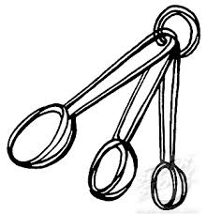
Current CTT Accommodation Practices
In the chat box,
  List a few ways that you are already supporting students with disabilities in your classrooms through:
    Accommodations
    Adjustments
    Modifications
      “Yes” or “No” – Are most of those accommodations, adjustments, or modifications taken from Job Corps Accommodation Plans?
Notes:
Now let’s take a moment to be a little more specific about our current practice.
In the chat box, list a few examples of accommodations, adjustments, or modifications you are providing or using to support students with disabilities in your classrooms or areas on center (e.g., posters of key information, extended time on quizzes…)
The 2nd part of this activity requires you to answer “yes” or “no” if most of the accommodations, adjustments, or modifications are taken from JC AP…do that now in the chat box.

Slide 6
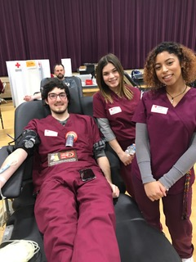
Career Technical Training
Inherent Benefits

Slide 7

Although CTT has many built-in instructional strategies that naturally meet the needs of ALL learners, we cannot be complacent about how each student is performing or should have to perform.
Students with disabilities often get left behind. They have learned to “blend” or “cope,” but that does necessarily mean they are making progress. Their accommodations give them equal “access” to the program but we have to be mindful of potential barriers that may prevent their accessing them.

Slide 8
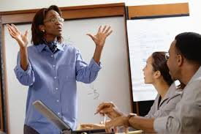
Accessing CTT
Accommodations and Strategies

Slide 9
CTT Instructional Strategies
Hands-on learning
Modeling
Project-based learning
Peer mentors
Cooperative learning
Multi-modal instruction
Real life applications
Checking for understanding
Set up your CTT environment with Universal Design for Learning (UDL)
in mind!
Accessible equipment
Accessible furniture
Accessible programming

Slide 10
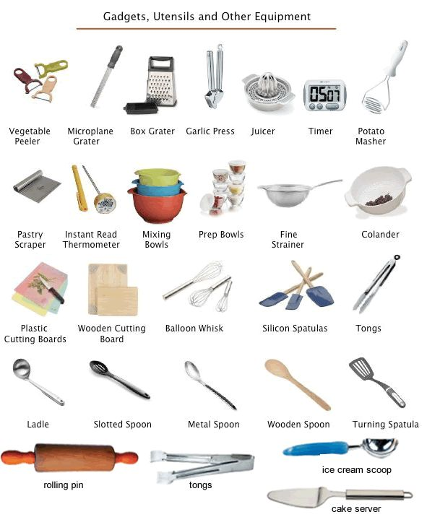
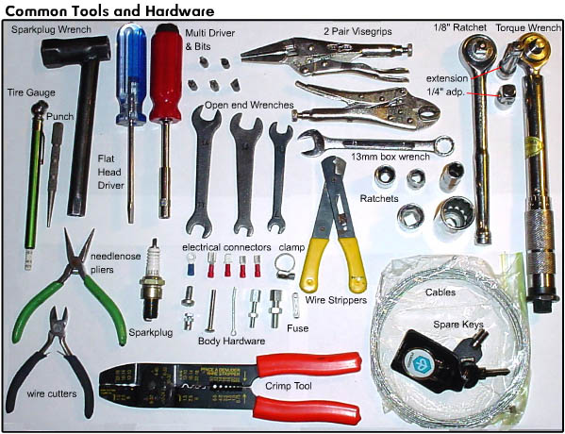
Instructional Strategies in CTT – “Word Walls”
Provides a meaningful approach to teaching vocabulary
Improves reading and writing skills
Provides visual cues for students
Reinforces understanding of subject-specific terminology
Helps students improve spelling and awareness of spelling patterns
Encourages increased student independence when reading and writing

Slide 11
What is Assistive Technology?
Assistive Technology (AT) is any item or piece of equipment that is used to increase, maintain or improve the functional capabilities of individuals with disabilities in all aspects of life, including at school, at work, at home and in the community. AT ranges from low tech to high tech devices or equipment.
http://www.gatfl.org/assistive.php
Notes:
Let’s start with AT by providing a definition (slide)
(AT) can also be thought of as an umbrella term that includes assistive, adaptive, and rehabilitative devices for people with disabilities and also includes the process used in selecting, locating, and using them.
Assistive technology promotes greater independence by enabling people to perform tasks that they were formerly unable to accomplish, or had great difficulty accomplishing.
AT may provide ways for our students with disabilities to no longer be dependent on a person for special support.

Slide 12
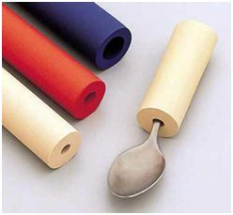
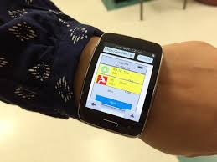
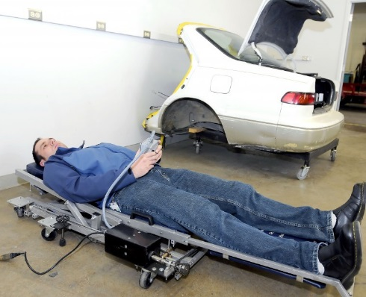
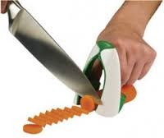
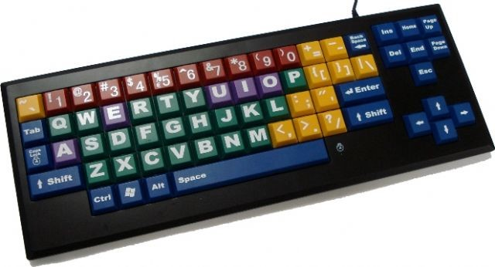
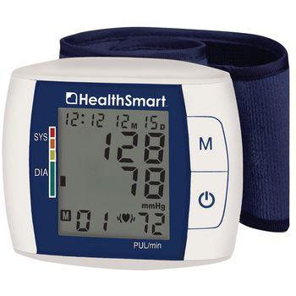
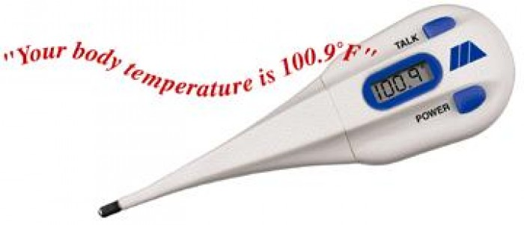
AT Examples
Large print text
Visually supported lists
Canes and walkers
Reachers and grabbers
Noise cancellation headsets
Specialized pen or pencil grips
Talking blood pressure monitors, Talking scales, talking calculators
Instructional videos (YouTubes…)
Amplifiers
Modified tools (handle grips, extenders…
Power wheelchairs, scooters
Digital hands-free headsets
Bluetooth integration for wireless connectivity
Automated creepers
Voice-recognition software

Slide 13
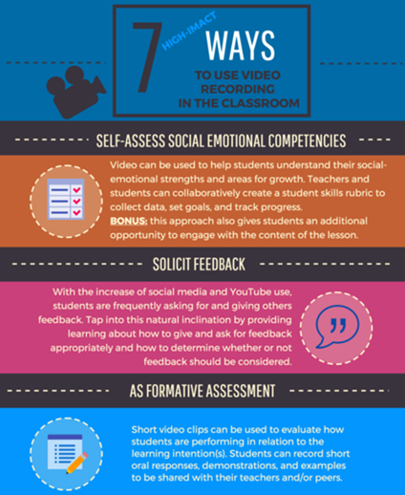
Using Videotaping of Instruction to Develop Accommodation and Instructional Resources
One of the ways to improve accessibility on center is to videotape instructional segments of the career technical program and create a career technical information library. How does this improve accessibility?
  Provides content in an alternative format
  Affords a student the opportunity to work independently because they can review instruction and work ahead and/or at least review the instructional content as frequently as they need for mastery

Slide 14
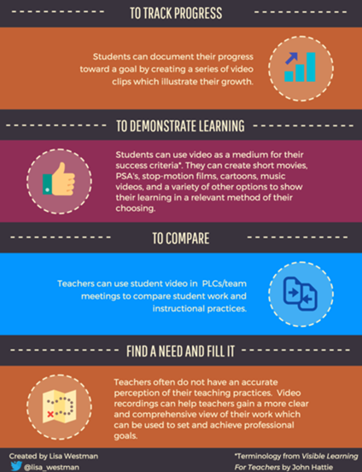
Using Videotaping of Instruction to develop Accommodation and Instructional Resources
Benefits instructionally?
  Provides a multi-sensory resource
  Allows the student to review at his/her own pace
  Allows the student to repeat content to enhance memory retention and automaticity of recall of skills
  Affords student an opportunity to have a model to compare completed work against
  Assists ELL/ESL learners with language/vocabulary development
Notes:
In addition to the student benefits listed here, instructors benefit by freeing up some of their instructional time to work with smaller groups, one-on-one—possible way to have devoted time to “check for understanding.”

Slide 15
Getting started with AT in CTT
(Accommodations in CTT)
What are the skills, activities, and job functions required to complete the trade or career path?
What are the student’s functional limitations? (e.g., difficulty reading printed materials, difficulty lifting heavy objects, hard-of hearing, controlling emotions…)
What job tasks are difficult to perform as a result of the impairment(s)? (e.g., lifting materials, tolerating stress, reading manuals, communicating in writing…)

Slide 16
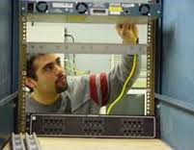
Getting started with AT in CTT
(Accommodations in CTT)
How can we remove the barriers or provide supports/services that will provide access, and allow each student with a disability to demonstrate the required skills, aptitudes, and abilities?
  Assistive Technology
  Instructional practices
What are our resources?
  The individual with a disability
  JAN, Tools for Life, other disability-related partners…

Slide 17
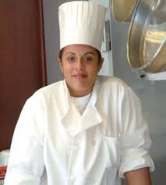
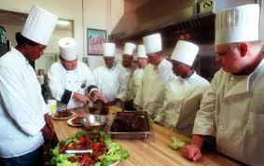
Assistive Technology in Career Technical Training
Case Study
Notes:
Let’s practice with one case study using the questioning approach that we just reviewed.

Slide 18
Practice: Case Study
Jordan is a Culinary Arts student who is legally blind impacting her ability to:
  Remember new information
  Read printed materials, see items, see materials, see tools
  Organize and prioritize
  Use ordinary kitchen gadgets, tools
What tasks, skills, job functions, activities might be difficult for Jordan?
  Remembering all of the culinary terms and tools
  Reading the directions, instructions, recipes, measurements…
  Completing a task or assignment from start to finish
  Pouring, measuring, spreading, cutting…
  Practicing culinary safety
Notes:
What are some possible AT accommodations that we could consider to support Jordan with “remembering, reading, completing tasks, practicing safety in the kitchen, measuring, and conversations?”
Use the chat box for any ideas you have…
How might these accommodations be used in other areas on center or to build independence?

Slide 19
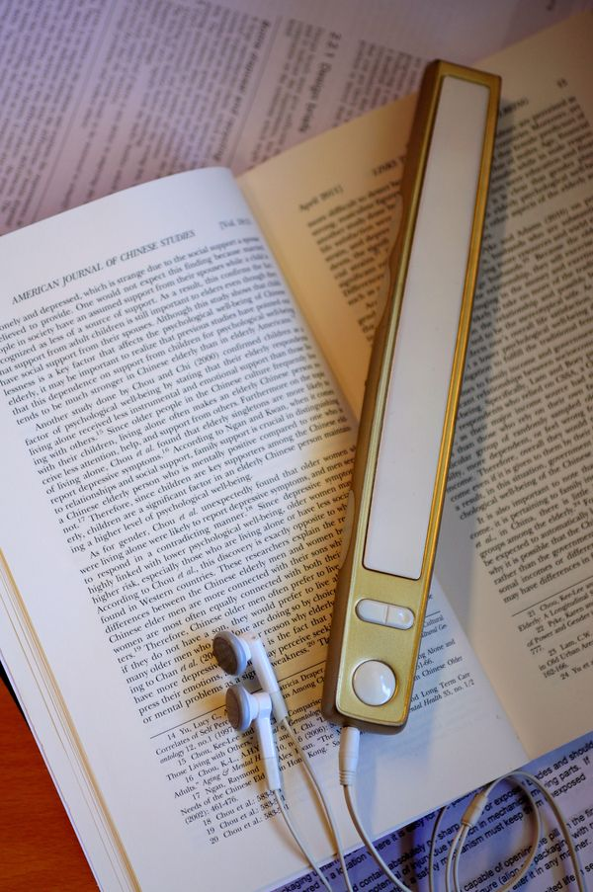
Possible AT Accommodations for Jordan
Remembering new information
  Recorded texts, lectures, notes
  Tactile or Braille graphic organizers
  Electronic audio notebooks
Reading recipes, directions, measuring…
  Talking culinary tools (scales, timers…)
  Text-to-Speech software
    Scanners and Optical Character Recognition (OCR)
  Accessible mobile apps
    “Be My Eyes”
      http://www.afb.org/prodProfile.aspx?ProdID=1911&SourceID=102
Notes:
Let’s see how we did…
Here are some possible AT accommodations to address Jordan’s functional limitations of memory… (slide)
Let’s take a look at one specific example of free AT that could support Jordan with learning and remembering new information (next slide).

Slide 20
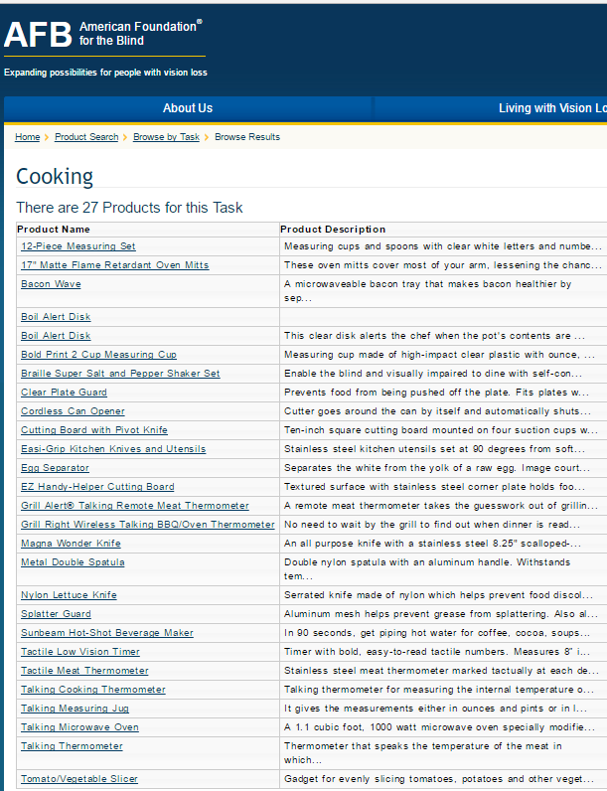
Possible AT Accommodations for Jordan
Organizing and prioritizing
  Mobile device for tracking tasks and scheduling
  Talking electronic organizers
Using culinary tools and kitchen safety
  Specific kitchen gadgets and tools designed for vision-impairments
    American Foundation for the Blind (AFB)
      http://www.afb.org/ProdBrowseTaskResults.aspx?TaskID=423&SpecID=26
Notes:
Again, this is not a complete list of possible accommodations for Jordan. She may have other ideas about supports and services that will help her throughout the center.

Slide 21
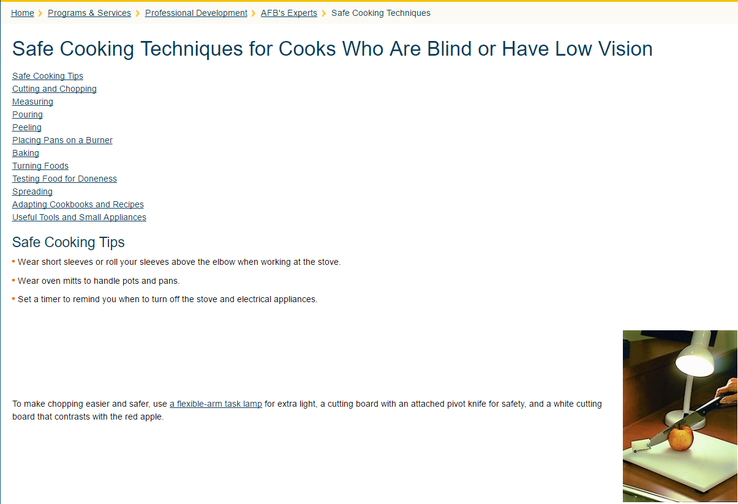

MasterChef, Christine Ha: How the Blind Cook
https://www.youtube.com/watch?v=65gqX2QhVRA
Notes:
https://www.youtube.com/watch?v=65gqX2QhVRA
Show 4-5 clip from “How the Blind Cook”

Slide 22
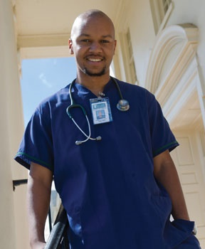
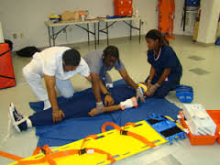
Assistive Technology in Career Technical Training
Case Study
Notes:
Let’s practice with another case study of a student with a learning disability enrolled in the nursing trade.

Slide 23
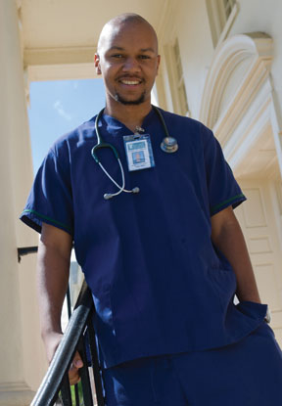
Practice: Case Study
Ethan is a CNA student who has a learning disability impacting his ability to:
  Remember new information
  Read print/text beyond 5th grade level
  Organize and prioritize
  Use medical equipment properly
What tasks, skills, job functions, activities might be difficult for Ethan?
  Remembering/memorizing medical terms, procedures…
  Reading the study texts, treatment instructions, prescriptions …
  Completing a task or assignment from start to finish
  Carrying out the functions of nursing
  Practicing safety in the medical field
Notes:
What are some possible AT accommodations that we could consider to support with “remembering, reading, completing tasks, practicing safety in the kitchen?
Use the chat box for any ideas you have…
How might these accommodations be used in other areas on center or to build independence?

Slide 24
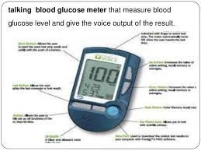
Possible AT Accommodations for Ethan
Remembering new information
  Recorded texts, lectures, notes
  Graphic organizers (electronic or hard copy)
  Electronic audio notebooks
  Visualization, pictures with concepts
Reading and understanding text
  Talking medical equipment (pictures)
  Text-to-Speech software
    Bookshare
  Accessible mobile apps
Notes:
Here are some possible AT accommodations to address Ethans’s functional limitations of memory and reading… (slide)
Don’t forget free accessible mobile apps (next slide…)

Slide 25
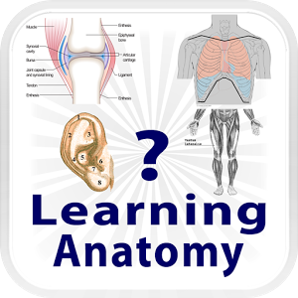
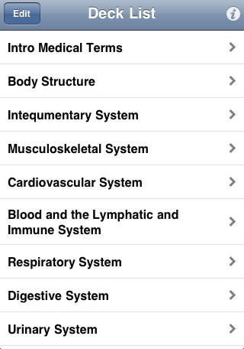



AT Examples:
Mobile Apps to support Ethan

Slide 26
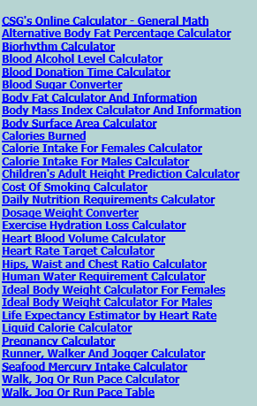
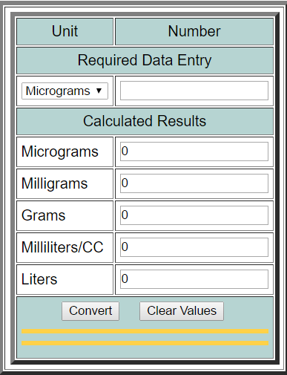
AT Example: Health Converters and Calculators
This is a list of health based calculators, conversion charts and converter programs.
To the left is a snapshot of the online “Dosage Weight Converter”
http://www.csgnetwork.com/healthconverters.html
Notes:
This is an example of free assistive technology. There are several websites such as this one that have a variety of converters and calculators to assist with some of the more complex math or conversion operations that may be required in some CTT classes.
This particular example could be used in the medical CT classes. It could certainly be used with students with learning disabilities—actually with all students when learning how to make these types of conversions.

Slide 27
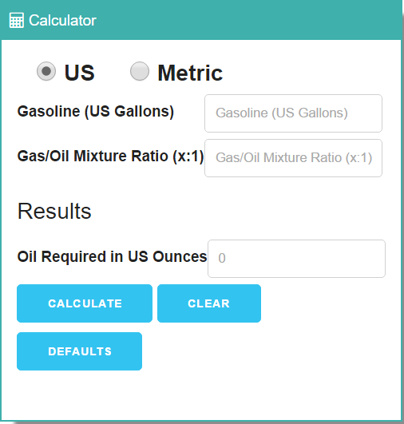
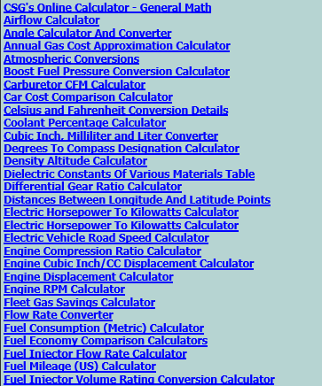
Automotive Converters and Calculators
Below is a list of automotive based calculators, conversion charts and converter programs available for use.
http://www.csgnetwork.com/automotiveconverters.html
Notes:
A similar free AT converter and calculator could be used in auto CT classes.
On the left of the slide is a snapshot of some of the links to webpages that assist with specific calculations and conversions.
On the right of the slide is a snapshot of a specific calculator (Gas Oil Mixture Ratio Calculator).

Slide 28
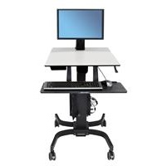
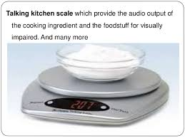
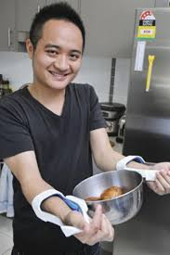
Other Examples of Assistive Technology in CTT
Adjustable work stations
Custom websites and phone/tablet apps
  e.g., BlueTube
Assessable equipment
  Talking tools (calculators, measuring tools, watches, calendars…)
Notes:
Some other examples of AT in CTT…

Slide 29

Poll Question #3
The accommodations, modifications, or adjustments that I make for students with disabilities in my CTT classes actually benefit all or most of my students.
A. Strongly Agree
B. Agree
C. Neutral
D. Disagree
E. Strongly Disagree

Slide 30
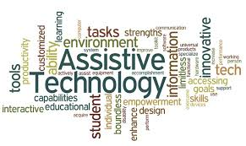
Center Examples
Notes:
Let’s take a look at some examples of AT being used on our centers that either benefit one student with a disability, or several student with or without disabilities.

Slide 31
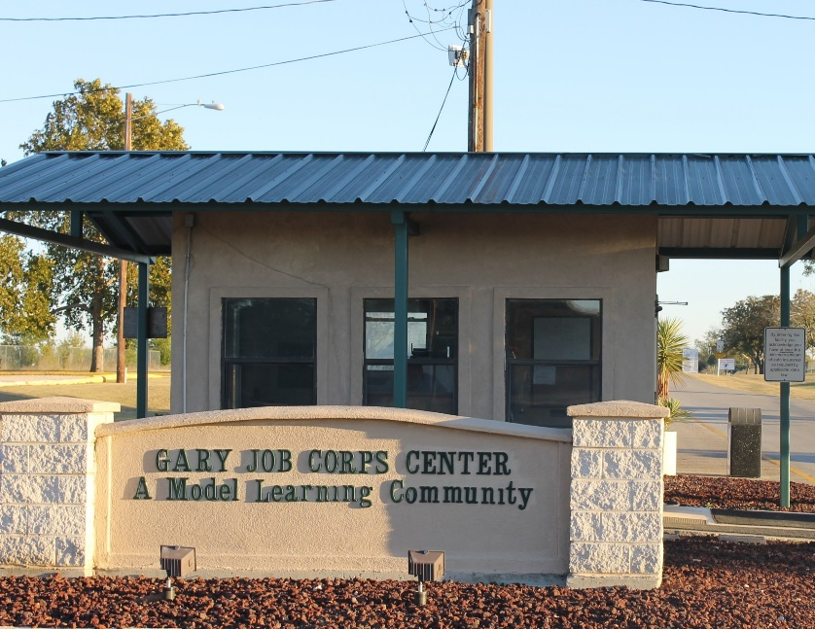
Gary Job Corps Center
Instructors adapted the curriculum for a student with missing limbs who needed to complete CPR training. The student was trained to complete chest compressions with their elbow because they did not have two hands.
Notes:
Our first example is from Gary Job Corps Center.
(Read slide)

Slide 32
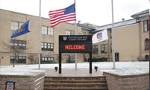
Pittsburgh Job Corps Center
Specialized hand tools and knifes were purchased for a culinary arts student that was missing fingers on one of his hands.
Notes:
Another example of a modification used in culinary comes from Pittsburgh JC Center.

Slide 33
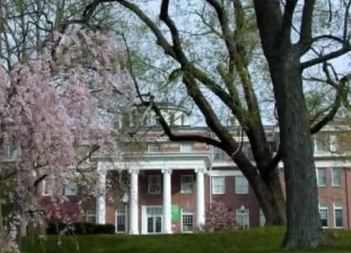
Blue Ridge Job Corps Center
Center staff created BlueTube (YouTube and Mimio technology), a designated website where trade students can access pre-recorded, self-paced lessons/lectures that follow the assigned reading materials.
Students that need repetition and instruction at their own pace are able to access the instructional materials on and off center.
Notes:
Here is an example of using layered technology to create a universal solution that applied to all students needed more support in CTT.
Some ways it supported students with specific disabilities included:
Built in extended time
Reading support (materials read to them)
Opportunity to review and repeat lessons for memory/retention
Addresses some attentional issues by allowing students go at their own pace and see/hear lessons

Slide 34

AT: Some Things to Consider
When purchasing AT equipment, think “universal” applications:
  Will the purchase benefit others on center?
  How might the purchase be used to remove barriers in other areas on center besides CTT?
Is training needed and if so, will it be included?
Is technical support available and if so, will it be included?
Is the product compatible with other technology used on center?
How will the AT be funded?
  University or other program giveaways when upgrading systems
Notes:
Now that we understand more about AT and its applications, let’s look at some things to consider when seeking to purchase or obtain AT for our students.
(Slide)

Slide 35

Remember, most accommodations and adaptations cost less than $500 with many being FREE!
As we have discussed, for example,
videotaping instruction is a great and essentially free accommodation that not only improves the accessibility of the center’s programs for students with disabilities but it also because an invaluable instructional tool for ALL students!

Slide 36

Resources
Assistive Technology

Slide 37
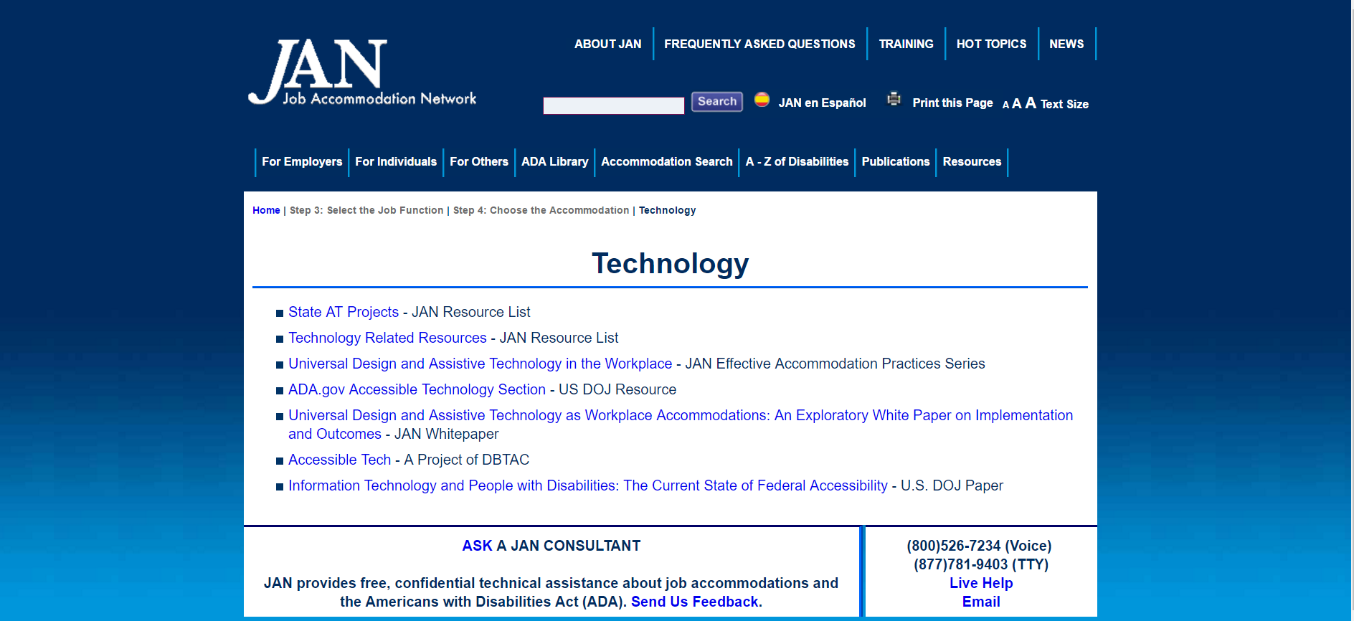
Job Accommodation Network http://askjan.org/topics/tech.htm

Slide 38
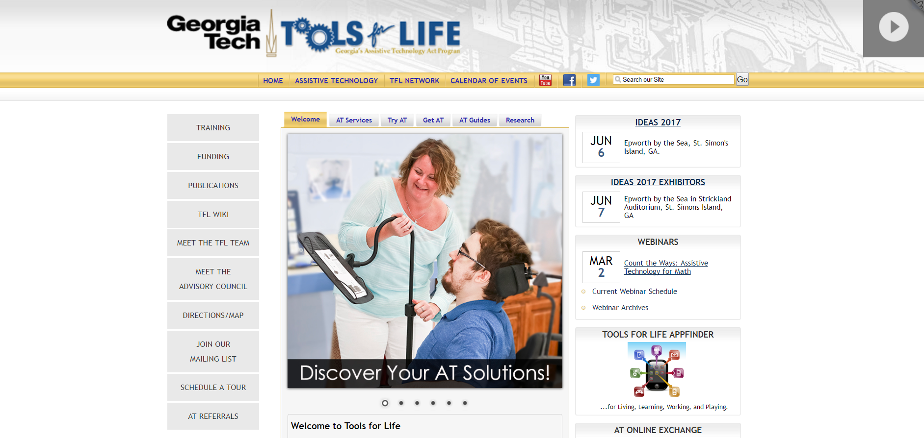
Tools for Life http://www.gatfl.org/

Slide 39
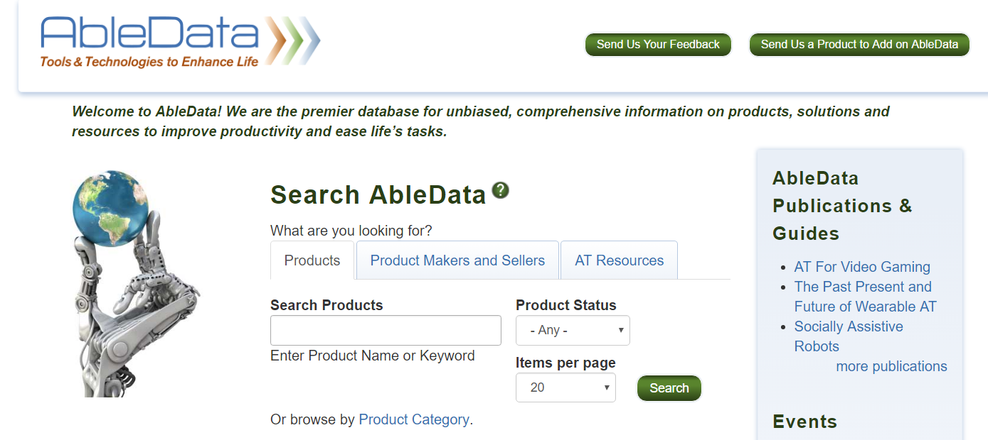
AbleData www.abledata.com
Notes:
Able Data is a searchable resource website that contains information on tools and technologies to “enhance life.” The user of this site can search by “product,” by “product makers/seller or categories” and by “AT Resources.”
The next slide shows a clip of searching by “Product Category.”

Slide 40
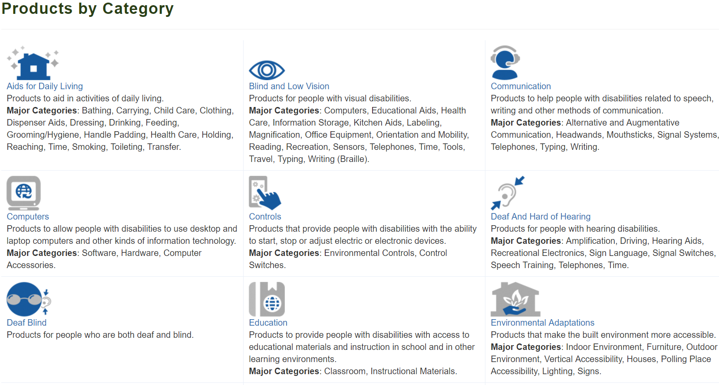
AbleData Search: Products by Category
Notes:
This is one way your can search on AbleData for possible AT or accommodations.

Slide 41
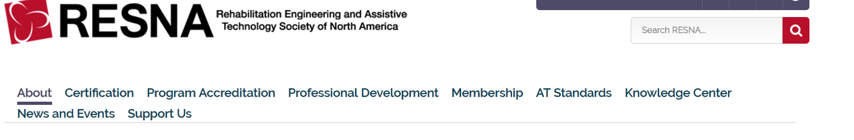
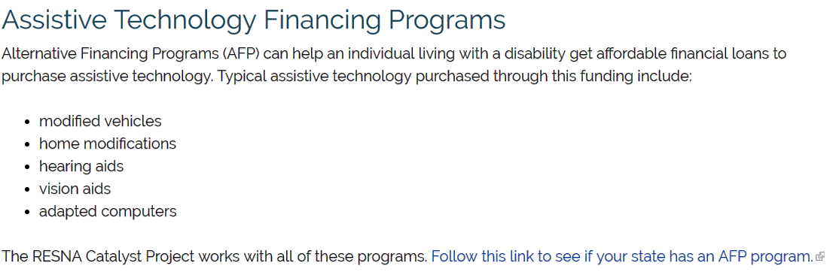
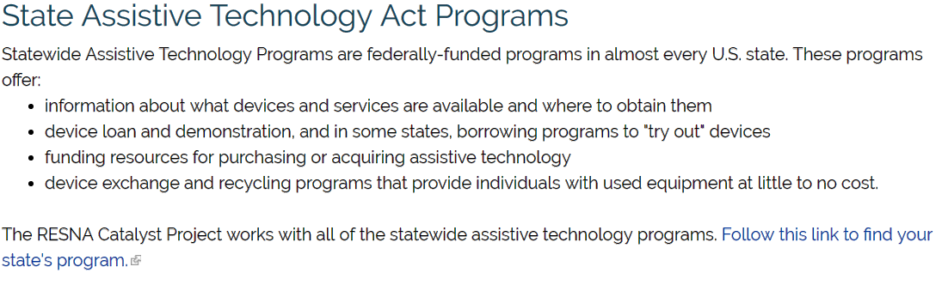
RESNA http://www.resna.org/
Notes:
RESNA is a national society engaged in the work of connecting those in need of AT to potential funding sources. Almost every state has a federally funded AT Program that offer device loans, funding sources, and further resources for AT.

Slide 42
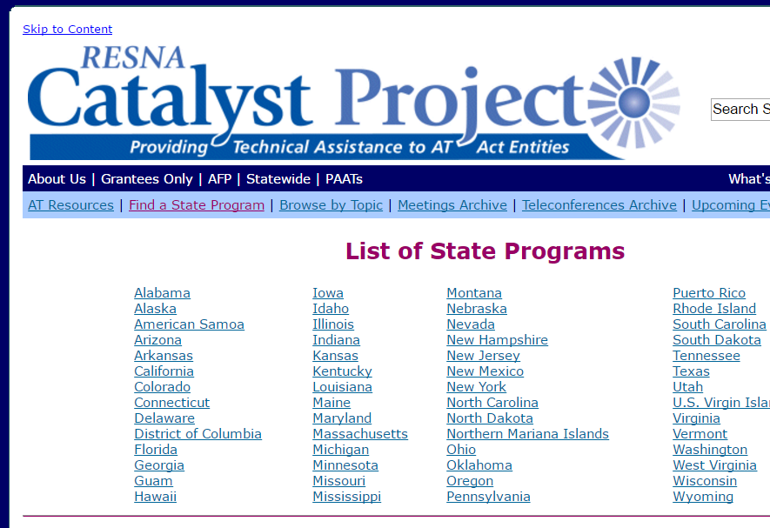
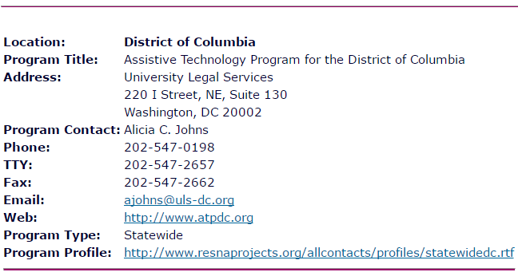
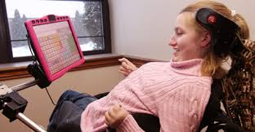
State AT Programs http://www.resnaprojects.org/allcontacts/statewidecontacts.html
Notes:
This slide is a snapshot of the actual list of state AT programs on the RESNA website. The right hand side of the slide has another snap shot of when you click on an individual state. In this case, it shows the contact info for the AT Program in DC.

Slide 43
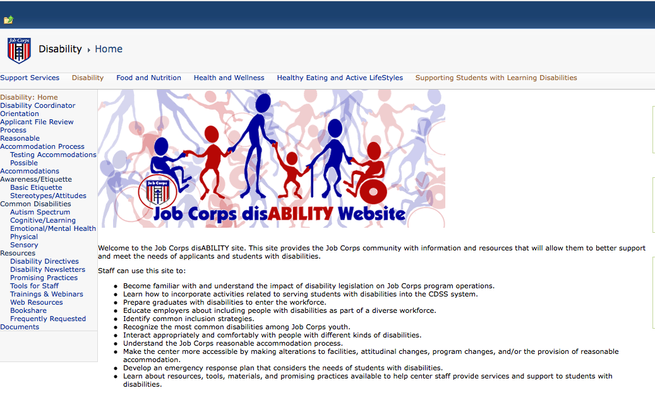
Job Corps Disability Website
https://supportservices.jobcorps.gov/disability/Pages/default.aspx

Slide 44
Regional Disability Coordinators
Boston Region – Kristen Philbrook
  kristen.philbrook@humanitas.com
Philadelphia Region – Annie Tulkin
  anne.tulkin@humanitas.com
Atlanta and Dallas Regions – Laura Kuhn
  laura.kuhn@humanitas.com
Chicago Regions – Sharon Hong
  sharon.hong@humanitas.com
San Francisco Region – Stephanie Karras
  stephanie.karras@humanitas.com

Slide 45
