Slide 1
Supporting Executive Functioning for Students
On Center and in Distance Learning Settings
Notes:
Welcome to “Supporting Executive Functioning for Students on Center and in Distance Learning Settings” webinar.
Reminder: We encourage you to use the chat box to share your questions, thoughts/ideas, and even strategies/accommodations that you might be using to address executive function challenges. If you are new to this concept, we will be defining and reviewing executive functioning with you today.

Slide 2
OBJECTIVES
Describe several common functional limitations experienced by individuals with executive function challenges.
List at least 3 possible reasonable accommodations for students with executive function challenges specific to their functional limitation manifestations on center and in distance learning settings.
Identify 1-2 strategies that may assist students with executive function challenges on the Job Corps center , in distance learning settings, and in the workplace.
Notes:
Our learning objectives for this webinar are…(slide)
In addition, we will be sharing many resources to support and build executive functioning skills for students in a variety of learning settings.

Slide 3
Poll Question
How familiar are you with Executive Functioning?
Very familiar
Somewhat familiar
Have heard of but that’s it
Not familiar at all
3
Notes:
In the chat box, type the letter for your response

Slide 4
How do you use your Executive Function Skills every day?
Did you arrive at work or begin work from home at a certain time?
Did someone happen to cut you off in traffic or interrupt you, and if so, did you refrain from yelling about them doing so?
Notes:
These are just a few hints as to how you use your Executive Function Skills.

Slide 5
How do you use your Executive Function Skills every day?
While monitoring on online classroom and despite there being lots of visual and auditory distractions, were you able to filter out the distractions and focus only on one student that with whom you were communicating in the chat box?
You are planning a student graduation for 6 months from now. Have you developed a timeline of events or a task list of items that need to be completed?
Notes:
These are just a few hints as to how you use your Executive Function Skills.

Slide 6
Defining Executive Functions
Notes:
Let’s begin by defining “executive functions” including a review of our key executive functions.

Slide 7
What are Executive Functions?
Refers to a set of neuro cognitive skills that are important for adaptive problem solving, creative thinking and goal-directed behavior.
3 primary skills involved in being able to translate what it is you know into goal-directed behavior:
Working memory - Working memory helps hold on to information long enough to use it and plays an important role in concentration and in following instructions. (www.understood.org)
Inhibitory control - Resisting temptation to respond to first impulse or what might not be the best thing to do in that moment.
A
B
Cognitive flexibility – The ability to look at a situation and see it from multiple points of view – to be able to take someone else’s perspective, for example.
Executive function skills are controlled by an area of the brain called the frontal lobe.
C
Notes:
Executive functions is an umbrella term for the neurologically-based skills involving mental control and self-regulation. These skills are controlled by an area of the brain called the “frontal lobe.”
If we take a more global look, Executive Functions refers to a set of neuro cognitive skills that are important for adaptive problem solving, creative thinking and goal-directed behavior.
We also know that individuals who have a variety of types of conditions may have executive functioning skill deficits (i.e., autism spectrum, ADHD, Anxiety for example).

Slide 8
https://www.youtube.com/watch?v=CYi2EzPkErs
Notes:
https://www.youtube.com/watch?v=CYi2EzPkErs (What Is Executive Function?) 0 – 3:21
Executive functions are a set of skills that include organization, attention, and planning. This includes impulse control, emotional control, and working memory. Learn more about executive functioning and how you can help your student improve these skills. In this video, Stephanie Carlson, PhD, Director of Research, Institute of Child Development University of Minnesota, explains how executive functioning skills develop in kids. “It refers to a group of important mental skills that allows us to set goals and get things done,” says Dr. Carlson. The three main areas of executive function are working memory, flexible thinking, and inhibitory control, according to Dr. Carlson. Kids that struggle with executive function may also face challenges in life and in school. Watch as Dr. Carlson shares advice on ways to improve executive function in kids. Keep in mind, executive function has nothing to do with intelligence.

Slide 9
Let’s Review the Key Executive Functions
Impulse Control
Thinking before acting
Emotional Control
Keeping feelings in check
Flexible Thinking
Adjusting to the unexpected
Working Memory
Keeping key information in mind
Self-Monitoring
Evaluate how s/he is doing
Planning and Prioritizing
Developing goals and planning how to meet them
Task Initiation
Taking action or getting started
Organization
Keeping track of things both physically and mentally
https://www.understood.org/en/learning-attention-issues/child-learning-disabilities/executive-functioning-issues/key-executive-functioning-skills-explained
Notes:
Although we just listened to a discussion about the 3 primary skills involved in being able to translate what one knows into goal-directed behavior, let’s briefly review/discuss all the key executive functions and the role they play.
Impulse/Emotional control: This is an individual’s ability to manage his/her feelings by focusing on the end result or goal. Emotional control and impulse control are closely related. Individuals who struggle with emotional control often have trouble accepting negative feedback. They also may overreact to little injustices. They may struggle to finish a task when something upsets them.
Flexibility: This is an individual’s ability to roll with the punches and come up with new approaches when a plan fails. Individuals who are inflexible think in very concrete ways. They don’t see other options or solutions. They find it difficult to change course. They may get panicky and frustrated when they’re asked to do so.
Working memory: This is an individual’s ability to hold information in his/her mind and use it to complete a task. Individuals who have weak working memory skills have trouble with multi-step tasks. They have a hard time remembering directions, taking notes or understanding something you’ve just explained to them. An individual who has trouble with working memory, you frequently may hear, “I forgot what I was going to say.”
Self-monitoring: This is an individual’s ability to keep track of and evaluate his/her performance on regular tasks. Individuals who have trouble self-monitoring lack self-awareness. They can’t tell if their strategies are working. They may not even realize they have strategies. They often don’t know how to check their work.
Planning and prioritizing: This is an individual’s ability come up with the steps needed to reach a goal and to decide their order of importance. Individuals with weak planning and prioritizing skills may not know how to start planning a project. They may be easily overwhelmed trying to break tasks into smaller, more manageable chunks. They may have trouble seeing the main idea.
Task initiation: This is an individual’s ability to get started on something. An individual who struggles with this skill often has issues with planning and prioritizing too. Without having a plan for a task, it’s hard to know how to start. Individuals with task initiation problems can come across as lazy or as simply procrastinating. But often they’re just so overwhelmed they freeze and do nothing.
Organization: This is an individual’s ability to keep track of information and things. Individuals with organizational issues are constantly losing or misplacing things. They can’t find a way to get organized even when there are negative consequences to being disorganized.

Slide 10
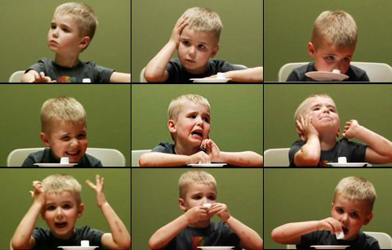
Executive Functioning Development “Review”
Executive functioning skills are developed throughout childhood and adolescence.
Notes:
Let’s stop for a minute now and review a few points. Executive functioning skills are developed throughout childhood and adolescence. So, we know that some of our students are still developing these executive function skills!
Just to demonstrate the context of this point, I am going to show you a brief video clip now where we can see in action how executive function skills are still under development in children of a very young age.
https://www.youtube.com/watch?v=qAC-5hTK-4c
2:58 – 4:22

Slide 11
Executive Functioning Development “Review”
Having opportunities to practice and use executive functioning skills have an impact on the individual’s skill level development.
Exposure to high levels of stress that result in the production of the hormone, “cortisol,” actually can negatively impact the development of executive functioning skills.
Notes:
Having opportunities to practice and use executive functioning skills also have an impact on the individual’s skill level development as well as the context within which the activity occurs. For example, a child may develop an appreciation of delay of gratification when they believe that they are part of a group (sight unseen) who made a choice to delay gratification – like with the relatively well-known marshmallow test. The adult performing the test puts a young child in a room with two plates – one with one marshmallow on it and the other with two marshmallows. The researcher instructs the child that they can have BOTH marshmallows if they wait until the adult returns. In one study, the researcher added a twist. She gave the child either a green or an orange t-shirt and then told them that their group waited and got the bigger reward, or they were part of the group that did not wait. Those children who thought they were part of the group that waited tended to also wait and developed a greater value or appreciation of waiting/delaying gratification. Given this, both practice and application of context, can help improve executive function performance. (From the same video as above: https://www.youtube.com/watch?v=qAC-5hTK-4c)
It is important to remember that perhaps some of our students are in need of more opportunities to develop these skills and/or need accommodations to support executive function deficits. Job Corps really is a perfect platform for such practice since the program is all about helping young people develop not only academic and career technical skills but also become more independent, build their employability skills, become self-sufficient, and so forth.
Exposure to high levels of stress that result in the production of the hormone, “cortisol,” actually can negatively impact the development of executive functioning skills. We added this one in, almost as an aside, just as an example to showcase the need and even perhaps the opportunity to collaborate with other center experts such as the Center Mental Health Consultant to teach students activities and strategies they can use to develop and support self-regulation, in particular. So, the RAC can identify specific accommodations such as frequent breaks that can help with attention, frustration, etc., but the long term benefit would come from the strategies that could be used during those frequent breaks to help the student learn to self-regulate (i.e., calm themselves down, refocus themselves, quiet their anxiety, etc.). We will discuss this further when we discuss accommodations.

Slide 12
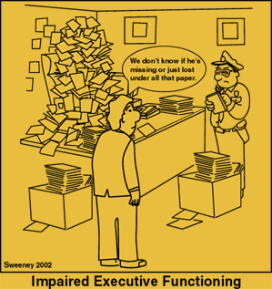
General Accommodations/ Strategies to Support Executive Function
Notes:
Now let’s move to some general accommodations and strategies to support Executive Functioning.

Slide 13
What do you think?
It is not uncommon to see students that are academically capable, really start to struggle or have some challenges in those middle school and early high school years. Certain phrases start to get attached to these students such as “if he would just try harder…,” etc. What do you think really MIGHT be going on with these students?
Notes:
What academic environment type demands tend to increase around these transition ages?
Demands to act and work more independently, initiate actions, organize oneself, remember multiple tasks/assignments. Think about how those demands translate to distance/online/virtual learning.
These are the areas that we often see students who have executive function challenges struggle with and they can very easily go unrecognized for what they really are…

Slide 14
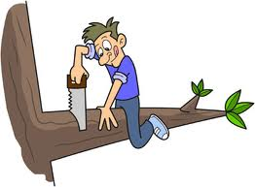
What executive function “functional limitations” might this person have?
Impulse Control
Self-Monitoring
Prioritizing
Notes:
In the chat box…

Slide 15
Can Executive Functioning be Improved?
The great news?
YES!!
Most importantly, we CAN accommodate executive functioning skill deficits.

Slide 16
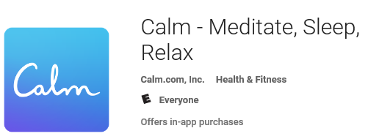
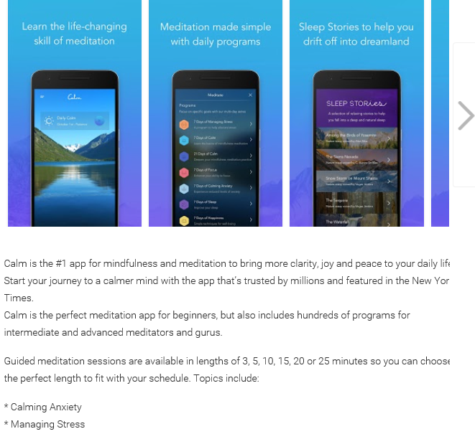
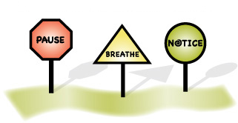
Mindfulness
Emotional/Impulse Control/Attention
“Mindfulness may be an ideal intervention for promoting EF: Trains sustained reprocessing while also creating conditions conducive to reflection by
Reducing stress (< cortisol)
Increasing openness and curiosity
(> Dopamine)
Dr. Philip Zelazo, University of Minnesota
Notes:
What are some of the accommodations that could be used?
Breaks to allow the student to use the app or apply their mindfulness training the CMHC taught them?
Mentor to practice mindfulness activities or learn new techniques
Model to show that all of us need to reduce stress/anxiety in order to function
Movement and mindfulness breaks are helpful for students who have difficulty with emotional, self-regulation, and/or impulse control and have been shown to increase executive function skills in numerous research studies.

Slide 17
https://www.youtube.com/watch?v=YDmHhvMVz4k
Dr. Philip Zelazo, University of Minnesota
Notes:
46:30 to 49:50 (a little over 3 minutes)

Slide 18
Reflective Thinking
Emotional/Impulse Control/Attention
Pre-school study based upon color and shape.
Stopping and giving basic instruction and opportunity to reflect and think through process resulted in performance improvement.
Dr. Philip Zelazo, University of Minnesota
How might we provide opportunities for “reflective thinking” in distance/online/virtual learning settings?
Notes:
Remember in the first video where the preschool children were given cards with items on them that were of different shapes and one of two different colors. They were told they would be asked to place the card in the box either based upon the shape or the color dependent upon which one the person directed them to do each time. After the first card, the child continued to place the cards essentially following the same pattern. If they placed based upon color, then they continued to do that despite a change in instruction. However, when stopped, and even given brief explanation and guidance so that they could reflect on how they were supposed to be choosing which box to place each card, their performance improved. In the controlled study, performance improved by 53%.
In the chat box, share your ideas on how we might provide opportunities for “reflective thinking” in distance/online/virtual learning settings?

Slide 19
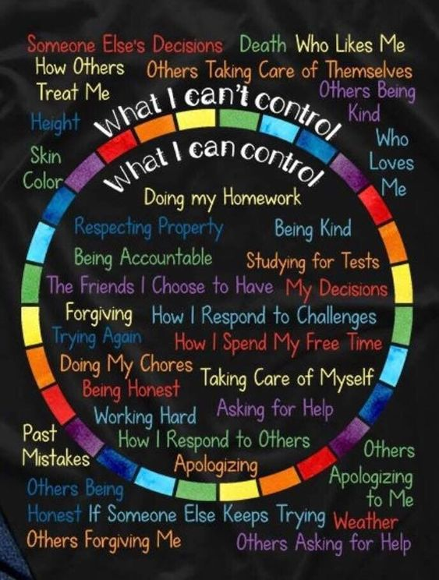
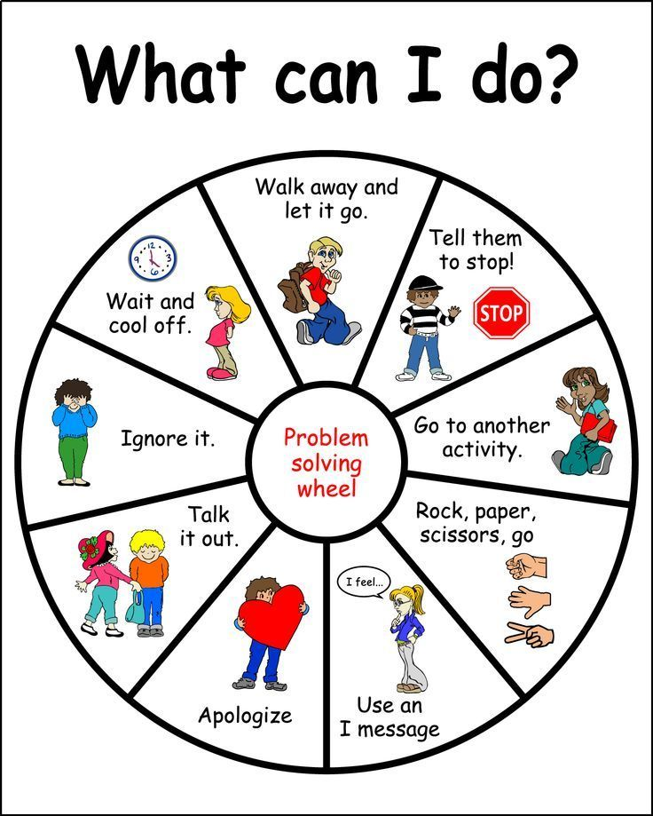
Problem Solving Wheels
Emotional/Impulse Control/Self-Monitoring
Adapt it for Job Corps environment (e.g., graphics), rules, expectations, etc.
Notes:
One possible way to address emotional/impulse control/self-monitoring is to provide a graphic such as these for students to identify/address/adjust their own behaviors. Students can help develop these types of graphics. Some centers have posted these types of graphics in the online classrooms.

Slide 20
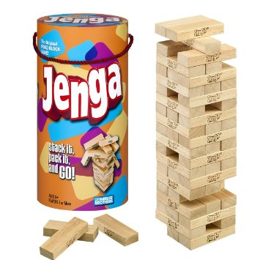
Jenga!
Self-Monitoring/Flexible Thinking/Impulse Control
Requires players to ask challenging questions: “What will happen if I remove this block from this tower? Will this whole structure wobble if I take away this one? How will pulling it out quickly affect the stack?”
Jenga requires players to be aware and in control of their actions, and those are great skills for kids to hone.
www.understood.org
Notes:
As we saw in the video clip(s), games (either in person/hands-on or virtually) can be helpful in teaching self-monitoring/flexible thinking/impulse control. One such game is represented here.
In the chat box, share any of the online or in-person games or activities that you have used to possibly improve social skills or address these type of functional limitations.

Slide 21
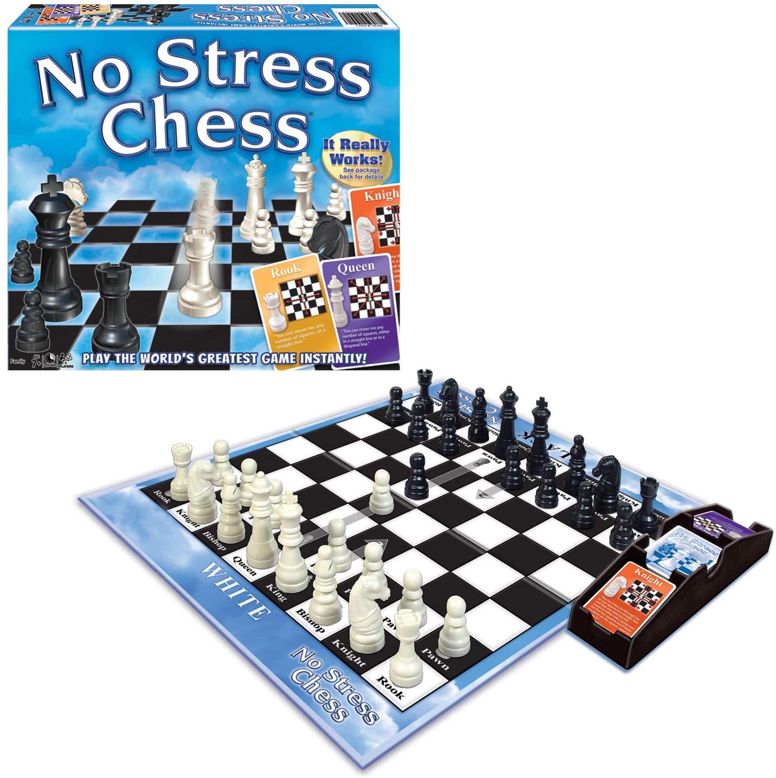
No Stress Chess
Planning Prioritizing/Organization/Task Initiation/Impulse Control/Flexible Thinking
Classic chess may be the best-known strategy game. No Stress Chess teaches users to play it.
A player draws a card that tells which piece to move. Then it’s up to the player to choose where the piece should go.
Over time, the players develop the logic skills and confidence to execute moves without the cards. Instructions are included for three levels of beginner’s play.
www.understood.org
Notes:
Here is another example of a game that can potentially improve the functional limitations represented on this slide.

Slide 22
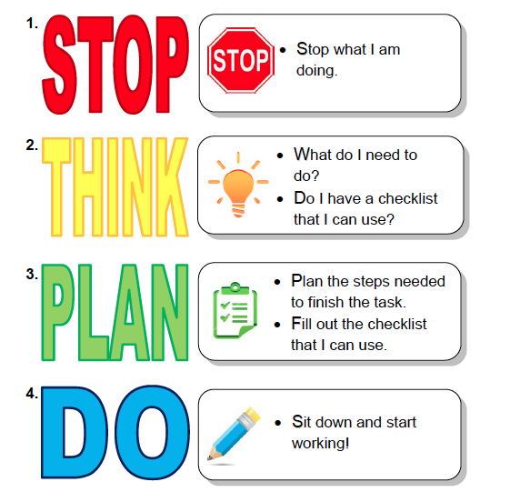
Accommodations/ Strategies to Support Executive Function
Notes:
Let’s shift to more specific accommodations and strategies to support some of the functional limitations we have discussed. Your center’s RAC

Slide 23
Working Memory
Working Memory
Accommodations
Strategies
Have them develop PowerPoint presentations related to a concept, draw sketches/story boards or tell you about the concept.
Use fun mnemonics to help associate details, connect new and old information, etc.
Provide lots of opportunity for student to repeat, restate, etc. information
Use multi-sensory instructional methods
Provide visual supports (e.g., picture supported content, use of videos, etc.)
Chunk information into smaller segments or assignments
Provide copies of notes or other relevant learning content
Repeat instructions
Provide formula sheets for classroom/career technical instruction
23
Notes:
We are going to select a few of the functional limitations and review accommodations that the RAC might consider.
This slide has some ideas for accommodations and supporting strategies to address “working memory” limitations.

Slide 24
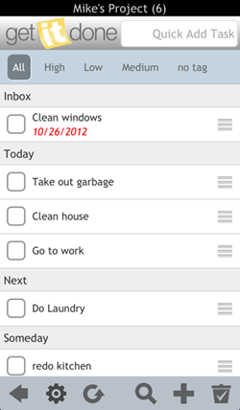
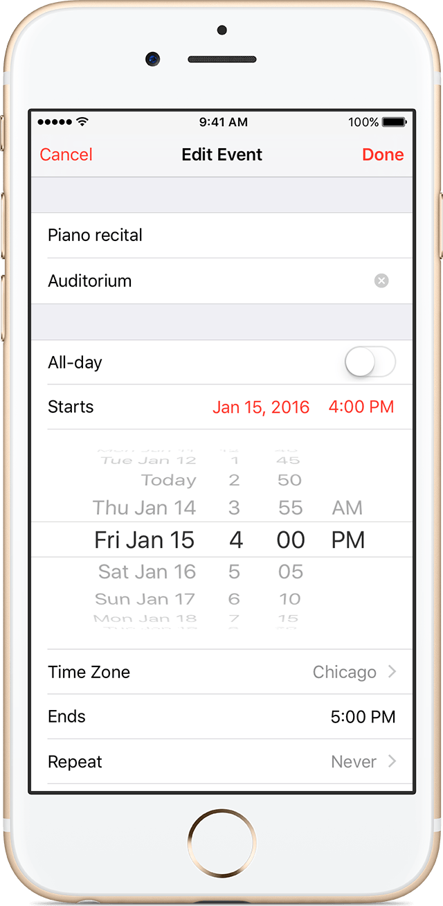
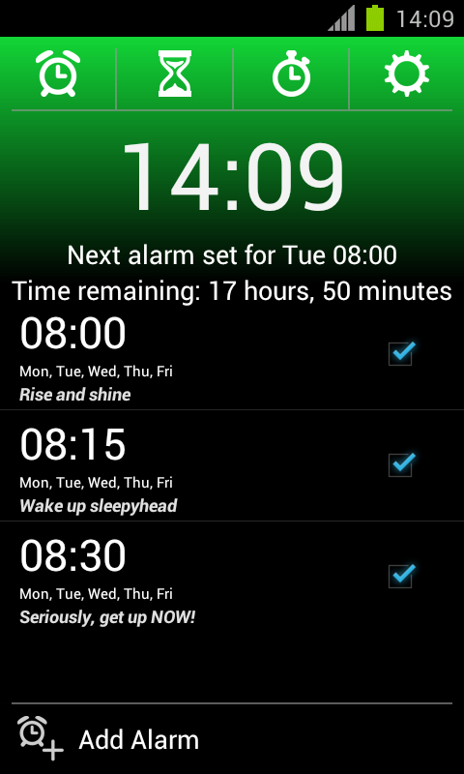
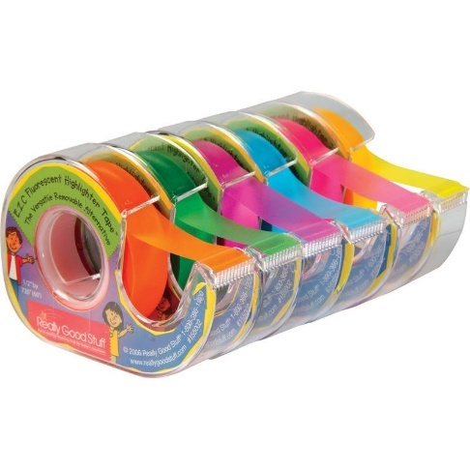
Organization
Accommodations
Using a watch, especially one with special features for reminders such as memos or that will vibrate to remind them to do something
Checklists, but keep these relevant, simple, and short (consider technology)
Color-coding systems which can include folders, notebooks, highlighters, etc.
Sticky notes or sticky tabs
Evernote
One Note
24
Notes:
Here we have some ideas on how to accommodate/support “organization” limitations…
Note: Digital Notebooks (Evernote and One Note)--Both apps allow students to create “notebooks” with unlimited notes, pictures, sound recordings, etc.
Notes and notebooks are searchable by keyword, share-able, and are device non-specific.

Slide 25
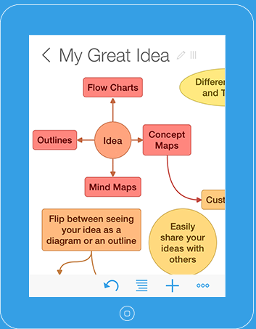
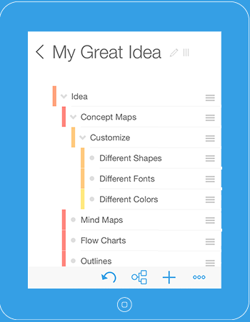
Working Memory/Organization
Ideament
25
Notes:
For “working memory” and “organization,” Ideament is a great app for students with functional limitations in executive function, especially student who struggle to retain new material. Ideament lets a student easily draw a diagram – mind map, concept map, or flow chart – and convert it to a text outline and vice versa. Students can use Ideament for anything such as brainstorming new ideas, illustrating concepts, making lists and outlines, planning projects, creating organizational charts, etc.

Slide 26
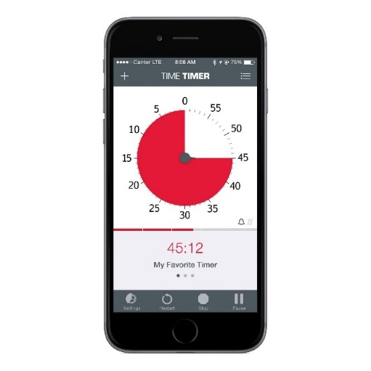
Task Initiation
Task Initiation
Accommodations
Strategies
Break tasks into smaller segments or chunks
Develop quick, brief videos that demonstrate the skill or task that the student can review repeatedly
Verify understanding of task
Use highlighters
Provide graphic organizers
Use visual timers
Complete the first problem, activity, etc. or two together and then have the student complete one independently.
Have them highlight key words in the instructions
FACTS
Notes:
On the left side of the slide, you see some accommodations that the RAC could consider when addressing task completion issues. On the right, are some supporting strategies for the same.
All of these accommodations and strategies can be applied to distance/online/virtual settings. In the chat box, share any idea on how you or your colleagues have provided these in distance learning settings.

Slide 27
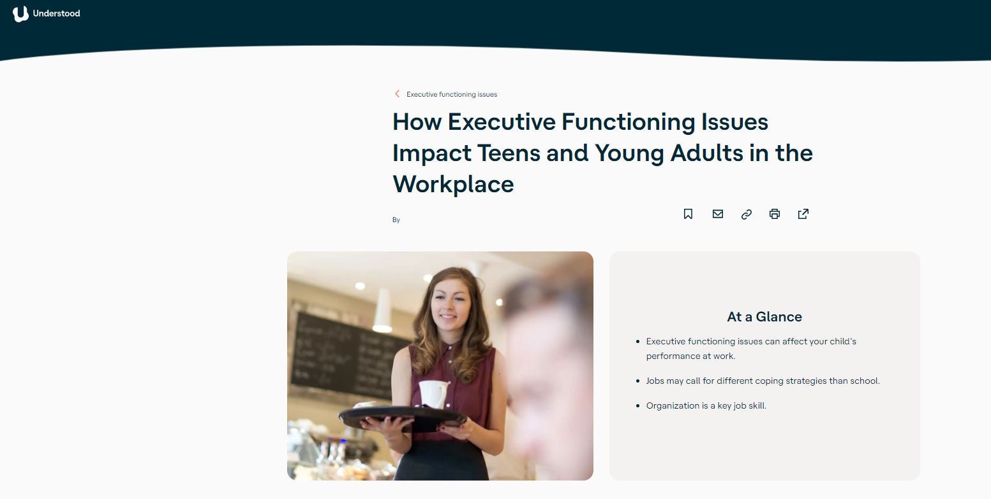
Notes:
Understood.org is a resource that provides support and resources for a variety of disabilities and related functional limitations. We encourage you to visit this page and the multitude of others on this site that are related to executive function supports.
https://www.understood.org/en/learning-thinking-differences/child-learning-disabilities/executive-functioning-issues/how-executive-functioning-issues-impact-teens-and-young-adults-in-the-workplace

Slide 28
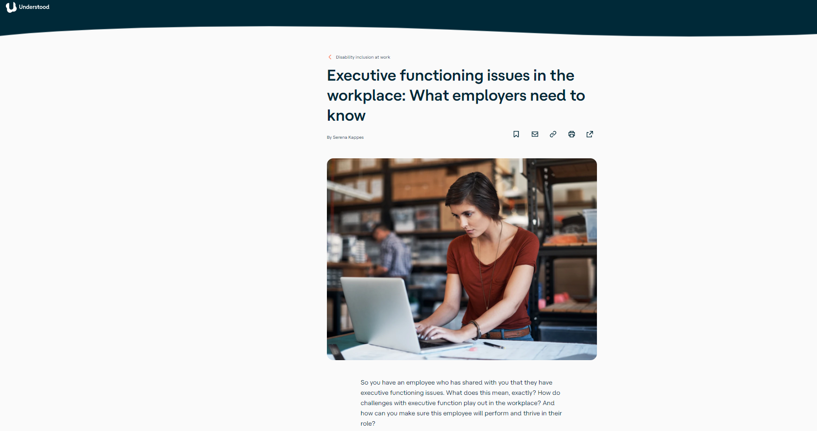
Notes:
Understood.org is a resource that provides support and resources for a variety of disabilities and related functional limitations. We encourage you to visit this page and the multitude of others on this site that are related to executive function supports.
https://www.understood.org/en/workplace/disability-inclusion-work/executive-functioning-issues-in-the-workplace-what-employers-need-to-know

Slide 29
Executive Functioning and Distance / Online Learning
Notes:
With the continued pandemic, many students have to be responsible for logging into online classes, finding assignments in multiple platforms (such as Google Classroom). checking email and portal messages and using other methods as well to successfully navigate. Additionally, in some instances, they have to teach themselves skills and material to a greater degree than if they were in person.
Obviously, all these tasks can make learning more difficult. On the other hand, while many people focus on the negatives of distance learning, it is highly possible that our students could potentially come out of the pandemic with stronger executive function skills. How is that possible? Let’s look at some ideas.

Slide 30
Distance Learning:
Strengthening Executive Functioning Skills
Keeping track of assignments:
Whiteboard
List on paper
School portal task list
Exporting assignments from Job Corps class portal to an external calendar or app
Making a daily and weekly plan written or digital form
Following through on completing assignments:
Set time of day to work on assignments
View list and check off items
Use system to double check to make sure assignments have been completed
Automating notifications and reminders:
Set automated reminders instead of having a person remind the student
Use reminders or alarms from a personal assistant such as Alexa, Google Home, Google Calendar …
Develop priority lists:
Teacher/Staff model the process of prioritizing tasks builds students’ ability to organize and manage their time
30
Notes:
We can help to further facilitate development of our students’ executive function skills during distance learning. The main concept is pretty simple: Give our students tools that they can use by themselves to simplify organization, keep track of assignments, and follow though on completing them (with oversight as a backup when needed). This will enhance their independence and employability as well.
Some ideas are listed here on the slide.

Slide 31
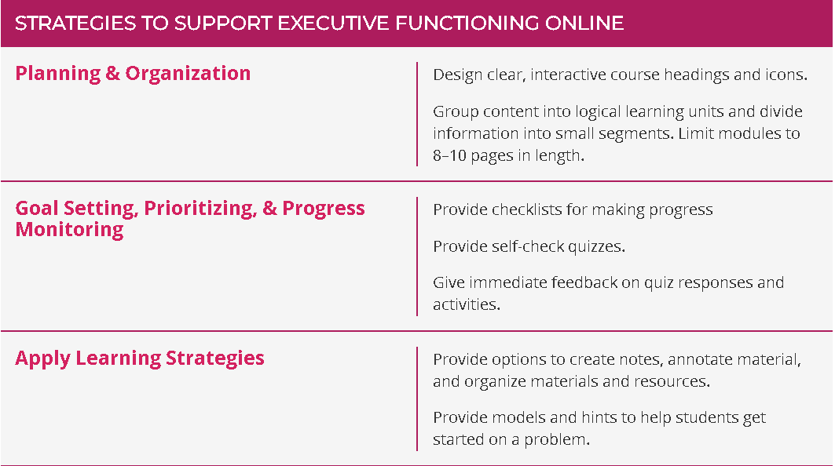
Distance/Online Learning Strategies
Notes:
When designing online learning courses, this table provides some strategies to support executive functioning.

Slide 32
Online Learning
Increasing Communication and Shared Experiences
Establish shared expectations
Use synchronous (real time) events when possible (e.g., instant messaging, video conferencing, webinars, chat box
Establish opportunities for peer interaction
Provide a common space to share questions/answers, learning strategies—allows peer mentors to model executive functioning strategies for others.
Establish routines to allow for planning
For example: The instructor may ask students to read a chapter and respond to a prompt twice a week on the discussion board.
Notes:
Often in online learning environments, students are required to move through material independently; apply learning strategies; reflect upon their learning; and demonstrate a great deal of self-regulation by monitoring their cognition, motivation and behavior. We can support executive functioning by increasing communication and shared experiences. These include the examples listed on this slide.

Slide 33
Resources

Slide 34
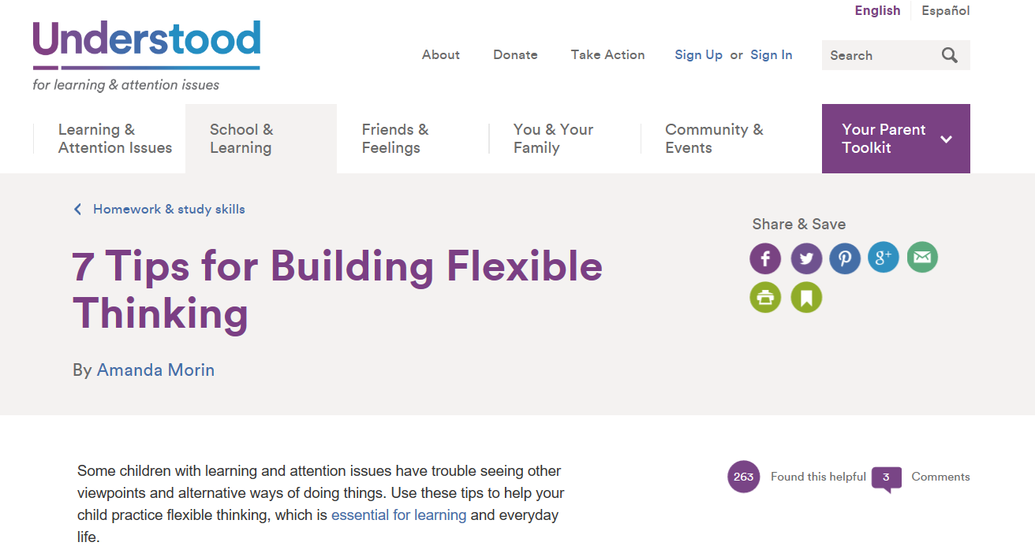
Understood https://www.understood.org

Slide 35
Job Accommodation Network (JAN) askjan.org
35
Notes:
Job Accommodation Network is an extremely comprehensive FREE resource on workplace accommodations and disability employment issues.
When you use the website or call to talk to a member of JAN’s expert staff, you will immediately get the impression that they were created just for us at Job Corps. They are that relevant to the work that we do.
Many of the accommodations in this webinar came from JAN and were used on actual JC centers.

Slide 36
Job Accommodation Network http://askjan.org/media/execfunc.html
Notes:
JAN provides detailed information on how to accommodate students who demonstrate functional limitations in executive function using the limitation A-Z feature.

Slide 37
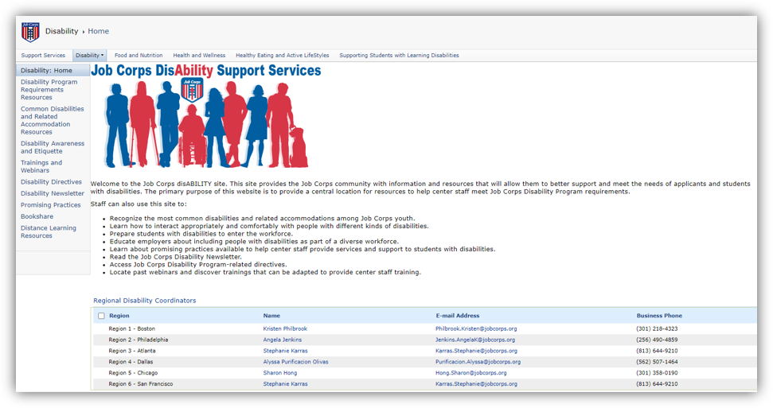
Job Corps Disability Website https://supportservices.jobcorps.gov/disability/Pages/default.aspx

Slide 38
THANK YOU!!

