Slide 1
Intellectual Disabilities
Considerations in Applicant File Review (AFR) and Disability Accommodation (DA)
Intellectual Disabilities
April 2024
Notes:
Welcome to the webinar on Intellectual Disabilities – Considerations in Applicant File Review (AFR) and Disability Accommodation (DA)

Slide 2
Contents
01
Applicant File Review Considerations
02
Disability Accommodation Considerations
03
Maximum Benefit Recommendations
04
Resources
2
Notes:
Today we will be covering:
Applicant File Review Considerations
Disability Accommodation Considerations
Review of Maximum Benefits Recommendations
Review of Resources

Slide 3
Applicant File Review
Considerations
01
Document Reviews, Clinical Interviews, Adaptive and Social Functioning,
and Recommendations of Denial
3
Notes:
Section 01 - Applicant File Review Considerations
Document Reviews, Clinical Interviews, Adaptive and Social Functioning, and Recommendations of Denial
The Job Corps program has always served/included students who have intellectual disabilities and without question, there are students with intellectual disabilities who have successfully completed the Job Corps program. However, as it is with all applicants in general, not every student’s health care needs can be met within the Job Corps program, even with disability accommodations. In this section, we are going to discuss the importance of the applicant file review triage process, conducting clinical interviews to include a review of adaptive and social functioning as well as when a recommendation of denial may be the appropriate course to consider.

Slide 4
Non-educational Document Reviews Feedback from DCs Center Applicant File Review Form (CAFR)(Form 1-06)
Health and Wellness Directors (HWDs) are the File Review Coordinators for the center, and they must complete the Center Applicant File Review (CAFR) Form from Form 1-06 for every applicant (or the corresponding form for possible direct threat found at the beginning of Form 2-04).
Many if not most individuals who have an intellectual disability disclose that they had an IEP when enrolled in the public school system.
Assign the non-health disability documents to the non-health or full-time DC for review unless the Center Mental Health Consultant (CMHC) reviews ALL non-health disability documents as a matter of routine.
4
Notes:
Center Applicant File Review – Form 1-06
The Center Applicant File Review Form is the form used to document the initial applicant file review of the HWD or the “triage” of the applicant file. Health and Wellness Directors (HWDs) are the File Review Coordinators for the center, and as such, they must complete the Center Applicant File Review (CAFR) form from Form 1-06 for every applicant (or the corresponding form for possible direct threat found at the beginning of Form 2-04).
Many if not most individuals who have an intellectual disability disclose that they had an IEP when enrolled in the public school system. Ensure that the non-health DC or full-time DC (whichever applies) is assigned the review of the non-health disability documents unless the Center Mental Health Consultant (CMHC) reviews ALL non-health disability documents as a matter of routine.
The non-health or full-time DC provides “feedback” to the HWD from the review of the non-health documents. DCs do not make decisions on enrollment.

Slide 5
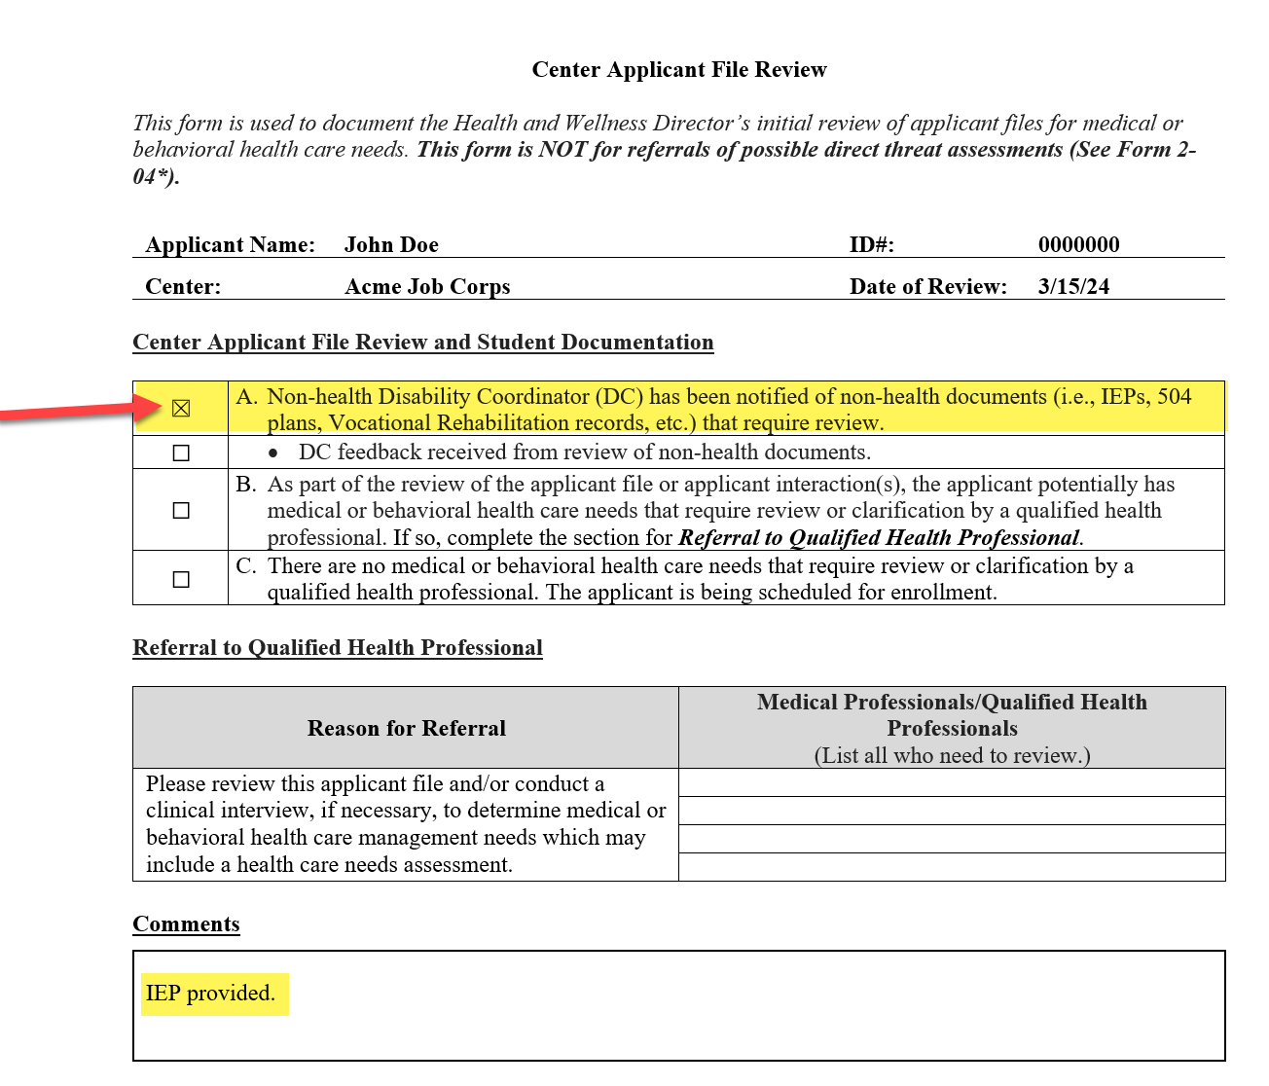
CAFR
Form 1-06
In this example, the applicant has an IEP, so the HWD assigns the IEP to the non-health DC for review.
It is critical for the DC to provide timely feedback to the HWD so that they (e.g., HWD) may also assign the document/file to the CMHC for review, if needed, and before a decision on enrollment is made.
5
Notes:
CAFR – Form 1-06
There is a screenshot of the Center Applicant File Review form from Form 1-06 on the left-hand side of the slide. In this example, the applicant has an IEP so the HWD assigns the IEP to the non-health DC for review (i.e., the HWD selects item A of the CAFR form).
Remember, within applicant file review, the DC’s role is ONLY to provide written feedback to the HWD so they can determine whether the CMHC or any other center qualified health professional (QHP) needs to review the feedback and the IEP document before a decision on enrollment is made. DCs do not contact applicants during applicant file review except when assisting the QHP with the disability accommodation considerations/interactive disability accommodation process within the completion of a health care needs or direct threat assessment.
It is critical for the DC to provide timely feedback to the HWD so that they (e.g., HWD) may also assign the document/file to the CMHC for review, if needed, before a decision on enrollment is made. The entire applicant file review process still must be completed within the center’s 30-day time review window or the center has to obtain a brief extension of time approval from their DOL Program Manager.

Slide 6
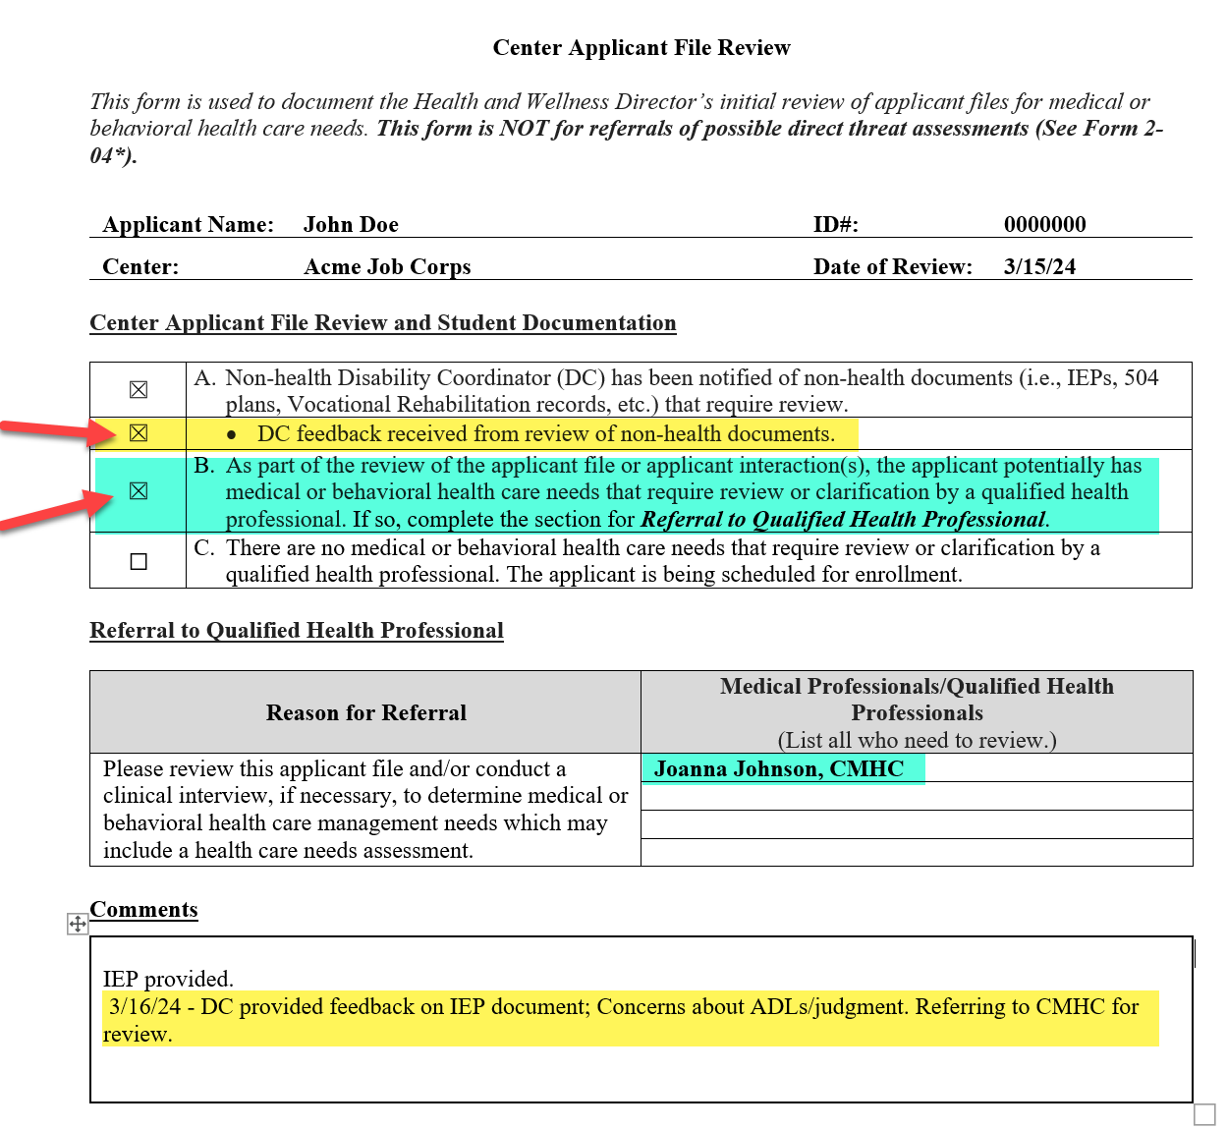
Examples
of DC Feedback
to HWD
Adaptive living skills, challenges (self-help and activities of daily living challenges)
Aggression or assaultive behaviors
Presence of functional behavior assessments (FBAs) or Behavior Intervention Plans (BIPs)
Presence of other health plans for medical management purposes
6
Notes:
Examples of DC Feedback to HWD
If the HWD checks Item A, then Item B should be selected when the written feedback is received from the non-health DC. In this example, when the HWD received the written feedback, they documented in the comments (yellow highlight) that on 3/16/24 the DC provided feedback on IEP document and that concerns about ADLs and judgment were noted so the HWD is referring to the CMHC for review as well.
What are some types of feedback that the non-health or full time DC might document?
Examples of feedback:
Adaptive living skills challenges (self-help and activities of daily living challenges)
Aggression or assaultive behaviors
Presence of functional behavior assessments or behavior intervention plans
Presence of other health plans for medical management purposes
Some Center Mental Health Consultants routinely review these documents. If so, note that in the comments section of this form. The center may forgo the Non-health DC's review if the CMHC is reviewing; however, the Non-health DC's participation in still encouraged given their background and experience reading these types of documents.

Slide 7
DC File Review Do Not’s
Applicant File Review Tips
Interview
Approve Files
Pre-Arrival Contact
Post Approval
DCs do not contact or interview applicants during applicant file review unless they are assisting a Qualified Health Professional (QHP) with completing the disability accommodation section of a Health Care Needs (HCNA) or a Direct Threat Assessment (DTA).
DCs do not approve files for enrollment.
They provide feedback for use by the QHP(s) to use in making enrollment decisions.
DCs do not initiate the interactive disability accommodation process/draft disability accommodation plans before applicants are approved for enrollment unless as part of a HCNA or DTA.
7
Notes:
Applicant File Review Tips – DC File Review Do Not’s
DCs do not contact or interview applicants during applicant file review unless they are assisting a Qualified Health Professional (QHP) with completing the disability accommodation section of a Health Care Needs (HCNA) or a Direct Threat Assessment (DTA).
DCs do not approve files for enrollment. They provide feedback for use by the QHP(s) to use in making enrollment decisions.
DCs do not initiate the interactive disability accommodation process/draft disability accommodation plans before applicants are approved for enrollment unless as part of a HCNA or DTA.
Why did we spend so much time on the CAFR within an ID webinar?
Because one of the most common scenarios that we see occur is an IEP being assigned to a DC for review, but the DC is not advised that they must provide feedback PRIOR to a decision on enrollment being made and the HWD and/or the HWD/QHP approves the individual for enrollment not realizing that the individual may have significant adaptive living skill challenges, judgment concerns and the like.

Slide 8
Communication Accommodations
Considerations for the Clinical Interview
The applicant may need communication accommodations to effectively participate in the interview and/or Disability Accommodation Process (DAP). If possible, conduct the interview in person or videoconference.
Communication Accommodation Examples:
Allowing extra time for processing and response to questions
Simplifying language used
Rephrasing or repeating questions
Checking for understanding; have the individual state their understanding
Use written communication or picture-related supports
8
Notes:
Communication Accommodations
Considerations for the Clinical Interview
The applicant may need communication accommodations to effectively participate in the interview and/or Disability Accommodation Process (DAP). If possible, conduct the interview in person or videoconference.
Communication Accommodation Examples:
Allowing extra time for processing and response to questions
Simplifying language used
Rephrasing or repeating questions
Checking for understanding; have the individual state their understanding
Use written communication or picture-related supports

Slide 9
Parental/Guardian Involvement in the Clinical Interview
Parent/Guardian Responding for Applicant
Advise the parent/guardian their input is welcomed after the applicant has an opportunity to try and respond to each question.
Explain that this is important so that you can see how well the applicant functions independently.
9
Notes:
Parental/Guardian Involvement in the Clinical Interview - Parent/Guardian Responding for Applicant
Parents/guardians of applicants with lower cognitive functioning often choose to participate in applicant interviews. While they can be present, it is helpful to inform them that their input is welcomed after the applicant has an opportunity to try and respond to each question. Explain that this is important so that you can see how well the applicant functions independently.

Slide 10
Assessing
Adaptive and Social Functioning
Adaptive Functioning
Judgment/ Safety
Social Interactions
It may also be important to assess adaptive and social functioning in applicants with traumatic brain injuries.
It is also not uncommon for individuals with ID to have comorbid conditions or symptoms related to ADHD, autism spectrum disorder, depression or anxiety.
10
Notes:
Assessing Adaptive and Social Functioning
During the clinical interview, CMHCs should assess adaptive functioning, judgment, social interactions, or any possible safety concerns when an applicant has cognitive issues or intellectual disabilities. It may also be important to assess adaptive and social functioning in applicants with traumatic brain injuries. It is also not uncommon for individuals with ID to have comorbid conditions or symptoms related to ADHD, autism spectrum disorder, depression or anxiety.

Slide 11
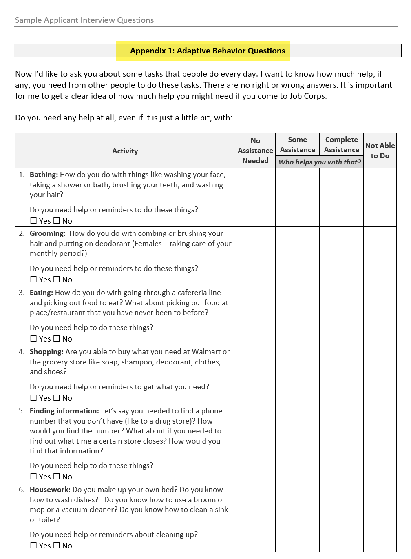
Sample
Applicant Clinical Interview Questions
Link: CMHC Sample Applicant Interview Questions
11
Notes:
Sample Applicant Interview Questions
On the left-hand side of the slide, there is a screenshot of the introductory guidance for the use of the Sample Applicant Clinical Interview Questions. Though the CMHC Sample Applicant Interview Questions are optional to use, the questions in Appendix 1: Adaptive Behavior Questions (see screenshot on the right-hand side of the slide), may be helpful to ask.
These questions explore how the applicant manages activities of daily living, self-care tasks, and social interactions.
They also ask about the level of support that the applicant needs to complete various activities and tasks.
If you download the PowerPoint, there is a link to the CMHC Sample Applicant Interview Questions at the bottom of this slide or contact your respective Regional Mental Health Specialist.

Slide 12
Recommendations
Of Denial
There are only two “primary” reasons that an applicant can be denied enrollment to Job Corps:
01.
Direct Threat to Others - The applicant currently poses an imminent risk of harm to others.
02.
Health Care Needs - The applicant has healthcare needs that are beyond the basic medical care available through Job Corps.
12
Notes:
Recommendations of Denial
There are only two “primary” reasons that an applicant can be denied enrollment to Job Corps:
Direct Threat to Others - The applicant currently poses an imminent risk of harm to others
Health Care Needs - The applicant has healthcare needs that are beyond the basic medical care available through Job Corps.

Slide 13
Functional Limitations (Symptoms/Behaviors)
A recommendation of denial could be made for an applicant with cognitive impairments, if the applicant has functional limitations that require healthcare services or supports beyond the basic health care available through Job Corps.
Examples include:
Difficulty with regulating emotions
Impaired decision-making impacting safety
Difficulty interacting with peers resulting in negative behaviors
Memory and concentration problems
Difficulty with communication
Uncontrolled behaviors such as impulsivity that impact positive relationships with peers, staff and/or safety
Requires daily assistance with hygiene tasks and requires supervision when navigating public spaces
13
Notes:
Functional Limitations – Symptoms/Behaviors
A recommendation of denial could be made for an applicant with cognitive impairments, if the applicant has functional limitations that require healthcare services or supports beyond the basic health care available through Job Corps.
Examples of functional limitations include:
Difficulty with regulating emotions
Impaired decision-making impacting safety
Difficulty interacting with peers resulting in negative behaviors
Memory and concentration problems
Difficulty with communication
Uncontrolled behaviors such as impulsivity that impact positive relationships with peers, staff and/or safety
Requires daily assistance with hygiene tasks and requires supervision when navigating public spaces

Slide 14
Remember…
01
Applicants cannot be denied enrollment due to academic challenges and/or deficits nor due to IQ.
Applicants cannot be denied enrollment due to disability accommodation needs.
02
Applicants cannot be denied enrollment due to perceived inability to complete components of the program, like earning their high school diploma or finishing a trade.
CMHCs are encouraged to contact their Regional Mental Health Specialist (RMHS) for consultation in these cases.
03
14
Notes:
Remember:
Applicants cannot be denied enrollment due to academic challenges and/or deficits.
Applicants cannot be denied enrollment due to disability accommodation needs.
Applicants cannot be denied enrollment due to perceived inability to complete components of the program, like earning their high school diploma or finishing a trade.
CMHCs are encouraged to contact their Regional Mental Health Specialist (RMHS) for consultation in these cases.

Slide 15
Disability Accommodation (DA)
Considerations
02
Pre-arrival Contact Post Approval, Individualized Assessment of Need with a Center-wide Focus, and Effectiveness Monitoring
15
Notes:
Section 02 – Disability Accommodation (DA) Considerations
In this section, Pre-arrival Contact Post Approval, Individualized Assessment of Need with a Center-wide Focus, and Effectiveness Monitoring

Slide 16
Pre-Arrival Contact Post Approval
If the enrollee (approved for enrollment) has disclosed an intellectual disability on the 6-53 or via documentation of disability, ensure that a DC contacts the applicant before arrival to determine individual accommodation needs.
Accommodations must be ready to implement upon arrival.
16
Notes:
Pre-Arrival Contact Post Approval
If the enrollee (approved for enrollment) has disclosed an intellectual disability on the 6-53 or via documentation of disability, ensure that a DC contacts the applicant to determine individual accommodation needs.
Accommodations must be ready to implement upon arrival.

Slide 17
Individualized Assessment of Need
Disability accommodations (DA) must:
be considered with a center-wide focus
be individualized based upon the specific enrollee’s functional limitation and areas of need
include processing disability accommodation requests made by the individual or others on their behalf (if they agree with the DA requested)
General Considerations:
Simplify handbook language or have student leaders create an audio version
Provide menus or bulletin board news in formats that can be digitally read out loud
“Check in” more routinely to add or adjust supports as needed
Think “fostering independence” and “employability”
17
Notes:
Individualized Assessment of Need
Disability accommodations (DA) must:
be considered with a center-wide focus. For example, individuals with intellectual disabilities likely will need access to information in an alternate format through the center. How might we do that? We can do things like simplifying handbook language or having student leaders create an audio version that the student can listen to as often as they need. We can provide menus or bulletin board news in formats that can be digitally read out loud or individual copies that can be scanned and then digitally read aloud.
be individualized based upon the specific enrollee’s functional limitation and areas of need. As with any individual having any condition, how it manifests may vary from individual to individual so be sure to talk to the student about their needs along with reviewing file documentation to determine where there may be barriers to participation. Because the student has an intellectual disability does not mean that they do not have awareness and understanding of the things that are difficult for them to do so give them an opportunity to ask questions and provide information/feedback about their own needs.
include processing disability accommodation requests made by the student or others on their behalf (if they agree with the DA requested). Sometimes a parent, an advocate, a case manager or an outside treating provider may share needs (i.e., which is the same as requesting disability accommodations) on behalf of the student. Be sure that the student wants those accommodations and if so, process the request as you would for any other disability accommodation request. Document the request on the RA/RM/AAS Request Form, consider reasonableness, offer equally effective alternative accommodations first if concerns about reasonableness and then contact your Regional Disability Coordinator if any concerns with providing the requested accommodations.
“Check in” more routinely (sooner than every 60 days) to see how the student is doing, if they are encountering barriers to participation and then add or adjust supports as needed. Also ensure that accommodations are being provided consistently throughout the center. It does make a difference!
Finally, keep a “fostering independence and employability” mindset as much as possible, meaning trying to identify and implement DA or employ strategies that help the student function as independently as possible. For example, providing portable read-aloud technology instead of having others read to the student; the technology enables the student to obtain information independently.

Slide 18
Disability Accommodations (DAs)
“
”
Video Modeling
Assistive Technology
A research-based practice with increasing evidence of benefitting students with autism and has carry-over to supporting students with intellectual disabilities.
The use of assistive technology builds independence and increases employability.
Other DA/
Strategies
Bookshare
An invaluable resource for making Job Corps curriculum accessible to individuals with reading/cognitive challenges.
Using visual supports, task analyses, chunking information, decluttering content, etc.!
18
Notes:
Disability Accommodations (DAs)
There are so many disability accommodations that we can discuss that are viable and effective for use with many students with intellectual disabilities. In the time we have today, we are going to review 4 primary areas.
Video Modeling
A research-based practice with increasing evidence of benefitting students with autism and has carry-over to supporting students with intellectual disabilities.
Bookshare
An invaluable resource for making Job Corps curriculum accessible to individuals with reading/cognitive challenges.
Assistive Technology
The use of assistive technology builds independence and increases employability.
Other DA/Strategies
Using visual supports, task analyses, chunking information, decluttering content, etc.!

Slide 19
Video Modeling
Video modeling is a research-based visual support that uses technology as the core component of instruction. Studies have been completed with people across all levels of education.
https://autisminternetmodules.org/m/531
While learners with autism have been the primary target of video modeling research, anyone can potentially benefit from this method!
Cox, A., & AFIRM Team. (2018). Video modeling. Chapel Hill, NC: National Professional Development Center on Autism Spectrum Disorder, FPG Child Development Center, University of North Carolina. Retrieved from http://afirm.fpg.unc.edu/video-modeling
Notes:
Video Modeling
Video modeling is a research-based visual support that uses technology as the core component of instruction. Studies have been completed with people across all levels of education
While learners with autism have been the primary target of video modeling research, anyone can potentially benefit from this method!

Slide 20
Still Not Convinced?
A study in 2014 found many benefits of teaching with video modeling including: faster skill acquisition rates, improved student performance, and an increase of independent correct responses.
Research has also shown that video modeling leads to greater ability to generalize skills learned outside of the therapy setting.
Benefits of Video Modeling for Adaptive Skills, Sarah Glass, MA, BCBA, CBA, Senior Behaviour Analyst at AEIOU Foundation for children with autism. Published June 22, 2016 [Domire, S., & Wolfe, P. (2014). Effects of Video Prompting Techniques on Teaching Daily Living Skills to Children With Autism Spectrum Disorders: A Review. Research and Practice for Persons with Severe Disabilities, 39(3), 211-226.]
20
Notes:
Still Not Convinced?
Getting folks on board with trying video modeling has been a challenging endeavor inside and outside of Job Corps for many years. There are perceptions of inordinate amounts of time needed to use this support when aspects of it really can be implemented in 20 to 30 minutes of time. Why should we bother?
A study in 2014 found many benefits of teaching with video modeling including: faster skill acquisition rates, improved student performance, and an increase of independent correct responses.
Research has also shown that video modeling leads to greater ability to generalize skills learned outside of the therapy setting and more recent research has shown benefit to a variety of types of learners in non-therapeutic learning environments. (i.e., school and other educational programs).

Slide 21
What Skills Can Be Taught?
Targeted Skills
Academic Skills
Career Technical Skills
Self-help Skills
Behavioral/Emotional Management Skills
Social Skills
Work Preparation Skills
...and more
21
Notes:
What Skills Can Be Taught?
Video modeling can be used to target skill development in almost any area to include:
Academic Skills
Career Technical Skills
Self-help Skills
Behavioral/Emotional Management Skills
Social Skills
Work Preparation Skills
...and more

Slide 22
When to Use Video Modeling?
When teaching a new skill/task.
When assisting with learning or mastery of a difficult skill/task.
As a reinforcement or as a refresher of previously learned skills.
CONTENT
22
Notes:
When to Use Video Modeling?
When teaching a new skill/task.
When assisting with learning or mastery of a difficult skill/task.
As a reinforcement or as a refresher of previously learned skills.

Slide 23
Why Use Video Modeling?
High Interest/Visual
Students often enjoy using technology and videography in their day-to-day activities.
Multi-sensory
This resource presents information visually and often with auditory support.
Instructional Support
The student can use the resource as often as they need, freeing up the instructor/teacher.
Repetitive/Consistent
The student can watch and practice the skills repetitively and the content/method is always consistent or the same.
Reduces Social Demands
For students who struggle with social interactions, this support reduces the pull on those social demands.
Easy/Fun
Students, peers, other staff, etc. can take part in developing the content and it is as easy as videotaping with a Smartphone.
23
Notes:
Why Use Video Modeling?
I can’t say enough good things about video modeling. Will it resolve all learning needs, issues, or concerns? No, not at all. BUT it is a powerful tool in your toolbox for scaffolding supports to a next level in such a way that you “might” see noticeable improvement in performance. There are so many reasons that video modeling makes sense for use with students who have more cognitive performance challenges.
High Interest/Visual
Students often enjoy using technology and videography in their day-to-day activities.
Instructional Support
The student can use the resource as often as they need, freeing up the instructor/teacher.
Reduces Social Demands
For students who struggle with social interactions, this support reduces the pull on those social demands.
Multi-sensory
This resource presents information visually and often with auditory support.
Repetitive/Consistent
The student can watch and practice the skills repetitively and the content/method is always consistent or the same.
Easy/Fun
Students, peers, other staff, etc. can take part in developing the content and it is as easy as videotaping with a Smartphone.
If you have students who have stagnated in their progress in any area really and you haven’t tried this approach, I would encourage you to ask yourself, why am I not using this?

Slide 24
Type 1: Basic Video Modeling
Someone other than the student (e.g., peer, staff, etc.) is videotaped CORRECTLY performing the targeted task.
Most common type of video modeling.
Video is played for the student before each teaching session on that task/behavior, etc.
The student then performs the task/behavior. Prompting, reinforcement, and repetition may be used.
24
Notes:
Type 1: Basic Video Modeling
Someone other than the student (e.g., peer, staff, etc.) is videotaped CORRECTLY performing the targeted task. It is the most common type of video modeling and similar to watching YouTube videos or other commercially produced videos. Video is played for the student before each teaching session on that task/behavior, etc. and then the student performs the task/behavior. Prompting, reinforcement, and repetition may be used.
I would suggest that video taping the actual teacher, instructor or residential advisor completing a task, demonstrating step-by-step instructions may be far more beneficial to the student with an intellectual disability because they do not have to generalize the information to how the center staff person wants them to perform a task as they must do when watching someone else perform the task (such as a student). Anything you can do to free those cognitive resources, if you will, for learning likely will be helpful.
Basic Video Modeling developed videos can be used for ALL students.

Slide 25
Type 2: Video Self-Modeling
The student is recorded performing the target behavior while any inappropriate behaviors/actions are edited out of the final video.
Not used for skill acquisition but for performance issues (consistency, memory, etc.).
Using a script and practicing can be used or staff can “catch” the student performing the desired skill and videotape it.
Editing is typically required because you want to edit out any errors or incorrect actions.
25
Notes:
Type 2: Video Self-Modeling
The student is recorded performing the target behavior while any inappropriate behaviors/ actions are edited out of the final video.
Not used for skill acquisition but for performance issues (consistency, memory, etc.).
Using a script and practicing can be used or staff can “catch” the student performing the desired skill and videotape it.
Editing is typically required because you want to edit out any errors or incorrect actions.
Students generally “like” to watch themselves on video! It is an easy way to engage them and as with basic video modeling, they can watch this type of video over and over to benefit from the repetition of the review of the content.

Slide 26
Type 3: Point of View Modeling
Helpful when the student has trouble translating the skill or action performed by someone else.
Shows how the behavior would look from the student’s point of view (as if the student was performing the skill).
Task analysis or defining the steps is a must.
Have the student watch the video of the task before having them perform it.
26
Notes:
Type 3: Point of View Modeling
Shows how the behavior would look from the student’s point of view (as if the student was performing the skill). This is like someone is wearing one of those go pro cams as they do various activities.
Helpful when the student has trouble translating the skill or action performed by someone else or even watching themselves because they cannot replicate the actions as well when viewed from a different perspective than the one you see while performing the skill or task.
Task analysis or defining the steps is a must and we are going to talk more about task analysis in just a bit.
Have the student watch the video of the task before having them perform it.

Slide 27
Type 4: Video Prompting Modeling
Single or smaller sub-steps of the task are videotaped.
Used to teach a sequence of skills.
Staff or student pauses the video after each step to actually perform the task.
Continue the playing (prompting) of each step one at a time followed by completion of the step or task until the task is fully completed.
27
Notes:
Type 4: Video Prompting Modeling
Used to teach a sequence of skills and provides the highest level of support of the video modeling options and is appropriate for students who struggle to know how to begin, who do not process information quickly, who have difficulty remembering multiple steps at once.
Single or smaller sub-steps of the task are videotaped.
Staff or student pauses the video after each step to actually perform the task or there is a pause built into the video to allow for time to complete the task or skill before moving on to the next step in the completion of the task or skill.
Continue the playing (prompting) of each step one at a time followed by completion of the step or task until the task is fully completed.

Slide 28
What type of video modeling should you use?
Review the student’s performance completing the task/behavior.
Does the student generally know the steps but has a hard time remembering the sequence or all the steps?
Does the student struggle to get started with the task altogether?
Does the student struggle to understand or understand a demonstrated task?
28
Notes:
What type of video modeling should you use?
Review the student’s performance completing the task/behavior.
Does the student generally know the steps but has a hard time remembering the sequence or all the steps?
Does the student struggle to get started with the task altogether?
Does the student struggle to understand or understand a demonstrated task?

Slide 29
Video Modeling in Action
“Nate”
Initial support was visually supported instructions (pictures)
20 minutes to make video
Nate watches it twice
What happens?
https://www.youtube.com/watch?v=wntRX4f1u10
29
Notes:
Video Modeling in Action
I wanted to show you a couple clips of video of a young man named “Nate.” Nate has autism and intellectual functioning with a moderate level of impairment. Nate’s functioning is lower than what we generally work with in the Job Corps program and as such, really showcases how effective video modeling can be.
In the first clip, we are going to watch Nate attempt to answer the phone and take a message with a first level support of a visual support that is hanging on the wall. Then we are going to watch Nate attempt to perform the same task after watching a basic video modeling support.
What we didn’t watch was how engaged Nate was watching the video instruction of the task. He was smiling and laughing while watching it.
20:33-22:49 (with only picture supported instructions)
27:24 – 29:11 (after watching video 2x)

Slide 30
Bookshare
Online library of millions of ebooks in alternative formats:
Audio
Audio + highlighted text
Braille
Large Print
FREE memberships for all qualified U.S. students of any age (funded by U.S. Dept of Education)
30
Notes:
Bookshare
Bookshare is the world's largest online library of ebooks, literally millions of ebooks in alternative formats, for people with reading barriers. Some of the alternative formats include audio format, audio format with highlighted text feature, braille, or even large print! Did you know that “some” students with reading related disabilities find reading large print text to be more manageable?
Job Corps students with qualifying disabilities can get FREE ebooks from Bookshare. Some of the benefits of using of digital books include the following:
They allow students to reread text, which reinforces and deepens learning
Animation and audio features can facilitate comprehension
Built-in tutors/virtual assistants can help focus attention and provide “on-the-spot” teaching of skills
Personal preference settings within digital books can support individualized learning strengths and enhances motivation.

Slide 31
The Bookshare Collection
Dedicated Job Corps Reading List
HiSet List
GED List
Textbooks
Career/Technical Training
Books for pleasure reading
Best Sellers/Award Winners
31
Notes:
The Bookshare Collection
The Bookshare Collection includes a dedicated Job Corps reading list. Within that list are resources for preparing for the HiSET and GED examinations. There are textbooks, career technical training manuals and guides, books for reading pleasure to include best sellers and award-winning authors.
If you don’t see a textbook or training manual in the list that you need in digitized format for a student with an intellectual disability, contact Bookshare and see if the student qualifies for an account and if they can digitize it for you!

Slide 32
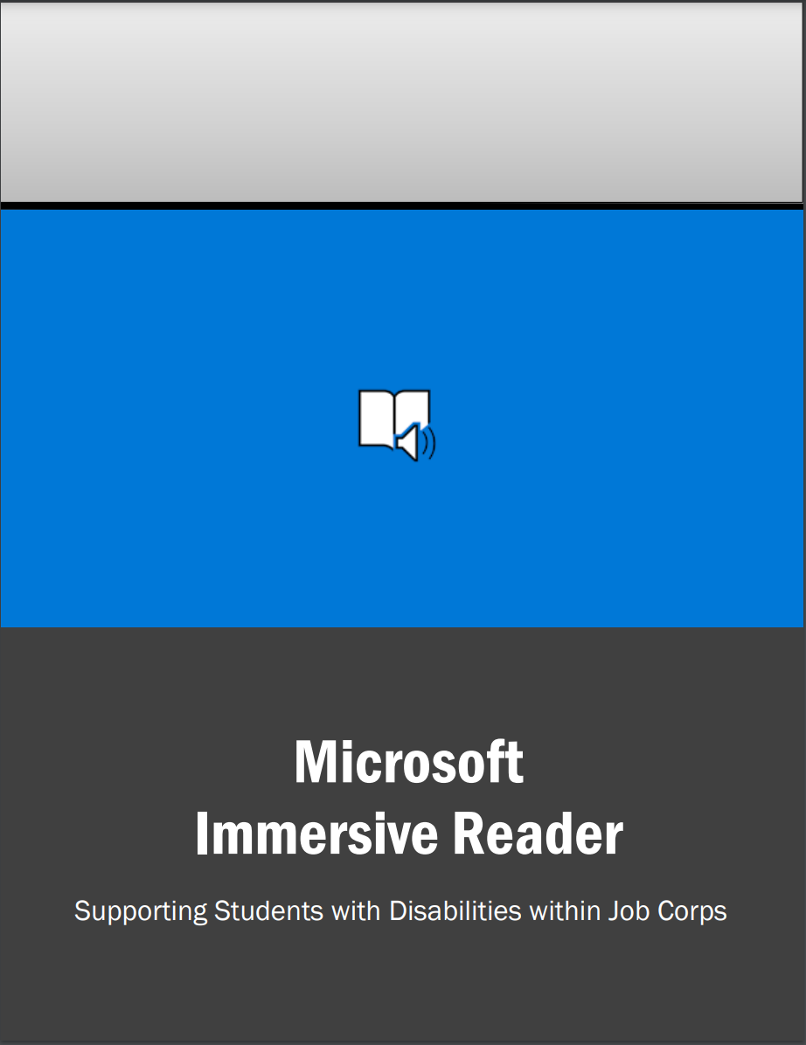
Assistive Technology
Reading Pens
Optical Character Recognition
Immersive Reader
Office Lens
Adobe Read Aloud
Dragon Products for Writing
Dragon Speak
Dragon Anywhere
All 3 guides are on the Job
Corps Disability
Website!
32
Notes:
Assistive Technology
There are so many assistive technology and other related tools that can help support students with intellectual disabilities. We are going to focus on some of the more significant ones today that provide the greatest access to the Job Corps program.
Reading Pens are great for students who have intellectual disabilities. They are not meant, however, to use in reading large volumes of content. Instead, they are helpful in reading questions, short amounts of content, or the student can use to look up the definition of a word. They are portable and can go from academics to career technical into the workplace – wherever they are needed.
Optical Character Recognition – is for longer passages of information and most of you are familiar with this type of software within the TABE testing format options. Any information can be scanned and read aloud or information on the Internet can be selected and read. Some of the more commonly day to day versions include:
Microsoft’s Immersive Reader
Microsoft’s Office Lens
Adobe’s Read Aloud
We have basic guides for all 3 of these software programs on the Job Corps Disability website!
Dragon Products for Writing – some students who have intellectual disabilities may have difficulty with handwriting, spelling, getting thoughts on paper. Software that uses speech to type the student’s responses or content can be very helpful to them. A couple of examples are:
Dragon Speak
Dragon Anywhere

Slide 33
Long Beach – Immersive Reader
33
Notes:
Long Beach – Immersive Reader
We wanted to share one example of how one center created a video using content on the Job Corps website to teach their students with disabilities how to use immersive reader. We don’t have time to show the video today but wanted to showcase some of the creative ways centers are teaching students how to use the power of assistive technology to enable participation in the Job Corps program.

Slide 34
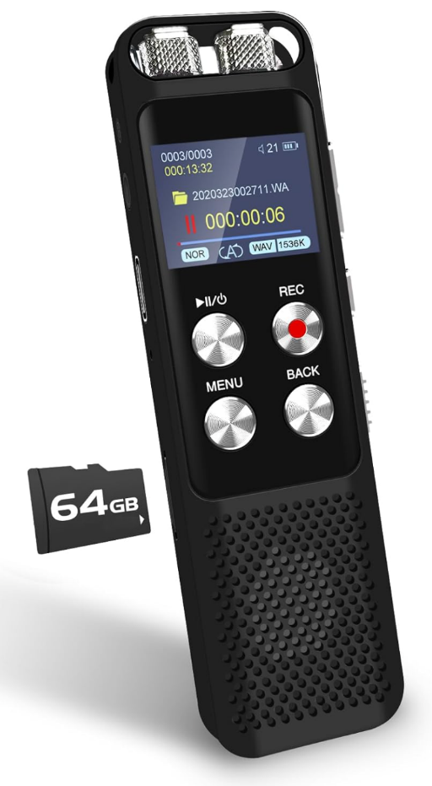
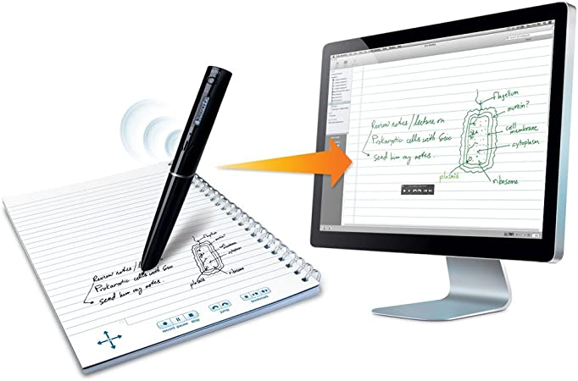
Other DA
Use of visual supports
Pictures
Basic graphics
Simplify Instructions
Reduce the amount of content per assignment
Reduce the visual clutter
Use variable speed digital tape recorders and/or digital pens for recording information
34
Notes:
Other DA
Some other examples of accommodations that may be particularly useful and helpful for students who have intellectual disabilities includes:
Use of visual supports – using pictures along with simplified language/terminology can significantly improve understanding of content and concepts for some students with intellectual disabilities. As we saw with Nate, some students even with milder impairments may require scaffolded supports (e.g., visual supports and the use of video modeling or other types of accommodations or learning strategies).
Pictures
Basic graphics
Simplify Instructions – reduce the content down to as brief as possible and still be understandable. Use more basic vocabulary to aid understanding.
Reduce the amount of content per assignment – we are not talking about reducing the number or types of skills the student has to master but instead reducing the volume of the number of problems or questions, the amount of content that needs to be read, etc., especially at one sitting.
Reduce the visual clutter – sometimes students who have intellectual disabilities can be distracted and/or overwhelmed by a lot of content or visual clutter on a document or assignment. Reduce the extraneous content and narrow it down to the critical points that are needed for understanding or demonstrating competency.
Use variable speed digital tape recorders and/or digital pens for recording information – variable speed digital tape recorders can be a wonderful tool for students who need lots of repetition. They can play back the information slowing the speed to one that is best for their processing/understanding. In some versions, digital files can be uploaded to computer if needed or if staff wants to save digital content for other students to use.

Slide 35
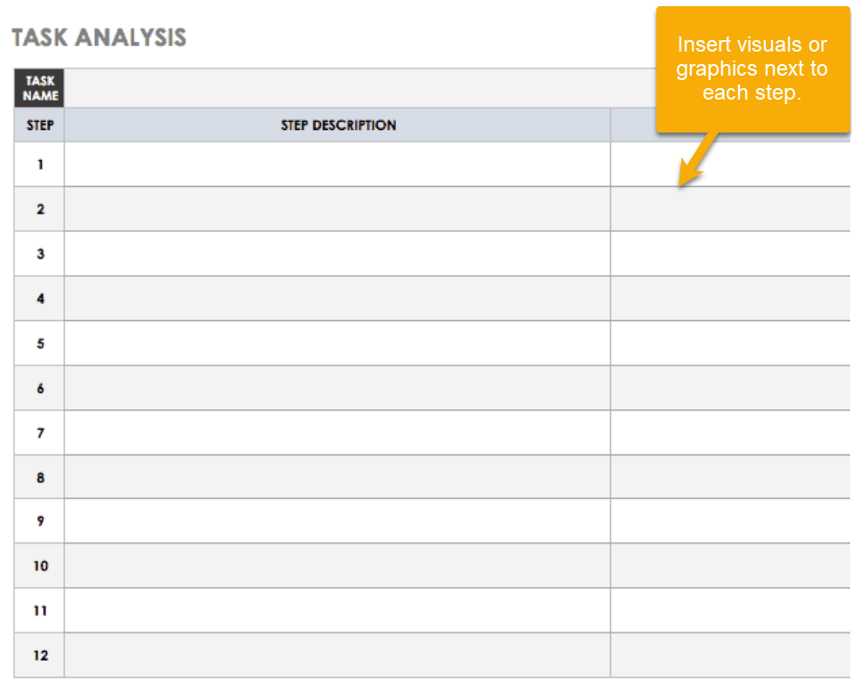
Task
Analysis
A process in which an activity or behavior is divided into small, manageable steps to assess and teach the skill.
Dependent upon the student and their skill levels, the student or a small group of peers and the student could be tasked with developing task analysis for various tasks.
35
Notes:
Task Analysis
Many of you probably use task analysis on a routine basis even if you do not realize that you do so. Task analysis is a process in which an activity or behavior is divided into small, manageable steps to assess and teach the skill. Look at the picture that says, “Example of a Task Analysis” for washing hands. The graphic identifies the main task and then lists each step in a simplified way and includes a related picture to aid understanding. Of course, you can make a task analysis more complex, but we need to keep these simple for students who have intellectual disabilities. You can develop a task analysis for many tasks in the academic areas, but they are especially useful in career technical, for instructions in completing dorm duties, etc.
Dependent upon the student and their skill levels, the student or a small group of peers and the student could be tasked with developing task analysis for various tasks. Having a group of students develop task analyses is a learning experience for all and is a great exercise for developing critical thinking skills.

Slide 36
Consistency in Task Analysis
When working with students who have ID, it can be helpful if staff approach various tasks the same way.
Use of applied academics, co-teaching, or collaboration between instructional staff is strongly encouraged!
For example, if a math teacher teaches a math concept one way and the career technical instructor teaches it a different way, it may be confusing for the student who does not generalize information well.
02
36
Notes:
Consistency in Task Analysis
When working with students who have ID, it can be helpful if staff approach various tasks the same way.
For example, if a math teacher teaches a math concept one way and the career technical instructor teaches it a different way, it may be confusing for the student who does not generalize information well or may take longer for the student to master the content.
Use of applied academics, co-teaching, or collaboration between instructional staff is strongly encouraged!

Slide 37
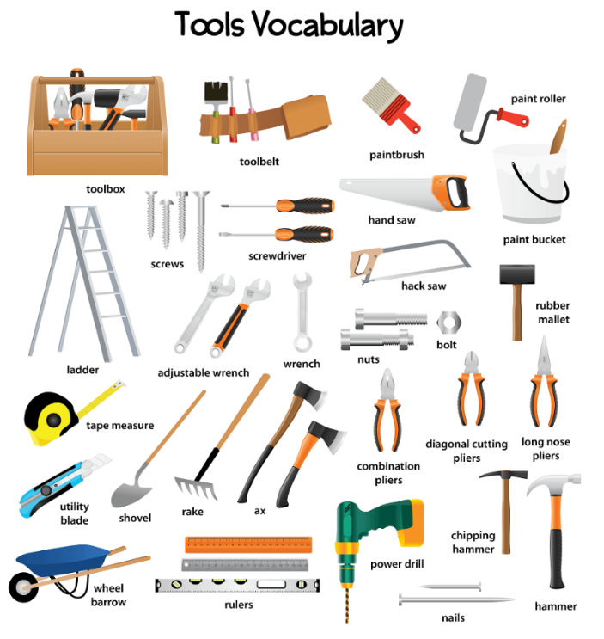
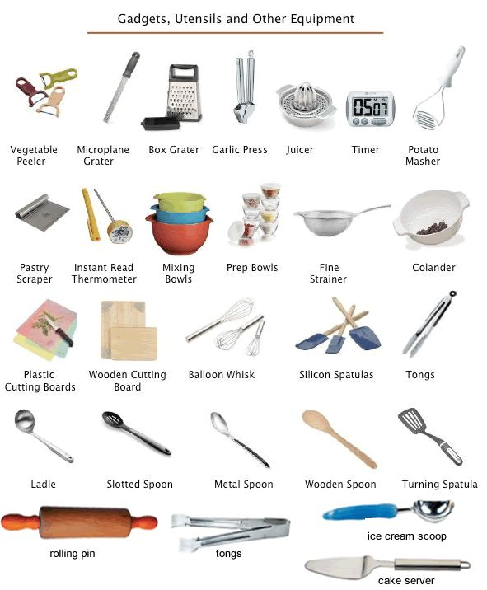
Vocabulary Development
Label items in the learning areas (both academic and career technical) and include picture representations.
The student could use a reading pen to assist with reading the labels.
The use of Word Walls can provide a meaningful approach to:
Teaching vocabulary
Improving reading and writing skills
Providing visual cues for students
Reinforcing understanding of subject-specific terminology
Helping students improve spelling and awareness of spelling patterns
Encouraging increased student independence when reading and writing
37
Notes:
Vocabulary Development
Growing and expanding our learning always requires that we have some foundational knowledge or information, even if it is very basic in nature. Ensuring that students can recognize subject specific terminology, identification of tools or equipment, etc. can be very beneficial to supporting the student’s progress with the content or skill being taught.
As a matter of routine, label items in the learning areas (both academic and career technical) and include picture representations. The student could use a reading pen to assist with reading the labels. Word walls can be specific to a topic or feature general vocabulary but can provide a meaningful approach to:
Teaching vocabulary
Improving reading and writing skills
Providing visual cues for students
Reinforcing understanding of subject-specific terminology
Helping students improve spelling and awareness of spelling patterns
Encouraging increased student independence when reading and writing

Slide 38
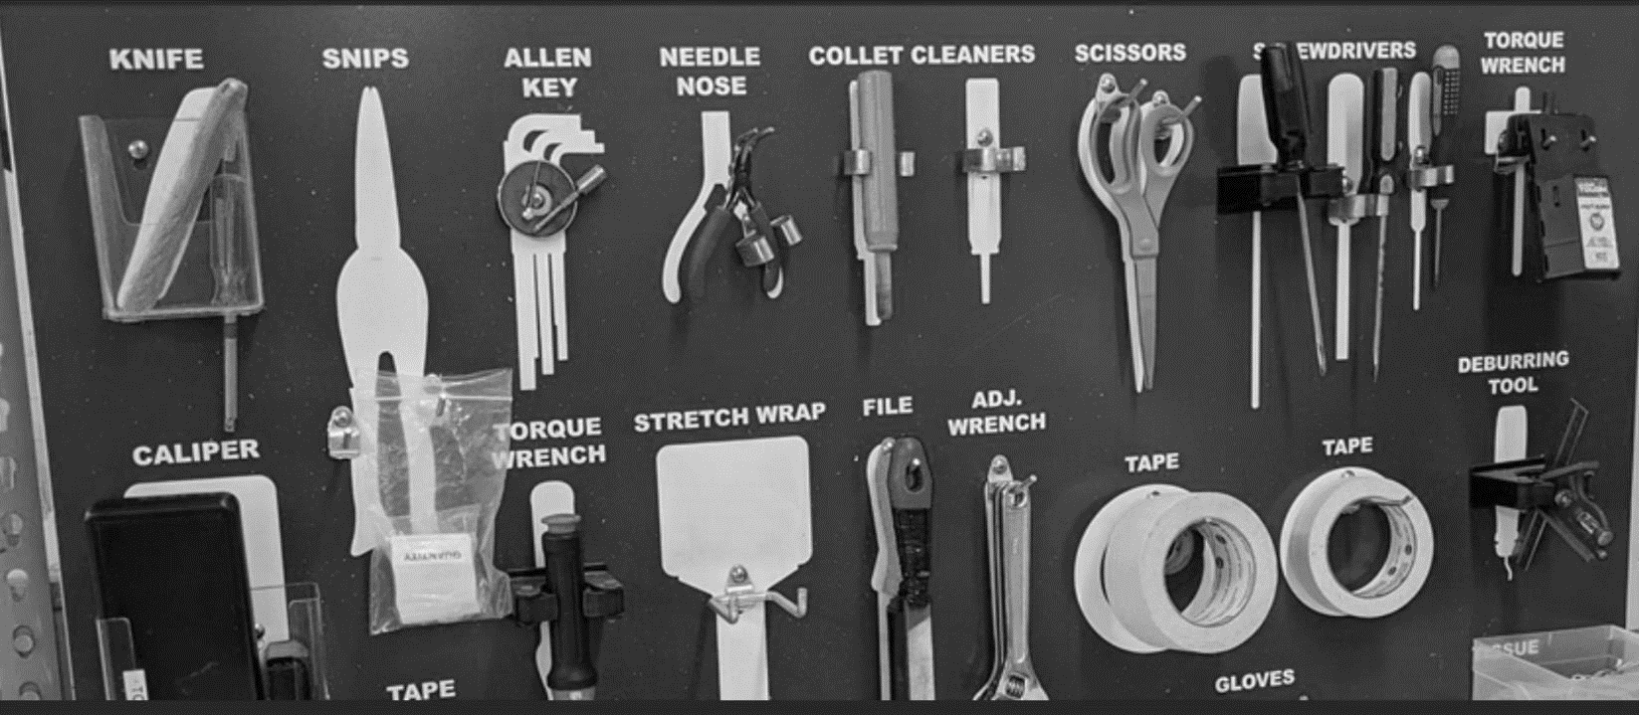
Label Actual Items
38
Notes:
Label Actual Items
Here we see where a shop had each type of tool or item used displayed and labeled.

Slide 39
Disability Accommodation
Effectiveness Reviews
39
Notes:
Disability Accommodation Effectiveness
One of the regulatory requirements is that disability accommodations are effective, at least to the extent we have control over and effectiveness monitoring is likely somewhat underutilized on center as a viable tool for assisting in evaluating student progress and performance.

Slide 40
Effectiveness Monitoring
As the student participates in the program, new needs may be identified or accommodation adjustments may be required.
Frequency
Documenting
The effectiveness of a student’s accommodation plan must be evaluated with the student at least every 60 days throughout the student’s enrollment in Job Corps.
Monitoring must be documented in the CIS Accommodation Notes tab.
40
40
Notes:
Effectiveness Monitoring
As the student participates in the program, new needs may be identified or accommodation adjustments may be required.
How often must effectiveness of accommodations be reviewed?
The effectiveness of a student’s accommodation plan must be evaluated with the student at least every 60 days throughout the student’s enrollment in Job Corps. The center may manage this process however you choose. The DC can meet with the student. The center can continue to use performance panels to monitor effectiveness and pass along the information to the DCs to enter into CIS AP Notes tab and/or to follow up with the student who may need an accommodation plan adjustment.
Documenting the Process
Monitoring must be documented in the CIS Accommodation Notes tab.

Slide 41
Key Points About Effectiveness Monitoring
Have all the accommodations on the accommodation plan been implemented and are being used consistently?
Is the student or staff reporting additional needs or challenges?
01
03
02
04
Is a Disability Accommodation Committee (DAC) being convened to consider new or additional needs?
Is the student failing to progress?
41
Notes:
Key Points About Effectiveness Monitoring
Here are the critical elements to remember, especially when we are using effectiveness monitoring for a student who has an intellectual disability.
Is the student or staff reporting additional needs or challenges or is the student failing to progress? Are you sure that accommodations on the accommodation plan have been implemented in all areas needed on center and are being used/applied consistently?
When additional or new needs are requested or brought to the DCs attention, convene a Disability Accommodation Committee (DAC) to determine if additional DA can be identified and added to the student’s accommodation plan. Remember, the DAC may only need to be a meeting of the DC and the student; however, if the student is not progressing in trade, for example, the career technical instructor likely should be invited in to help identify specific areas of need. Contact Vocational Rehabilitation and ask if they might be able to assist. Contact the Job Accommodation Network and ask for accommodation ideas and of course, contact your Regional Disability Coordinator for assistance as needed.

Slide 42
Key Takeaways
For Working with Students with ID
Build in repetition and review of content! It is essential!
Continuously build background knowledge; ensure that the foundational pieces are solid before adding new content.
Add new content while keeping some of the previously learned content within the assignment, on the document, in the video, etc.
Ensure consistency in using the accommodations in the AP and other instructional/learning strategies.
Be flexible!
42
Notes:
Key Takeaways For Working with Students with ID
Build in repetition and review of content! It is essential!
Continuously build background knowledge; ensure that the foundational pieces are solid before adding new content
Add new content while keeping some of the previously learned content within the assignment, on the document, in the video, etc.
Ensure consistency in using the accommodations in the AP and other instructional/learning strategies.
Be flexible!

Slide 43
Maximum Benefit
Separation
03
What is it and when to consider?
43
Notes:
03 – Maximum Benefit Separation – What is it and when to consider?

Slide 44
Related Policy
References
Chapter 6
6.2 R4(c)(2) – Maximum Benefit Separation
Form 2-03 – Engaging in the Interactive Process (Disability Accommodation Committee)
Form 6-01 – Maximum Benefit Separation
Attachment A – Recommendation for Maximum Benefit Termination Considerations Checklist
Attachment B – Recommendation for Maximum Benefit Separation Summary Statement
44
Notes:
Related Policy References for a Maximum Benefit Separation Recommendation
Chapter 6
6.2 R4(c)(2) – Maximum Benefit Separation
Form 2-03 – Engaging in the Interactive Process (Disability Accommodation Committee)
Form 6-01 – Maximum Benefit Separation
Attachment A – Recommendation for Maximum Benefit Termination Considerations Checklist
Attachment B – Recommendation for Maximum Benefit Separation Summary Statement

Slide 45
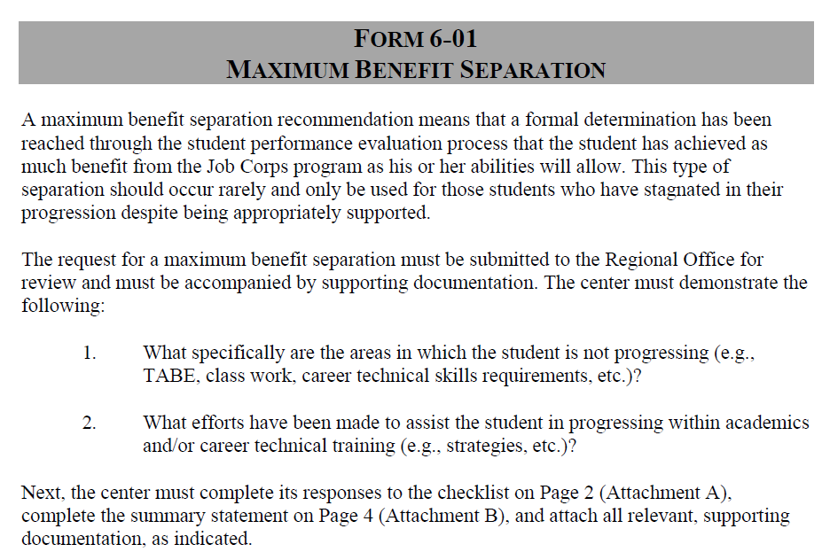
Maximum Benefit
Recommendation
Defined
A maximum benefit separation (Form 6-01) recommendation
means that a formal determination has been reached through the student performance evaluation process that the student has achieved as much benefit from the Job Corps program as their abilities will allow.
should occur rarely and only be used for those students who have stagnated in their progression despite being appropriately supported.
45
Notes:
Maximum Benefits Recommendation Defined
PRH Form 6-01 contains the related policy requirements for consideration and recommendation of a maximum benefits separation recommendation.
A maximum benefit separation recommendation
means that a formal determination has been reached through the student performance evaluation process that the student has achieved as much benefit from the Job Corps program as their abilities will allow.
should occur rarely and only be used for those students who have stagnated in their progression despite being appropriately supported.

Slide 46
The Burden
of Proof
01.
What specifically are the areas in which the student is not progressing (e.g., TABE, class work, career technical skills requirements, etc.)?
02.
What efforts have been made to assist the student in progressing within academics and/or career technical training (e.g., strategies, etc.)?
46
Notes:
The Burden of Proof
Before preparing a Maximum Benefit Separation recommendation, make sure you are able to adequately answer these questions.
1. What specifically are the areas in which the student is not progressing (e.g., TABE, class work, career technical skills requirements, etc.)?
2. What efforts have been made to assist the student in progressing within academics and/or career technical training (e.g., strategies, etc.)?

Slide 47
Other Considerations
What does the student’s documentation indicate about the student’s functional limitations (i.e., what is the background information and current status)?
What are the strengths of the student? Are there strengths that can be used/developed to compensate for areas of weakness/deficit?
What is the length of time in the program and any special factors related to attendance? Would an extension provide the time needed to complete the program?
Are there external resources that can assist such as Vocational Rehabilitation?
47
Notes:
Other Considerations to think about before a maximum benefit separation recommendation is made include:
What does the student’s documentation indicate about the student’s functional limitations (i.e., what is the background information and current status)?
What are the strengths of the student? Are there strengths that can be used/developed to compensate for areas of weakness/deficit?
What is the length of time in the program and any special factors related to attendance? Would an extension provide the time needed to complete the program?
Are there external resources that can assist such as Vocational Rehabilitation?

Slide 48
Confirm Compliance!
Similar to Effectiveness!
Have all accommodations been implemented?
01
Are all accommodations implemented consistently?
02
Has the DAC convened and/or the AP been adjusted as progress has stagnated and has a TABE waiver request been considered?
Has effectiveness monitoring been routinely completed?
03
04
Contact your Regional Disability Coordinator for assistance!
48
Notes:
Similar to Effectiveness! Confirm Compliance!
Have all accommodations been implemented
Has effectiveness monitoring been routinely completed?
Are all accommodations implemented consistently?
Has the DAC convened and/or the AP been adjusted as progress has stagnated and has a TABE waiver request been considered?
If all of these things have not been done and/or not done consistently, then the maximum benefit separation recommendation should be halted and the center ensure that all the associated supports have been implemented, used consistently, adjustments made as needed, and then if still no progress, revisit the possible maximum benefit separation recommendation. It also would be very difficult to show failure to progress or stagnation in progress in a short window of time. Ensure you can demonstrate and document a good faith effort over a period of time.
Contact your Regional Disability Coordinator for assistance!

Slide 49
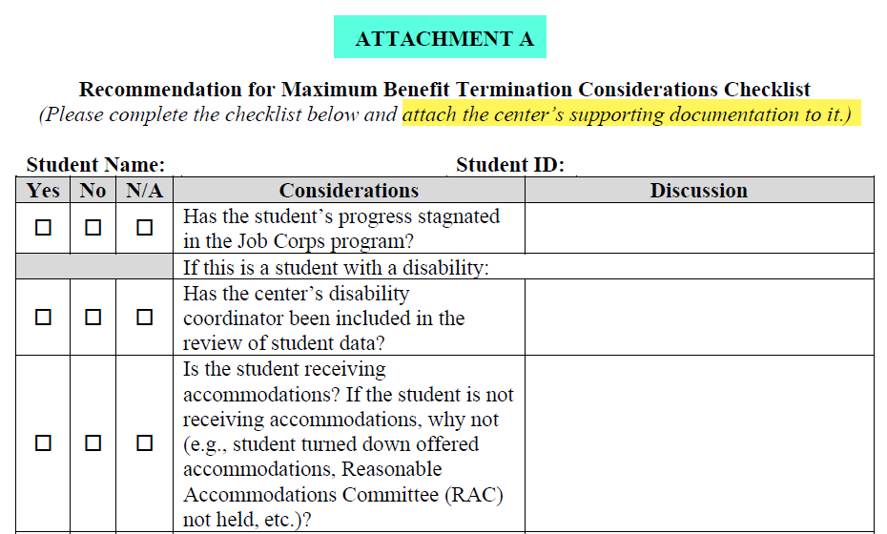
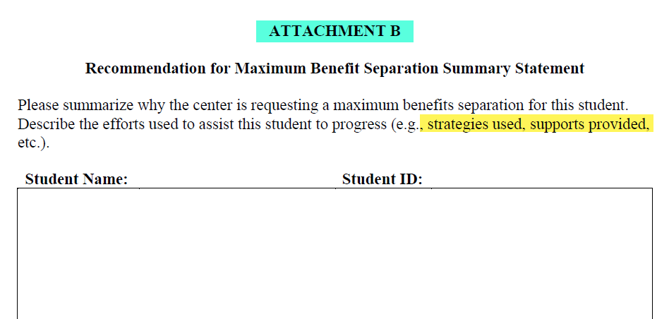
Submitting a Max Ben Request to the Regional Office
Form 6-01, Attachment A – Recommendation for Maximum Benefit Termination Considerations Checklist
DAC Meeting Notes
Accommodation Plan
TABE History
Academic and Career Technical Training Progress/Status
Form 6-01, Attachment B – Recommendation for Maximum Benefit Separation Summary Statement
49
Notes:
Submitting a Max Ben Request to the Regional Office
When preparing to submit a Max Ben Separation recommendation request to the Regional Office, you will need to complete Attachments A and B from Form 6-01.
Attachment A is the Recommendation for Maximum Benefit Termination Considerations Checklist. Attachment A also instructs the center to attach a list of documents to the request and those documents include:
The DAC meeting minutes documenting when the DAC convened to consider progress, review or consider DA adjustments, and the outcomes of those meetings
A copy of the student’s Accommodation Plan
A copy of the student’s TABE History
The student’s academic and career technical training progress/status which might include copies of any certificates of completion or diplomas, TARs, etc.
Attachment B is the Recommendation for Maximum Benefit Separation Summary Statement where the center has to provide a written narrative of why the center is requesting a maximum benefit separation consideration and the center’s efforts to assist the student in progressing (i.e., the impact of the use of the accommodations, instructional and learning strategies, etc.).

Slide 50
Resources
Reminders and Disability Job Corps Website
04
50
Notes:
04 Resources - Website

Slide 51
Reminders!
Contact your respective RDIC if an applicant or a student requests:
access for a service animal
an assistance animal as a disability accommodation
Contact your RDIC before starting to process a need for or a request for a Sign Language Interpreter (SLI).
Do not tell an applicant that Job Corps does not provide SLIs.
Do not refer an applicant who may need a SLI to another center.
Do not enroll an applicant who needs a SLI prior to completing the process for requesting National Office funding for high-cost disability accommodations.

Slide 52
Job Corps Disability Support Services Website https://supportservices.jobcorps.gov/disability/Pages/default.aspx
52
Notes:
Job Corps Disability Website
The Job Corps Disability Support Services website contains numerous resources and tools on applicant file review and disability accommodation requirements, processes and procedures.
As new resources and tools are developed, they are listed under the New Items heading to the right side of the website page. See teal highlighted area. Resources that are more commonly used and/or requested are listed under the Frequently Requested Tools section also highlighted in teal.
On the left-hand side of the slide is the general menu for the Disability website. Most everything you will need is found is the Disability Program Requirements Resources section (highlighted in yellow). That is the area I personally go to most often. The PowerPoint for this webinar can be found in the Trainings and Webinars section of the website (also highlighted in yellow).
The Job Corps Disability Website link is located at the top of the slide.

Slide 53
Questions?
Intellectual Disabilities
53
Notes:
Questions?

