Slide 1
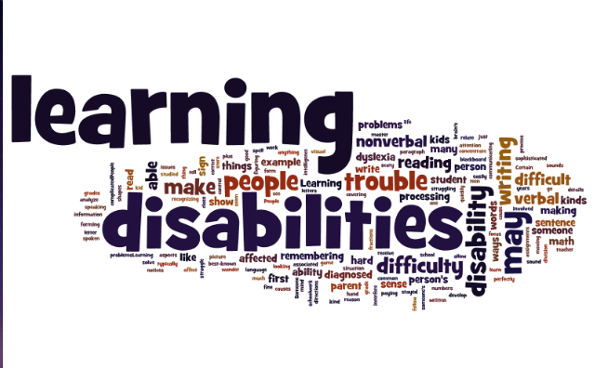
Part 1 of a 3 Part Webinar Series on Learning Disabilities
100
Notes:
The purpose of today’s webinar is to understand what learning disabilities are, how they impact our students in the Job Corps program, and what can we do to best serve these students by providing appropriate and specific accommodations.

Slide 2
Objectives
List 3-4 various types of learning disabilities.
Identify at least two specific accommodations to support corresponding functional limitations of each type of learning disability.
Describe 1-2 examples of how assistive technology might be utilized to support students with LD in various Job Corps settings.
List 2-3 resources that support the development of accommodation plans for students with LD.

Slide 3
Understanding LD
LD defined and the areas of impact
Notes:
In this section, we will define “learning disability,” see some of the processes that are impacted by learning disabilities, and talk about what a LD is NOT.

Slide 4
What is a Learning Disability?
A LD is a neurobiological condition that affects the way individuals of average to above average intelligence:
Receive information
Process information
Store information
Retrieve information
Express information
A LD can impact the ability to acquire basic skills of listening, speaking, thinking, reading, spelling, writing, and/or mathematics
Notes:
Review Slide
Note: “average to above average intelligence” refers to the individual’s ability to learn—we used to talk about his in terms of IQ, but we now know that “Intelligence Quotient/IQ” is only one form of intelligence.

Slide 5
Processing is Impacted
There are four stages of information processing used in learning:
Input
The way we take in information
Integration
The way information is organized and understood
Memory
Output
The way we store information whether it is in the long term memory, short term memory, or discarded
The way we communicate and express information
Notes:
There are four stages of information processing used in learning that can be impacted by someone having a learning disability.
Those stages are (read slide)

Slide 6
Executive Functioning is Impacted
Cognitive processes:
Organizing/planning
Memory
Attention
Problem solving
Transitioning between tasks
Initiating and completing tasks
Time management
Notes:
It is common for IEPs to describe a student with a LD as having difficulties with executive functions. So what does that actually mean? Executive function is a blanket term that refers to a number of cognitive process such as organizing/planning, memory, attention, problem solving, transitioning between tasks, initiating and completing tasks.
You can think of this as your “command center.” When your “command center” is not functioning properly, it is difficult to make decisions.

Slide 7
What a Learning Disability is Not
It is not:
Economic disadvantage
Emotional disorders
Lack of educational opportunities due to:
English as a second language
Frequent changes of schools
Lack of instruction in basic skills
Poor school attendance
Intellectual disability
Normal process of learning a second language
Physical disabilities
Notes:
We want to talk about some of the things that are not a LD but are frequently confused for a LD.
(slide)

Slide 8
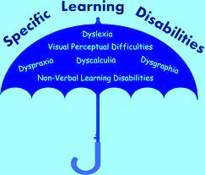
Talking Specifics
Notes:
We are going to look at 6 different types of learning disabilities, how they manifest, and some possible accommodations.

Slide 9
Types of Learning Disabilities
Dyslexia
Dysgraphia
Dyscalculia
Dyspraxia
Auditory Processing Deficits
Visual Processing Deficits
Notes:
The 6 types of LD that we will discuss include dyslexia, dysgraphia, dyscalculia, dyspraxia, auditory processing deficits/disorders, and visual/perceptual deficits/disorders.

Slide 10
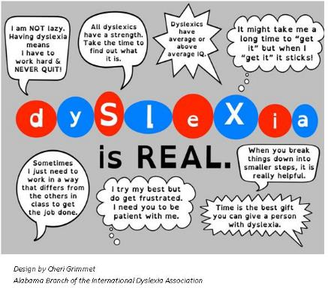
Dyslexia Defined
Difficulties with accurate and /or fluent word recognition, poor spelling and decoding abilities which typically result from a deficit in the phonological component of language often resulting in secondary consequences such as difficulties with reading comprehension and reduced reading experiences that impede vocabulary and background knowledge development
Notes:
Dyslexia is defined by difficulties accurate or fluent word recognition, poor spelling and decoding which result in a deficit in the phonological component of language.
Lets take a look at some of the other areas that dyslexia can cause difficulties.

Slide 11
Dyslexia
There is no single pattern of difficulty that affects all individuals with dyslexia. Individuals may:
Have difficulty distinguishing between certain letters with similar shapes like o, e, and c
Transpose or “see” letters backwards, upside down
Experience text appearing to jump around on the page
Read text fine but feel nauseous or get a headache when reading
See the letters but not be able to sound out words
Connect letters and sounds out words but not recognize a word even if previously known
Not remember or make sense of what was read so has to read and re-read passages over and over
Notes:
With Dyslexia there is no single pattern of difficulty that everyone with dyslexia will display but some of the things that may notice include the text appears to jump (or flip) on the page.
We may have a student that is reading and frequently loses their place and half way through a sentence you notice that they have jumped to a different sentence on the page and suddenly the passage doesn't’t make much sense. Or the student who reads a passage and when you ask them what it was about they say “I don’t know” or “I can’t remember”.

Slide 12
Functional Limitation & Accommodation - Dyslexia
Functional Limitation
Accommodation Options
Difficulty reading grade level text
Poor handwriting and spelling
Poor memory skills
Trouble summarizing a story
Provide extra time to complete reading tasks or books on tape
Provide use of a computer and/or spell check
Use picture imagery
Provide visual aids and extra time
Notes:
The areas of difficulty (or functional limitations) that we may see with a student that has dyslexia include:
difficulty reading at grade level,
poor handwriting and spelling,
poor memory skills, and
trouble summarizing a story.
Some accommodation options for each of the functional limitations are listed on the right hand side of this slide. Can you think of other accommodation options/ideas that could be suggested?

Slide 13
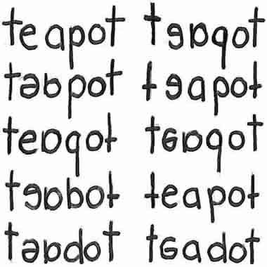
Example
Transposing or seeing letters backward
Use of picture imagery
Provides a visual clue for the brain to process the word
Notes:
On the left side of this slide are examples of what a person with dyslexia might see when reading the word, “teapot.”
On the right side of the slide, is an example of an accommodation using pictures or imagery to provide a visual cue for the brain to process the word, “teapot.”

Slide 14
Dyscalculia Defined
Dyscalculia is:
Dyscalculia is not:
A learning issue that makes it hard to understand concepts related to numbers and do tasks like add and subtract.
A common condition.
A common co-occurrence.
A sign of low intelligence. You can be very smart and have dyscalculia.
The same thing as math anxiety. But it often co-occurs with this emotional issue, which involves self-doubt and fear of failure.
A lack of effort. Kids with dyscalculia need different kinds of interventions to make progress—not more of the same instruction.
Notes:
A second type of Learning Disability is Dyscalculia. It is often referred to as a “math” disability. As you can see from the definition, Dyscalculia is:
A learning issue that makes it hard to understand concepts related to numbers and difficulty completing tasks like adding and subtracting.
This is a common condition, and
A common co-occurrence (often co-occurring with disabilities such as dyslexia and ADHD).
Dyscalculia is NOT: (read right side of slide)…

Slide 15
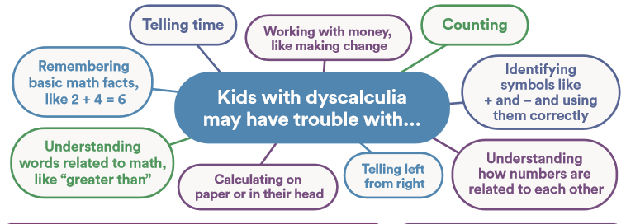
Dyscalculia
https://www.understood.org/~/media/9cf33f7a6a07467d8c4c0db0ceb9535b.pdf
Notes:
Again, Someone with dyscalculia is a student who struggles with math. This may be a student who understands how to perform basic math but can not complete multi step math problems.
This graphic contains a few more examples of areas of difficulty for students with dyscalculia (read a few examples).

Slide 16
Functional Limitation & Accommodation - Dyscalculia
Functional Limitation
Accommodation Options
Difficulty with word problems
Difficulty using multiple steps in math calculations
Difficulty with telling time
Difficulty organizing problems on the page
Provide visual representations of words
Break math assignments down into single steps
Provide manipulative to work through math problems
Use a digital watch or phone apps
Provide color coded notes
Use graph paper
Notes:
Here we have some examples of functional limitations and possible associated accommodations for Dyscalculia.
(Read the examples)

Slide 17
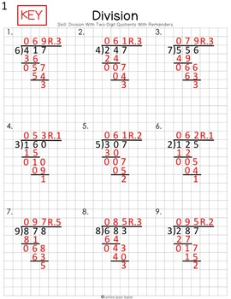
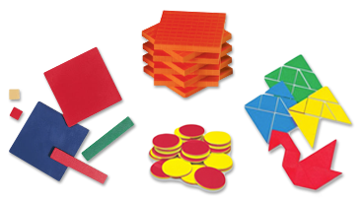
Examples
17
Notes:
As previously mentioned, “manipulatives” such as these examples can be used to teach basic Math facts, as well as demonstrate multiple step mat operations.
Manipulatives provide another modality (kinesthetic – hands on) for students that may have strengths in that areas. Students that may have difficulty grasping math concepts by listening or seeing numbers often benefit from pairing numbers/concepts with tangible objects.
Graph paper (like the graphic on the right hand side of this slide) can be a tool for organizing math problems. Students with most types of LDs benefit from these type of organizational tools.
There are also excellent manipulatives to teach time and money skills.

Slide 18
Dysgraphia Defined
An issue that impacts written language. It can affect both information and motor processing (which can impact handwriting). And it can cause trouble with many aspects of writing, usually because of language-based weaknesses.
Notes:
Let’s now take a look at the definition for another type of LD—Dysgraphia.
(Read slide)

Slide 19
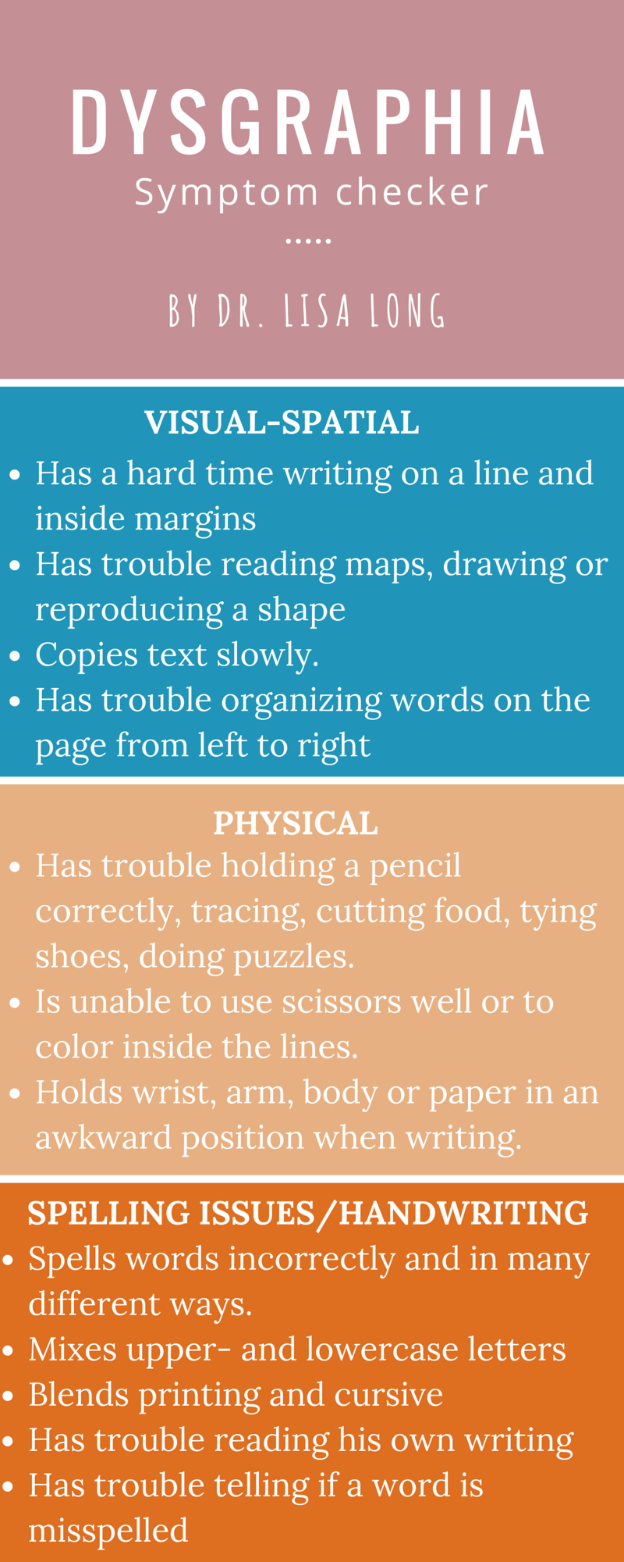
Dysgraphia
http://www.drlisalong.com/learning-disability-testing-charlotte-nc/
19
Notes:
The term Dysgraphia is used to capture both the physical act of writing and the quality of written expression.
Dysgraphia can manifest in difficulties with spelling, putting thoughts on paper, and poor handwriting, including difficulty in forming letters or writing within a defined space, organizing thoughts on paper, keeping track of thoughts already written down, and difficulty with syntax, structure, and grammar.

Slide 20
Functional Limitation & Accommodation - Dysgraphia
Functional Limitation
Accommodation Options
May have illegible printing and cursive writing
Inconsistent spacing between words and letters
Exhibits strange wrist, body, or paper positioning
Allow the use of word processor or computer
Provide alternatives to writing assignments (video-taped reports, audio taped reports)
Provide pencil grips and/or specially designed writing aids
Notes:
Here are some examples of functional limitations and possible accommodations for Dysgraphia.
(Read the examples)
Other possible accommodations include:
Providing sentence starters to help the student begin a writing assignment
Breaking writing assignments into steps
Providing extended time on tests and assignments that involve writing
Permission to record class lectures
A few more examples are on this next slide…

Slide 21
Functional Limitation & Accommodation - Dysgraphia
Functional Limitation
Accommodation Options
Copying or writing is slow and labored
Difficulty thinking and writing at the same time
Allow the use of a note taker or provide copies of the notes
Allow oral examines and/or tape recorded lectures
Notes:
(Read slide)

Slide 22
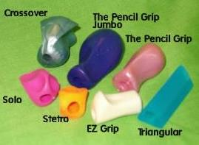
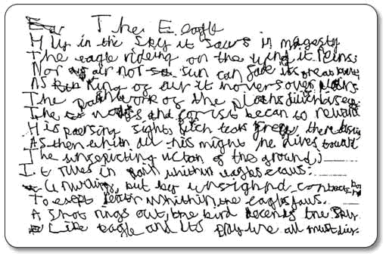
Examples
Illegible handwriting
22
Notes:
On the left side of this slide is a handwriting example from a student with dysgraphia. What do you see?
On the right side of this slide are two examples of accommodations—the pencil grips can help with the physical challenges that some students with Dysgraphia may have. Dragon Naturally Speaking is an example of “dictation software” that can support issues such as transferring ideas to writing

Slide 23
Dyspraxia
An issue that can impact fine and gross motor skills. Trouble with fine motor skills in particular can affect handwriting.
Dyspraxia also typically affects a person’s conception of how his body moves in space.
It is estimated that dyspraxia affects at least two percent of the general population, and 70% of those affected are male. As many as six percent of all children show some signs of dyspraxia.
http://www.ncld.org/types-learning-disabilities/dyspraxia/what-is-dyspraxia
https://www.understood.org/en/learning-attention-issues/child-learning-disabilities/dysgraphia/difference-between-dysgraphia-dyspraxia
Notes:
A fourth type of Learning Disabilities is called Dyspraxia. It is in issue that can impact fine and gross motor skills. Trouble with fine motor skills in particular can affect handwriting.
Dyspraxia also typically affects a person’s conception of how his/her body moves in space. The next slide provides some details about this.

Slide 24
Dyspraxia
Difficulties with:
Trouble riding a bike or throwing a ball
A tendency to bump into and drop things
Delayed development of right or left hand dominance
Trouble grasping a pencil correctly
Poor letter formation
Slow and messy handwriting
Trouble using buttons, snaps, zippers, utensils
Notes:
(Read slide)
Dyspraxia isn’t a sign of muscle weakness or of low intelligence. It’s a brain-based condition that makes it hard to plan and coordinate physical movement. Students with dyspraxia tend to struggle with balance and posture. They may appear clumsy or “out of sync” with their environment.
As you can see from this list, several of the challenges are similar to those of a person with Dysgraphia.

Slide 25
Functional Limitation & Accommodation - Dyspraxia
Functional Limitation
Accommodation Options
Unable to follow a set of instructions in the correct sequence
May seem easily distractible
May be slow learning new rules
Sense of balance may be affected
May appear to be disorganized or have difficulty finding things
Provide step by step instructions
Provide a distraction free space or headphones
Provide instructions in writing
Provide adaptive seat/furniture/workspace
Clearly label frequently used classroom materials and provide color coded notes
Notes:
Some of the functional limitations and accommodations associated with Dyspraxia are (read slide)

Slide 26
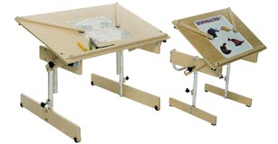
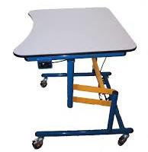
Examples
Adaptive seating/furniture
Motor control adaptations
26
Notes:
If a student has balance or motor control difficulties, then it may be necessary to consider their ability to navigate their environment. A student with balance and motor difficulties when asked to sit in a chair with a desk attached may get caught in the chair and tip it over. They may need to sit at a table and be able to freely move the chair away from the desk to get in and out--Or use a desk on wheels that they can push away.
For fine motor control, highlighters and post-its are a low-tech way to stay organized without having to take word-for-word notes.

Slide 27
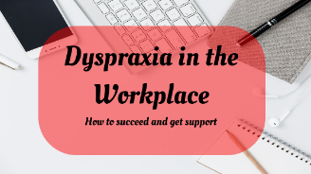
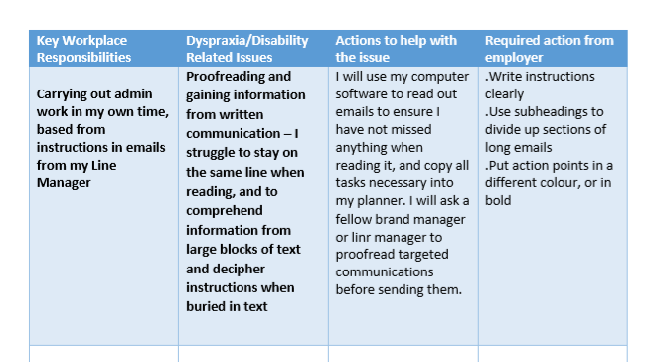
https://dyspraxiasurvivalguide.files.wordpress.com/2018/02/workplace-disability-printable-blog.pdf
27
Notes:
On this slide, we have a strategy designed by a person who has dyspraxia uses in the workplace. She has carefully thought out her workplace responsibilities, any related issues, actions she can take to help with the issues, and support/accommodations that her employer can provide to help with the limitations.

Slide 28
Visual Processing Deficits/ Disorders
Difficulty with:
Interpreting visual information, not related to difficulty with poor vision
Visual Discrimination
Visual Figure-Ground
Visual- Sequencing
Seeing the difference between similar letters, shapes, objects, or patterns
Seeing one specific piece of information in a busy background.
Being able to recall a sequence of objects in the correct order.
Notes:
The 5th LD we are looking at today is Visual Processing Deficits or Disorders. This individual will have difficulty with interpreting visual information. This is a processing disorder in the brain, and is not related to difficulty with poor vision. Vision issues must be ruled out when giving this diagnosis.
Some areas impacted by Visual Processing Deficits/Disorders are: (read 3 boxes)
A student with these issues may often (when reading text) get lost on the page.

Slide 29
Functional Limitation & Accommodation – Visual Processing
Functional Limitation
Accommodation Options
Difficulty copying accurately
Frequently loses place
Messy looking papers (i.e. letters colliding or not on the line and/or irregular spacing)
Difficulty navigating around center
Provide a copy of notes or reduce copying tasks
Provide tracking tools: ruler, text windows and check in frequently
Allow use of computer or alternative to writing assignments
Provide visual aids to navigate the center
Notes:
Like some of the previous disorders, we have some related functional limitations and accommodation options for visual processing deficits/disorders.
As you can see, we already provide several of these type of accommodations easily and at a low cost in the Job Corps setting.

Slide 30
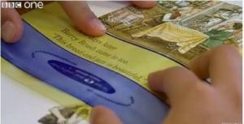
Examples
Tracking tools for readers who lose their place
Notes:
Here are a couple of examples of tracking tools for readers who lose their place while reading.

Slide 31
Auditory Processing (Perceptual) Deficits
Difficulty with:
Interpreting auditory information, not related to difficulty with hearing
Auditory Discrimination
Auditory Figure-Ground
Interpreting auditory information, not related to difficulty with hearing
Comparing and distinguishing the difference between similar sounds
Ex. obvious/oblivious
Being able to distinguish important sounds from within a noisy background and focusing on auditory information being given
Ex. Able to listen to the teacher when other students are working in a small group elsewhere in the room
Notes:
The last type of LD that we will talk about today is Auditory Processing Deficits or Disorders. Some experts refer to the processing deficits as LD- associated disorders/deficits. Either way, you will often see processing deficits/disorders documented on former IEPs, and related support, services, goals, etc. referenced.
Keep in mind that auditory processing deficits/disorders are not related to difficulty hearing. That is why hearing loss is a separate disability category.
When interpreting auditory information, a person may have difficulty with: 1. Auditory Discrimination (read slide bullets); and/or 2. Auditory Figure-Ground (ready slide bullets)
You might recognize a student with auditory processing issues—they might be constantly asking, “what?” You might give them a direction or task, and they might look at you blankly (seem a bit lost about what you are requesting) This could also be the student who has difficulty remembering information that is provided to them orally.

Slide 32
Functional Limitation & Accommodation – Auditory Processing
Functional Limitation
Accommodation Options
Difficulty remembering directions given orally
Difficulty following multiple directives given at one time
Difficulty comprehending complex sentence structures or rapid speech
Says “what” a lot
Provide directions in writing
Limit the number of directions given at one time
Slow down and show rather than explain
Frequent check ins to verify understanding
Notes:
Some of the related functional limitations and accommodations for auditory processing are…

Slide 33
Functional Limitation & Accommodation – Auditory Processing
Functional Limitation
Accommodation Options
Easily distracted by background noise
Processes thoughts and ideas slowly and have difficulty explaining them
Mispronounces and misspells similar sounding words
Provide noise eliminating headphones
Provide extra time to respond
Allow the use of a dictionary
Notes:
Other related functional limitations and accommodations might include…

Slide 34
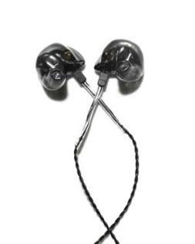
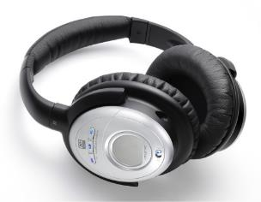
Examples
Headphones
Earbuds
Notes:
Some examples of accommodations might be specific headphones or earbuds with ability to cancel noise.
You might know about “noise isolating headphones” vs “noise cancelling.”
The short version is this: noise isolating headphones physically block ambient noise with their seal against your ear; noise cancelling may do that too, but also electronically cancel the actual soundwaves.

Slide 35
Developing Accommodation Plans
Students with LD
Notes:
In this next section of the webinar, we are going to work together to develop some sample APs for students with the various types of LD that we have reviewed.

Slide 36
Tips for Drafting Accommodation Plans
Talk to the individual with the disability– they know best
Individualize plans
LD manifests itself differently in each individual - what works for one student might not work for another
Consider accommodations that use or support the strengths of the individual
Consider adaptations that incorporate preferred learning styles
Determine ultimately what accommodations will eliminate barriers to participation
Notes:
First, let’s review a few tips for drafting APs… (slide)

Slide 37
Remember!
Ensure the accommodation plan is individualized and not just a cookie cutter template of general supports used for everyone
Ensure that the accommodations are sufficient to provide the student access to all areas of the program
If not, what additional accommodations are necessary (e.g., in career technical, residential, other areas)?
Consider accommodations the individual may have received in the past? (IEP, 504 plan, vocational rehabilitation documentation); accommodations are not the same as special education services on an IEP, for example.
Are the accommodations relevant to the current situation?
Notes:
A few more reminders when drafting APs.
In Job Corps, we accommodate students throughout the entire program—not just classroom and testing environments. We also include the dorms, cafeteria, career tech/trades environments, recreation, etc.
When considering accommodations that the individual may have received in the past, we sometimes have to consider how current and well-written the previous documents are…some accommodations may be completely outdated and/or written for a specific environment. That is a key reason why we must interact with the applicant/student.

Slide 38
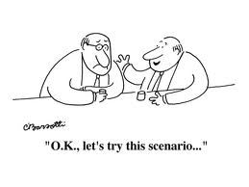
Test Your Knowledge
Notes:
So now we have a few Job Corps-related scenarios to practice accommodating students with LD.

Slide 39
Chris
39
Notes:
Let’s start with Chris.

Slide 40
Chris
Has difficulty copying from the board
Leaves out whole words or letters so that what he writes does not make sense
Handwriting is very sloppy and so it is very difficult to read his papers
What accommodations could help Chris?
Notes:
Read slide
Have participants help with accommodation ideas.

Slide 41
Accommodation Options
Use of computer
Note taker
Reduce copying tasks
Provide copies of notes or necessary information
Allow oral presentations for assignments
Notes:
A few options could include…

Slide 42
Tiffany
42
Notes:
Now let’s try to help Tiffany…

Slide 43
Tiffany
When giving oral directions to she often responds with “what”
When listening to a lecture, her notes often do not make sense
She writes down half a thought
She states that she only hears part of what was said and then the person moves on
What accommodations could help Tiffany eliminate frustration when taking notes?
Notes:
Read slide…
In the chat box, what accommodations could help Tiffany eliminate frustration when taking notes?

Slide 44
Accommodation Options
Use of a tape recorder
Smart Pen
Note taker
Provide visuals when possible
Provide handouts of notes prior to lecture
Use buddy system
Notes:
Some ideas for accommodations to help Tiffany with note-taking and/or remember information that is provided orally include… (slide)

Slide 45
David
45
Notes:
Last we have David…

Slide 46
David
Struggles with organization
Appears clumsy quite often, falling out of his chair, bumping into things
What accommodations could help David with organization?
Notes:
Slide…
In the chat box, what accommodations could help David with organization, and address his issue falling out of his chair or bumping into things?

Slide 47
Accommodation Options
Use color code system
Provide binder with labeled sections
Provide calendar
Use computer to create folders to save assignments and documents
Provide student with copy of schedule or display schedule in classroom
Provide seating with arm rest on one side
Arrange classroom with clear pathways
Notes:
Some accommodation ideas for David’s functional limitations include…

Slide 48
Resources
Notes:
That concludes the webinar content portion. We now have a few resources that can support you when attempting to accommodate students with various types of learning disabilities.

Slide 49
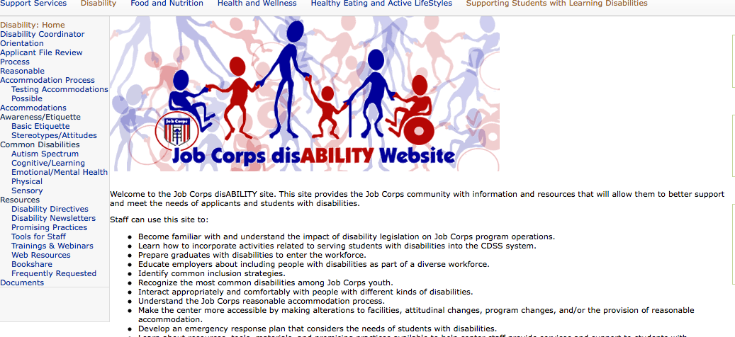
Job Corps Disability Website https://supportservices.jobcorps.gov/disability/Pages/default.aspx
49
49
49

Slide 50
Job Corps Learning Disabilities Website https://supportservices.jobcorps.gov/SupportingStudentsLD/Pages/default.aspx
50

Slide 51
Job Accommodation Network https://askjan.org
51

Slide 52
Questions?
52

