Slide 1
Maintaining and Managing Applicant File Review (AFR) Tracking
Final Dispositions
FRT Reviewers
30 days
Part of the Disability Coordinator Orientation Series Part 1c
Notes:
Welcome to Maintaining and Managing Applicant File (AFR) Tracking webinar! This webinar is targeted to center Records Managers and Disability Coordinators but certainly all members of the applicant file review team can benefit from learning the requirements of AFR tracking including a review of the Wellness Tracking Log requirement along with reminders about protecting sensitive health and disability information.

Slide 2
NOTE: TO CHANGE OUT THIS ICON OUT WITH YOUR OWN YOU MAY HAVE TO CLICK ON THE ICON A FEW TIMES TO HIGHLIGHT IT (SINCE IT IS IN A GROUP). ONCE HIGHLIGHTED… 1*RIGHT CLICK ON TOP OF THE ICON.
2*CHOOSE “CHANGE GRAPHIC”
3* CHOOSE WHERE TO FIND YOUR NEW ICON OR PICTURE AND PLACE IT.
Part 1a - Applicant File Review - Policy
Part 3:
Disability Data and Accommodation Plan Entry/ Notes
Disability
Coordinator
Orientation
Webinar Series
Part 1b - Applicant File Review - Process
Part 1c - Maintaining and Managing AFR Tracking
Part 4:
General Disability and Other Disability Program Requirements
Part 2a - Disability Accommodation - Policy
Part 2b - Disability Accommodation - Process
The individual webinars can be attended in ANY order and routine attendance is strongly encouraged as content is updated on a regular basis.
2

Slide 3
Objectives
01
Identify and implement a file review log that meets all the PRH requirements for tracking an applicant file from the time it arrives on center until there is a disposition on the application.
02
List the acceptable reasons a file may be “returned” to Admissions Services.
03
List several common errors and/or pitfalls in maintaining the Center File Review Tracking Log and subsequently how to avoid errors.
04
Identify AFR Tracking resources and where those resources are located.
05
Review Wellness Tracking Log requirements and considerations.
3
Notes:
Before we go over the objectives for today’s webinar, a little background. While the AFR process is not specific to students with disabilities, it is the center’s primary documentation that determines compliance with many of the AFR process components. Requirements related to the log are reviewed as part of the center’s Disability Program Compliance Review.
Identify and implement a file review log that meets all of the PRH requirements for tracking an applicant file from the time it arrives on center until there is a disposition on the application.
As previously mentioned, maintenance of an accurate tracking log is critical to a positive applicant file review process and the lack of accurate tracking can significantly impact the outcome of your center program review.
List the acceptable reasons a file may be “returned” to Admissions Services.
Meaning what are the allowable reasons in Job Corps policy that enable a center to return a file to Admissions Services prior to the completion of the applicant file review?
List several common errors and/or pitfalls in maintaining the Center File Review Tracking Log and subsequently how to avoid errors.
Identify AFR Tracking resources and where those resources are located.
Review Wellness Tracking Log requirements and considerations.

Slide 4
Policy
PRH Requirements
4
4
4
Notes:
It is critically important to understand the policy requirements related to maintaining and managing the tracking of the applicant file review process for several reasons:
To ensure that the process is documented consistently and accurately.
To ensure that all components of the process are documented should there be a civil rights complaint.
To ensure that all applications are reviewed to a final disposition except for those electronically returned to Admissions Services for allowable policy reasons.

Slide 5
A
Center File Review Tracking Log
PRH Chapter 1: 1.5(R3)
Records MUST maintain a single ongoing center file review tracking log which documents ALL applicant files received for review.
Center File Review Tracking Log Requirements
File Receipt Date | Extension Requested
File Review Due Date | Final Disposition
Applicant ID# | Disposition Date
Applicant Last and First Name | Days File in Review
Health and Wellness Director (HWD) Reviewer | Date of Assignment
Date HWD Review Completed | Date of Enrollment
Other Reviewer | Comments
Other Review Completed Date
B
A new log should be started each Program Year and entries MUST NOT be deleted.
C
Wellness MUST maintain its own internal tracking log. (PRH Chapter 1:1.5(R2)(b).
5
Notes:
The requirements of the Center File Review Tracking Log are listed in the table and we will discuss those further later in the presentation but first let’s review some of the overarching requirements you need to be aware of in maintaining your Center File Review Tracking Log.
Records MUST maintain a single ongoing center file review tracking log which documents ALL files received for review.
A new log should be started each Program Year and entries MUST NOT be deleted.
Wellness MUST maintain its own internal tracking log.
The AFR log is critically important if discrimination or any other type of complaint is filed, as it provides a historical record of people who interacted with the file, the timeline of the file review process, and the final disposition of the application. Requirements pertaining to the AFR log can be found in PRH Section 1.5, R3.

Slide 6
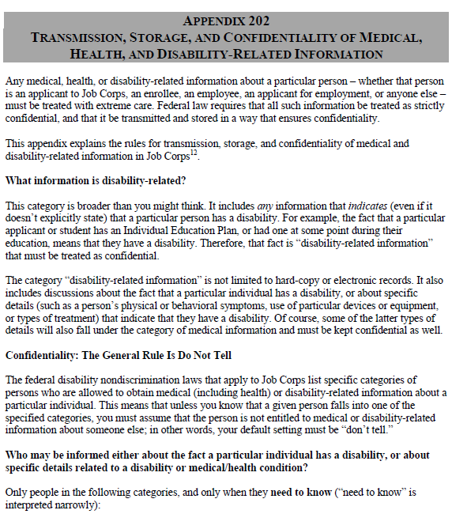
Confidential Information Within the Log
Specifically, on the Center File Review Tracking Log,
Avoid using such terms as IEP, names of conditions, etc.
If awaiting receipt of an IEP, for example, simply state "awaiting documentation" or "awaiting Wellness documentation.“
Use generic phrases that tell the story but do not inadvertently disclose protected health information or disability status.
6
Notes:
Confidentiality Review
We cannot over emphasize the need for discretion and appropriate maintenance of protected health and disability information. It is serious business, and we must treat it as such.
Let’s talk about some things that we can do to minimize sharing/disclosure of protected health and disability information.
Avoid using such terms as IEP, names of conditions, etc. If awaiting receipt of an IEP, for example, simply state "awaiting documentation" or "awaiting Wellness documentation.“
Ultimately, try and use generic terms that tell the story but do not inadvertently disclose protected health information or disability status.
Appendix 202, Transmission, Storage, and Confidentiality of Medical, Health, and Disability-Related Information is your go to policy resource for understanding the maintenance of protected health and disability information.

Slide 7
Responsibilities of Records Staff
The records department is the gatekeeper of all applicant files.
The Records Manager (or designated Records staff) is accountable for ensuring the Center File Review Tracking Log tracks all required components and contains complete and accurate information.
Regular quality audits of the log are recommended to identify and correct missing or inaccurate information.
7
Notes:
Job Corps policy requires that the Records department serve as the “gatekeeper” for tracking all applicant files and must manage/oversee the tracking of all applicant files from the time the center receives the applicant file until there is a final disposition. Regular audits of the log are recommended to identify and correct missing or inaccurate information.

Slide 8
Operational Plan
Center Applicant File Review Timelines
Timelines
Extensions
Extension Request Timeframe
The applicant’s file must be processed within 30 calendar days from electronic receipt by center.
If the center reasonably can substantiate needing the file longer than 30 calendar days to complete the file review process, then an extension request must be requested from your DOL Program Manager.
The extension request must be submitted to the relevant Regional Office no later than 25 calendar days after receipt of the file.
8
Notes:
The center has 30 calendar days from electronic receipt of the file by the center to complete the review of an applicant file. In other words, to make a decision to enroll or to recommend denial of enrollment.
Centers may request extensions of time to complete the review of an application if the center reasonably can substantiate needing the file longer than 30 calendar days to complete the file review process. The extension request must be requested from your DOL Program Manager and it should be documented in the Center’s File Review Tracking Log. Your extension request must be submitted to the Regional Office no later than 25 calendar days into your 30-day review timeframe. The 25-day deadline for submitting an extension is a requirement that was added to the PRH in November of 2022.
Caution – extensions are to give the center time to secure a needed accommodation to participate in the file review process, to schedule a tour if that is logistically possible and needed, or to receive anticipated documentation. Extensions to complete file reviews should not function as delays in enrollment.

Slide 9
Center File Review Tracking Log
Review of log requirements
9
9
Notes:
Now let’s review the Sample Center File Review Tracking Log from the Job Corps Disability website and discuss the log requirements.

Slide 10
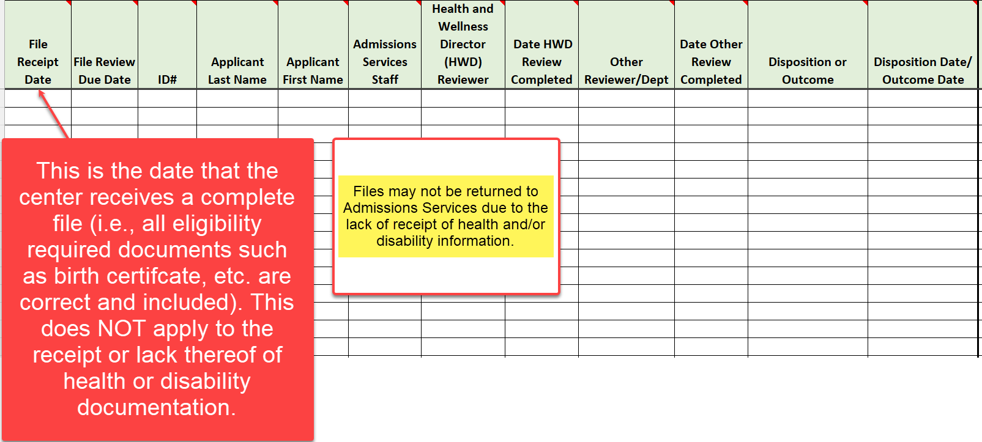
Center File Review Tracking Log Review File Receipt Date
10
Notes:
Center File Review Tracking Log Review
The first column is the File Receipt Date. This is the date that the center receives a complete file (i.e., all eligibility required documents such as birth certificate, etc. are correct and included.) This does NOT apply to the receipt or lack thereof of health or disability documentation. Why? The disclosure of protected health and disability documentation is voluntary and if no documents are forthcoming (due to time constraints, not available, etc.), the center file review team must proceed with the completion of the applicant file review. Files may not be returned to Admissions due to the lack of receipt of Health and/or Disability information.

Slide 11
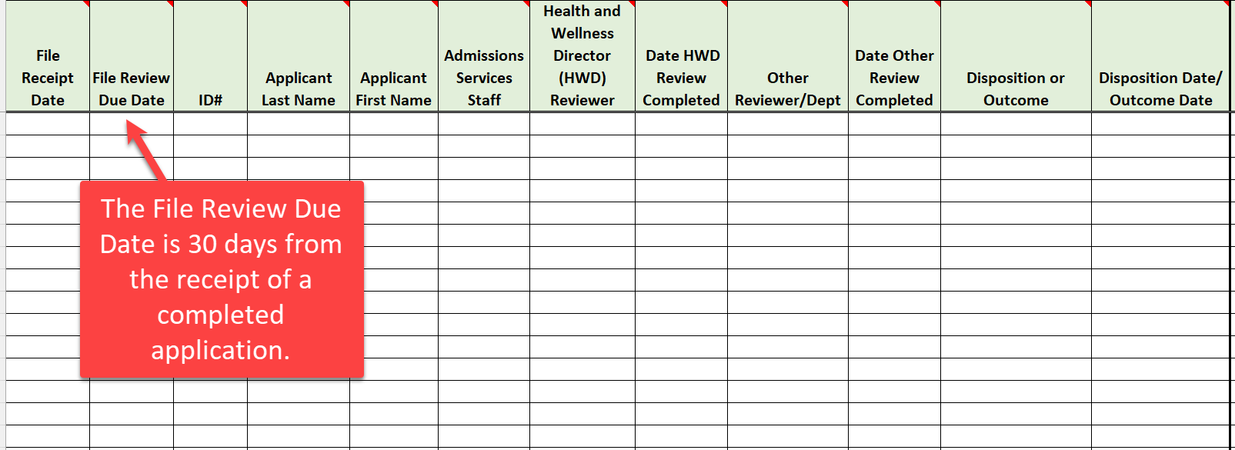
Center File Review Tracking Log Review File Review Due Date
11
Notes:
Center File Review Tracking Log Review
The next column is the File Review Due Date. The File Review Due Date is 30 days from the receipt date of a completed application, which is the date you entered into the first column.

Slide 12
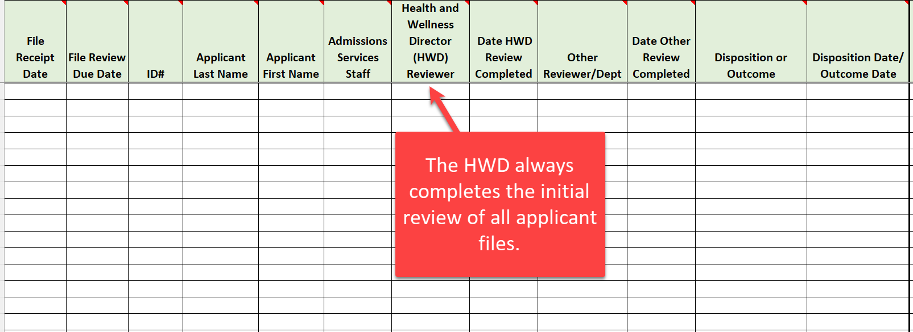
Center File Review Tracking Log Review Health and Wellness Director (HWD) Reviewer
12
Notes:
Center File Review Tracking Log Review
Now let’s skip over to the Health and Wellness Director (HWD) Reviewer column. The HWD is the File Review Coordinator for the center and is the person identified in Job Corps policy to triage applicant files. Given this, the Health and Wellness Director (HWD) Reviewer column should consistently list the name of the HWD as the initial reviewer of the applicant file.

Slide 13
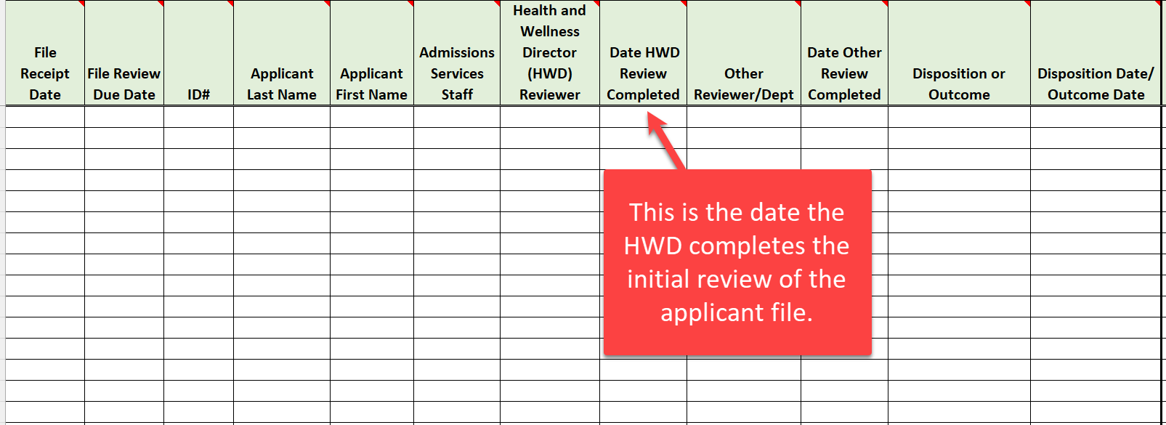
Center File Review Tracking Log Review Date HWD Review Completed
13
Notes:
Center File Review Tracking Log Review
The next column is the Date HWD Review Completed meaning the date the Health and Wellness Director completed their triage or initial review. There should always be a date in this column unless the applicant file has been returned to Admissions Services for an allowable reason within Job Corps policy and before the 30-day file review window had expired and/or before the Health and Wellness Director completed their initial review. This typically occurs when there has been a withdrawal of application early in the center’s file review process.

Slide 14
Center File Review Tracking Log Review Other Reviewer/Dept.
14
Notes:
Center File Review Tracking Log Review
The next column is the Other Reviewer/Dept. This column is where the non-health DC would be listed when there are non-health documents to be reviewed such as IEPs, 504 plans, vocational rehabilitation documents and the like. Qualified Health Professionals (QHPs) should only be listed on the Wellness Tracking Log that we are going to discuss shortly. Do not list the title of the non-health DC. Only list their name to not overtly divulge the disability status of the applicant.

Slide 15
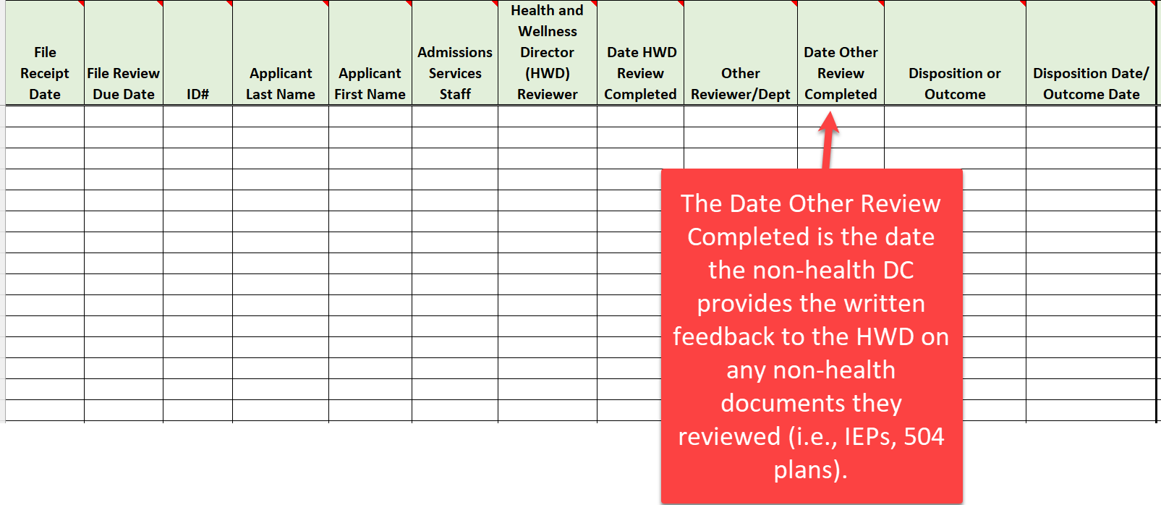
Center File Review Tracking Log Review Date Other Review Completed
15
Notes:
Center File Review Tracking Log Review
The next column is the Date Other Review Completed, so this is the date that the non-health DC has completed their review and provided written feedback to the HWD on any non-health documents they reviewed (i.e., IEPs, 504 plans).

Slide 16
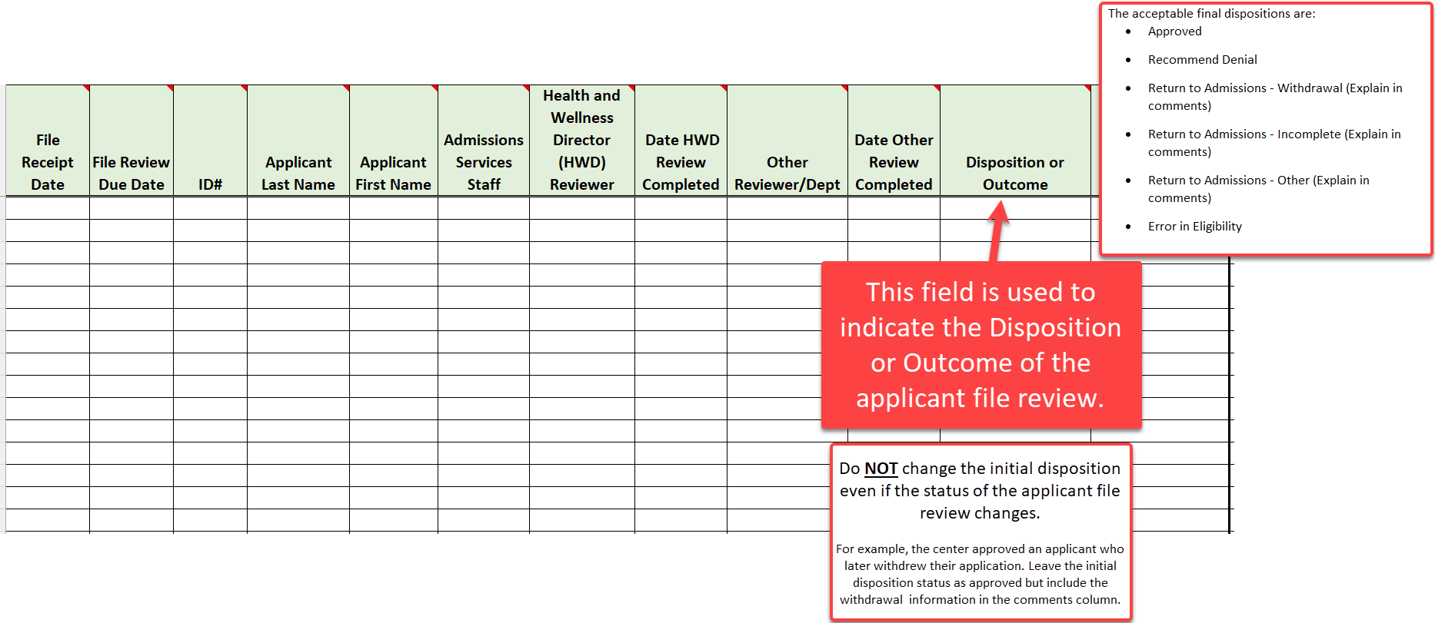
Center File Review Tracking Log Review Disposition or Outcome
16
Notes:
Center File Review Tracking Log Review
The Disposition or Outcome is a critical column and should NEVER be blank. Every application has some type of outcome. There is a dropdown box that includes the following fields:
Approved
Recommend Denial
Return to Admissions – Withdrawal (Explain in comments)
Return to Admissions – Incomplete (Explain in comments)
Return to Admissions – Other (Explain in comments)
Error in Eligibility
When there is a return to admissions, there should always be an explanation in the comments box to include adding any additional dates that may apply. Generic statements that do not provide sufficient explanation do result in concerns during your center assessments. For example, stating that Admissions Services requested it back but including no other clarifying information is insufficient. Why did Admissions Services request it back and is the return allowable under Job Corps policy? If it is not allowable under Job Corps policy, then the file may not be returned to Admissions Services and the center must complete the applicant file review process.
Reminder – an applicant file cannot be returned just for an applicant being hospitalized (we’ll talk more about it later); it may turn into a withdrawal or an incomplete application but what’s important is that the hospitalization information is not divulged in the comments section on this center file review tracking log.
Do NOT change the initial disposition even if the status of the applicant file review changes. For example, the center approved an applicant who later withdrew their application. Leave the initial disposition status as approved but include the withdrawal information in the comments column.

Slide 17
Recommending Denial of Enrollment
17
17
17
Notes:
Let’s stop here and discuss the possible dispositions for recommending denial of enrollment. This will be a very high-level review of the specific types of recommendations of denial. For more detailed discussion, please ensure you attend the Applicant File Review webinars when they are scheduled and/or visit the Disability website to review the PPT presentations from the last AFR webinar trainings we presented.

Slide 18
Eligibility Review Due to New Information
Center applicant file review teams may only revisit the determination that an applicant is qualified for admission (i.e., an applicant’s eligibility status) if:
There is new information presented that Admissions Services could not have reasonably known at the time the applicant’s qualification for admission was established; and
The new information indicates that the applicant offered enrollment may no longer meet an eligibility requirement.
PRH 1:1.5(R1)(a)
18
Notes:
Eligibility Review Due to New Information
Center applicant file review teams may only revisit the determination that an applicant is qualified for admission (i.e., an applicant’s eligibility status) if:
There is new information presented that Admissions Services could not have reasonably known at the time the applicant’s qualification for admission was established; and
The new information indicates that the applicant offered enrollment may no longer meet an eligibility requirement.
For example, an applicant has become incarcerated in between the time Admissions Services certified them as eligible and the time the center is reviewing the applicant file. This likely would be a “new information” scenario and may result in the center recommending denial based upon new information that “may” render the applicant now ineligible for the Job Corps program.
New Information related eligibility recommendations of denial require that Wellness complete the Center Applicant File Review – Center Recommendation of Denial Form – Eligibility Review/New Information found in Form 1-06 and submit it to the Regional Office for review.
An Eligibility Review Due to New Information should not occur often and is limited to very specific situations because the Program cannot arbitrarily revisit an enrollee’s eligibility status.

Slide 19
What is and is NOT New Information
IS New Information
IS NOT New Information
Incarceration after certification of eligibility
Charges/conviction of a crime such as sexual assault after certification of eligibility
Disclosure of medical or mental health condition(s)
Medical or mental health stability or non-compliance with treatment provider regimen including medication non-compliance
What do you do with an applicant file you are reviewing when you learn that
the applicant has just become incarcerated?
19
Notes:
Although the determination of a new information recommendation of denial rests with Wellness, it is also important that Records Managers understand that files cannot be returned to Admissions because of new information such as an incarceration that occurred after certification of eligibility. Instead, the applicant must be recommended for denial of enrollment to the Regional Office and that responsibility rests with the Wellness Department.
Equally important is understanding what is Not “NEW” Information
Health and Wellness Directors - If the basis of the new information review is due to a disclosure of a medical condition or medically-related, it is not likely that you have a “new information” situation at least as it relates to eligibility.
Audience Participation: What do you do with an applicant file you are reviewing when you learn that the applicant has just become incarcerated?
Review the facts of the situation and if it is determined that the applicant is likely no longer eligible, then the center would complete the Center Recommendation of Denial Form – Eligibility Review/New Information Form in Form 1-06 and submit to the Regional Office for review by uploading the form and selecting the Notify Regional Review within Health E-Folder in CIS.

Slide 20
Eligibility Due to Disability Status
If the applicant is or will be older than 24 years old on the date of enrollment, the maximum age limit may be waived if the applicant is a person with a disability.
If the applicant would not meet the low-income requirement unless the applicant is considered a “family of one” because of a disability.
PRH 1: 1.2 (R3)(b)(1)
PRH 1: 1.5 (R8)
20
Notes:
Eligibility Due to Disability Status
An applicant may exceed the upper age limit restriction and/or the applicant may be considered a “family of one” for income purposes and enroll in Job Corps if they have a disability.
Age and income are eligibility essential requirements (ER) in Exhibit 1-1 of the PRH and cannot be certified by Admissions Staff because Admissions Staff may not review health/disability documentation, only collect it. Health/disability documentation may include medical records, IEPs, Chronic Care Management Plans, etc.

Slide 21
Health Care Needs
A Health Care Needs Assessment (HCNA) is conducted for an applicant if the qualified health professional on the File Review Team (FRT) determines that:
The applicant’s health care needs may not be manageable through the basic healthcare services provided for in Exhibit 2-4, Job Corps Basic Health Responsibilities.
PRH 1: 1.5 (R6)(a)
Exhibit 2-4
Form 2-05
21
Notes:
A Health Care Needs Assessment (HCNA) is conducted for an applicant if the qualified health professional on the File Review Team determines that:
The applicant’s health care needs may not be manageable through the basic healthcare services provided for in Exhibit 2-4, Job Corps Basic Health Responsibilities. This is Form 2-05 in the PRH.

Slide 22
Direct Threat to Others
A Direct Threat Assessment (DTA) is conducted for an applicant if the qualified health professional on the File Review Team determines that:
An applicant or student may pose a significant risk of substantial harm to the health or safety of others that cannot be eliminated or reduced sufficiently by disability accommodations.
PRH 1: 1.5 (R6)(c)
Form 2-04
22
Notes:
The Individualized Assessment of Possible Direct Threat (Form 2-04) is completed if the qualified health professional on the File Review Team determines that an applicant or student may pose a significant risk of substantial harm to the health or safety of others that cannot be eliminated or reduced sufficiently by disability accommodations.

Slide 23
Other Possible Applicant File Review Outcomes
23
23
23
Notes:
Now let’s review the Other Possible Applicant File Review Outcomes.

Slide 24
Withdrawal of Application
If an applicant is no longer interested in attending Job Corps and withdraws their application, the applicant file should be electronically returned to Admissions Services.
If the withdrawal request was made in writing, hard copy or electronically, copies of the withdrawal request must be maintained.
PRH 1: 1.5 (R5)(a)
24
Notes:
A withdrawal of application is relatively straightforward in that if an applicant is no longer interested in attending Job Corps and withdraws their application, the applicant file should be electronically returned to Admissions Services.
If the withdrawal request was made in writing, hard copy or electronically, copies of the withdrawal request must be maintained.

Slide 25
…even with Admissions Services assistance
Incomplete Application
If the center is unable to reach the applicant to complete a needed clinical interview or to complete barrier removal considerations (i.e., disability accommodations when recommending denial based on health care needs or direct threat), the FRT or DAC must:
Have attempted to contact the applicant at least twice
Document each attempted contact in an applicant contact log
Maintain a copy of the applicant contact log
PRH 1: 1.5 (R5)(b)
Provide the contact log information to the center Records Department to include in the Center File Review Tracking Log
25
Notes:
What is the difference between an incomplete application and a withdrawal of application. As we just discussed, a withdrawal of application occurs when an applicant has withdrawn their interest in attending Job Corps. An incomplete application is when the center File Review Team is unable to complete a required component of the applicant file review process, meaning either an inability to reach the applicant to complete the clinical interview or to complete barrier removal considerations (i.e., disability accommodations when recommending denial based on health care needs or direct threat). One important note – the center FRT must collaborate with Admissions Services to determine whether they can reach the applicant or not as well.
If neither the FRT nor Admissions Services staff is able to reach the applicant, then the FRT must:
Have attempted to contact the applicant at least twice
Document each attempted contact in an applicant contact log
Maintain a copy of the applicant contact log
Provide the contact log information to the center Records Department to include in the Center File Review Tracking Log

Slide 26
Incomplete Application (cont.)
If the center FRT in collaboration with Admissions Services staff is unable to contact the applicant, the applicant file is returned electronically to Admissions Services.
If the application is in regional review, the center must notify the reviewer via email and upload any supporting documentation including the applicant contact log into the Wellness and Accommodation E-Folder labeled “Other.”
PRH 1: 1.5 (R5)(b)
26
Notes:
If the center FRT in collaboration with Admissions Services staff is unable to contact the applicant, the applicant file is returned electronically to Admissions Services.
If the application is in regional review, the center must NOT return the file electronically to Admissions Services because the outcome of the application review is now in the purview of the Regional Office. The center must notify the regional reviewer via email and upload any supporting documentation including the applicant contact log into the Wellness and Accommodation E-Folder labeled “Other.”

Slide 27
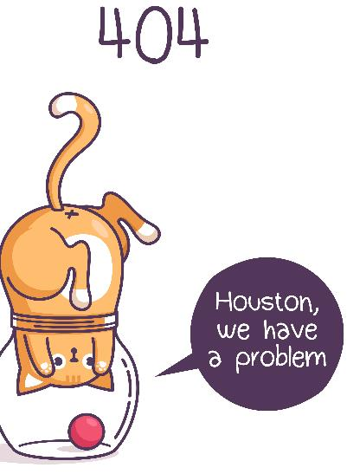
Rare!
Error in Initial Eligibility Process
If the center FRT identifies a potential eligibility concern that occurred as a potential error in the initial eligibility review process, then the center should contact the DOL Program Manager for guidance.
If the initial eligibility determination was made in error as determined by the respective Regional Office, then the file may be returned to Admissions Services.
PRH 1: 1.5 (R5)(c)
Exhibit 1-1
What is the difference between “new information” that may make an individual now ineligible for the program and an error in the initial eligibility process?
27
Notes:
Error in the Initial Eligibility Process. This has been an informal category in the past and not included in the PRH. This outcome should only occur very rarely and is different than a “new information” recommendation of denial. If the center FRT identifies a potential eligibility concern that occurred as a potential error in the initial eligibility review process, then the center should contact the Program Manager for guidance. If the initial eligibility determination was made in error as determined by the respective Regional Office, then the file may be returned to Admissions Services.
What is the difference between “new information” that may make an individual now ineligible for the program and an error in the initial eligibility process?
Let’s compare these outcome types further.

Slide 28
Review!
New Information
Error in Eligibility
New information that makes the applicant “newly” ineligible; information Admissions Services could not have known at the time of the original certification (e.g., incarceration occurs during center file review).
Center reviews information KNOWN by Admissions Services at the time of the initial eligibility certification and believes the applicant was never eligible.
New Information
vs
Error in Eligibility
Center recommends denial of enrollment via “Notify Regional Review” option in CIS.
Center contacts (calls or emails) the DOL Program Manager for discussion/review.
28
Notes:
Let’s Review the differences between a New Information recommendation of denial and a determination of a possible error in eligibility.
New Information
There are some key words that distinguish the differences between these two categories:
New information that makes the applicant “newly” ineligible; information Admissions Services could not have known at the time of the original certification (e.g., incarceration occurs during center file review)
Center recommends denial of enrollment via “Notify Regional Review” option in CIS.
Error in Eligibility
Center reviews information KNOWN by Admissions Services at the time of the initial eligibility certification and believes the applicant was never eligible.
Center contacts (calls or emails) the DOL Program Manager for discussion/review.

Slide 29
Residential Settings or Hospitalization
If an applicant is in a treatment facility, residential program, or is currently hospitalized, the center FRT (to conduct clinical interviews) and/or Disability Accommodation Committee (DAC) (to complete barrier removal considerations when recommending denial based on health care needs or direct threat) must make at least two attempts to contact the applicant using contact information provided in the applicant file.
Made contact?
Complete the applicant file review process.
Unable to make contact?
Document the attempts to contact and electronically return the file to Admissions Services as an incomplete application.
What does the center do if the file is in Regional Review?
PRH 1: 1.5 (R5)(d)
29
Notes:
Residential Settings or Hospitalization
If an applicant is in a treatment facility, residential program, or is currently hospitalized, the center FRT (to conduct clinical interviews) and/or Disability Accommodation Committee (DAC) (to complete barrier removal considerations when recommending denial based on health care needs or direct threat) must make at least two attempts to contact the applicant using contact information provided in the applicant file.
If the center can reach the applicant to conduct necessary applicant file review procedures, the center may not return the applicant file to Admissions Services but must process the recommendation of enrollment or denial unless the applicant states that they wish to withdraw their application.
If the center is unable to reach the applicant, then the center must document the attempts to contact and then may electronically return the file to Admissions Services due to the inability to complete the application process.
What if the center is unable to reach the applicant but the file is in Regional Review?
Contact the Regional Reviewer and let them know that the center has been unable to reach the applicant to complete a required contact (usually a clinical interview or the disability accommodation process) and the Regional Reviewer will manage the next steps.

Slide 30
Other
Centers may not arbitrarily return an applicant file to Admissions Services if outside the scope of or in conflict with Job Corps policy.
Examples:
Returning a file requested by Admissions Services without knowing why it is being requested.
Returning a file to Admissions Services that has a new legal action pending instead of submitting as a recommendation of denial to the Regional Office.
Reasons for returning an application to Admissions Services must be clearly documented in the Center File Review Tracking Log.
PRH 1: 1.5 (R5)(e)
If the comments in your Center File Review Tracking Log state, “returned to Admissions” or “requested file be returned by Admissions, is this sufficient information?
30
Notes:
The “OTHER” category serves as a valuable reminder that applicant files may not be returned to Admissions Services if outside the scope of or in conflict with Job Corps policy.
Examples:
Returning a file requested by Admissions Services without knowing why it is being requested.
Returning a file to Admissions Services that has a new legal action pending instead of submitting as a recommendation of denial to the Regional Office.
Reasons for returning an application to Admissions Services must be clearly documented in the Center File Review Tracking Log.
Audience Participation:
If the comments in your Center File Review Tracking Log state, “returned to Admissions” or “requested file be returned by Admissions, is this sufficient information?
No, this does not tell why the file was returned or why Admissions Services requested the file to be returned.

Slide 31
Center File Review Tracking Log (cont.)
How to complete the requirements within the log
31
31
31
Notes:
Now let’s pick back up with the log and finish reviewing the rest of the columns.

Slide 32
Center File Review Tracking Log Review Disposition Date/Outcome Date
32
Notes:
Center File Review Tracking Log Review
The Disposition or Outcome Date is the date the initial applicant file review was completed whether that occurred by making a decision on enrollment or by returning files to Admissions Services due to a withdrawal of application or the inability to reach the applicant to complete the required clinical interviews and disability accommodation interactive process.
Once a date has been entered for the initial disposition of an applicant file, do not change this date even if the status changes. For example, the center approved an applicant who later withdrew their application. Leave the disposition/outcome as approved here and update the withdrawal status info in the comments column.

Slide 33
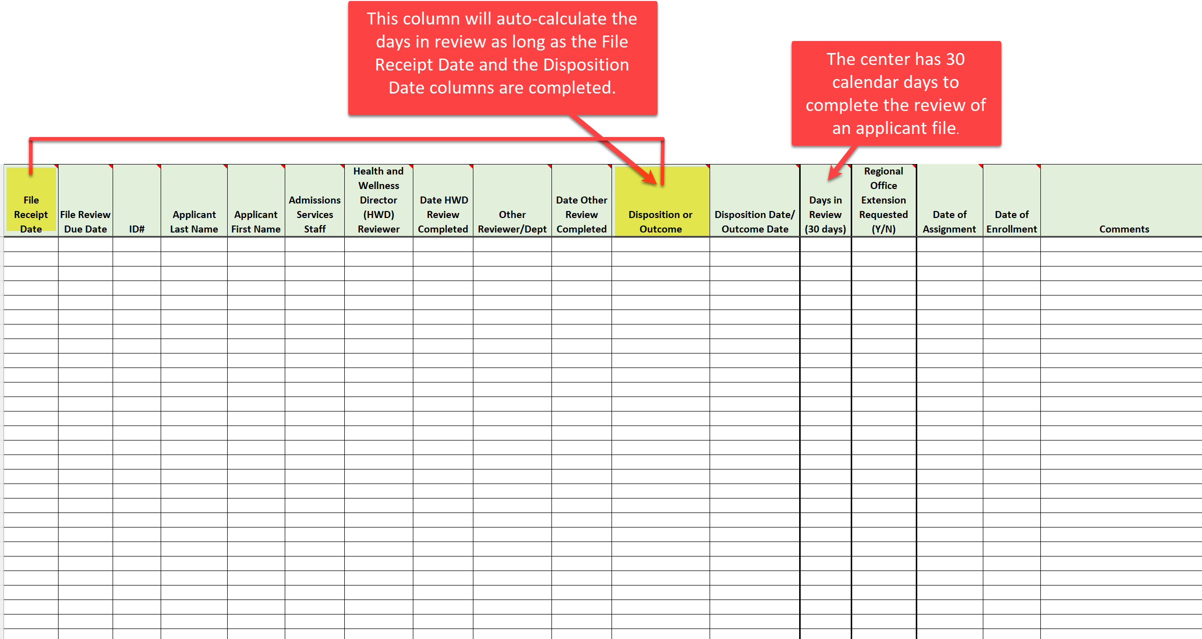
Center File Review Tracking Log Review Days in Review (30 days)
Notes:
Center File Review Tracking Log Review
Remember, the center has 30 calendar days to complete the review of an applicant file. The Days in Review column is an auto-calculate column if the File Receipt date and the Disposition/Outcome dates are filled in or completed.

Slide 34
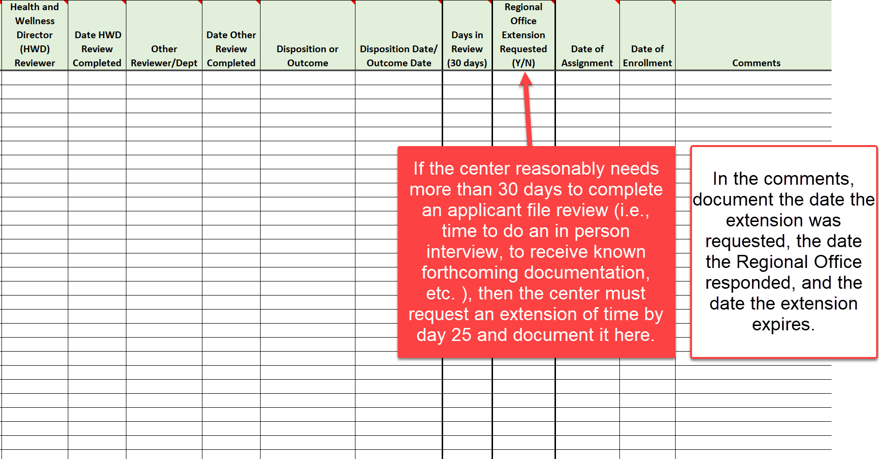
Center File Review Tracking Log Review Regional Office Extension Requested
34
Notes:
Applicant File Review Tracking Log Review
If the center reasonably needs more than 30 days to complete an applicant file review (i.e., time for the applicant to do an in-person interview, to receive known forthcoming documentation, etc.), then the center must request an extension of time and document it here in the Regional Office Extension Requested column.
Please document if you have requested an extension and then document the details of the extension in the Comments column, such as the date the approval of the extension was received and the date the extension expires. As a reminder, extensions must be requested by day 25 for typical reviews and by day 10 for alternate center referral reviews.

Slide 35
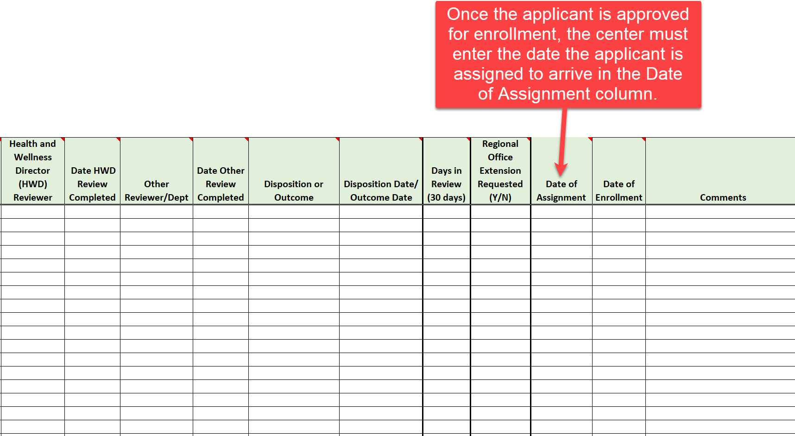
Center File Review Tracking Log Review Date of Assignment
35
Notes:
Center File Review Tracking Log Review
Once the applicant is approved for enrollment, the date the applicant is assigned to arrive should be entered into the Date of Assignment column.

Slide 36
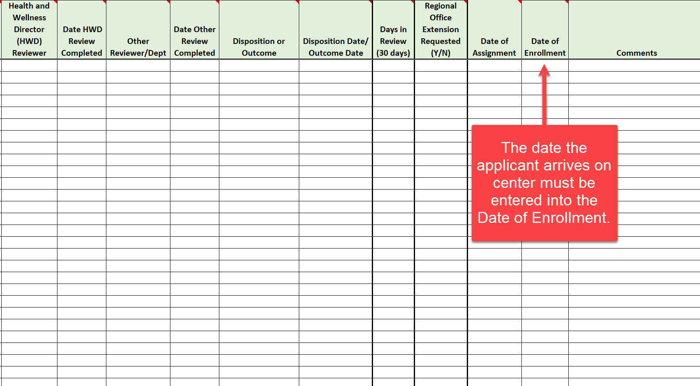
Center File Review Tracking Log Review Date of Enrollment
36
Notes:
Center File Review Tracking Log Review
The Date of Enrollment column should have the date that the applicant arrives and enrolls at the center.

Slide 37
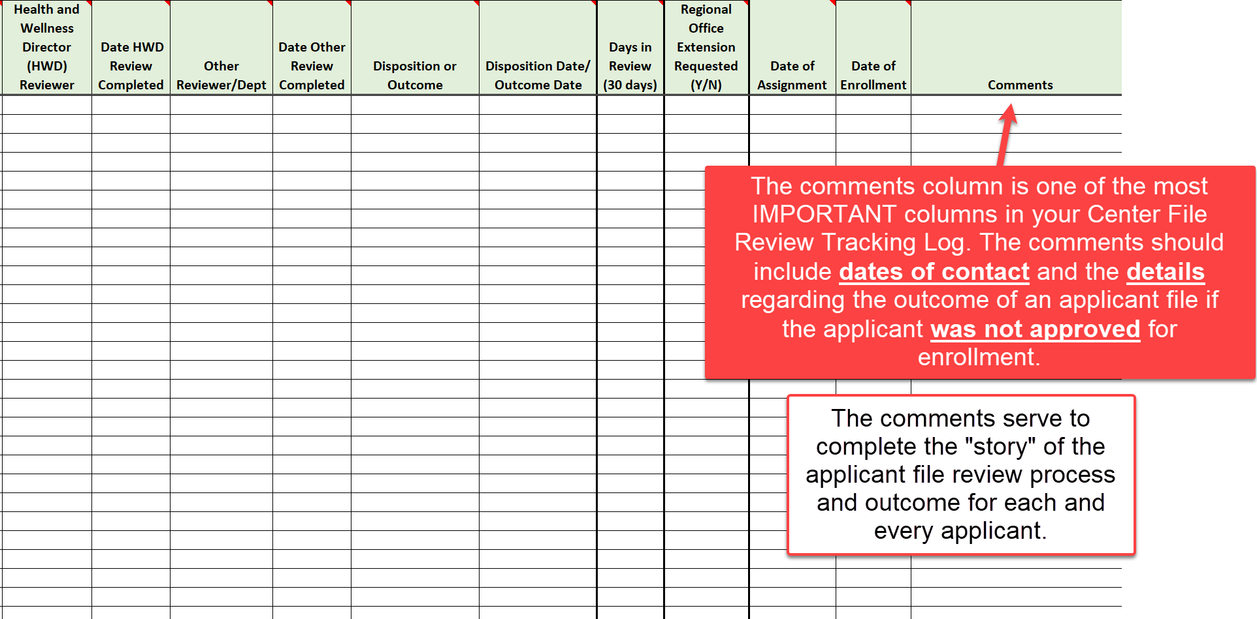
Center File Review Tracking Log Review Comments
Notes:
Center File Review Tracking Log Review
The Comments column is critical to provide the full picture of an applicant file review. The comments should include dates of contact and the details regarding the outcome of an applicant file if the applicant was not approved for enrollment. The comments serve to complete the "story" of the applicant file review process and outcome for each and every applicant.
Ensure that your explanations are clear, that anyone reviewing the log can readily understand what occurred with the application and easily determine the final outcome. For example, if you document that Admissions Services staff requested the file back without an explanation as to why, this is insufficient. However, if you documented that Admissions Services requested the applicant file back because the applicant has stated that they found a job and they are no longer interested in enrolling in Job Corps, that outcome would be clear.

Slide 38
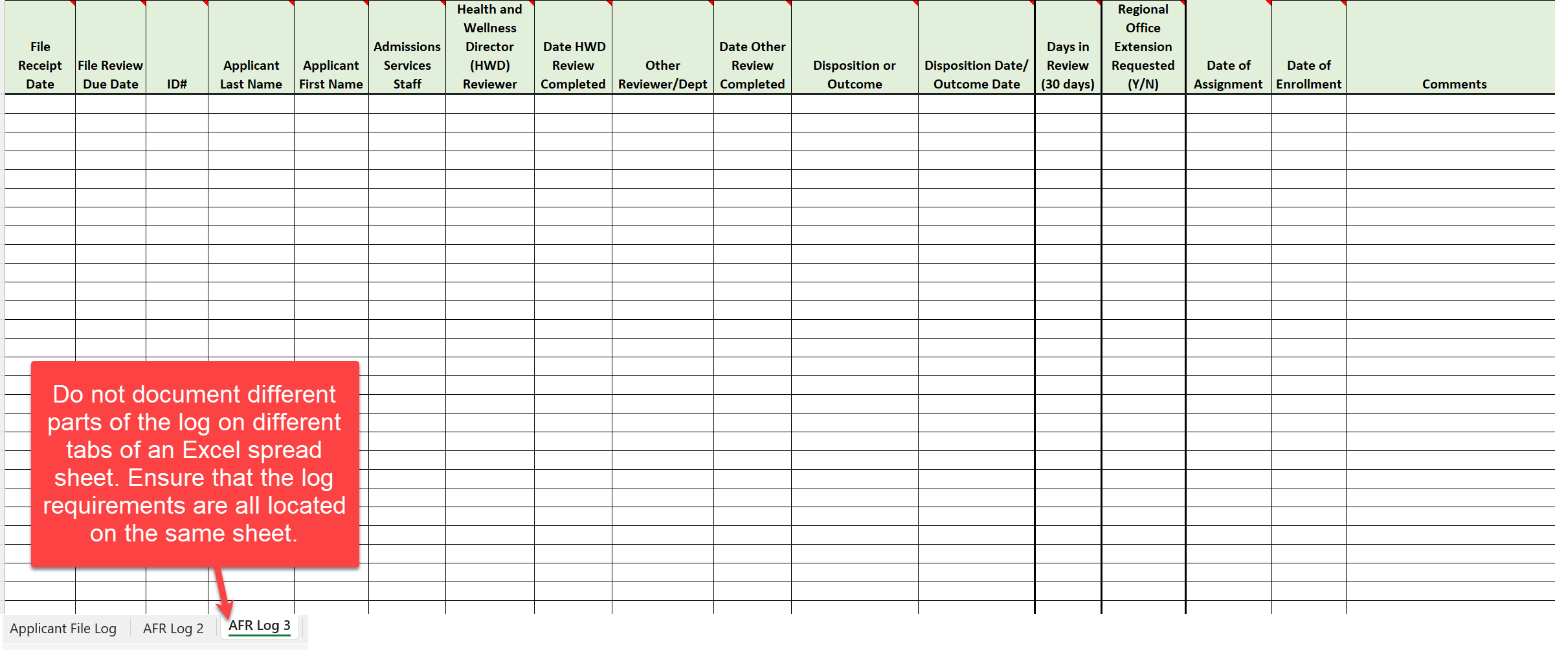
Center File Review Tracking Log Review Multiple Logs or Using Multiple Tabs
38
Notes:
Center File Review Tracking Log Review
Remember, Job Corps policy states that the center must maintain a single ongoing log. Given this, be sure that the center is not capturing required tracking data in pieces and parts amongst multiple logs or on multiple tabs of a spreadsheet. All the requirements must be included on one tab within a single log or in one file, etc.

Slide 39
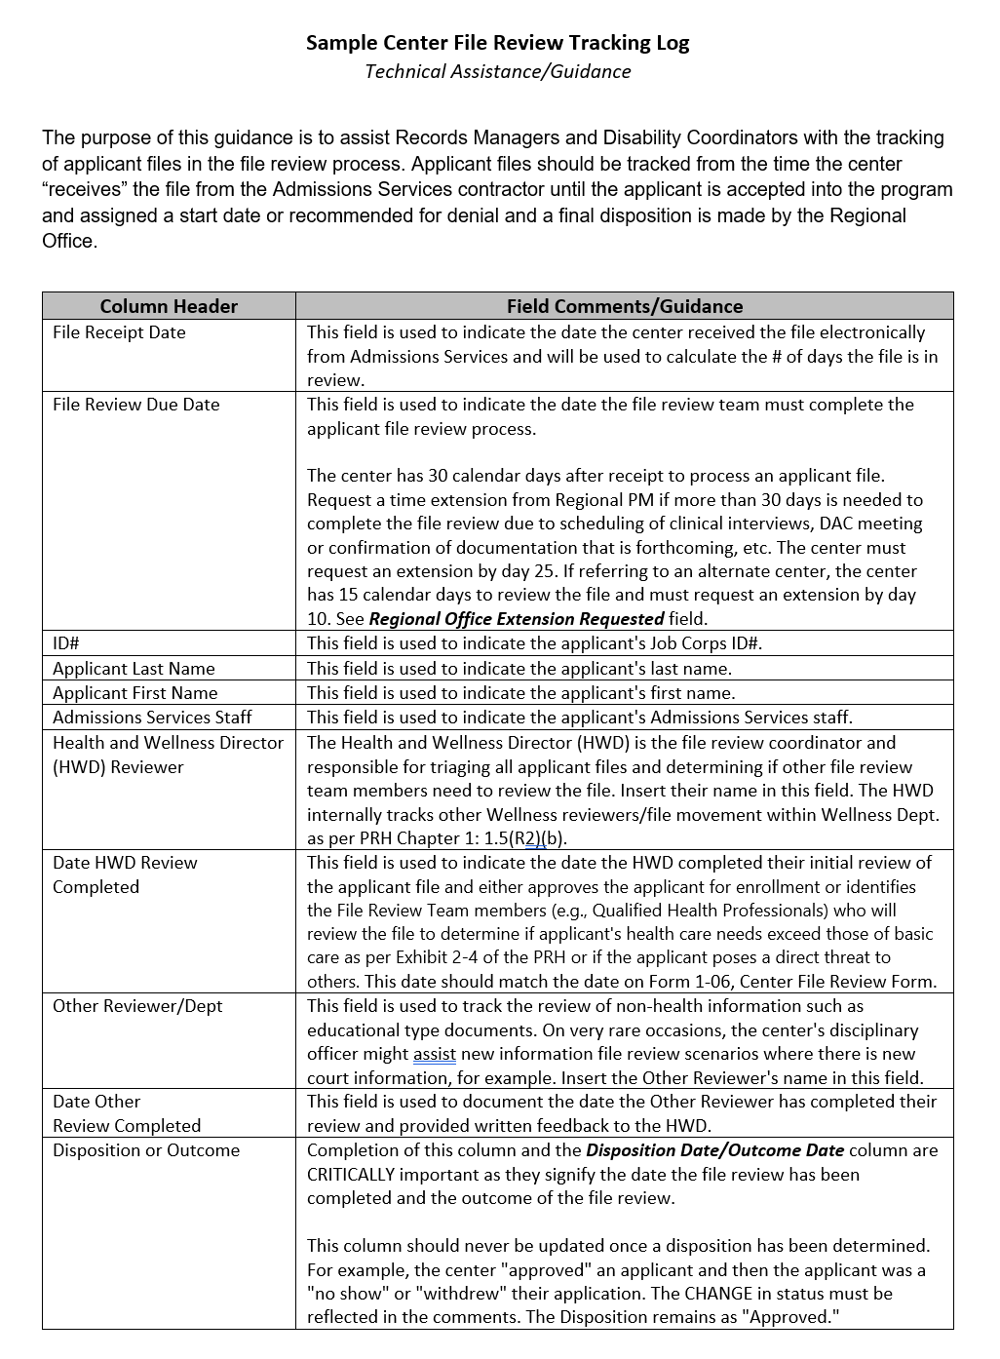
Center File Review Tracking Log
Technical Assistance/Guidance
Two resources:
Stand alone Technical Assistance/Guidance document
Instructions/Guidance embedded within the log
39
39
Notes:
Center File Review Tracking Log Technical Assistance/Guidance
There are two resources to assist you in using the Center File Review Tracking Log. The first one is a stand-alone technical assistance/guidance document and a screen shot of the first page is located on the right-hand side of the slide. This document explains the purpose of each of the columns within the Center File Review Tracking Log.
Secondly, there are instructions and guidance embedded within the sample log and we will look at those next.

Slide 40
Instructions and Guidance Embedded in Log
Both the Center File Review and Wellness Tracking Logs contain embedded guidance.
40
Notes:
Note that each column has a red triangle in the upper right corner (look at the screenshot on the left-hand side of the slide). If you hover your cursor on the triangle, a dropdown box appears that includes an explanation of what type of information goes in that column and that is shown in the screenshot on the right-hand side of the screen.
Both the sample Center File Review and Wellness Tracking Logs contain embedded guidance.

Slide 41
Center File Review Tracking Log Comments Acceptable or Unacceptable?
Awaiting receipt of IEP. (No final disposition noted.)
CMHC requested additional documentation and did not receive it. File returned to Admissions Services.
Applicant stated they got a job, so the file was returned to Admissions Services as a withdrawal of application on March 15, 2023.
File returned to Admissions Services as per Admissions Services staff request.
Applicant’s case worker called and informed center that applicant is incarcerated. File was returned to Admissions Services.
41
Notes:
Let’s Review!
In the chat box, type whether you think the comment is an acceptable or an unacceptable one to be on the Center File Review Tracking Log.
Awaiting receipt of IEP. (No final disposition noted.)
Unacceptable – (1) the center must make a decision based upon the clinical interview and any information received if the additional documentation is not forthcoming within the 30-day window or the timeframe of the extension granted by the RO; (2) the comments contain protected disability/health information (IEP).
CMHC requested additional documentation and did not receive it. File returned to Admissions Services.
Unacceptable – just as in the last example, (1) the center must make a decision based upon the clinical interview and any information previously received. The file may not be returned to Admissions Services. (2) The comment also contains protected health information (CMHC).
Applicant stated they got a job, so the file was returned to Admissions Services as a withdrawal of application on March 15, 2023.
Acceptable.
File returned to Admissions Services as per Admissions Services staff request.
Unacceptable – it is not clear why the file was returned to Admissions staff and must not be returned unless the basis is a valid one as per JC policy.
Applicant’s case worker called and informed center that applicant is incarcerated. File was returned to Admissions Services.
Unacceptable. The center must complete a Recommendation of Denial for New Information and submit to the Regional Office for review.

Slide 42
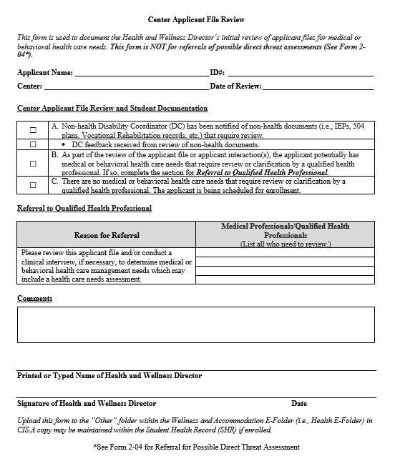
Center Applicant File Review Form
The HWD must complete this form with each file review.
Form 1-06 (page 1 only)
If there is reasonable belief, based on objective evidence, that the individual has a medical condition or disability that may pose a significant risk of substantial harm to the health or safety of others, then the HWD must complete a similar form in Form 2-04 instead.
42
42
42
Notes:
The Center Applicant File Review Form is a new form (only page 1 of Form 1-06) that will document the initial applicant file review of the HWD. This form will be completed for all applicant file reviews UNLESS there is reasonable belief, based on objective evidence, that the individual has a medical condition or disability that may pose a significant risk of substantial harm to the health or safety of others; when there is a potential direct threat to others, then the HWD must instead complete the Center Applicant/Student File Review Form – HWD’s Initial Review of Applicant Files or Review of Student Documentation for Assignment of Possible Direct Threat Assessment in Form 2-04.

Slide 43
Center Applicant File Review Form
HWD Triage Form
The HWD uses this form to document who should review a particular applicant file.
To document the members of the File Review Team!
This form is not intended to travel from reviewer to reviewer.
What is the PRIMARY function of this form?
PRH 1.5 R1(b): The Health and Wellness Director (HWD) must complete the Center Applicant File R​eview Form in Form 1-06 for each application reviewed
43
Notes:
Center Applicant File Review Form – HWD Triage Form found in Form 1-06 of the PRH.
PRH 1.5 R1(b): The Health and Wellness Director (HWD) must complete the Center Applicant File Review Form in Form 1-06 for each application reviewed. With each applicant file, the HWD uses this form to document who should review a particular applicant file. This form is not intended to travel from reviewer to reviewer.
Given this, what is the PRIMARY function of this form? To document the members of the File Review Team for each applicant!

Slide 44
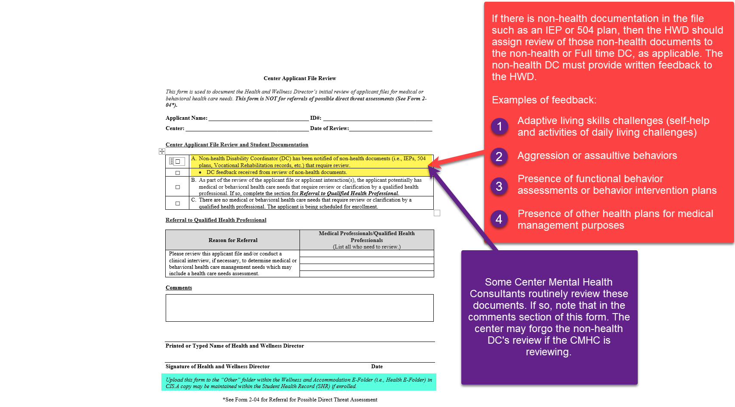
44
Notes:
Since this form is still relatively new, let’s review it more closely starting with Item A.
If there is non-health documentation in the file such as an IEP or 504 plan, then the HWD should assign review of those non-health documents to the non-health or Full time DC, as applicable to your center. The non-health DC must provide written feedback to the HWD. This feedback should come back promptly so the HWD may determine whether a center qualified health professional also needs to review the information and you want both of those reviews to occur within your 30-day window. So if the non-health DC or designated DC was involved in reviewing non-health documentation and provided feedback to the HWD as required, then both boxes in item A should be checked.
Key points - This is a paper review and does not require any contact with the applicant by the non-health DC. Do not confuse applicant file review processes with pre-arrival contact to determine the need for RA/RM/AAS for an individual ENROLLING in Job Corps.
Examples of feedback:
Adaptive living skills challenges (self-help and activities of daily living challenges)
Aggression or assaultive behaviors
Presence of functional behavior assessments or behavior intervention plans
Presence of other health plans for medical management purposes
Some Center Mental Health Consultants routinely review these documents. If so, note that in the comments section of this form. The center may forgo the non-health DC's review if the CMHC is reviewing; however, the non-health DC's participation in still encouraged given their background and experience reading these types of documents.

Slide 45
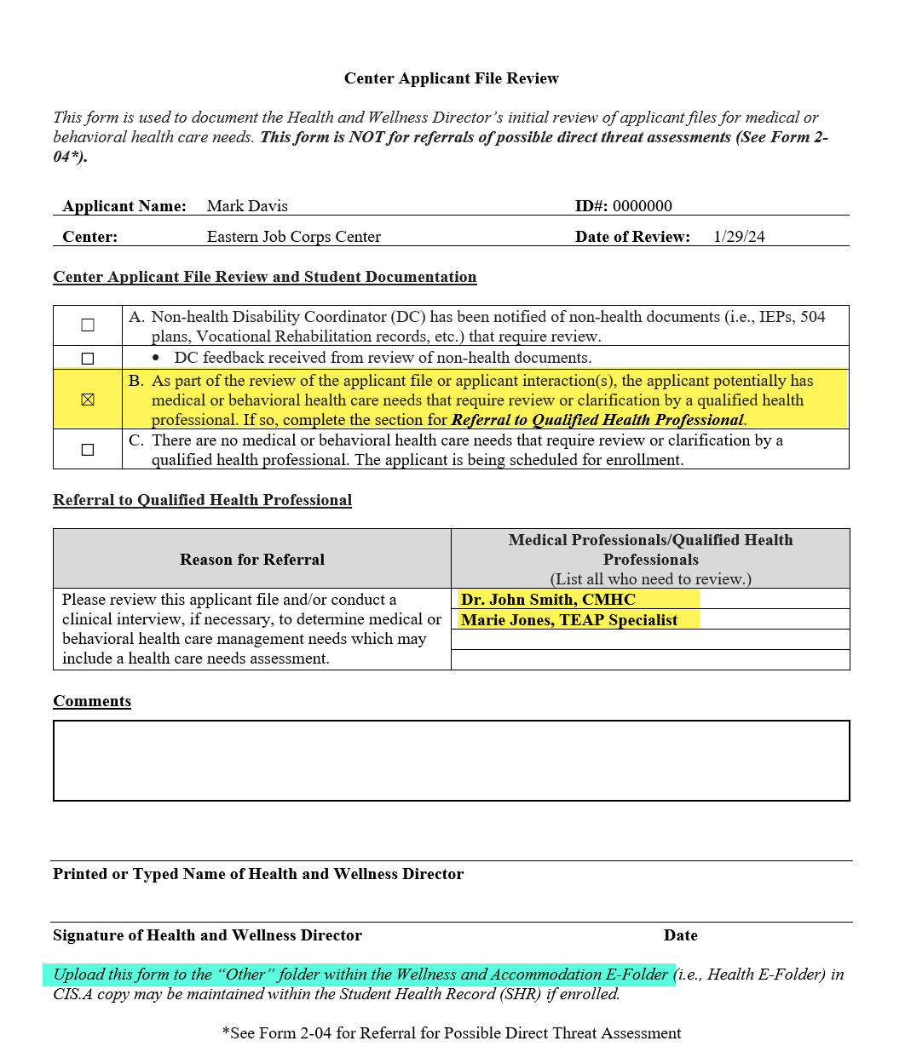
Please ensure that the Qualified Health Professional(s) being assigned review of the file are listed by both their name and by their title.
Ensure that all reviewers are listed if there are multiple disciplinary areas of review needed.
The HWD is not a QHP for file review purposes; the HWD determines the composition of the FRT so their name should not be listed as a QHP.
DC names/titles should not be listed here because they are not QHPs and are instead identified in item “A” of the form.
Notes:
Form 1-06, Center Applicant File Review – Item B
As part of the review of the applicant file or applicant interaction(s), the applicant potentially has medical or behavioral health care needs that require review or clarification by a QHP. If so, complete the section for Referral to Qualified Health Professional.
In the Medical Professional/Qualified Health Professionals section, list the name/title of each QHP(s) being assigned review of the file. Please ensure that all reviewers are listed if there are multiple disciplinary areas of review needed (i.e., both the CMHC and the TEAP Specialist, for example).
The HWD is not a QHP and only determines the composition of the FRT so their name should not be listed here.
DCs should not be listed here because they also are not QHPs and are instead identified in item “A” of the form.

Slide 46
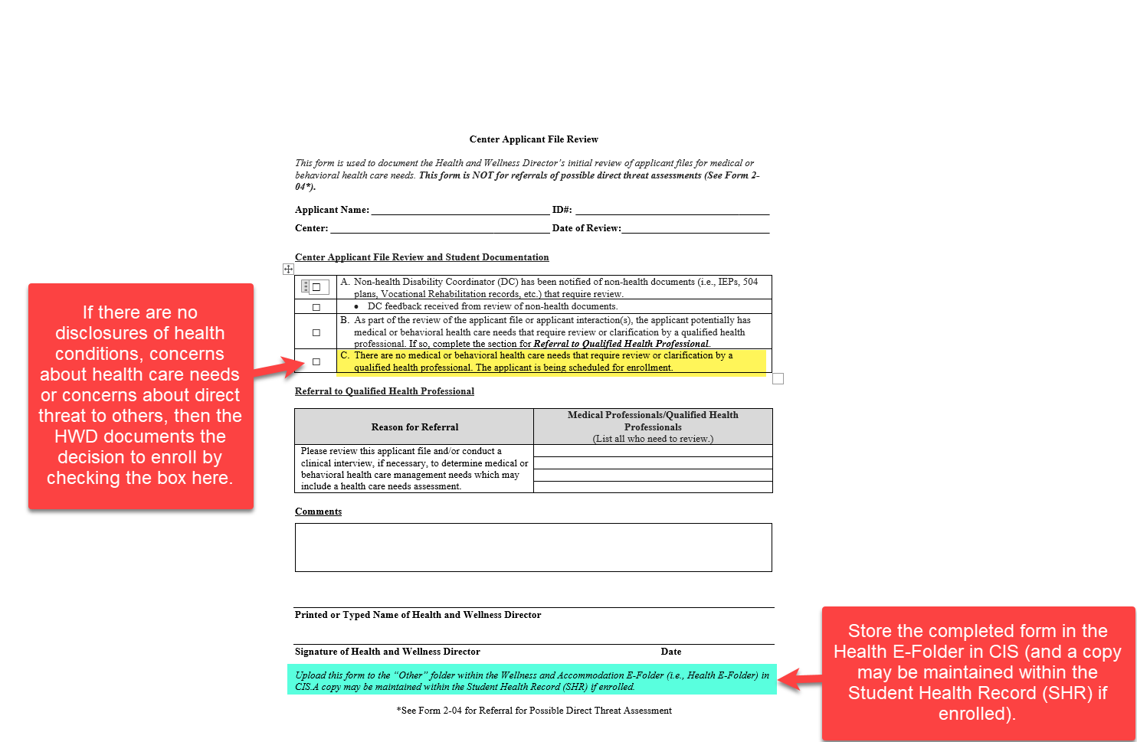
Make sure that all disclosed conditions have been cleared for enrollment.
For example, if a Health Care Needs Assessment is completed based upon mental health related symptoms and behaviors, but the applicant also disclosed diabetes, then the HWD either affirms there are no health care needs barriers to enrollment or assigns the file to the Center Physician for a file review and a possible clinical interview if there are concerns that the applicant’s health care needs exceed those of basic care or if the applicant poses a direct threat to others.
46
Notes:
Form 1-06, Center Applicant File Review – Item C
If there are no disclosures of health conditions, concerns about health care needs or concerns about direct threat to others, then the HWD documents the decision to enroll by checking the box here.
One reminder when there are disclosed conditions in more than one clinical area: make sure that all disclosed conditions have been cleared for enrollment. For example, if a Health Care Needs Assessment is completed based upon mental health related symptoms and behaviors, but the applicant also disclosed diabetes, then the HWD either affirms there are no health care needs barriers to enrollment or assigns the file to the Center Physician for a file review and a possible clinical interview, if there are concerns that the applicant’s health care needs exceed those of basic care or if the applicant poses a direct threat to others.
Upload the completed form to the “Other” folder in the Health E-Folder in CIS (and a copy may be maintained within the Student Health Record (SHR) if enrolled).

Slide 47
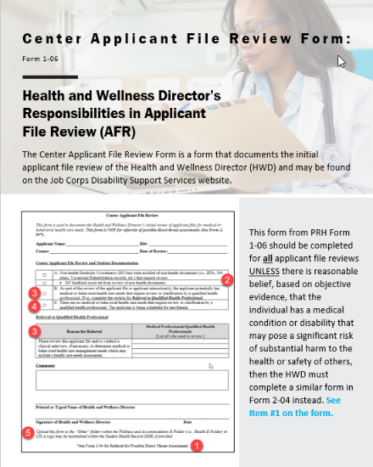
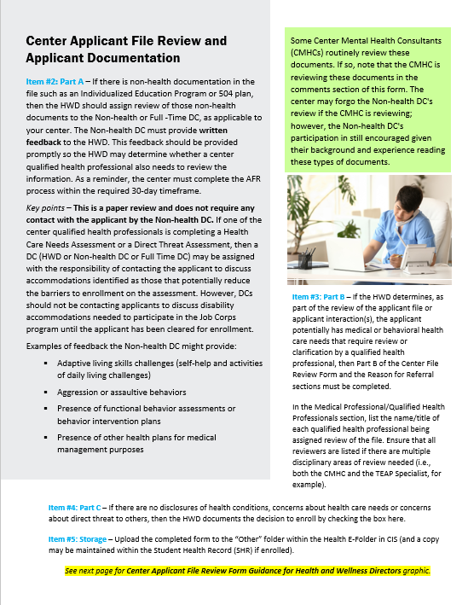
Center Applicant File Review Form Technical Assistance Snapshot
47
Notes:
Another resource to assist in the completion of the Center Applicant File Review Form is this 3-page Snapshot document that provides guidance to Health and Wellness Directors on the completion of the Center Applicant File Review Form, which again is found in Form 1-06 of the PRH.

Slide 48
Wellness AFR Review Tracking Log
PRH 1: 1.5, R2(b)
48
48
48
Notes:
Wellness AFR Review Tracking Log
PRH 1: 1.5,R2(b) Standard Operating Procedure (SOP)
Wellness must maintain its own internal tracking log.

Slide 49
Wellness Tracking Log
PRH Chapter 1: 1.5(R2)(b)
A
Wellness MUST maintain its own internal tracking log. (PRH Chapter 1:1.5(R2)(b).
Wellness Tracking Log Components
HWD Reviewer | QHP #2 Assigned File to Review
Date HWD Review Complete | Date QHP #2 Review Complete
Non-health DC Reviewer | Wellness Disposition or Outcome
Non-health DC Review Complete | Wellness Disposition or Outcome Date
QHP #1 Assigned File to Review | Comments (PHI Redacted)
Date QHP #1 Review Complete
B
Specific QHPs (i.e., the Center Physician, Center Mental Health Consultant (CMHC), Trainee Employment Assistance Program (TEAP) Specialist, or other qualified health professionals) must not be listed on the Center File Review Tracking Log by title for confidentiality reasons.
Information highlighted in Peach must be reported to Records for inclusion in the Center’s File Review Tracking Log.
49
Notes:
The PRH does not provide a detailed list of what is required to be tracked on the Wellness Log unlike the Center File Review Tracking Log. However, the PRH does require that the entire AFR process be tracked; thus, the items listed in this table are the ones that are necessary to adequately track the AFR process. The items highlighted in peach (i.e., HWD Reviewer, Date HWD Review Complete, etc.) must be reported to Records for inclusion on the Center File Review Tracking Log.
Wellness MUST maintain its own internal tracking log. (PRH Chapter 1:1.5(R2)(b).
Specific QHPs (i.e., the Center Physician, Center Mental Health Consultant (CMHC), Trainee Employment Assistance Program (TEAP) Specialist, or other qualified health professionals) must not be listed on the Center File Review Tracking Log by title for confidentiality reasons.

Slide 50
Sample Wellness Tracking Log
https://supportservices.jobcorps.gov/disability/Documents/Sample%20Wellness%20File%20Review%20Tracking%20Log.xlsx
50
Notes:
There is also a sample Wellness Tracking Log on the Disability Website. This log is not a duplicate of the Center FR Tracking Log because it serves a different purpose. For example, there is not a column that tracks the number of days in review. The tracking log managed by Records is required to track that information. Some of the information tracked on the Wellness log also needs to be added to the Records log and those columns are in the peach color. There is a statement at the top explaining that the information in peach must be provided to Records with a reminder to not send any PII/PHI. REVIEW some of the columns. Access should be limited because this log will contain PHI.

Slide 51
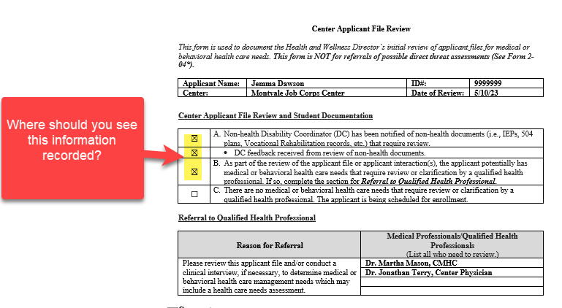
What Do You Think? Connecting the Center Applicant File Review Form Information to the Information on the Tracking Logs
The HWD must be listed on the Center File Review Tracking log and “should” be on the Wellness Tracking Log as well.
The non-health DC and their dates of review must be on the Center File Review Tracking Log.
The CMHC and the CP should be listed as reviewers on the Wellness Tracking Log.
51
Notes:
What Do You Think?
Items A and B of the Center Applicant File Review Form have been checked. Where should we see this information recorded?
First, since the HWD must complete the initial review of every applicant file, we would expect to see their name listed on the Center File Review Tracking Log and on the Wellness Tracking log along with the completion date of the initial review.
Then we would anticipate that the non-health DC and the completion date of their review must be on the Center File Review Tracking log (and may be on the Wellness Tracking log).
Finally, we would expect to the see the names and titles of the Center Mental Health Consultant and the Center Physician as reviewers on the Wellness Tracking log.

Slide 52
Documenting Outcomes
What information must be provided to Records for inclusion on the Center File Review Tracking Log?
Wellness Review Start Date | Health and Wellness Director (HWD) Reviewer | Date HWD Review Complete | Non-health DC Reviewer | Date Non-health DC Review Complete | QHP #1 Assigned File to Review | Date QHP #1 Review Complete | QHP #2 Assigned File to Review (if applicable) | Date QHP #2 Review Complete
4/27/2023 | Smith, S. | 4/29/2023 | Morgan, R. | 5/01/2023 | Davis, J., CMHC | 5/20/2023 | Martin, M., TEAP | 5/17/2023
4/27/2023 | Smith, S. | 5/01/2023
4/28/23 | Smith, S. | 5/01/2023 | Morgan, R. | 5/01/2023 | Davis, J., CMHC | 5/20/2023
Since the Wellness Tracking Log is a secure document maintained in Wellness only, centers may document the outcomes within the comments instead of using a separate sheet or form.
Wellness Disposition or Outcome | Wellness Disposition Date/Outcome Date | Comments (Redact any PII/PHI before sharing any comments with Records)
Approved | 5/20/2023 | CMHC and TEAP Specialist approved the applicant for enrollment.
Approved | 5/11/2023 | No disclosures on 653 or via health or disability documentation. HWD approved for enrollment.
Approved | 5/20/2023 | Non-health DC Review: Applicant has an IEP. There is some mention of challenges with ADLs. HWD Note: adding CMHC to review. CMHC approved applicant for enrollment.
What comments should be provided to records in these three scenarios?
52
Notes:
What information on the Wellness Tracking Log must be shared with Records?
The information in Peach on the example slides would be provided to Records. The center MUST redact any protected health or disability information (typically in the comments) before sharing this information.
Since the Wellness Tracking Log is a secure document maintained in Wellness only, centers may document the outcomes within the comments instead of using a separate sheet or form.
What comments should be provided to records in these three scenarios?
The first comment states: CMHC and TEAP Specialist approved the applicant for enrollment. Does this comment need to be reported to Records? No, it does not need to be reported to Records nor can it be reported due to the PHI disclosed. It is sufficient for Records to be informed the applicant is approved and the date approved.
The second comment states: No disclosures on 653 or via health or disability documentation. HWD approved for enrollment. No, it does not need to be reported to Records nor can it be reported due to PHI disclosed. It is sufficient for Records to be informed the applicant is approved and the date approved.
What about that third comment? Non-health DC Review: Applicant has an IEP. There is some mention of challenges with ADLs. HWD Note: adding CMHC to review. CMHC approved applicant for enrollment.
Is there anything in that comment that would need to be reported to Records?
No. It would be the same as the first 2 examples. It is sufficient for Records to be informed the applicant is approved and the date approved.

Slide 53
More Review of Comments on Wellness Tracking Log
Determine whether each comment needs to be reported to Records and if so, can it be reported to Records as is or does it require redacting of information.
Recommending denial of enrollment to the Regional Office. Submitted the recommendation of denial via the Notify Regional Review option within the Wellness module of CIS on 6/22/23.
53
Notes:
Let’s review some additional comments on the Wellness Tracking Log and determine whether each comment needs to be reported to Records and if so, can it be reported to Records as is or if it requires redacting of information.
The comment states: “Recommending denial of enrollment to the Regional Office. Submitted the recommendation of denial via the Notify Regional Review option within the Wellness module of CIS on 6/22/23.”
In this example, this information is important and relevant to the Center File Review Tracking log and should be provided to Records. No redacting of information is necessary.

Slide 54
More Review of Comments on Wellness Tracking Log
Determine whether each comment needs to be reported to Records and if so, can it be reported to Records as is or does it require redacting of information.
Wellness attempted to contact the applicant 2x (5/5/23 and 5/10/23) with no response. Left voicemails and instructions to call back within 5 days. Contacted admissions on 5/15/23 and admissions staff confirmed inability to reach the applicant. Returning the file to admissions on 5/28/23, notified Records Manager to return file to Admissions staff as an incomplete application.
This is what your comments should look like when sending a file back as an incomplete application: (1) # of attempts to contact, (2) outcome of efforts to contact, (3) collaboration with Admissions Services staff, and (4) final action taken.
54
Notes:
What about this example? Does the comment need to be reported to Records and if so, can it be reported to Records as is or does it require redacting of information?
Wellness attempted to contact the applicant 2x (5/5/23 and 5/10/23) with no response. Left voicemails and instructions to call back within 5 days. Contacted admissions on 5/15/23 and admissions staff confirmed inability to reach the applicant. Returning the file to admissions on 5/28/23, notified Records Manager to return file to Admissions staff as an incomplete application.
The history of the contacts with the applicant and the outcomes of those contacts must be included on the Center File Review Tracking Log. This example can be provided to Records as it is and in its entirety.

Slide 55
More Review of Comments on Wellness Tracking Log
Determine whether each comment needs to be reported to Records and if so, can it be reported to Records as is or does it require redacting of information.
Admissions informed the center on 5/15/23 that the applicant was no longer interested in being considered for enrollment. Returned file to admissions on 5/15/23.
55
Notes:
What about the comments in this example?
Admissions informed the center on 5/15/23 that the applicant was no longer interested in being considered for enrollment. Returned file to admissions on 5/15/23.
Should they be reported to Records and if so, does anything need to be redacted?
This example can be provided to Records as it is and in its entirety.

Slide 56
More Review of Comments on Wellness Tracking Log
Determine whether each comment needs to be reported to Records and if so, can it be reported to Records as is or does it require redacting of information.
Wellness requested additional documentation on 6/15/23 based upon applicant's disclosures. Documentation not yet received as of 6/25/23 but provider office confirmed request was received and is working to fulfill. Extension request submitted to the Regional Office on 6/25/23 and approved same date for 14 days. Received documentation on 7/5/23.
CMHC reviewed additional documentation and contacted mental health services outside treating provider on 7/6/23. CMHC approved applicant for enrollment.
The second part of the comments (in pink) must not be shared with Records because it has protected information and is not needed on the Center File Review Tracking Log; however, the applicant’s approval for enrollment and the date the applicant was approved does need to be reported to Records.
56
Notes:
Wellness requested additional documentation on 6/15/23 based upon applicant's disclosures. Documentation not yet received as of 6/25/23 but provider office confirmed request was received and is working to fulfill. Extension request submitted to the Regional Office on 6/25/23 and approved same date for 14 days. Received documentation on 7/5/23.
CMHC reviewed additional documentation and contacted mental health services outside treating provider on 7/6/23. CMHC approved applicant for enrollment.
In our final comments example, the first portion in light blue is simply documenting the history of trying to secure documentation the related extensions of time that were requested from the Regional Office. The second half of the comments includes protected information (CMHC, mental health services) and must not be shared with Records. However, the applicant’s approval and the date the applicant was approved does need to be reported to Records.

Slide 57
Resources
57
57

Slide 58
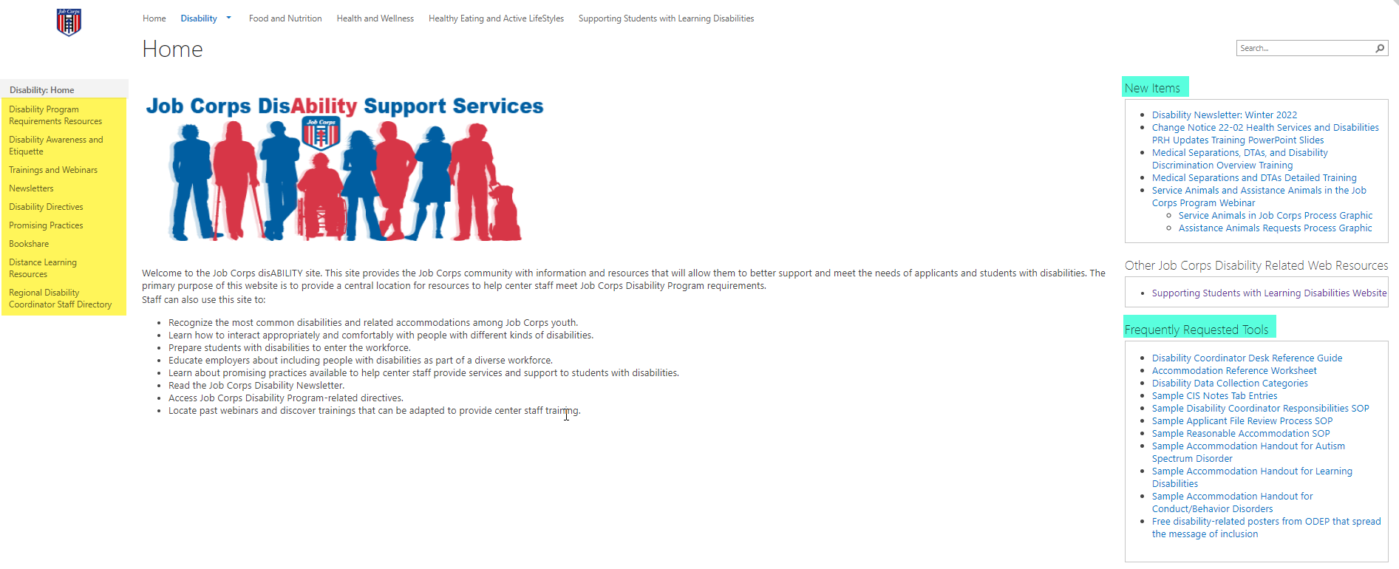
Job Corps Disability Support Services Website https://supportservices.jobcorps.gov/disability/Pages/default.aspx
58
Notes:
Job Corps Disability Website
The Job Corps Disability Support Services website contains numerous resources and tools on applicant file review and disability accommodation requirements, processes and procedures.
As new resources and tools are developed, they are listed under the New Items heading to the right side of the website page. See teal highlighted area. Resources that are more commonly used and/or requested are listed under the Frequently Requested Tools section also highlighted in teal.
The categories of resources are listed on the left-hand side of the website and are highlighted in yellow.
The Job Corps Disability website link is located at the top of the slide.

Slide 59
Questions?
59

