Slide 1
Need Accommodation Solutions: Ask JAN Learning Disabilities (LD) & Intellectual Disabilities (ID)
Sarah Small, M.S., CRC
Consultant, Cognitive/Neurological Team

Slide 2
Job Accommodation Network
Objectives
JAN Overview
Disclosure
Reasonable Accommodation
Accommodation Examples
JAN Website Tour/SOAR
Questions
Notes:
Sarah

Slide 3
Job Accommodation Network
▪ Established in 1983 as a national, free service.
▪ Specialize in workplace accommodations and the employment provisions of the Americans with Disabilities Act/Rehabilitation Act.
▪ Assist with the interactive process.
▪ Give targeted technical assistance.
▪ Provide comprehensive resources.
▪ Confidential.
▪ Easy to use.
▪ Offer live and archived training.
Notes:
Sarah

Slide 4
Job Accommodation Network
▪ Employers
▪ Individuals
▪ Service Providers
▪ HR Professionals
▪ Family Members
▪ Others
Notes:
Sarah

Slide 5
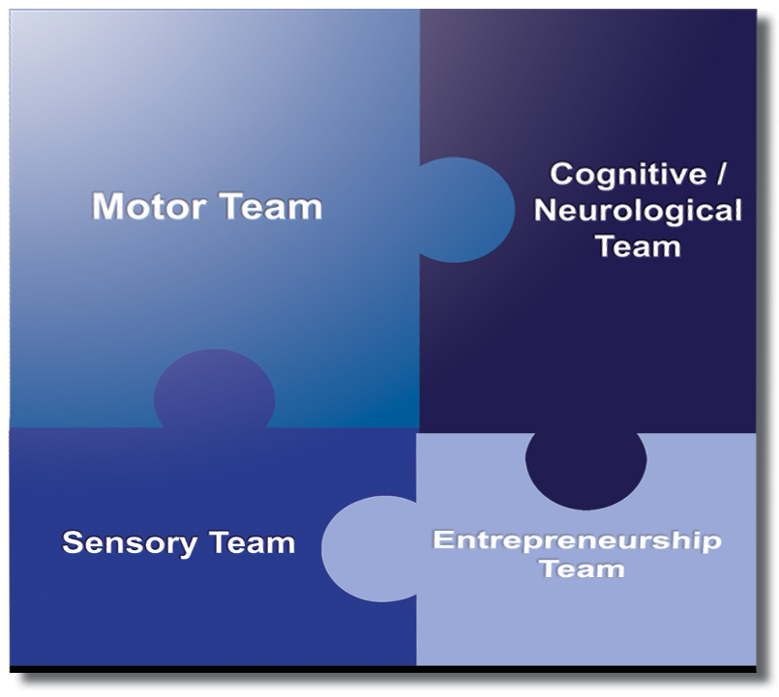
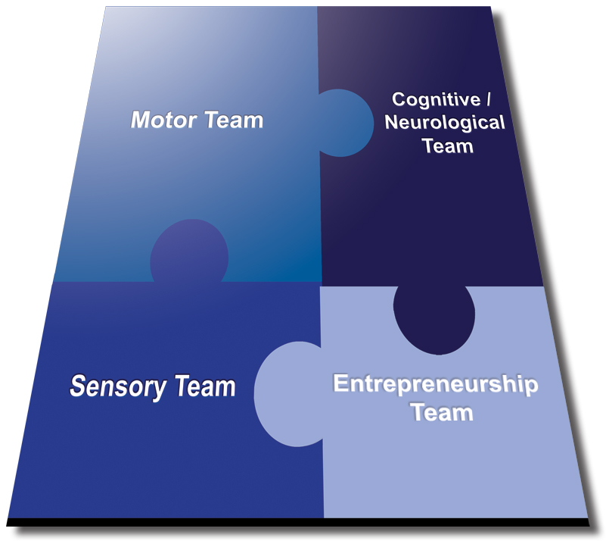
Job Accommodation Network

Slide 6
Job Accommodation Network
Self-Advocacy:
An effective self-advocate understands his own strengths, weaknesses, and needs. He will then feel comfortable talking about his disability and accommodation needs to educators and employers.
Notes:
Lisa

Slide 7
Disclosure
Disclosure is when an individual gives out specific, personal information about their disability.
Important to provide:
The nature of the disability
The limitations, or how the disability affects the capacity to learn and/or perform the training/job effectively
Accommodations that will be needed in order to do the training/job

Slide 8
Disclosure
Why Disclose?
To ask for job accommodations
To receive benefits or privileges of employment
To explain an unusual circumstance

Slide 9
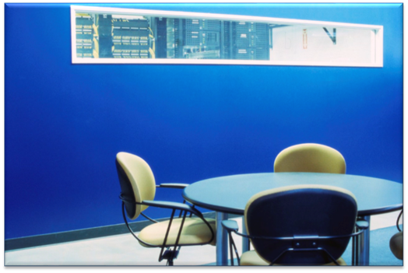
Disclosure
What is a Reasonable Accommodation?
“Reasonable accommodation is a modification or adjustment to a job, the work environment, or the way things usually are done that enables a qualified individual with a disability to enjoy an equal employment opportunity”
Technical Assistance Manual: Title I of the ADA https://AskJAN.org/links/ADAtam1.html
Notes:
Lisa

Slide 10
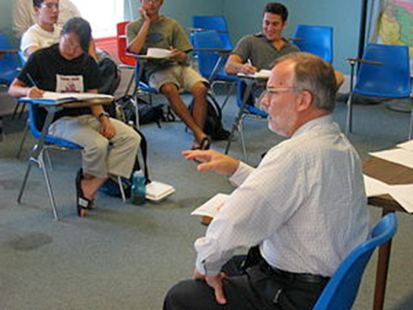
Disclosure
How Can You Help?
▪ Promote Self-Advocacy
▪ Inform students/employees of the ADA and ability to seek accommodations
▪ Help identify possible accommodation solutions

Slide 11
Disclosure
The 411 on Disability Disclosure:
A Workbook for Youth with Disabilities
http://www.ncwd-youth.info/resources_&_Publications/411.html
Information about ODEP can be found at http://www.dol.gov/odep/

Slide 12
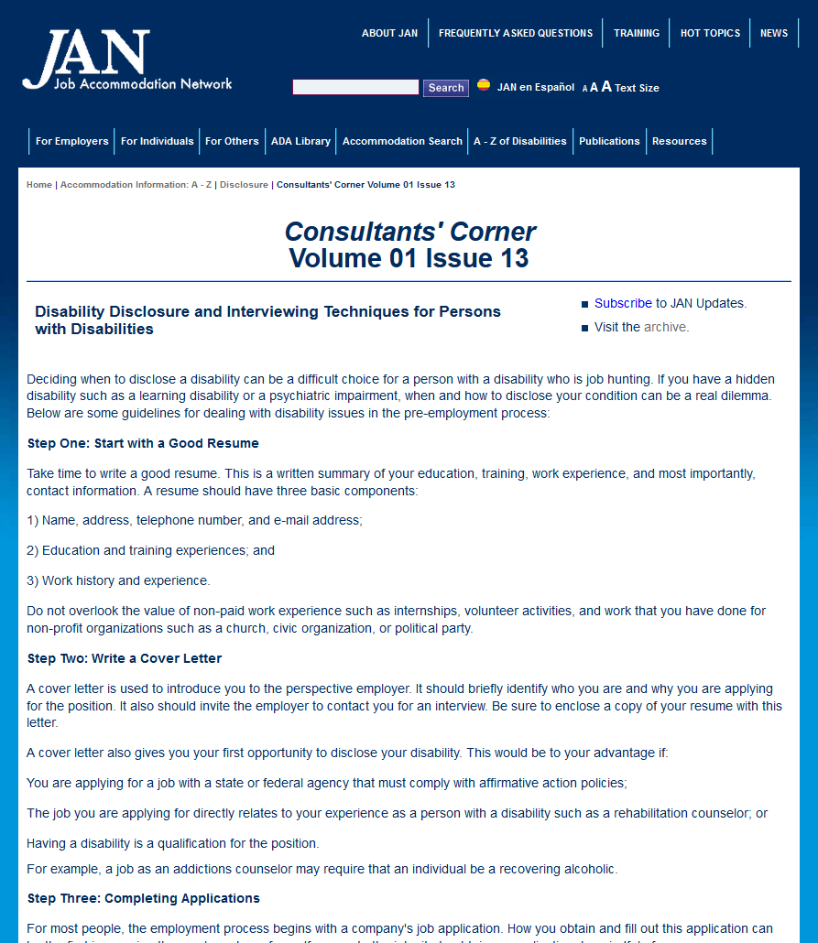
Disclosure

Slide 13
Documentation
Documentation of a learning/intellectual disability may differ from that of other disabilities.
▪ Psychologist vs. Medical Doctor
▪ Lifelong and Static
▪ Individualized Education Plan (IEP) vs. Accommodation Plan
Consultants’ Corner: Documentation of a Learning Disability https://AskJAN.org/corner/vol05iss03.htm

Slide 14
Limitations
Common Limitations
Reading
Spelling
Writing
Mathematics
Speaking/Communicating
Organization
Memory
Time Management/Completing Tasks
Social Skills
Working Effectively

Slide 15
Accommodations
Accommodation Examples
Notes:
TG into sensory examples

Slide 16
Accommodations
Reading from a paper copy:
Convert text to audio
Provide larger print
Double space the text of print material
Use color overlays (Irlen lenses)
Provide materials that are typewritten
Have someone read the document aloud
Scan the documents into a computer and use Optical Character Recognition (OCR)
Use a reading pen, which is a portable device that scans a word and provides auditory feedback

Slide 17
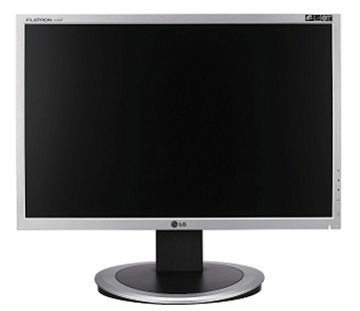
Accommodations
Reading from a computer screen:
Use voice output software
Use form-generating software
Use an on-screen "ruler" or strip or screen-highlighting software
Alter color scheme on computer screen
Adjust the font on computer screen

Slide 18
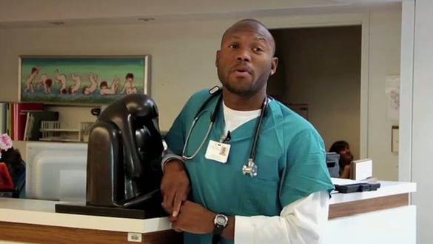
Accommodations
Example:
Individual with LD
Career technical choice: Health Care
Limitations:
Deficit in reading skills
Deficit in writing skills

Slide 19
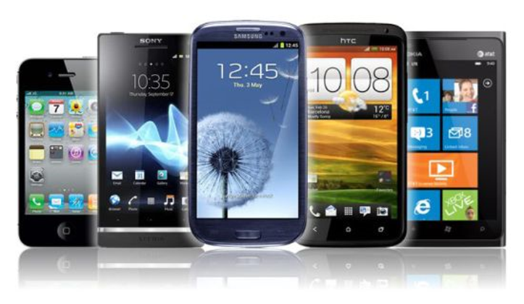
Accommodations
Accommodation Ideas
“Talking” medical products
Apps
Electronic Medical Speller
Talking medical devices

Slide 20
Accommodations
Spelling:
Allow use of reference materials such as dictionary or thesaurus
Provide electronic and talking dictionaries as well as apps
Use word prediction software that displays a list of words that typically follow the word that was entered in a document
Use word completion software that displays sample words after someone starts typing part of a word
Allow a buddy, coworker, or supervisor to proofread written material

Slide 21
Accommodations
Example:
Individual with LD
Career technical choice: Education
Limitations:
Deficits in spelling
Problems when writing on chalkboard

Slide 22
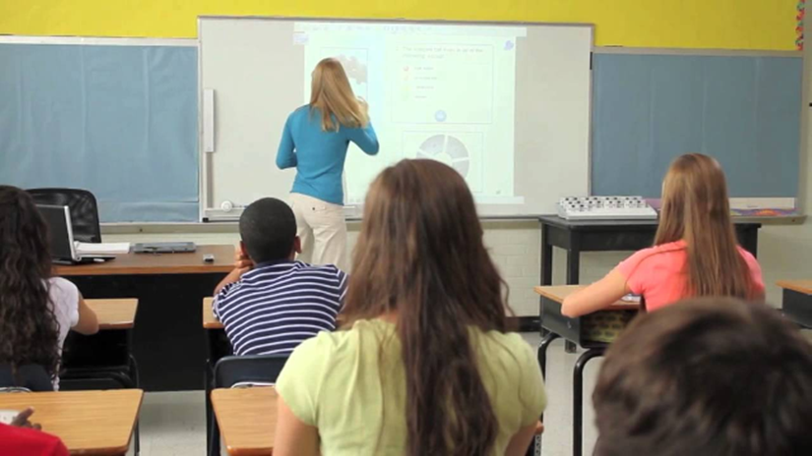
Accommodations
Accommodation Ideas:
Interactive whiteboard
Word prediction and spellchecking software

Slide 23
Accommodations
Cognitive process of writing:
Use Inspiration software, a computerized graphic organizer
Use writing/editing software such as Texthelp Read & Write Gold or WhiteSmoke to assist with spelling, reading, and grammar
Provide electronic/talking dictionaries/spellcheckers
Permit use of reference books such as a thesaurus or dictionary
Create written forms to prompt the employee
Allow the employee to create a verbal response instead of a written response

Slide 24
Accommodations
Physical process of writing:
Provide writing aids
Use line guides and column guides
Supply bold line paper
Permit typewritten response instead of handwritten response
Allow use of personal computers, laptops, and tablets
Use Inspiration software, a computerized graphic organizer
Use speech recognition software that recognizes the employee’s voice and changes it to text on the computer screen

Slide 25
Accommodations
Example:
Individual with Cognitive Impairment
Career technical choice: Finance and Business
Limitations:
Handwriting materials
Keeping track of forms
Tracking when working with numbers

Slide 26
Accommodations
Accommodation Ideas:
Electronic forms/templates
Color coding/labeling
Claro Software- “screen ruler”
Uninterrupted work time

Slide 27
Accommodations
Mathematics:
Use scratch paper to work out math problems
Permit use of fractional, decimal, statistical, or scientific calculators
Use calculators or adding machines with large display screens
Use construction calculator, such as Jobber 6
Use pre-measurement guides or jigs
Post mathematical tables at desk or in work area
Provide talking tools such as tape measures, scales, watches, and calculators

Slide 28
Accommodations
Example:
Individual with Dyscalculia and Auditory Processing Disorder
Career technical choice: Construction
Limitations:
Difficulty with measurement
Difficulty with counting and math calculations
Difficulty telling time
Difficulty processing written materials

Slide 29
Accommodations
Accommodation Ideas:
Mathematics
Using construction or other scientific calculators
Using measurement guides or markers
Using talking tools such as watch, tape measure, scale, calculator
Information Processing
Provide written instructions and feedback
Ability to record meetings and trainings to listen to as needed

Slide 30
Accommodations
Speaking/Communicating
To help facilitate communication, provide advance notice of topics to be discussed in meeting/training
To reduce or eliminate anxiety, provide advance notice of date of meeting when employee is required to speak
Allow employee to provide written response in lieu of verbal response
To reduce or eliminate the feeling of intimidation, allow employee to have a friend or coworker attend meetings

Slide 31
Accommodations
Example:
Individual with Cognitive Impairment
Career technical choice: Information Technology- Help Desk
Limitations:
Difficulty processing information and troubleshooting for other staff members
Became impatient, rude, and disrespectful when coworkers approached him for assistance

Slide 32
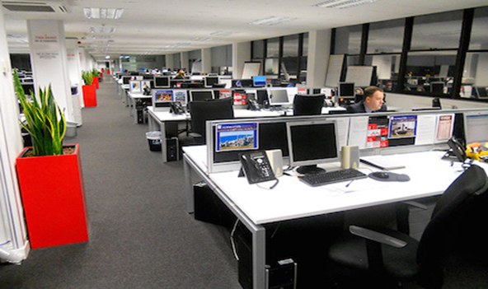
Accommodations
Accommodation Ideas
Policy modification to allow requests by email instead of in person or by phone
Reduced stress and helped to keep emotions and behavior in check

Slide 33
Accommodations
Organizing
Use daily, weekly, and monthly task lists
Use calendar with automated reminders to highlight meetings and deadlines
Use electronic organizers, mobile devices, apps
Divide large assignments into smaller tasks
Use color coding to prioritize tasks and identify materials
Hire a job coach or a professional organizer
Assign a mentor to assist employee
Build organization skills by attending time management workshops (e.g., Franklin Covey)

Slide 34
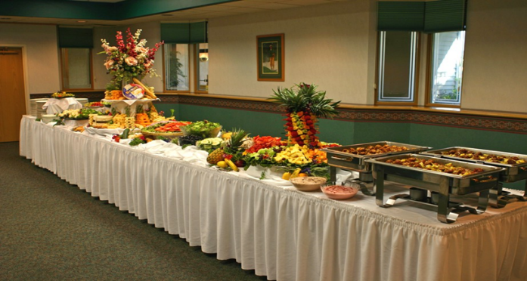
Accommodations
Example:
Individual with ADHD
Career technical choice: Caterer’s Assistant
Limitations:
Keeping track of dates and events
Difficulty showing up on time for an event

Slide 35
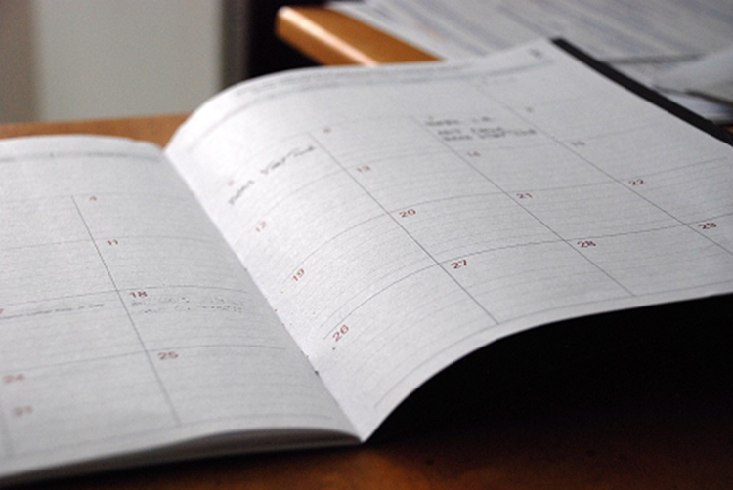
Accommodations
Accommodation Ideas
Shared, color-coded calendar/agenda
Reminders/calendar synced to phone or watch

Slide 36
Accommodations
Memory:
Provide written as well as verbal instructions
Provide written checklists
Use a wall calendar
Use a daily or weekly task list
Provide verbal prompts and reminders
Use electronic organizers, hand held devices, and/or apps
Allow the employee to record meetings and trainings
Provide printed minutes of meetings and trainings

Slide 37
Accommodations
Memory:
Allow additional training time for new duties
Provide a mentor for daily guidance
Provide reminders of important deadlines via emails, memos, and weekly supervision
Use notebooks, planners, or sticky notes to record information for easy retrieval
Provide cues to assist in location of items by using labels, color coding, or bulletin boards

Slide 38
Accommodations
Example:
Individual with Cognitive Impairment
Career technical choice: Janitorial
Remembering the order of tasks
Difficulty completing tasks in timely manner

Slide 39
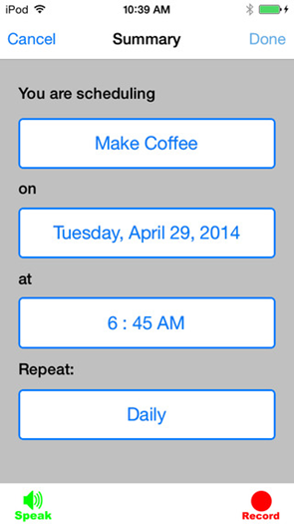
Accommodations
Accommodation Ideas:
Written task lists
Instructions posted in different rooms
CanPlan app
Visual step-by-step
Pictures

Slide 40
Accommodations
Time Management/Completing Tasks:
Daily TO-DO lists and check items off as they are completed
Organizational tools such as electronic schedulers, recorders, software organizers, calendars, watches, and apps
Divide large assignments into smaller tasks
Weekly meetings with supervisor, manager, or mentor to determine if goals are met
Reminders of important deadlines

Slide 41
Accommodations
Example:
Individual with Intellectual Disability
Career technical choice: Retail
Limitations
Memory
Time Management

Slide 42
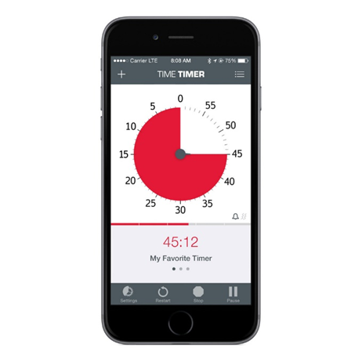
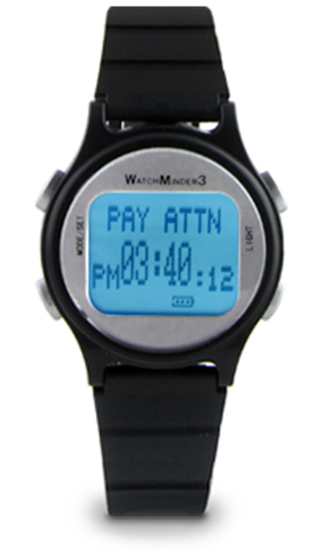
Accommodations
Accommodation Ideas
Programmable watch
Set timer
Job coach assisted with programming times for breaks and lunch

Slide 43
Accommodations
Social Skills: Behavior
To reduce incidents of inappropriate behavior, thoroughly review conduct policy with employee
Provide concrete examples to explain inappropriate behavior
Provide concrete examples to explain consequences in a disciplinary action
To reinforce appropriate behavior, recognize and reward appropriate behavior

Slide 44
Accommodations
Social Skills: Coworker Interaction
Provide sensitivity training to promote disability awareness
If feasible, allow employee to work from home
Help employee “learn the ropes” by providing a mentor
Make employee attendance at social functions optional
Allow employee to transfer to another workgroup, shift, or department
Encourage the employee to walk away from frustrating situations and confrontations

Slide 45
Accommodations
Example:
Individual with Autism
Career technical choice: Food Industry
Limitations
Social Skills
Communication

Slide 46
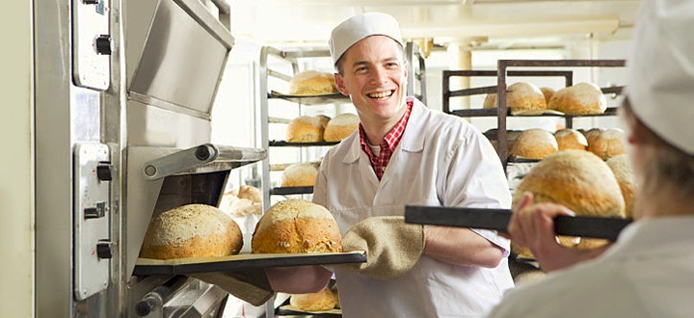
Accommodations
Accommodation Ideas
Mentor
Job Coach
Social skills training

Slide 47
Accommodations
Example:
Individual with Autism
Career technical choice: Library Assistant
Limitations
Communication
Voice modulation

Slide 48
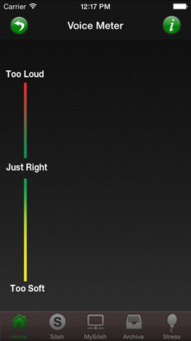
Accommodations
Accommodation Ideas:
▪ Sōsh app/color-coded voice meter
▪ Job Coach/Mentor

Slide 49
Accommodations
Working Effectively:
Establish written long-term and short-term goals
Develop strategies to deal with conflict
Develop a procedure to evaluate the effectiveness of the accommodation
Educate all employees on their right to accommodations
Provide sensitivity training to coworkers/supervisors
Do not mandate that employees attend work-related social functions
Encourage all employees to move non-work-related conversations out of work areas.

Slide 50
Accommodations
Working Effectively:
Provide positive praise and reinforcement
Provide day-to-day guidance and feedback
Provide written job instructions via email
Develop clear expectations of responsibilities and the consequences of not meeting performance standards
Schedule consistent meetings with employee to set goals and review progress
Allow for open communication

Slide 51
Accommodations
Example:
Individual with Expressive Language Disorder
Career technical choice: Office Setting
Limitations:
Communication

Slide 52
Accommodations
Accommodation ideas:
Allow for written communication
Supervisor adjusted the method of supervision
Email vs. Face to Face

Slide 53
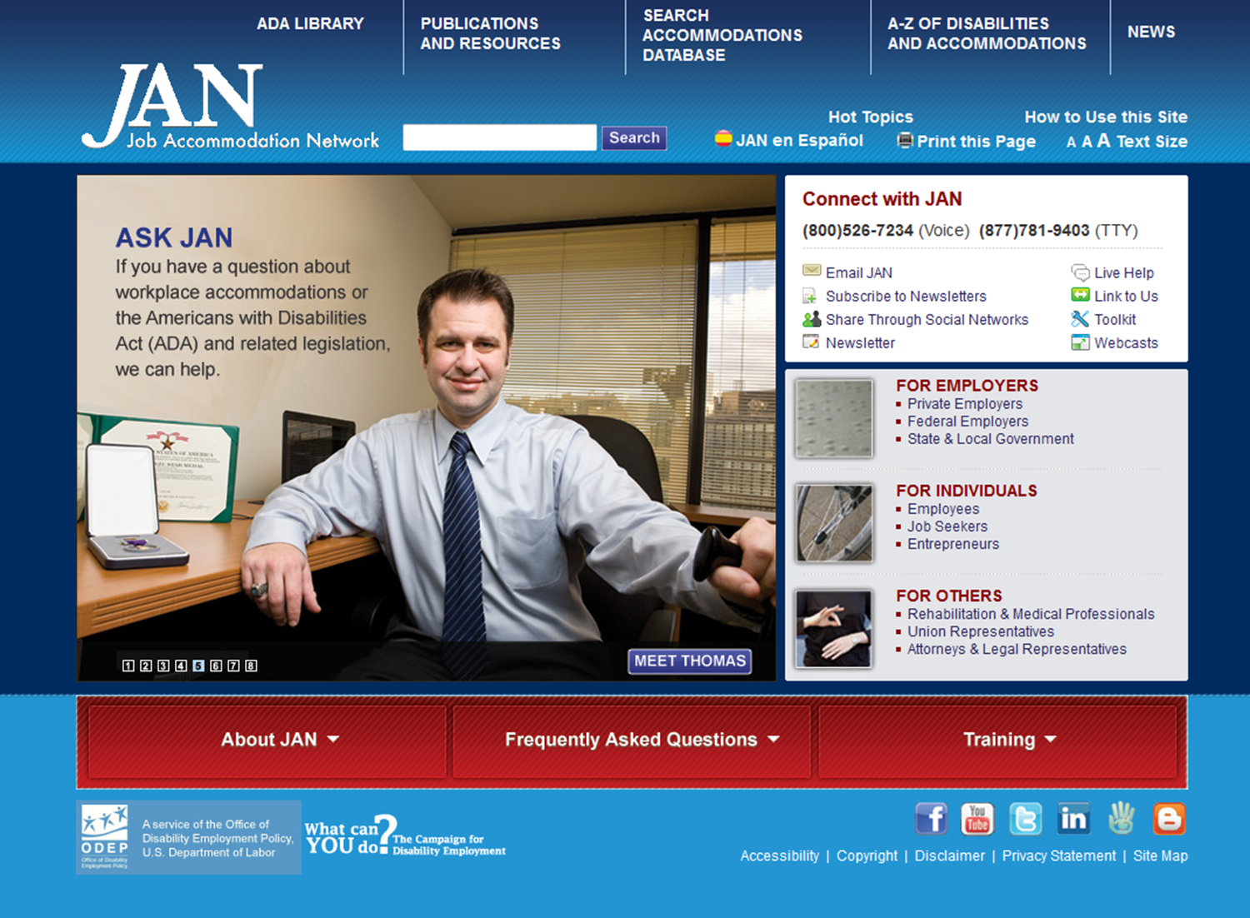

Slide 56
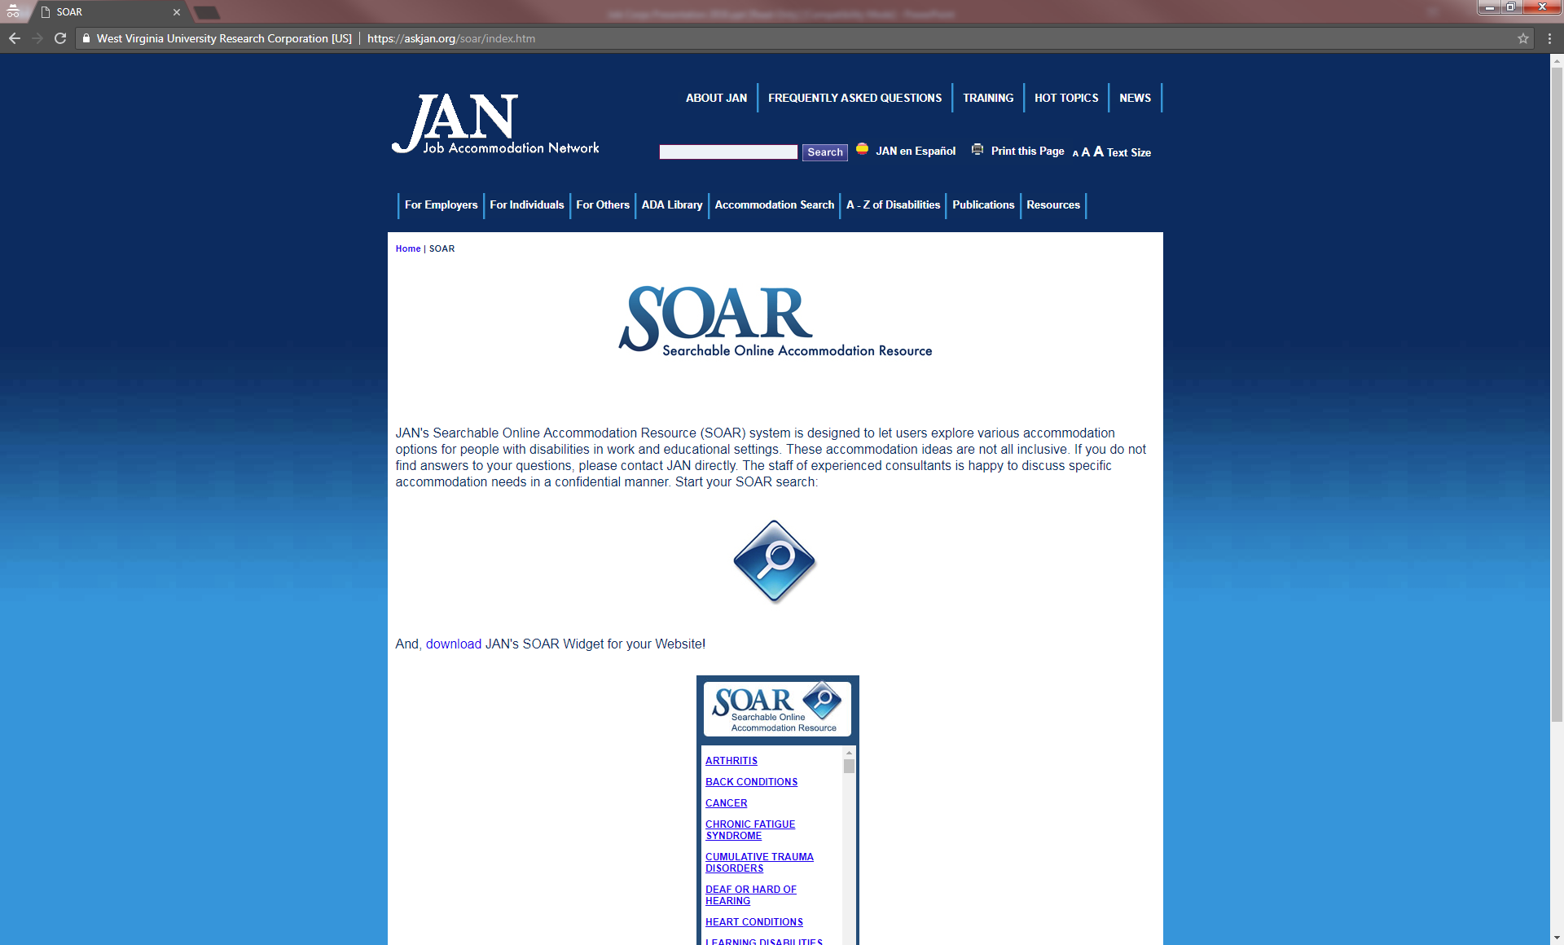

Slide 57
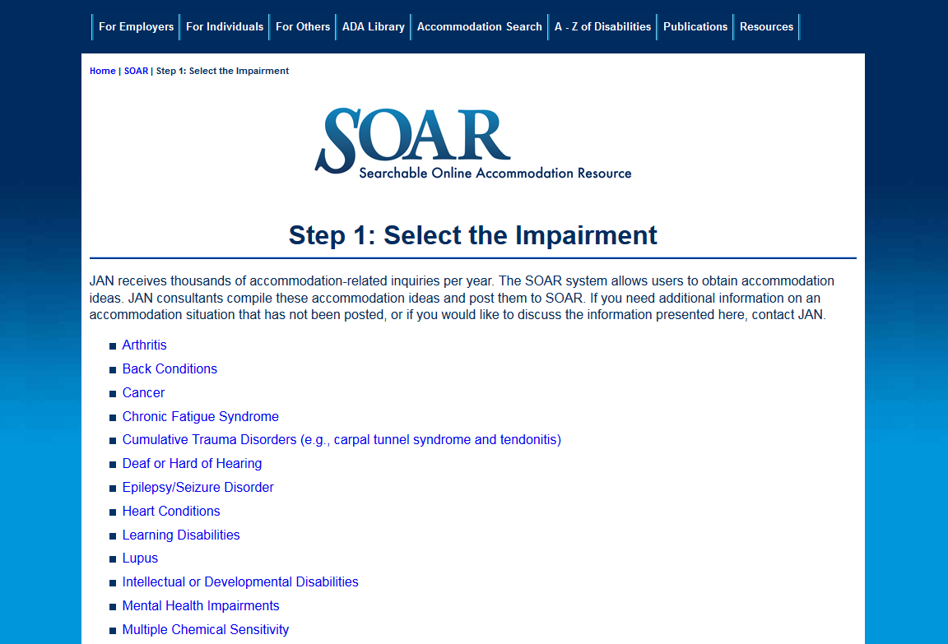

Slide 59
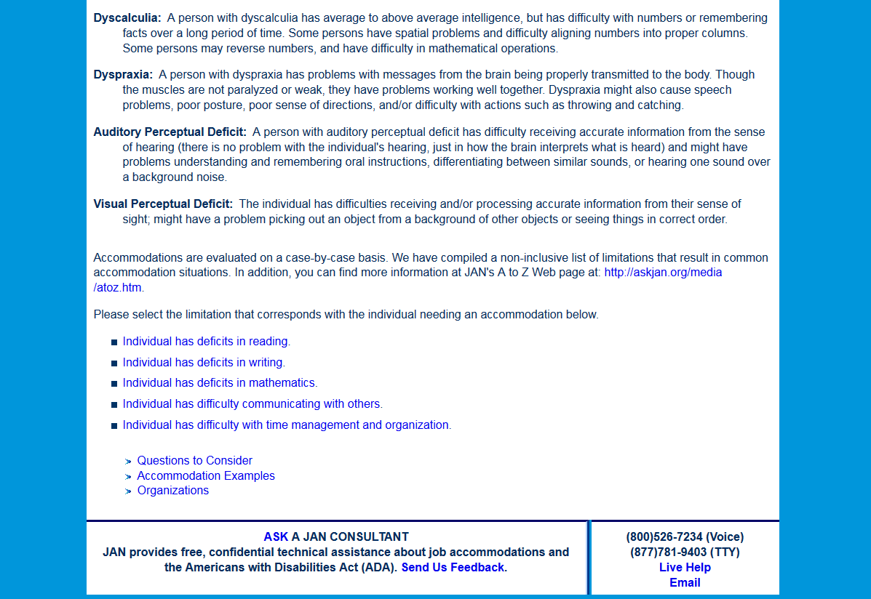

Slide 64
Accommodations
Questions

Slide 65
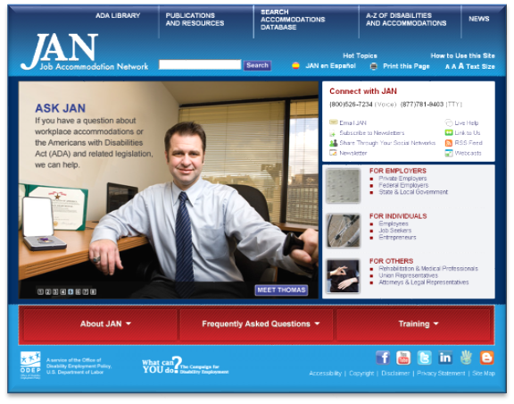
Accommodations
Contact
(800)526-7234 (V) & (877)781-9403 (TTY)
AskJAN.org & jan@askjan.org
(304)216-8189 via Text
janconsultants via Skype

