Slide 1

Presentation and Management of Oral Health Issues
in Students with Autism Spectrum Disorder (ASD)

Slide 2

Objectives
01
Describe the diagnostic criteria for ASD and the associated symptoms, behaviors, and strengths.
02
Identify disability accommodations and support strategies to prepare students with ASD for successful oral health visits, including ways to reduce anxiety.
03
Explain the common side effects of drugs used to treat the associated features of ASD and their interactions with drugs used in dentistry.
2

Slide 3

Autism Spectrum Disorder (ASD)
More Than What Meets The Eye
3

Slide 4
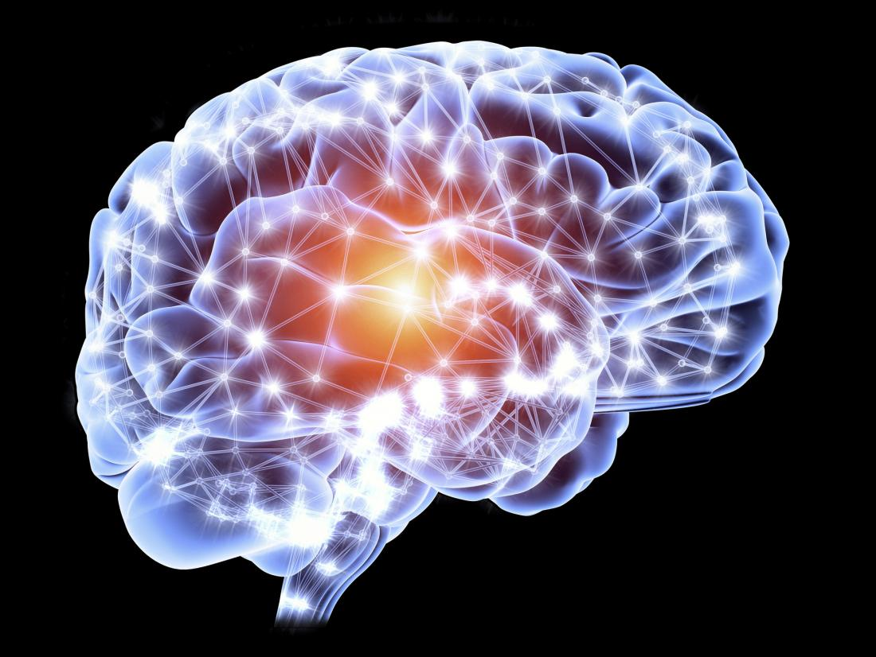
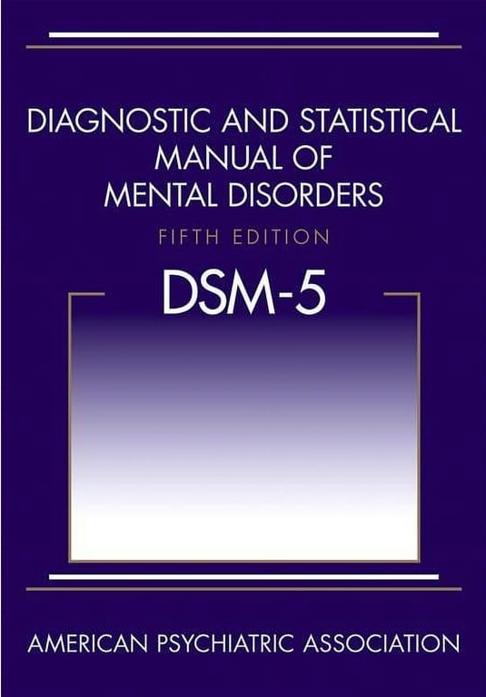
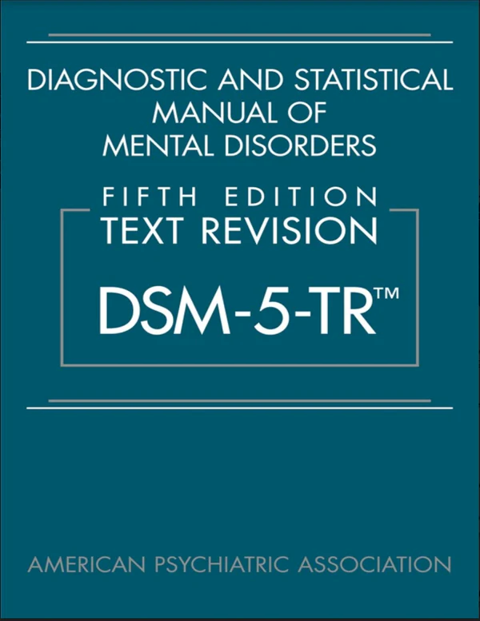
Neurodevelopmental Disorder
DSM-5
DSM-5-TR
4
Notes:
The first text revision in the new DSM-5-TR adds two words to that description: “as manifested by all of the following.”
Dispelled “a serious ambiguity” that left many clinicians confused about whether a diagnosis required any or all of those deficits.
The second change swaps out a single word describing the “specifiers” that can accompany an autism diagnosis.
It no longer requires specifiers to be diagnosable conditions. This second change now makes it possible for clinicians to indicate co-occurring problems, such as self-injury, that don’t “rise to the level of disorder."

Slide 5
DSM 5- 2013 Major Changes
Combined four independent diagnoses — autistic disorder, Asperger syndrome, pervasive developmental disorder-not otherwise specified (PDD-NOS) and childhood disintegrative disorder — into a single label of autism spectrum disorder
Combined social and language deficits into a single measure
5
American Psychiatric Association. (2013). Diagnostic and statistical manual of mental disorders (5th ed.). https://doi.org/10.1176/appi.books.9780890425596

Slide 6
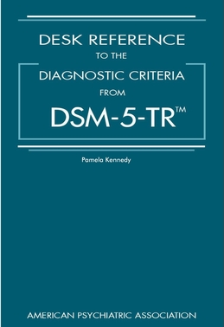
DSM 5-TR – March 2022
Added two words to the description of the diagnosis: “as manifested by the following” was revised to read “as manifested by all of the following.”
The second change swaps out a single word describing the “specifiers” that can accompany an autism diagnosis. Changed one word - “associated with another neurodevelopmental, mental or behavioral disorder,” was revised to read “associated with a neurodevelopmental, mental, or behavioral problem.”
6
American Psychiatric Association. (2022). Diagnostic and statistical manual of mental disorders (5th ed., text rev.). https://doi.org/10.1176/appi.books.9780890425787

Slide 7

Autism Diagnostic Criteria
To meet diagnostic criteria for ASD according to DSM5-TR, a child must have persistent deficits in each of three areas of social communication and interaction:
Nonverbal communicative behaviors used for social interaction
Social-emotional reciprocity
Developing, maintaining, and understanding relationships
7
American Psychiatric Association. (2022). Diagnostic and statistical manual of mental disorders (5th ed., text rev.). https://doi.org/10.1176/appi.books.9780890425787
Notes:
American Psychiatric Association. Diagnostic and statistical manual of mental disorders. 5th ed. Arlington, VA: American Psychiatric Association; 2013.
Deficits in social-emotional reciprocity (i.e., abnormal social approach and failure of normal back- and –forth conversation; reduced sharing of interests, emotions, or affect, failure to initiate or respond to social interactions).
Deficits in nonverbal communicative behaviors used for social interaction, from poorly integrated verbal and nonverbal communication; to abnormalities in eye contact and body language or deficits in understanding and use of gestures; to a total lack of facial expressions and nonverbal communication.
Deficits in developing, maintaining, and understanding relationships, ranging, for example, from difficulties adjusting behavior to suit various social contexts; to difficulties in sharing imaginative play or in making friends to absence of interest in peers

Slide 8
Restricted, Repetitive Behaviors
At least two of four types of restricted, repetitive behaviors
Stereotyped or repetitive motor movements, use of objects, or speech (e.g., simple motor stereotypes, flipping objects, echolalia, idiosyncratic phrases).
Insistence on sameness, inflexible adherence to routines, or ritualized patters of verbal or nonverbal behavior (e.g., extreme distress at small changes, difficulties with transitions, rigid thinking patterns, greeting rituals, need to take same route or eat same food every day).
Highly restricted, fixated interests that are abnormal in intensity or focus (e.g., strong attachment to or preoccupation with unusual objects, excessively circumscribed or perseverative interests).
Hyper- or hypo reactivity to sensory input or unusual interest in sensory aspects of the environment (e.g., apparent indifference to pain/temperature, adverse response to specific sounds or textures, excessive smelling or touching of objects, visual fascination with lights or movement).
8
American Psychiatric Association. (2022). Diagnostic and statistical manual of mental disorders (5th ed., text rev.). https://doi.org/10.1176/appi.books.9780890425787

Slide 9
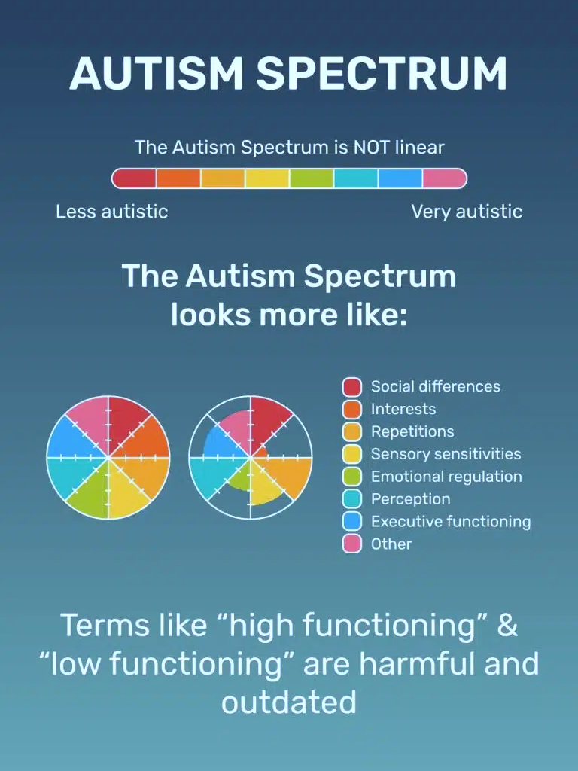
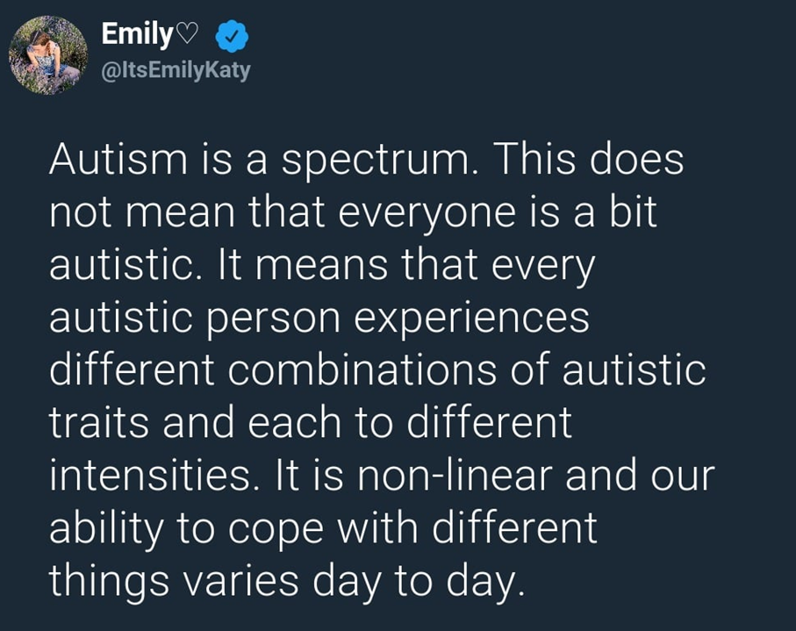
Autism Spectrum is NOT linear
9

Slide 10

Older Youth and Young Adults with ASD
Social Communication
Verbal
Nonverbal
Find it hard to take turns in conversations
Talk a lot about their special interests
Their voices or ways of speaking may be different
Find it hard to follow verbal instructions with more than 1-2 steps
Have difficulty reading nonverbal cues, like body language or tone of voice, to guess how someone else is feeling
Make less eye contact than other students or not use much eye contact when they’re spoken to
Show fewer emotions on their faces or not able to read other students’ or staff facial expressions
10

Slide 11
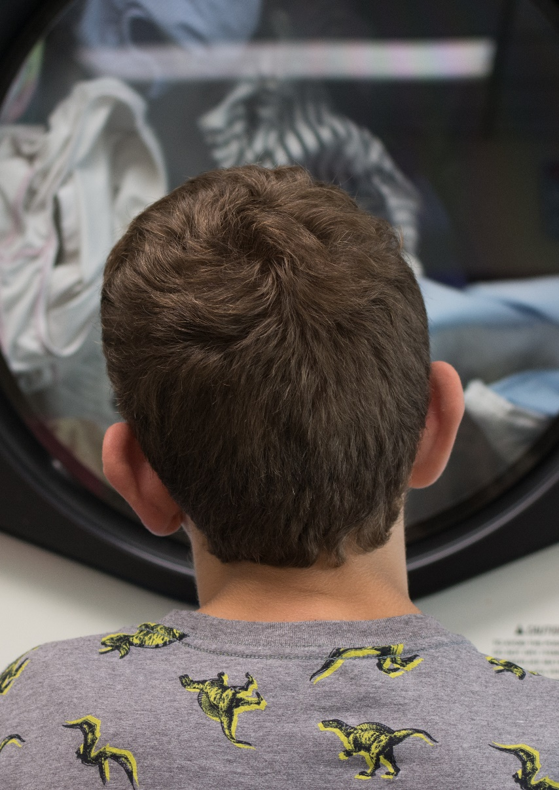
Older Youth and Young Adults with ASD (cont.)
Developing Relationships and Repetitive Behavior and Interests
Developing relationships
Repetitive behavior and interests
Prefer to spend time on their own, rather than with their peers
Trouble understanding the social rules of friendship or social situations
Difficulty making friends and have few or no friends
Particular or special interests
Behavior that may be compulsive
Attachment to certain objects
Upset by change and prefers routines
Repeat body movements or move their bodies in unexpected ways
Enjoy making repetitive noises – for example, grunts, throat-clearing or squeals.
11

Slide 12
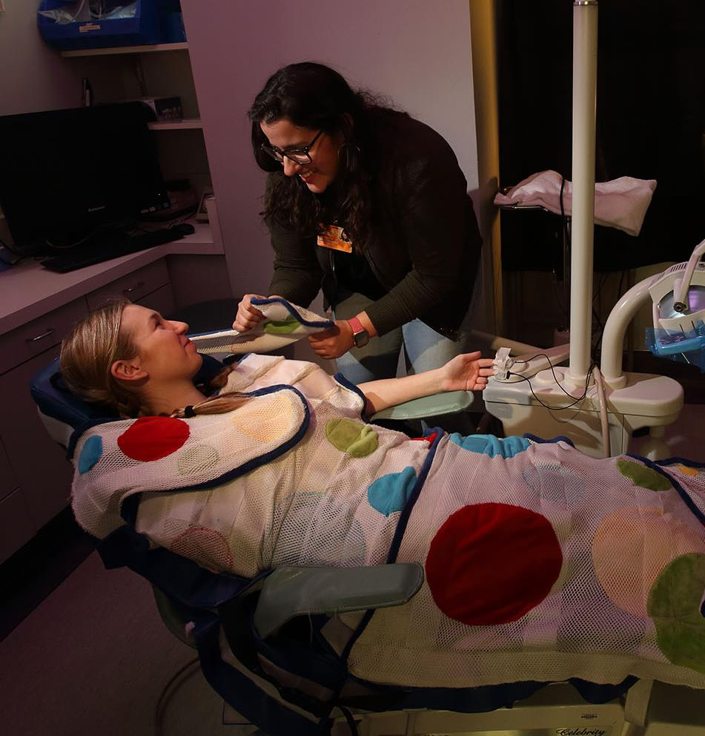
Sensory Sensitivities and Other Possible Issues
Sensory sensitivities
Might be more easily upset by loud noises than other people, like the sounds in the dental office, not like being touched, tags on clothes, or eat only foods with a certain texture or color
Might like deep pressure, seek vibrating objects like washing machines, or flutter fingers to the sides of their eyes to watch the light flickering
Other possible issues
Sleep difficulties
Anxiety
Depression
Eating disorders
Executive functioning difficulties (ADHD)
Bullying
12

Slide 13
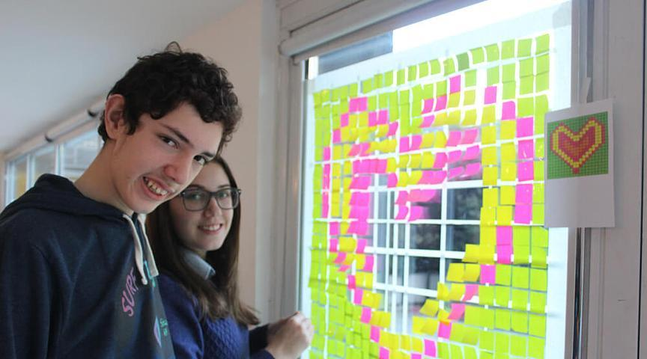
Strengths and More
Many youth with ASD have strengths, abilities and interests that non-ASD youth don't have. Everyone is different, but some common strengths are:
Attention to detail
Visual perception
Creative and artistic talents
Mathematical and technical abilities.
Interests or expertise in ‘niche’ areas
13
Notes:
https://www.youtube.com/watch?v=YnAUy4BM0w8

Slide 14
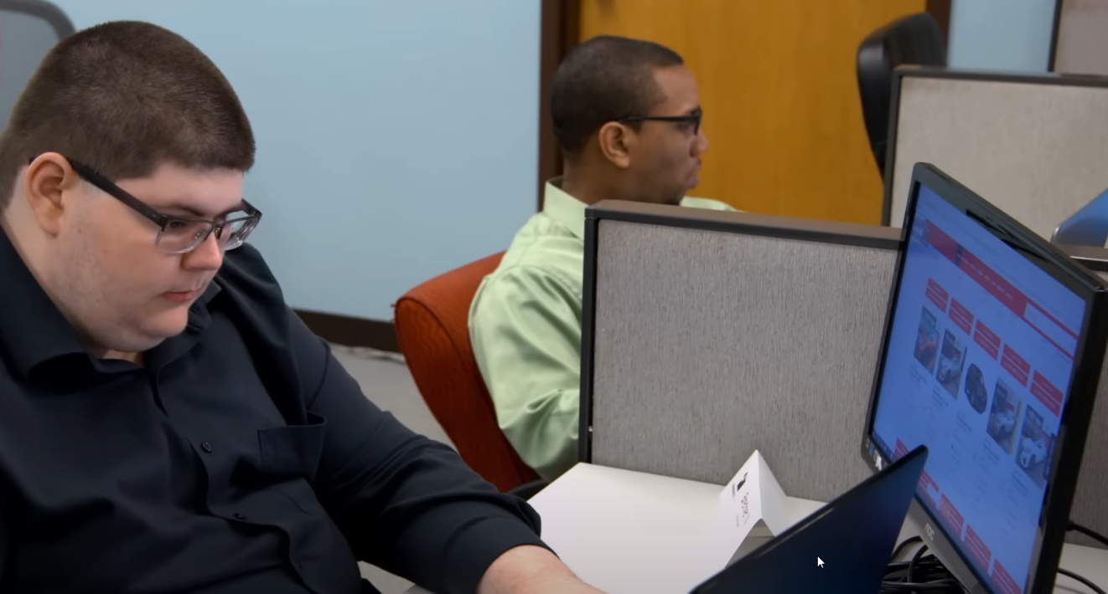
Strengths and More (cont.)
Everyone is different, but some additional common strengths are:
Able to concentrate for long periods of time when motivated
A drive for perfection and order
A capability for alternate problem solving
Character strengths such as honesty and loyalty
A rare freshness and sense of wonderment
14
Notes:
In the picture above, the individuals are on the autism spectrum and they are part of a team who monitors thousands of websites reviewing for content errors in details such as pricing that can result in thousands of dollars of lost profit if not identified and corrected.

Slide 15

True or False
Youth with ASD:
  Have lower intelligence
  Have a lack of emotion or desire for relationships
  Are more likely to be girls
  Are more violent
  Are more likely than other youth to identify as gender diverse
15

Slide 16
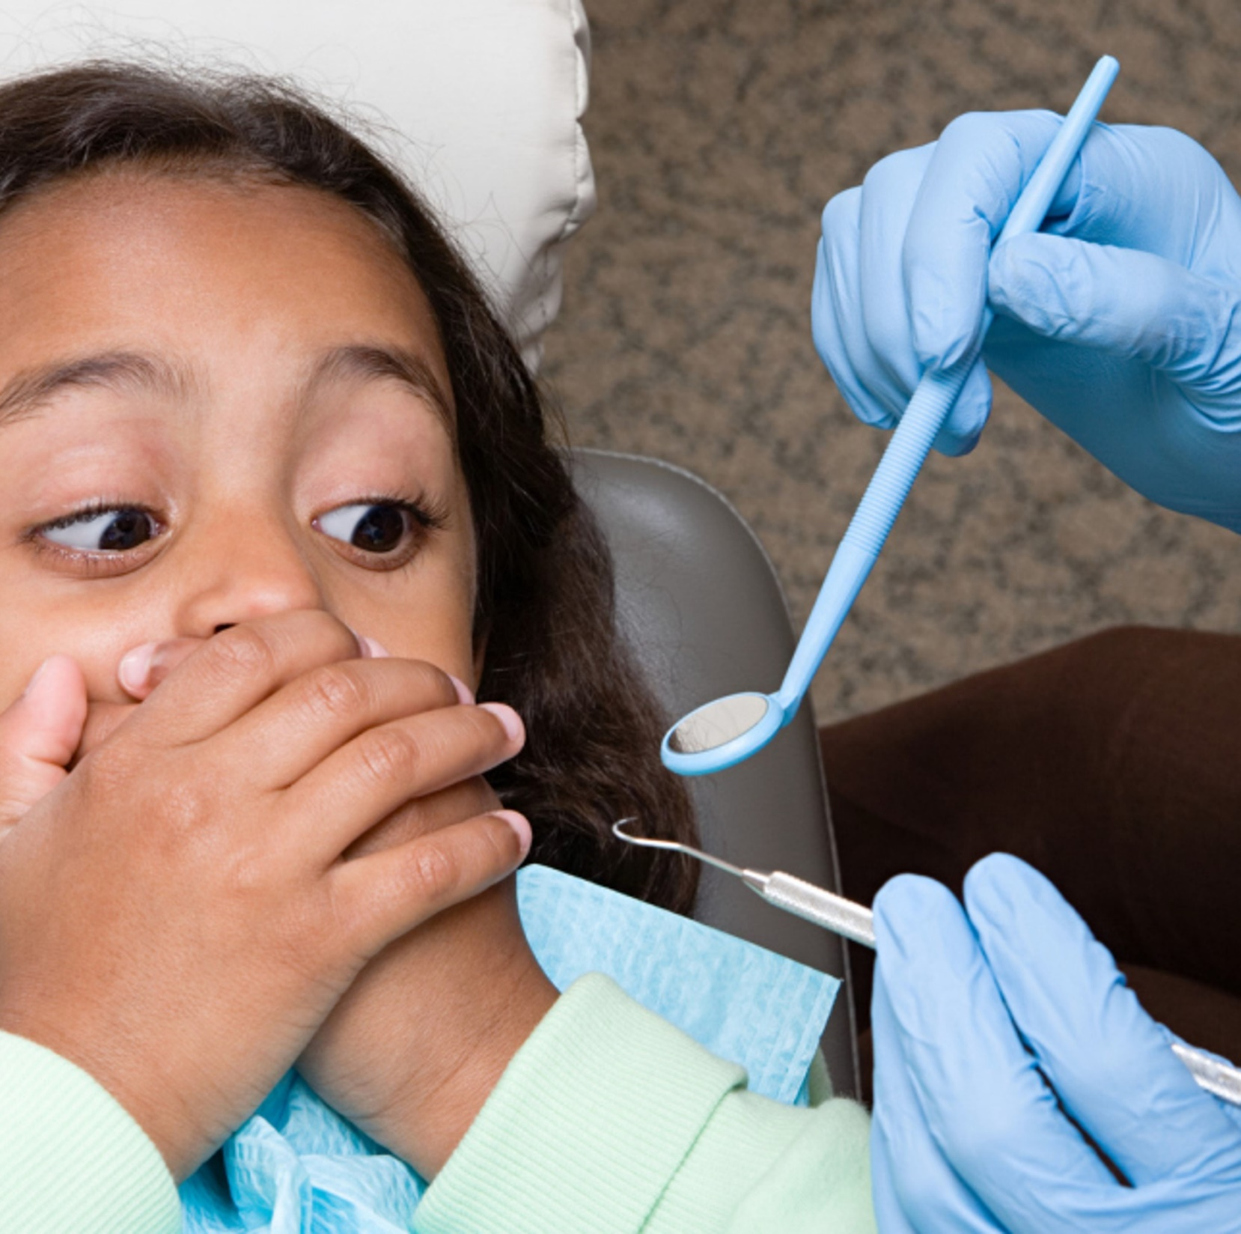
Disability Accommodations
Preparing for and Managing Oral Health Visits
16

Slide 17

Key Points!
Preparation/Pre-planning
Patience
Adequate Time
Calm Environment/Voice
Individualize
17

Slide 18

Multidisciplinary collaboration on center
Preparation for oral health care should involve all Wellness Center staff
  Center physician to review medical history and potential drug interactions
  CMHC to review behavioral management techniques
  Nursing to share prior encounters with the student in a health care setting
18

Slide 19




Preparation and Planning
Have visual or picture supports of the basic steps that occur during an oral health visit. Not all students with ASD require visual supports.
Set up ambient lighting (provider uses loupes instead of dental light).
Review the student’s accommodation plan.
P
19

Slide 20
Schedule a Pre-visit
Gather as much information as possible about the student’s behavior, likes and dislikes, triggers for negative behavior, and coping techniques.
Explain the sequence of steps during the upcoming oral health visit.
Ask the student if they have questions or concerns about the upcoming appointment.
Ask the student if they would like to see the items to be used in the upcoming visit, explain the purpose of each item, and allow the student to touch them, if desired.
S
20

Slide 21
Review Accommodations with the Student
R
Discuss the student’s accommodation plan and other possible adaptations/supports.
Identify cue to use if break is needed during appt.
Determine if a flavorless dental cleanser is needed.
Discuss other needed supports such as the use of fidget or weighted items (use of lead apron).
Ask if eye masks/sunglasses would be helpful.
Ask if noise cancelling headsets would be helpful.
21

Slide 22
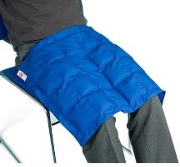
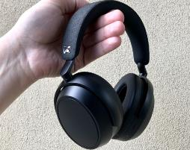
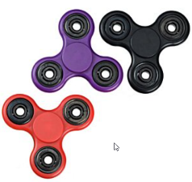
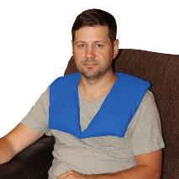
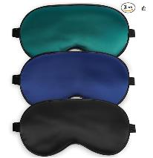
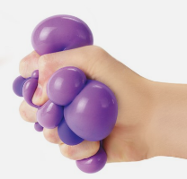
Review of Accommodation Examples
Weighted Lap Pad
or Lead Apron
Noise Cancelling Headphones
Spinners
Weighted
Shoulder Pad
Eye masks
(or sunglasses)
Stress balls
22

Slide 23
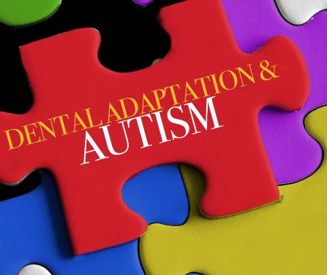

Other Disability Accommodation Considerations
Play soft music in the background.
Play projected slow-moving visual effects on the ceiling both to calm and distract the student.
Place other visual stim supports in the dental exam area such as lava lamps.
23

Slide 24
During the Oral Health Visit
Ensure that discussed/needed disability accommodations are in place prior to beginning the exam/procedure.
Give positive verbal reinforcement.
Maintain a quiet environment to the extent possible.
Place a dental mouth prop with the student’s permission to help the student keep the mouth open.
Use tell-show-do techniques.
Completely set up the operatory and prepare all materials needed for the visit before the student is seated.
Keep movements by oral health personnel to a minimum.
D
24

Slide 25
Behavioral Manifestations During the Oral Health Visit
If the student begins to show signs of distress or increasing anxiety that are not alleviated by a break or discussion of other reasonable supports that may be immediately used, stop the appointment and reschedule.
In the meantime, inform the center Disability Coordinator who should convene a Disability Accommodation Meeting.
  The Center Physician, Center Dentist, Center Mental Health Consultant and the Health and Wellness Director (if not the DC) should be invited along with the student to discuss next steps (i.e., sedation, other supports, etc.).
25

Slide 26

When an outside referral becomes necessary
The oral condition necessitates urgent care and the attempt to perform dental treatment in the dental facility fails.
MSWR but there are access barriers for adults with special health care needs.
26

Slide 27

Medication Management
Behavioral and Pain Management
27

Slide 28

Most Common Dental Problems Seen in Patients with Autism
Gingival overgrowth
Tooth decay
Periodontal gum disease
Bruxism - grinding teeth
Tooth anomalies
Eruption of one or more teeth
Pits, discoloration, lines
emergencydentistsusa.com/dentably
28

Slide 29
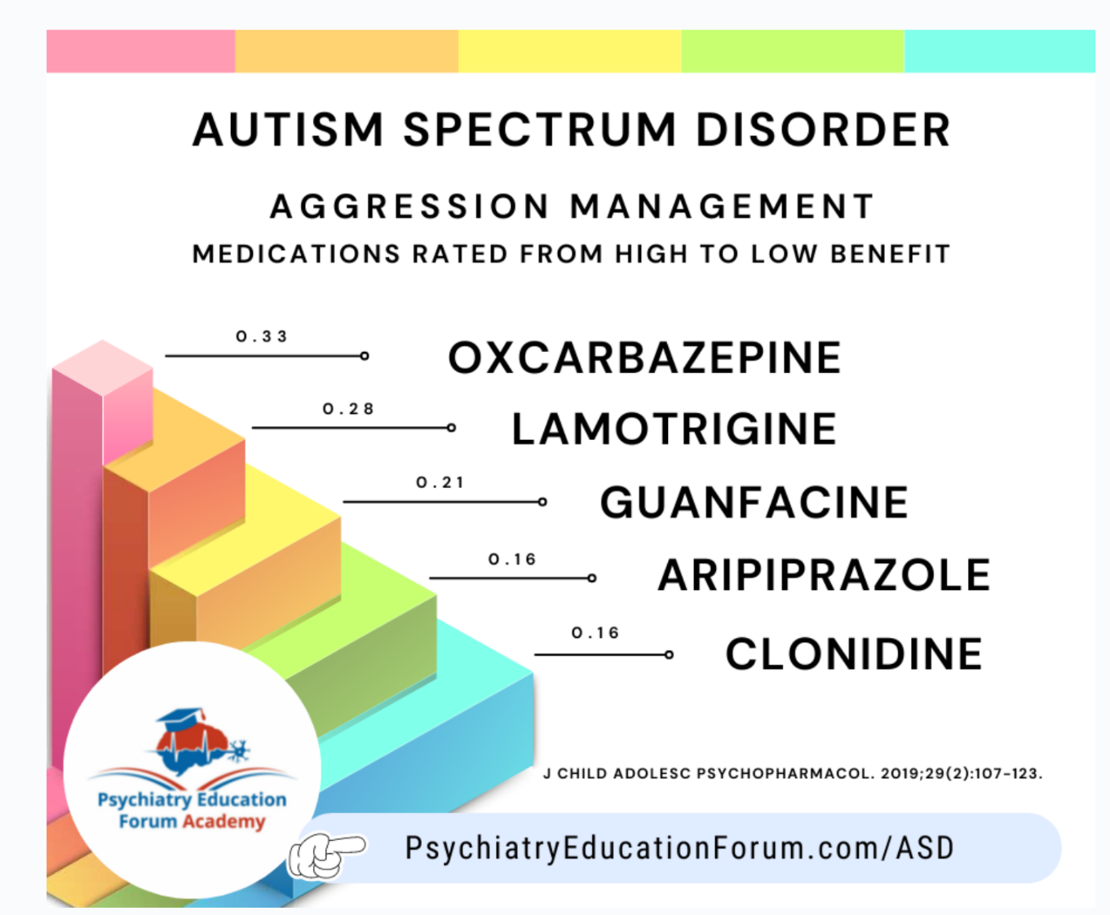
Autism Spectrum Disorder Aggression Management with Medications
29

Slide 30
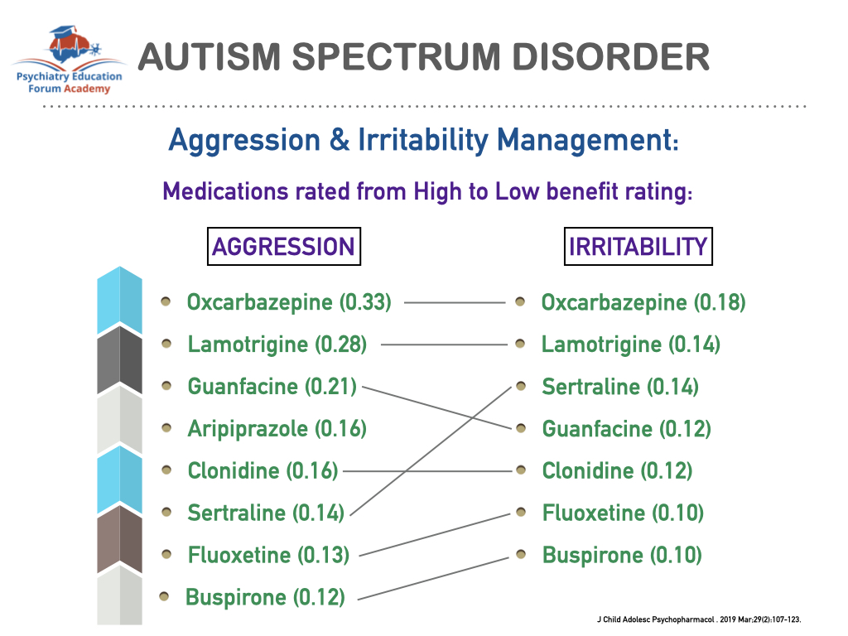
Aggression & Irritability Management with Medication
30

Slide 31
FDA Approved Drugs for ASD
Risperidone (Risperdal) and aripiprazole (Abilify) are the only two drugs, both second generation antipsychotics, approved for the treatment of autism spectrum disorder (ASD) in conjunction with behavioral management.
Risperdal is now prescribed less frequently due to sedation, weight gain, and hyperprolactinemia.
Many other drugs are used “off label” for treatment of ASD.
Controlled trials have shown no benefit from vitamin B-6, magnesium salts, steroids, immunoglobulins, secretin, gluten or casein-free diets, and electroconvulsive therapy.
31

Slide 32
Atypical Antipsychotics
Atypical antipsychotics are prescribed to manage irritability, agitation,
self-injurious behavior, aggression, repetitive behaviors, delusions and
hallucinations.
risperidone (Risperdal) side effects
  sedation, weight gain, dyskinesia, constipation, diarrhea
  swollen breasts due to elevated prolactin levels
aripiprazole (Abilify) side effects
  nausea, vomiting, dizziness, anxiety, insomnia, constipation
  movement disorders and restlessness, compulsive behavior
  less sedation and weight gain
32

Slide 33
Mood Stabilizers
Anticonvulsants with mood stabilizing properties such as valproate and carbamazepine are prescribed to manage aggression, mood fluctuation and seizures.
  Side effects include impaired hemostasis and hepatotoxicity.
  Excessive bleeding may occur with concomitant use of aspirin and non-steroidal anti-inflammatory drugs.
  Erythromycin and clarithromycin may cause carbamazepine toxicity by inhibiting its metabolism in the liver.
33

Slide 34
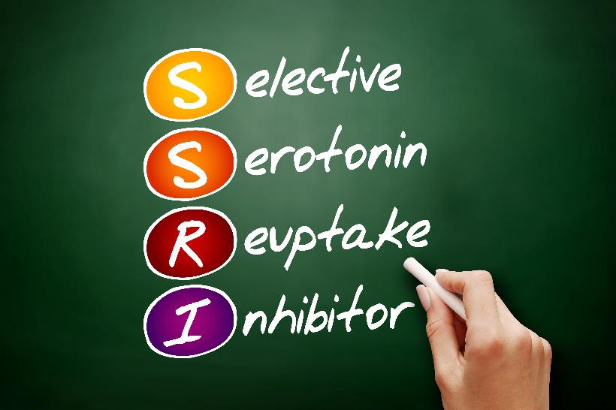
Selective Serotonin Reuptake Inhibitors
Antidepressants (SSRIs) are prescribed to manage fear, anxiety, depression, self-mutilation, repetitive thoughts and compulsive behaviors.
  Side effects include diarrhea, nausea, dizziness, sexual dysfunction, and increased bleeding time.
  Adverse drug interactions with codeine, benzodiazepines, erythromycin and clarithromycin – use with caution in reduced dosages.
34

Slide 35
Antihypertensives
Clonidine (Catapres) is a non-stimulant alpha_{2A} adrenergic receptor agonist prescribed once daily to control inattention, impulsivity, irritability, hyperactivity and oppositional behavior.
  Side effects include orthostatic hypotension and CNS depression.
Guanfacine (Intuniv) is a non-stimulant alpha_{2A} adrenergic receptor agonist prescribed once daily to decrease symptoms of ADHD including hyperactivity, impulsivity, anxiety, irritability, temper tantrums, and tics.
  Side effects include sedation, headache, fatigue, and orthostatic hypotension.
35

Slide 36
Adverse Orofacial Reactions to ASD Meds
 | Xerostomia (dry mouth) | Sialorrhea (hypersalivation) | Disgeusia (distorted taste) | Gingivitis (inflammation gums) | Other
Oxcarbazepine (Trileptal) | yes | no | yes | yes | anaphylaxis hyponatremia
Lamotrigene (Lamictal) | yes | yes | no | yes | severe rash decr w/OCPs
Guanfacine (Intuniv) | yes | no | yes | no | hypotension bradycardia
Aripiprazole (Abilify) | yes | yes | no | no | suicidality NMS, TD
Clonidine (Catapres) | yes | no | no | no | parotid swelling bradycardia
Sertraline (Zoloft) | yes | no | yes | no | suicidality bruxism
36

Slide 37
Monitoring atypical antipsychotic use
Baseline and annually: Assess personal/family history, lifestyle, current treatment, potential drug interactions
Every visit: Monitor adherence, treatment efficacy, clinical measures (height, weight, BMI, BP, pulse), lifestyle, somnolence/sedation, prolactin-related effects, new medications and drug interactions
Baseline, 3 and 6 months on treatment, then every 6 months: Monitor fasting glucose, glycosylated hemoglobin, liver function, lipid panel
Baseline, during titration, then every 3 months: Monitor for movement disorders with objective rating scales

Slide 38
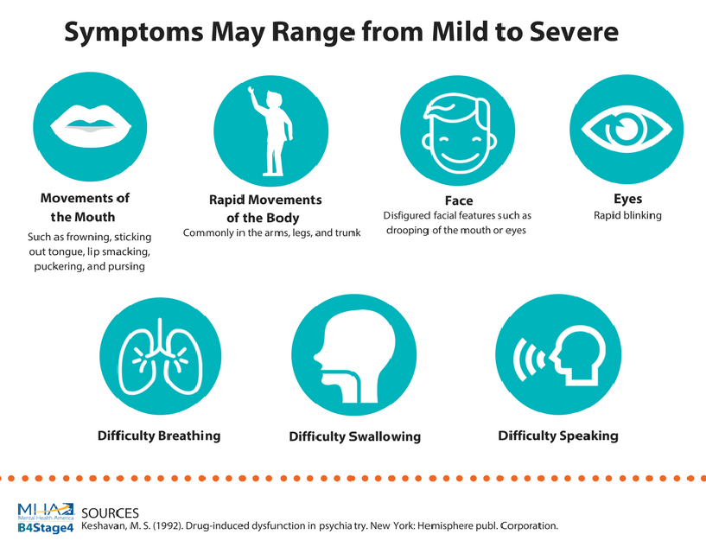
Tardive Dyskinesia
38

Slide 39
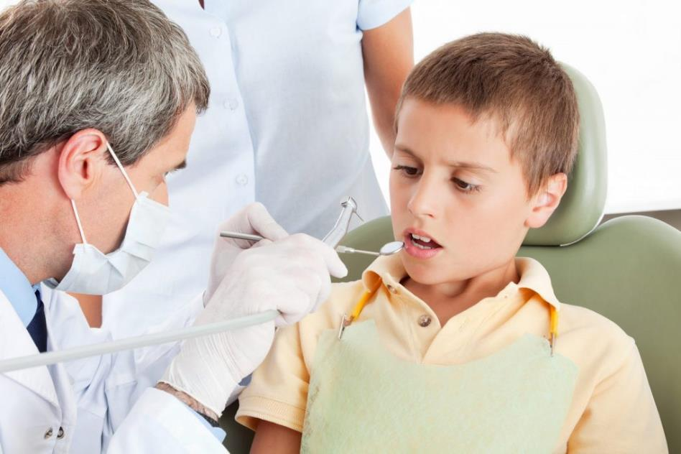
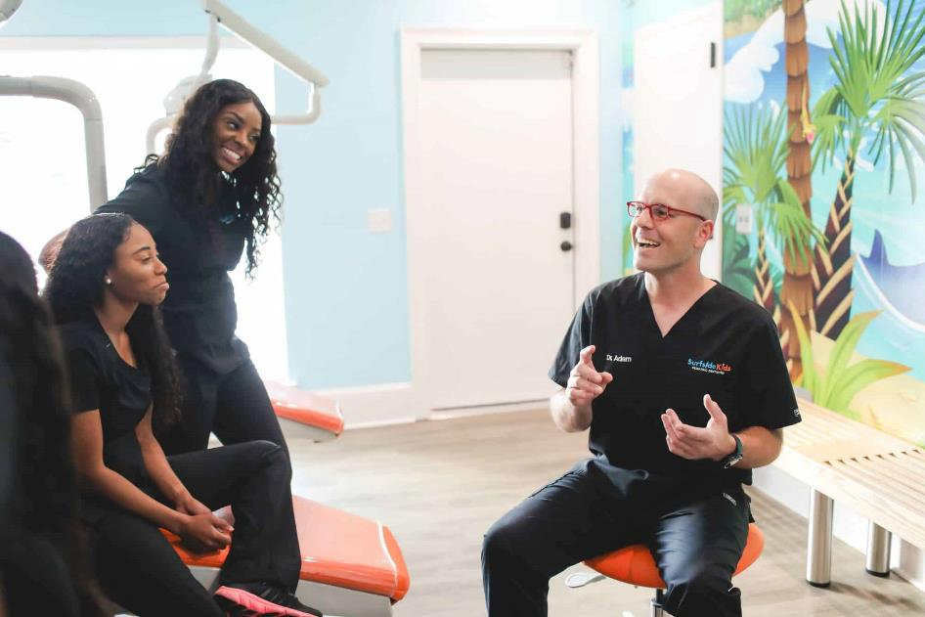
Behavioral Management via Medication
for Oral Health Visits
39

Slide 40
Conscious Sedation for Dental Treatment
Conscious sedation is considered advanced oral care and is often not covered by Medicaid. If the oral health needs of a student require conscious sedation to be treated and the treatment needs cannot be postponed until the student graduates, an MSWR would likely be needed.
Conscious sedation has variable effects on a patient with autism. Check with the physician for any underlying health problems or potential drug interactions that would pose a contraindication for sedation.
If the patient has dental treatment needs that can be accomplished in two operative appointments or less, then conscious sedation can be considered in the treatment plan.

Slide 41
Conscious Sedation for Dental Treatment (cont.)
Sedation drugs most commonly used alone or in combination are midazolam (Versed) or diazepam (Valium) oral or IV, propofol IV, ketamine IV, and nitrous oxide by mask.
During sedation, a patient must be monitored with a blood pressure and heart monitor, pulse oximeter, and a precordial stethoscope. There must be a second assistant employed to document these vital signs every 5 minutes during a sedation appointment.
Management of patients with autism under general anesthesia may be necessary for effective full mouth rehabilitation.

Slide 42

Questions?
42

