Slide 1

Post Traumatic Stress Disorder (PTSD)
Background &
Accommodation considerations
Suzanne G. Martin PSYD, MPH
Region 3 (Atlanta) Mental Health Specialist
&
Debbie Jones
Disability Program Analyst
Notes:
Welcome and thank you for joining us today. We are going to start with an overview of PTSD including symptoms presentation, diagnostic considerations, risk factors and treatment options. Debbie will follow with a presentation on accommodations for students with behaviors typically seen in students with PTSD.

Slide 2
Preface
PTSD necessarily involves exposure to a traumatic stressor
  Not everyone exposed to these events develops PTSD
  However, among those who develop PTSD, significant impairments in daily functioning (including interpersonal and academic functioning) are observed
Notes:
A traumatic stressor can generate initial stress reactions in just about anyone.  Typically, the majority of exposed individuals recover and only a minority develop PTSD.  Developmentally younger individuals are more vulnerable to PTSD.

Slide 3
DSM-IV-TR Diagnostic Criteria for
PTSD Core Symptoms
Persistent re-experiencing of the trauma
Persistent avoidance of stimuli associated with the trauma and numbing of general responsiveness
Persistent symptoms of increased arousal
Duration of the disturbance is more than one month.
The disturbance causes clinically significant distress or impairment in social, occupational, or other important areas of functioning.
Notes:
PTSD necessarily involves exposure to a traumatic stressor.  A traumatic stressor can generate initial stress reactions in just about anyone.  However, not everyone exposed to these events develops PTSD.  Typically, the majority of exposed individuals recover and only a minority develop PTSD.  However, among those who develop PTSD, significant impairments in daily functioning (including social and work/school )
But wait DSM 5 comes out in May! Expect PTSD to be moved from an anxiety disorder to a trauma based disorder.

Slide 4
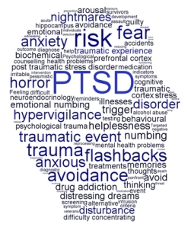
Symptoms of PTSD
Symptoms of PTSD are grouped into 3 categories:
  Intrusive elements
  Avoidance
  Increased arousal
Notes:
Symptoms of PTSD are grouped into 3 categories:
1. Intrusive elements
2. Avoidant behavior and
3. Increased Arousal
Let’s take each in turn

Slide 5
Intrusive Elements
Recurrent and intrusive distressing memories of the event
Recurrent dreams of the event
Sudden acting or feeling as if the traumatic event were recurring
Intense psychological distress at exposure to things that symbolizes or resembles an aspect of the trauma, including anniversaries thereof
Physiological reactivity when exposed to internal or external cues of the event
Notes:
Intrusive or Re-experiencing Symptoms
Recurrent/intrusive distressing recollections.
Recurrent distressing dreams.
Acting/feeling as if the event were recurring.
Psychological distress at exposure to cues that symbolize/resemble the traumatic event.
Physiological reactivity on exposure to cues that symbolize/resemble the traumatic event.
At least one of these symptoms must be present to be diagnosed with Post Traumatic Stress Disorder

Slide 6
Avoidance & Numbing Features
Efforts to avoid the thought or feelings associated with the trauma
Efforts to avoid activities, places, people or situations that arouse recollection of the trauma.
Inability to recall an important aspect of the trauma (psychological amnesia)
Feelings of detachment or estrangement from others
Restricted range of affect-unable to have loving feelings
Sense of foreshortened future - does not expect to have career, marriage, children or normal life span
Notes:
Avoidance & Numbing Symptoms
Avoids thoughts, feelings, or conversations.
Avoids activities, places, or people that remind one of the trauma
Inability to recall important aspects of the trauma.
Diminished interest/participation in significant activities.
Feeling of detachment/estrangement (emotionally numb)
Restricted range of affect (flat).
Sense of a foreshortened future.
At least three of these symptoms to be diagnosed with PTSD

Slide 7
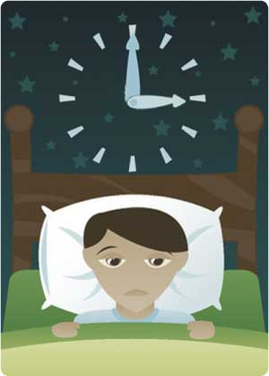
Increased Arousal
(not present before trauma)
Difficulty falling asleep or staying asleep
Irritability or outburst of anger (may lead to rage)
Difficulty concentrating
Hyper-vigilance (may look like paranoia)
Exaggerated startled response
Notes:
Increased Arousal Symptoms
1. Difficulty falling or staying asleep (restless sleep)
2. Irritability or outbursts of anger.
3. Difficulty concentrating.
4. Hyper-vigilance (checking behavior)
5. Exaggerated startle response.
At least two of these symptoms to be diagnosed with PTSD

Slide 8

Symptom Summary
A traumatic event plus:
  1 or more re-experiencing symptoms
  3 or more avoidance symptoms
  2 or more increased arousal symptoms
Notes:
Symptoms must be present for a duration of more than 1 month and causes clinically significant distress or impairment in social, occupational, or other important areas of functioning.
It is not unusual to see an individual with these symptoms but able to function or impairment is minimal

Slide 9
Environmental Factors
Parental reactions
Social supports
History of traumatic stress
Family atmosphere
Family mental health history
Poverty
Notes:
In addition to environmental factors there are also situational variables that will factor into presentation
Predictability
Assaultive Interpersonal Violence
Fatalities
Physical Proximity
Emotional Proximity
You may also see related features:
Survivor guilt
Social withdrawal
Auditory hallucinations & paranoid ideation
Impaired affect modulations
Self-destructive and impulsive behavior
Somatic complaints
Shame, despair, or hopelessness
Hostility
Social withdrawal

Slide 10

Types of PTSD
Acute PTSD:
  Symptoms less than 3 months
Chronic PTSD:
  Symptoms more than 3 months
Notes:
PTSD may be classified as acute (< 3 months) or chronic (> 3 months +)
Although symptoms usually begin within 3 months of exposure, a delayed onset is possible months or even years after the event has occurred.

Slide 11

Diagnosis of PTSD
There are no laboratory tests to detect PTSD.
To diagnose PTSD, a healthcare provider will consider the above symptoms together with history of trauma.
Notes:
He or she may also use psychological assessment tools to confirm the diagnosis. These involve an appropriately trained licensed provider.

Slide 12
Cultural Features
Can occur at any age, including childhood, and can affect anyone
Individuals who have recently immigrated from areas of considerable social unrest and civil conflict may have elevated rates of PTSD
No clear evidence that members of different ethnic or minority groups are more or less susceptible than others
Notes:
A cultural assessment is important to understand the significance of the event to the individual and their value system

Slide 13
Symptom Onset
Immediate Onset
Delayed Onset
Better response to treatment
Better prognosis (i.e. less severe symptoms)
Fewer associated symptoms or complications
Symptoms are resolved within 6 months
Onset of symptoms at least 6 months after the stressor
Condition more likely to become chronic
Possible repressed memories
Worse prognosis
Notes:
Symptoms usually begin within the first 3 months after the trauma, although there may be a delay of months, or even years, before symptoms appear. Left untreated, PTSD symptoms tend to increase over time.
It is not unusual for symptoms to be delayed for months or years and be precipitated by another trauma or a period of relative calm

Slide 14
PTSD Course
The symptoms and the relative predominance of re-experiencing, avoidance, and increased arousal symptoms may vary over time
Duration of symptoms also varies: Complete recovery occurs within 3 months after the trauma in approximately half of the cases. Others can have persisting symptoms for longer than 12 months after the trauma
Notes:
Symptom reactivation may occur in response to reminders of the original trauma, life stressors, or new traumatic events. Recovery also varies but approximately half of all individuals with PTSD recover within 3 months

Slide 15
Course Considerations
The severity, duration, and proximity of an individual’s exposure to a traumatic event are the most important factors affecting the likelihood of developing PTSD
PTSD can also develop in individuals without any predisposing conditions, particularly if the stressor is extreme
The disorder may be especially severe or long lasting when the stressor is of human design (torture, rape)
Notes:
Social supports, family history, childhood experiences, personality variables, and pre-existing mental disorders may influence the development of PTSD

Slide 16
Examples of Traumatic Events
Military combat
Violent personal assault (sexual assault, physical attack)
Being kidnapped
Being taken hostage
Terrorist attack
Torture
Incarceration as a prisoner of war
Natural or manmade disasters
Severe automobile accidents
Being diagnosed with a life threatening illness
Notes:
Let’s look at some examples of traumatic events. A person develops PTSD in response to exposure to
an extreme traumatic stressor involving direct personal experience of an event.
This includes:
actual or threatened death or serious injury
threat to one’s physical integrity
witnessing an event that involves death, injury, or a threat to the physical integrity of another person
learning about unexpected or violent death, serious harm, or threat of death or injury experienced by a family member or other close associate
Traumatic events can also be witnessed. For example, observing the serious injury or unnatural death of another person due to violent assault, accident, war, or disaster . Unexpectedly witnessing a dead body or body parts. Learning of a violent personal assault, serious accident, or serious injury experienced by a family member or a close friend. Traumatic events can also be learned about from others.

Slide 17
Prevalence
Approximately 70% of adults in the United States have experienced a traumatic event at least once in their lifetime. Up to 20% of these people will go on to develop PTSD
Women are about twice as likely as men to develop PTSD
Notes:
An estimated 5.2 million American adults ages 18-54 have PTSD (or approximately 3.6%).
Of approximately 70% of adults in the United States have experienced a traumatic event at least once in their lifetime. Up to 20% of these people will go on to develop PTSD.

Slide 18
Assessment Tools
2 main categories of PTSD evaluations are structured interviews and self report questionnaires
  Interviews
    Clinician Administered PTSD Scale (CAPS) developed by National Center for PTSD
  Self Reports
    PCL
www.ncptsd.va.gov
Notes:
There are tools that can help you make a diagnosis of PTSD including the CAPS (available for free from the National Center for PTSD) and different self reports such as the PTSD Checklist for Civilians that are easily administered and scored. These self-report measures have been developed as a cost and time efficient way of obtaining information about PTSD distress. These measures provide a single score representing the amount of distress an individual is experiencing.

Slide 19
PTSD Symptoms May Include:
Distressing dreams of the event that may change into generalized nightmares
Reliving the trauma may occur in repetitive behavior
May report diminished interest in activities
Constricted affect
Sense of a foreshortened future
Omen formation
Physical symptoms (e.g., stomachaches and headaches)

Slide 20
Differential Diagnosis
Differential diagnosis of the disorder or problem; that is, what other disorders or problems may account for some or all of the symptoms or features
PTSD is frequently co-morbid with other psychiatric disorders including:
  Anxiety disorders
  Acute stress disorder
  Obsessive compulsive disorder
  Adjustment disorder
  Depressive disorders
  Substance abuse disorders
Notes:
PTSD symptoms can overlap other disorders and is frequently co-morbid with other psychiatric disorders including:
Anxiety disorders
Acute Stress Disorder
Obsessive compulsive disorder
Adjustment disorder
Depressive disorders
Substance Abuse disorders

Slide 21
Differences Between
PTSD and Acute Stress Disorder
In general, the symptoms of acute stress disorder must occur within 4 weeks of a traumatic event and come to an end within that 4-week time period
If symptoms last longer than 1 month and follow other patterns common to PTSD, a person’s diagnosis may change from acute stress disorder to PTSD
Notes:
The deciding factor here is time. If it is than one month following a traumatic event it is considered an acute stress disorder.

Slide 22
Differences Between PTSD and Obsessive-Compulsive Disorder
Both have recurrent, intrusive thoughts as a symptom, but the types of thoughts are one way to distinguish these disorders. Thoughts present in obsessive-compulsive disorder do not usually relate to a past traumatic event.
With PTSD, the thoughts are invariably connected to a past traumatic event.
Notes:
Remember PTSD is a trauma based OCD behavior in the absence of a traumatic event is not PTSD even though some of the symptoms may look similar

Slide 23
Differences Between PTSD and Adjustment Disorder
PTSD symptoms can also seem similar to adjustment disorder because both are linked with anxiety that develops after exposure to a stressor. With PTSD, this stressor is a traumatic event.
With adjustment disorder, the stressor does not have to be severe or outside the “normal” human experience.
Notes:
Both an occur after a stressful event but in the case of PTSD the stressor is extreme and life threatening.

Slide 24
Differences Between PTSD and Depression
Depression after trauma and PTSD both may present numbing and avoidance features, but depression would not induce hyper-arousal or intrusive symptoms
Notes:
Depression can exist in addition to PTSD but either PTSD or depression can exist alone.

Slide 25

Treatment
The most comprehensive and widely cited guidelines for treating PTSD include using variants of cognitive therapy
Notes:
“PTSD is typified by both automatic, involuntary symptoms, (e.g. flashbacks, intrusive thoughts, autonomic hyperarousal) and consciously mediated attempts to make meaning of the trauma experience. The automatic and involuntary symptoms appear to represent conditioned responding to environmental triggers associated with the trauma.”
However, much less is known about the origins and consequences of victims’ efforts to understand their traumas or about how best to treat the symptoms associated with personal beliefs about traumas.
Massas., Phillip M and Hulsey, Timothy L. (2006)Causal Attributions in Posttraumatic Stress Disorder: Implications for Clinical Research and Practice, Psychotherapy: Theory, Research, Practice, Training 43, 201-215
Cognitive Restructuring involved teaching and reinforcing self-monitoring or thoughts and emotions, identifying automatic thoughts that accompany distressing emotions, learning about different types of cognitive distortions, and working to dispute the distress-enhancing cognitions, with a particular focus on abuse-related cognitions, for which the therapist remained alert during the personal experience work.”

Slide 26
Treatment Types
Exposure Therapy
  Education about common reactions to trauma, breathing retraining, and repeated exposure to the past trauma in graduated doses. The goal is for the traumatic event to be remembered without anxiety or panic resulting.
Cognitive Therapy
  Separating the intrusive thoughts from the associated anxiety that they produce
Stress inoculation training
  Variant of exposure training teaches client to relax. Helps the client relax when thinking about traumatic event exposure by providing client a script.
Notes:
Exposure Therapy
EMDR
Cognitive Processing Therapy

Slide 27
SSRI Medication
Sertraline (Zoloft), Paroxetine (Paxil), Escitalorpram (Lexapro), Fluvoxamine (Luvox), Fluxetine (Prozac)
  Affects the concentration and activity of the neurotransmitter serotonin
  May reduce depression, intrusive and avoidant symptoms, anger, explosive outbursts, hyper-arousal symptoms, and numbing
  FDA approved for the treatment of anxiety disorders including PTSD
Notes:
SSRI medications have been found to be useful in the treatment of PTSD
Tricyclics have also been found to be helpful9such as amitryptyline)

Slide 28
PTSD Myths
MYTH: People suffer from PTSD right after they experience a traumatic event
FACT: PTSD symptoms usually develop within the first 3 months after trauma but may not appear until months or years have passed
MYTH: You have to serve in combat to experience PTSD
FACT: Anyone who has experience a traumatic event can experience PTSD
Notes:
These symptoms may continue for years following the trauma or, in some cases, symptoms may subside and reoccur later in life, which often is the case with victims of childhood abuse.
Some people don't recognize that they have PTSD because they may not associate their current symptoms with past trauma. In domestic violence situations, the victim may not realize that their prolonged, constant exposure to abuse puts them at risk.

Slide 29
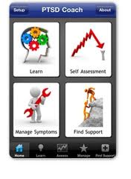
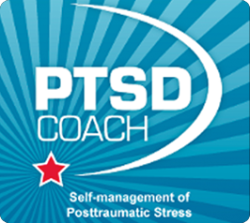

Free SMART Phone Apps
Notes:
PE Coach is the first mobile app designed to support the tasks associated with prolonged exposure treatment for PTSD. Providing pocket access to the necessary tools for successful PE participation, the app includes audio recording capability for easy playback after sessions; tools to support patient tasks between sessions; and visual displays of symptom reduction over time. In addition, PE Coach is integrated with smartphone calendar functionality to encourage patient recall and session attendance.

Slide 30

Accommodation Considerations

Slide 31
Strategies vs. Accommodations
Strategies
  Refers to techniques used to assist one in learning how to do a task or to accomplish a goal
Accommodations
  Changes to the environment or in the way things are customarily done, that give a person with a disability an opportunity to participate in the application process, job, program or activity that is equal to the opportunity given to similarly situated people without disabilities

Slide 32
Let’s Practice
Strategy
Accommodation
Use a highlighter to “highlight” key points or key words, etc.
Use relaxation techniques.
Provide a highlighter or provide highlighted content.
Provide a private place to use relaxation techniques.

Slide 33
Symptoms Experienced by
Job Corps Students with PTSD
Symptoms
Examples of Functions Impacted
Sleep problems
Irritability
Avoidance of certain situations/places
Anxious behavior and Jitteriness (CMHC description/word)
Impulsiveness which sometimes is related to aggressive behavior
Depression like symptoms - no interest in activities, sad mood, general numbness, low energy
Concentration
Memory
Mood
Social Interactions
Movement/Alertness

Slide 34

Accommodations:
Concentration
Distraction free workspace/secluded space for testing
Reduce visual and audio clutter
  Noise cancelling headset/MP3 player with soothing music
  Limit content on the walls
Vibrating watches/visual timers

Slide 35

Accommodations:
Concentration
Preferential seating
Break up large assignments into smaller tasks
Extended time for assignments, tasks, or in testing
Increased wait time for responses
Cues to return to task
Allow breaks

Slide 36

Accommodations:
Memory
Provide written instructions and materials
Create daily task lists
Provide verbal prompts and reminders
Electronic organizers
Copies of notes
Allow to tape record

Slide 37

Accommodations:
Mood
Irritable, angry, jittery, sad, etc. Some could also assist with sleep disturbance issues
MP3 player with soothing/relaxation music
Use of a therapy support animal
Special lighting
Re-locating or assigning a specific location for work space or sleeping space away from distractions/known stressors

Slide 38

Accommodations:
Mood
Irritable, angry, jittery, sad, etc. Some could also assist with sleep disturbance issues
Special pass to go to Health & Wellness or other designated person when frustrated, angry, or highly anxious
Frequent breaks or shorter breaks combined into one longer one

Slide 39

Accommodations:
Mood
Irritable, angry, jittery, sad, etc. Some could also assist with sleep disturbance issues
Private space to use relaxation strategies or other stress management techniques

Slide 40
Accommodations:
Social Interactions
Set-up workspace so that the person isn’t surprised by others walking into the area
Permit individual to avoid certain mandated events (i.e. assemblies taped and provided on video tape)
Leave each class a few minutes early to get to next class and avoid crowded halls
Strategy – Train student to use conflict management techniques.

Slide 41
Accommodations:
Low Energy Levels
Dependent upon where the energy levels are low or high, accommodations might include:
Frequent breaks
Vibrating watches
Modify training schedule to place more difficult class or classes in timeframe individual is typically most alert
Break assignments into smaller segments
Provide daily checklists with short term goals that are provided to a designated staff person at the end of the day

Slide 42

Resources

Slide 43
Regional Health Specialists
Regional Mental Health Specialists
Region 1
  Dave Kraft, MD, MPH
  dkraft@external.umass.edu
  Maria Acevedo, PhD
  mmacevedo@onelinkpr.net
Region 2/Lead
  Valerie Cherry, PhD
  vcherryphd@aol.com
Region 3
  Suzanne Martin, PsyD, MPH
  SuzanneM@aol.com
Regions 4 and 6
  Vicki Boyd, PhD
  vdelboyd@aol.com
  Lydia Santiago, PhD
  lydia.v.santiago@att.net
Region 5
  Helena MacKenzie, PhD
  helena.mackenzie530@gmail.com

Slide 44
Regional Disability Support
Regional Disability Coordinators
Boston Region (interim) and Dallas Region
  Laura Kuhn
  laura.kuhn@humanitas.com
Philadelphia and Atlanta Regions
  Nikki Jackson
  nikki.jackson@humanitas.com
Chicago and San Francisco Regions
  Kim Jones
  kim.jones@humanitas.com

Slide 45
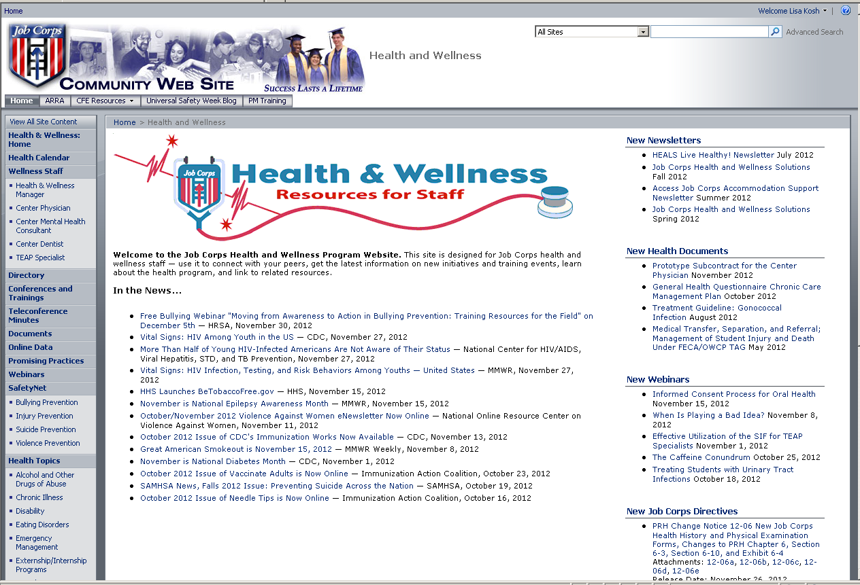
Job Corps
Health & Wellness Website

Slide 46
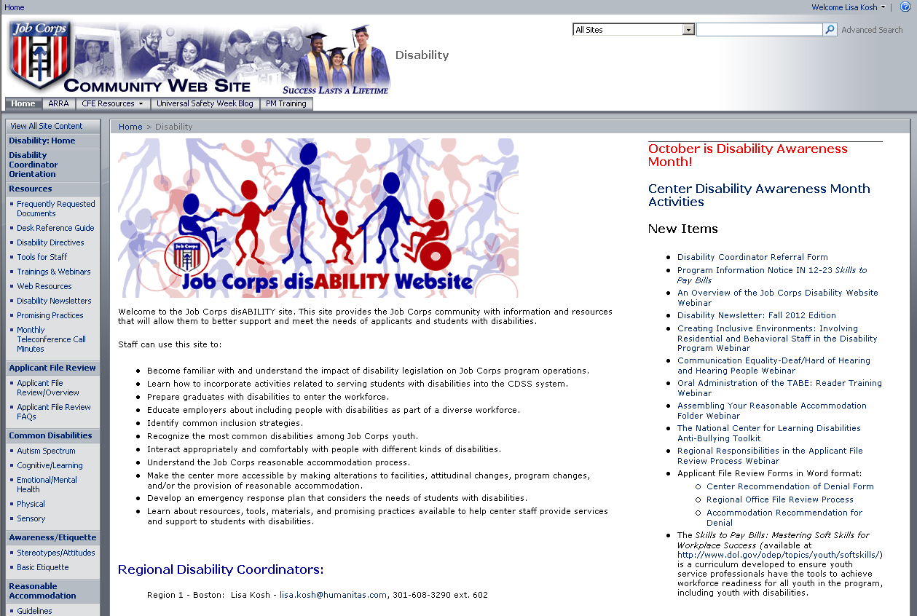
Job Corps
Disability Website

Slide 47
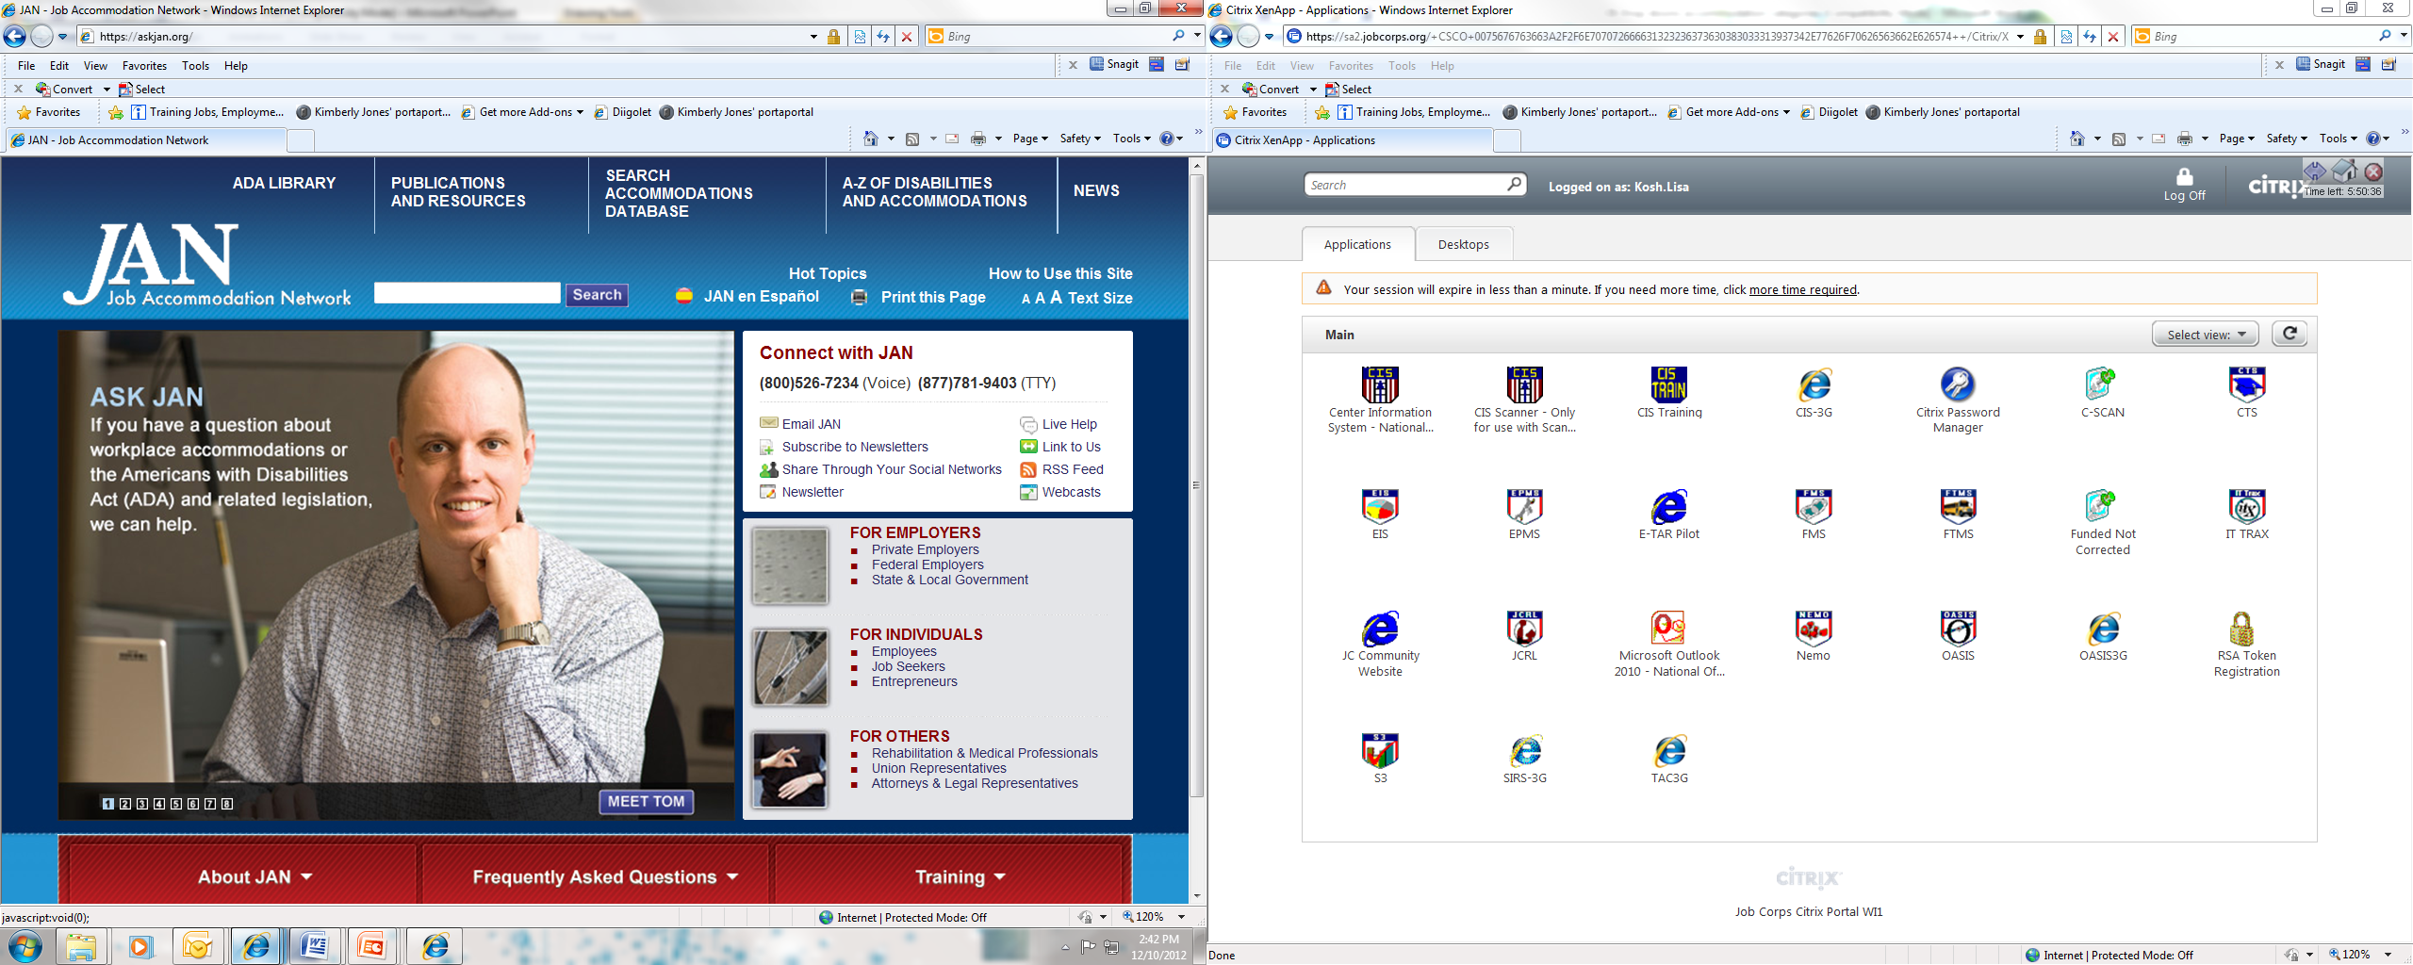
Job Accommodation Network (JAN)

Slide 48

Questions

