Slide 1



Reasonable Accommodation
Process
October 2016

Slide 2
What you can expect!
Communicating with People with Disabilities
Reasonable Accommodation Basics
Step-by-Step Review of the Reasonable Accommodation Process
Red Flags within the Reasonable Accommodation Process
Reasonable Accommodation Resources

Slide 3
What is not included
Reasonable Accommodation in the file review process
  Center Applicant File Review webinars - quarterly
Reasonable Accommodation Committee (RAC) Guidance
  RAC webinars – at least annually
Completing funding requests for students who need accommodations exceeding $5,000
  Contact your Regional Disability Coordinator

Slide 4
Communicating with People with Disabilities
Legal Obligations

Slide 5
Legal Obligations
Communication requirements are separate from accommodation requirements.
  Your obligation to communicate effectively with people with disabilities – whether those people are students, staff, applicants for admission or employment, parents, guardians, or members of the public – is separate from your obligation to provide reasonable accommodations for qualified people with disabilities.
    PRH 6: Appendix 606

Slide 6
Legal Obligations
The Workforce Innovation and Opportunity Act (WIOA) nondiscrimination regulations, distinguish between these two obligations, for a very simple reason:
  Without clear, accurate, effective communication, any encounter between a person with a disability and a program from which he or she is seeking services, such as Job Corps, will be literally meaningless.

Slide 7

Key Considerations for communication
The first thing you should do is find out how to communicate effectively with that person.

Slide 8
Key Considerations for communication
Under the law, the burden is on Job Corps to provide the auxiliary aids and services (communication aids) that are needed for equally effective communication with a particular person with a disability.

Slide 9
Key Considerations for communication
Primary consideration should be given to the requests of the person with a disability.
Why do you think the law does this?

Slide 10
Why is Primary consideration given to the individual?
Because the individual with a disability is the best source of information about his or her own needs. Not everyone who appears to have “the same” disability, or type of disability, is able to use and understand the same communication method.
For example, while some people with hearing impairments understand American Sign Language, others communicate in Signed English, while still others do not understand sign language at all, and need a different communication method such as Computer Assisted Real-Time Transcription (CART).

Slide 11
Reasonable Accommodation Basics
Defining & Understanding Reasonable Accommodation

Slide 12

What are reasonable accommodations?
Any changes to the environment or in the way things are customarily done, that gives a person with a disability an opportunity to participate in the application process, job, program or activity that is equal to the opportunity given to similarly situated people without disabilities

Slide 13
ID the type of modification
Policy, program or procedure
Allowing the use of headphones during the training day as an accommodation.
Providing documents in alternate formats.
Academic environment
Allow student 30 minutes of access to fitness equipment prior to training day.
Work environment
Extended time to perform a task

Slide 14
Reasonable Accommodation Process

Slide 15
Test your knowledge!
What is the policy reference for the Reasonable Accommodation (RA) process and SOP requirement?
  PRH 6.14 (R3)
What is the “go to” document for policy guidance with RA requests and the RA process in general?
  Appendix 605

Slide 16
Reasonable accommodation process Defined in SOP
Requesting Accommodation
Determining the Need for Accommodation
Ensuring Appropriate Documentation
Reviewing a Request
Determining Reasonableness
Entering the Accommodation Plan
Notifying Staff/Viewing the Accommodation Plan
Determining Accommodation Effectiveness
Documenting the Accommodation Process
Maintaining the Accommodation File
Storing Accommodation and Disability Documentation
Reasonable Accommodation Process

Slide 17
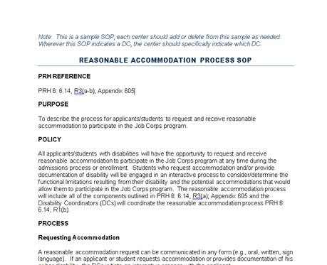
Sample Reasonable Accommodation SOP

Slide 18
When Does Process Occur?
Interactive RA process takes place if 1 of 4 scenarios occur:
  An applicant:
    Requests accommodation by completing the Reasonable Accommodation Request Form – Program (RARF);
    Indicates on the RARF that s/he would like to discuss the need for accommodations with the DC; or
    Provides documentation that s/he may be an individual with a disability who may need reasonable accommodation to participate in Job Corps.
  A student:
    Requests accommodation to any staff person and/or completes the RARF.
Notes:
RARF = Reasonable Accommodation Request Form

Slide 19
Reasonable accommodation process
Requesting Accommodation
STEP 1

Slide 20
Requesting accommodation
A RA request can be communicated in any form (e.g., oral, written, sign language).
Request for accommodations must be documented on the RARF.
  This form cannot be changed, and must be used to document the request.

Slide 21
Requesting accommodation
  If an applicant, the Admissions Counselor (AC) informs of the right to request accommodation and assists with the completion of the form, if needed.*
  If a student, the Disability Coordinator (DC) provides the form and assists with the completion, if needed.
All requests for accommodations to participate in the Job Corps program are reviewed at the center level.

Slide 22
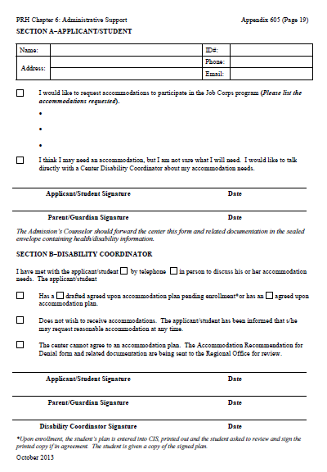
Job Corps Reasonable Accommodation Request Form – Program (RARF)

Slide 25
Reasonable accommodation process
DETERMINING THE NEED FOR REASONABLE ACCOMMODATION
STEP 2

Slide 26
Determining the need for Reasonable accommodation
If an applicant/student provides documentation that indicates s/he may be an individual with a disability who may need RA to participate in Job Corps, the DC must engage the applicant in an interactive process to determine the need for accommodation, even if the applicant did not request accommodation

Slide 27
Determining the need for Reasonable accommodation
When an applicant/student declines accommodation(s), it must be documented using the Reasonable Accommodation Review/Documentation of Disability Form (RAR/DDF) (if documentation was present in the applicant file, but no request was made) or the RARF (if applicant/student makes a request or indicates s/he may need an accommodation)

Slide 28
Reasonable Accommodation Review/ Documentation of Disability Form (RAR/DDF)

Slide 29
Reasonable Accommodation Review/ Documentation of Disability Form

Slide 30
Request for Accommodation Form - Program

Slide 31
Reasonable accommodation process
Ensuring Appropriate Documentation
STEP 3

Slide 32
Ensuring Appropriate Documentation
If an applicant/student has requested accommodation, the AC or DC, respectively, may ask the applicant for reasonable documentation about his/her disability and functional limitations.

Slide 33
Functional Limitations
Functional Limitation | Examples
Self Care | activities of daily living like bathing, dressing
Mobility | walking or getting around the center
Difficulty with medication side effects | drowsiness, dry mouth, slowed response times
Screening out environmental stimuli | unable to screen out sounds, sights, odors, etc. which interferes with managing daily tasks and sometimes results in emotional/physical responses as the individual becomes overwhelmed with the sensations
Sustaining Concentration | restlessness, distraction, shortened attention span, memory difficulties, etc.)

Slide 34

Ensuring Appropriate Documentation
The AC and/or DC may only secure limited documentation that is needed to establish that
  A person has a disability
  The disability necessitates a RA.

Slide 35

Sources of Disability-related documentation
Appropriate health care or rehabilitation professionals, that could include:
  Physicians
  Psychiatrists
  Psychologists
  Nurses
  Physical/Occupational/Speech Therapists
Notes:
If in doubt, work with your RDIC to sort it out.

Slide 36
Types of supporting documentation
Might include:
  IEPs and 504 Plans
  Psychological evaluations
  Doctor’s notes/records – Medical disability
  Hospital records
  Treatment center report
  Social Security documentation

Slide 37
Documentation Examples to establish accommodation need
Condition/ Disability | Type(s) of Documentation* | Consideration(s)
Learning | IEP/504 Plan | Was the student released from services?
ADHD | Psychological, IEP/504 Plan, CCMP
Generalized Anxiety Disorder | Psychological, CCMP, General Medical Records | Is there a diagnosis? What are the functional limitations? Are there medication side-effects impacting the person?
Seizure Disorder or Diabetes | CCMP, General Medical Records
*These lists are examples and not all inclusive.

Slide 38
Ensuring Appropriate Documentation
DC should not spend a lot of time analyzing whether that applicant’s/student’s condition meets the definition of a disability or requesting extensive documentation.
Instead the focus should be on the accommodation:
  Is it reasonable?
  Are there other accommodation alternatives that can be considered?

Slide 39
Accommodations Supported by the documentation?
Review the documentation to determine whether or not the applicant or student’s functional limitations resulting from the impairment or condition are relevant to the accommodations being considered or provided.
Does the accommodation match the manifestation of the individual’s disability?

Slide 40
Accommodations Supported by the documentation?
  For example, a student who has a mobility impairment would not be entitled to the use of a calculator on the non-allowable portions of the TABE unless there was also a corresponding disability in the area of math calculations.

Slide 41
No documentation provided
If an applicant fails or refuses to provide the reasonable documentation requested, and the disability is not obvious (i.e., not a person who is blind or deaf, etc.), then he or she may not be entitled to accommodations.

Slide 42
Do’s & don'ts of Documentation
True or False
  If an applicant or student has given you documentation that substantiates their disability, you can still ask for additional disability documentation.
FALSE

Slide 43
Do’s & don'ts of Documentation
True or False
Determining whether an applicant or student is a person with a disability requires extensive documentation and a lot of analysis.
FALSE

Slide 44
Reasonable accommodation process
Reviewing a Request
STEP 4

Slide 45

Reviewing a request
Simple Accommodation Request
  If the accommodation request is straightforward and does not involve significant expense, the review can be an informal meeting (phone or face-to-face) between a DC and the applicant/student.
  Agreed upon accommodations can be determined at this meeting and approved by a DC.

Slide 46
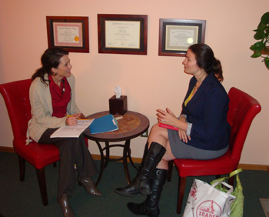
Reviewing a request
Complex Accommodation Request
  If the request involves complex accommodation issues and/or significant expense, a RAC meeting may be required.
  RAC participants will vary depending on the nature of the request, but must always include a DC (chairperson) and applicant/student.
    Who else might need to serve as participants on the RAC?
  A DC provides information on the applicant’s/ student’s accommodation request, functional limitations, and manifestations of the disability.

Slide 47
Reviewing a request
Complex Accommodation Request
  If appropriate accommodations can be developed/ agreed to at RAC meeting, an Accommodation Plan can be developed.
  If there are concerns about reasonableness, then the center may need to submit one of the following to the Regional Office, dependent upon which is appropriate:
    Accommodation Recommendation of Denial Form
    Reasonable Accommodation Request for Funding Assistance Form

Slide 48
CONSIDERATIONS IN
REVIEWING REQUESTS
If the applicant or student is requesting accommodation but is unsure of their specific accommodation needs, what should the RAC do first?

Slide 49
Developing an accommodation plan
Determine the functional limitations the individual may have as a result of the disability
  Example – If an applicant or student is blind, one functional limitation would be that s/he cannot see
Determine barriers to the program, if any, and accommodations needed to alleviate barriers
Review existing documentation
Obtain input from the applicant

Slide 50
DEVELOPING AN
ACCOMMODATION PLAN
Use expertise of staff and other resources
  JAN or other community resources (Centers for Independent Living, VR, Universities, etc.)
Determine what accommodations are necessary and appropriate for the applicant/student in the Job Corps setting

Slide 51
Reasonable accommodation process
Determining Reasonableness
STEP 5

Slide 52

Determining reasonableness
Job Corps does not have a specific list of accommodations that will or will not be provided.
  Each request is evaluated individually and assessed for reasonableness.
Assessing for reasonableness:
  Did the applicant request accommodations that may be unreasonable?
    Unduly Costly
    Fundamental Alteration to the Program

Slide 53
Evaluating the request
The RAC convenes and considers the following:
  What are the accommodation requests of the applicant/student?
    Are there specific communication needs? Remember, those are given priority consideration.
  What are the costs associated with the applicant/ student’s request?
  Are there local resources available that could assist the center?

Slide 54
Evaluating the request
  Are there equally effective alternatives that would be appropriate to use or to supplement the accommodation or is there an alternate solution that would permit the applicant/student to participate in the program?
  Will there be accommodation costs that exceed $5,000?

Slide 55
Making a decision
The Center Director, supported by the RAC, reviews the collected information and makes a decision. The center may either:
  Recommend denial of the accommodation
  Request assistance for funding if the specific criteria have been met
The accommodation/funding review process must be completed within 30 days of request.
  If you need to request funding assistance, contact your Regional Disability Coordinator who can get you started with this process

Slide 56
If Recommending Denial of accommodation
Complete the Accommodation Recommendation of Denial Form (available in Appendix 605) and submit to the Regional Office along with supporting documentation and notes
  Applicants must not be denied admission based solely on the need to provide reasonable accommodation or modification.

Slide 57
Regional Office Disposition
What happens after the applicant/student receives a letter denying their accommodation?
Region
Grants
Accommodation
Region
Does Not Grant
Accommodation
Center Provides Accommodation
Applicant/Student
Receives a Letter from the Region

Slide 58
Reasonable accommodation process
ENTERING THE ACCOMMODATION PLAN
STEP 6

Slide 59

Entering the accommodation plan
When testing accommodations are required, TABE accommodations are entered prior to first administration of the TABE test.
Exceptions:
  Student did not disclose disability and need for accommodation until after testing.
  Student declined accommodations until a later time.

Slide 60
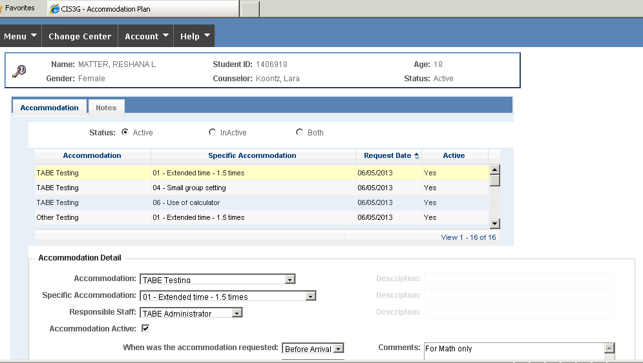

Entering the accommodation plan

Slide 61
Entering the accommodation plan
Accommodation Plans should not contain:
  Diagnosis
  Medication needs
  Other health information
DC should print out plan, DC and student should sign the plan
DC should provide student with a copy of the signed plan and the original signed plan is stored in the student’s Accommodation File

Slide 62
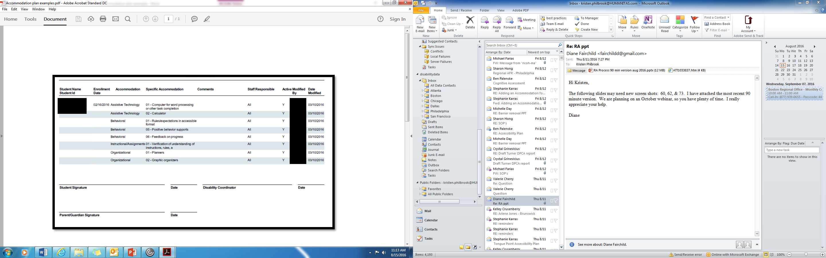

Slide 63
Reasonable accommodation process
Notifying Staff/Viewing the Accommodation Plan
STEP 7

Slide 64
Notifying Staff/Viewing the Accommodation Plan
As necessary (i.e., when Accommodation Plans are added or updated in CIS), but at least biweekly, a DC should e-mail all staff members who interact with students a list of students with Accommodation Plans available in the CIS

Slide 65
Notifying Staff/Viewing the Plan
Sample list 1
Sara Jane Parker
Laura Linney – NP
Sheera Jenkins
Bob Marley – UP
NP – New Accommodation Plan
UP – Updated Accommodation Plan
Sample List 2
Melissa Gilbert
Tony Machado*
Ethel Mertz
Albert Einstein*
* New or Updated Plan

Slide 66
Reasonable accommodation process
Determining Accommodation Effectiveness
STEP 8

Slide 67

Determining accommodation effectiveness
  The effectiveness of the student’s accommodation should be monitored as needed, but at least every 60 days as part of student performance panel reviews

Slide 68
Determining accommodation effectiveness
Counselor should:
  Gather information from appropriate staff about the effectiveness of accommodation prior to panel. All staff who interact with student have a responsibility to provide feedback on accommodation effectiveness
  Check with student about effectiveness of plan at each meeting
  Forward information to DCs
DCs should review feedback and conduct RAC as needed to update plan or resolve issues

Slide 69
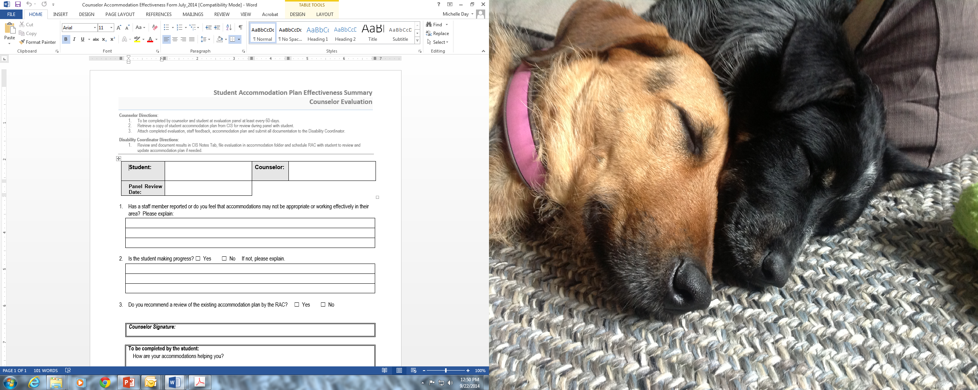
Accommodation Plan Effectiveness Summary

Slide 70
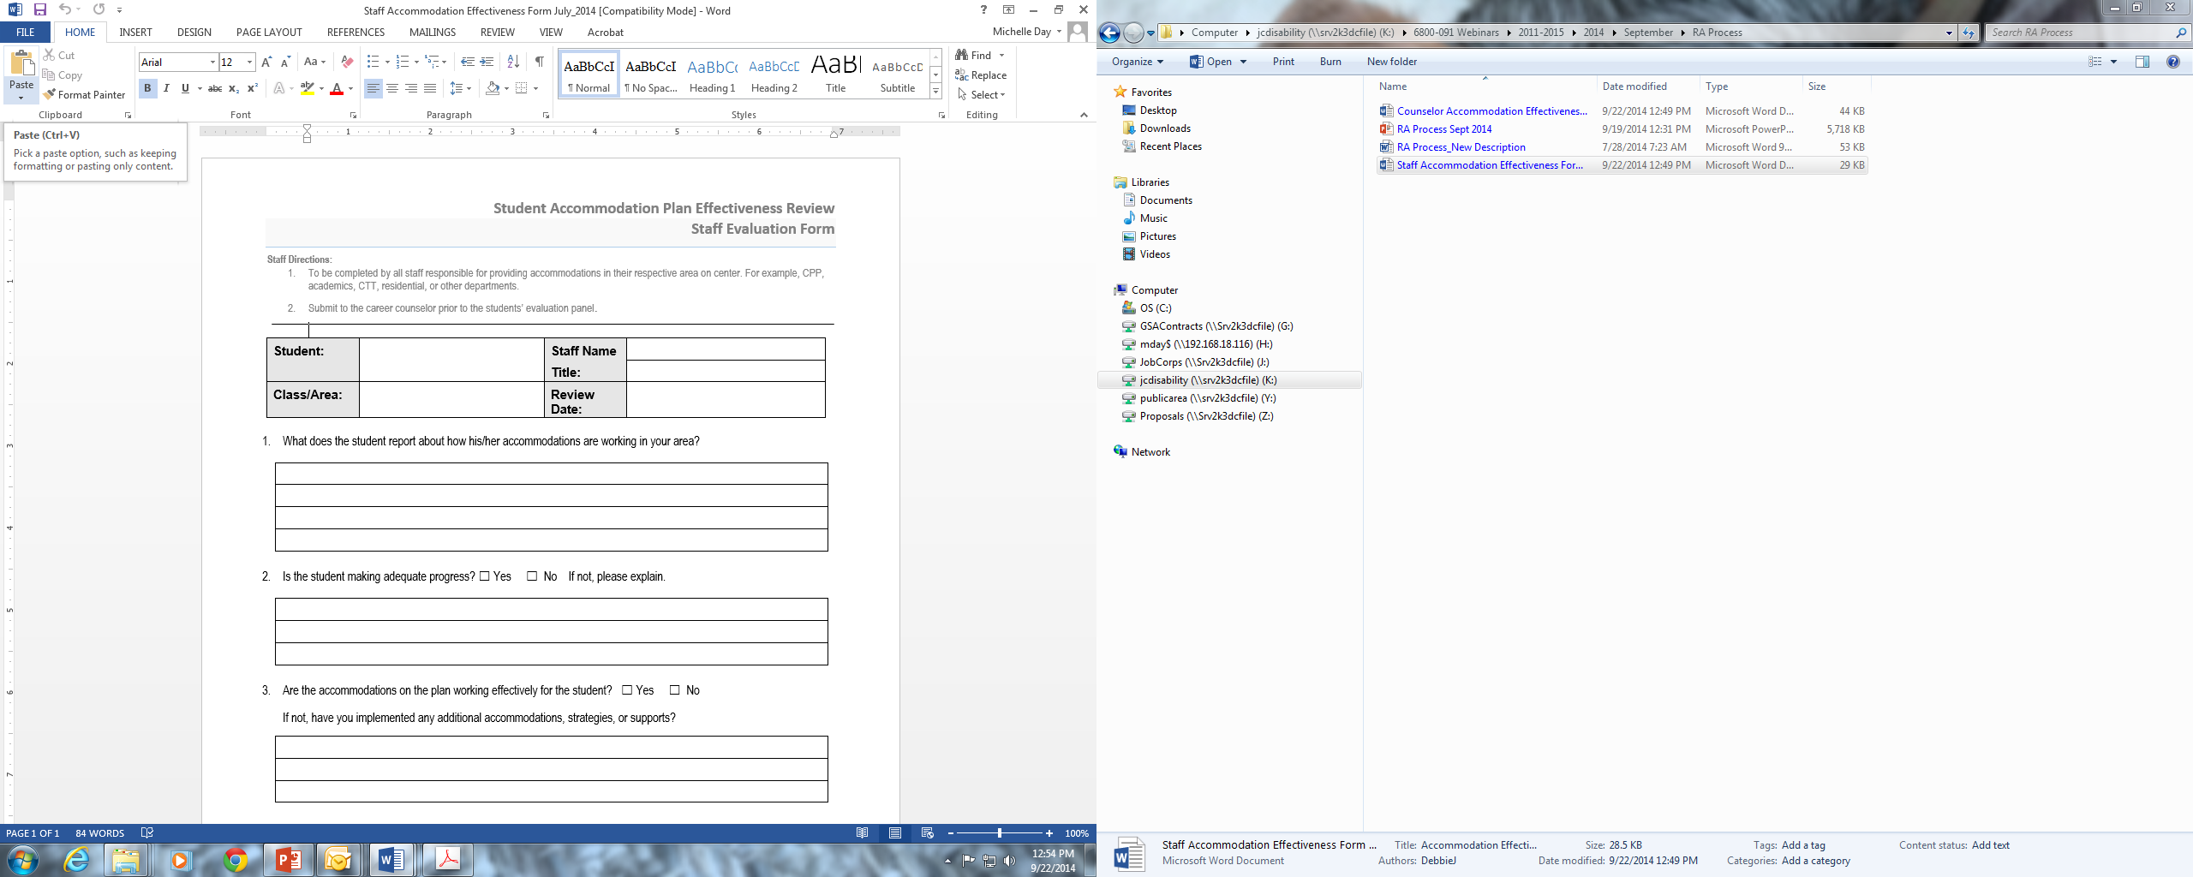
Accommodation Plan Effectiveness Review

Slide 71
Reasonable accommodation process
Documenting the Accommodation Process
STEP 9

Slide 72
Documenting the accommodation process
All interactions with the applicant/student and activities related to the provision of reasonable accommodation should be documented in the CIS Notes tab

Slide 73
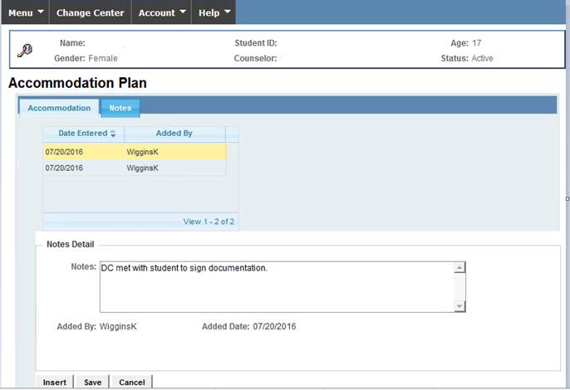
Documenting the accommodation process in cis

Slide 74
Documenting the accommodation process
SAMPLE NOTES PRIOR TO ENTRY – RA WITH DC
7/7/2015 | R – Accommodation Plan Meeting A – Contacted applicant prior to entry on 7/2/15 after reviewing supporting documentation. Discussed accommodations and applicant agreed to all recommendations except proctor read testing. Applicant entered program on 7/6/2015. Met with student on 7/7/2015 to go over plan discussed prior to entry. Entered plan in CIS, student signed plan and was provided a copy. Student was also given the new student disability packet. P – Monitor effectiveness of accommodations through Effectiveness Process. | M. Johnson
8/28/2015 | R – 45-Day Effectiveness Review A – After reviewing the Accommodation Effectiveness Forms from instructors and counselor there are no concerns with the accommodation plan at this time P – Continue to monitor effectiveness through Effectiveness Review forms every 60 days. | K. Reed
10/27/2015 | R – 60 Day Effectiveness Review A – After reviewing the Accommodation Effectiveness Forms from instructors and counselor there was a concern noted by Academic Instructor P – Will call in student to go over accommodation issues. | K. Reed
10/31/2015 | R – Follow-up meeting with student A –Instructor and student are requesting a calculator for both parts of the TABE test. Documentation supports request – plan updated. P – Continue to monitor effectiveness through Effectiveness Review forms every 60 days. | K. Reed
11/15/2015 | R – Student meeting with DC A –Student feels that additional time for testing is needed. Documentation supports this request – plan updated. P – Continue to monitor effectiveness through Effectiveness Review forms every 60 days. | K. Reed
CIS Notes EXAMPLE

Slide 75
Documenting the accommodation process
SAMPLE NOTES WHEN A REFERRAL IS RECEIVED AFTER ENTRY
6/9/2015 | DC received a referral from the counselor on this date; student disclosed on SIF. | S. Strong
6/11/2015 | DC met with student to discuss referral. Student received services from South Mountain Clinic over the past several years. Student signed a release of information. DC faxed request for records | S. Strong
6/12/2015 | DC received records and forwarded to CMHC for review. CMHC reviewed records and provided DC recommendations for appropriate accommodations | S. Strong
6/15/2015 | DC and CMHC met with student to discuss possible accommodations. Student feels all suggestions would be helpful including a behavioral plan (drafted), frequent breaks, pass to leave class to a safe place when needed, extended time for assignments. Entered plan into CIS, student signed plan and was provided a copy | S. Strong
8/1/2015 | 60-day ESP – Accommodation effectiveness – no changes at this time | S. Strong
Another CIS Notes EXAMPLE

Slide 76
Reasonable accommodation process
Maintaining the Accommodation File
STEP 10

Slide 77

Maintaining the accommodation file
A separate a Accommodation File should be maintained for each student receiving accommodation.
All documents relating to the reasonable accommodation request should be located in this file.
Only appropriate staff with a reasonable “need to know” should have access to the information; medical records must be stored separately.

Slide 78
Reasonable accommodation process
Storing Accommodation and Disability Documentation
STEP 11

Slide 79
A disability,
“no accommodations file”
A Disability, No Accommodation file must be created for each student that has a disability, but no Accommodation Plan. This file will contain the documentation of disability form and any non-health disability-related documentation such as the IEP.

Slide 80
Storing disability and accommodations files
Each student entered into disability data has ONE file. That file is either going to be a Disability, No Accommodation File” or an Accommodation File.
All files should be stored in the same location, but the files should be differentiated (e.g., stored as a group in a separate area of the cabinet or color coded).

Slide 81
Accommodation file vs. disability file Layout comparison
Accommodation File
Disability File
Documentation of a disability
Job Corps RARF or RAR/DDF
Signed Accommodation Plan
Documentation of the process (CIS Notes tab printout)
Accommodation Effectiveness Review Forms
Referral Form
Documentation of a disability
Job Corps RAR/DDF
Documentation of Process
Referral Form

Slide 82
Transmission and storage at separation
When the student separates, the Accommodation or Disability file, whichever applies, must be sealed and sent to the Records Department
All protected health and disability information must remain in sealed envelopes and labeled accordingly.

Slide 83
Reasonable accommodation process
Confidentiality
STEP 12

Slide 84

Confidentiality
To maintain confidentiality, documentation is made available on a need-to-know basis only and participants in the process should not discuss information about the request outside of the process.

Slide 85
RED FLAGS in the RA PROCESS

Slide 86

Red flags in the ra process
Can you name some of the more commonly occurring “Red Flags” in the RA process that might exist?

Slide 87
Red Flags in the RA Process
Failing to engage applicants or students in the interactive process if they didn’t request an accommodation, but provided documentation of their disability
Not documenting declinations of accommodations
Not documenting the accommodation process thoroughly or using the CIS Notes tab

Slide 88
Red Flags in the RA Process
Providing accommodations without supporting documentation
Entering “cookie cutter” Accommodation Plans instead of individualizing through interactive process

Slide 89
Resources
Tools, Websites, & Technical Assistance

Slide 90
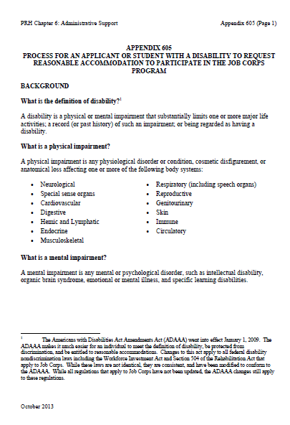
Appendix 605
Appendix 605
Process for an Applicant or Student with a Disability to Request RA to participate in the Job Corps Program
October 1, 2013

Slide 91
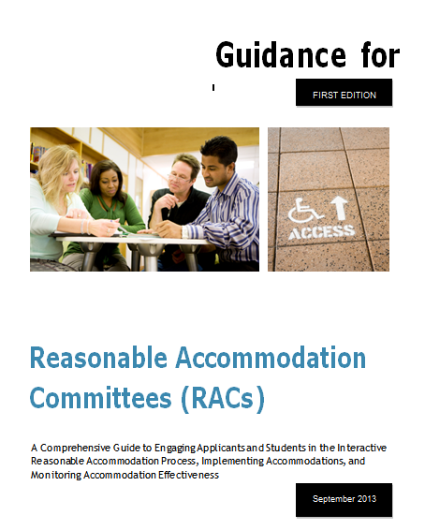
Reasonable accommodation Committee guide
A Comprehensive Guide to Engaging Applicants and Students
in the
Interactive Reasonable Accommodation (RA) Process, Implementing Accommodations, and Monitoring Accommodation

Slide 92
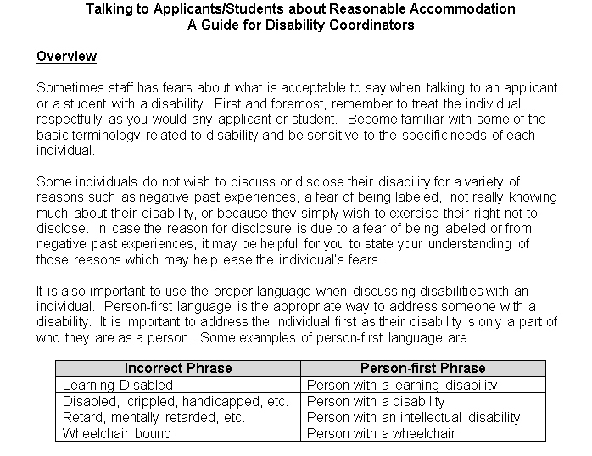
Talking about reasonable accommodation

Slide 93
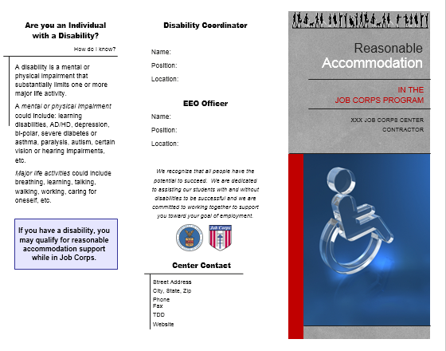
Reasonable accommodation brochure

Slide 94
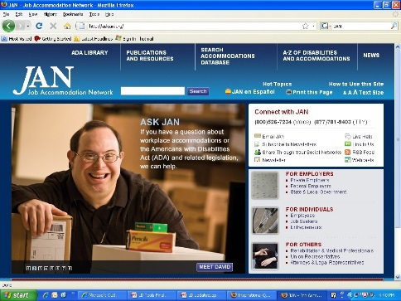
Job accommodation network askjan.org

Slide 95
JAN – Accommodation Information by Limitation A-Z
Allows JAN website users to find workplace accommodation ideas by the type of limitation an employee is experiencing, regardless of the underlying disability.
This feature joins the current A-Z options to search by disability and by topic.

Slide 96
JAN – Limitation A-Z Search
Students experiencing difficulty concentrating:
  Providing access to a white noise machine
  Increasing natural lighting
  Providing auditory and visual directions
Students experiencing fatigue:
  Developing a modified schedule
  Eliminating unnecessary environmental stressors such as uncomfortable temperatures, clutter, and lighting
  Providing a goal-oriented workload

Slide 97
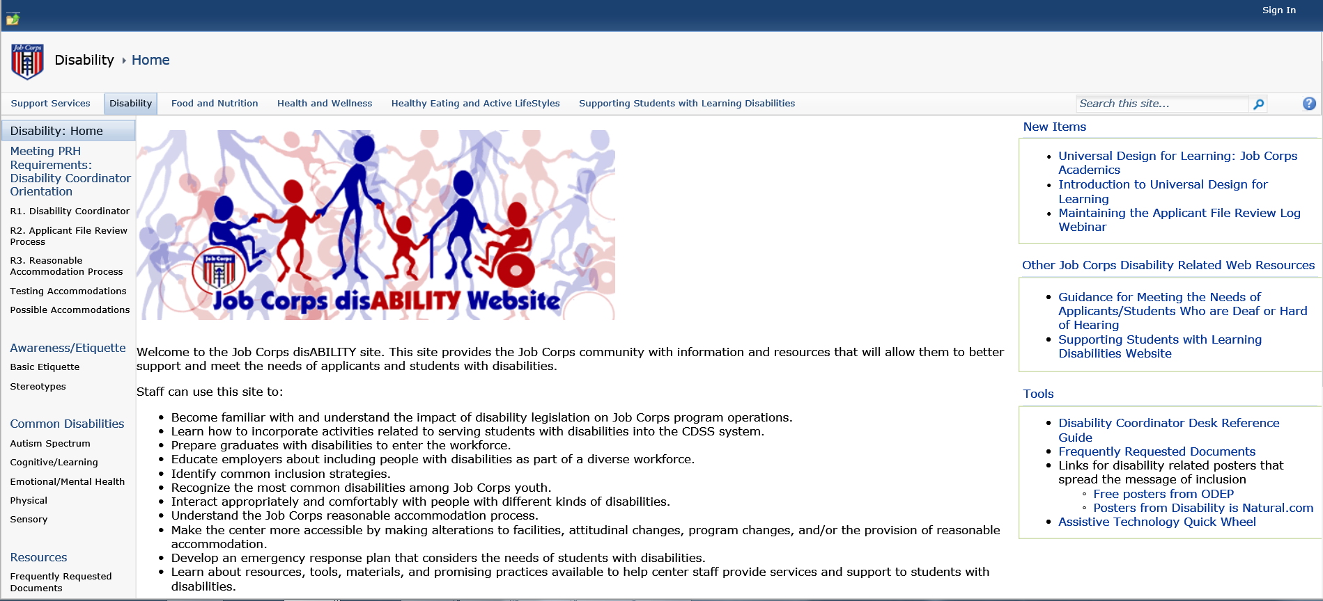
Job corps disability website
https://supportservices.jobcorps.gov/disability/Pages/default.aspx

Slide 98
Regional disability coordinators
Boston and Philadelphia Regions – Kristen Philbrook
  kristen.philbrook@humanitas.com
Atlanta and Chicago Regions – Sharon Hong
  sharon.hong@humanitas.com
Dallas Region – Laura Kuhn
  laura.kuhn@humanitas.com
San Francisco Region – Stephanie Karras
  Stephanie.karras@humanitas.com

Slide 99

Questions?

