Slide 1
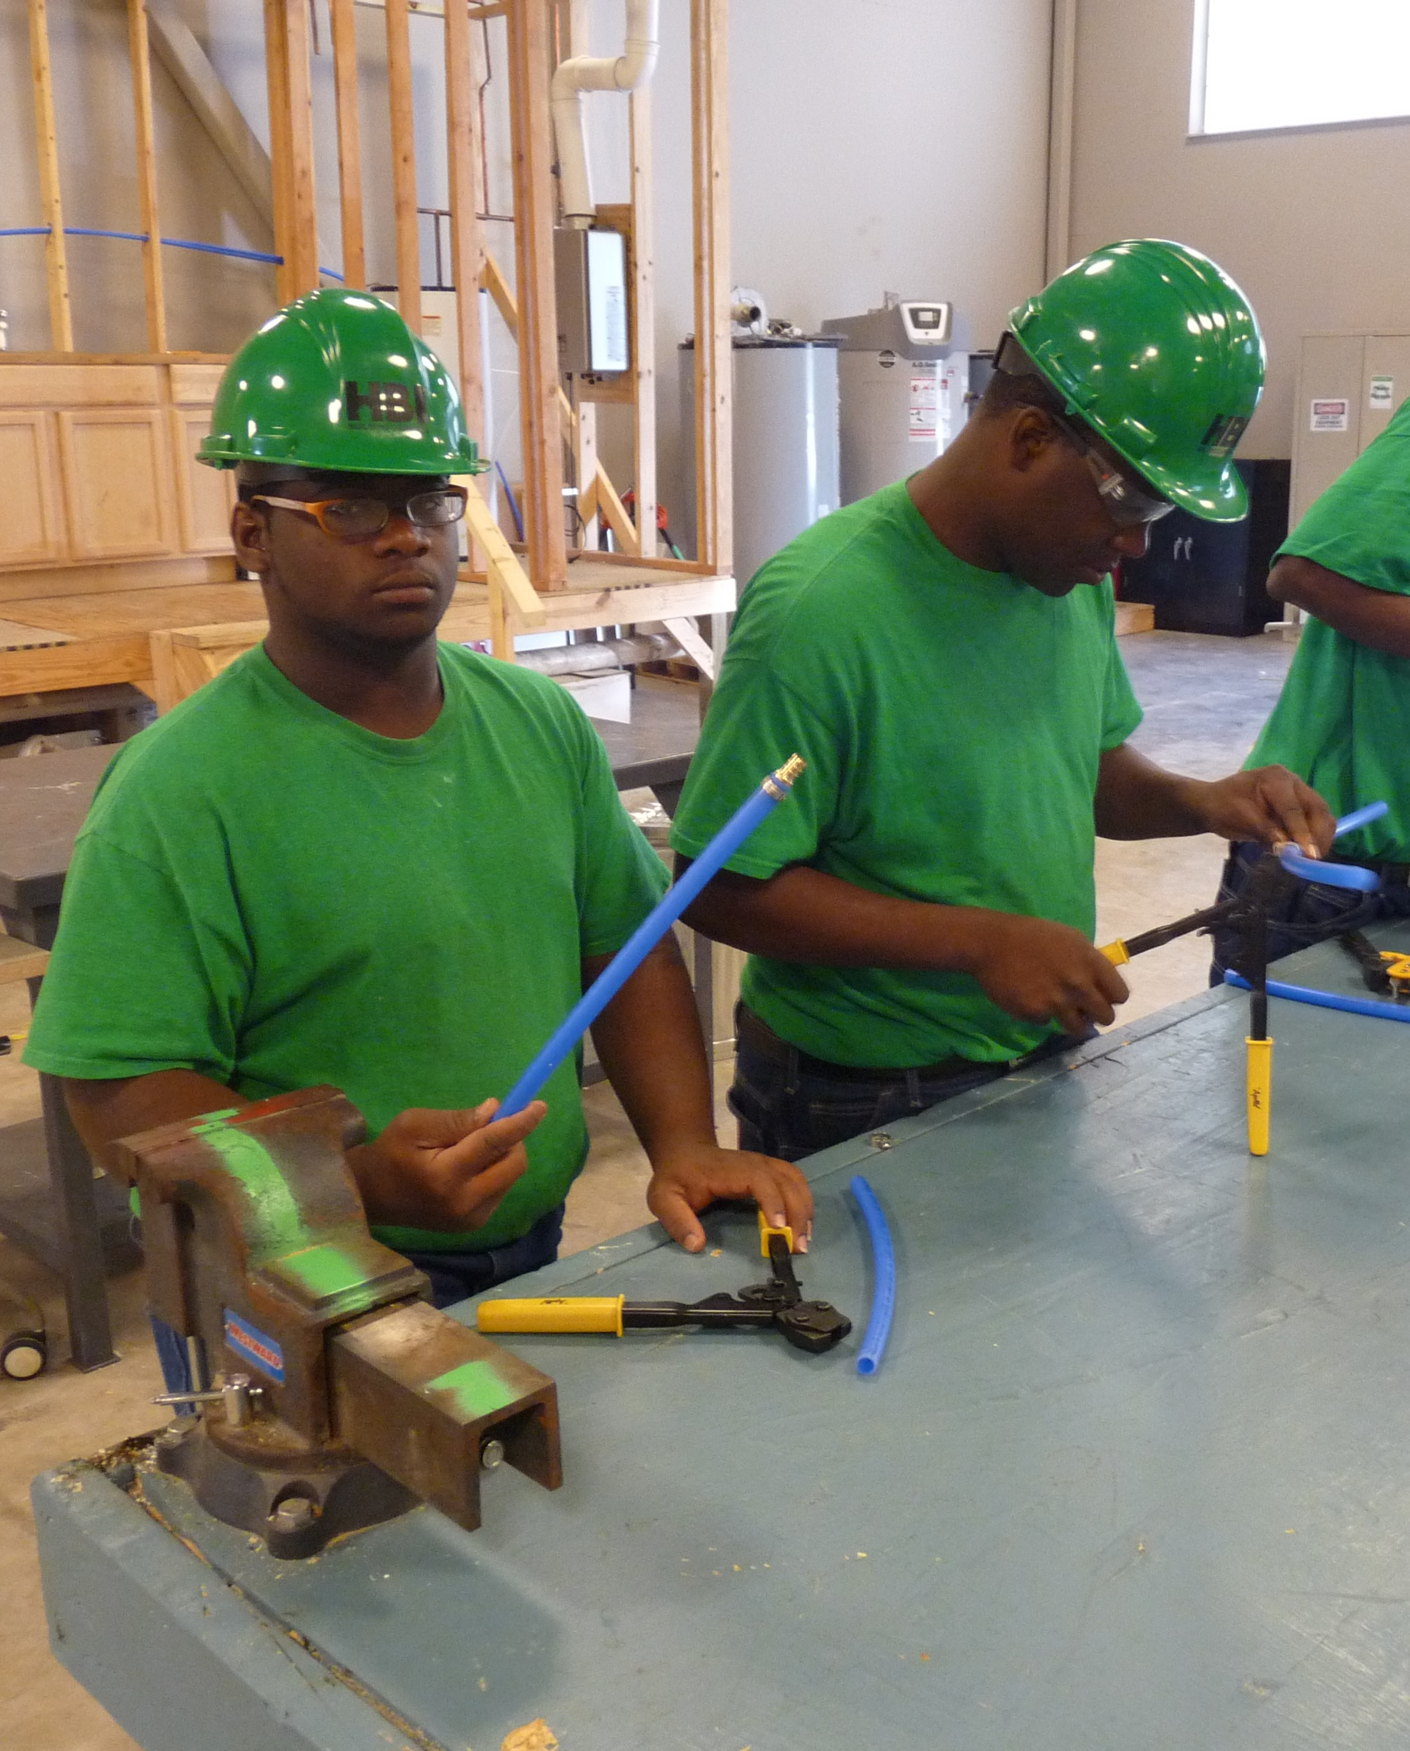
Part 1 Reasonable Accommodation in Career Technical Training (CTT)
Easy and Practical Ways to Accommodate and Adapt the “Hard” Trades
Notes:
Easy and Practical Ways to Accommodate and Adapt the “Hard Trades” is Part 1 of a 2-part webinar series that will highlight assistive technology accommodations and other practical adaptations that support both independence and employability for students with disabilities enrolled in the building or construction-related trades. The importance of developing supports that are portable and transferrable into the workplace also will be discussed.
When we use the term “hard trades,” we are simply referring to the construction trades such as plumbing, electrical, masonry, carpentry, facilities maintenance, bricklaying, welding…
A little later in the webinar, we will hear from one of our center HBI Instructors who will be sharing some of his ideas.

Slide 2
Webinar Objectives
List at 2-3 assistive technologies that are available in local stores and used in daily life that also can be used to accommodate students with disabilities in CTT hard trades.
List at least 3 specific assistive technology resources that provide support and services for students with disabilities who are enrolled in CTT.
Describe at least 2 ways to modify instruction that would remove barriers and provide access for students with various disabilities in CTT hard trades.

Slide 3
Poll Question #1
My primary role in Job Corps is
Disability Coordinator
Career Technical Instructor or Manager
Academic Instructor
Center Management
Corporate Management
Other

Slide 4
Poll Question #2
Within your CTT program, have you implemented the accommodations in your students’ accommodation plans (APs)?
I know the APs, generally, of my students and ensure routine implementation
I have reviewed my students’ APs but do not always consistently implement
I rarely review my students’ APs because my program naturally accommodates
I have never reviewed or implemented a student’s AP

Slide 5
Current CTT Accommodation Practices
In the chat box,
List a few ways that you are already supporting students with disabilities in your classrooms through:
Accommodations
Adjustments
Modifications
“Yes” or “No” – Are most of those accommodations, adjustments, or modifications taken from JC Accommodation Plans?

Slide 6
Career Technical Training
Inherent Benefits

Slide 7
Although CTT has many built-in instructional strategies that naturally meet the needs of ALL learners, we cannot be complacent about how each student is performing or should have to perform.
Students with disabilities often get left behind. They have learned to “blend” or “cope,” but that does necessarily mean they are making progress. Their accommodations give them equal “access” to the program but we have to be mindful of potential barriers that may prevent their accessing them.

Slide 8
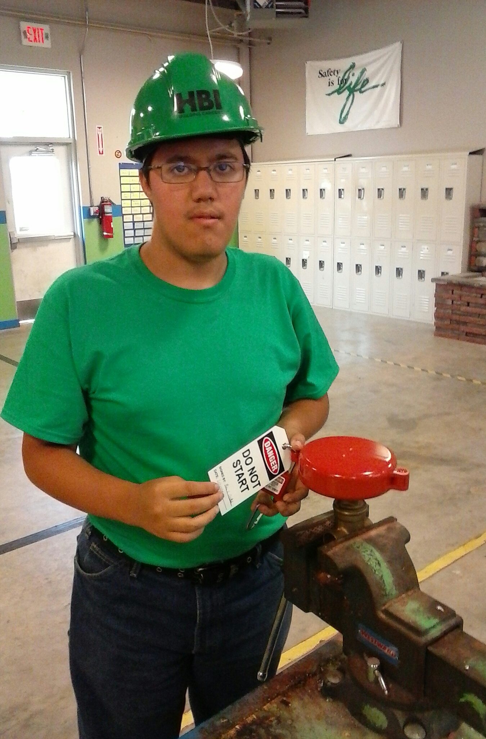
Accessing CTT
Accommodations and Strategies

Slide 9
CTT
Instructional Strategies
Hands-on learning
Project-based learning
Peer mentors
Modeling
Cooperative learning opportunities
Multi-modal (visual, auditory, sensory, kinesthetic…)
Checking for understanding (Step-offs)
Real life applications – Engaging materials; new concepts tied directly to trades
Set up your CTT environment with Universal Design for Learning in mind!
Accessible equipment
Accessible furniture
Accessible programming
Notes:
As we mentioned in the previous section, CTT is one of those areas in which there is a fair amount of inherently beneficial practices and strategies for students with disabilities that are naturally built into how we train and educate. Certainly, we know that hands on and project-based learning often is a more successful model and more of an interesting mode of learning for many of our students, with and without disabilities. We know we can promote even greater access by thinking in terms of universal design and setting up the CTT environments with that concept in mind. Even so, we also know that that we still have to be diligent about ensuring access for our students with disabilities .
One way to further provide access, to further individualize instruction and also grow and develop universal design based programming is through the use of technology. We recognize that technology is not meant to replace the role of the instructor. It is used to enhance or support teaching and learning. It is used to provided access, promote independence, improve employability.

Slide 10
Instructional Strategies in CTT – “Word Walls”
Notes:
An good example of a UDL CTT strategy is the use of word walls…in this case a tool wall with the words printed next to each tool.
Students get more exposure from things they see often, so this is a great way to reinforce new learning.

Slide 11
What is Assistive Technology?
Assistive Technology (AT) is any item or piece of equipment that is used to increase, maintain or improve the functional capabilities of individuals with disabilities in all aspects of life, including at school, at work, at home and in the community. Assistive Technology ranges from low tech to high tech devices or equipment.
http://www.gatfl.org/assistive.php
Notes:
Assistive Technology (AT) is an umbrella term that includes assistive, adaptive, and rehabilitative devices for people with disabilities and also includes the process used in selecting, locating, and using them.
Assistive technology promotes greater independence by enabling people to perform tasks that they were formerly unable to accomplish, or had great difficulty accomplishing, by providing enhancements to, or changing methods of interacting with, the technology needed to accomplish such tasks.

Slide 12
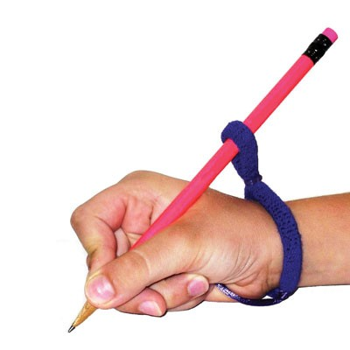
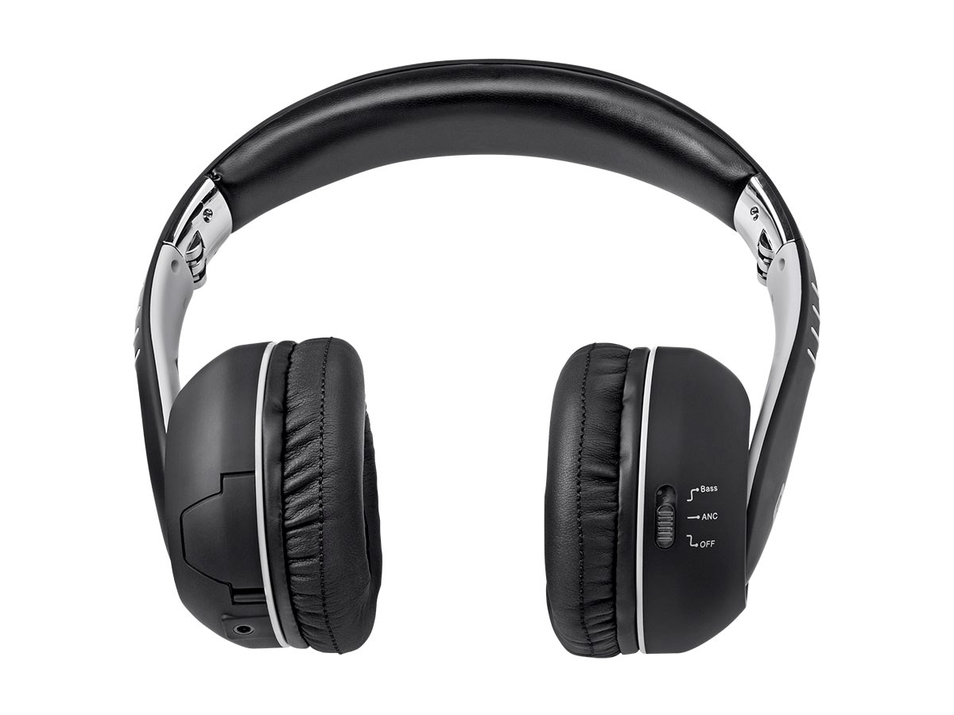
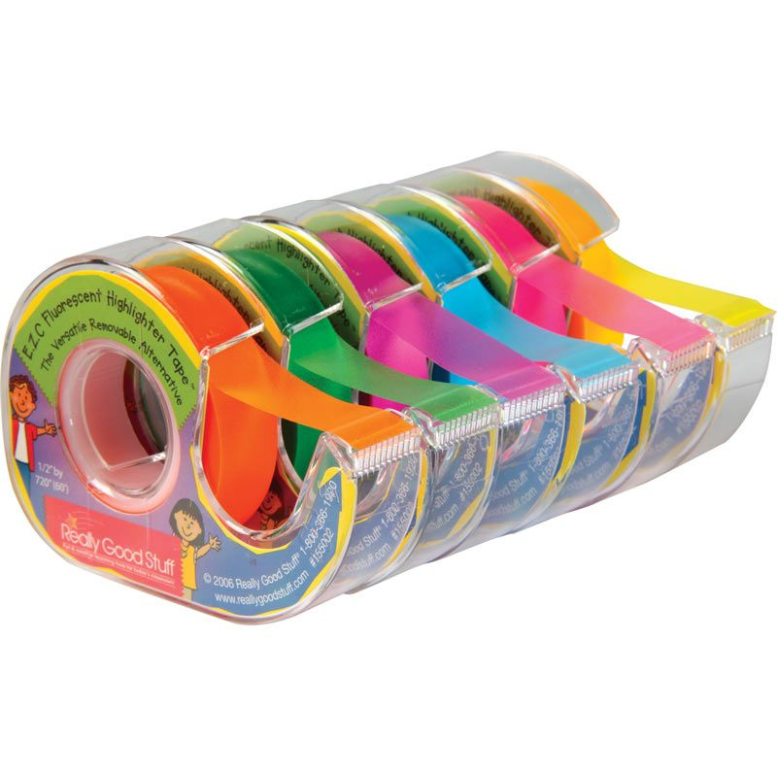
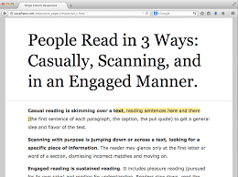
Low Tech
handheld magnifiers
large print text
visually supported lists
using paper and pen to communicate
canes and walkers
reachers/grabbers
noise cancellation headsets
specialized pen or pencil grips and much more
Low tech AT are devices or equipment that don't require much training, may be less expensive and do not have complex or mechanical features.

Slide 13
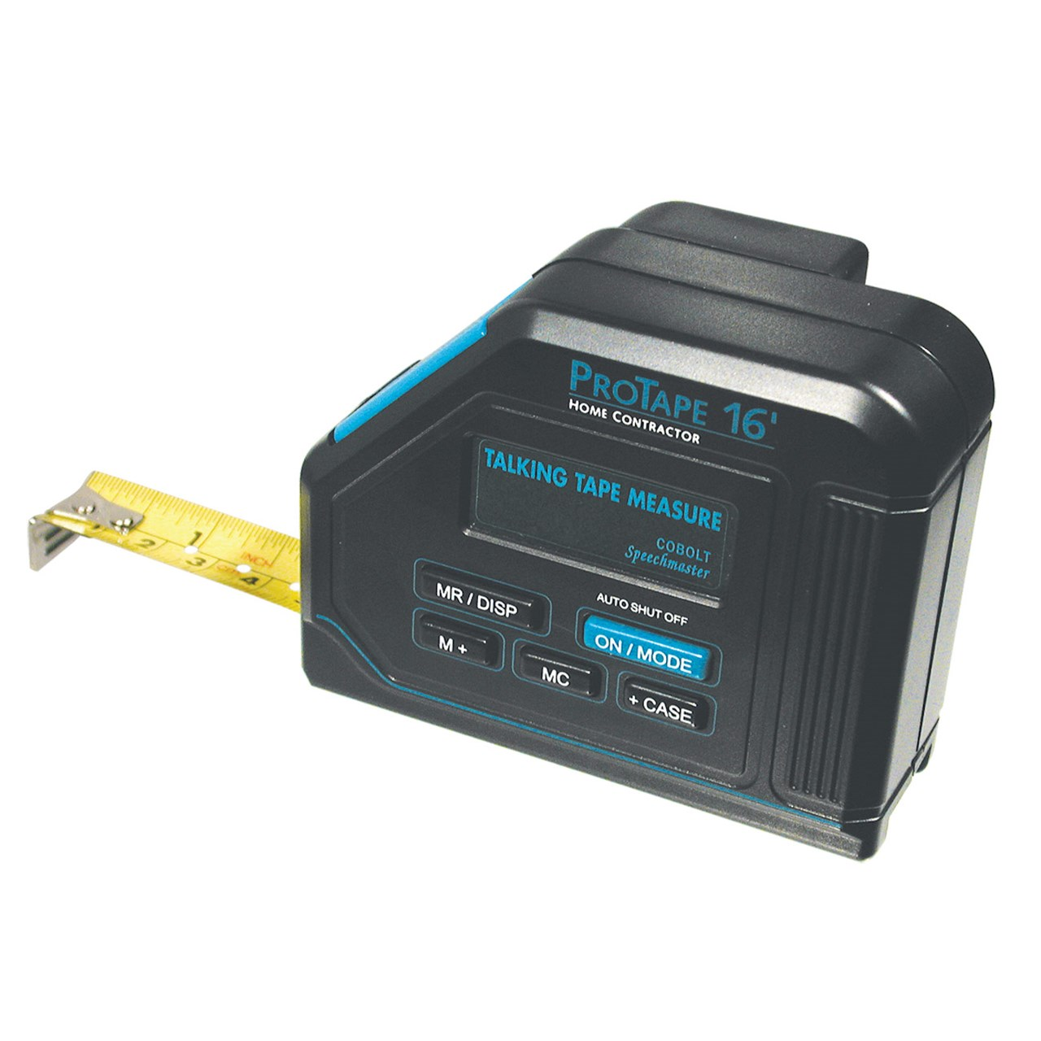
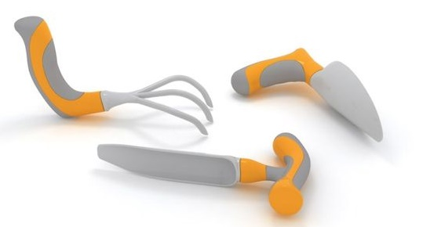
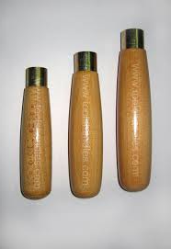
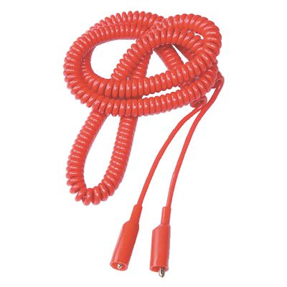
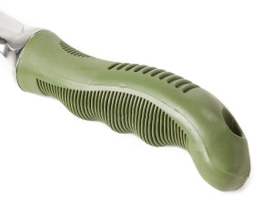
Mid-range Tech
talking tape measures, talking calculators, talking dictionaries…
electronic organizers
instructional videos (YouTubes, instructor/student-created videos etc.)
amplifiers
digitized printed materials (workbooks, manuals, texts…)
manual wheelchairs
modified tools (handle grips, extenders…)
AT devices or equipment that range in the middle of the continuum may have some complex features, may be electronic or battery operated, may require some training to learn how to use and are more expensive than the low-tech devices.

Slide 14
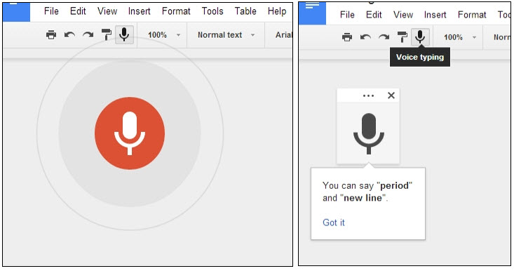
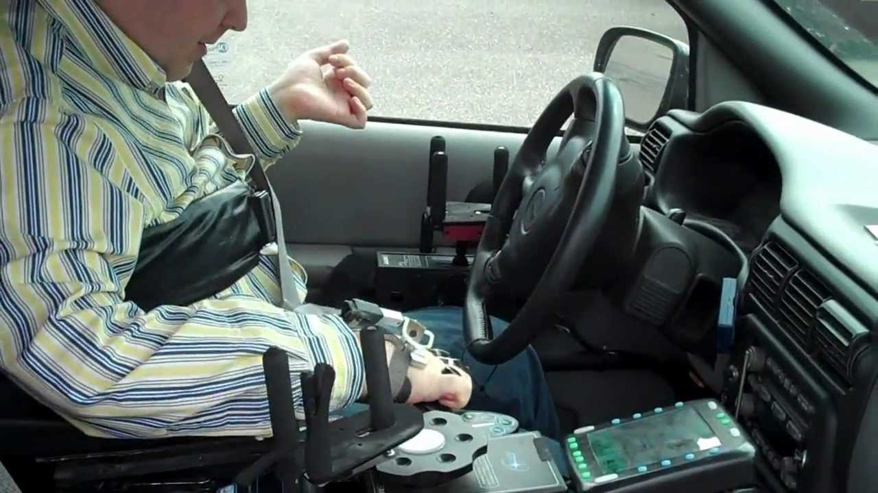
High Tech
power wheelchairs and scooters
digital hands-free headsets
Bluetooth integration for wireless connectivity
digi-drive technology (operating a vehicle with a joystick)
computers with voice-recognition software or magnification software
High Tech AT refers to the most complex devices or equipment, that have digital or electronic components, and may be computerized. Surprisingly, high tech AT can range from “free technology” to the most priciest of the technology available!

Slide 15
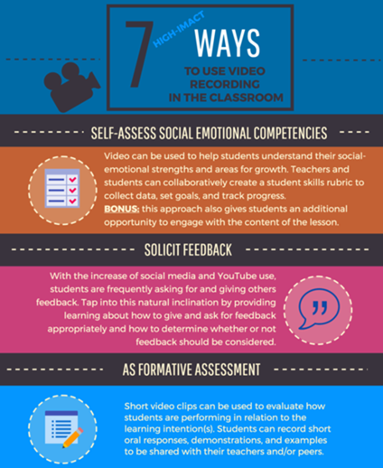
Using Videotaping of Instruction to Develop Accommodation and Instructional Resources
One of the ways to improve accessibility on center is to videotape instructional segments of the career technical program and create a career technical information library. How does this improve accessibility?
Provides content in an alternative format
Affords a student the opportunity to work independently because they can review instruction and work ahead and/or at least review the instructional content as frequently as they need for mastery

Slide 16
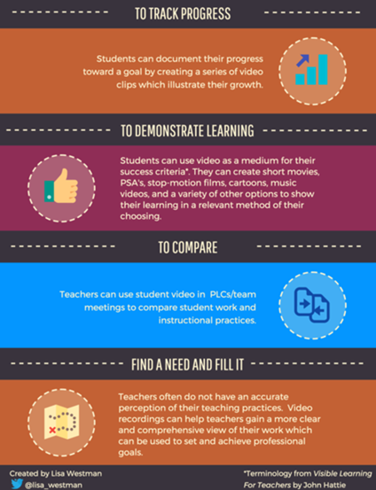
Using Videotaping of Instruction to develop Accommodation and Instructional Resources
Benefits instructionally?
Provides a multi-sensory resource
Allows the student to review at his/her own pace
Allows the student to repeat content to enhance memory retention and automaticity of recall of skills
Affords student an opportunity to have a model to compare completed work against
Assists ELL/ESL learners with language/vocabulary development

Slide 17
Getting started with AT in CTT (Accommodations in CTT)
What are the skills, activities, and job functions required to complete the trade or career path?
What are the student’s functional limitations? (e.g., difficulty reading printed materials, difficulty lifting heavy objects, hard-of hearing, controlling emotions…)
What job tasks are difficult to perform as a result of the impairment(s)? (e.g., lifting materials, tolerating stress, reading manuals, communicating in writing…)
Notes:
As I review the process for accommodating students with disabilities, be thinking about a student that you have or may have had in your Career Tech area that came with some type of disability or challenge.

Slide 18
Getting started with AT in CTT (Accommodations in CTT)
How can we remove the barriers or provide supports/services that will provide access, and allow each student with a disability to demonstrate the required skills, aptitudes, and abilities?
Assistive Technology
Instructional practices
What are our resources?
The individual with a disability
JAN, disABILITY Work Tools, Tools for Life, etc.

Slide 19
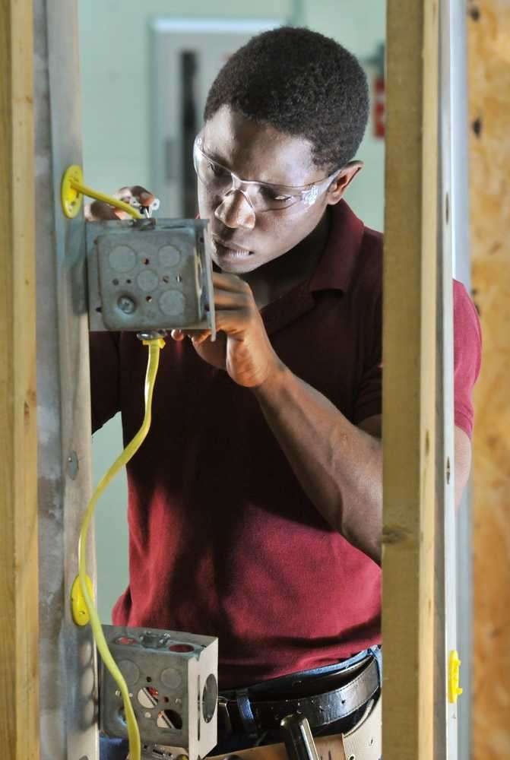
Assistive Technology in Career Technical Training
Case Study
Notes:
Let’s practice with one case study using the questioning approach that we just reviewed.

Slide 20
Practice: Case Study
Pat is an electrical student with a learning disability that impacts his ability to:
Remember new information
Read and understand texts beyond a 4th grade level
Organize and prioritize
Compute multi-step math calculations
What tasks, skills, job functions, activities might be difficult for Pat?
Remembering all of the electrical terms and tools
Reading the directions, instructions, manuals, contracts…
Completing a task or assignment from start to finish
Using multi-step math to calculate certain electrical supplies and formulas
Notes:
What are some possible AT accommodations that we could consider to support Pat with “remembering, reading, completing tasks, and math calculation?”
Use the chat box for any ideas you have…

Slide 21
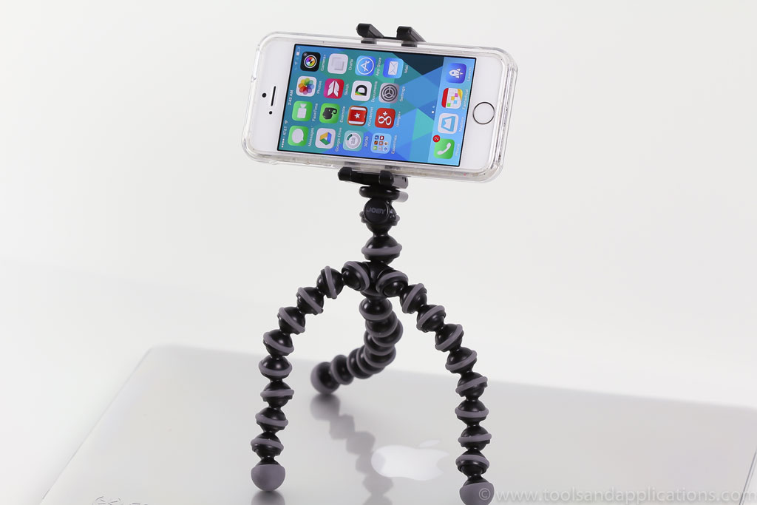
Possible AT Accommodations for Pat
Remembering new information
Recorded texts, lectures, notes
Highlighting key information and concepts
Instructional videos
Graphic organizers
Reading and comprehending text
Bookshare (digital/recorded printed text)
Text-to-Speech software
Notes:
How did you do?
Here are some possible AT accommodations… (slide)
Continued on the next slide…

Slide 22
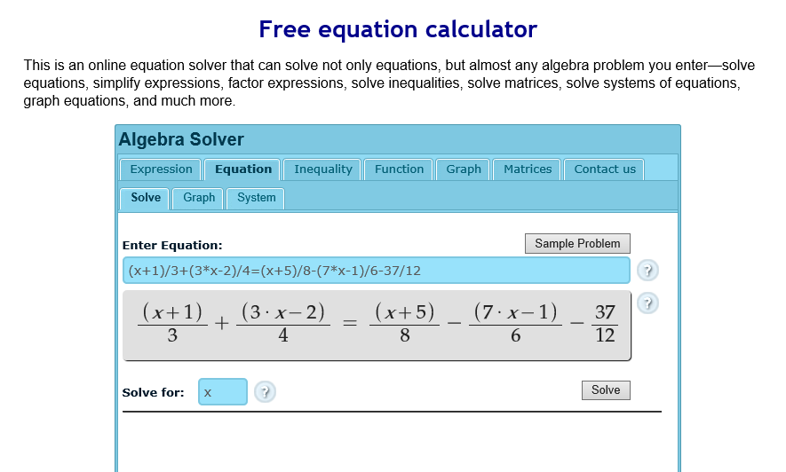
Possible AT Accommodations for Pat
Organizing and prioritizing
Mobile device for tracking tasks and scheduling
Electronic organizers
Multi-Step math calculations
Construction calculator
Equation solving tools
(Free Online Equation Solving Calculator)
Graph paper

Slide 23
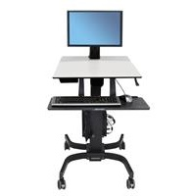
Other Examples of Assistive Technology in CTT
Adjustable work stations
Instructional videos
e.g. , Student generated videos
Custom websites
e.g., BlueTube
Assessible equipment
Talking tools (calculators, measuring tapes, watches, calendars…)

Slide 24
Poll Question #3
The accommodations, modifications, or adjustments that I make for students with disabilities in my CTT classes actually benefit all or most of my students.
A. Strongly Agree
B. Agree
C. Neutral
D. Disagree
E. Strongly Disagree

Slide 25
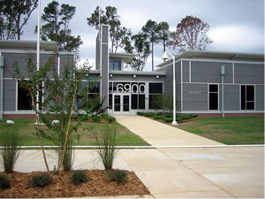
Assistive Technology in Career Technical Training
Little Rock Job Corps
Jim Cook, HBI
Notes:
We are fortunate to have a special guest speaker with us today on this webinar. Jim Cook is the lead HBI (Home Builders Institute) Instructor at Little Rock Job Corps.
Jim is going to share a little about his own learning background, then talk about how he uses some very simple assistive technology to provide access for all of his diverse learning students while also ensuring that each student is given multiple ways to demonstrate knowledge and understanding of the trade concepts.

Slide 26
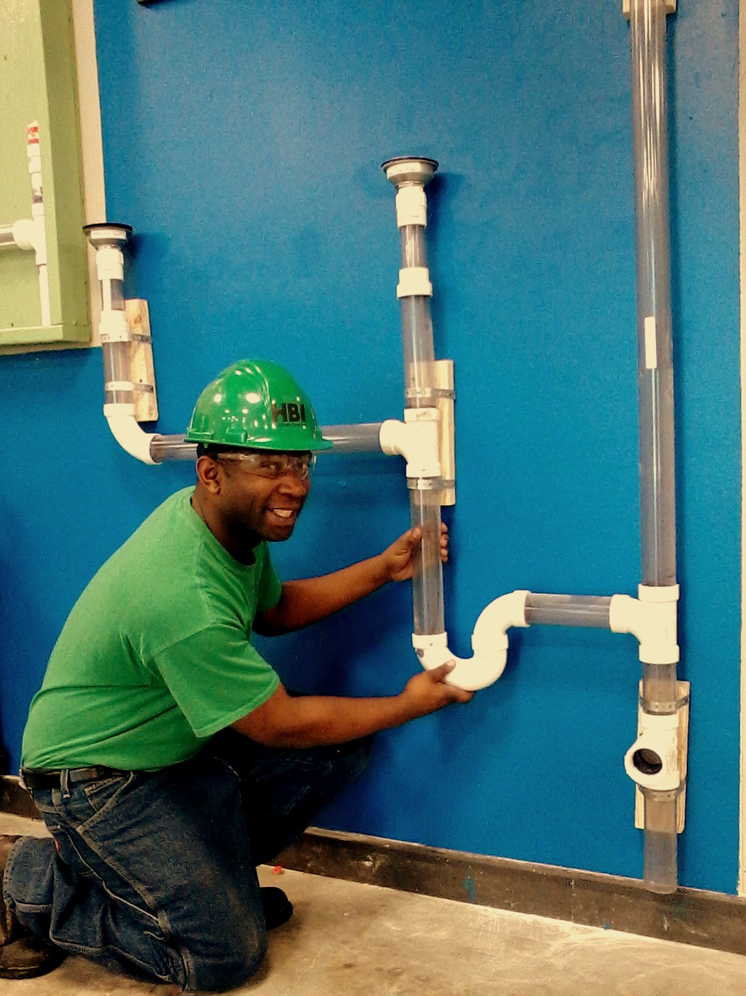
AT in HBI at Little Rock Job Corps
James Cook, HBI Lead Instructor
Student-created short instructional video
4 minute video - Soldering
HBI Jeopardy
Designed to teach vocabulary and concepts
Testimonials
Notes:
First, I am going to show segment of a student-created instructional video. Jim will then explain how he came to allowing his students to create instructional videos using his cell phone. He will also explain how the videos are used.
Jim also created a Jeopardy Game that we will take a look at, and he will describe how he uses it to check for understanding and reinforce concepts.

Slide 27
Terms 1
Types of Pipe 2
Abbreviations
Pipe Connecting
Summary ?
10
10
10
10
10
20
20
20
20
20
30
30
30
30
30
40
40
40
40
40
50
50
50
50
50
Notes:
Jim – talk a little about the game…how you display it on your computer, and how you organize teams etc…

Slide 28
Category 1
Category 1 question for 10 points
Pipe that allows airflow in a drainage system
10
Notes:
Jim - This is an example of a 10 point question under category 1 “terms.”

Slide 29
Category 1
Category 1 answer for 10 points
Vent
10
Notes:
Jim – I have made slides with all of the answers to each question.
Jim – talk a little about how the game teaches vocabulary, and anything else you think it does.

Slide 30
Gary Job Corps Center
Instructors adapted the curriculum for a student with missing limbs who needed to complete CPR training. The student was trained to complete chest compressions with their elbow because they did not have two hands.

Slide 31
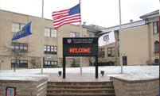
Pittsburgh Job Corps Center
Specialized hand tools and knifes were purchased for a culinary arts student that was missing fingers on one of their hands.

Slide 32
Blue Ridge Job Corps Center
Center staff created BlueTube (YouTube and Mimio technology), a designated website where trade students can access pre-recorded, self-paced lessons/lectures that follow the assigned reading materials.
Students that need repetition and instruction at their own pace are able to access the instructional materials on and off center.

Slide 33
AT: Some Things to Consider
When purchasing AT equipment, think “universal” applications:
Will the purchase benefit others on center?
How might the purchase be used to remove barriers in other areas on center besides CTT?
Is training needed and if so, will it be included?
Is technical support available and if so, will it be included?
Is the product compatible with other technology used on center?
How will the AT be funded?
University or other program giveaways when upgrading systems

Slide 34
Remember, most accommodations and adaptations cost less than $500 with many being FREE!
As we have discussed, for example,
videotaping instruction is a great and essentially free accommodation that not only improves the accessibility of the center’s programs for students with disabilities but it also because an invaluable instructional tool for ALL students!

Slide 35
Resources
Assistive Technology

Slide 36
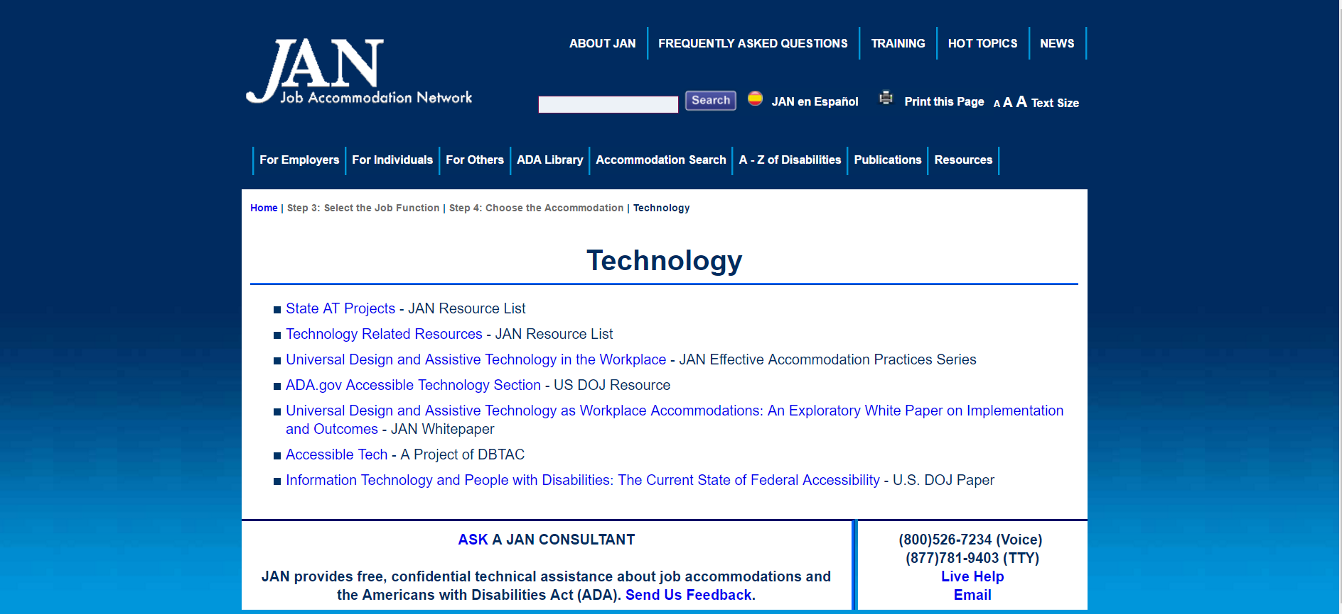
Job Accommodation Network http://askjan.org/topics/tech.htm
Notes:
Website tour: May use SOAR to demo LD (Case Study-Pat)…choose reading, math, and organization to show how AT can accommodate

Slide 37
Tools for Life http://www.gatfl.org/

Slide 38
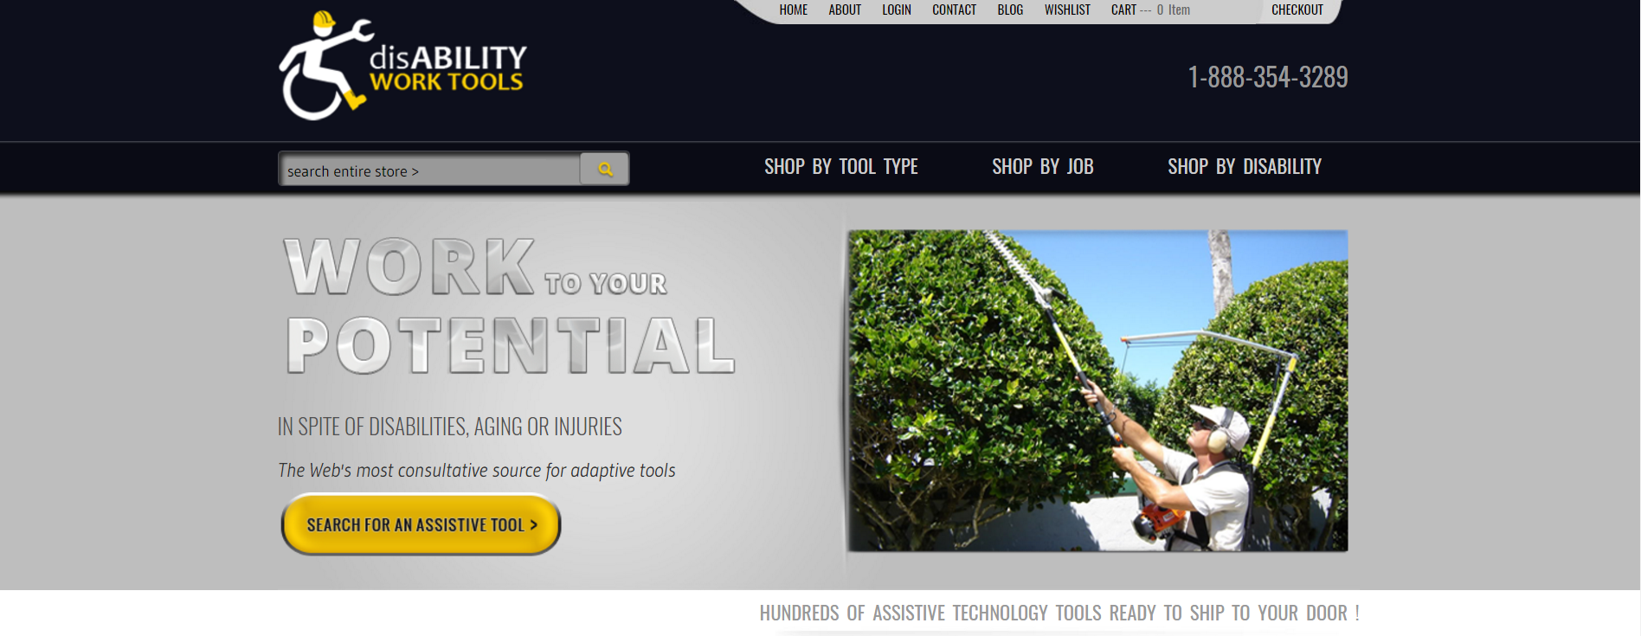
Disability Work Tools https://disabilityworktools.com/
Notes:
Website tour

Slide 39
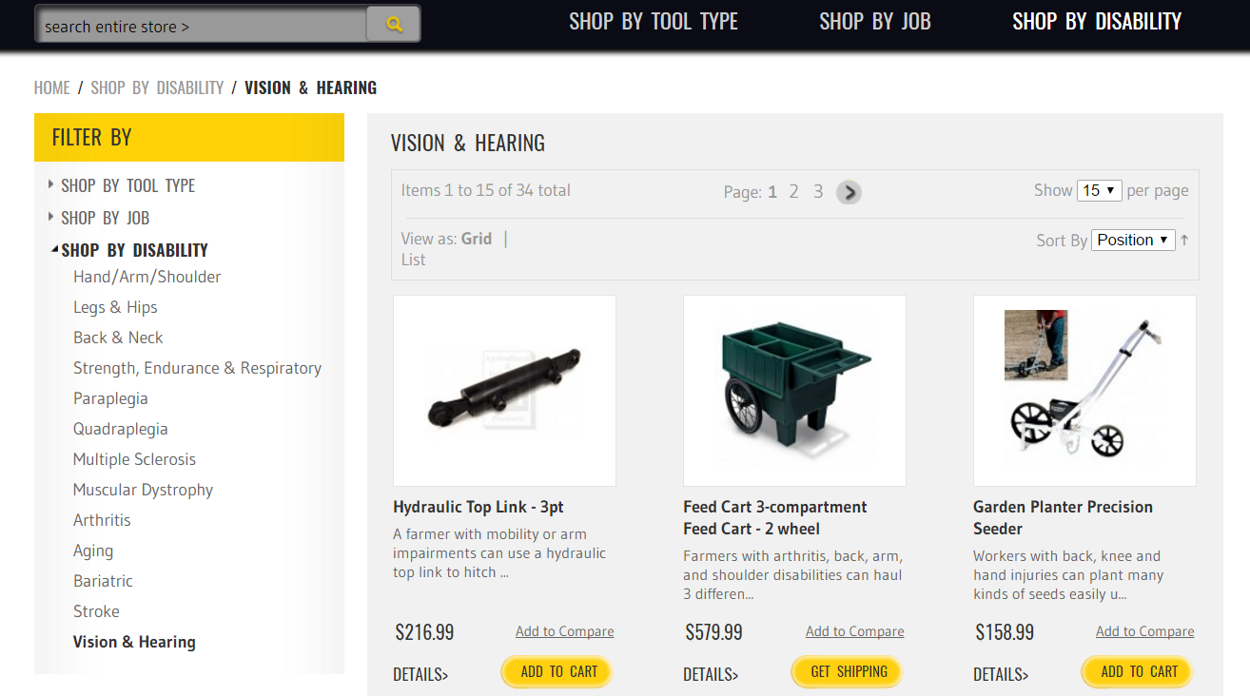
Disability Work Tools https://disabilityworktools.com/
Notes:
Website tour

Slide 40
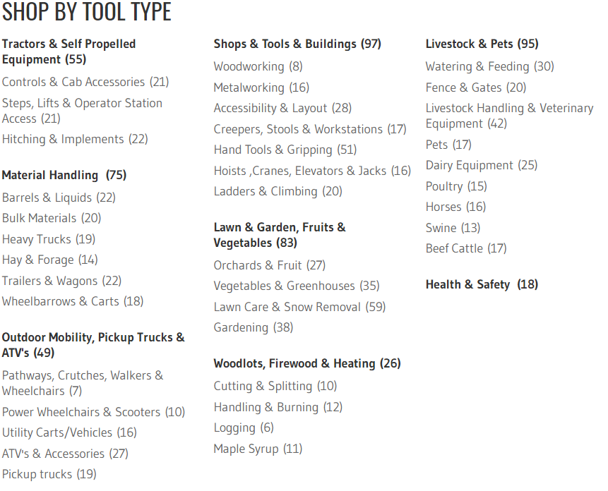
Disability Work Tools https://disabilityworktools.com/
Notes:
Website tour

Slide 41
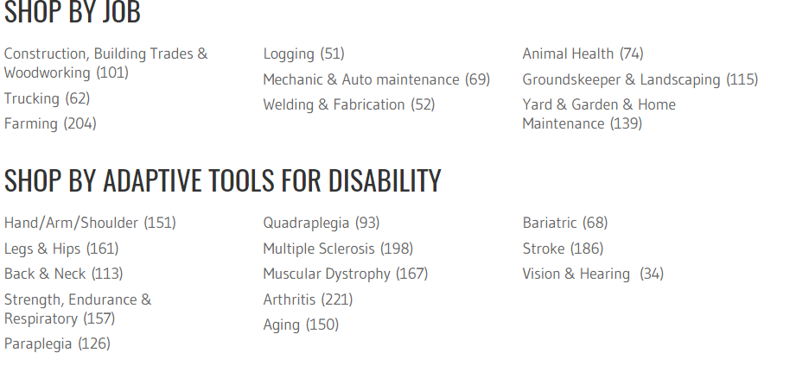
Disability Work Tools https://disabilityworktools.com/
Notes:
Website tour

Slide 42
RESNA http://www.resna.org/
Notes:
Describe the benefits of partnering with State AT Programs—how best to use in CTT

Slide 43
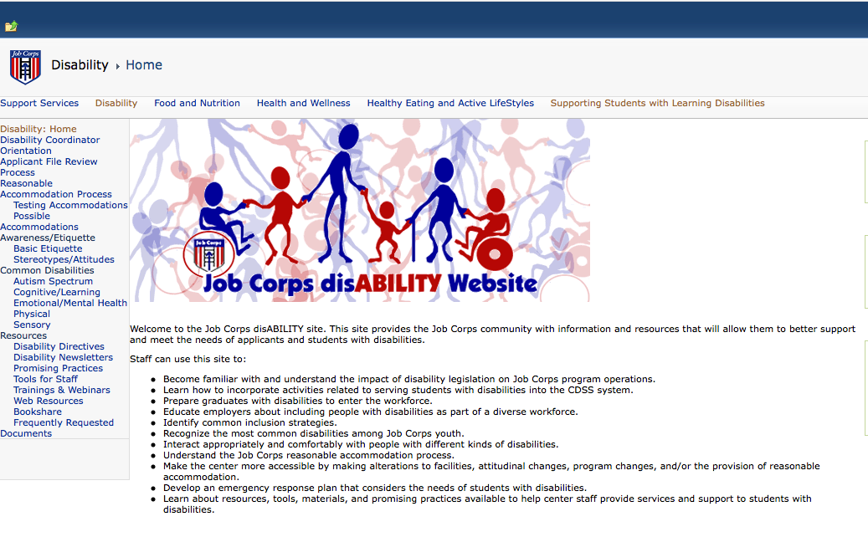
Job Corps Disability Website https://supportservices.jobcorps.gov/disability/Pages/default.aspx

Slide 44
Regional Disability Coordinators
Kristen Philbrook - Region 1
kristen.philbrook@humanitas.com
Annie Tulkin - Region 2
anne.tulkin@humanitas.com
Laura Kuhn - Regions 3, 4
laura.kuhn@humanitas.com
Sharon Hong - Region 5
sharon.hong@humanitas.com
Stephanie Karras - Region 6
stephanie.karras@humanitas.com

