Slide 1
Reading 200 Part 2 of 3
Methods to Accommodate and Support Reading Deficiencies using a Center-wide Approach
Notes:
The purpose of this webinar is to expand on the basic literacy challenges and functional limitations presented in Reading Support 100.
We will practice identifying accommodations and teaching strategies that support mild, moderate, and severe reading challenges in various areas/settings on the Job Corps centers.
Sample accommodation plans, with supports specific to reading-related functional limitations will be collaboratively developed, with a center-wide focus and an emphasis on building independence and improving employability.

Slide 2
Learning Objectives
After this webinar, you will be able to:
Identify several functional limitations related to reading challenges as they apply to the Job Corps settings.
Develop a very basic accommodation plan for students with mild, moderate, and severe reading disabilities that include accommodations that allow for center -wide access to information and barrier removal.
Describe at least two community resources that support students with reading challenges.
List several reading-related accommodations commonly found in the workplace.

Slide 3
Poll Your Use of Resources & Strategies
Notes:
After attending Reading 100, I was able to use some of the information and/or resources to support students with reading difficulties on center.
Yes or No.

Slide 4
Review
Reading 100:
Mild, Moderate, Severe
Photo credit: www.huffingtonpost.com
Notes:
In Reading 100, we framed reading difficulties and functional limitations in terms of mild, moderate, and severe.
Today we will focus on a center-wide approach, and discuss how those mild, moderate, and severe manifestations impact throughout the program.

Slide 5
Functional Limitations (Mild)
Can read, but may have difficulty reading and comprehending longer passages or text
May read passage multiple times to understand
May have difficulty summarizing complex content
May have mild gaps in writing skills
Handwriting
Spelling
Process

Slide 6
Functional Limitations (Moderate)
Can decode, but may have some comprehension issues
Hit and miss with reading strategies
May have issues with fluency
May have moderate memory issues
May have problems with spelling and writing in general
May have some difficulty with spoken language
Notes:
It takes explicit work to get the visual representation, meaning, sound, and grammatical function all working together.

Slide 7
Functional Limitations (Severe)
Significant decoding issues
May be a non-reader
May have severe processing deficits
May have severe speech and language issues
May have severe difficulties with written expression
Difficulty with verbal input and output

Slide 8
Impact of Functional Limitations
Job Corps Center, Employability and Independence
Notes:
Let’s take a look at how mild, moderate, or severe reading limitations might impact certain areas on center.
In doing so, we want to ask ourselves what types of activities, assignments, expectations, and outcomes are relative to each area on center.
How will reading difficulties impact progress?

Slide 9
Academics
Written instructions and information
TABE
Assignments requiring a great deal of reading
Writing assignments, note-taking
Reading comprehension
Signs, symbols, rules, expectations
Memorizing facts, information, etc.
Time factor with activities involving reading

Slide 10
Career Technical Education
Written instructions and information
Safety manuals
Signs, symbols, rules, expectations
Complex written passages related to trade
Performance tests and assessments
Memorization of facts, details, information
Time factor with activities involving reading

Slide 11
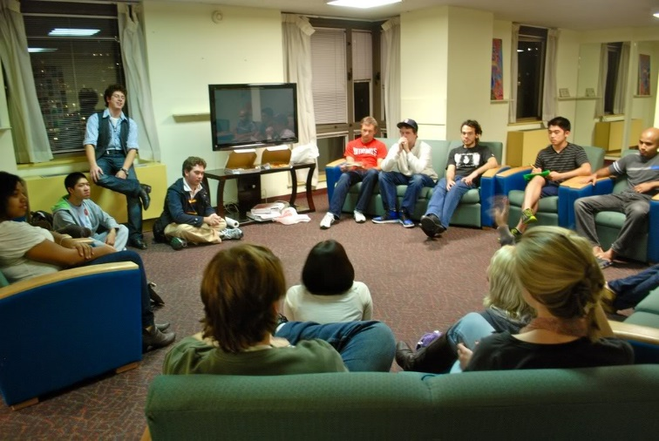
Residential Living
Access to dorm rules, regulations, codes, expectations when they are in writing only
Clear understanding of dorm assignments when they are in writing only
Proper equipment use if reading instructions is required
Complex vocabulary, signs, or symbols used to communicate with students
Access to center activity schedules including residential, recreation, daily meal menu options, etc.

Slide 12
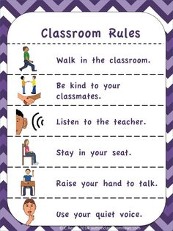
Behavior
Rules and expectations
posted throughout the center
in the handbook
lists provided by teachers, instructors, residential advisors, etc. during classroom, residential or other orientations
Written incident reports

Slide 13
Work-based Learning and Employability
Employee expectations and requirements
Instructions for job-related activities/tasks
Completing applications, résumé, letter of introduction/interest
Note-taking
Safety manuals
Task requiring large amounts of written material
Tasks requiring good spelling and grammar

Slide 14
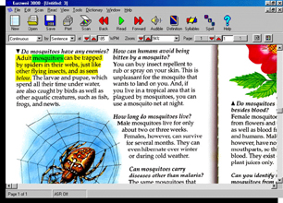
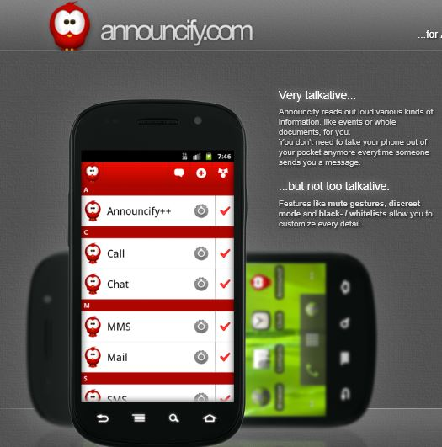
Building Independence
Accessing information throughout the center!!
Reading:
Learning content
Schedules and upcoming events
Menus
Rules and expectations
Student handbook

Slide 15
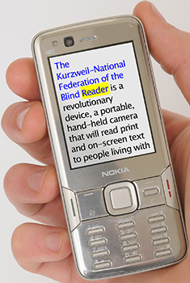
Universal Design for Learning
Creating a Digital Literacy Environment

Slide 16
Reading as Thinking
Integrating Strategy Instruction in a Universally Designed Digital Literacy Environment (Bridget Dalton, Ed. D. and Patrick Proctor, Ed. D. - http://www.udlcenter.org/resource_library/articles/reading_as_thinking)
As reading content in a digital format becomes more important, a question emerges: how can digital reading environments be created to support all students?
Here Dalton and Proctor discuss the variety of supports that could be included in designing a “Universal Literacy Environment” for students “in the margins.” In particular, they focus on how to help build learners’ comprehension.
Notes:
We have included this article for you to download in the Resource box below the chat box.

Slide 17
What do your Struggling Readers Say?
“I do not know what this means?”
“I do not know these words.”
“This is too long.”
“I can’t keep up with the others when reading.”
“I hate reading,” or “I don’t really like to read.”
Notes:
Tell me some of the things you hear your struggling readers say when they are trying to read material?
Excerpted from Integrating Strategy Instruction in a Universally Designed Digital Literacy Environment
“Children struggle to understand text for a variety of reasons, including lack of engagement, weak decoding and fluency skills, inadequate vocabulary and background knowledge, and ineffective strategies for setting a purpose for reading, monitoring one’s understanding, and resolving problems (Lipson & Wixson, 1997; Paris, Wasik & Turner, 1991 ). It is rare to have just one area of concern, and if the struggle goes on too long, motivation and engagement inevitably enter into the equation, depressing performance even further (Guthrie & Wigfield, 2000). The two most prevalent reasons for these challenges are lack of access to good instruction and learner differences that often interfere with learning from good instruction.”

Slide 18
Difficulty with Decoding and/or Fluency
Digital Supports to use while remediating decoding and fluency skills
Text-to-speech tool (TTS)
Student may click on a word, phrase, or passage and have it read aloud
What is a reading strategy that you could also use while using digital reading supports?
Have the student read along in the text as they are listening to the TTS so that they are both seeing and hearing the words simultaneously
Notes:
What about students who are deaf or hard of hearing? How might they access reading content if they cannot read it and cannot hear it?
Technologies are still limited in this area and generally still only for use with brief passages, instructions, etc. but there has been some use of using ASL and signing clips where a student could click on a word or passage and see it signed.
In a recently completed project with the Laurent E. Clerc Center at Gallaudet University, Dalton and colleagues (2005) embedded American Sign Language (ASL) video and Signing Avatar clips (VCom3D) in digital texts for middle school students. Students could click on a word or passage and view it signed in ASL (see Figure 2). In this case, the “reading” of the word is necessarily connected to its meaning, since ASL is a fully developed language system where the sign and meaning are interrelated (finger spelling is an exception). Just as TTS is no substitution for human voice, the expressivity of a signing avatar is fairly restricted, and thus was used for more routine messages to the student.
http://www.udlcenter.org/sites/udlcenter.org/files/ReadingAsThinking_0.pdf

Slide 19
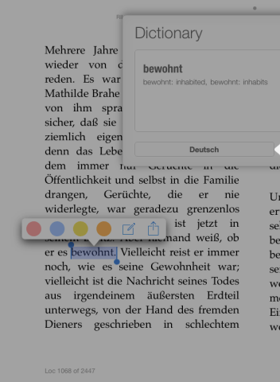
What are some other digital media benefits?
Hyperlinks in digital text and books
Access to dictionary features for vocabulary – click on the word and it gives you a definition of the word and some may even have pictorial representations
Access to a thesaurus – offers synonyms or alternative word options
Allows for access to information not already in digital format
Provides accessibility to information and reading content in ALL areas of the center

Slide 20
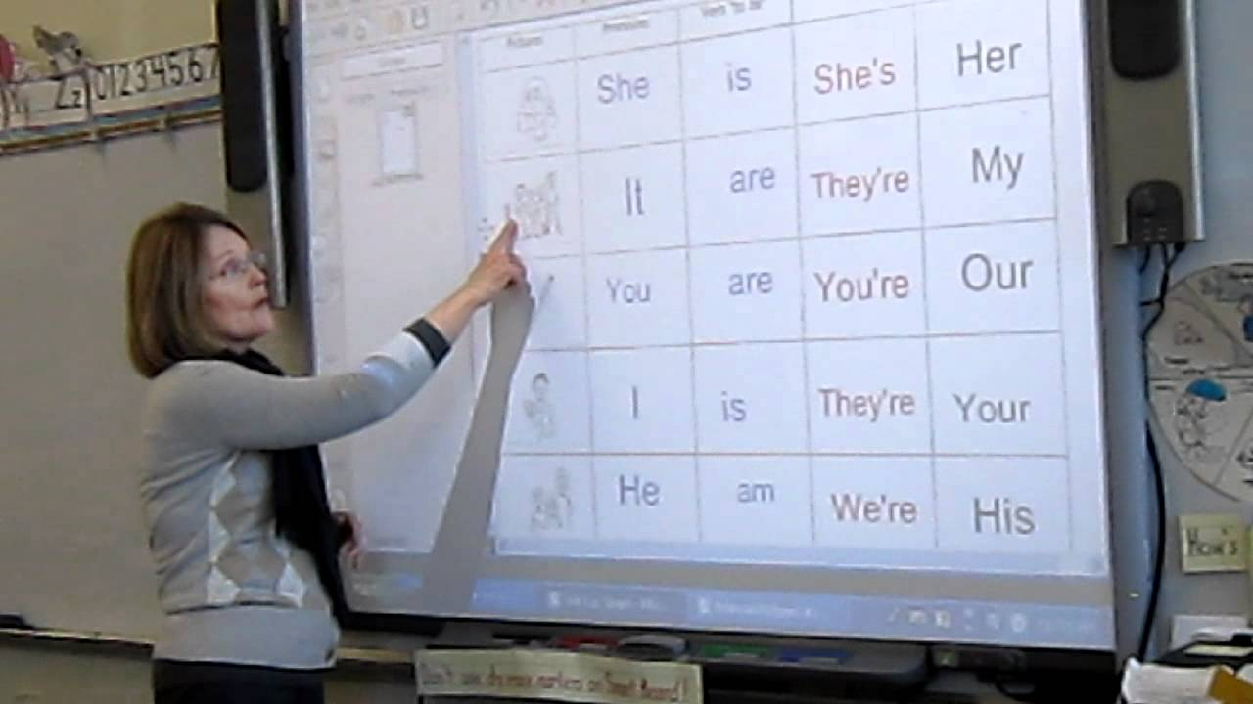
Accommodations & Strategies
Center-wide Access to Information and Barrier Removal Using a Universal Design for Learning Approach

Slide 21
UDL Review Reading Accommodations
Presentation
Allow students to access information in ways other than reading traditional print (e.g., text-to-speech software)
Response
Allow students to complete assignments or assessments in different ways (e.g., using a computer program that allows them to organize their thoughts visually)
Engagement
Tap students’ interests and prior knowledge; provide meaningful choices; utilize peer mentors
Setting
Change the location and conditions (e.g., alternate seating, room…)
Notes:
Brainstorm how UDL can be used in the various areas on center.
Example:

Slide 22
Accommodation & Strategy Considerations Specific to Areas of Impact/Functional Limitations
When we think about assisting students with disabilities in supporting reading needs, what are some of the goals we need to keep in mind?
Building independence – What accommodations that promote independence and make the student less dependent upon others?
Accessibility – How can we best provide access to all areas of the program?
Employability – What accommodations translate well into the workplace if still needed?
Those that consider the first two bullet points (building independence and allowing for accessibility with the least amount of inter-dependence on other individuals)

Slide 23
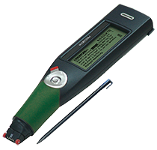
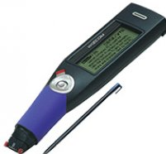
Center-wide Accommodations
Assistive Technology
Hand-held Reading/
Information Supports
Info-scan
Decoding Software
Screen Reader
Reading Pen
Reading Pen
Digital pen for recording audio and syncing with written notes
Notes:
How could these accommodations be used throughout the center?
How might they be used to create a digital literacy environment throughout the center? Do these tools only benefit students who have reading-related disabilities?

Slide 24
Center-wide & UDL Discussion
How could the AT reading-related accommodations be used to create a digital literacy environment throughout the center?
Do these tools only benefit students who have reading-related disabilities? If so, how and who?
Notes:
Now, let’s look at another example on the next slide.

Slide 25
Center-wide Accommodations
Assistive Technology
Video-supported Instruction
Videos of specific instructional topics
YouTube or like options
Created on center
Purchased video series, particularly in career technical
Videos of specific tasks being performed in sequence
Notes:
How could these accommodations be used throughout the center?
How might they be used to create a digital literacy environment throughout the center? Do these tools only benefit students who have reading-related disabilities?

Slide 26
Center-wide & UDL Discussion
Same questions as posed earlier:
How could the AT video-instruction-related accommodations be used to create a digital literacy environment throughout the center?
Do these tools only benefit students who have reading-related disabilities? If so, how and who?
Notes:
Low to no cost
(Debbie’s input)…Initial time investment but with potentially substantial pay-offs in terms of accessibility, elevating learning for all including ELL, etc., rehearsal for certification or other tests and such.
Hopefully, you are beginning to see a pattern here in terms of how students with reading disabilities benefit, how all learners benefit and how overall accessibility is improved throughout the center.
Let’s look at one more…

Slide 27
Center-wide Accommodations
Assistive Technology
Web and Computer Content Access
Text-to-Speech Tools and Apps specific to websites, email or computer use
Announcify
NaturalReader
Spell check, grammar check, and word prediction functions
Notes:
We provide you with the links to these tools and apps at the end of the presentation within the Resources review segment.
Now that you know the drill, how might these tools be used in Residential, by the CSO even?

Slide 28
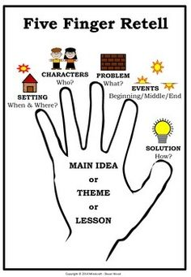
General Accommodations& Strategies
Mild, Moderate, Severe Reading Disabilities

Slide 29
Accommodations and Strategies (Mild)
Comprehension Skills
Allow use of graphic organizers, highlighters, colored overlays, other AT as needed
Allow students to ask questions or retell as they go
Frequently check for understanding (Who, What, Where, When, Why, How…)
Have student(s) look at the pictures, table of contents, chapter headings, maps, diagrams, and bold print words to make predictions
Connect the text to life experiences or prior knowledge

Slide 30
Accommodations and Strategies (Moderate)
Screen readers, reading pens, other AT as needed to fill in gaps (decoding or comprehension)
Peer tutor or mentor (good reader)
Reteach or provide good reading strategies
Provide memory devices or strategies
For spelling difficulties, allow use of reference materials (dictionary, word prediction software)
For writing process difficulties, allow verbal response
Quiet space or minimized distractions

Slide 31
Accommodations and Strategies (Severe)
Direct instruction
Assistive Technology
OCR, Screen Reader, convert text to audio
Reading Pen
Decoding program(s)
Peer tutor or designated person to read printed materials aloud
Colored overlays, larger print, spaced materials
Allow verbal responses when writing is impacted

Slide 32
Workplace-related Reading Accommodations
Job Problem: You have difficulty reading text. What are some accommodations that might be provided in Job Corps that can readily translate into the work environment?
Request text-to speech tools (TTS) in either a portable format and/or on your computer for more complex reading needs and/or to read web content out loud.
Have people communicate via phone, voicemail and face-to-face when possible.
Request that your boss gives you oral rather than written directions.
Ask that important information be highlighted.
Manage your work so that you have enough time to read what is required to get the job done or ask for reading content ahead of time so that there is extra time to read and review it.
Get information from drawings, diagrams, and flow charts. Your supervisor, team members, or subordinates may be able to organize some information in this way.
Notes:
How do these accommodations apply to meeting the needs of someone with a mild reading disability versus a moderate or a severe one?
How might these apply across areas of the center?

Slide 33
Disability-related and Reading Resources
READING
Resources

Slide 34
Bookshare https://www.bookshare.org/cms
Audio version materials can be used with eBooks, computers, tablets, Smartphones, MP3 players, and other assistive technology
Dedicated Job Corps Library – a collection of textbooks often used at centers
The book isn’t in the library?
Bookshare offers free book digitizing services
Notes:
Bookshare is free for JC centers and provides access to digitized audio books for academics, career technical trades, job seeking skills and transition, pleasure reading, periodicals and newspapers. Contact your RDIC for more information on Bookshare. We also have a webinar available on how to get a bookshare membership. Essentially this is the simplest resource to take advantage of.

Slide 35
Bookshare https://www.bookshare.org/cms
Bookshare offers a free organizational membership to all Job Corps centers and individual memberships for our students
The service provides individuals with print disabilities access to digitized audio books for:
Academics
Career technical trades
Job seeking skills and transition
Pleasure reading
Periodicals and newspapers
Notes:
Read2Go is an app that can be downloaded on any apple device (iphone, ipad, ipod touch) to access Bookshare files on the go! Also has a dedicated JC library- a collection of textbooks often used at centers.

Slide 36
Text-to-Speech Tools (TTS) and Other AT
eLearning Industry
http://elearningindustry.com/14-free-text-to-speech-tools-educators-tts-teachers
Understood
https://www.understood.org/en/tools/tech-finder
Job Accommodation Network
Text-to-Speech Tools List (download in file share box)

Slide 37
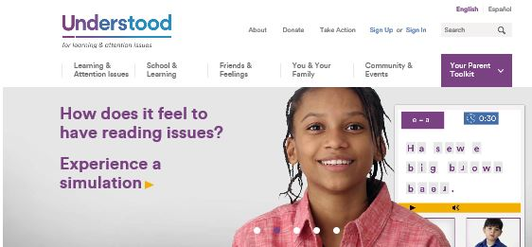
Understood www.understood.org

Slide 38
http://www.readingresource.net/teachingreadingcomprehension.html

Slide 39
Job Corps Learning Disabilities Website https://supportservices.jobcorps.gov/disability/Pages/default.aspx
Notes:
The LD website is located within the JC Community website portal and includes detailed information about all of those specific LDs, accommodation recommendations and possible teaching and learner strategies and supports.

Slide 40
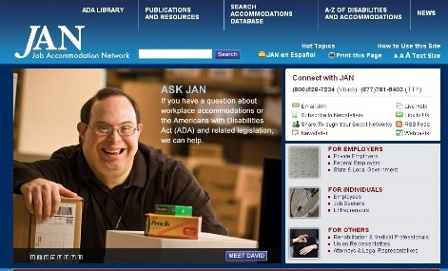
Job Accommodation Network http://askjan.org

Slide 41
Regional Disability Coordinators
Atlanta and Chicago Regions-Sharon Hong
Sharon.hong@humanitas.com
Boston, Philadelphia, and San Francisco Regions-Kristen Philbrook
Kristen.Philbrook@humanitas.com
Dallas Region-Laura Kuhn
Laura.Kuhn@humanitas.com

Slide 42
Thank you for attending!

