Slide 1
REASONABLENESS
DETERMINATIONS
Undue Hardship and Fundamental Alteration
Notes:
Welcome to the Reasonableness Determinations webinar. Today we are going to review the process for making a reasonableness determination (e.g., determination if the program is obligated to provide a particular DA).

Slide 2
CONTENTS
Regulations and Policy
Defining Reasonableness
Disability Accommodation (DA) Process Review
Determining Reasonableness
Submitting a Reasonableness Review for National Office Review
Resources
2
Notes:
Specifically, we are going to review:
Defining Reasonableness
Disability Accommodation (DA) Process
Determining Reasonableness
Submitting a Reasonableness Review for National Office Review
Resources

Slide 3
POLICY
DISABILITY ACCOMMODATIONS (DA) AND REASONABLENESS
3
Notes:
Policy – Disability Accommodations (DA) and Reasonableness
Let’s start by reviewing Job Corps policy.

Slide 4
OBLIGATIONS TO PROVIDE REASONABLE ACCOMMODATIONS/MODIFICATIONS
Modifications or adjustments may be made to:
The environment where work is performed or aid, benefits, services, or training are given.
The customary manner in which, or circumstances under which, a job is performed, or aid, benefits, services, or training are given.
Enable a qualified individual with a disability to enjoy the same benefits and privileges of the aid, benefits, services, training, or employment as are enjoyed by other similarly situated individuals without disabilities.
Modifications or adjustments that enable a qualified individual with a disability to perform the essential functions of a job, or to receive aid, benefits, services, or training equal to that provided to qualified individuals without disabilities.
As defined in 29 CFR § 38.4(yy)
4
Notes:
Obligations to Provide Reasonable Accommodations/Modifications as defined in 29 CFR § 38.4(yy)
Modifications or adjustments that enable a qualified individual with a disability to perform the essential functions of a job, or to receive aid, benefits, services, or training equal to that provided to qualified individuals without disabilities.
Modifications or adjustments may be made to:
The environment where work is performed or aid, benefits, services, or training are given
The customary manner in which, or circumstances under which, a job is performed or aid, benefits, services, or training are given
Enable a qualified individual with a disability to enjoy the same benefits and privileges of the aid, benefits, services, training, or employment as are enjoyed by other similarly situated individuals without disabilities.

Slide 5
REASONABLE ACCOMMODATION
Includes:
Making existing facilities used by applicants, students, applicants for employment, and employees readily accessible to and usable by individuals with disabilities; and
Restructuring of a job or a service, or of the way in which aid, benefits, services, or training is/are provided; part-time or modified work or training schedules
Acquisition or modification of equipment or devices;
Appropriate adjustment or modifications of examinations, training materials, or policies;
The provision of readers or interpreters; and other similar accommodations for individuals with disabilities.
5
Notes:
Reasonable Accommodation
Includes:
Making existing facilities used by applicants, students, applicants for employment, and employees readily accessible to and usable by individuals with disabilities; and
Restructuring of a job or a service, or of the way in which aid, benefits, services, or training is/are provided; part-time or modified work or training schedules
Acquisition or modification of equipment or devices;
Appropriate adjustment or modifications of examinations, training materials, or policies;
The provision of readers or interpreters; and other similar accommodations for individuals with disabilities.

Slide 6
What Does This Mean?
The Job Corps program must:
Consider adjustments to policy
For example, if the use of headphones or cell phones are prohibited by center policy, they must be considered as disability accommodations if needed to access/participate in the Job Corps Program. Some exceptions “may” exist for safety reasons such as adhering to OSHA regulations, etc.
Ensure physical and programmatic access when it is reasonable to do so
For example, ensuring that a person in a wheelchair can open doors and/or has access to needed areas.
For example, ensuring access to written content if the individual cannot read due to a disability.
Restructure the “job” or “service”
For example, if all students attend trade one week on and one week off, adjust the schedule to allow an individual to attend trade every morning or afternoon if needed to assist in and to maintain progress.
Acquire or modify equipment or devices
For example, a student who is an amputee of one arm may need a one-handed keyboard or other modified equipment.
6
Notes:
What Does This Mean?
The Job Corps program must:
Consider adjustments to policy
For example, if the use of headphones or cell phones are prohibited by center policy, they must be considered as disability accommodations if needed to access/participate in the Job Corps Program. Some exceptions “may” exist for safety reasons such as adhering to OSHA regulations, etc.
Ensure physical and programmatic access when it is reasonable to do so
For example, ensuring that a person in a wheelchair can open doors and/or has access to needed areas.
For example, ensuring access to written content if the individual cannot read due to a disability.
Restructure the “job” or “service”
For example, if all students attend trade one week on and one week off, adjust the schedule to allow an individual to attend trade every work day morning or afternoon if needed to assist in and to maintain progress.
Acquire or modify equipment or devices
For example, a student who is an amputee of one arm may need a one-handed keyboard or other modified equipment.

Slide 7
DEFINING
REASONABLENESS (Form 2-03)
7
Notes:
Defining Reasonableness (Form 2-03 of the PRH)

Slide 8
UNDUE HARDSHIP/ FUNDAMENTAL ALTERATION
Undue Hardship
Means a significant difficulty or expense incurred by JC program
Applies to reasonable accommodation
Fundamental Alteration
Means a change in the essential nature of JC program or a cost that JC can demonstrate is undue burden
Applies to reasonable modification
8
Notes:
UNDUE HARDSHIP/ FUNDAMENTAL ALTERATION
Undue Hardship
Generally, results in significant difficulty or expense incurred by the Job Corps program
Applies to reasonable accommodation
Fundamental Alteration
Generally, results in a change in the essential nature of Job Corps program or a cost that Job Corps can demonstrate is undue burden
Applies to reasonable modification

Slide 9
ANALYSIS AND FACTORS TO CONSIDER
The analysis and the factors to consider for determining undue hardship and fundamental alteration are essentially the same.
The factors to consider can be found in Form 2-03 of the PRH.
JC uses the Reasonableness Form to document undue hardship/ fundamental alteration considerations/ analysis.
Example of Fundamental Alteration
If a student with a disability requests that major pieces of equipment in a career technical trade be modified for their use such that the other students do not get the benefit of using or learning how to operate the machinery to industry standards, the request “might” result in a fundamental alteration to the Job Corps program.
9
Notes:
ANALYSIS AND FACTORS TO CONSIDER
The analysis and the factors to consider for determining undue hardship and fundamental alteration are essentially the same.
The factors to consider can be found in Form 2-03 of the PRH and include:
1. The nature and net cost of the accommodation needed, taking into consideration the availability of tax credits and deductions, and/or outside funding, for the accommodation;
2. The overall financial resources of the Job Corps program involved in the provision of the reasonable accommodation, including:
• The number of persons aided, benefited, served, or trained by, or employed at, the Job Corps program; and
• The effect the accommodation would have on the expenses and resources of the Job Corps program;
3. The overall financial resources of Job Corps, including:
The overall size of Job Corps;
The number of persons aided, benefited, served, trained, or employed by Job Corps; and
The number, type, and location of Job Corps’ facilities;
4. The type of operation or operations of Job Corps, including:
• The geographic separateness and administrative or fiscal relationship of the Job Corps program in question to Job Corps; and
• Where the individual is seeking an employment-related accommodation, the composition, structure, and functions of Job Corps’ workforce; and
5. The impact of the accommodation upon the operation of the Job Corps program, including:
• The impact on the ability of other students to receive aid, benefits, services, or training, or of other employees to perform their duties; and
• The impact on the Job Corps program’s ability to carry out its mission.
JC uses the Reasonableness Form to document undue hardship/ fundamental alteration considerations/ analysis.
Example of Fundamental Alteration
If a student with a disability requests that major pieces of equipment in a career technical trade be modified for their use such that the other students do not get the benefit of using or learning how to operate the machinery to industry standards, the request “might” result in a fundamental alteration to the Job Corps program.

Slide 10
There is no specific list of RA/RM/AASs that will or will not be provided.
REASONABLENESS
If Job Corps can prove that a proposed accommodation would cause undue hardship or that a proposed modification would fundamentally alter the program, Job Corps is not obligated to provide it.
NO SPECIFIC LIST
Each request for RA/RM/AAS must be evaluated individually, and a determination made regarding whether it is reasonable.
UNDUE HARDSHIP/FUNDAMENTAL ALTERATION
INDIVIDUALIZED
10
Notes:
Reasonableness
If Job Corps can prove that a proposed accommodation would cause undue hardship or that a proposed modification would fundamentally alter the program, Job Corps is not obligated to provide the RA/RM/AAS.
There is no specific list of RA/RM/AASs that will or will not be provided.
Each request for RA/RM/AAS must be evaluated individually on a case-by-case basis, and a determination made regarding whether it is reasonable.
The National Office makes the final decision on whether the disability accommodation will be provided or not because the resources of and the impact to the entire Job Corps program must be factored into the reasonableness review. If your center believes an accommodation is unreasonable and the applicant/student refused equally effective alternative accommodations, please contact your RDIC for assistance! There are forms in PRH Form 2-03 that must be completed for submission to the National Office.

Slide 11
DA PROCESS
Considerations/Review
11
Notes:
DA Process Considerations and Review

Slide 12
Did the applicant/student or someone on their behalf make a request for a disability accommodation?
Why is that important to know?
The center MUST consider disability accommodations requested not only by the applicant but also by anyone else on behalf of the individual with a disability as long as the individual agrees that they would like the requested accommodation.
DISABILITY REQUESTS AND DOCUMENTATION
12
Notes:
Disability Requests and Documentation
Did the applicant/student or someone on their behalf make a request for a disability accommodation?
Why is that important to know?
The center MUST consider disability accommodations requested not only by the applicant but also by anyone else on behalf of the individual with a disability as long as the individual agrees that they would like the requested accommodation.

Slide 13
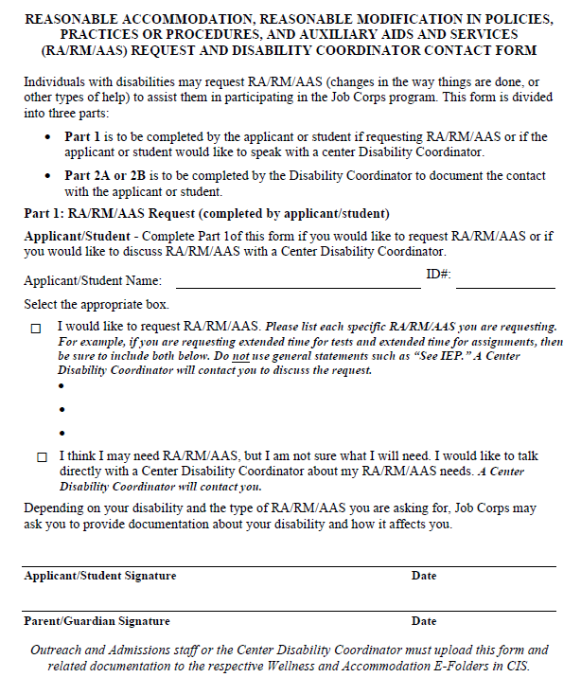
RA/RM/AAS
Request and
DC Contact Form
Ensure that all disability accommodation requests are documented on the RA/RM/AAS Request and DC Contact Form.
13
Notes:
RA/RM/AAS Request and DC Contact Form
Here is a screenshot of the RA/RM/AAS Request and DC Contact Form. Please ensure that you are using the most current form and that you discard and/or delete any forms released in the PRH prior to 11/29/22.
Ensure that all disability accommodation requests are documented on the RA/RM/AAS Request and DC Contact Form.

Slide 14
DOCUMENTATION
OF DISABILITY
Is the disability obvious or has documentation that supports the DA request been disclosed?
If disability documentation has not been provided, offer the applicant/student an opportunity to provide documentation to support the request.
If the disability is obvious, no documentation of disability can be requested or required.
If disability documentation has been provided, continue with the interactive disability accommodation process.
14
Notes:
Documentation of Disability
Is the disability obvious or has documentation that supports the DA request been disclosed?
If the disability is obvious, no documentation of disability can be requested or required.
If disability documentation has been provided, continue with the interactive disability accommodation process.
If disability documentation has not been provided, offer the applicant/student an opportunity to provide documentation to support the request.

Slide 15
DOCUMENTATION (CONT.)
If not, provide opportunity for individual to obtain more specific documentation.
If so, next steps may include:
Is the DA reasonable?
Are there reasonable alternative accommodations that may be offered?
Agree to requested DA and add to the individual’s accommodation plan (AP).
Does the disability documentation reasonably support the functional limitations or reasons for the need for the DA?
Contact your RDIC for assistance.
15
Notes:
Documentation (cont.)
Does the disability documentation reasonably support the functional limitations or reasons for the need for the DA?
If not, provide opportunity for individual to obtain more specific documentation.
If so, next steps may include:
Is the DA reasonable?
Are there reasonable alternative accommodations that may be offered?
Agree to requested DA and add to the individual’s accommodation plan (AP).
Contact your RDIC for assistance if you have any questions regarding the disability accommodation process or unclear as to how to proceed.

Slide 16
For example: Instead of allowing a student with a sleep disorder to nap during the day, the Disability Accommodation Committee (DAC) might consider/offer:
1-2 regular breaks a day,
more frequent movement opportunities,
access to gym at lunch, alter schedule so certain activities, like those in career technical, are scheduled when the individual is typically the most alert, etc.
If the center deems the accommodation request as potentially unreasonable, are there alternative, yet equally effective accommodations that could address that same need and be offered to the applicant?
ALTERNATIVE ACCOMMODATIONS
16
Notes:
Alternative Accommodations
If the center deems the accommodation request as potentially unreasonable, are there alternative, yet equally effective accommodations that could address that same need and be offered to the applicant?
What might be some examples of alternative accommodations?
For example: Instead of allowing a student with a sleep disorder to nap during the day, the Disability Accommodation Committee (DAC) might consider/offer:
1-2 regular breaks a day,
more frequent movement opportunities,
access to gym at lunch, alter schedule so certain activities (if any in career technical) are scheduled when the individual is typically the most alert, etc.

Slide 17
If there are equally effective alternative DAs, does the individual with a disability accept or agree to the offered DA?
If not, proceed with the completion of a reasonableness review.
Alternative Accommodation Outcomes
17
Notes:
Alternative Accommodation Outcomes
If the center has identified equally effective alternative DAs and offered them to the applicant, then the next steps obviously depend upon the individual’s agreement or acceptance of those accommodations in place of the originally requested one.
If the individual does not agree to the offered alternative accommodations, then the center must proceed with the completion of a reasonableness review.

Slide 18
CRITICAL ALERTS!
The center must not recommend disability accommodations and then attempt to determine that they are unreasonable.
18
Notes:
Critical Alerts #1
The center must not recommend disability accommodations and then attempt to determine that they are unreasonable.

Slide 19
CRITICAL ALERTS! (cont.)
The center must not deny enrollment due to accommodation requests.
19
Notes:
Critical Alerts (cont.) #2
The center must not deny enrollment due to accommodation requests.

Slide 20
CRITICAL ALERTS! (cont.)
The center must not and may not deny disability accommodations at the center level.
20
Notes:
Critical Alerts (cont.) #3
The center must not and may not deny disability accommodations at the center level.

Slide 21
If an individual with a disability requests a private room, the center cannot tell the individual that Job Corps does not provide private rooms.
Instead, the center must offer reasonable alternative DA, if possible. If the applicant rejects those, then the center must continue the disability accommodation process.
PRIVATE ROOM REQUEST
The Center Director/DCs determine whether the request is reasonable. If determined unreasonable, the center must complete the Reasonableness Review form (Form 2-03) but the final decision rests with the National Office.
21
Notes:
Private Room Request
If an individual with a disability requests a private room, the center cannot tell the individual that Job Corps does not provide private rooms.
Instead, the center must offer reasonable alternative DA, if possible. If the applicant rejects those, then the center must continue the disability accommodation process.
The Center Director/DCs determine whether the request is reasonable. If determined unreasonable, the center must complete the Reasonableness Review form (Form 2-03) but the final decision rests with the National Office.

Slide 22
CRITICAL ALERTS! (cont.)
DA must not be made conditional. For example,
The individual with a disability may have a private room if:
they are compliant with other miscellaneous requirements.
they can try having roommates first.
they agree they may not have a private room the entire time they are enrolled.
22
Notes:
Critical Alerts (cont.) #4
When an individual with a disability requests a disability accommodation, the Job Corps program has an obligation to process that request to a final determination meaning that there is either agreement that the DA will be provided or the National Office has ruled that a specific DA is unreasonable and will not be provided. However, do not place conditions on providing or continuing a DA.
For example,
The individual with a disability may have a private room if:
they are compliant with other miscellaneous requirements.
they can try having roommates first.
they agree they may not have a private room the entire time they are enrolled.

Slide 23
DETERMINING
REASONABLENESS
23
Notes:
Determining Reasonableness

Slide 24
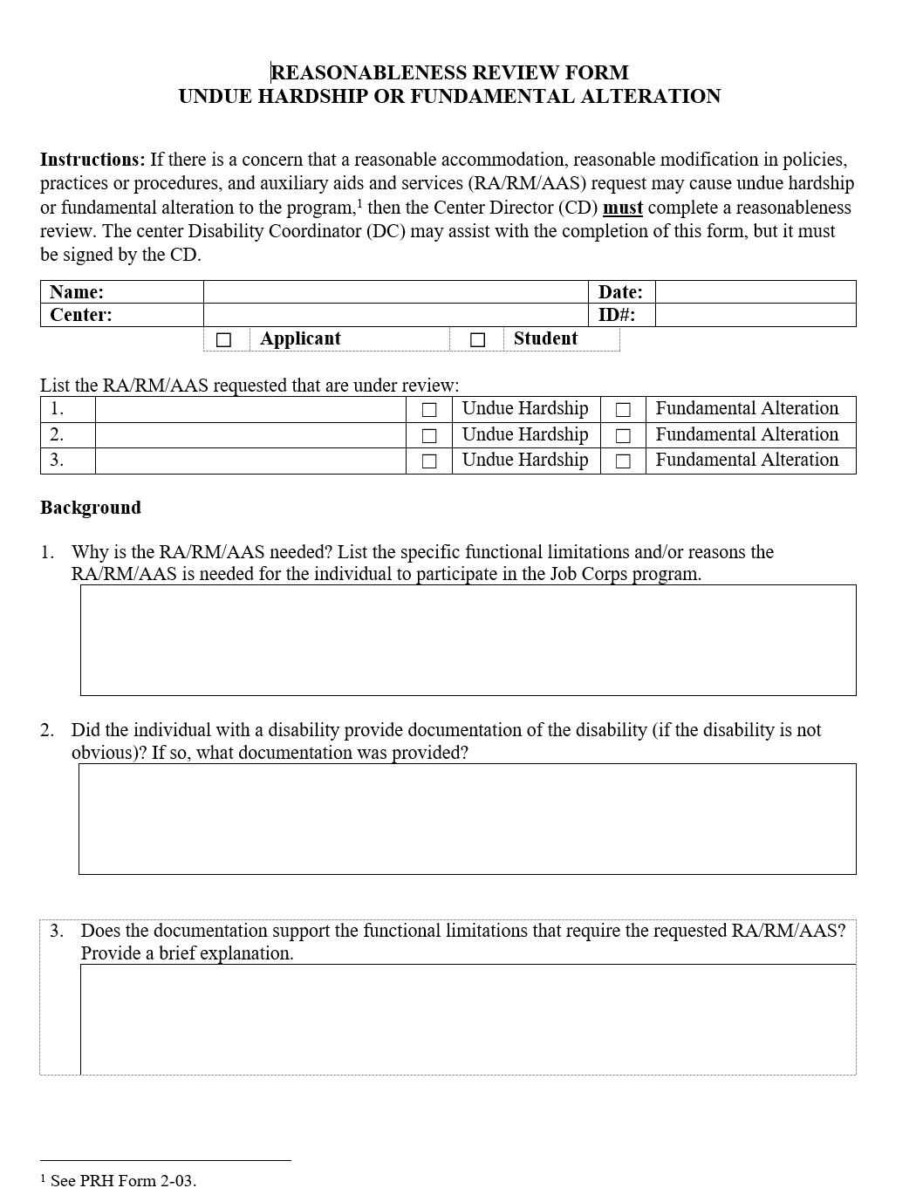
REASONABLENESS REVIEW FORM
Form 2-03
Procedures For Providing Reasonable Accommodation, Reasonable Modifications In Policies, Practices, Or Procedures, And Auxiliary Aids And Services For Participation In The Job Corps Program
24
Notes:
Reasonableness Review Form – Undue Hardship or Fundamental Alteration
Form 2-03 - Procedures For Providing Reasonable Accommodation, Reasonable Modifications In Policies, Practices, Or Procedures, And Auxiliary Aids And Services For Participation In The Job Corps Program
A screenshot of the first page of the Reasonableness Review Form is on the left-hand side of the screen. This is the form that MUST be completed when the center is completing a reasonableness review.

Slide 25
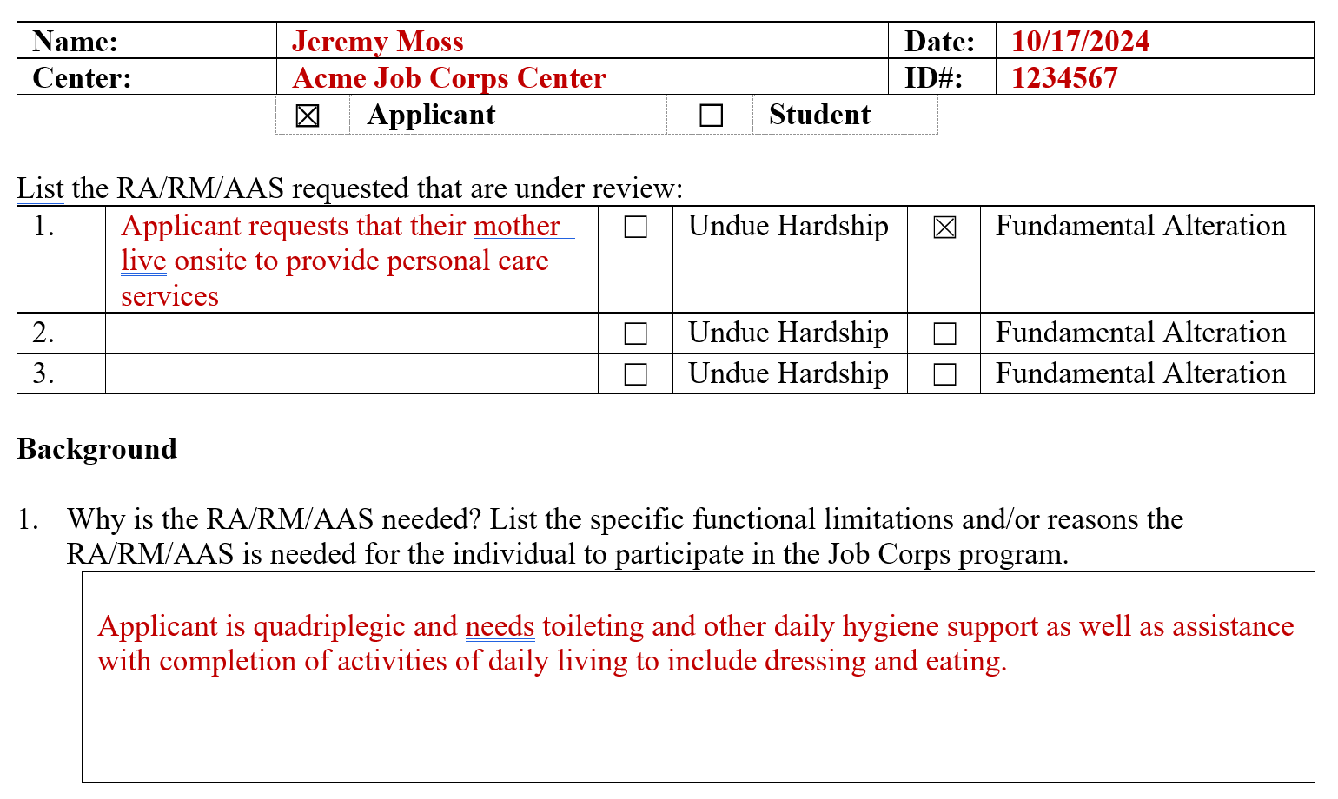
REASONABLENESS REVIEW FORM
Background
25
Notes:
Reasonableness Review Form – Background
Complete the basic background information (e.g., name, Center, etc.) and then list the disability accommodation(s) that the individual is requesting. In this case, the applicant is requesting that their mother live onsite to provide personal care services.
Next, select the boxes that you believe apply (e.g., undue hardship or fundamental alteration). Remember, you can contact your Regional Disability Coordinator to discuss any questions you may have and you should contact them before starting this reasonableness determination.
Then in item #1, explain why the DA is needed to participate in the Job Corps program including the related functional limitations resulting from the condition or conditions that cause the DA to be needed.

Slide 26
REASONABLENESS REVIEW FORM
Background (cont.)
26
Notes:
Reasonableness Review Form – Background (cont.)
Item #2 asks the center to document any documentation of disability that has been disclosed. If the disability is obvious, no documentation can be requested or required. If it is not obvious, then make sure the applicant has provided documentation of the condition.
In this instance, the disability was obvious, but the applicant voluntarily disclosed medical documentation about their condition which came about as a result of a car accident 5 years ago. The applicant provided hospital records from Miller Memorial Hospital as well as medical records from current outside treating provider, Dr. Henrietta Marsh.

Slide 27
REASONABLENESS REVIEW FORM
Background (cont.)
27
Notes:
Reasonableness Review Form – Background (cont.)
The next section, Item #3, is to document whether the documentation supports the functional limitations that require the requested disability accommodation. In this example, the applicant is a quadriplegic and the Center Physician determined that their basic health care needs generally could be met. However, the individual does need personal care assistance and Job Corps does not provide care assistance services and is not required to within the federal regulations.
Job Corps has to consider the person’s request, however, if they are able to secure a PCA on their own via insurance, for example. In this example, the applicant does not have insurance so the mother is willing to provide the support but lives too far away and would need to live on center.

Slide 28
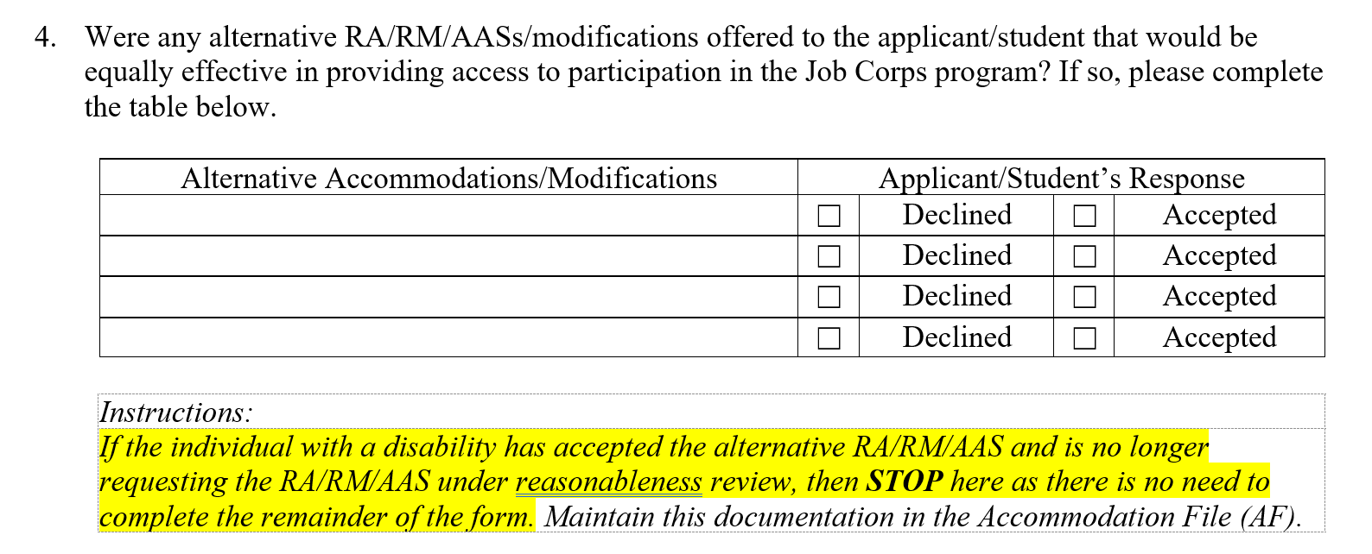
REASONABLENESS REVIEW FORM
Background (cont.)
28
Notes:
Reasonableness Review Form – Background (cont.)
Before reaching any final conclusions or determinations about reasonableness, the center must first attempt to identify reasonable alternative accommodations that it can offer the individual. Remember earlier where we talked about how critical it is to attempt to identify reasonable alternative accommodations such that the Job Corps program can demonstrate that if a requested accommodation would result in undue hardship, Job Corps must, after consultation with the individual with a disability, take any other action that would not result in such hardship but would nevertheless ensure that, to the maximum extent possible, individuals with disabilities receive the aid, benefit, service, training, or employment provided by Job Corps.
Unfortunately, in this scenario with the applicant requesting that the mother live on center, there is no reasonable alternative accommodations that can be identified. If there were alternative accommodations and if the individual accepts the alternative DA, then the reasonableness review can stop here as there is no need to complete the remainder of the form. In that situation, the applicant would be enrolled and given the agreed upon DA.

Slide 29
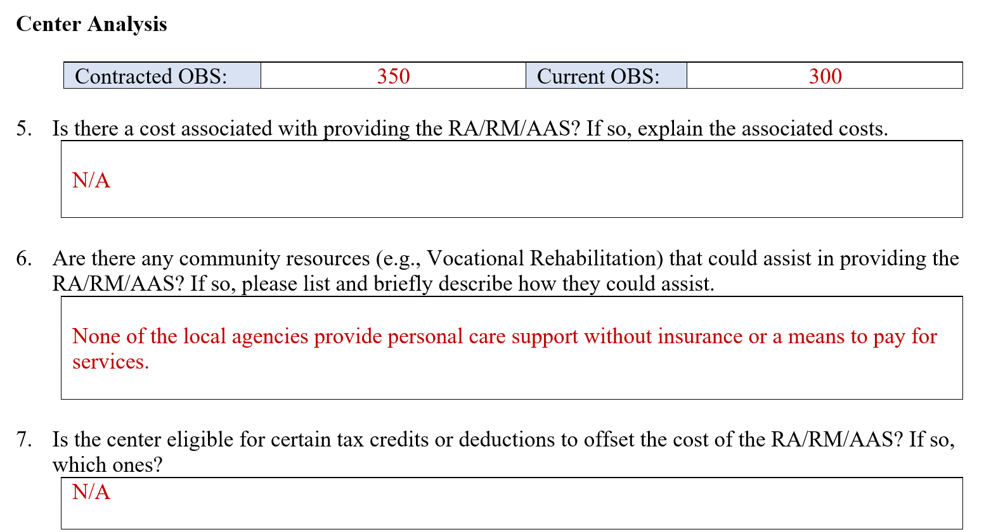
REASONABLENESS REVIEW FORM
Center Analysis
29
Notes:
Reasonableness Review Form – Center Analysis
Completed the contracted OBS for the center and the current OBS. In this case, this information confirms that the center has bed space. Then answer whether there is a cost associated with providing the requested DA (i.e., allowing the mother to stay on center and provide personal care assistance).
In item #5, there is no direct cost associated with providing the DA requested.
In item #6, the center is asked to document whether there are any community resources such as Vocational Rehabilitation, etc. that could assist in providing the requested DA? If so, we would document the agencies and the types of resources here but in this example, there are no local agencies that provide personal care support free of charge.
In item #7, the center is asked if it is eligible for certain tax credits or deductions to offset the cost of the DA? In this example, there are none.

Slide 30
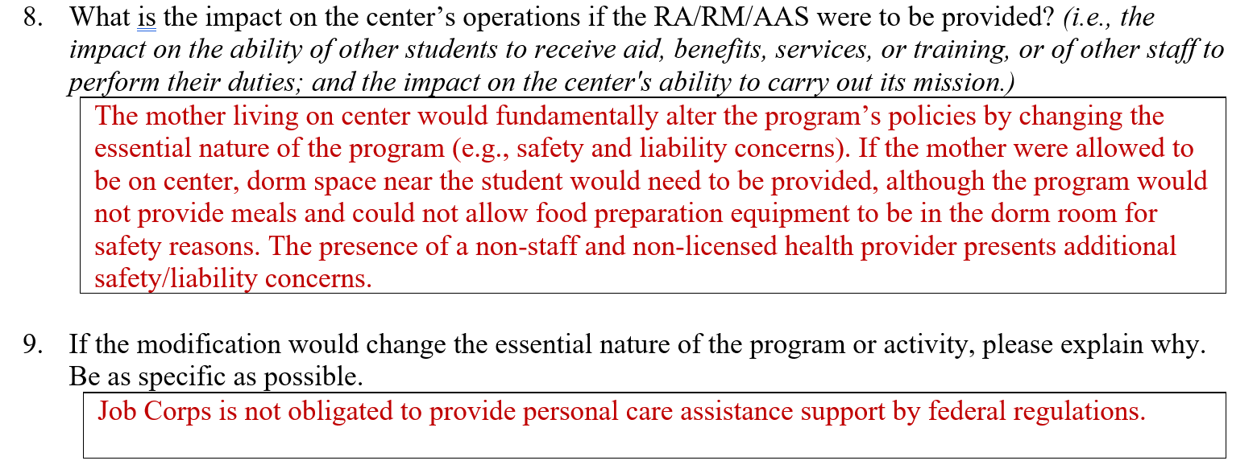
REASONABLENESS REVIEW FORM
Center Analysis (cont.)
30
Notes:
Reasonableness Review Form – Center Analysis (cont.)
Items #8 and #9 are two of the most critical items of the reasonableness determination. They essentially are your justification statements that support the outcome of your reasonable determination. It is like making closing arguments in a court case where you must bring the facts together to demonstrate your reasonableness determination assertion.
Item #8 asks what the impact of providing the DA is on the center?
In this example, the following assertions were documented:
Providing a DA would fundamentally alter the program’s policies by changing the essential nature of the program (e.g., safety and liability concerns).
If the mother were on center, dorm space would have to be allocated for non-student housing (possibly impacting other students' ability to participate).
Food preparation equipment would not be allowed to be in the dorm room due to safety concerns and the center would not provide meals.
The presence of a non-staff and non-licensed health provider presents additional safety/liability concerns.
Then item #9 asks if the modification would change the essential nature of the program or activity.
In this example, it does change the essential nature of the program or activity because Job Corps is not obligated to provide personal care assistance support by federal regulations and is not staffed to do so. Allowing the mother to live on center reduces open rooms and presents potential and unique liability risks as the mother is not center staff.

Slide 31
PCA Requests
If someone requests a PCA, contact your Regional Disability Coordinator (RDIC) to assist you in completing the Disability Accommodation Process.
Do not tell an applicant that Job Corps does not provide PCA services without talking to your RDIC first. There are required steps to be completed.
31
Notes:
PCA Requests
If someone requests a PCA, contact your Regional Disability Coordinator (RDIC) to assist you in completing the Disability Accommodation Process.
Do not tell an applicant that Job Corps does not provide PCA services without talking to your RDIC first. There are required steps to be completed.

Slide 32
SUBMITTING
A Reasonableness Determination for National Office Review
32
Notes:
Submitting A Reasonableness Determination for National Office Review

Slide 33
FIRST, upload the signed Reasonableness Review Form and all supporting documentation to the Wellness and Accommodation E-Folders (e.g., health/disability) in CIS.
NEXT, email your RDIC that a Reasonableness Review has been uploaded for review.
SUBMITTING REASONABLENESS DETERMINATIONS FOR REVIEW
33
Notes:
Submitting Reasonableness Determinations for Review
There are only 2 steps to complete to submit your reasonableness review documents for a National Office determination.
FIRST, upload the signed Reasonableness Review Form and all supporting documentation to the Wellness and Accommodation E-Folders (e.g., health/disability) in CIS.
NEXT, email your RDIC that a Reasonableness Review has been uploaded for review. Your RDIC will handle the movement of the documents to the National Office.

Slide 34
RESOURCES
RDICs and Job Corps Disability Website
34
Notes:
Resources – RDICs and Job Corps Disability Website

Slide 35
REGIONAL DISABILITY COORDINATORS
Boston
Kristen Philbrook
Philbrook.Kristen@jobcorps.org
Philadelphia
Angela Jenkins
Jenkins.AngelaK@jobcorps.org
Atlanta and San Francisco
Stephanie Karras
Karras.Stephanie@jobcorps.org
Dallas
Alyssa Purificacion Olivas
Purificacion.Alyssa@jobcorps.org
Chicago
Sharon Hong
Hong.Sharon@jobcorps.org
35
Notes:
Regional Disability Coordinators

Slide 36
JOB CORPS DISABILITY WEBSITE https://supportservices.jobcorps.gov/disability/Pages/default.aspx
36
Notes:
Job Corps Disability Website
The Job Corps Disability Support Services Website contains numerous resources and tools on applicant file review and disability accommodation requirements, processes and procedures.
As new resources and tools are developed, they are listed under the New Items heading to the right side of the website page.
Resources that are more commonly used and/or requested are listed under the Frequently Requested Tools section also highlighted in teal.
The categories of resources are listed on the left-hand side of the website and the Job Corps Disability website link is located at the top of the slide.

