Slide 1
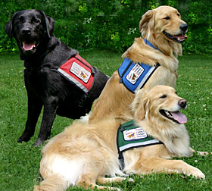
Lions, Tigers, and Bears – OH MY!
Service and Assistance Animals in the Job Corps Program

Slide 2
Objectives
Identify the differences between a “service” animal and an “assistance” animal
Articulate the 2 inquiries that can be made to determine if an animal qualifies as a “service” animal
List several tasks that a service animal may perform for a person with a disability
Identify the related policy resources for completing the interactive disability accommodation process
Describe how center staff can prepare for the arrival of a service/assistance animal

Slide 3
Has your center ever had a service and/or assistance animal?
Yes or No?
Notes:
For those of you who answered “yes,” what kind of animal? (Type in the chat box)

Slide 4
Service Animals

Slide 5
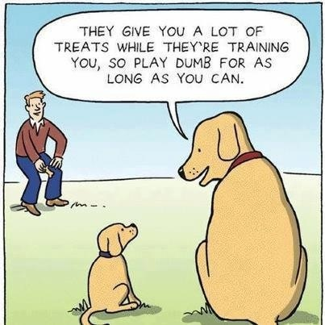
What are service animals?
Question

Slide 6
Service Animals Defined
A service animal is any dog that is individually trained to do work or perform tasks for the benefit of an individual with a disability, including a physical, sensory, psychiatric, intellectual, or other mental disability.
Other species of animals, whether wild or domestic, trained or untrained, are not service animals.
Answer
Notes:
Other species of animals, whether wild or domestic, trained or untrained, are not service animals.
The work or tasks performed by a service animal must be directly related to the person’s disability.
The crime deterrent effects of an animal’s presence and the provision of emotional support, well-being, comfort, or companionship, without more, do not constitute work or tasks.

Slide 7
A Service Animal is
NOT
an accommodation.
Notification about a service animal is about “access” and is not an accommodation request

Slide 8
Service Animals Step 1
Individual informs or discloses use of a service animal.

Slide 9
Service Animals Step 2
If an animal’s service tasks are not obvious, the center DC makes two inquiries to determine whether it qualifies as a service animal.
Is the animal required because of a disability?
What work or task has the animal been trained to perform?

Slide 10
Service Animals Step 3
The individual confirms that the animal is:
required because of a disability and
indicates work or task the animal has been trained to perform?
No?
Process stops.
Yes?
Proceed to Step 4.

Slide 11
Service Animals Step 3 (cont.)
Since the ACCESS issue has been resolved AND because the individual confirmed that they are an individual with a disability, engage the individual in the interactive disability accommodation (DA) process.
The individual confirms that the animal is:
required because of a disability
BUT cannot indicate work or task the animal has been trained to perform?
Notes:
If there is disclosure that this is a person with a disability, the individual will need to be engaged in the interactive disability accommodation process even if it is determined that the animal in question is not a service animal. In working through the interactive reasonable accommodation process, it “may” be determined that the animal is actually an assistance animal and therefore an accommodation request that must be processed in the same manner as all other accommodation requests. If there are questions related to this process, please contact your RDIC for assistance.

Slide 12
Service Animals Step 4
No?
The animal will not be able to accompany the individual.*
Yes?
Prepare for arrival of the service animal!
The center DC verifies the animal is housebroken and that the individual can maintain control of the animal?
*Since the ACCESS issue has been resolved AND because the individual confirmed that they are an individual with a disability, engage the individual in the interactive disability accommodation (DA) process.
Notes:
Regarding “within the student’s control:
Unless either the handler is unable because of a disability to use a harness, leash, or other tether, or the use of a harness, leash, or other tether would interfere with the service animal’s safe, effective performance of work or tasks, in which case the service animal must be otherwise under the handler’s control (e.g., voice control, signals, or other effective means)
If the service animal acts aggressively, it must be removed from center

Slide 13
13

Slide 14
Can a service animal be denied access to the center?
Question

Slide 15
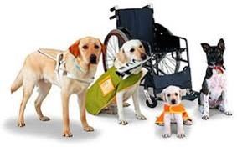
Service Animals Access to Job Corps
A center cannot deny an individual with a service animal access to the center. Such access is legally mandated.
Answer

Slide 16
What documentation can be requested related to a service animal?
Question

Slide 17
Service Animal Documentation
You may not request documentation of disability in this instance.
The center must NOT ask about the nature or extent of a person’s disability but may make two inquiries (i.e., (1) required because of a disability; and (2) indicate work or task the animal has been trained to perform) to determine whether an animal qualifies as a service animal?
Answer

Slide 18
Service Animal Documentation
The center may not ask for documentation of training of the animal or any certification documents of the animal.
Generally, a center may not make these inquiries about a service animal when it is readily apparent that an animal is trained to do work or perform tasks for an individual with a disability.
For example, the dog is observed guiding an individual who is blind or has low vision, pulling a person’s wheelchair, or aiding with stability or balance to an individual with an observable mobility disability.
Answer
Notes:
A center cannot require documentation, such as proof that the animal has been certified, trained, or licensed as a service animal.
Generally, a center may not make these inquiries about a service animal when it is readily apparent that an animal is trained to do work or perform tasks for an individual with a disability (e.g., the dog is observed guiding an individual who is blind or has low vision, pulling a person’s wheelchair, or providing assistance with stability or balance to an individual with an observable mobility disability).

Slide 19
What are some tasks that a service animal may perform for a person with a disability?
Question

Slide 20
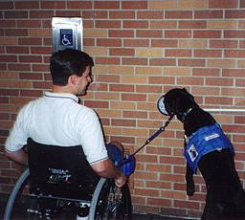
Service Animals Examples of Tasks - Assisting
Pulling
Assisting
Answer
a person’s wheelchair
a person who is blind or has low vision with navigation and other tasks
by providing physical support and assistance with balance and stability to a person with a mobility disability
Fetching
or picking up an item for a person
Notes:
Examples of tasks that a service animal may perform include, but are not limited to: (slide)

Slide 21
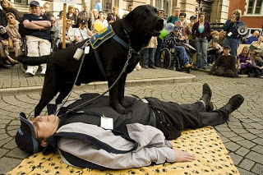
Service Animals Examples of Tasks - Alerting
Alerting
Alerting
a person who is deaf or hard of hearing to the presence of people or sounds (e.g., when there is a knock at the door)
a person during a seizure (e.g., standing guard over the person during a seizure, going for help, or predicting a seizure and warning the person in advance to sit down or move to a safe place)
Answer

Slide 22
Service Animal Examples of Tasks - Other
Interrupting
Reminding
Providing
for a person with psychiatric or neurological disorders (e.g., interrupting self-mutilation for people with dissociative identity disorders)
a person with a psychiatric disability to take medicine or retrieving medicine
safety checks, or room searches, or turning on lights for a person with post-traumatic stress disorder
Answer

Slide 23
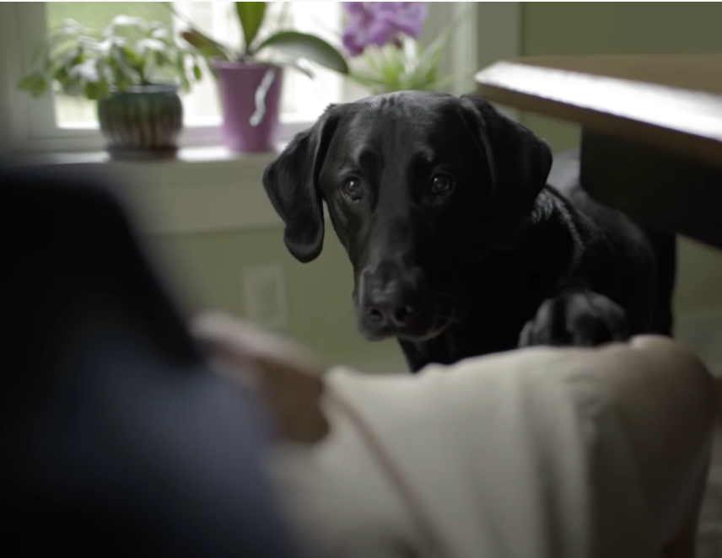
Service Dog
Diabetes
Notes:
https://www.youtube.com/watch?v=ycxFbFemibE
00:00 – 03:32 and stop

Slide 24
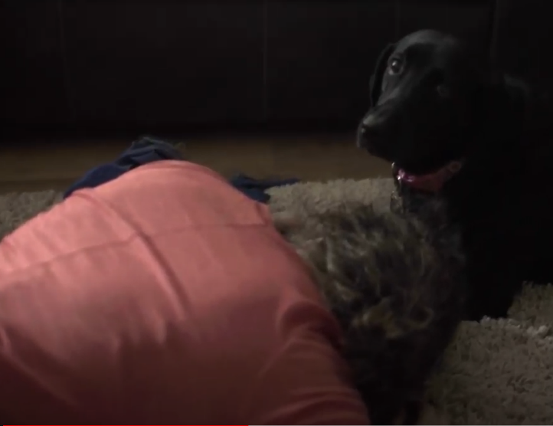
Service Dog
Seizure Disorder and MORE
Notes:
https://www.youtube.com/watch?v=2Ijj4Q9TIN8
00:00 - 03:45 and stop

Slide 25
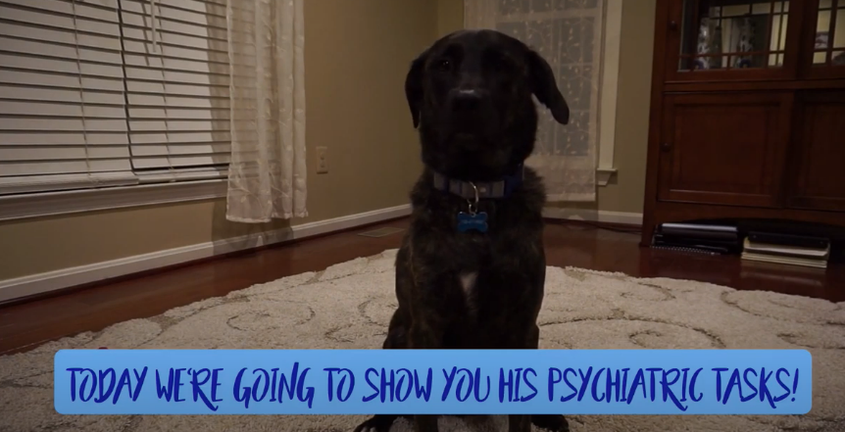
Service Dog
PTSD
Notes:
https://www.youtube.com/watch?v=iXm0hinvs7U
00:00 – 01:10 and stop

Slide 26
Can a student’s service animal accompany the student in all areas of the center?
Question

Slide 27
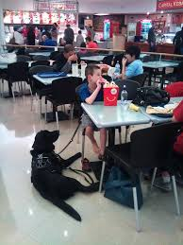
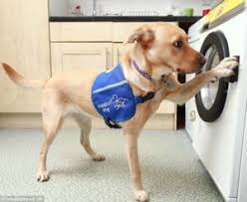
Service Animals Access to Center Facilities
A student with a service animal must be permitted to be accompanied by their service animal in all areas of the center where students are allowed to go.
Answer
Notes:
A student who needs to use a service animal in a food preparation area must be allowed to do so unless it is determined that the presence of the service animal presents a direct threat to health or safety that cannot be eliminated or reduced by a reasonable accommodation to the student.

Slide 28
Assistance Animals

Slide 29
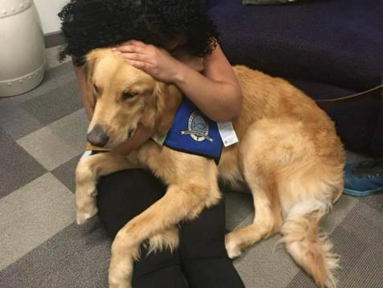
What are assistance animals?
Question

Slide 30
Assistance Animals Defined
Assistance animals provide companionship, relieve loneliness, and sometimes help with depression and certain phobias, but do not have training to perform specific tasks that assist people with disabilities.
Consequently, these animals do not meet the definition of service animal.
“Assistance animals” is a term that includes “emotional support” or “comfort” animals.
Answer

Slide 31
An Assistance Animal is
an accommodation.
The center should process the assistance animal accommodation request like any other accommodation request.

Slide 32
Does Job Corps allow assistance animals?
Question

Slide 33
Are Assistance Animals Allowed in Job Corps?
Job Corps will consider assistance animals as a disability accommodation on a case-by-case basis (see Form 2-03).
Consideration will be given to the
specific needs and request of the individual with the disability
the type of assistance it provides
the type of animal
Answer
Notes:
Center staff who need guidance should contact their Regional Disability Coordinator.

Slide 34
Assistance Animals Modification/ Accommodation Request Step 1 Request
Applicant or student requests accommodation/ modification to use assistance animal.

Slide 35
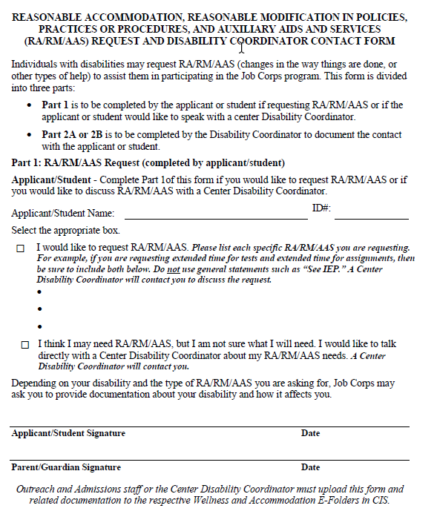
Assistance Animals Modification/ Accommodation Request Step 2 Document Request
Document the request on the RA/RM/AAS Request Form found in Form 2-03.

Slide 36
Assistance Animals Modification/ Accommodation Request Step 3 Disability Status
Ensure that documentation of the disability was received (if the disability is not obvious).

Slide 37
Yes?
Proceed to the next step!
Person with a disability?
No?
Give the individual an opportunity to secure documentation. If unable to secure, the process ends.

Slide 38
Assistance Animals Modification/ Accommodation Request Step 4 Need for Animal
Ensure that documentation for the need of the animal was received.

Slide 39
Yes?
Was documentation provided?
Proceed to the next step!
No?
Give the individual an opportunity to secure documentation. If unable to secure, the process ends.

Slide 40
Assistance Animals Modification/ Accommodation Request Step 5 DAC (Part 1)
Documentation: Review the specific functional limitations and/or reasons the accommodation/ modification is needed.

Slide 41
It will not be enough for the student to present a prescription or a letter from their doctor summarily stating that they require the animal while in Job Corps.
Does the documentation support the need for the AA?
Yes?
Proceed to Step 6!
No?
Give the individual an opportunity to secure documentation. If unable to secure, the process ends.
Notes:
If the disability is not obvious and/or the reason the animal is needed is not clear, then documentation may be required to
establish the existence of a disability
the manner in which the animal alleviates one or more symptoms or effects of the disability
the necessity of the animal in order for the student to participate in Job Corps

Slide 42
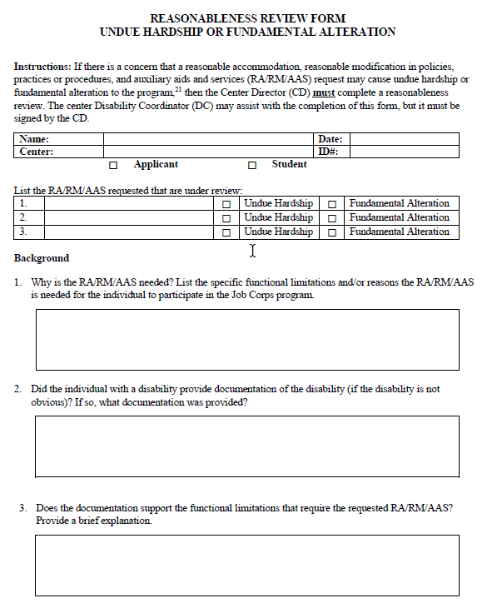
Assistance Animals Modification/ Accommodation Request Step 6 DAC (Part 2)
Reasonableness:
Complete a reasonableness review (including behavior expectations (housebroken, under control) and discuss care and monitoring.
Notes:
The center can expect that the assistance animal:
is currently vaccinated against rabies, when appropriate
is within the student’s control at all times (e.g., harness, leash, carrier) and that the animal’s behavior is appropriate
is housebroken

Slide 43
Yes?
Does the accommodation/ modification potentially pose an undue hardship/fundamental alteration?
First, offer alternative accommodations/ modifications that are reasonably considered/ determined to be equally effective (if any) and do not cause an undue hardship/fundamental alteration.*
No?
Enter accommodations/ modifications into
accommodation plan and implement. Process ends.
*Contact your RDIC for assistance with reasonableness process/determination including the offer of alternative accommodations.

Slide 44
Yes?
Enter accommodations/ modifications into accommodation plan and implement. Process ends.
Applicant accepts alternative accommodations/ modifications?
No?
Complete the Reasonableness Review Form found in Form 2-03 which will include a detailed center reasonableness analysis. If an undue burden, submit Reasonableness Review Form to RDIC for review and submission to the National Office.
Notes:
Each request should be evaluated on a case-by-case basis.
The process for completing a reasonableness review is outlined in Form 2-03.
The DCs should contact their Regional Disability Coordinator if considering recommending the denial of a request for an assistance animal.

Slide 45
Reasonableness Decision
National Office
issues a decision.
The center
will be notified
of the
National Office’s decision

Slide 47
What should the Disability Accommodation Committee (DAC) consider when reviewing a request for an assistance animal?
Question

Slide 48
Reviewing a Request for an Assistance Animal
During the DAC, discuss:
behavior expectations
the details of how the assistance animal will be cared for and monitored
any accommodations that will be needed to allow the student to attend to these necessary tasks
other specific accommodations needed by the student
Answer
Notes:
During the DAC it is important to discuss behavior expectations, the details of how the assistance animal will be cared for and monitored and any accommodations that will be needed to allow the student to attend to these necessary tasks. Other specific accommodations that are needed by the student should also be discussed. This meeting should be documented, and an accommodation plan should be created for the student.

Slide 49
Documenting the RA Process
Document the DAC meeting
Create an accommodation plan for the student
Consider developing a plan of what was agreed to as far as care, behavior, and monitoring related to the animal
Answer
Notes:
The center may want to consider developing a plan of what was agreed to as far as care, behavior, and monitoring related to the animal. This will help ensure center staff and the student are clear about the expectations and responsibilities of everyone and allow for focused discussion should any issues arise.

Slide 50
Other Considerations

Slide 51
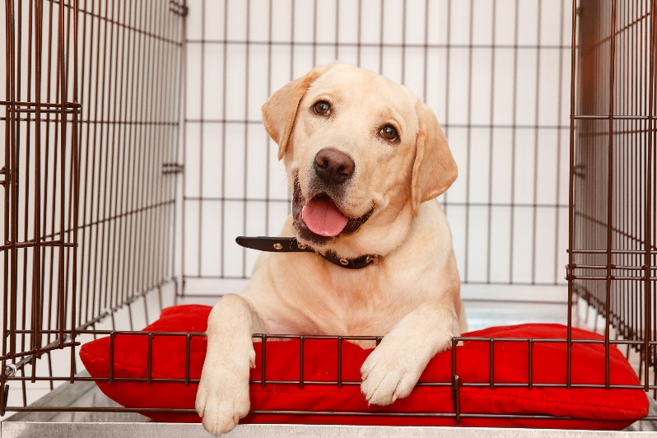
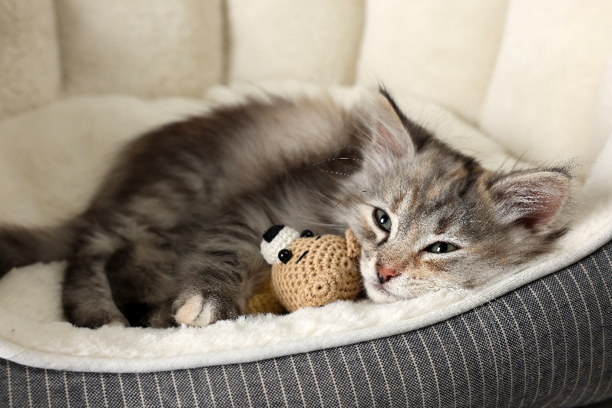
Where is an assistance animal generally maintained during the training day?
Question

Slide 52
Where Assistance Animal is Maintained
Unlike a service animal who is “working” for the individual with a disability and accompanies the individual throughout the training day, assistance animals generally are maintained in the dorm during the training day.
Remember, accommodations may be needed to allow the individual with a disability to provide care to the animal during the training day.
Answer
Notes:
During the DAC it is important to discuss behavior expectations, the details of how the assistance animal will be cared for and monitored and any accommodations that will be needed to allow the student to attend to these necessary tasks. Other specific accommodations that are needed by the student should also be discussed. This meeting should be documented, and an accommodation plan should be created for the student.

Slide 53
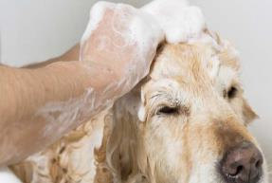
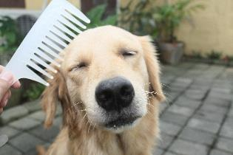
Who is responsible for the care and supervision of the service or assistance animal?
Question

Slide 54
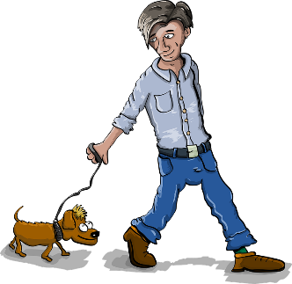
Animal Care Responsibility
The student is responsible for the care or supervision of the animal.
Answer

Slide 55
What if other students or center staff are allergic to or fearful of the service or assistance animal?
Question

Slide 56
Allergies to Animal
Allergies and fear of animals are not valid reasons for denying access/determining the accommodation is unreasonable to a student using either a service animal or an assistance animal.
Answer

Slide 57
Allergies (cont.)
Suggestions for addressing issues related to allergies include:
Try to keep the animal and staff/students who are allergic in different areas of the center and establish different paths of travel for each student
Provide the student with a private room
Use a portable air purifier and add HEPA filters to existing ventilation system
Avoid use of common areas at the same time
Allow student to change to career technical uniform in the specific training area
Check with Wellness for OTC allergy medications
Notes:
Ask the student if s/he is willing to use dander care products on the animal and bathe it regularly
Ask the student/employee who is allergic to the animal if s/he wants to, and would benefit from, wearing an allergen/nuisance mask
Have areas where the animal is present - including carpets, walls, and window treatments - cleaned, dusted, and vacuumed regularly

Slide 58
Resources

Slide 59
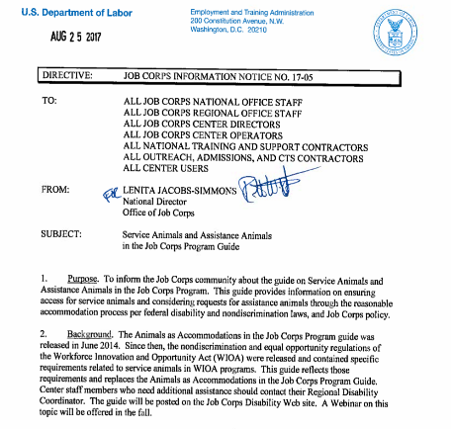
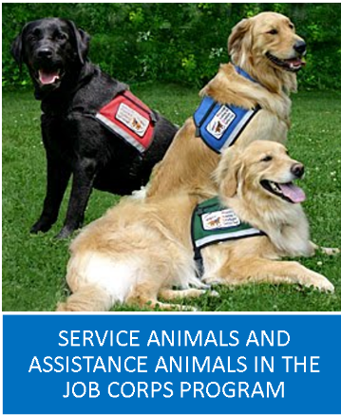
Information Notice 17-05:
Service Animals and Assistance Animals
https://supportservices.jobcorps.gov/disability/Pages/default.aspx
Notes:
The Job Corps Information Notice 17-05 was released to centers in August 2017. It announced the availability of a guide on Service Animals and Assistance Animals in the Job Corps Program. The guide provides information on ensuring access for service animals and considering requests for assistance animals through the RA process. The original guide was released in 2014. Since then more specifics from WIOA were released. The guide reflects those specifics.

Slide 60
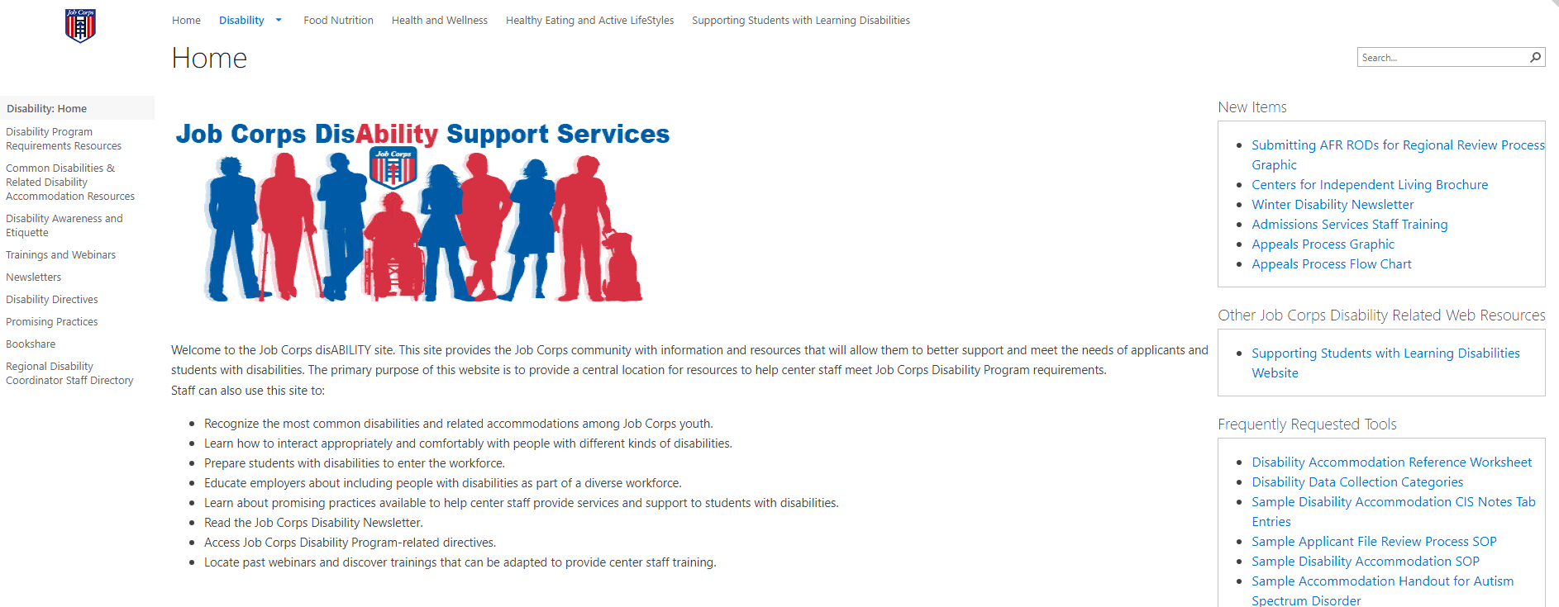
Job Corps Disability Website https://supportservices.jobcorps.gov/disability/Pages/default.aspx

