Slide 1
Job Corps Center Physician Monthly Teleconference
John Kulig MD MPH Region 1 Boston & Region 2 Philadelphia
Sara Mackenzie MD MPH Region 6 San Francisco
Drew Alexander MD Region 4 Dallas
Gary Strokosch MD Region 3 Atlanta & Region 5 Chicago
HIPAA compliant messages use @jobcorps.org email address
Wednesday, February 28th, 2024

Slide 2
Webinar tomorrow
New Drug Zero Tolerance Policy Nuts and Bolts on Thursday,
February 29th at 11 am (ET), 10 am (CT), 9 am (MT), and 8 am (PT).
The webinar is listed in the Upcoming Sessions tab on WebEx
at https://jobcorps.webex.com and is open for registration.
All center clinicians are encouraged to attend.

Slide 3
Measles outbreaks
As of February 22, 2024, a total of 35 measles cases were reported by 15 jurisdictions: Arizona, California, Florida, Georgia, Indiana, Louisiana, Maryland, Minnesota, Missouri, New Jersey, New York City, Ohio, Pennsylvania, Virginia, and Washington.
Measles is one of the world’s most contagious diseases, spread by contact with infected nasal or throat secretions (coughing or sneezing) or breathing the air that was breathed by someone with measles.
The virus remains active and contagious in the air or on infected surfaces for up to two hours. It can be transmitted by an infected person from four days prior to the onset of the rash to four days after the rash erupts.

Slide 4
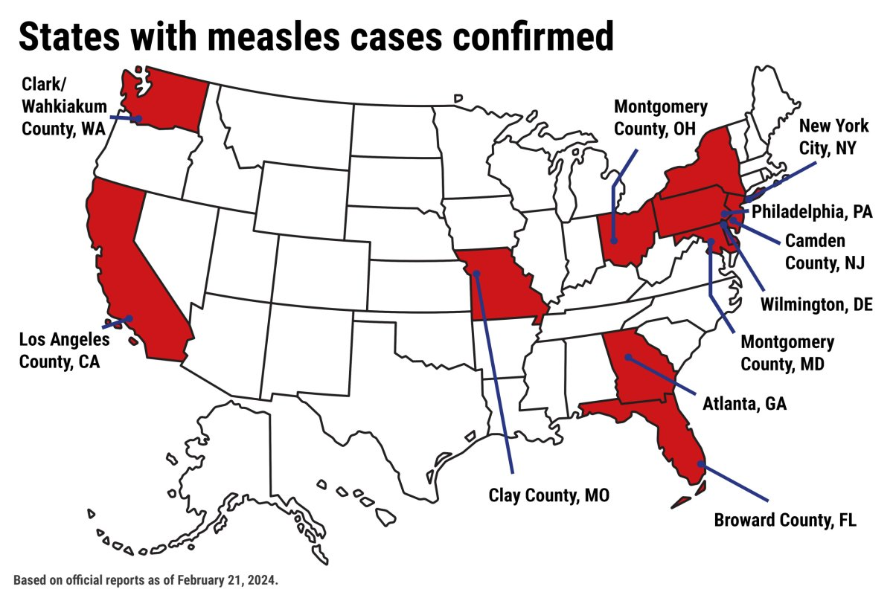

Slide 6
Clinical presentation of measles
Symptoms of measles usually begin 10–14 days after exposure to the virus. A prominent rash is the most visible symptom.
Early symptoms usually last 4–7 days: three Cs
running nose/coryza
cough
red and watery eyes/conjunctivitis
small white spots inside the cheeks – Koplik spots
The rash begins about 7–18 days after exposure, usually on the face and upper neck. It spreads over about 3 days, eventually to the hands and feet. It usually lasts 5–6 days before fading.

Slide 7
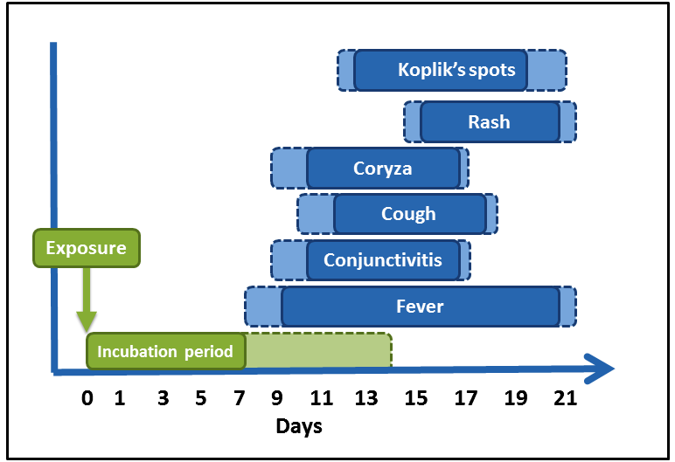
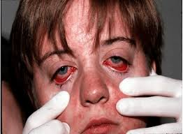
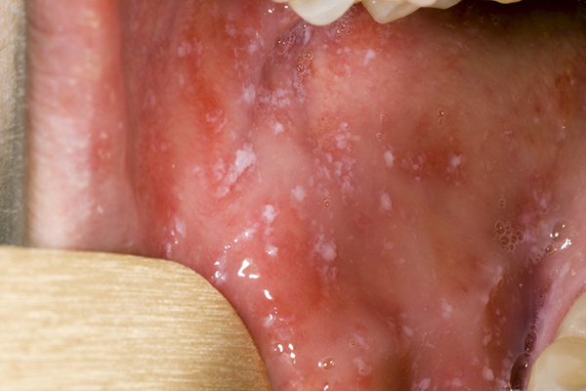

Slide 8
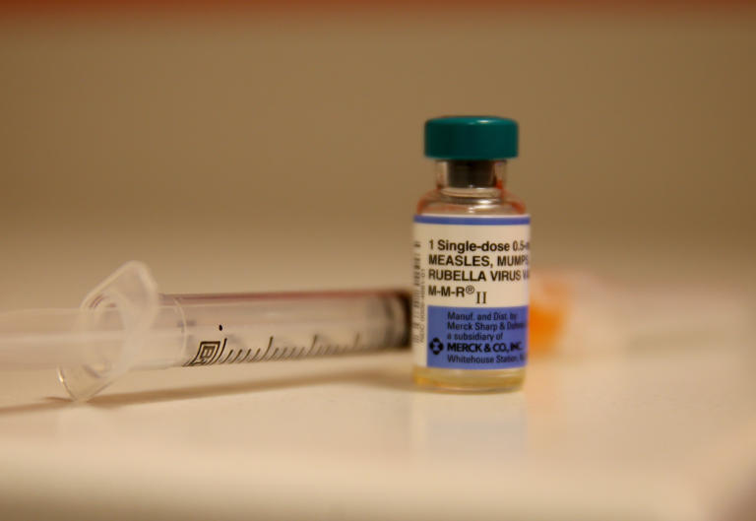
Measles vaccine
PRH 2.3 R2 (d) 1 (c)
Immunizations or boosters if the following immunization series are incomplete or if current immunization records cannot be produced:
Tetanus and diphtheria toxoid (Td) or Tetanus-diphtheria-acellular pertussis (Tdap)
Inactivated polio vaccine (IPV) for students younger than 18 years
Measles, mumps, and rubella vaccine

Slide 9
Norovirus outbreaks
Since late January, norovirus has been circulating in the Northeast at the highest rates since April of last year.
Norovirus is somewhat seasonal — cases occur most frequently in cold months (late fall, winter and early spring).
Highly contagious – only 10-100 virus particles needed to transmit infection. Norovirus can survive on surfaces for up to two weeks.
Severe vomiting, diarrhea, abdominal cramping leading to dehydration. Onset of symptoms 12 to 48 hours after ingestion.
Symptomatic management only. Oral rehydration therapy.

Slide 10
Norovirus annual burden of illness in US
CDC

Slide 11
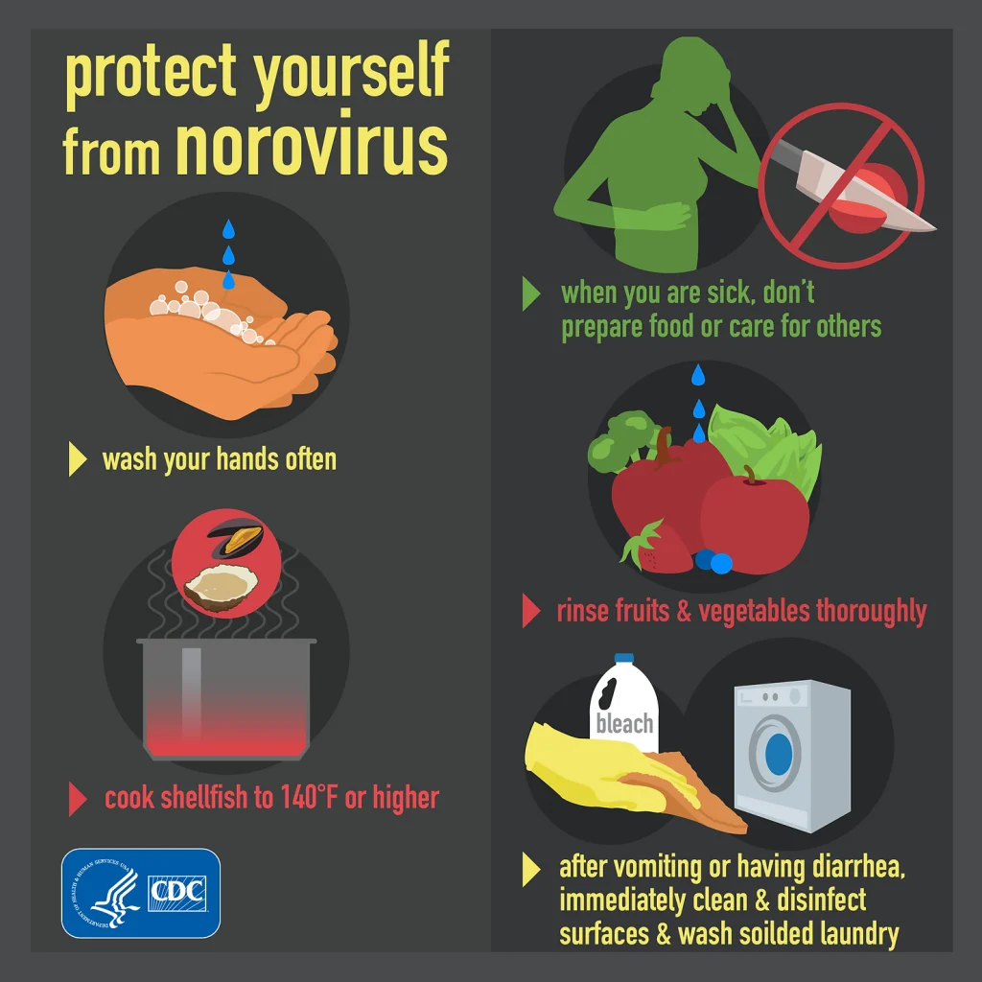

Slide 12
Sara Mackenzie, MD, MPH
February 28, 2024

Slide 13
Antibiotic stewardship:
An effort to measure and improve antibiotic prescribing and minimize inappropriate use
Antibiotic resistance a major public health threat
~2.8 million resistant infections per year
~35,000 deaths d/t resistance per year
Primary care clinics prescribe approximately half of all antibiotics in the U.S.
~half might be inappropriate (dosing, duration, maybe unnecessary)
~30 percent unnecessary
Notes:
https://emergency.cdc.gov/newsletters/coca/2024/012524.html

Slide 14
Clinical Impact Areas:
Gonorrhea resistance
Ceftriaxone IM as the first line treatment
Centers should have access to ceftriaxone
URIs and Sore Throats
Commonly viral

Slide 15
Clinical Impact Areas:
Acute uncomplicated UTIs
Self-diagnosis is accurate with typical symptoms (frequency, urgency, dysuria, nocturia, suprapubic pain) & no vaginal discharge
Urine culture and susceptibility if recurrent infection (>2 in 6 months or >3 in 1 year) or treatment failure
To treat or not to treat
Health Care Guideline (Know local resistance patterns)
NSAID and delayed antibiotics?
Acute Uncomplicated UTIs in Adults: Rapid Evidence Review | AAFP

Slide 16
Center potential actions:
Education to wellness staff and students
Healthcare Guidelines
CDC handouts/posters
Shared Decision-Making
Importance of taking antibiotics correctly and completing prescription if required
Notes:
https://emergency.cdc.gov/newsletters/coca/2024/012524.html

Slide 17
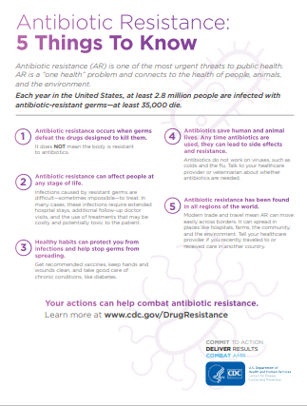
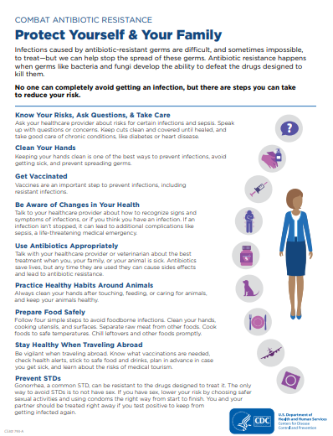
About Antibiotic Resistance | CDC

Slide 18
Syphilis:
Rising rates across the country
Shifting pattern of infection
Increase in heterosexual community
Increase in congenital syphilis

Slide 19
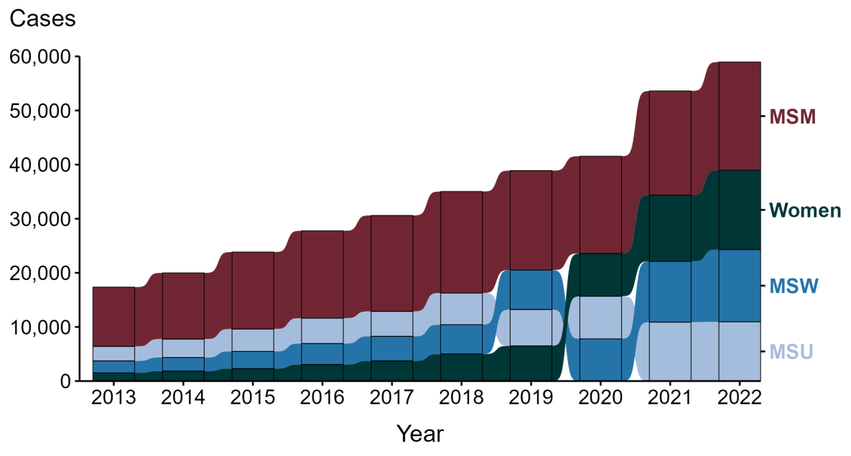
Primary and Secondary Syphilis: reported cases by sex and sex of sex partners, U.S. 2013-2022
National Overview of STIs, 2022 (cdc.gov)

Slide 20
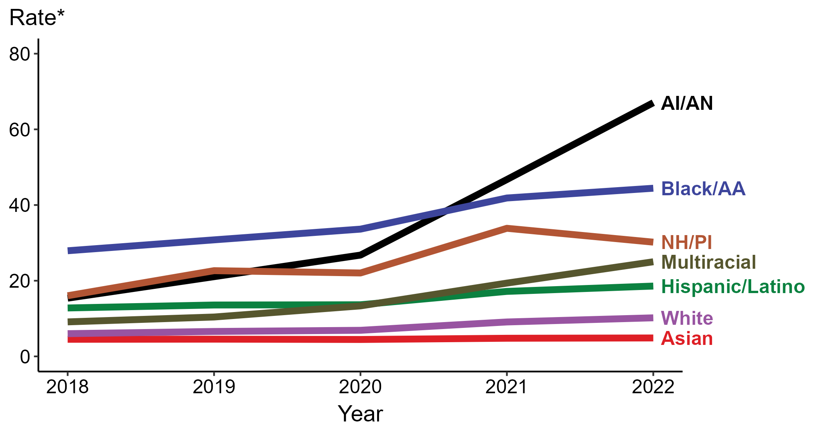
Primary and Secondary Syphilis: Rates of reported cases by Race/Ethnicity, U.S. 2018-2022
National Overview of STIs, 2022 (cdc.gov)

Slide 21
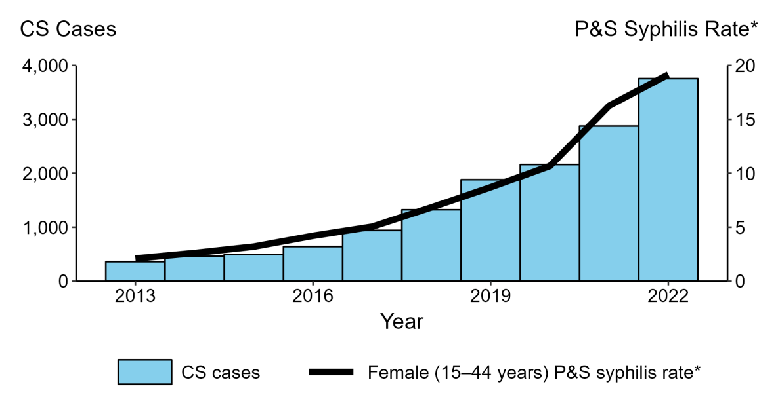
Congenital Syphilis: Rates of reported cases by year of birth & rates of P & S among women 15-44, U.S. 2013-2022
National Overview of STIs, 2022 (cdc.gov)

Slide 22
Syphilis Screening:
MSM – at least annually (q3-6 months if increased risk)
MSW – if increased risk (male <29, history incarceration, transactional sex work, geography, race/ethnicity)
Women – increased risk (history incarceration, transactional sex work, geography, race/ethnicity)
ALL pregnant people
STI Screening Recommendations (cdc.gov)
Notes:
PRH states optional but continue screening on entry if significant prevalence in center population

Slide 23
Syphilis Treatment:
Coordinate with local public health
Benzathine penicillin
Confusion regarding benzathine-procaine products
Bicillin L-A is recommended (shortage)
Partner identification and treatment
If diagnosis of primary, secondary or early latent, sexual partners in the 90 days prior to diagnosis should be treated even if serology negative

Slide 24
Wilson’s disease
rare recessive genetic disorder characterized by excessive copper accumulation in the liver, brain, eyes, and other organs
results from a mutation in the copper-transporting gene ATP7B
also known as hepatolenticular degeneration
with proper medical management, including lifelong medication and dietary modifications, many individuals with Wilson's disease can lead relatively normal lives
if left untreated or poorly managed, the disease can progress and cause severe liver and neurological damage, potentially reducing life expectancy
early detection, regular monitoring, and consistent treatment are crucial for optimizing the prognosis and extending the lifespan of individuals with Wilson's disease

Slide 25
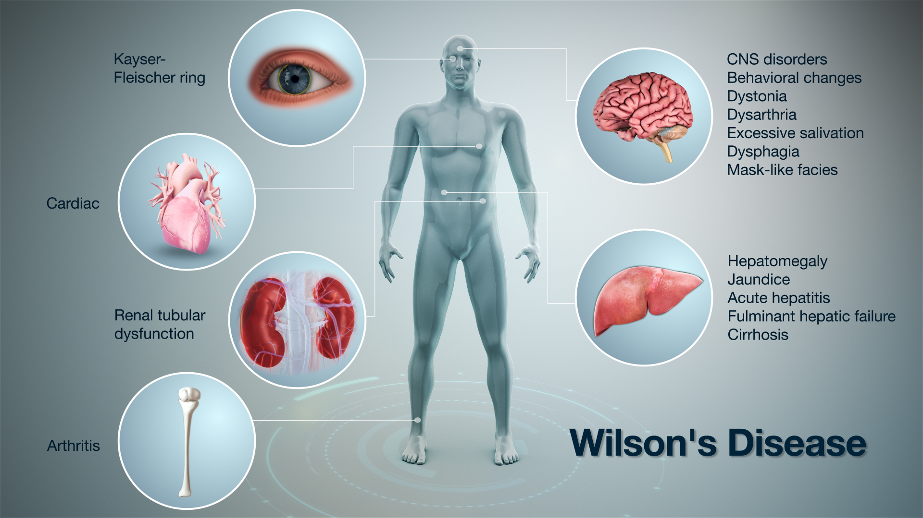

Slide 26
Wilson’s disease: Clinical presentation
Chronic liver disease - 42% of cases
Neurological disease - 34% of cases
Psychiatric disorders
Hemolytic anemia
Renal tubular lesions
Common neurological features include dysarthria, dystonia, tremor, parkinsonism, choreoathetosis, ataxia, and gait anomalies
Kayser-Fleischer rings are seen in nearly all patients with neurological manifestations of Wilson’s disease

Slide 27
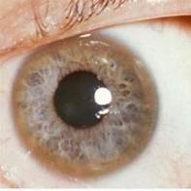
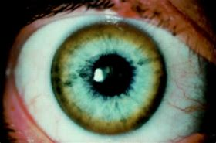
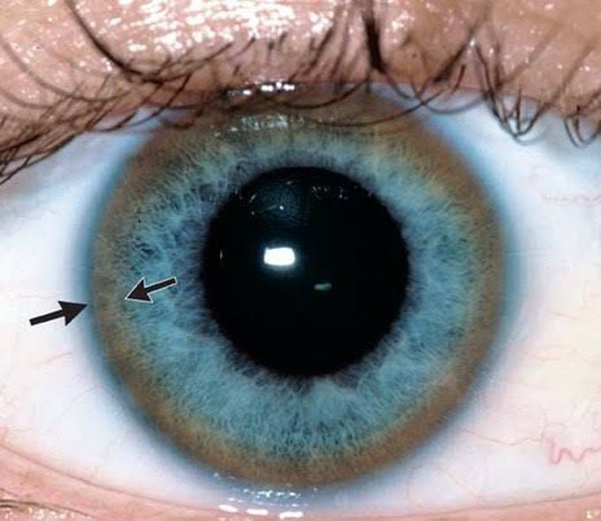
Wilson’s disease: Kayser-Fleischer rings
dark rings that appear to encircle the cornea of the eye due to copper deposition in Descemet’s membrane

Slide 28
Wilson’s disease: Diagnostic evaluation
Serum Ceruloplasmin: low level of ceruloplasmin in the blood, usually below 0.2 g/L (normal range: 0.2–0.5 g/L) or below 50% of the lower limit of the normal range
Urinary Copper: high 24 h urinary copper excretion, which usually exceeds 100 µg/24 h in adults - most sensitive single screening tool
Serum Copper: total serum copper (TSC) consists of copper incorporated in ceruloplasmin and non-ceruloplasmin-bound copper called free copper. The TSC diagnostic value is poor as it does not indicate tissue concentrations.
Coombs-Negative Hemolytic Anemia: may occur in up to 15% of patients with Wilson’s disease
Blood Liver Tests: hepatic dysfunction is a typical feature of Wilson’s disease seen in more than 50% of patients. The condition should be considered in the differential diagnosis of any unexplained abnormal liver tests, especially in patients below the age of 40
Genetic testing for individuals at-risk of Wilson’s Disease

Slide 29
Wilson’s disease: Management
early diagnosis and prompt treatment introduction; careful and lifelong monitoring of patient compliance and strict adherence to treatment, and screening for adverse effects and evaluation of treatment efficacy
avoid copper-rich meals containing liver, chocolate, nuts, and seafood (especially lobster), and consume low-copper water
D-penicillamine is the first line oral chelating agent for induction of treatment – trientine is second line and less effective – both mobilize copper from the tissues and increase urinary excretion
zinc salts for maintenance treatment prevent copper absorption
liver transplantation (5%)

Slide 30
Webinar tomorrow
New Drug Zero Tolerance Policy Nuts and Bolts on Thursday,
February 29th at 11 am (ET), 10 am (CT), 9 am (MT), and 8 am (PT).
The webinar is listed in the Upcoming Sessions tab on WebEx
at https://jobcorps.webex.com and is open for registration.
All center clinicians are encouraged to attend.

Slide 31
Open Forum
https://www.surveymonkey.com/r/B2ZYS83

Slide 32
Job Corps Center Physician Monthly Teleconference Next call: Wednesday, March 27th, 2024
John Kulig MD MPH Region 1 Boston & Region 2 Philadelphia
Sara Mackenzie MD MPH Region 6 San Francisco
Drew Alexander MD Region 4 Dallas
Gary Strokosch MD Region 3 Atlanta & Region 5 Chicago
HIPAA compliant messages use @jobcorps.org email address
https://www.surveymonkey.com/r/B2ZYS83

