Slide 1
Job Corps Center Physicians Monthly Teleconference
John Kulig MD MPH Region 1 Boston & Region 2 Philadelphia
Sara Mackenzie MD MPH Region 6 San Francisco
Drew Alexander MD Region 4 Dallas
Gary Strokosch MD Region 3 Atlanta & Region 5 Chicago
HIPAA compliant messages use @jobcorps.org email address
Wednesday, April 26th, 2023

Slide 2
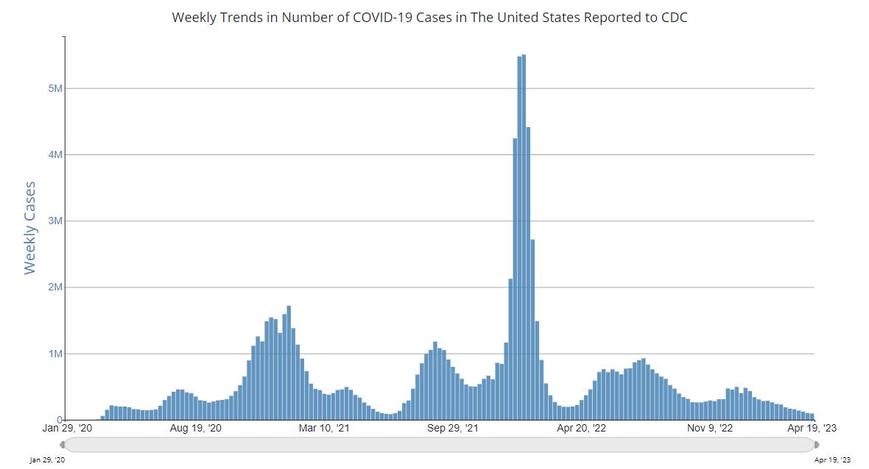

Slide 3
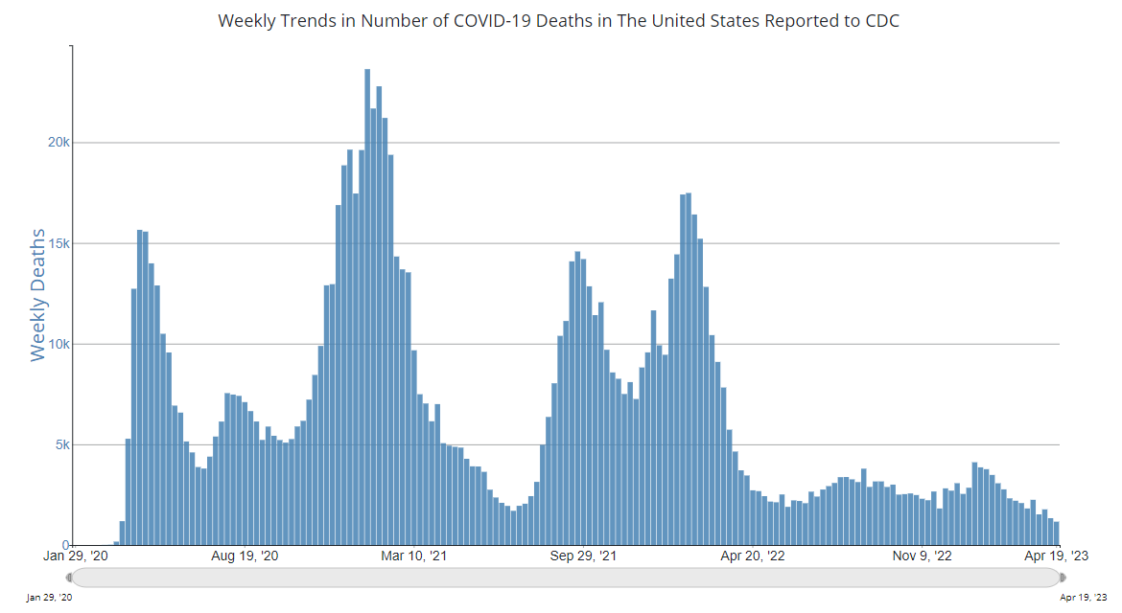

Slide 4
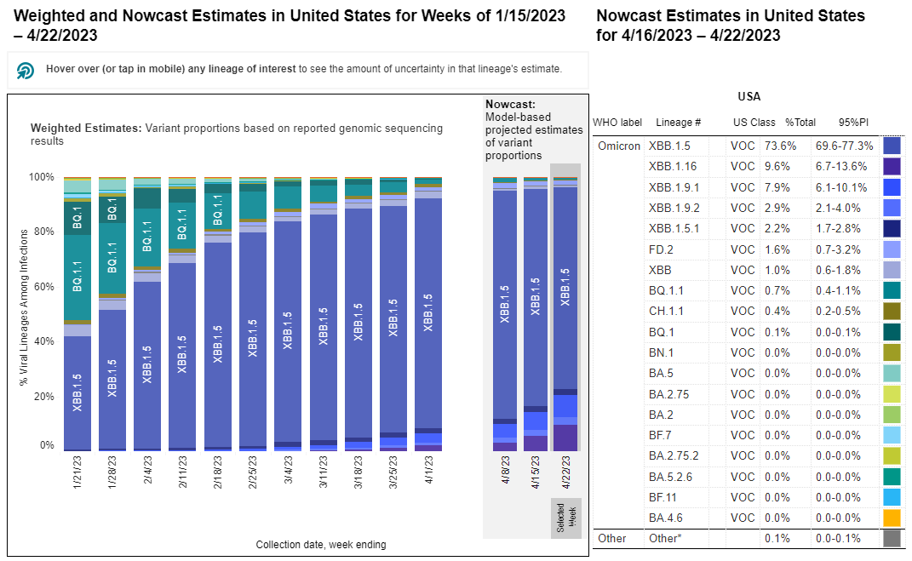
CDC Genomic Surveillance: Monitoring variants

Slide 5
New Omicron Variant
XBB.1.16, a new variant, is increasing across the country and appears to spread more easily than previous variants.
The bivariant booster vaccine and the antiviral medication Paxlovid remain effective at reducing disease severity.
New symptom with the XBB.1.16 variant is conjunctivitis (red, itchy eyes). Be on the lookout and test for COVID-19 if a student presents with conjunctivitis and any of the usual COVID symptoms - runny nose, sore throat, fever, cough, etc.
Continue to encourage and provide access to the bivariant booster COVID-19 vaccine if not yet received by the student.

Slide 6
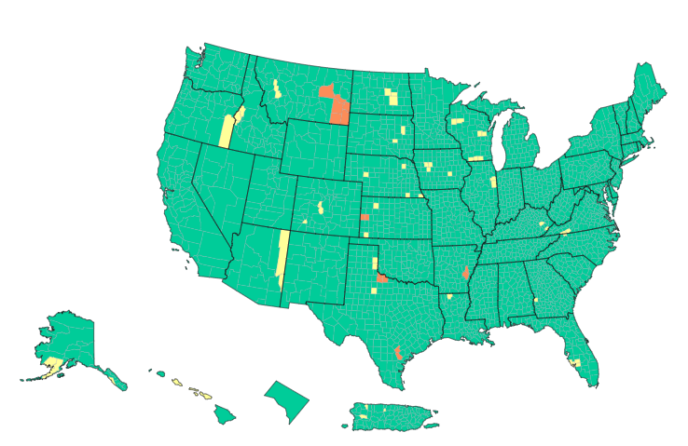
Community levels
COVID-19 Community Levels were
calculated on Thursday Apr 20 2023

Slide 7
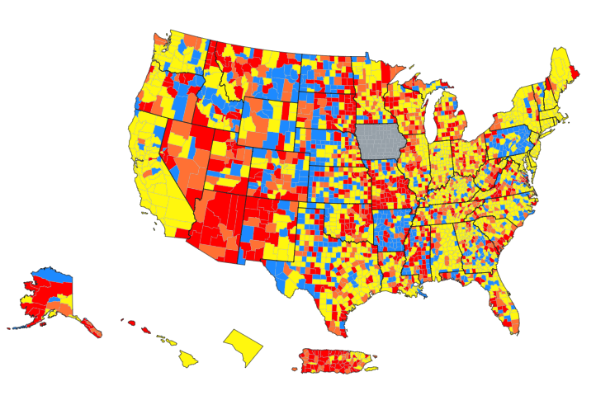
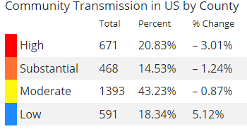
Community transmission
New cases per 100,000 in past 7 days:
High > 100
Positive NAAT tests in past 7 days:
High > 10%
Current 7-days is Apr 13 2023 - Apr 19 2023 for case rate and Apr 11 2023 - Apr 17 2023 for percent positivity.

Slide 8
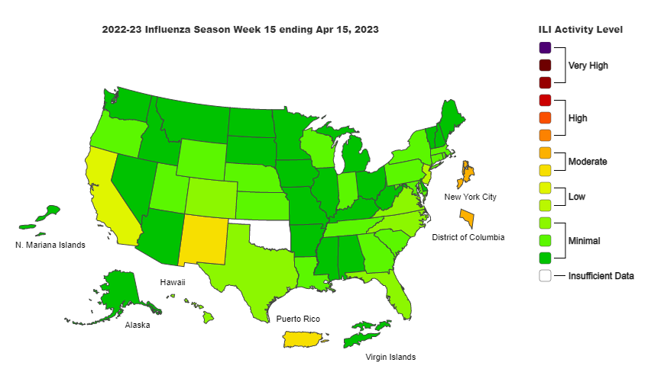

Slide 9
Job Corps Student Mortality: Preliminary Data PY 2022
Cause of death | Count – July 1, 2022 to date
Drug and alcohol | 7* 58%
Homicide | 3 25%
Suicide | 1 9%
Medical | 1 9%
Unintentional injury | 0 -
Unknown | 0 -
Total | 12 100%
*Three on-center & four off-center. Six male. One female.

Slide 10
Staff Preparedness for Student Drug Overdose
Staff training:
CPR/First Aid
Recognition of substance use symptoms
Administration of Narcan
Staff knowledge:
Location of emergency kits with Ambu bags on center
Location of automated external defibrillators (AEDs) on center
Location of nearest Narcan – multiple sites on center, center vehicles
Note that Narcan nasal spray can be administered as one squirt every 2 to 3 minutes until EMS arrives. Narcan is not harmful, even when not clinically indicated, as with a non-opioid overdose.

Slide 11
Medication Assisted Treatment (MAT) for Opioid Use Disorder
November 18, 2016
DIRECTIVE: JOB CORPS PROGRAM INSTRUCTION NOTICE NO. 16-21
“Medication Assisted Treatment (MAT) for Opioid Addiction in Job Corps”
Centers need to consider the logistics of the individual’s MAT participation as it relates to Job Corps program requirements. MAT will occur off center because Job Corps does not provide addiction treatment services or long-term therapy.
Options:
Daily methadone by mouth – licensed clinics only
Daily sublingual buprenorphine/naloxone
Buprenorphine/naloxone subdermal implant – 6 months
Monthly naltrexone intramuscular injection

Slide 12
Controlled Substances in Lockboxes
Centers may choose to dispense controlled substances exclusively in the Wellness Center, but . . .
Storage of controlled substances in the student lockboxes is NOT prohibited
Quantities of medication in the lockboxes should be limited to a 7-day supply with resupply and collection of the Controlled Medication Observation Record (CMORs) weekly
Controlled substances on center are almost exclusively psychostimulant medications for ADHD
Weekend dosing may not be needed if not driving or studying

Slide 14
Getting the Conversation Started
Assess your own comfort by discussing sex with various patient groups. Identify any biases that you may have. If you are uncomfortable talking about sex and sexuality, your patient will be too.
• Avoid making assumptions about your patient based on age, appearance,
marital status, or any other factor.
• Gather your patient’s basic information during the initial clinic assessment.
This includes their name, pronouns, sexual orientation, and gender identity.
• For gender identity, incorporate a two-step method into the assessment.
Ask for their sex assigned at birth (female, male, or decline to answer) and
then current gender identity (female, male, transgender female, transgender
male, gender diverse, additional gender category, or decline to answer).

Slide 15
Getting the Conversation Started
Ask for correct pronouns and terminology. Use the pronouns they share and support the patient’s current gender identity, even if their anatomy does not match that identity.
• Use neutral and inclusive terms such as “partner.”
• Make your patient feel comfortable by establishing a rapport before
asking sensitive questions.
• Ask other people to step into the waiting room while you talk with
your patient privately.
Family members should not serve as interpreters.

Slide 16
Keeping the Conversation Going
• Let your patient know that you ask everyone these questions.
• Transition into asking sensitive questions.
• Pose your questions in a non-judgmental manner.
• Try not to react overtly, even if you feel uncomfortable or
embarrassed. Pay attention to your body language and posture.
• Rephrase your questions or briefly explain why you are asking a
question if a patient seems offended or reluctant to answer.
• Ensure that you and your patient share an understanding of the terms
being used, to avoid confusion. If you are not familiar with a term your
patient used, ask for an explanation.

Slide 17
The 5 Ps approach to taking a sexual history

Slide 18
Partners
Are you currently having sex of any kind—oral, vaginal, or anal—with anyone? (Are you having sex?)
• If no, have you ever had sex of any kind with another person?
• In recent months, how many sex partners have you had?
• What is/are the gender(s) of your sex partner(s)?
• Do you or your partner(s) currently have other sex partners?

Slide 19
Practices
• I need to ask some more specific questions about the kinds of sex you have
had over the last 12 months to better understand if you are at risk for
sexually transmitted infections or STIs. Would that be OK?
• We have different tests that are used for the different body parts that
people use to have sex.
What kinds of sexual contact do you have, or have you had? What parts of your body are involved when you have sex? – Do you have genital sex (penis in the vagina)? – Anal sex (penis in the anus)? – Oral sex (mouth on penis, vagina, or anus)? – Are you a top and/or a bottom?
• Have you or any of your partners used drugs?
• Have you exchanged sex for your needs (money, housing, drugs, etc.)?

Slide 20
Protection from STIs
• Do you and your partner(s) discuss STI prevention?
• If you use prevention tools, what methods do you use? (For example, external or internal condoms— also known as male or female condoms—dental dams, etc.)
• How often do you use this/these method(s)? More prompting could include specifics about: – Frequencies: sometimes, almost all the time, all the time. – Times they do not use a method.
• If “sometimes,” in which situations, or with whom, do you use each method?
• Have you received human papilloma virus (HPV), hepatitis A, and/or hepatitis B vaccine shots?
• Are you aware of pre-exposure prophylaxis or PrEP, a medicine that can prevent HIV infection? Have you ever used it or considered using it?

Slide 21
Past History of STIs
Have you ever been tested for STIs and HIV? Would you like to be tested?
• Have you been diagnosed with an STI in the past? When? Did you get
treatment?
• Have you had any symptoms that keep coming back?
• Has your current partner or any former partners ever been diagnosed
or treated for an STI? Were you tested for the same STI(s)? Do you
know your partner’s (or partners’) HIV status?

Slide 22
Pregnancy Intention
Do you think you would like to have (more) children at some point?
• When do you think that might be?
• How important is it to you to prevent pregnancy (until then)?
• Are you or your partner using contraception or practicing any form of
birth control?
Would you like to talk about ways to prevent pregnancy?
Do you need any information on birth control?

Slide 23
Announcement
Guest speaker next month:
Tamara Warner, PhD
Regional Mental Health Specialist
Dallas, San Francisco
“Introduction to Trauma Informed Care”

Slide 24
Open Forum
https://www.surveymonkey.com/r/PQX3J6P

Slide 25
Job Corps Center Physicians Monthly Teleconference Next call: Wednesday, May 24, 2023
John Kulig MD MPH Region 1 Boston & Region 2 Philadelphia
Sara Mackenzie MD MPH Region 6 San Francisco
Drew Alexander MD Region 4 Dallas
Gary Strokosch MD Region 3 Atlanta & Region 5 Chicago
HIPAA compliant messages use @jobcorps.org email address
https://www.surveymonkey.com/r/PQX3J6P

