Slide 1
Job Corps Center Physician Monthly Teleconference
Wednesday, April 24th, 2024

Slide 2
Confidentiality
FROM THE AMERICAN ACADEMY OF PEDIATRICS| APRIL 22 2024
Confidentiality in the Care of Adolescents: Policy Statement
https://doi.org/10.1542/peds.2024-066326 FREE
Confidentiality in the Care of Adolescents: Technical Report
https://doi.org/10.1542/peds.2024-066327 FREE

Slide 3
Reproductive Health Services for Minors
Contraceptive services
For access to contraceptives for those younger than 18, the U.S. Supreme Court specifically affirmed their right to access contraceptives in the 1977 decision Carey v. Population Services International.
No state has enacted a blanket requirement that individuals must obtain parental consent for contraceptive services.
https://www.guttmacher.org/state-policy/explore/overview-minors-consent-law

Slide 4
Reproductive Health Services for Minors
Contraceptive services
27 states and the District of Columbia explicitly allow all individuals to consent to contraceptive services or those at a specified age (such as 12 or 14) and older to consent to such care.
19 states allow only certain categories of people younger than 18 to consent to contraceptive services.
4 states have no explicit policy or relevant case law.
https://www.guttmacher.org/state-policy/explore/overview-minors-consent-law

Slide 5
Reproductive Health Services for Minors
Sexually transmitted infection
All states and DC allow young people to consent to STI services.
39 states and DC allow all individuals, regardless of age, to consent to STI and HIV services, while the remaining states allow certain categories of young people or those at a specified age (such as 12 or 14) and older to consent to such care.
18 states allow, but do not require, a physician to inform a young person’s parents that their child is seeking or receiving STI services when the doctor deems it in the patient’s best interests.
https://www.guttmacher.org/state-policy/explore/overview-minors-consent-law

Slide 6
Reproductive Health Services for Minors
Prenatal care
33 states and DC explicitly allow all individuals younger than 18 to consent to prenatal care.
14 of these states allow, but do not require, a physician to inform parents that their child is seeking or receiving prenatal care when the doctor deems it in the young person’s best interest to do so.
North Dakota allows young people to consent to prenatal care during the first trimester and requires parental consent for most care during the second and third trimesters.
4 states allow young people who can be considered “mature” to consent to receive care.
13 states have no explicit policy or relevant case law.
https://www.guttmacher.org/state-policy/explore/overview-minors-consent-law

Slide 7
Reproductive Health Services for Minors
Abortion
2 states and the District of Columbia explicitly allow all individuals to consent to abortion services, regardless of age.
20 states require that at least one parent provide consent before a patient younger than 18 can obtain an abortion, while 10 states require prior notification of at least one parent.
6 states require both notification of and consent from a parent before a minor’s abortion.
5 states have parental involvement laws that are temporarily or permanently enjoined.
6 states have no explicit policy or relevant case law.
https://www.guttmacher.org/state-policy/explore/overview-minors-consent-law

Slide 8
State laws governing reproductive health services for minors (age < 18 years)
https://www.guttmacher.org/state-policy/explore/overview-minors-consent-law

Slide 9
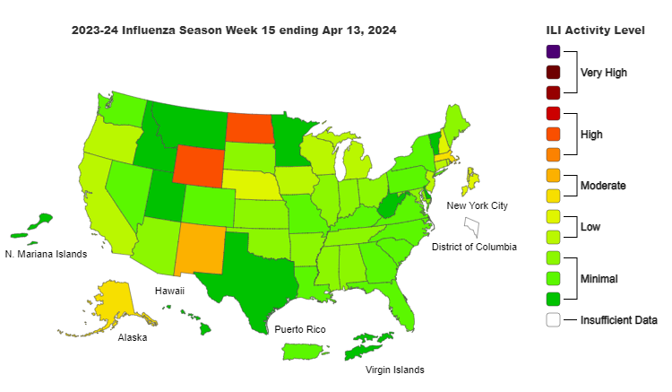

Slide 10
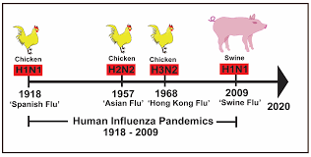

Slide 11
Avian influenza (“bird flu”)
Highly pathogenic avian influenza (HPAI) caused by A(H5N1) virus (“H5N1 bird flu”) – 2 human cases reported in US – exposed to infected dairy cattle. No human-to-human transmission.
From 1 January 2003 to 26 February 2024, a total of 254 cases of human infection with avian influenza A(H5N1) virus have been reported from four countries within the Western Pacific Region. Of these cases, 141 were fatal, resulting in a case fatality rate (CFR) of 56%.
Avoid unprotected exposures to sick or dead animals including wild birds, poultry, other domesticated birds, and other wild or domesticated animals (including cattle), as well as with animal carcasses, raw milk, feces, litter, or materials contaminated by birds or other animals with confirmed or suspected HPAI A(H5N1)-virus infection.
People should not prepare or eat uncooked or undercooked food or related uncooked food products, such as unpasteurized (raw) milk, or products made from raw milk such as cheeses, from animals with confirmed or suspected HPAI A(H5N1)-virus infection (avian influenza or bird flu).
People exposed to birds or other animals with confirmed or suspected HPAI A(H5N1) virus infection should be monitored for any signs and symptoms of illness for 10 days after the last known exposure.
CDC

Slide 12
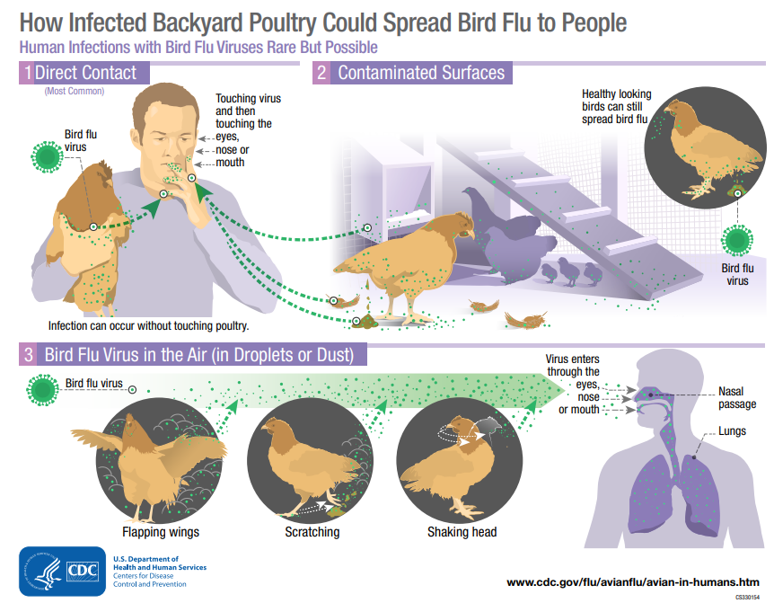

Slide 13
Swine flu
Swine influenza is a respiratory disease of pigs caused by type A influenza viruses that regularly cause outbreaks in pigs.
When a flu virus that normally spreads in pigs but not people is found in a person, it is called a “variant flu virus.”
Human infections with variant flu viruses most commonly happen in people with exposure to infected pigs.
Documented cases of limited person-to-person spread of variant flu viruses have occurred .
A pandemic occurred in 2009 when a flu A H1N1 virus with genes from swine, avian and human flu viruses emerged in the spring.

Slide 14
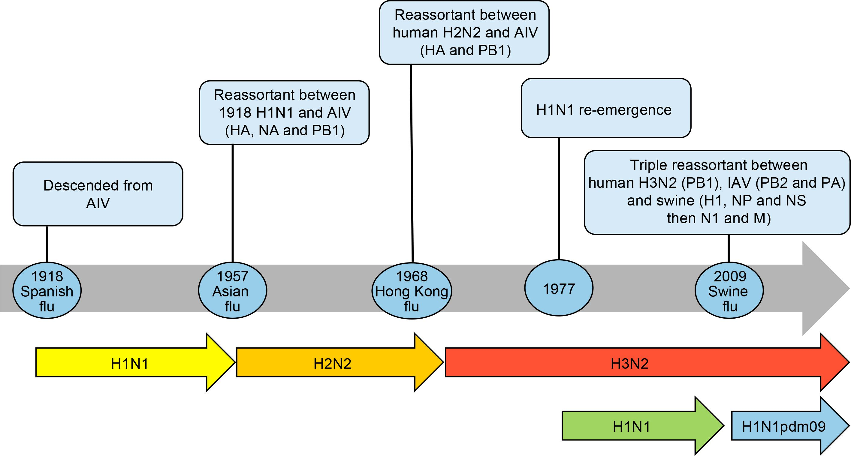

Slide 15
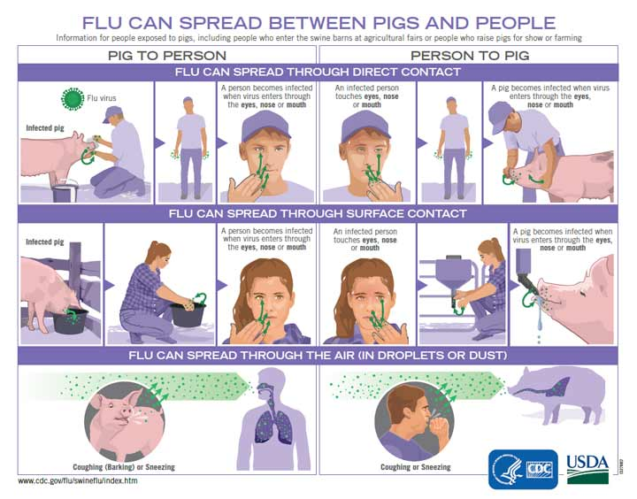

Slide 16
COVID-19 vaccine not associated with sudden cardiac death
Starting in April 2021, cases of myocarditis reported after COVID-19 vaccination, particularly among young males Investigators examined June 2021–December 2022 Oregon death certificate data for decedents aged 16–30 years 40 deaths in this age group among mRNA COVID-19 vaccinees Only 3 deaths < 100 days after vaccination – 2 in persons with underlying illness, 1 undetermined Data do not support an association of COVID-19 vaccination with sudden cardiac death among previously healthy young persons COVID-19 vaccination is recommended for all persons aged ≥ 6 months to prevent COVID-19 and complications, including death MMWR / April 11, 2024 / 73(14);317–320

Slide 17
Syndrome of the month
Charcot-Marie-Tooth (CMT) disease
a spectrum of nerve disorders named after the three physicians who first described it in 1886 — Jean-Martin Charcot and Pierre Marie of France and Howard Henry Tooth of the United Kingdom
the most common hereditary polyneuropathy - most types of CMT are inherited in an autosomal dominant manner, but X-linked and autosomal recessive forms also occur
insidious onset of distal predominant motor and sensory loss, muscle wasting, and pes cavus (high arched foot deformity)

Slide 18
Charcot-Marie-Tooth (CMT) disease

Slide 19
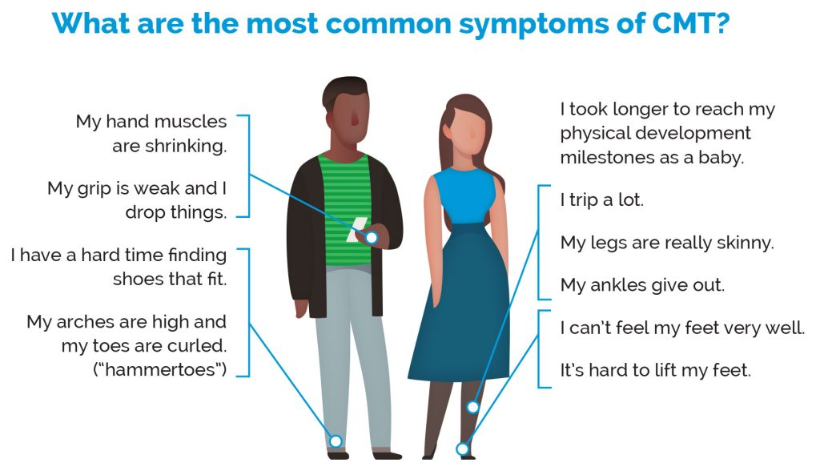

Slide 20
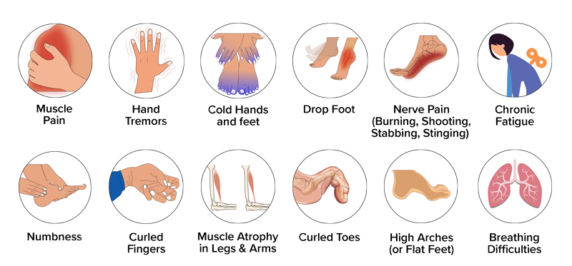
Charcot-Marie-Tooth (CMT) disease

Slide 21
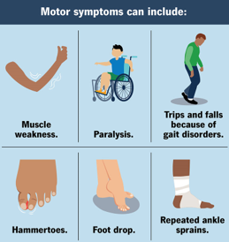
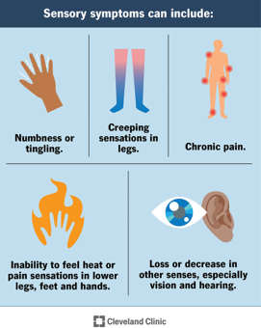

Slide 22
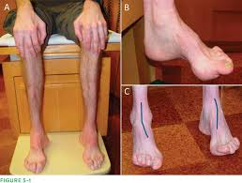
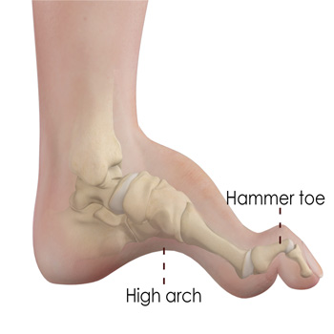
Charcot-Marie-Tooth (CMT) disease

Slide 23
Charcot-Marie-Tooth (CMT) disease
CMT, also known as hereditary motor and sensory neuropathy, is one of the most common inherited neurological disorders, affecting an estimated 126,000 individuals in the U.S. and 2.6 million people worldwide.
Progressive muscle weakness typically becomes noticeable in adolescence or early adulthood, but the onset of disease can occur at any age.
Because longer nerves are affected first, symptoms usually begin in the feet and lower legs and then can affect the fingers, hands, and arms.
Most individuals with CMT have some amount of physical disability, although some people may never know they have the disease.

Slide 24
Charcot-Marie-Tooth (CMT) disease
CMT affects both sensory and motor nerves in the arms, hands, legs, and feet.
The affected nerves slowly degenerate and lose the ability to communicate with their distant targets, resulting in muscle weakness and atrophy in the arms, legs, hands, or feet.
Some individuals may need to rely on foot or leg braces or other orthopedic devices to maintain mobility.
Some people living with CMT experience tremor, and vision and hearing can also be affected.
The severity of symptoms can vary greatly among individuals and even among family members with the disease and gene mutation.
Progression of symptoms is gradual.

Slide 25
Charcot-Marie-Tooth (CMT) disease
Symptoms may include:
Weakness or paralysis of the foot and lower leg muscles, which can cause difficulty lifting the foot (foot drop)
A high-stepped gait with frequent tripping or falling
Balance problems
Foot deformities, such as high arches and curled toes (hammertoes)
Lower legs may take on an "inverted champagne bottle" shape due to the loss of muscle bulk
Reduced ability to feel heat, cold, and touch
Weakness and atrophy may occur in the hands, causing difficulty with fine motor skills
Decreased sense of vibration and position (proprioception)
Curvature of the spine (scoliosis)
Hip displacement
Contractures (chronic shortening of muscles or tendons around joints)
Muscle cramping
Nerve pain

Slide 26
Charcot-Marie-Tooth (CMT) disease
CMT is caused by mutations in genes that support or
produce proteins involved in the structure and function
of either the peripheral nerve axon or the myelin sheath.
Although different proteins are abnormal in different forms of CMT disease, all the mutations mainly affect the normal function of the peripheral nerves.
Gene defects in myelin cause dysfunction of the coating, which distorts or blocks nerve signals, while other mutations limit axon function and cause axonal loss.

Slide 27
CMT diagnosis
Diagnosis begins with a detailed medical history, family history, and neurological examination. A clinician will look for evidence of:
Muscle weakness in the arms, legs, hands, and feet
Decreased muscle bulk
Reduced tendon reflexes
Sensory loss
Foot and orthopedic problems, such as mild scoliosis or an abnormal formation of the hip joint
A specific sign that may be found in individuals with CMT1 is nerve enlargement that may be felt or even seen through the skin, especially at the elbow. These enlarged nerves, called hypertrophic nerves, are caused by thickened myelin sheaths.
Additional tests including:
Nerve conduction studies
Electromyography (EMG)
Genetic testing
Nerve biopsy

Slide 28
CMT management
No cure for CMT, but lifespan normal.
Physical and occupational therapies, braces and other orthopedic devices, and orthopedic surgery may help with the disabling symptoms of the disease. In addition, pain-relief drugs can be prescribed for severe nerve pain.
Maintaining mobility, flexibility, and muscle strength is important. Beginning a treatment program early may delay or reduce nerve degeneration and muscle weakness before it progresses to the point of disability.
High-top shoes or boots also can give the person support for weak ankles. Thumb splints can help with hand weakness and loss of fine motor skills. Assistive devices should be used before disability sets in because the devices may prevent muscle strain and reduce muscle weakening.

Slide 29
Webinar: “Men’s Mental Health”
Session date: Tuesday, May 14, 2024
Session time: 2 pm – 3 pm EDT
Description: Men's Mental Health Awareness Month was first observed in 2023. This webinar highlights the unique and urgent call to recognize and meet the mental health needs of young men on Job Corps centers.
The webinar is listed in the Upcoming Sessions tab on WebEx at https://jobcorps.webex.com and is open for registration. All center clinicians are encouraged to attend.

Slide 30
Open Forum
https://www.surveymonkey.com/r/9B3WZZM

Slide 31
Regional Medical Specialists Contact us with policy or clinical questions
John Kulig MD MPH Region 1 Boston & Region 2 Philadelphia
Gary Strokosch MD Region 3 Atlanta & Region 5 Chicago
Drew Alexander MD Region 4 Dallas
Sara Mackenzie MD MPH Region 6 San Francisco
HIPAA compliant messages => use @jobcorps.org email address
https://www.surveymonkey.com/r/9B3WZZM

Slide 32
Monthly Teleconference
Next call: Wednesday, May 29th, 2024
Center Physician Call - May 2024 May 29, 2024, 2:00 – 3:00 PM (America/New York) Please join our meeting from your computer, tablet or smartphone. https://meet.goto.com/951673333 You can also dial in using your phone. Access Code: 951-673-333 United States: +1 (224) 501-3412 Get the app now and be ready when your first meeting starts: https://meet.goto.com/install

