Slide 1
Job Corps Center Physician Monthly Teleconference
John Kulig MD MPH Region 1 Boston & Region 2 Philadelphia
Sara Mackenzie MD MPH Region 6 San Francisco
Drew Alexander MD Region 4 Dallas
Gary Strokosch MD Region 3 Atlanta & Region 5 Chicago
HIPAA compliant messages use @jobcorps.org email address
Wednesday, August 30th, 2023

Slide 2
Health and Wellness
Public Health Updates
Sara Mackenzie, MD, MPH
August 30, 2023

Slide 3
Respiratory Season Approaching
Covid-19
Influenza
Respiratory Syncytial Virus (RSV)

Slide 4
COVID-19 – hospitalizations increasing

Slide 5
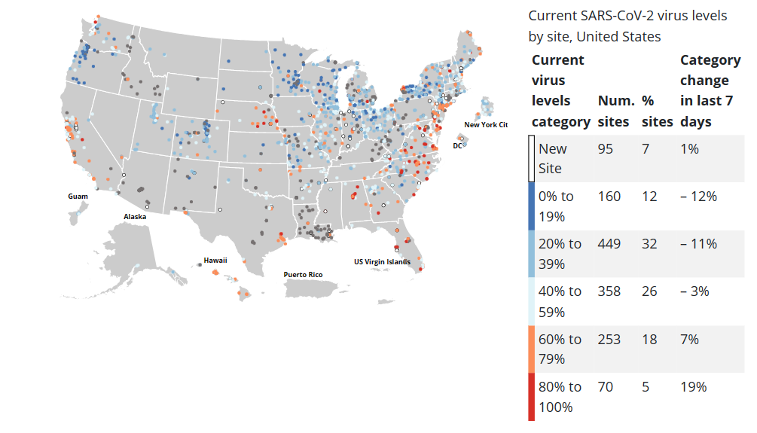
COVID-19 – wastewater surveillance

Slide 6
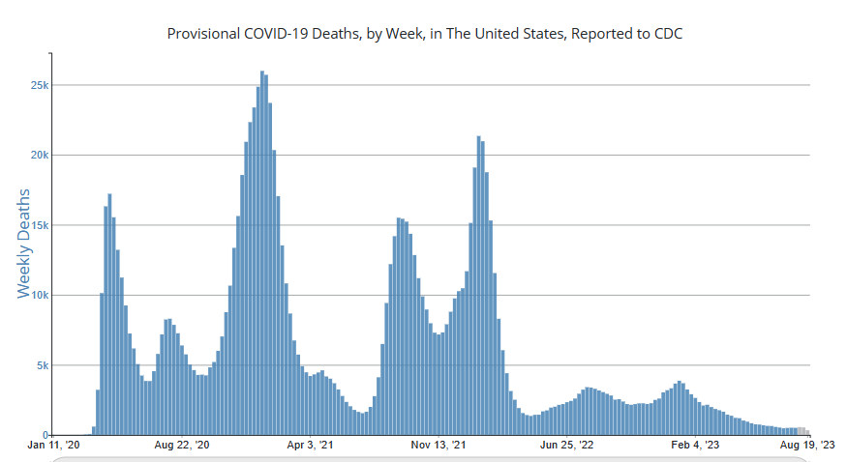
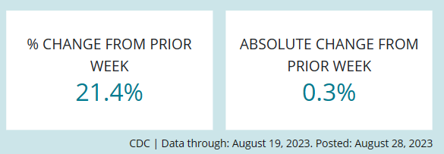
COVID-19 – deaths increasing

Slide 7
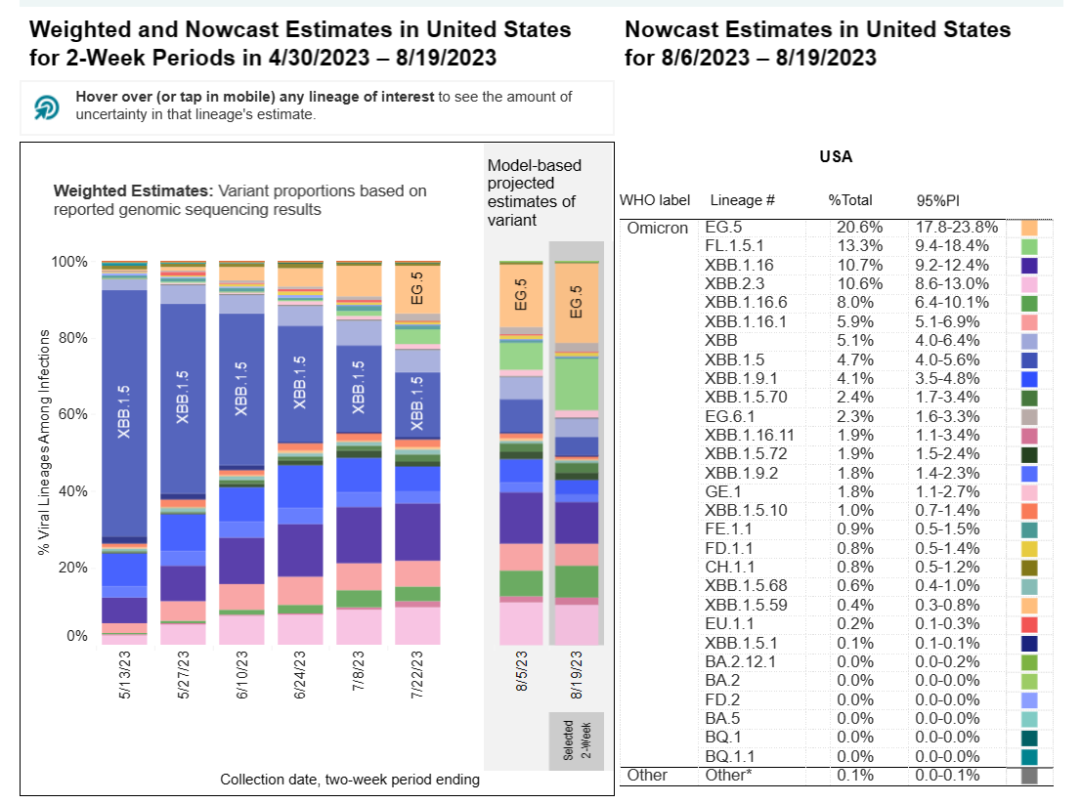
COVID-19 genomic variants
BA.2.86 (“pirola”) new variant being monitored as may cause increase cases

Slide 8
COVID-19 on Job Corps Centers
Increase in number of centers with active cases & outbreaks (evidence of possible on-center transmission)
Increase in number of centers at or near 10% of students involved
Set expectations: remind staff & students procedures/policies
Mitigation options that can be implemented if outbreak:
Masking (recommend or require)
Social distancing (recommend as possible, avoid large gatherings)
Training staff and students on procedures- especially monitoring for new illness symptoms and reporting/testing!

Slide 9
Influenza activity

Slide 10
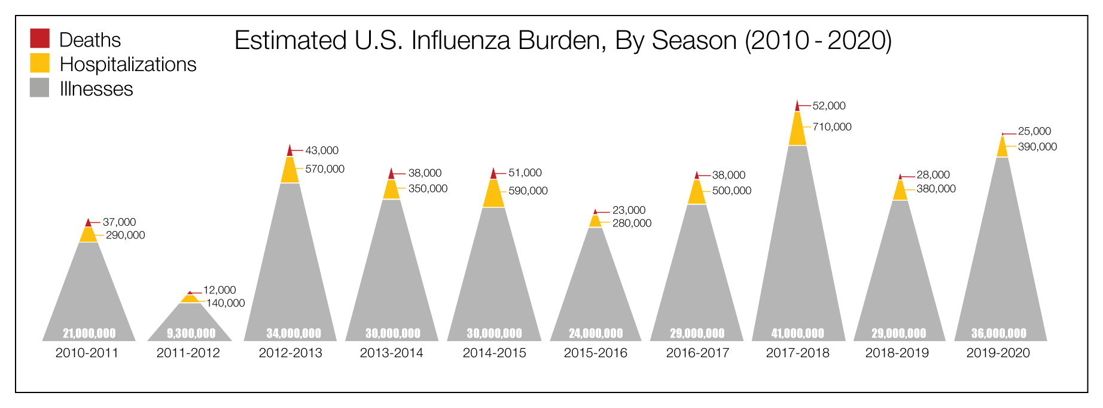
Estimated Influenza Disease Burden, by Season
United States, 2010-11 through 2019-20 Influenza Seasons
https://www.cdc.gov/flu/about/burden/index.html

Slide 11
Influenza

Slide 12
Influenza

Slide 13
RSV Patterns
58,000-80,000 hospitalizations/year children less than 5 years old
60,000-160,000 hospitalizations/year adults older than 65 years
C19 pandemic disrupted usual seasonal patterns in 2020-2022

Slide 14
Respiratory Syncytial Virus (RSV)
Seasonality of Respiratory Syncytial Virus — United States, 2017–2023 | MMWR (cdc.gov)

Slide 15
Respiratory Syncytial Virus (RSV)

Slide 16
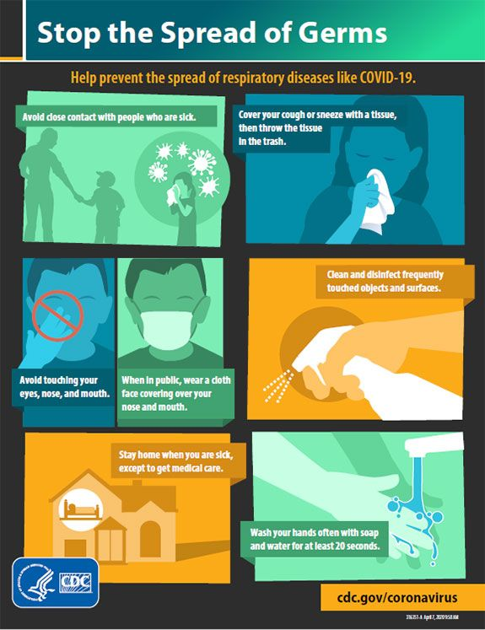
Prevention:

Slide 17
REMINDER: PIN 22-17 COVID-19 Procedures:
When county hospitalization rates high - masking required across center
If rapidly increasing cases with outbreak or approaching 10% - consider requiring masking across center
Remind staff/students to monitor for illness – report symptoms and get tested!
Contact trace – CCEs COVID-19 test day 0 & day 6
Confirmed COVID-19 cases – isolate for 5 full days, then mask until day 10
SIR per case – please include details (CCEs, reason for testing)

Slide 18
REMINDER: PIN 22-17 COVID-19 Procedures:
Must continue promoting and supporting access to COVID-19 vaccination, like handling of seasonal influenza vaccination
Center operators must ensure students’ vaccination records are obtained and maintained consistent with existing Job Corps policies
*Fall Covid-19 booster expected to be released in September

Slide 19
COVID_19 testing supplies:
30,000+ Abbott ID Now tests in field (will start expiring in December 2023)
Many antigen tests in field now expired– no requirement for use at this time
If center is low on Abbott ID Now test supplies, email region for redistribution & copy
4s Kaycie Ludwig - 4S <kaycie.ludwig@4s-llc.com>
N.O. Lesley Nesmith <Nesmith.Lesley@dol.gov>
Expired tests should be discarded (just throw away) and NOT reported in weekly survey!

Slide 20
Vaccination for seasonal respiratory illness 2023-2024
COVID-19: new single component vaccines targeted at the XBB.1.5 variant, in hopes of broadening immunity, expected to be available by the end of September/early October
Influenza: MMWR / August 25, 2023 / 72(2);1–25 - inactivated influenza vaccines (IIV4s), recombinant influenza vaccine (RIV4), and live attenuated influenza vaccine (LAIV4) are expected to be available – all quadrivalent – administration in September or October preferred
NEW: “Egg allergy alone necessitates no additional safety measures for influenza vaccination beyond those recommended for any recipient of any vaccine, regardless of severity of previous reaction to egg.”
RSV: AbrysvoTM by Pfizer – may be used for adults age 60 and older and for pregnant women at 32-36 weeks gestation

Slide 21
New alternatives to Narcan nasal spray
The US Food and Drug Administration (FDA) has approved a second opioid overdose reversal agent for prescription use. Opvee nasal spray contains 2.7 mg nalmefene, a long-acting opioid antagonist.
Nalmefene has a plasma half-life of almost 11 hours, compared to 60–90 minutes for naloxone. Nalmefene has been shown to reverse opioid intoxication for as long as 8 hours, reducing the need for continuous monitoring of intoxicated patients and repeated dosing of naloxone.
RiVive is a 3 mg naloxone nasal spray manufactured by Harm Reduction Therapeutics (HRT) Inc, the first nonprofit pharmaceutical company to receive FDA approval for an over-the-counter (OTC) naloxone nasal spray. HRT was funded by the Purdue Pharma bankruptcy.

Slide 22
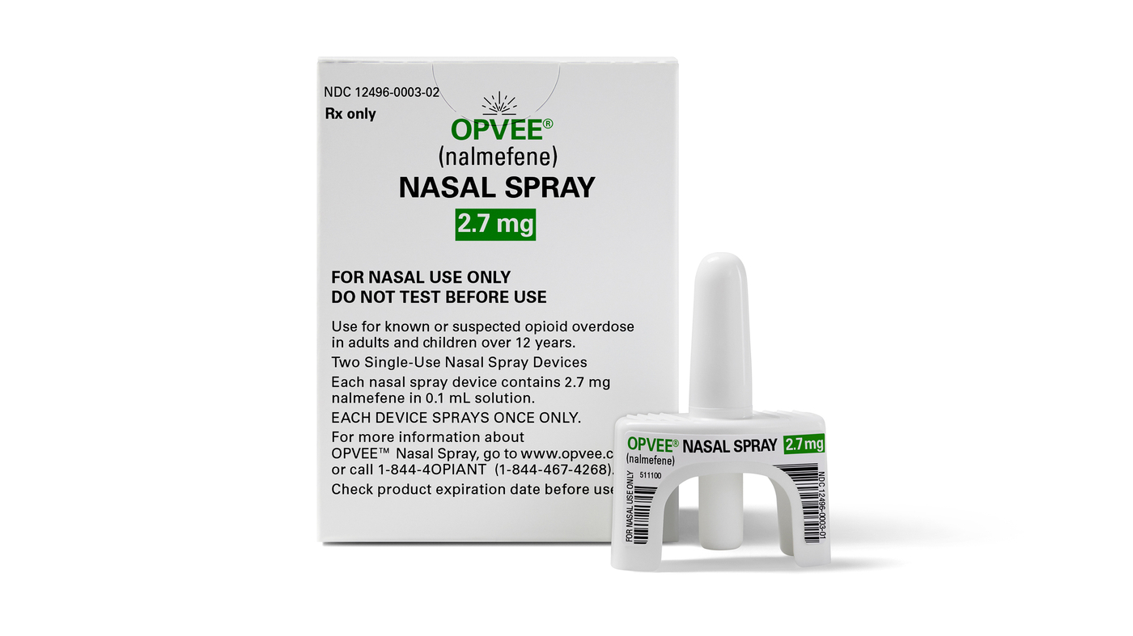
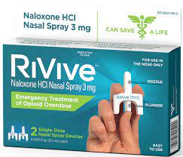

Slide 23
Cost of opioid antagonist nasal sprays
Narcan - 2 single dose nasal spray devices – naloxone 4 mg each -
retail Rx cost $120 to $185 – OTC release late summer $50
Opvee - 2 single dose nasal spray devices – nalmefene 2.7 mg each -
cost “undisclosed” – available this fall
RiVive - 2 single dose nasal spray devices – naloxone 3 mg each -
cost $36 – available January 2024

Slide 24
Treatment of ADHD with Stimulants
Question
Is adolescents’ use of stimulant therapy for attention-deficit/ hyperactivity disorder (ADHD) associated with cocaine and methamphetamine use as young adults?
Findings
In this cohort study of 5034 respondents, adolescents who used stimulant therapy for ADHD did not differ from their peers in cocaine and methamphetamine use at 19 to 24 years of age. In contrast, adolescents’ prescription stimulant misuse was associated with greater adjusted odds of later cocaine and methamphetamine use compared with population controls.
Meaning
These findings suggest that adolescents’ use of stimulant therapy was not associated with increased risk for illicit stimulant use; however, prescription stimulant misuse was a signal for cocaine or methamphetamine use and warrants monitoring and screening.
JAMA Network Open. 2023;6(7):e2322650. doi:10.1001/jamanetworkopen.2023.22650 July 11, 2023

Slide 25
Oral contraceptive pill recall
FDA is warning consumers that two lots of Tydemy (drospirenone/ethinyl estradiol/levomefolate calcium), a prescription oral contraceptive manufactured by Lupin Pharmaceuticals, may have reduced effectiveness due to decreased levels of ascorbic acid, an ingredient in the product, and “high levels of a known impurity.”
The affected lots (L200183 and L201560) were distributed in the U.S. from June 3, 2022, to May 31, 2023.
This potential reduction in the effectiveness of this oral contraceptive could result in unexpected pregnancy. Lupin advises patients to continue taking their medication. Patients should contact their health care provider for advice regarding an alternative contraceptive method.

Slide 26
Tydemy

Slide 27
FDA Advisory
Food and Drug Administration (FDA) is advising consumers not to purchase or use Mens Maximum Energy Supplement, a product promoted and sold as an energy booster.
Labeled as a dietary supplement that promotes “strength, energy and endurance.”
FDA laboratory analysis confirmed that Mens Maximum Energy Supplement contains sildenafil, the active ingredient in the FDA-approved prescription drug Viagra, used to treat erectile dysfunction.

Slide 28
Mens Maximum Energy Supplement

Slide 29
Syndrome of the Month
Review of common findings on physical examination suggestive of a specific syndrome that may first be suspected in the Job Corps age population
Presentation of diagnostic criteria commonly used to support the diagnosis
Indications for syndrome-specific evaluation
Indications for subspecialty referral(s), if any
Implications for career choice, if any

Slide 30
Marfan Syndrome Systemic Score Calculation
Feature Value
Wrist AND thumb sign 3
Wrist OR thumb sign 1
Pectus carinatum deformity 2
Pectus excavatum or chest asymmetry 1
Hindfoot deformity 2
Plain flat foot (pes planus) 1
Pneumothorax 2
Dural ectasia 2
#1 of 2

Slide 31
Marfan Syndrome Systemic Score Calculation
Feature Value
Protrusio acetabulae 2
Reduced upper segment / lower segment
AND increased arm span/height ratios 1
Scoliosis or thoracolumbar kyphosis 1
Reduced elbow extension 1
3 of 5 facial features 1
Skin striae 1
Myopia 1
Mitral valve prolapse 1
#2 of 2

Slide 32
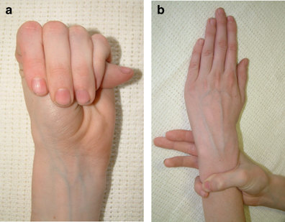
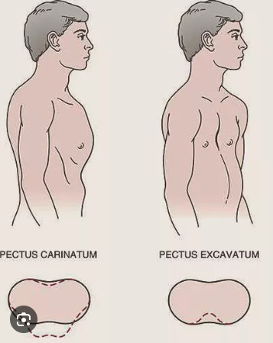
Thumb and wrist signs

Slide 33
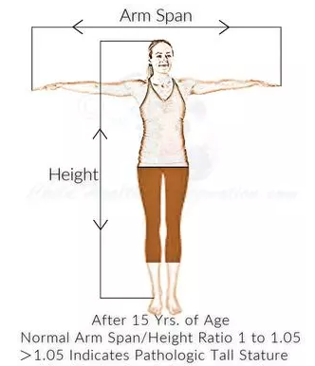
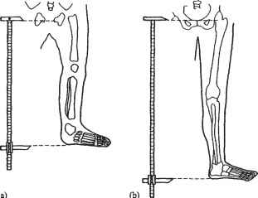
Upper/Lower Segment Ratio
< 0.85 in whites, <0.78 in blacks

Slide 34
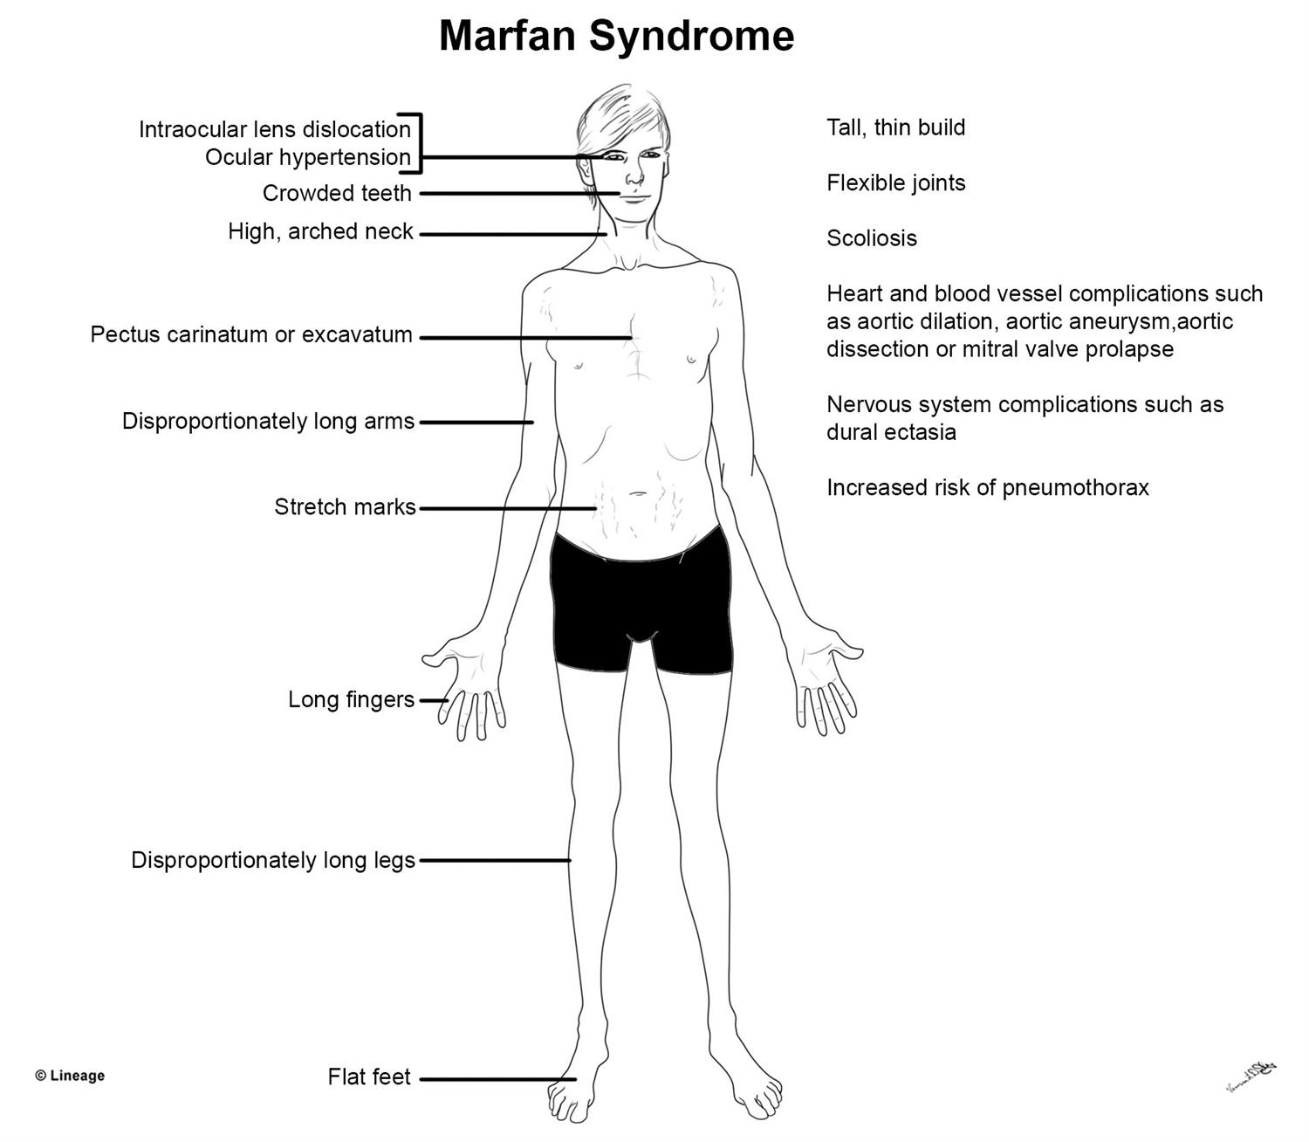

Slide 35
Revised Ghent Nosology for Marfan Syndrome 2010
IN THE ABSENCE OF FAMILY HISTORY:
Aortic Root Dilatation Z score ≥ 2 AND Ectopia Lentis = Marfan syndrome
Aortic Root Dilatation Z score ≥ 2 AND FBN1 = Marfan syndrome
Aortic Root Dilatation Z score ≥ 2 AND Systemic Score ≥ 7pts = Marfan syndrome
Ectopia lentis AND a FBN1 mutation associated with Aortic Root Dilatation = Marfan syndrome
IN THE PRESENCE OF FAMILY HISTORY:
Ectopia lentis AND Family History of Marfan syndrome = Marfan syndrome. A systemic score ≥ 7 points AND Family History of Marfan syndrome = Marfan syndrome
Aortic Root Dilatation Z score ≥ 2 above 20 yrs. old, ≥ 3 below 20 yrs. old + Family History of Marfan syndrome = Marfan syndrome

Slide 36
Diagnostic evaluation
Cardiology – echocardiogram – first priority
Ophthalmology – slit lamp examination, glaucoma test
Orthopedics – back, hips, feet
Oral health care – orthodontics
Genetics

Slide 37
Management
Monitoring for progression
Antihypertensive medication to help prevent aortic enlargement and to reduce the risk of dissection and rupture.
Glasses or contact lenses to correct vision problems associated with dislocated lens.
Surgery: aortic repair, scoliosis treatment, pectus correction, eye surgery
Orthodontic care
Avoid competitive sports and weightlifting

Slide 38
Open Forum
https://www.surveymonkey.com/r/FSR5MLM

Slide 39
Job Corps Center Physician Monthly Teleconference Next call: Wednesday, September 27th, 2023
John Kulig MD MPH Region 1 Boston & Region 2 Philadelphia
Sara Mackenzie MD MPH Region 6 San Francisco
Drew Alexander MD Region 4 Dallas
Gary Strokosch MD Region 3 Atlanta & Region 5 Chicago
HIPAA compliant messages use @jobcorps.org email address
https://www.surveymonkey.com/r/FSR5MLM

