Slide 1
Job Corps Center Physician Monthly Teleconference
John Kulig MD MPH Region 1 Boston & Region 2 Philadelphia
Sara Mackenzie MD MPH Region 6 San Francisco
Drew Alexander MD Region 4 Dallas
Gary Strokosch MD Region 3 Atlanta & Region 5 Chicago
HIPAA compliant messages use @jobcorps.org email address
Wednesday, July 26th, 2023

Slide 2
Guest speaker
Karen Hover MD
Center Physician
Penobscot Job Corps Center
Center for Family Medicine
Eastern Maine Medical Center
Bangor, Maine

Slide 3
A Quality Improvement Project at Penobscot Job Corps Academy
Presenter
Karen Hover MD
With help from
Sara Mackenzie MD, MPH
July 26, 2023

Slide 4
Outline
History of this project
The problem
Literature review
Choosing a plan
Implementation
Results

Slide 5
History
Almost completely new team (mental health lead, 4 nurses, wellness director, unit secretary, dentist, TEAP coordinator, center director).
Covid 19 introduced new challenges.

Slide 6
The problem
Turnover was impacting team performance and ability to meet mission requirements.

Slide 7
Literature

Slide 8
Information sharing
Teams possess more information than individuals do, but additional information cannot improve performance unless shared.
Information sharing markedly improves subjective performance measures but only weakly improves objective measures.
“Teams often fail to share information when they most need to do so.”
Mesmer-Magnus J and DeChurch L. Information sharing and team performance: a meta-analysis. Journal of Applied Psychology. 2009; 94 (2): 535-546. https://web-p-ebscohostcom.proxygw.wrlc.org/ehost/pdfviewer/pdfviewer?vid=0&sid=dd77692e-b39d-40ef-b495-1c051a1a6365%40redis

Slide 9
Types of training
“Training programs involving a single training strategy (i.e., information, demonstration, or practice) were just as effective as training programs that used multiple strategies.”
Training involving feedback from a senior staff member to a junior staff member decreased effectiveness, (perhaps because a power differential can shift the focus from task to personal-related content).
Hughes A, Gregory M, Joseph D, et al. Saving lives: A meta-analysis of team training in healthcare. Journal of Applied Psychology. 2016; 101 (9): 1266. https://www.proquest.com/docview/2394160740?pq-origsite=primo

Slide 10
Needs Assessment
Interviewed nurses to understand what they saw as the challenges and to identify their strengths.
Observed meetings were irregular, reactive, sometimes felt critical.
Audited charts to create lists of students with chronic diseases.
Recognized that turnover is a circle. If the team isn’t organized and supportive, people leave, and if people leave, it is harder to get organized.

Slide 11
Which interventions?

Slide 12
Changes Implemented
Structured team meetings
Assign “Team Leads” for complex team tasks
Shared training responsibility

Slide 13
1. Structured Team Meetings
Schedule and set tone
Daily huddles about daily workflow
Weekly team meetings with planned agendas
Focus on team process, not reaction to problems
Celebrate victories
Barrier: “We don’t have time to meet!”
Barriers: External pressures from administration and students

Slide 14
Set the weekly agenda
Informational communications
Review of a work process
(i.e. medications)
“Just in time” education
(i.e. Norovirus transmission)
Difficult patient issues
Plan for next meeting

Slide 15
2. Assign leads for complex team tasks
List essential tasks (PRH)
Medications, physicals, sick call, chronic care, referrals, immunizations, labs, etc.
Designate team leads.
Barrier: “We can’t specialize because no nurse is here all of the time.”
Clarification: Everyone must be cross-trained but the team lead for that particular task defines practice, educates, and organizes.

Slide 16
3. Shared training responsibility
Peer-to-peer training more effective
Leads guide conversation
Identify current practice
Review PRH guidance
Define best practice
Find inefficiencies
Training
Peer onboarding
“Just in time” education

Slide 17
What changed?

Slide 18
Performance indicators
Better medication management processes
More consistent SOAP notes with vital signs for acute visits
More consistent chronic care management

Slide 19
Process
More use of PRH and other online Job Corps resources. https://supportservices.jobcorps.gov/health/Pages/default.aspx
Team more effectively identifying need for communication.
More trust to manage complex problems.

Slide 20
Questions or comments?
karen.hover@gmail.com

Slide 21
Center Physician Call
July 26, 2023
Sara Mackenzie, MD, MPH

Slide 22
Heat-related illness
Heat & Health Tracker | Tracking | NCEH | CDC

Slide 23
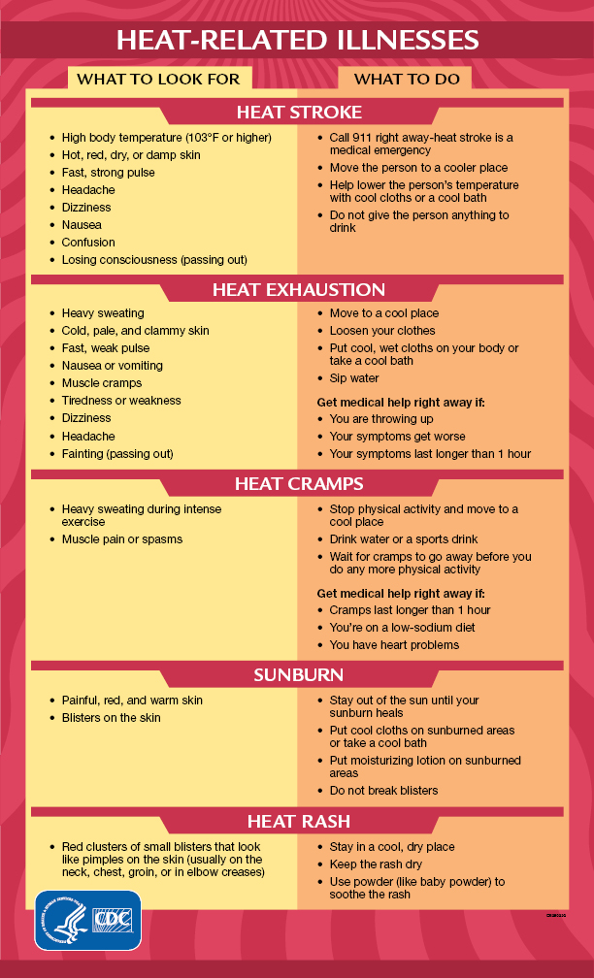
Heat-related illness
Warning Signs and Symptoms of Heat-Related Illness | Natural Disasters and Severe Weather CDC

Slide 24
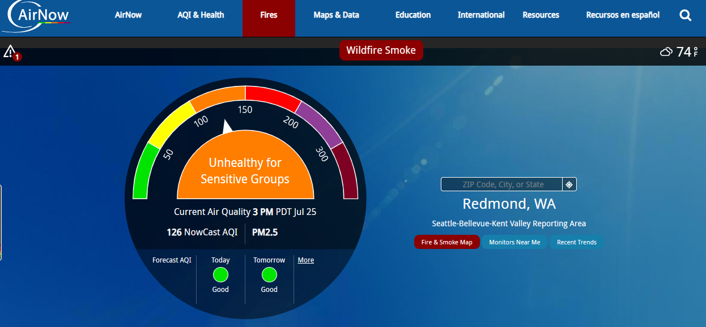
AirNow
AirNow.gov

Slide 25
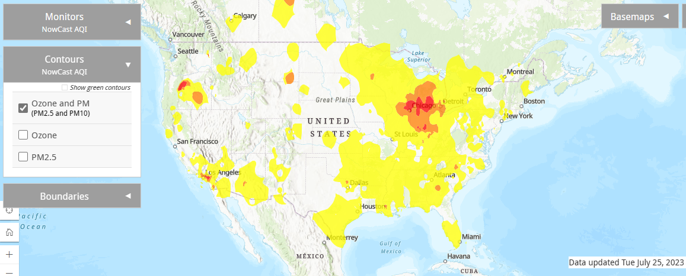
Air Quality
AirNow Interactive Map (epa.gov)

Slide 26
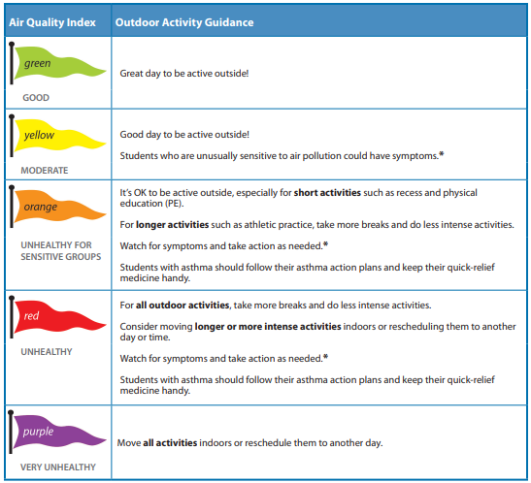
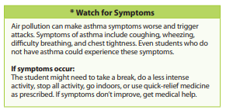
Physical activity
Guide for Schools | AirNow.gov

Slide 27
Actions
Air Quality | Air | CDC

Slide 28
CDC Recommendations for skin cancer prevention:
Stay in the shade, especially during midday hours from 10 am to 4 pm DST.
Wear clothing that covers your arms and legs.
Wear a hat with a wide brim to shade your face, head, ears, and neck.
Wear sunglasses that wrap around and block both UVA and UVB rays.
Use broad-spectrum sunscreen with sun protection factor (SPF) 15 or higher, and both UVA and UVB protection.
Avoid indoor tanning.
http://www.cdc.gov/cancer/skin/basic_info/prevention.htm

Slide 29
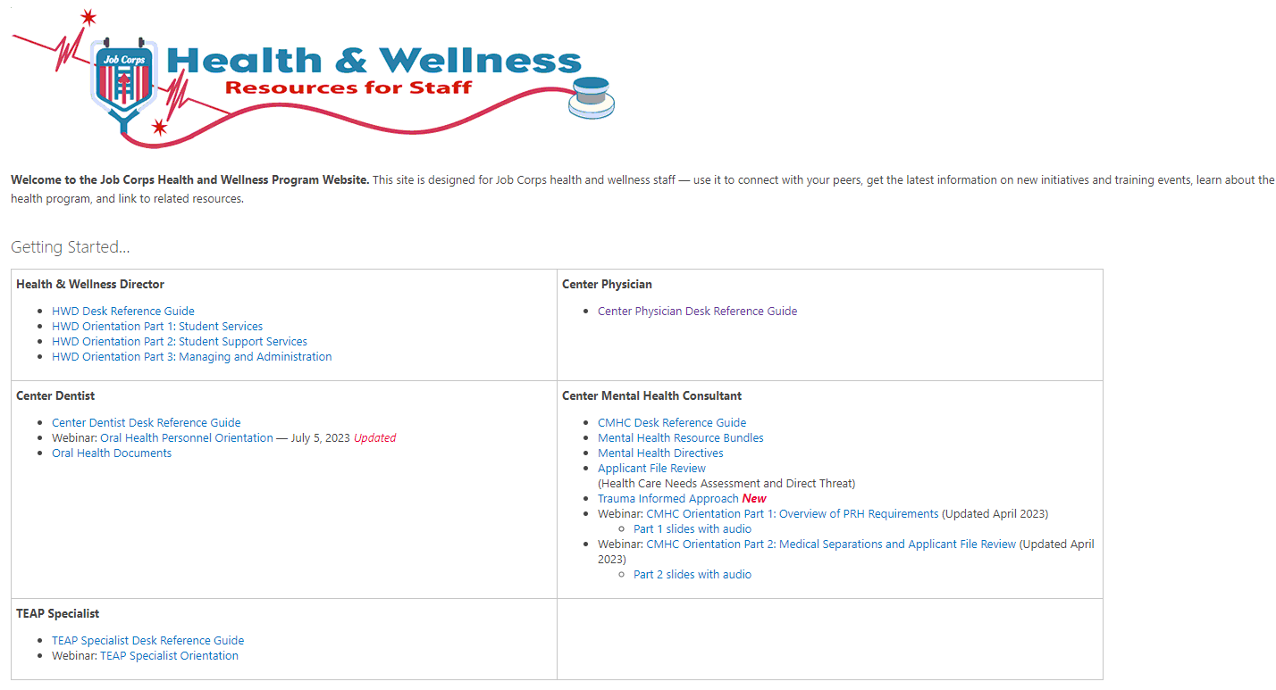
Center Physician’s Desk Reference Guide
https://supportservices.jobcorps.gov/health/Pages/default.aspx

Slide 30
Nonalcoholic fatty liver disease (NAFLD) Nonalcoholic steatohepatitis (NASH)
New nomenclature adopted by a global consensus panel of hepatologists:
metabolic dysfunction–associated steatotic liver disease (MASLD) will replace NAFLD
metabolic dysfunction–associated steatohepatitis (MASH) will replace NASH
terms such as “nonalcoholic” and “fatty” are considered stigmatizing
98% of people registered in a European NAFLD cohort would meet the new criteria for MASLD
Diagnostic criteria:
MASLD must have a cardiometabolic risk factor such as type 2 diabetes

Slide 31
Classification of obesity
Body mass index (BMI)
class 1 obesity – BMI 30 to < 35
class 2 obesity – BMI 35 to < 40
class 3 obesity – BMI > 40 – “extreme” not “morbid”
Waist circumference
adult men > 40 in/ > 102 cm
adult women > 35 in/ > 88 cm

Slide 32
Laboratory studies for obesity
Fasting lipid panel - cholesterol, triglycerides, HDL, LDL
Liver function studies - transaminases
Thyroid function test - TSH
Fasting glucose and hemoglobin A1c (HbA1c)
All obese Job Corps students should be enrolled in case management on center and encouraged to participate in the Weight Management Program.

Slide 33
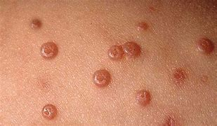
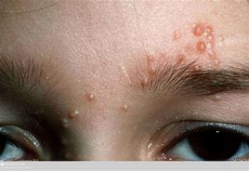
Molluscum contagiosum

Slide 34
Molluscum contagiosum treatment
Natural history
spontaneous resolution in 6-12 months
Topical medications
salicylic acid, potassium hydroxide, retinoids (tretinoin, adapalene)
Physical methods
curettage, cryotherapy, laser therapy

Slide 35
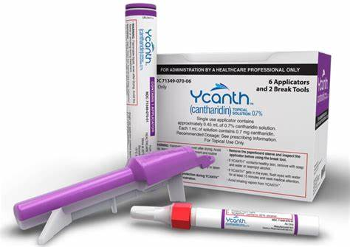
Molluscum contagiosum First FDA-approved treatment
FDA has approved Ycanth (cantharidin) for the topical treatment of molluscum contagiosum in adult and pediatric patients 2 years of age and older.
Ycanth is administered to patients only by health care providers. Providers apply a single application of Ycanth on the areas of patients’ skin with molluscum bumps every 21 days as needed – maximum of 4 applications – 54% with complete clearance vs 15% with vehicle alone at 84 days

Slide 36
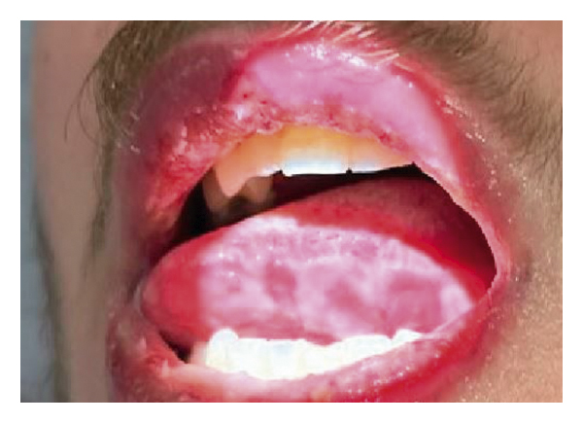
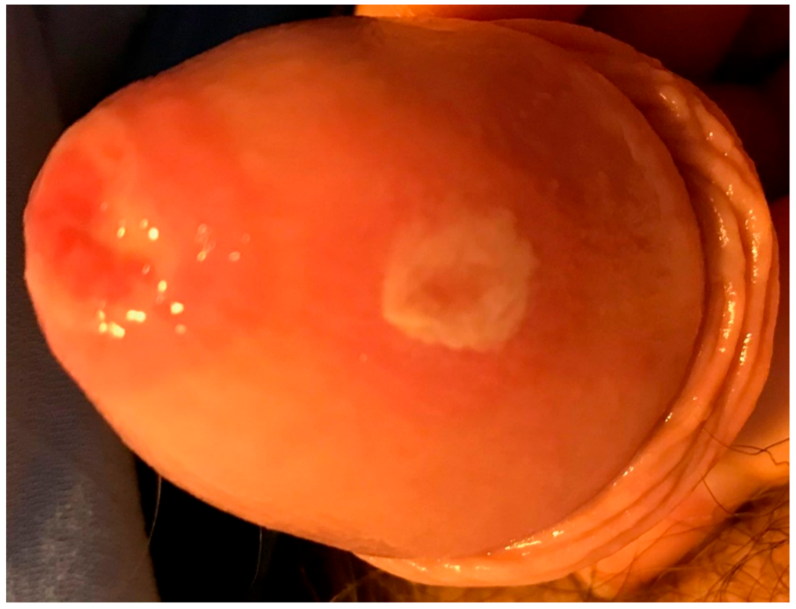
Reactive infectious mucocutaneous eruption (RIME)
oral, ocular, genitourinary mucosal ulceration,
with or without rash
typically follows respiratory infection caused
by Mycoplasma, Chlamydophilia, and multiple
viruses including influenza and SARS-CoV-2
supportive treatment
may become recurrent

Slide 37
Open Forum
https://www.surveymonkey.com/r/CXQLN9B

Slide 38
Job Corps Center Physician Monthly Teleconference Next call: Wednesday, August 30th, 2023 Note 5th Wednesday of the month
John Kulig MD MPH Region 1 Boston & Region 2 Philadelphia
Sara Mackenzie MD MPH Region 6 San Francisco
Drew Alexander MD Region 4 Dallas
Gary Strokosch MD Region 3 Atlanta & Region 5 Chicago
HIPAA compliant messages use @jobcorps.org email address
https://www.surveymonkey.com/r/CXQLN9B

