Slide 1
Job Corps Center Physician Monthly Teleconference
Wednesday, July 24th, 2024

Slide 2
Dengue
Dengue is the most prevalent mosquito borne viral illness worldwide and is endemic in Puerto Rico.
Dengue’s clinical spectrum can range from mild, undifferentiated febrile illness to hemorrhagic manifestations, shock, multiorgan failure, and death in severe cases.
The disease presentation is nonspecific; therefore, various other illnesses (e.g., arboviral and respiratory pathogens) can cause similar clinical symptoms.
MMWR May 30, 2024/73(3);1–29

Slide 3
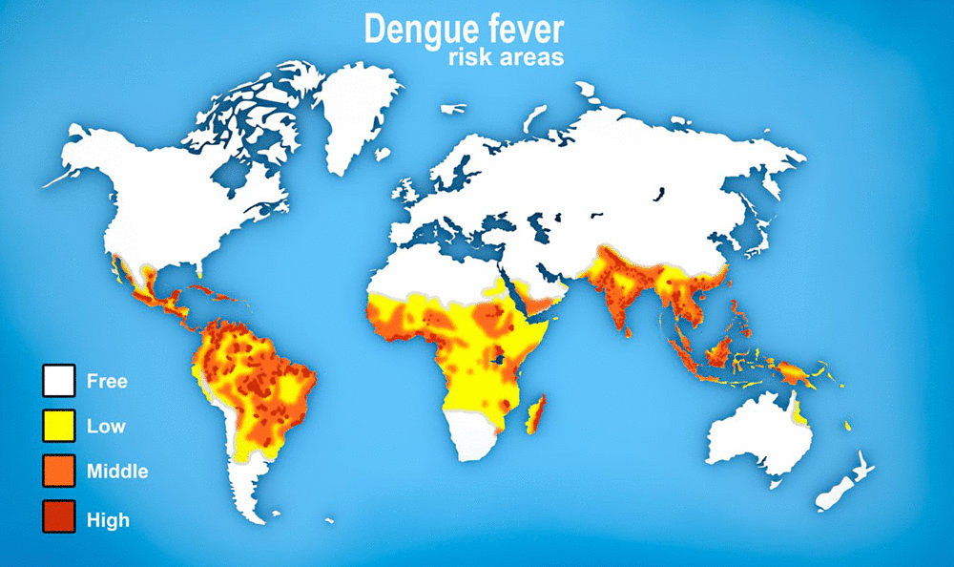

Slide 4
Dengue surveillance
The Sentinel Enhanced Dengue Surveillance System (SEDSS) was established to monitor trends of dengue and dengue-like acute febrile illnesses (AFIs), characterize the clinical course of disease, and serve as an early warning system for viral infections with epidemic potential.
During the surveillance period from May 2012 to December 2022, there were 1,432 confirmed or probable cases of dengue, 2,293 confirmed or probable cases of chikungunya, and 1,918 confirmed or probable cases of zika in Puerto Rico.
DENV1 was endemic. Chikungunya and zika were sporadic, peaking in 2014 and 2016, with few cases since then.

Slide 5
Dengue
Dengue is an acute febrile viral illness transmitted by Aedes spp. mosquitoes and caused by four closely related dengue virus serotypes (DENV 1-4).
DENV causes an estimated 390 million infections and 40,500 deaths worldwide each year.
In contrast to data suggesting that the prevalence of most communicable diseases is declining worldwide, dengue incidence and disease prevalence have been increasing over time, measured both by disability-adjusted life years and mortality attributed to dengue.

Slide 6
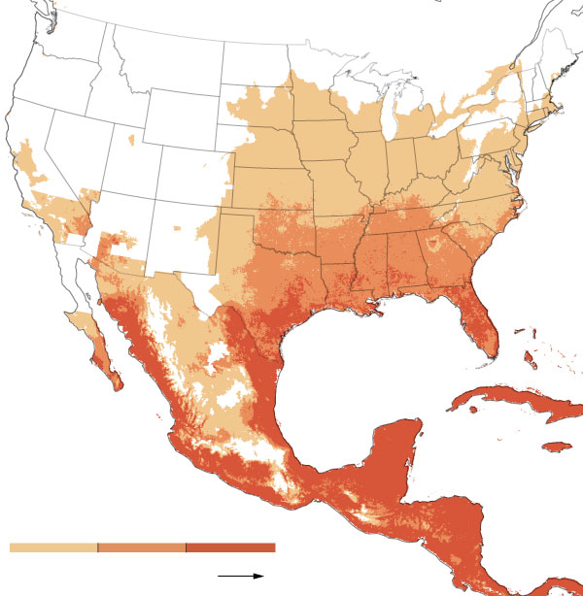
Projection
2080

Slide 7
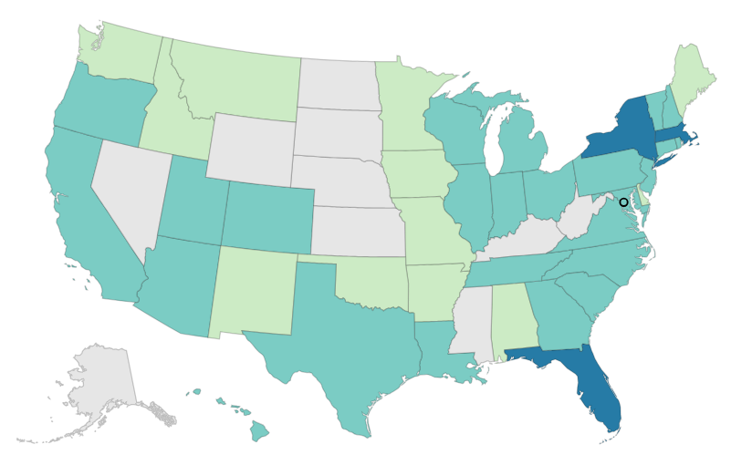
Dengue fever
January 1, 2024 – July 17, 2024

Slide 9
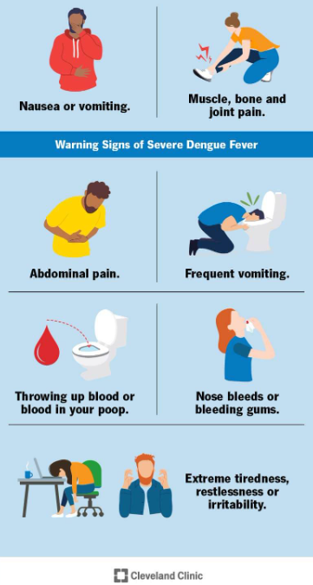
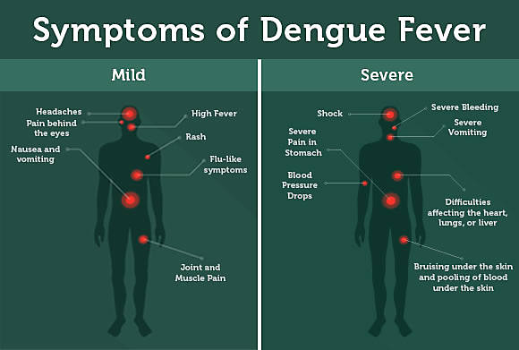

Slide 10
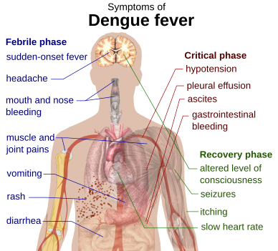
Dengue fever

Slide 11
Dengue hemorrhagic fever warning signs
Abdominal pain or tenderness.
Persistent vomiting.
Clinical fluid accumulation.
Mucosal bleeding.
Lethargy or restlessness.
Liver enlargement > 2 cm.
Laboratory finding of increasing hematocrit concurrent with rapid decrease in platelet count.

Slide 12
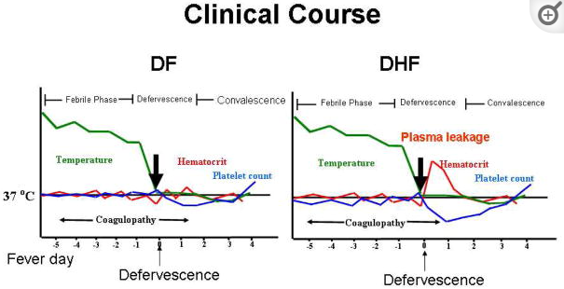

Slide 13
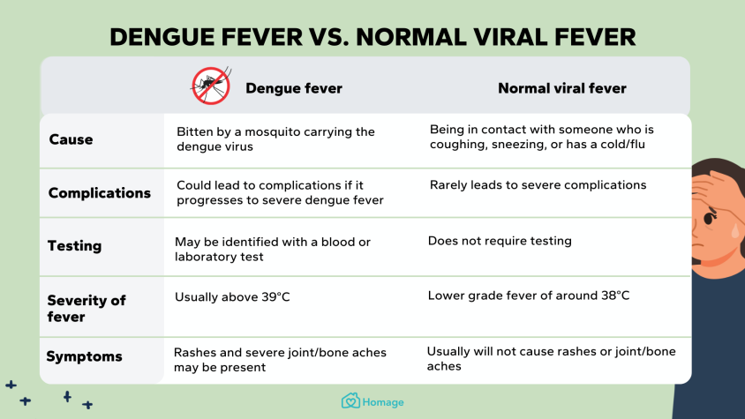

Slide 14
Dengue fever diagnosis
Dengue virus RNA can be detected by nucleic acid amplification tests (NAAT) for the first 7 days of illness. A positive NAAT (e.g. RT-PCR) result confirms current dengue virus infection.
The NS1 antigen test, also known as Dengue Virus NS1 Antigen, Serum (DNSAG), is a diagnostic test that detects the non-structural protein 1 (NS1) of the dengue virus in the blood; recommended during the first 7 days of illness, before antibodies appear. The test uses an Enzyme-Linked Immunosorbent Assay (ELISA).
IgM ELISA is recommended as the primary test after day 7 of symptom onset. Some patients may be positive on NAAT or NS1 antigen tests after day 7 of illness. IgM antibodies can be reliably detected for 3 months or longer after infection.
Elevated IgG may indicate past or current infection.

Slide 16
Dengue fever: Treatment
No specific antiviral agents exist for dengue.
Supportive care is advised.
Patients should stay well hydrated and avoid aspirin (acetylsalicylic acid), aspirin-containing drugs, and other nonsteroidal anti-inflammatory drugs (such as ibuprofen) because of their anticoagulant properties.
Take acetaminophen to control fever and relieve pain.
Severe cases can include serious bleeding and shock, which can be life threatening, requiring hospitalization and ICU care.
CDC

Slide 17
Dengue vaccine
Two dengue vaccines have been licensed:
Dengvaxia® (CYD-TDV), developed by Sanofi Pasteur – indicated for 6 to 16 year-olds with confirmed prior infection - production discontinued due to “lack of demand in the global market”
Qdenga® (TAK-003), developed by Takeda – based on live-attenuated dengue serotype 2 virus – indicated at age 4 years and older – not yet FDA approved in US
Two other dengue vaccines “in late stages of development”

Slide 18
Dengue fever: Prevention
Protect yourself from mosquito bites by wearing long-sleeved shirts and long pants, using mosquito nets if sleeping during the day, and using mosquito repellents.
Review country-specific travel recommendations, health notices, and warnings.
Visit a travel clinic or your healthcare provider for pre-travel medical care.
Pack an EPA-registered insect repellent and acetaminophen in your first aid kit.
Take steps to prevent mosquito bites for 3 weeks after your trip.

Slide 19
Common rashes in Job Corps students
Atopic dermatitis/eczema
Urticaria/hives
Contact dermatitis
Bites/stings – mosquito, wasp, bedbug
Infestations – scabies
Poison ivy
Acanthosis nigricans
Pityriasis rosea
Secondary syphilis
Herpes simplex/herpes zoster
Erythema multiforme
Psoriasis
Tinea corporis/cruris/pedis
Tinea versicolor
Molluscum contagiosum

Slide 20
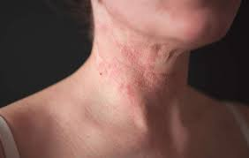
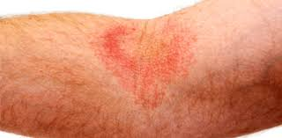
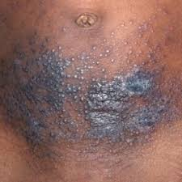
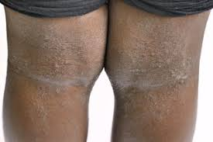

Slide 21
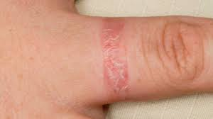
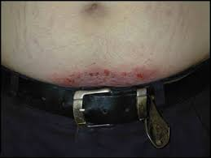
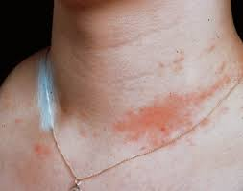
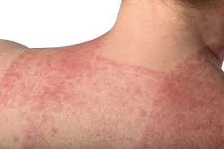

Slide 22
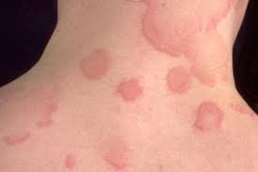
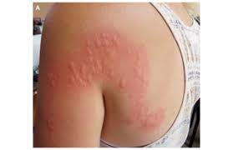

Slide 23
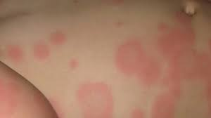
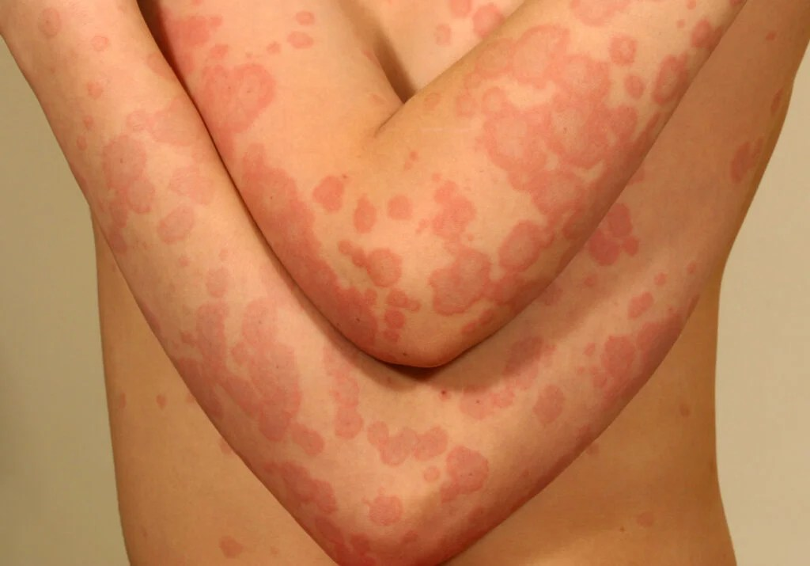
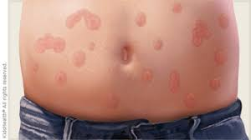

Slide 24
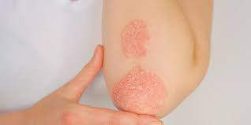
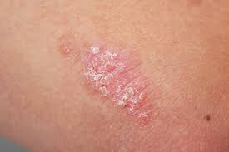
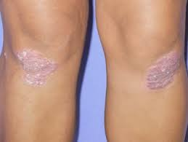
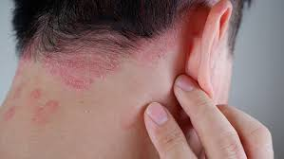

Slide 25
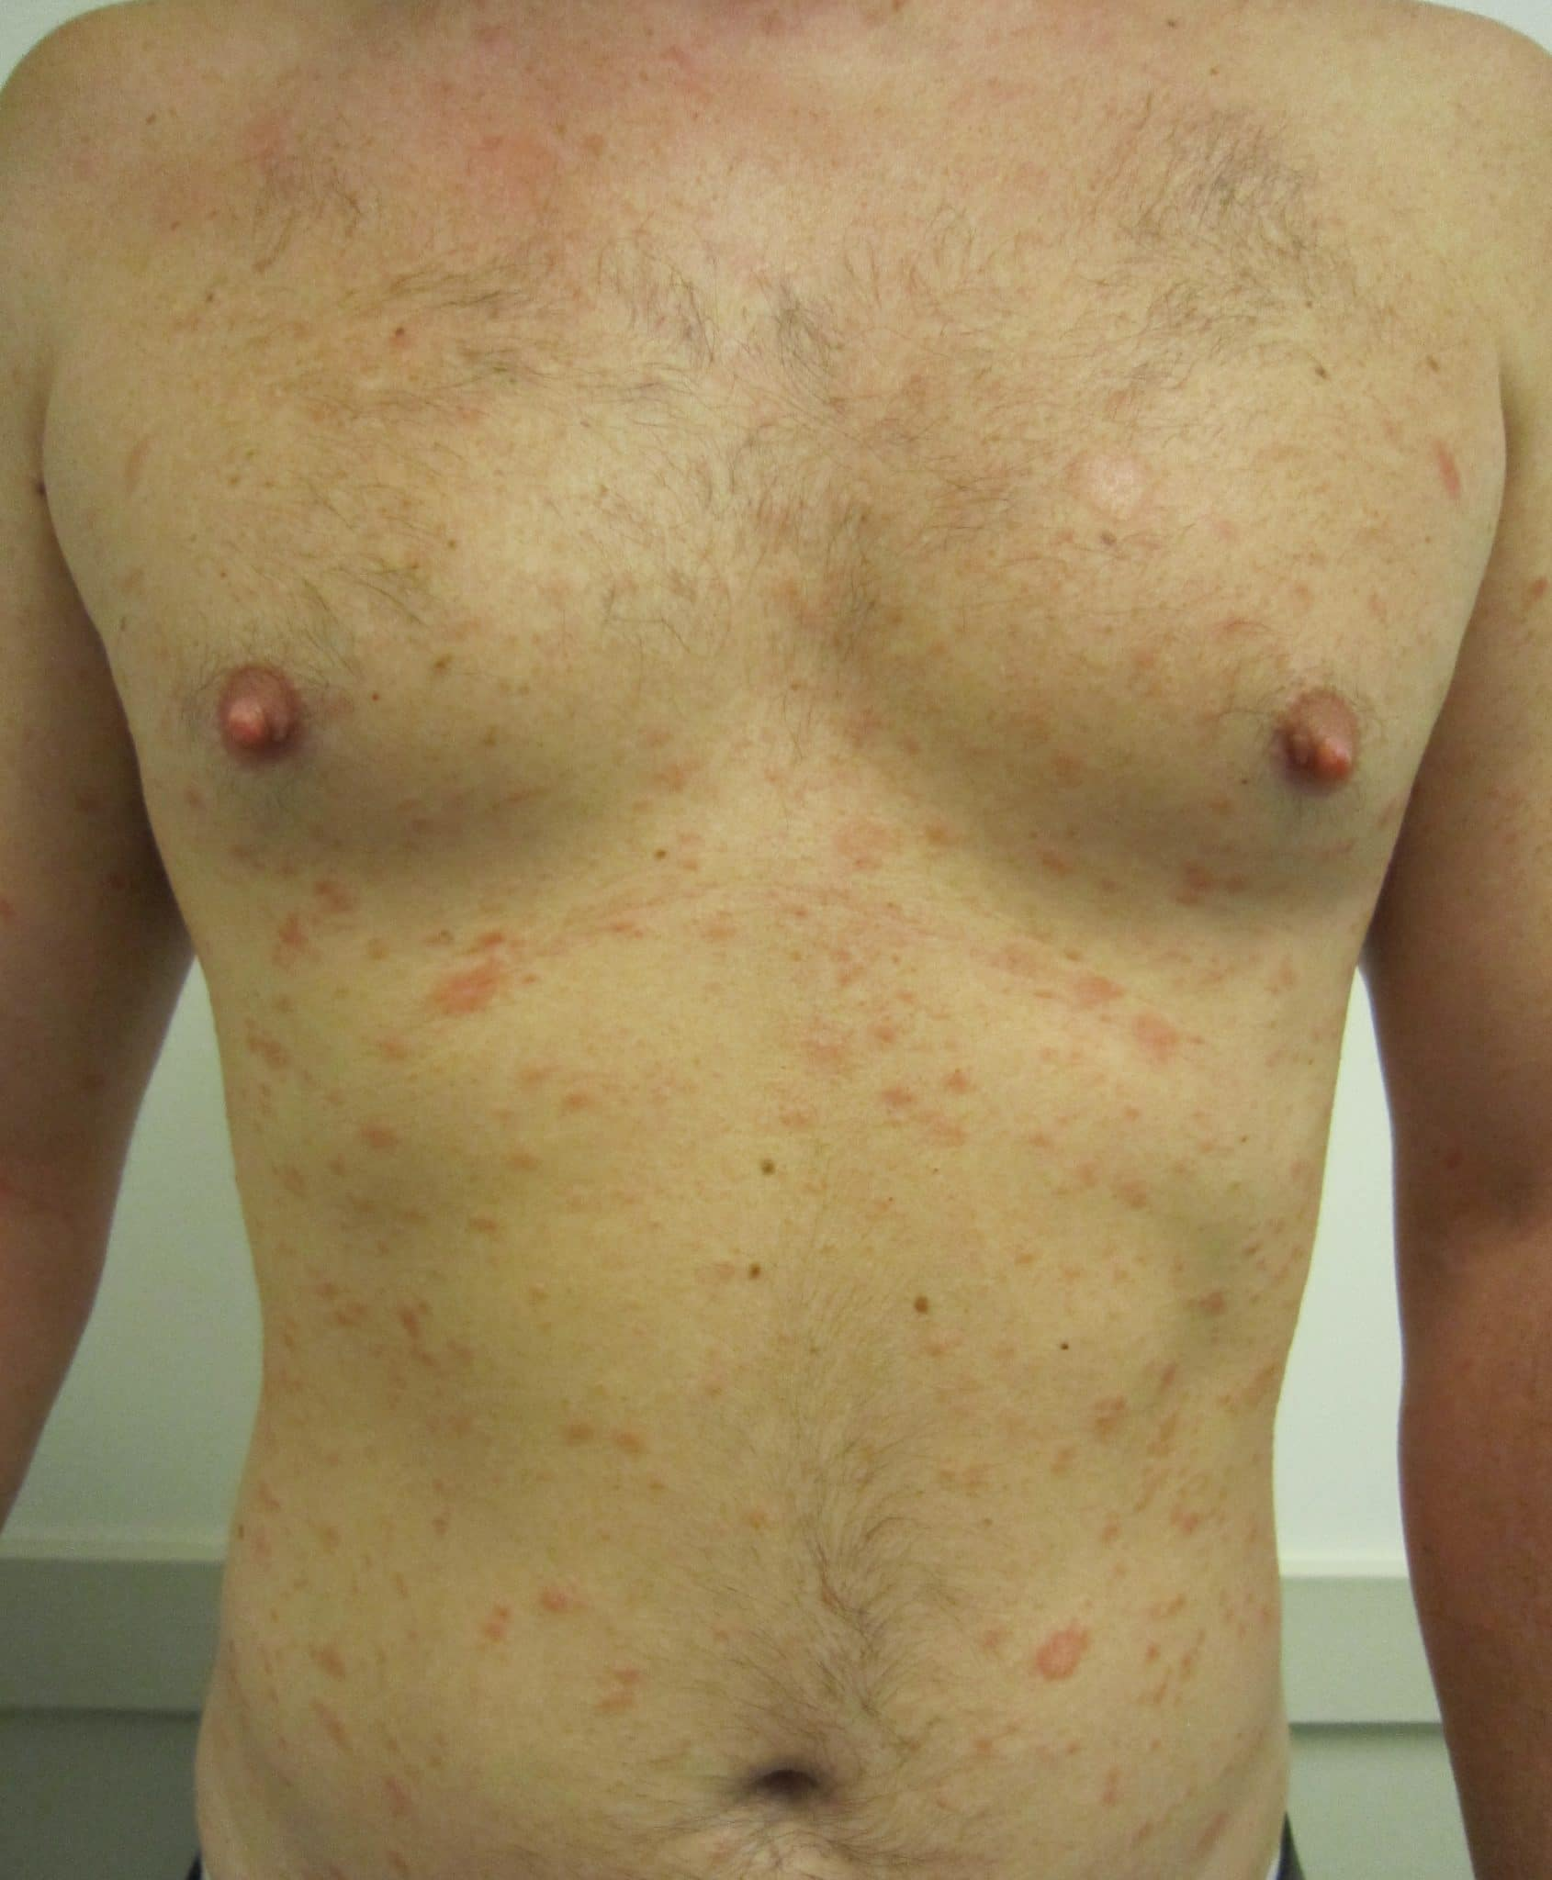
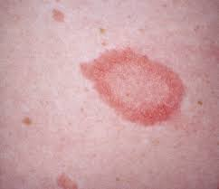
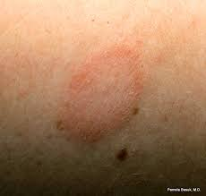

Slide 26
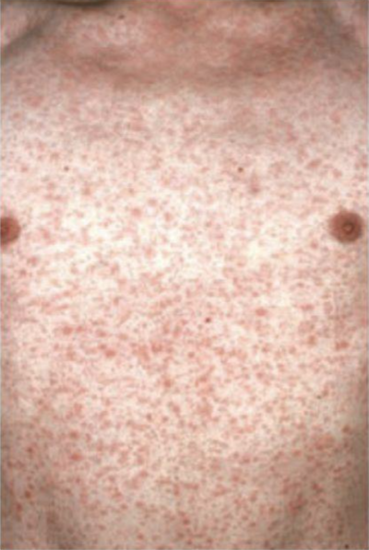
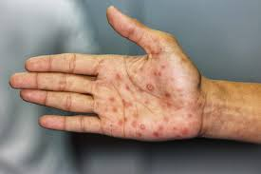

Slide 27
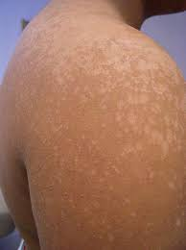
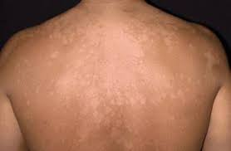

Slide 28
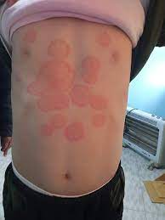
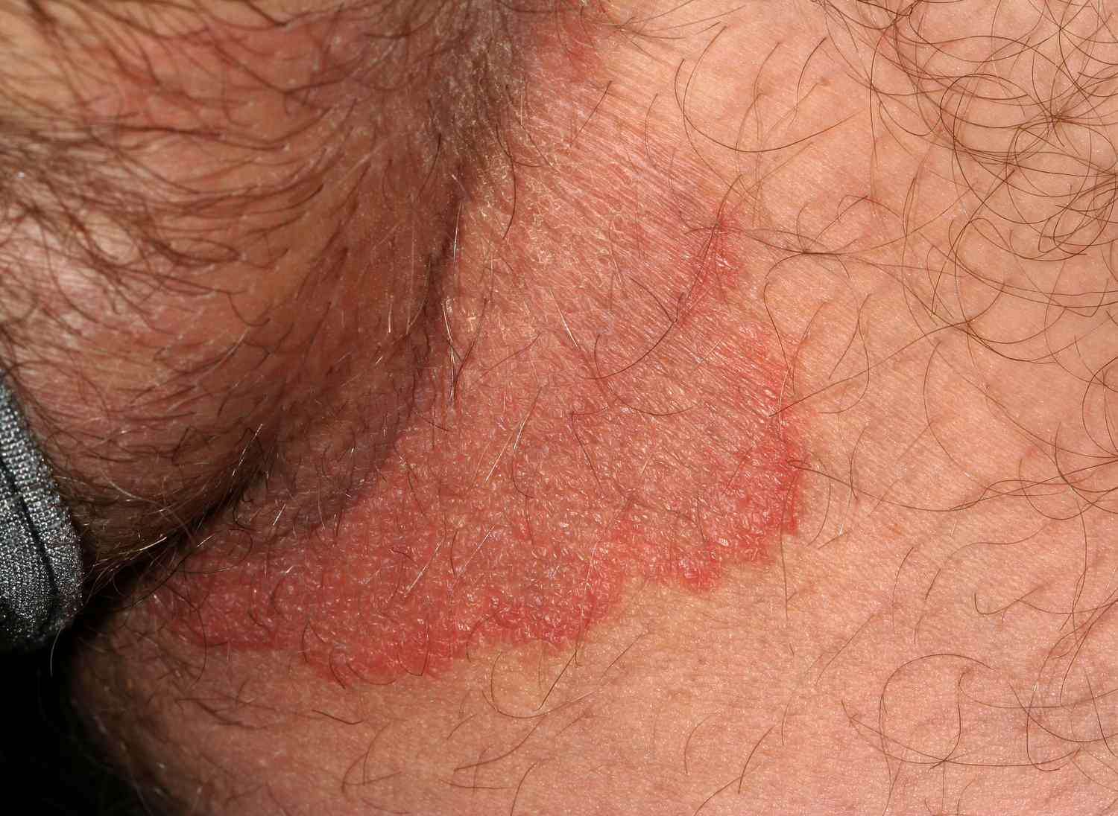
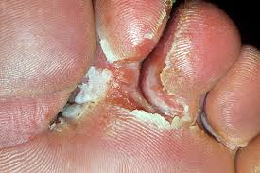

Slide 29
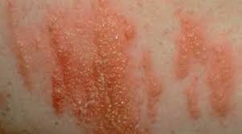
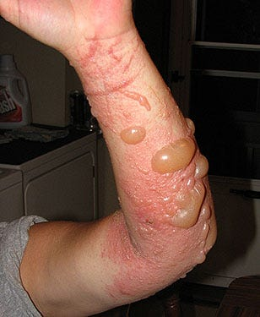
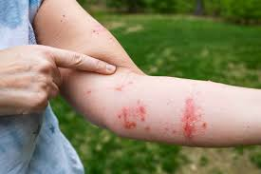

Slide 30
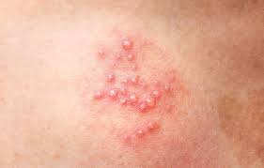
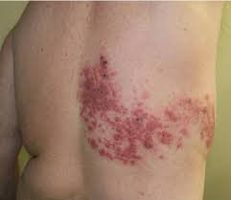
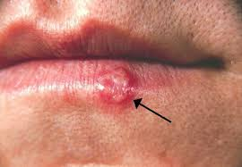

Slide 31
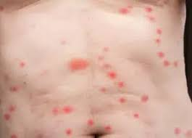
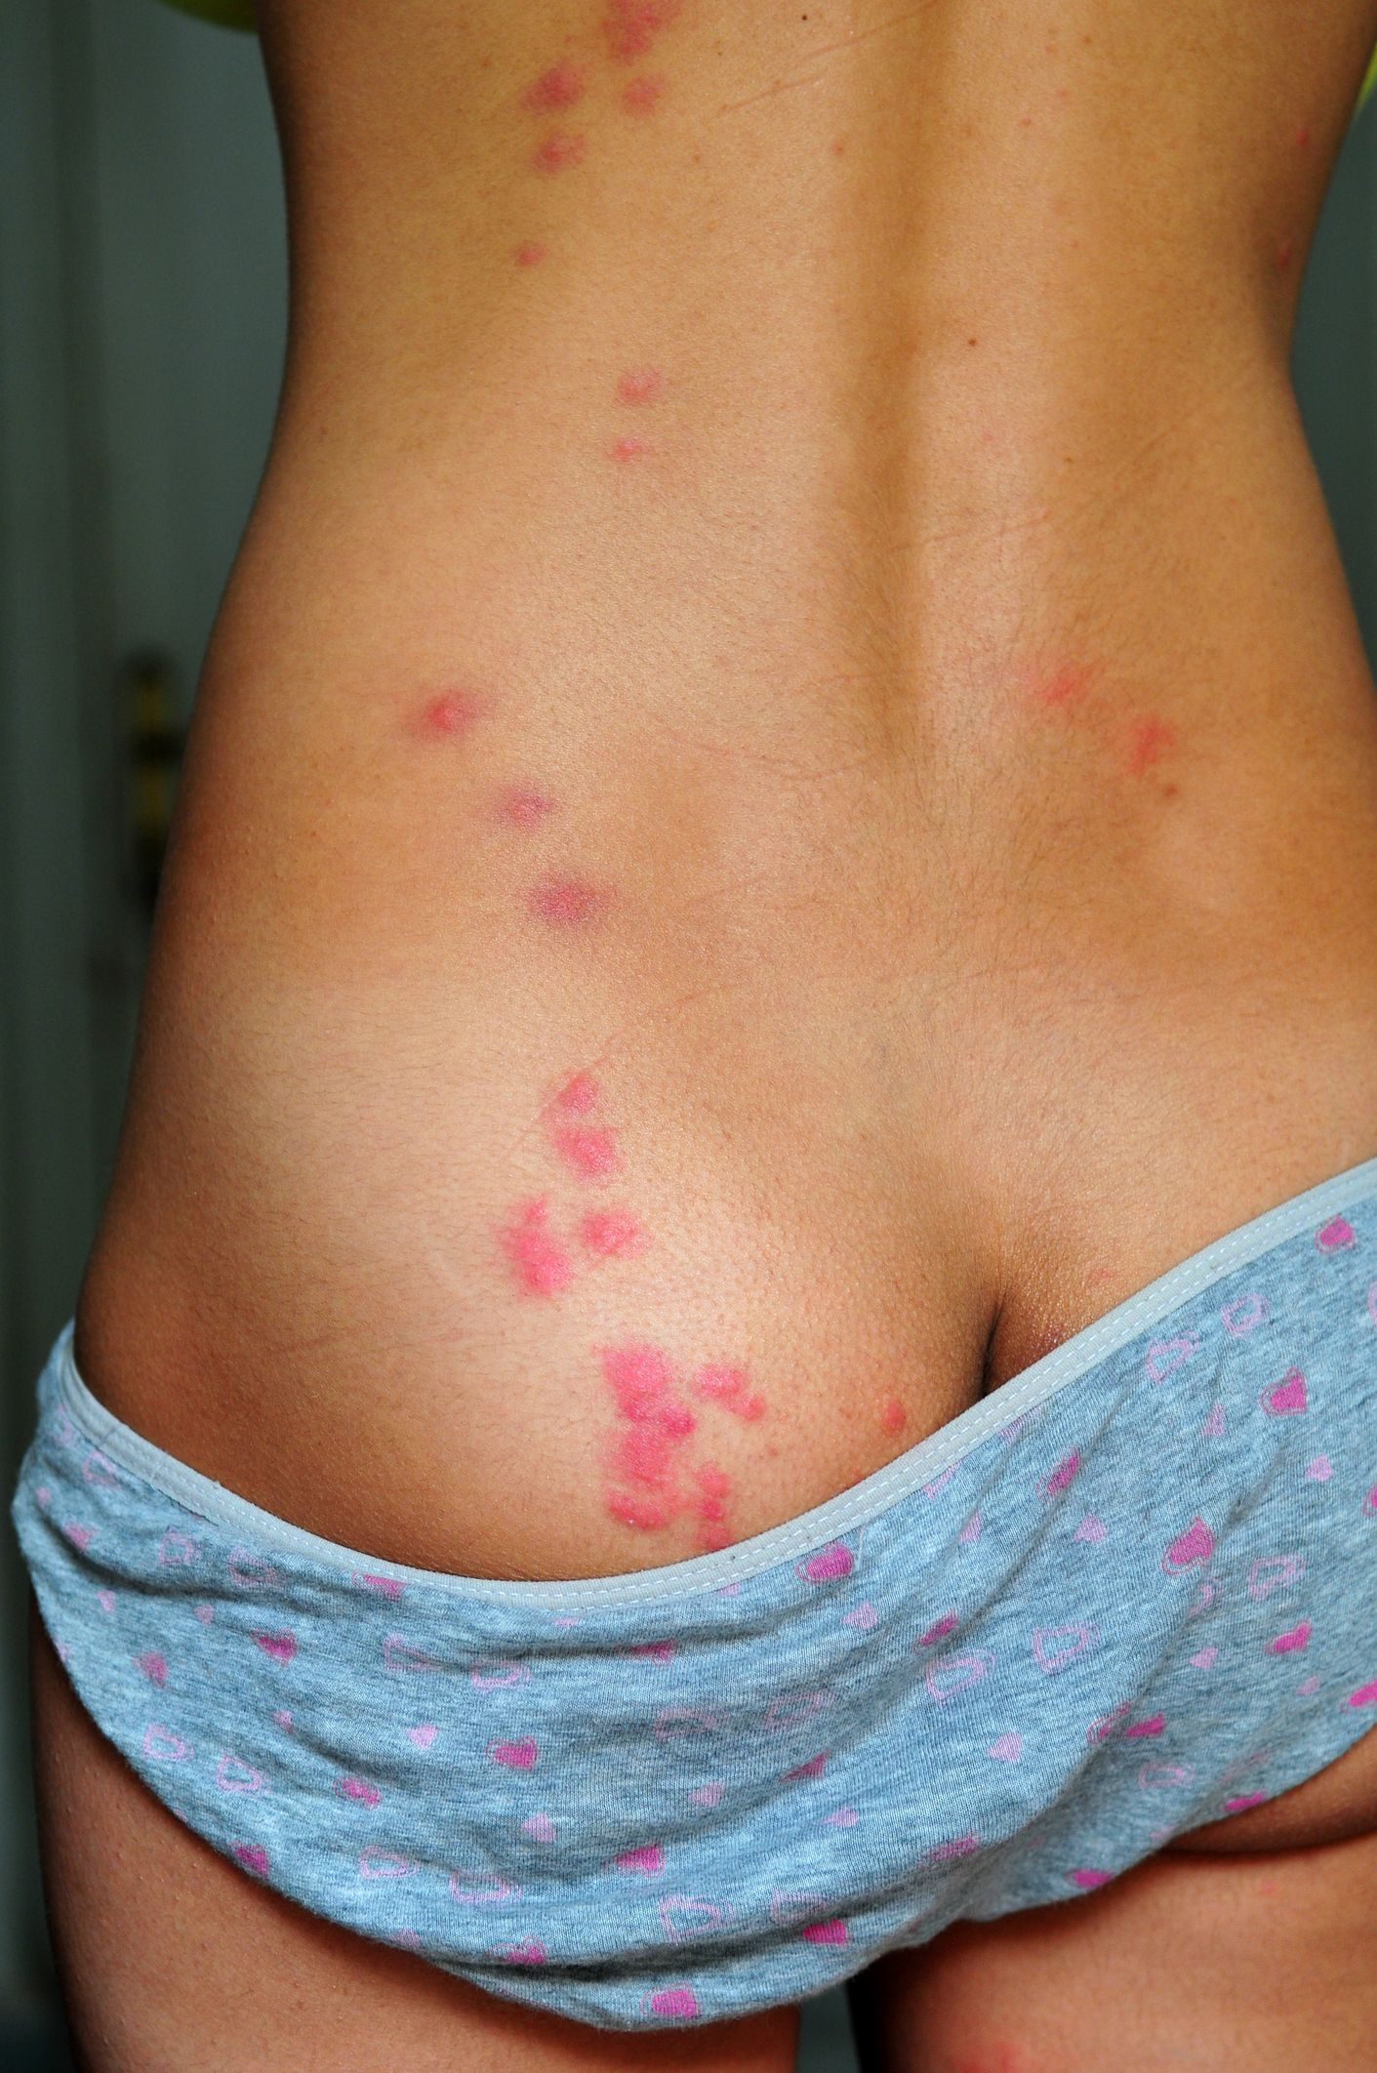
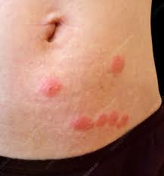
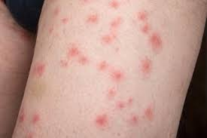

Slide 32
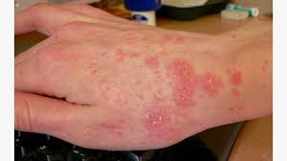
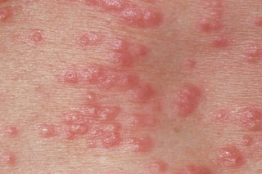
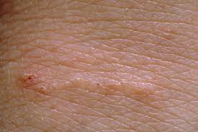

Slide 33
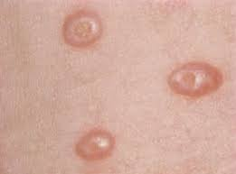
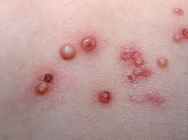

Slide 35
Follicular keratotic disorders
keratosis pilaris
lichen spinulosus
follicular hyperkeratosis
pityriasis rubra pilaris
keratosis follicularis (Darier’s disease))

Slide 36
Keratosis pilaris

Slide 37
Lichen spinulosus

Slide 38
Lichen spinulosus
follicular keratotic papules grouped into large symmetric patches – pruritic in 38%
1-3 mm papules with hairlike horny spine protruding 1-2 mm – “nutmeg grater” sensation
neck, buttocks, abdomen, elbows, knees, arms
most often seen in children, teens, young adults
no seasonal variation, unlike keratosis pilaris
associated with atopy, like keratosis pilaris

Slide 39
Lichen spinulosus: Treatment
keratolytics and emollients
salicylic acid gel
tretinoin gel
adapaline gel
ammonium lactate lotion
urea gel

Slide 40
Webinars
Coming soon: dates and times to be announced
MSWRs for TEAP students
Applicant File Review for TEAP Specialists
Hot Topics: Opioids
Vaping and Nicotine Use
Collection of Urine Drug Screens
A Multigenerational View of Mental Health Matters
Mental Health First Aid
Dietary Supplements

Slide 41
Open Forum
https://www.surveymonkey.com/r/FLW2F8N

Slide 42
Regional Medical Specialists Contact us with policy or clinical questions
John Kulig MD MPH Region 1 Boston & Region 2 Philadelphia
Gary Strokosch MD Region 3 Atlanta & Region 5 Chicago
Drew Alexander MD Region 4 Dallas
Sara Mackenzie MD MPH Region 6 San Francisco
HIPAA compliant messages => use @jobcorps.org email address

Slide 43
Monthly Teleconference
Next call: Wednesday, August 28th, 2024
Center Physician Call - August 2024 Aug 28, 2024, 2:00 – 3:00 PM (America/New_York) Please join my meeting from your computer, tablet or smartphone. https://meet.goto.com/347061669 You can also dial in using your phone. Access Code: 347-061-669 United States: +1 (571) 317-3122 Get the app now and be ready when your first meeting starts: https://meet.goto.com/install

