Slide 1
Job Corps Center Physician Monthly Teleconference
John Kulig MD MPH Region 1 Boston & Region 2 Philadelphia
Sara Mackenzie MD MPH Region 6 San Francisco
Drew Alexander MD Region 4 Dallas
Gary Strokosch MD Region 3 Atlanta & Region 5 Chicago
HIPAA compliant messages use @jobcorps.org email address
Wednesday, June 28th, 2023

Slide 2
Zero new cases of COVID-19 infection reported by SIR among Job Corps students nationwide on Tuesday, June 27, 2023.

Slide 3
Responding to Opioid Overdose in Job Corps JOB CORPS PROGRAM INSTRUCTION NOTICE NO. 22-16 5/31/2023
Two boxes with four doses of Narcan hydrochloride nasal spray with 4 milligram (mg) naloxone must be available in the following locations:
Health and Wellness Center in the Medical Emergency Response Grab-and-Go Kit
Safety and Security Office in the First Aid Emergency Response Grab-and-Go Kit
Each dormitory (new)
Recreation (new)
Academic and trade buildings/areas (new)
In a portable kit for center transportation vehicles (new)
Consider mounting Narcan Supply Kits (e.g. Naloxone Safety) on the wall next to fire extinguishers
Automated External Defibrillator (AED) must be accessible 24/7/365 and located near the First Aid Emergency Grab-and-Go Response Kit

Slide 4
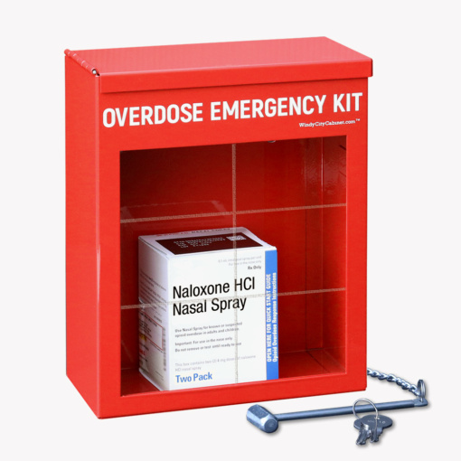

Slide 5
Responding to Opioid Overdose in Job Corps JOB CORPS PROGRAM INSTRUCTION NOTICE NO. 22-16 5/31/2023
Ensure all staff are trained on the following topics annually:
Signs of an opioid overdose.
This training may be provided by the Trainee Employee Assistance Program (TEAP) Specialist, an alternative staff member, or an outside organization.
Naloxone/Narcan administration. All staff must:
Watch the Lifesaving Naloxone (cdc.gov) training video, or a video from the Naloxone/Narcan manufacturer or professional organization, or staff may participate in an in-person training that reviews Narcan administration; and
receive an electronic or hard copy of the CDC’s How and When to Use
Naloxone for an Opioid Overdose.
Identifying opioids. This training may be provided by the TEAP Specialist, an alternative staff member, or an outside organization.

Slide 6
Responding to Opioid Overdose in Job Corps JOB CORPS PROGRAM INSTRUCTION NOTICE NO. 22-16 5/31/2023
Center-specific Naloxone/Narcan protocols. This staff training must include the following:
Locations of Narcan nasal spray on centers.
Assurance that Narcan is safe and should be administered if there is any possibility of an opioid overdose. If Narcan is mistakenly administered, no adverse effects will occur in a healthy individual.
Information on state Good Samaritan or Medical Amnesty Laws (if applicable), which protect the person administering life-saving measures from legal ramifications.
Guidance on responding to a student who is unconscious or losing consciousness or otherwise exhibiting symptoms of an opioid overdose.
Follow-up procedures to notify the applicable center staff (e.g., Health and Wellness, Center Director) after a medical emergency.

Slide 7
Responding to Opioid Overdose in Job Corps JOB CORPS PROGRAM INSTRUCTION NOTICE NO. 22-16 5/31/2023
Ensure all students are trained by the TEAP Specialist, an alternative staff member, or an outside agency on the following topics during the Career Preparation Period:
Role of synthetic opioids in overdose deaths and risk with use of any illicit drugs.
Signs of an opioid overdose and response actions.
Naloxone/Narcan administration. All students must:
Watch the Lifesaving Naloxone (cdc.gov) training video, or a video from
the Narcan manufacturer or professional organization; or students may
participate in an in-person training that reviews Narcan administration;
and receive an electronic or hard copy of the CDC’s How and When to Use
Naloxone for an Opioid Overdose.

Slide 8
Responding to Opioid Overdose in Job Corps JOB CORPS PROGRAM INSTRUCTION NOTICE NO. 22-16 5/31/2023
Center-specific Naloxone/Narcan protocols. This training for all students must include the following:
Locations of Narcan on centers.
Assurance that Narcan is safe and should be administered if there is any possibility of an opioid overdose. If Narcan is mistakenly administered, no adverse effects will occur in a healthy individual.
Information on state Good Samaritan or Medical Amnesty Laws (if applicable), which protect the person administering life-saving measures from legal ramifications.
Guidance on responding to a fellow student who is unconscious or losing consciousness or otherwise exhibiting symptoms of an opioid overdose, as outlined in How and When to Use Naloxone for an Opioid Overdose.
How to alert staff of emergencies.

Slide 9
PIN 22-16 Attachment A. Infectious Disease and Medical Emergency Plan Template
Instructions for Template Use
Pursuant to Job Corps’ Policy and Requirements Handbook (PRH) 5.1, R18, all centers are required to develop an Emergency Action Plan (EAP). This template serves as a guide to address necessary steps in response to infectious diseases and medical emergencies per PRH 5.1, R18.a.1(d).
The sections included in this template represent the minimum required components. Other components should be added as needed. Center staff drafting this plan should consider lessons learned during the COVID-19 pandemic and focus on capturing lessons learned if called to respond to a pandemic again.

Slide 10
Treatment Guideline Emergency Supplies, Medications, and Grab & Go Kits
Equipment
Automated external defibrillator (AED)
Ambu bag with oral airways
Glucometer
Oximeter
Oxygen source
Stretcher/backboard

Slide 11
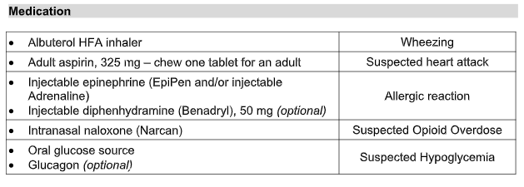
Treatment Guideline Emergency Supplies, Medications, and Grab & Go Kits

Slide 12
Treatment Guideline Emergency Supplies, Medications, and Grab & Go Kits
Medical Supplies
Ace wraps Gauze roll bandages (Kling)
Bandages Needles/syringes
Blood pressure cuff Stethoscope
Eye irrigation bottle Tape
Eye patches Tourniquet
Gauze pads Tweezers

Slide 13
Treatment Guideline Emergency Supplies, Medications, and Grab & Go Kits
Personal protective equipment (PPE) (disposable)
Gloves (non-latex)
Face masks
Gowns
All emergency response equipment and supplies must be readily accessible 24/7/365.
Contents should be inspected monthly, including medication expiration dates and the oxygen tank gauges.

Slide 14
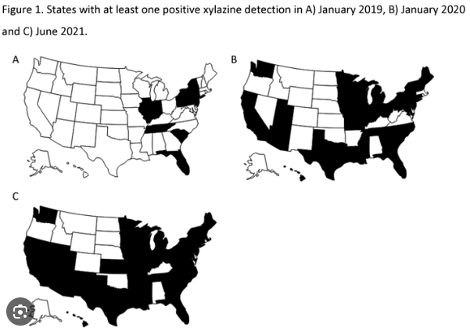

Slide 15
Xylazine
Active ingredient in a non-opioid veterinary tranquilizer not approved for human use, that can worsen the life-threatening effects of opioids.
When used in combination with opioid drugs such as fentanyl and heroin, xylazine may damage the ability of the brain to get enough oxygen, one of the most dangerous effects of opioid drugs, and can lead to death.
Xylazine is known to cause sedation and dangerously slow breathing, heart rate, and lower blood pressure in people.
Harms of xylazine and risk of fatal overdose are known to increase when used in combination with other central nervous system depressants like alcohol, benzodiazepines, and opioids like fentanyl or heroin.
No response to naloxone/Narcan.
NIDA

Slide 16
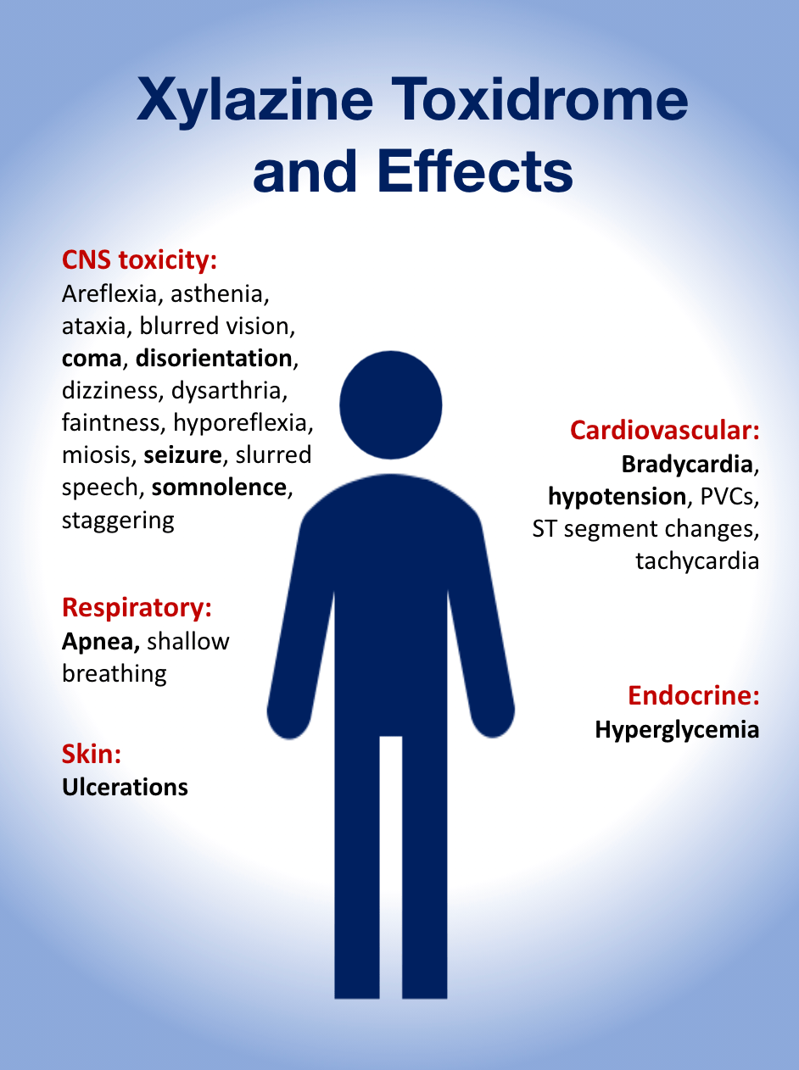

Slide 17
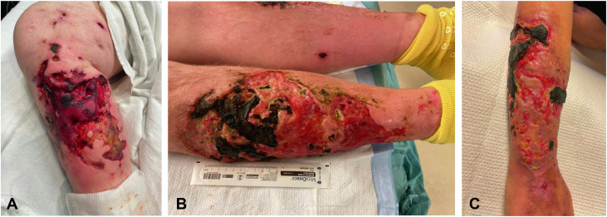
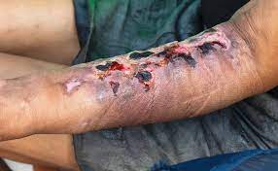

Slide 18
Group A streptococcal infection
Mild-moderate infection | Invasive infection/Sequelae
strep throat | necrotizing fasciitis
scarlet fever | streptococcal toxic shock syndrome
impetigo | bacteremia/sepsis
cellulitis | acute rheumatic fever
erysipelas (face) | post-streptococcal glomerulonephritis

Slide 19
Sore throat
Most sore throat caused by respiratory viruses in adolescents and young adults (AYA) associated with cold symptoms.
Viruses that cause sore throat in AYA include:
influenza
coronavirus
enterovirus
adenovirus
Epstein-Barr virus (mononucleosis)
Perhaps 10% to 20% due to group A beta hemolytic streptococcus (GABHS)

Slide 20
Sore throat
When to test for strep:
known exposure
Centor criteria score > 2: fever, tonsillar exudate, anterior cervical lymphadenopathy, absence of cough
if rapid antigen strep test negative, obtain throat culture
When to test for mono:
known exposure
sore throat, significant fatigue, palatal petechiae, posterior cervical or auricular lymphadenopathy, splenomegaly
CBC with differential, Monospot test

Slide 21
Treatment of strep throat
Oral antibiotic:
penicillin VK 500 mg bid x 10 days -or-
cephalexin (Keflex) 500 mg bid x 10 days
Symptomatic management:
lozenges or sore throat spray
acetaminophen, ibuprofen or naproxen
oral hydration

Slide 22
Casual Marijuana Use Harmful to Adolescents
National Survey on Drug Use and Health - annual - 68,000 teens - 2021
Teenagers who use cannabis recreationally are 2 to 3 times more likely to have depression and suicidal thoughts than those who don't use it.
Teens who have cannabis use disorder – which means they can't stop using it despite health and social problems – are 4 times more likely to have those same thoughts and feelings.
Marijuana use was also linked to other issues including not doing well in school, skipping school, and getting in trouble with the police.
Marijuana is neither safe nor benign for the developing brain.
Ref: JAMA Network: "Nondisordered Cannabis Use Among US Adolescents.” May 19, 2023

Slide 23
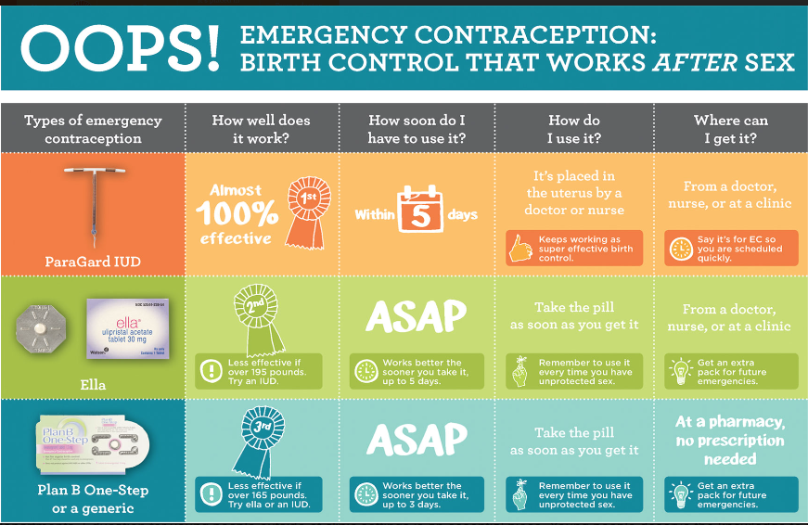

Slide 24
High Risk TikTok Viral Internet Challenges 2023
Angel of Death challenge - the participant has to run and jump in front of a moving vehicle. The challenge is complete if the vehicle stops before hitting the person.
Borg challenge - the "borg" typically consists a mixture of alcohol, electrolytes, caffeinated flavoring and water in a one-gallon jug.
Devious Licks challenge - encourages students to record a video of themselves stealing or vandalizing school property.
Cha Cha Slide challenge - teenagers drive recklessly to the rhythm of a song first released 20 years ago by DJ Casper - every time Casper sings “slide left” the driver steers the car according to the lyrics and turns into the oncoming lane.
Orbeez challenge - jumping out of vehicles and firing hydrated gel balls at strangers.
Beezin challenge - rubbing Burt’s Bees lip balm onto the eyelids before going out - consumers believe the menthol and peppermint in the lip balm will enhance their alertness and increase their buzz while partying.

Slide 25
Guest speaker next month
Karen Hover MD
Center Physician
Penobscot Job Corps Center
Center for Family Medicine
Eastern Maine Medical Center
Bangor, Maine

Slide 26
Open Forum
https://www.surveymonkey.com/r/DGR3K2B

Slide 27
Job Corps Center Physician Monthly Teleconference Next call: Wednesday, July 26th, 2023
John Kulig MD MPH Region 1 Boston & Region 2 Philadelphia
Sara Mackenzie MD MPH Region 6 San Francisco
Drew Alexander MD Region 4 Dallas
Gary Strokosch MD Region 3 Atlanta & Region 5 Chicago
HIPAA compliant messages use @jobcorps.org email address
https://www.surveymonkey.com/r/DGR3K2B

