Slide 1

Job Corps Center Physician
Monthly Teleconference
      Wednesday, June 26th, 2024

Slide 2

Sara Mackenzie, MD, MPH
June 26, 2024

Slide 3
Hot topics in Respiratory Illness:
Rates of respiratory Illness
H5N1
Avian influenza
Actions for Job Corps centers

Slide 4
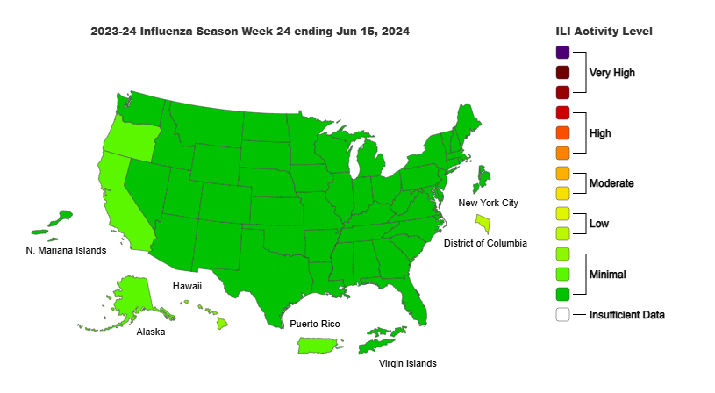
CDC Dashboard Influenza-like Illness*:
*Percent of visits to enrolled outpatient providers or ERs for fever and cough or sore throat

Slide 5
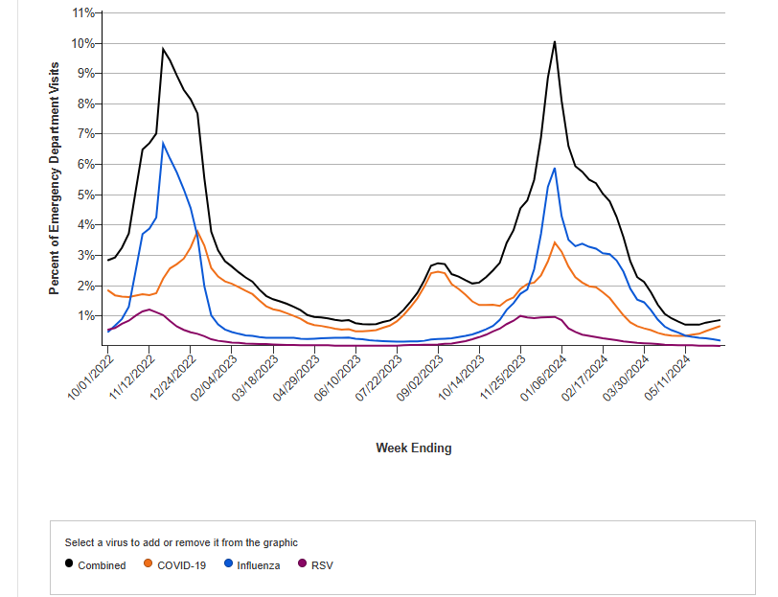
CDC Dashboard ER visits for Viral Respiratory ILlness:

Slide 6
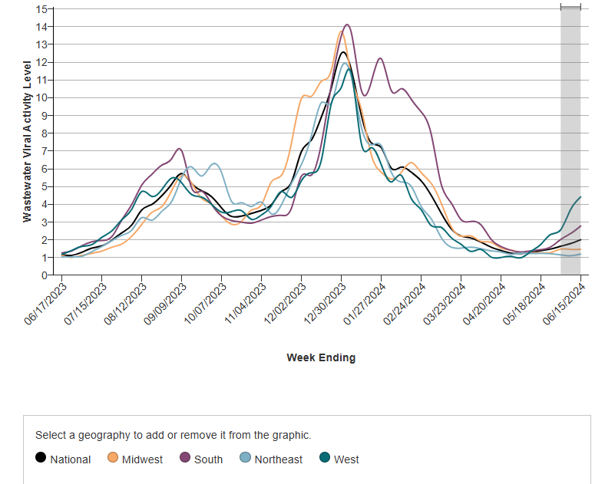
CDC Dashboard C19 Wastewater trends:

Slide 7
Covid-19:
Omicron variant
Continues to mutate with small changes to spike protein
FDA recommended updated vaccine formulation – ACIP to determine vaccine eligibility for fall boosters

Slide 8
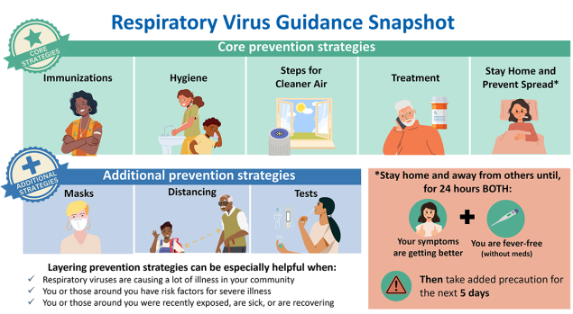
Management & Prevention of Respiratory Illness in Job Corps:
Respiratory Virus Guidance (cdc.gov)

Slide 9
H5N1 (Bird flu or avian flu):
Highly pathogenic avian influenza virus A (H5N1) or HPAI
Starting 2022- large ongoing outbreak among birds- initial wild birds and then domestic (chickens and such)
Since 2022, increased detection among other mammals
Starting 2024, detected in American dairy cows

Slide 10
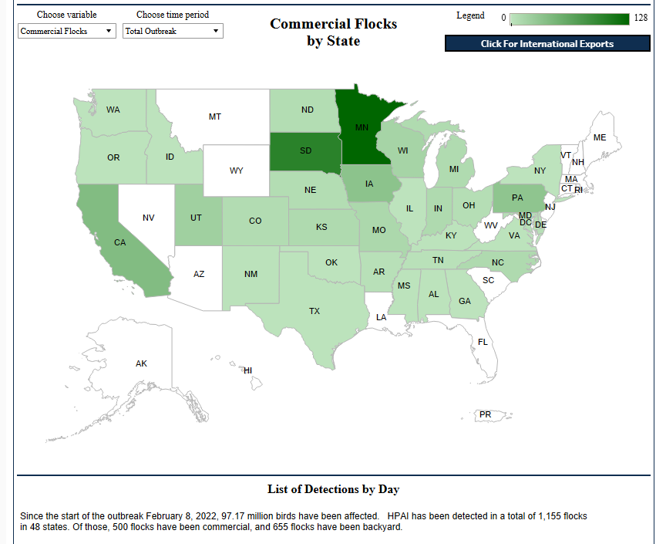
H5N1 commercial birds:
Confirmations of Highly Pathogenic Avian Influenza in Commercial and Backyard Flocks | Animal and Plant Health Inspection Service (usda.gov)

Slide 11
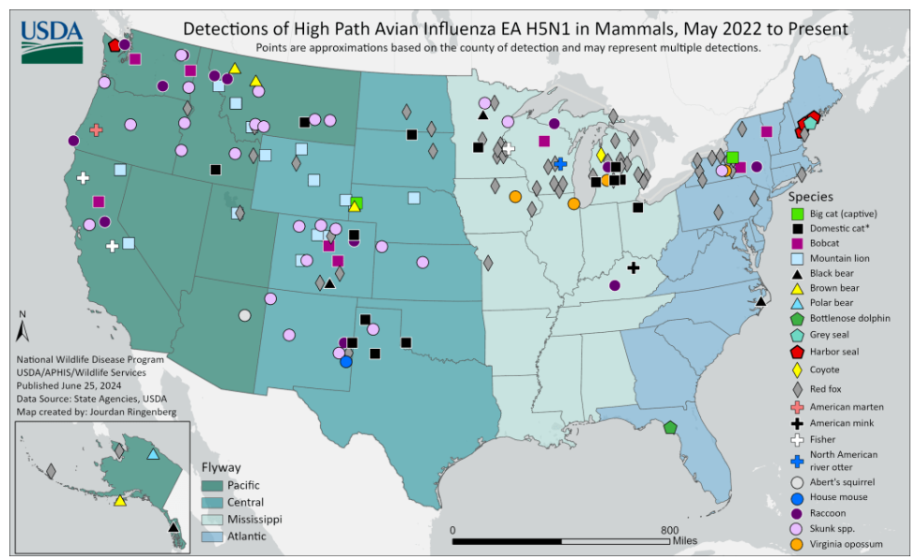
H5N1 mammals:

Slide 12
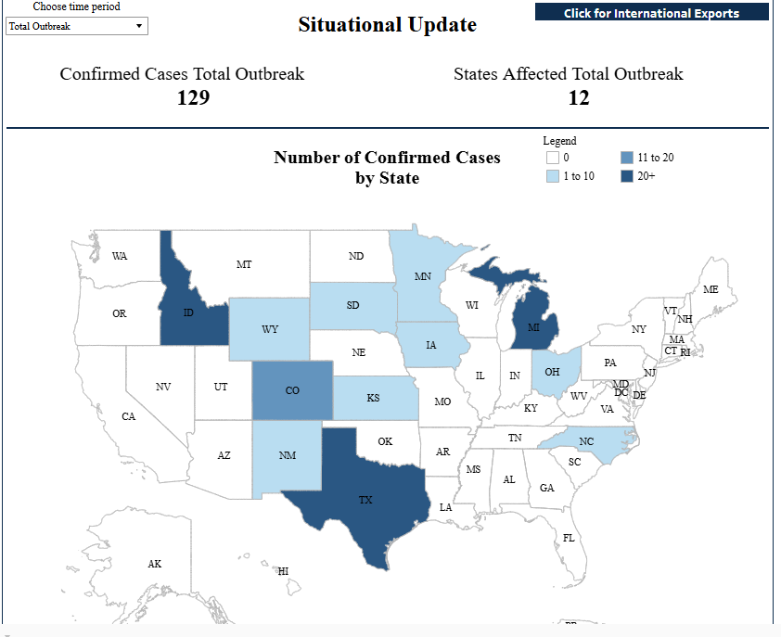
H5N1 Diary cows:
HPAI Confirmed Cases in Livestock | Animal and Plant Health Inspection Service (usda.gov)

Slide 13
What is the risk to humans?:
At present, very low risk
Some human cases linked to direct contact with cattle or domesticated birds
No human-to-human spread thus far
But…

Slide 14
Influenza
RNA virus
Four types: A, B, C, and D
Influenza A and B cause seasonal epidemic disease in humans
Influenza A only known type to cause pandemics in humans
  Influenza A subtypes: H (18 subtypes) and N (11 subtypes)
  Genetic Drift: Frequent minor genetic changes
  Genetic Shift: Infrequent abrupt major genetic changes
  Influenza A subtypes can infect birds, pigs, horses, dogs and other animals
Notes:
C mild illness
D primarily infects cattle

Slide 15
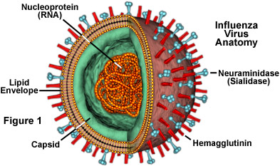

Slide 16
Influenza virus
Pandemics – genetic shift (large change in RNA structure
1918: H1N1
1947: H1N1
1957: H2N2
1968: H3N2
1978: H1N1
2009: H1N1
“Reassortment” – swap gene segments when 2 types infect host at same time
*Pigs are especially concerning for genetic shift as they have avian and human influenza receptors & serve as “mixing pot”
Notes:
1918 pandemic: 675,000 U.S. deaths; 20 million deaths worldwide
1957: 116,000
1968: 100,000
2009: 12,469
Compared to 36,000 U.S. deaths annually

Slide 17
Management & Prevention of Respiratory Illness in Job Corps:
Respiratory Virus Guidance (cdc.gov)

Slide 18
John Kulig, MD, MPH
June 26, 2024

Slide 19
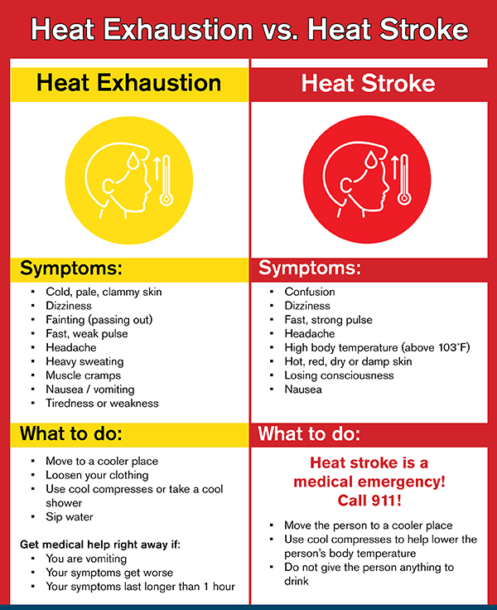

Heat injury

Slide 20
Primary axillary hyperhidrosis
FDA has approved sofpironium topical gel 12.45% (Sofdra), a topical anticholinergic/antimuscarinic for primary axillary hyperhidrosis. The approval stipulates once daily use in adults and children 9 years or older.
Sofpironium bromide indirectly reduces the rate of sweating by preventing the stimulation of acetylcholine receptors that are located on sweat glands.
Alternatives treatments include Drysol (Rx aluminum chloride hexahydrate 20%), injections of botulinum toxin, laser, and surgery.

Slide 21
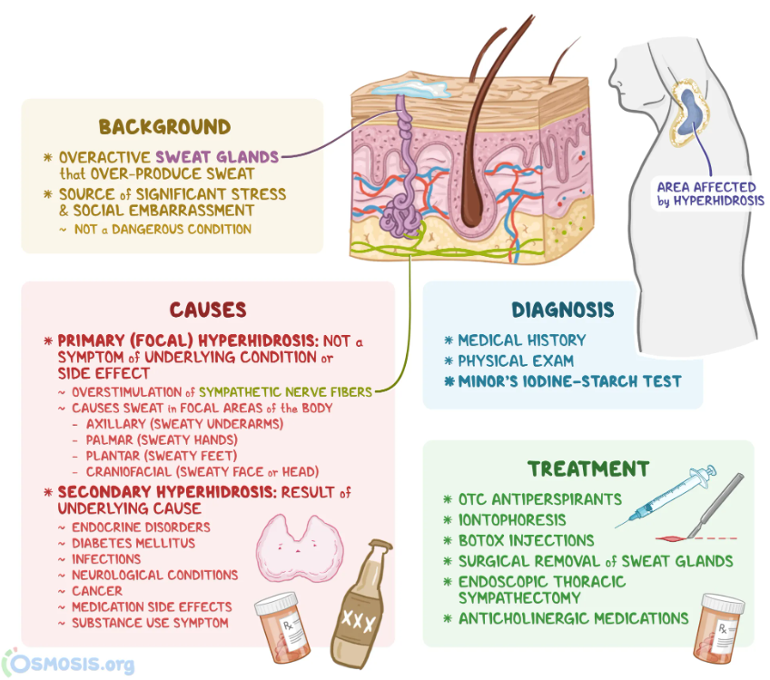


Slide 22
Hepatitis C epidemiology
Hepatitis C is a bloodborne virus that can be transmitted through sharing needles, syringes, or other drug-injection equipment, from a pregnant person to their baby, and rarely through sexual contact
During 2021, rates of acute hepatitis C were highest among males, persons aged 20–39 years, non-Hispanic American Indian/Alaska Native (AI/AN) persons, and those living in the Eastern and Southeastern states.
Among cases with risk information reported, the most common was injection drug use.
Current spike in acute incidence rates among millennials aligns closely with the age cohort most affected by the opioid crisis

Slide 23
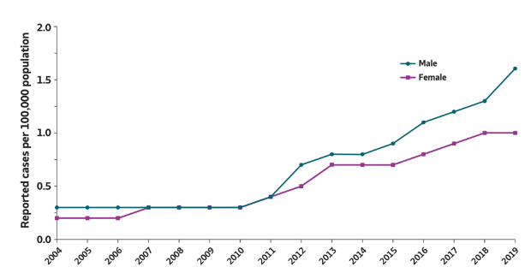

Slide 24
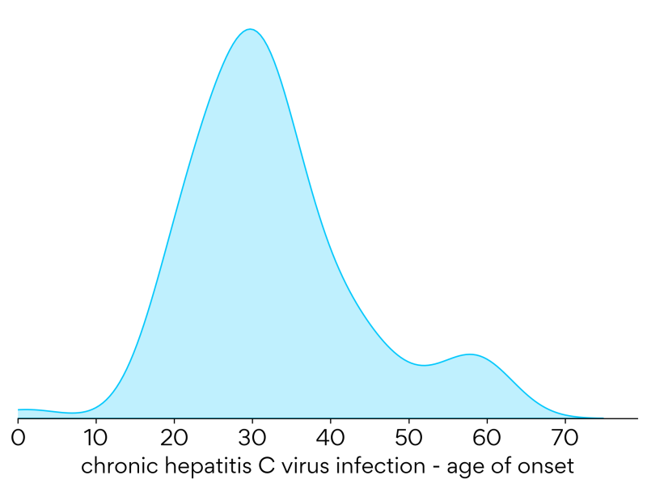

Slide 25
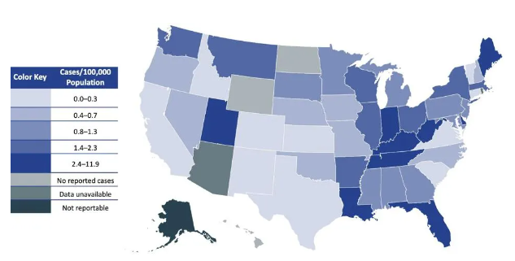
2020

Slide 26
Hepatitis C infection
Symptoms may appear2-12 weeks after infection with the hepatitis C virus, but 70%-80% are asymptomatic.
Less than half of people who get hepatitis C are able to clear the virus in the first 6 months after infection without treatment.
Most people who get infected will develop a chronic lifelong infection.
Left untreated, chronic hepatitis C can cause serious health problems including liver disease, liver failure, liver cancer, and death.
Chronic hepatitis C is a leading cause of liver cancer and the leading cause of liver transplants in the United States.
CDC

Slide 27
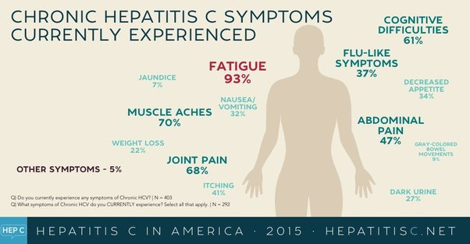

Slide 28

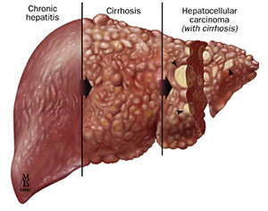
Hepatitis C virus (HCV)
Progression of liver disease

Slide 29
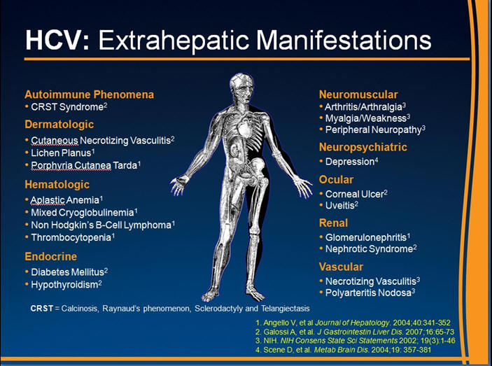

Slide 30
Hepatitis C transmission
HCV transmission is bloodborne and most often involves exposure to contaminated needles or syringes, or receipt of blood or blood products that have not been screened for HCV.
Although infrequent, HCV can be transmitted through other procedures that involve blood exposure (e.g., tattooing, during sexual contact, perinatally from mother to child).

Slide 31
Hepatitis C screening - CDC
CDC recommends that all adults 18 and older and all pregnant people get screened for hepatitis C at least once in their lifetime and during each pregnancy, respectively.
CDC also recommends that certain high-risk groups get tested more frequently. These groups include:
  People who inject drugs, or have injected drugs in the past
  People with HIV infection
  People with liver disease, abnormal liver tests, or who are on hemodialysis

Slide 32
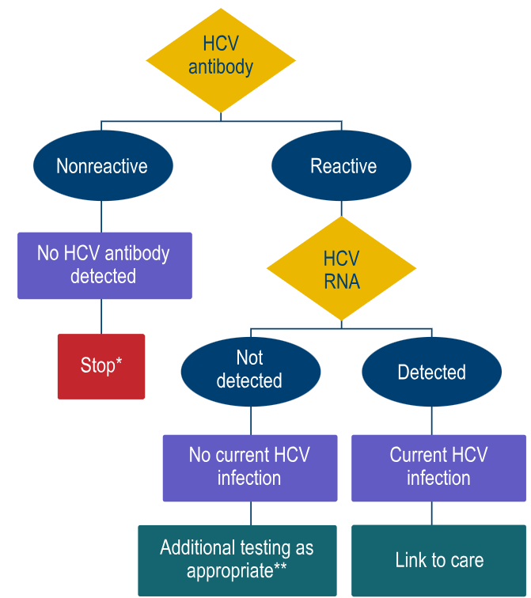
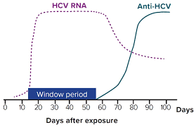
Source: CDC. Testing for HCV infection: An update of guidance for clinicians and laboratorians. MMWR 2013;62(18)

Slide 33
Hepatitis C screening – New York state
New York State legislation requiring universal hepatitis C screening went into effect May 3, 2024.
Every individual age eighteen and older be offered a hepatitis C screening test.
Every individual younger than eighteen, if there is evidence or indication of risk activity, be offered a hepatitis C screening test.
Every physician or practitioner caring for a pregnant person shall order a hepatitis C screening test and record the hepatitis C test results prominently in the pregnant person's medical record at or before the time of hospital admission for delivery.

Slide 34
Guidance for New York state JC centers
Job Corps centers in New York state should not initiate universal screening for hepatitis C among students at this time.
Guidance will be provided by the national Office of Job Corps once policy has been established.

Slide 35
Hepatitis C prevention
Avoiding behaviors that can spread the disease, including:
  Sharing needles, syringes, or other drug equipment.
  Practicing poor or unsanitary procedures in health care facilities.
  Engaging in sexual activity with a person who is infected with HCV.
  Getting unregulated tattoos or body piercings.
  Receiving a blood transfusion or organ transplant from a donor with HCV infection.
No vaccine to prevent hepatitis C, but all with HCV infection should be immunized against hepatitis A and hepatitis B.
Costly antiviral medications taken for 8-12 weeks can cure HCV infection (95%+).

Slide 36
Hepatitis C treatment
The cost of hepatitis C treatment varies depending on the type of drug. An 8- to 12-week course can range from $23,000–$95,000 or higher without insurance.
Some examples of drug costs include:
Sovaldi: $1,000 per pill, or $84,000 for a 12-week course
Harvoni: $94,500 for a 12-week course
Technivie: $76,653 for a 12-week course
Zepatier: $54,600 for a 12-week course
Mavyret: $39,600 for a 12-week course

Slide 37
Job Accommodation Network (JAN) Webinar tomorrow
THURSDAY, JUNE 27th 2:00 PM CT
Ask JAN! We can help. . . . . . . . . . . . . . . . . . As the leading source of expert and trusted guidance on workplace accommodations and the Americans with Disabilities Act (ADA), the Job Accommodation Network (JAN) has the knowledge, resources, and tools to help employers recognize the valuable contributions that qualified workers with disabilities add to the workforce. Job accommodations are typically low in cost, positively impact the workplace in many ways, and play a vital role in creating inclusive workplaces. This presentation will introduce attendees to JAN services and resources and explain how JAN can be a partner in exploring accommodation solutions.
Register at: https://jobcorps.webex.com (outside of Citrix)

Slide 38
Webinar PowerPoint slides recently posted
Webinar: Anxiety and Psychotropic Medication Management
https://supportservices.jobcorps.gov/health/Pages/default.aspx
Webinar: ​Management Series: Recruitment and Retention for Health and Wellness Staff
https://supportservices.jobcorps.gov/health/Pages/default.aspx

Slide 39



Open Forum
Attendance link: https://www.surveymonkey.com/r/FGFDFQL

Slide 40
Regional Medical Specialists
Contact us with policy or clinical questions
John Kulig MD MPH Region 1 Boston & Region 2 Philadelphia
Gary Strokosch MD Region 3 Atlanta & Region 5 Chicago
Drew Alexander MD Region 4 Dallas
Sara Mackenzie MD MPH Region 6 San Francisco
HIPAA compliant messages => use @jobcorps.org email address

Slide 41
Monthly Teleconference
Next call: Wednesday, July 24th, 2024
Center Physician Call - July 2024
Wed, July 24, 2024, 2:00 – 3:00 PM (America/New_York)
Please join my meeting from your computer, tablet or smartphone.
https://meet.goto.com/318859485
You can also dial in using your phone.
Access Code: 318-859-485
United States: +1 (872) 240-3412
Get the app now and be ready when your first meeting starts.
https://meet.goto.com/install

