Slide 1
Job Corps Center Physician Monthly Teleconference
Wednesday, March 27th, 2024

Slide 2
PIN 23-09: Managing Respiratory Viruses on Job Corps Centers
Rescinds previous covid pins
Encourage centers to:
Be familiar with new CDC guidance
Encourage immunizations – flu and COVID-19
Promote good hygiene
Educate and support precautions to prevent spread of respiratory illness
Evaluate and treat, as indicated
SIR if 10 percent of greater students respiratory illness

Slide 3
Impact on Health Systems from COVID-19 and the Role of Social Determinants of Health
Pandemic strain on health care systems
Exacerbated shortages: staffing, supplies
Social Determinants of Health
Economic stability
Education access and quality
Health care access and quality
Neighborhood and built environment
Social and community context
Call to Action:
SDoH influence outcomes and we can help
Recognize and tailor approach to optimize care
Schneider, A. (2024) Family Practice Management; 31(2):23-26

Slide 4
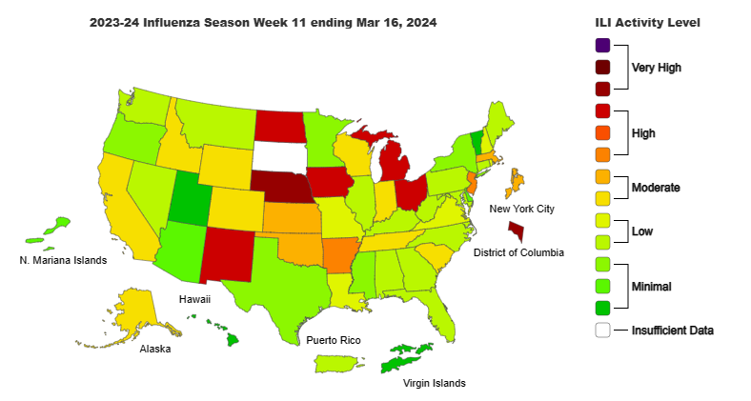
Influenza-like illness activity:

Slide 5
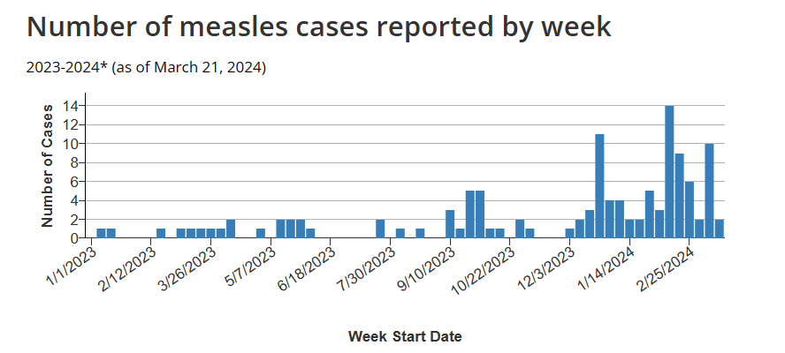
Measles activity:

Slide 6
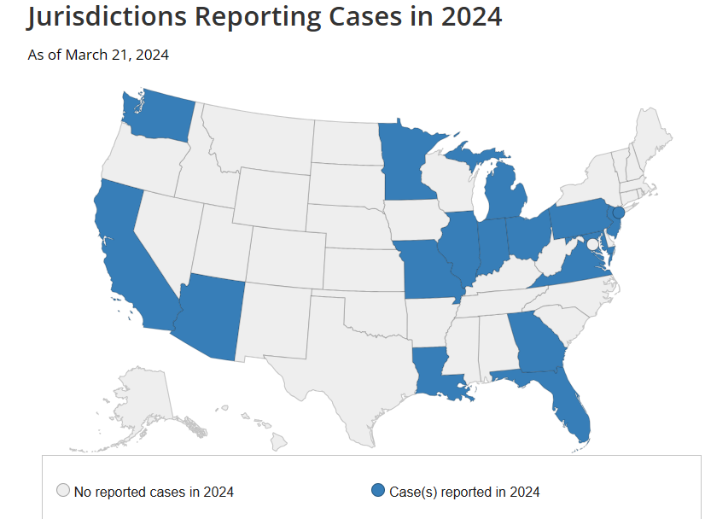
Measles activity:

Slide 7
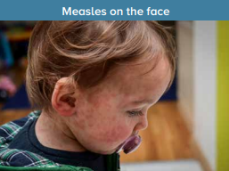
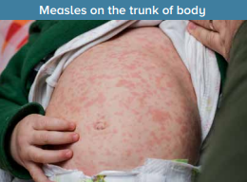
Measles:
Incubation 11-12 days from exposure
Prodromal symptoms (fever, cough, coryza, Koplik spots)
Rash – maculopapular, starts head and face, then spreads downward
Fever - may spike to 104 with rash onset
Complications – diarrhea, otitis media; pneumonia, encephalitis, death

Slide 8
If suspect case:
Immediately mask and isolate student in a room with closed door
Only allow health care workers with presumptive evidence of immunity to work with student; must wear N95 mask
Evaluate student and order confirmatory testing
Throat or nasopharyngeal swab for RT-PCR &
Serum for IgM measles testing
Immediately call local and/or state health department
Measles (Rubeola) (cdc.gov)

Slide 9
Prevention:
MMR vaccination required for students in Job Corps
Ensure system to check vaccinations at arrival is in place
If newly arriving student requesting MMR waiver, educate regarding current outbreak status & importance of measles vaccination
If you have students who had a waiver for MMR upon arrival, might be worth contacting and encouraging again to consider vaccination.

Slide 10
Webinar tomorrow
Diabetes Update with Dr. Drew Alexander and Dr. Gary Strokosch
Thursday March 28th, 2024 @ 11 am ET, 10 am CT, 9 am MT, 8 am PT
The webinar is listed in the Upcoming Sessions tab on WebEx
at https://jobcorps.webex.com and is open for registration.
All center clinicians are encouraged to attend.

Slide 11
JC PIN 23-09: Managing Respiratory Viruses on Job Corps Centers
Rescinds JC PIN 22-17 (COVID-19 emergency) and PIN 23-04 (vaccines for 2023-2024 seasonal respiratory infections)
Reduced threat from COVID-19 due to population immunity, vaccines, and treatment options
Follows CDC’s unified approach to common viral respiratory illnesses, including COVID-19, influenza, and respiratory syncytial virus (RSV) with similar symptoms and transmission
Updated guidance on prevention strategies applicable to all, regardless of the viral etiology

Slide 12
JC PIN 23-09: Managing Respiratory Viruses on Job Corps Centers
Ensure that Health & Wellness staff review online CDC’s new Respiratory Virus Guidance [March 1, 2024]
Encourage immunizations following current CDC guidelines, including both COVID-19 and influenza
Promote good hygiene practices – frequent handwashing, covering coughs, cleaning high touch areas
Support precautions to prevent spread when ill – stay away from others, hygiene, masks, physical distancing
Clinicians will determine the need for COVID and/or influenza testing

Slide 13
JC PIN 23-09: Managing Respiratory Viruses on Job Corps Centers
Instruct students to contact the Health & Wellness Center if they develop respiratory symptoms
Clinicians should evaluate each student with respiratory symptoms to assess severity and risk to determine the need for treatment
Resume normal activities when symptoms are improving and fever has resolved (without medication)
After resuming activities, continue precautions over the next 5 days
Centers should submit a Significant Incident Report (SIR) if 10% or greater of students have a respiratory illness

Slide 15
PIN 23-08: Electronic prescribing
Designed to increase the oversight of prescription medications, to prevent medication misuse, and to reduce medication errors
Applies to all centers, not just in states with e-prescribing laws
May be used for all prescriptions, not just controlled substances
e-prescribing software options must meet all criteria specified in PIN 23-08
Submit to Regional Office for approval
Purchase subscription and begin use on center

Slide 16
Immunization update
One of two manufacturers of tetanus-diphtheria (Td) vaccine has discontinued production, leading to supply constraints during 2024
CDC advises transition to use of Tdap vaccine in lieu of Td vaccine whenever possible
Tdap vaccine is an acceptable alternative to Td vaccine, including when a tetanus booster is indicated for wound management
Tdap vaccine is not an acceptable alternative in the presence of a specific contraindication to pertussis-containing vaccines – very rare

Slide 17
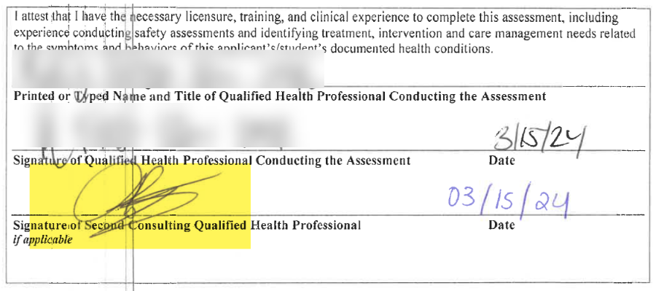
Applicant file review
Please document name and title on all student health forms.
Self-inking rubber stamps may be used adjacent to the signature.

Slide 18
Ehlers-Danlos syndromes
Ehlers-Danlos syndromes (EDS) are a group of 14 inherited connective tissue disorders caused by abnormalities in the structure, production, and/or processing of collagen.
Symptoms of EDS vary by type and range from mildly loose joints to serious complications.
Features shared by many types include joint hypermobility and soft, velvety skin that is highly elastic and bruises easily.
Fewer than 5,000 people in the U.S. have this disease.
NIH: Genetic & Rare Diseases (GARD)

Slide 19
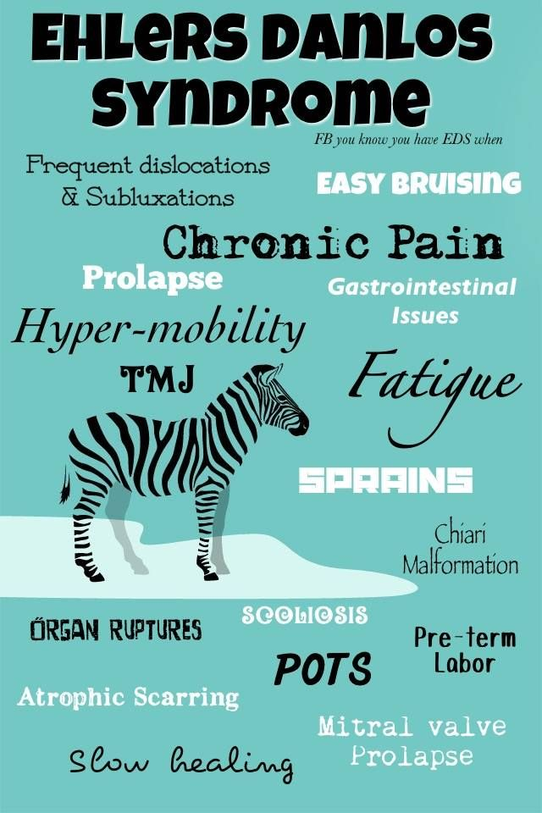
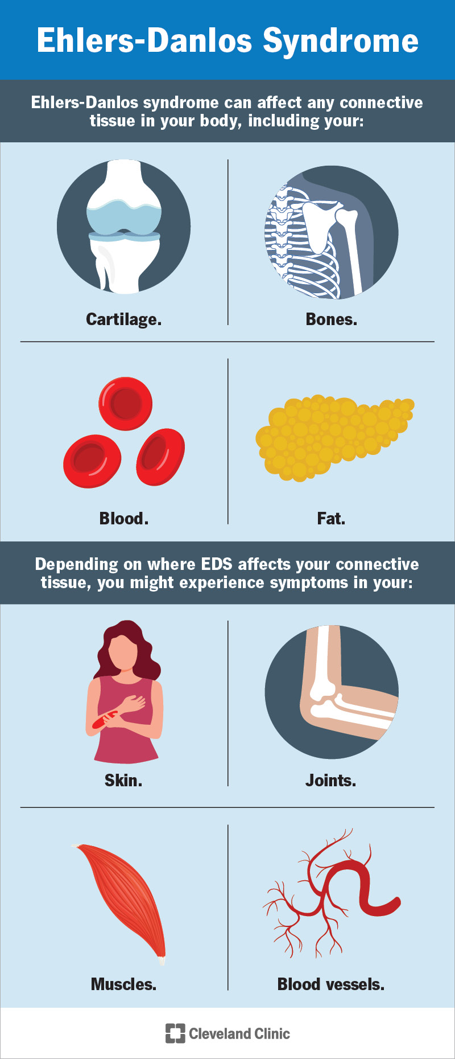

Slide 20
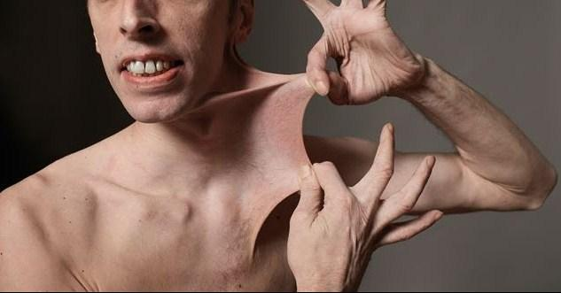

Slide 21
Ehlers-Danlos syndromes
Ehlers-Danlos syndrome is caused by genetic mutations, also known as pathogenic variants.
Genetic mutations can be hereditary, when parents pass them down to their children, or they may occur randomly when cells are dividing.
Genetic mutations may also result from contracted viruses, environmental factors, such as UV radiation from sunlight exposure, or a combination of any of these.
NIH: Genetic & Rare Diseases (GARD)

Slide 22
Ehlers-Danlos syndromes
A heterogeneous group of diseases characterized by fragility of the soft connective tissues resulting in widespread skin, ligament, joint, blood vessel and/or internal organ manifestations.
Clinical spectrum is highly variable, ranging from mild skin and joint hyperlaxity to severe physical disability and life-threatening vascular complications.
Management consists of a care team responsible for surveillance of major organ-specific complications (for example, arterial aneurysm and dissection), integrated physical medicine and rehabilitation.
No specific medical or genetic therapies are available for any type of EDS.
Orphanet

Slide 23
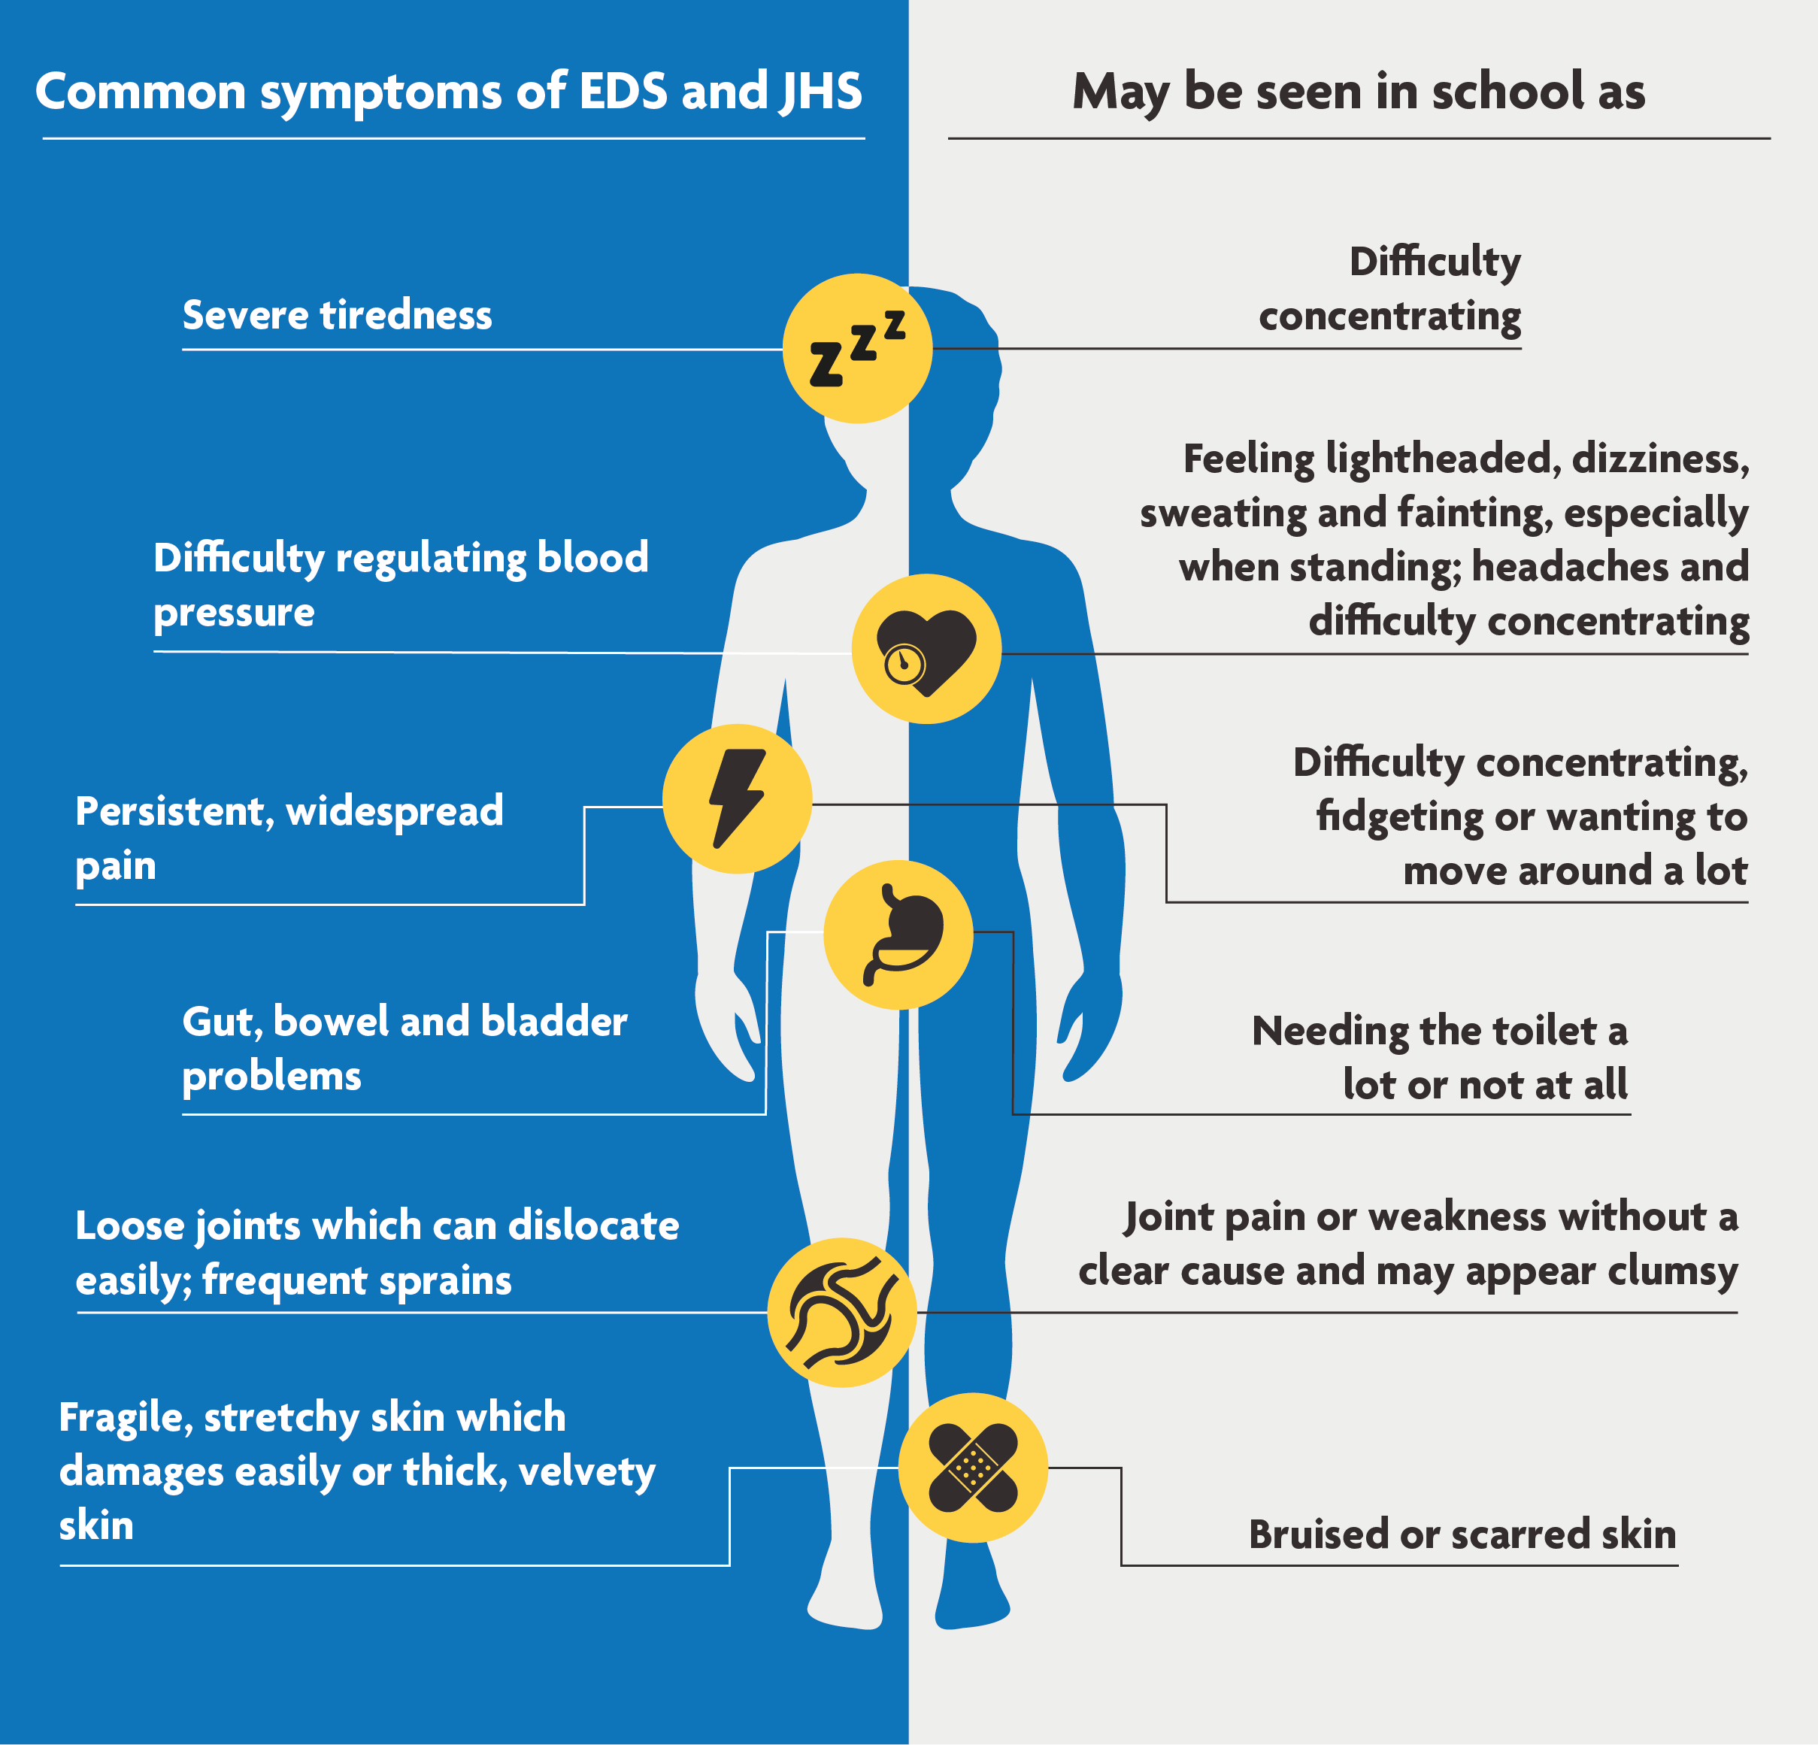

Slide 24
Webinar tomorrow
Diabetes Update with Dr. Drew Alexander and Dr. Gary Strokosch
Thursday March 28th, 2024 @ 11 am ET, 10 am CT, 9 am MT, 8 am PT
The webinar is listed in the Upcoming Sessions tab on WebEx
at https://jobcorps.webex.com and is open for registration.
All center clinicians are encouraged to attend.

Slide 25
Open Forum
https://www.surveymonkey.com/r/9B3WZZM

Slide 26
Job Corps Center Physician Monthly Teleconference Next call: Wednesday, April 24th, 2024
John Kulig MD MPH Region 1 Boston & Region 2 Philadelphia
Gary Strokosch MD Region 3 Atlanta & Region 5 Chicago
Drew Alexander MD Region 4 Dallas
Sara Mackenzie MD MPH Region 6 San Francisco
HIPAA compliant messages => use @jobcorps.org email address
https://www.surveymonkey.com/r/9B3WZZM

