Slide 1
Job Corps Center Physician Monthly Teleconference
Wednesday, May 29th, 2024

Slide 2
Sara Mackenzie, MD, MPH
May 29, 2024

Slide 3
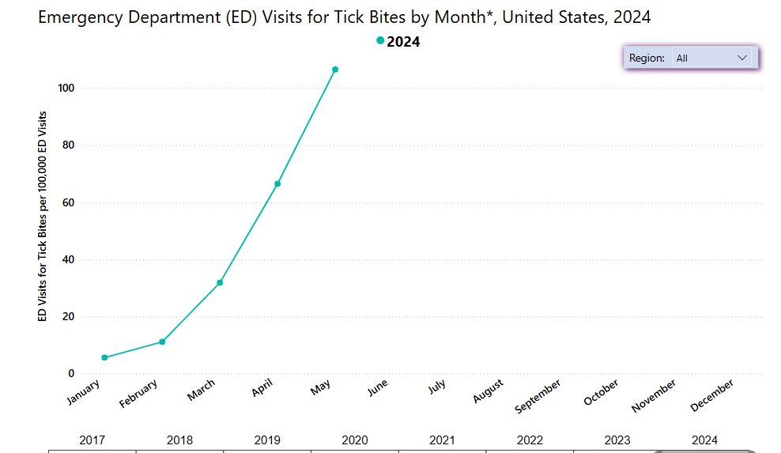
CDC Dashboard ED Visits for Tick Bites :
Tickborne Disease Surveillance Data Summary | Ticks | CDC
Notes:
Pce95hc.G-C:Kyq

Slide 4
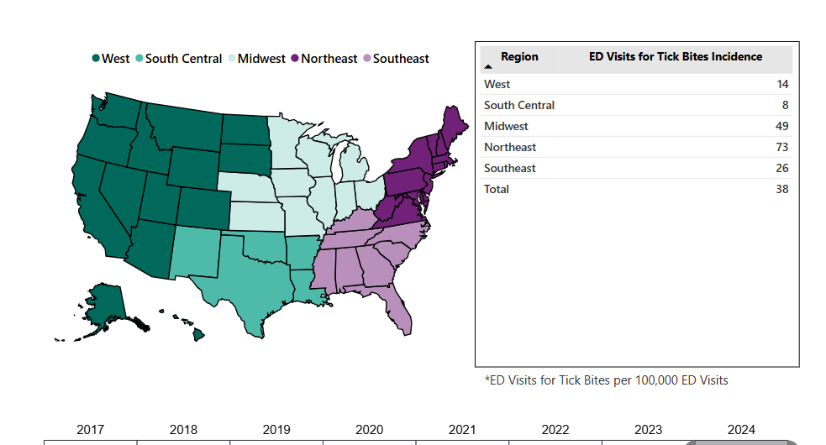
CDC Dashboard ED Visits for Tick Bites :

Slide 5
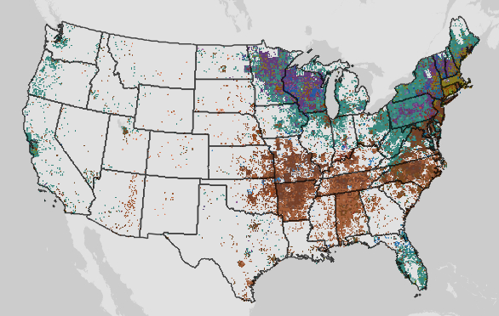
CDC Dashboard Reported Cases Tickborne Disease:

Slide 6
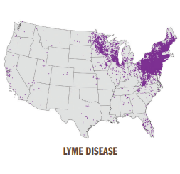
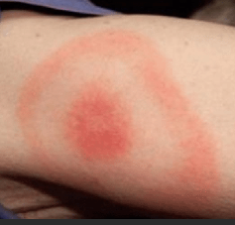
Borrelioses (Lyme Disease):
Incubation: 3-30 days
Erythema migrans – 70-80% have
Fever, chills, malaise, fatigue, headache, myalgia, arthralgia, lymphadenopathy
Neurologic – neuritis, meningitis,
Carditis with conduction abn.
Arthritis- transient, migratory,
Tickborne Diseases of the United States | Ticks | CDC

Slide 7
Borrelioses (Lyme Disease):
Laboratory: elevated ESR, mild elevated LFTs, microscopic hematuria/proteinuria
Two-step serologic test
Treatment
If EM rash and in area with Lyme – treat empirically
Doxycycline or amoxicillin or cefuroxime
Tickborne Diseases of the United States | Ticks | CDC

Slide 8
Tickborne Relapsing Fevers (Borrelia):
Borrelia hermsii, B. turicatae: Western mountainous states & Texas
Borrelia miyamotoi: upper Midwest, northeastern and mid-Atlantic states; Pacific coastal; most common July and August
Incubation: 4-21 days
Recurrent febrile episodes lasting ~3 days and separated by afebrile periods ~7 days
High fever, chills/rigor, sweats, headache, myalgia, arthralgia, dizziness, nausea/vomiting, facial palsy (rare)

Slide 9
Tickborne Relapsing Fevers (Borrelia hermsii, B. turicatae):
Lab:
leukocytosis, thrombocytopenia, mild hyperbilirubinemia, increased ESR, prolonged PT/PTT
Spirochetes on peripheral blood during febrile episode
Molecular PCR or serology
Treatment:
Doxycycline, azithromycin, Penicillin G IV, ceftriaxone
Monitor for first 4 hours of treatment for Jarisch-Herxheimer reaction

Slide 10
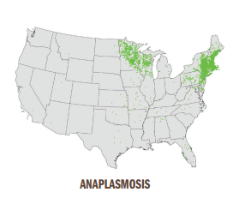
Rickettsioses- Anaplasmosis:
Incubation: 5-14 days
Fever, chills, rigors, severe headache, malaise, myalgia, GI symptoms, rash (<10%)
Lab:
Mild anemia, thrombocytopenia, leukopenia, mild/mod increase LFTs
DNA PCR whole blood first week
Increase in IgG-specific Ab paired samples

Slide 11
Rickettsioses- Anaplasmosis:
Severe and life-threatening disease not as common as with RMSF & Ehrlichiosis but do not delay treatment if suspect
Treatment:
Docycycline 100 mg BID oral or IV for 10-14 days

Slide 12
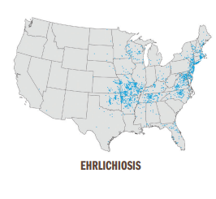
Rickettsioses- Ehrlichiosis:
Incubation: 5-14 days
Fever, chills, headache, malaise, muscle pain, GI symptoms, altered mental status, rash (more common in children)
Lab:
Thrombocytopenia, leukopenia, anemia, mild/mod increase LFTs
DNA PCR whole blood
IgG Ab increase paired serology

Slide 13
Rickettsioses- Ehrlichiosis:
Confirmation based on lab testing but do not delay if suggestive clinical presentation.
Treatment:
Docycycline 100 mg BID oral or IV for at least 3 days after fever subsides and evidence improvement; minimum 5-7 days

Slide 14
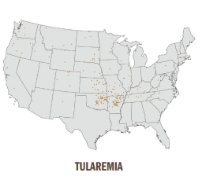
Tularemia- Francisella tularensis:
Spread by infected arthropods (deer flies, ticks), contact with infected carcasses or animals (rabbits, hares, rodents), contaminated food or inhalation of aerosols
Incubation 3-5 days
Route influences symptoms: fever, chills, headache, malaise, fatigue, anorexia, cough, sore throat, lymphadenopathy, skin ulcerations, eye symptoms, …

Slide 15
Tularemia- Francisella tularensis:
Laboratory:
Hyponatremia, leukocytosis, thrombocytopenia, increase LFTs, increase creatinine kinase, Increase ESR, myoglobinuria, sterile pyuria
Seroconversion IgM or IgG; DFA, PCR
*notify lab if suspect
Treatment:
Gentamicin, ciprofloxacin, doxycycline
Prophylaxis for laboratory exposure

Slide 16
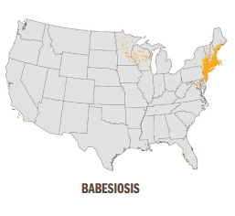
Babesiosis (parasitic):
1-4 weeks
Fever, chills, sweats, malaise, fatigue, myalgia, arthralgia, headache, GI, dark urine, less common: cough, sore throat, photophobia, conjunctival injection; mild splenomegaly,
Severe cases: thrombocytopenia, DIC, ARDS, organ failure, death

Slide 17
Babesiosis (parasitic):
Laboratory:
Hemolytic anemia, thrombocytopenia, elev CK, BUN, LFTs, proteinuria
Intraerythrocytic Babesia parasites on peripheral smear
PCR or IgG
Treatment:
Azithromycin & atovaquone

Slide 18
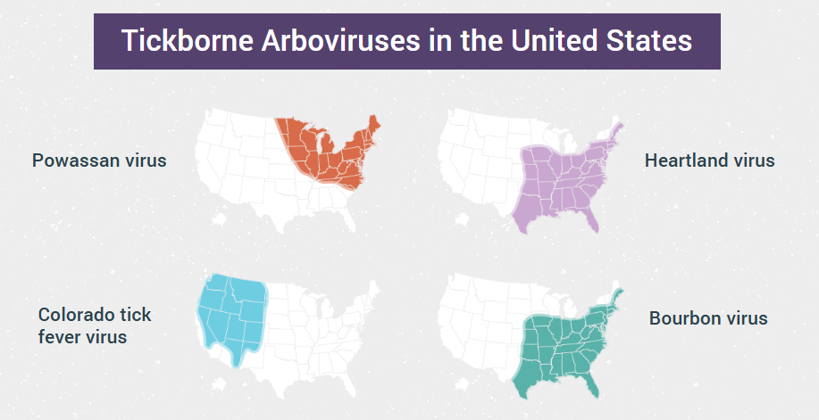
Tickborne Arboviruses in the U.S.:
Notes:
Powassan virus- no human diseases in U.S. reported; Ixodes Scapularis tick
Colorado tick fever virus- endemic in areas at 4,000-10,000 feet – Dermacentor andersoni tick
Heart land Virus – amblyomma Americanum (lone star tick); 1st human case 2009 in Missouri, over 50 cases since
Bourbon virus- lone star tick; 1st case in 2014 in patient with history of tick bite; limited number of cases since

Slide 19
Tickborne Arboviruses in the U.S.:
Home - CDC TRAIN - an affiliate of the TRAIN Learning Network powered by the Public Health Foundation
Notes:
Powassan virus- no human diseases in U.S. reported; Ixodes Scapularis tick
Colorado tick fever virus- endemic in areas at 4,000-10,000 feet – Dermacentor andersoni tick
Heart land Virus – amblyomma Americanum (lone star tick); 1st human case 2009 in Missouri, over 50 cases since
Bourbon virus- lone star tick; 1st case in 2014 in patient with history of tick bite; limited number of cases since

Slide 20
Powassan Viral Disease:
May-November (but highest cases May and June)
Rare but cases have increased in U.S.
Incubation: 1-4 weeks after tick bite
Signs/symptoms: mild, nonspecific febrile illness to severe neuroinvasive disease (meningitis, encephalitis)
Complications: obstructive hydrocephalus, intraparenchymal hemorrhage, death;
50% with neuroinvasive have long lasting symptoms
Tickborne Diseases of the United States | Ticks | CDC

Slide 21
Powassan Viral Disease:
Acute febrile or neurologic illness
Recent exposure to ticks in endemic area
Differential: west nile, st louis encephalitis, Eastern equine encephalitis, herpes virus, & tickborne bacterial diseases (Lymes, anaplasmosis, ehrlichiosis and Rocky Mountain spotted fever)

Slide 22
Colorado Tick Fever:
March – July
Incubation: 3-4 days but can range 1-14 days
Symptoms: fever, chills, headache, myalgias; can have photophobia, stiff neck, rash, vomiting
CBC shows leukopenia & thrombocytopenia
50% have biphasic- initial fever, improvement then recurrence
Self-limiting; severe disease and complications – neuroinvasive disease, hepatitis, pericarditis, epididymo-orchitis and death are rare

Slide 23
Colorado Tick Fever:
Acute febrile illness (especially if biphasic)
Reportable in 9 western states
Recent exposure to ticks in endemic area
Differential: tick-borne relapsing, Rocky Mountain Spotted Fever, Tularemia, (doxycycline for bacterial and rickettsial diseases)

Slide 24
Heartland Virus:
Fever, fatigue, anorexia, nausea, diarrhea, myalgias and arthralgias
Leukopenia and thrombocytopenia common
Almost all patients hospitalized
Severe complications: hemophagocytic lympohistiocytosis (HLH); death in immunocompromised has occurred.

Slide 25
Heartland Virus:
Consider if recent exposure ticks in endemic area
Leukopenia
Thrombocytopenia
No response to doxycycline

Slide 26
Bourbon Viral Disease:
Fever, fatigue, rash, headache, myalgias, nausea and vomiting
Leukopenia and thrombocytopenia
Few cases identified; 2 cases developed multiorgan failure and died;

Slide 27
Bourbon Viral Disease:
Suspect if in area endemic to Heartland and Bourbon virus
Leukopenia
Thrombocytopenia
No clinical response to doxycycline

Slide 28
Consider Tickborne Disease if:
Symptoms
Geographic area or travel
Activities that may place at risk for tick bite or known tick bite
Diagnostic testing:
State or local health department can help with determining testing

Slide 29
Prevention of Tickborne Disease:
No vaccines to prevent viral diseases
No antiviral medicines to treat
Antibiotics (primarily doxycycline) for bacterial
Prevent tick bites!
EPA-registered insect repellants
DEET Oil of lemon eucalyptus
Picaridin Par-menthane-diol
IR3535 2-undecanone
Avoid brushy or wooded areas, walk in center of trails

Slide 30
Prevention of Tickborne Disease:
Can transmit viral infections within 15 minutes of attachment (bacterial can take longer for transmission)
Remove before they attach!
Full body check after returning indoors
Scalp, ears, under arms, belly button, around waist, between legs, back of knees
Check pets and tick prevention products for pets
Remove attached tick asap; grasp close to skin surface, pull upward, thoroughly clean bite area

Slide 31
John Kulig, MD, MPH
May 29, 2024

Slide 32
Clinical presentation of tuberculosis (TB)
Gradual onset of systemic symptoms are common to TB in any part of the body:
Fever
Night sweats
Weight loss
Loss of appetite
Sense of illness or loss of energy
Most cases of TB disease are pulmonary. Symptoms of pulmonary disease include:
Cough (especially lasting for 3 weeks or longer)
Coughing up sputum or blood (hemoptysis)
Chest pain
Shortness of breath
https://www.cdc.gov/tb/hcp/clinical-signs-and-symptoms/index.html

Slide 33
Tuberculin testing
Two tests are used to determine if a person has been infected with TB bacteria:
TB blood tests (Interferon Gamma Release Assay [IGRA])
TB skin test (Mantoux tuberculin skin test) – 5 tuberculin units – not 1 or 250 units
TB blood tests or skin tests should not be performed on people who have written documentation of a previous positive TB test results (TB blood test or TB skin test) or treatment for TB disease. Most people who have a positive TB test result will continue to have a positive test result.
TB blood tests are the preferred test for people who have received the TB vaccine (also known as Bacille Calmette-Guérin or BCG).
TB skin tests are contraindicated only for people who have had a severe reaction (e.g. necrosis, blistering, anaphylactic shock, or ulcerations to a previous TB skin test).
https://www.cdc.gov/tb/hcp/testing-diagnosis/interferon-gamma-release-assay.html
https://www.cdc.gov/tb/hcp/testing-diagnosis/tuberculin-skin-test.html

Slide 34
Tuberculin testing
prior treated TB – obtain medical records
prior positive TB skin test - obtain medical records
TB skin test severe reaction in the past – obtain blood for IGRA testing
prior BCG vaccine - obtain blood for IGRA testing
needle phobia – offer EMLA cream or equivalent
chest x-ray is indicated for pulmonary symptoms, current positive skin test or IGRA blood test, or history of prior TB infection, but will not detect latent tuberculosis

Slide 35
Disease of the month - Case presentation
A 15 year-old female is seen in an urban hospital’s Emergency Department with complaints of headache, “feeling wierd and lightheaded” and “losing track of time.” Symptoms occurred several times in the past two weeks, always lasting several hours. She was recently treated with penicillin for pharyngitis. Neurologic exam is normal.

Slide 36
Clinical features of EBV infection/mononucleosis
symptoms:
sore throat, malaise, headache,
anorexia, myalgia, fatigue
signs:
fever, lymphadenopathy,
pharyngitis, splenomegaly,
periorbital edema, rash

Slide 38
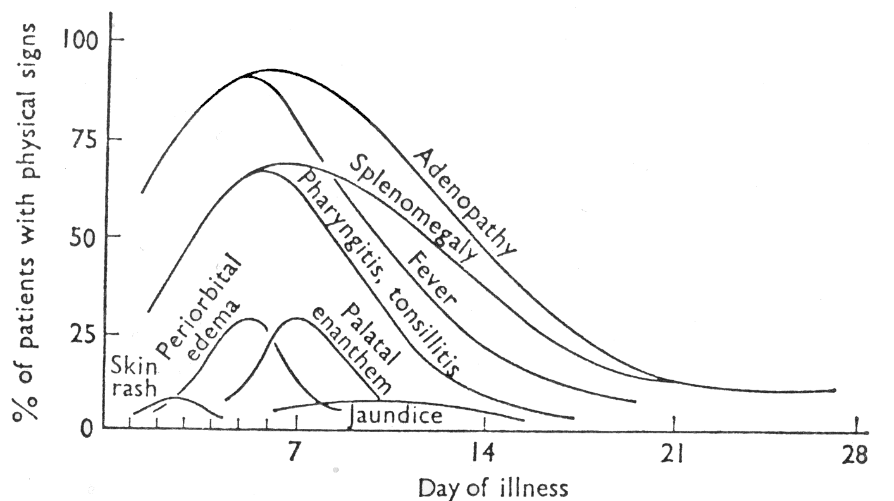

Slide 39
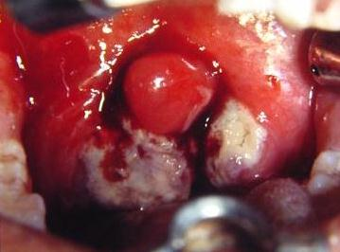

Slide 40
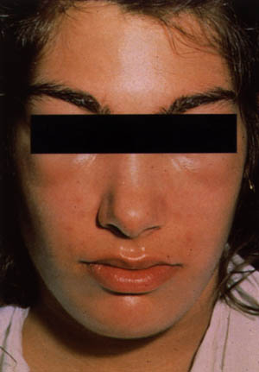

Slide 41
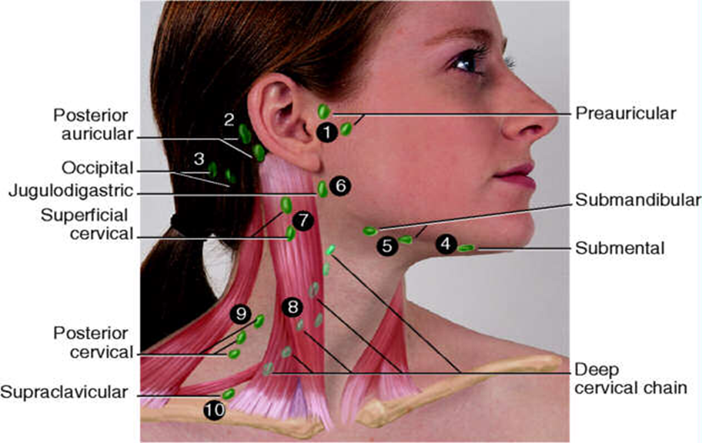

Slide 42
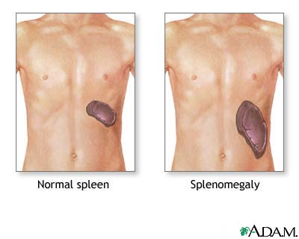

Slide 43
Diagnostic studies in mononucleosis
CBC with lymphocytosis and > 10% atypical lymphs
75% sensitivity – 92% specificity
Monospot test for heterophile antibodies
85% sensitivity – 94% specificity
25% negative in first week of infection
5% -10% negative in second week of infection
antibodies persist for one year or longer
aminotransferase levels elevated in older children and adults

Slide 44
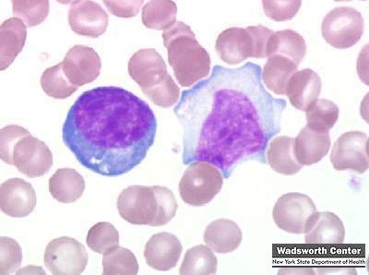

Slide 45
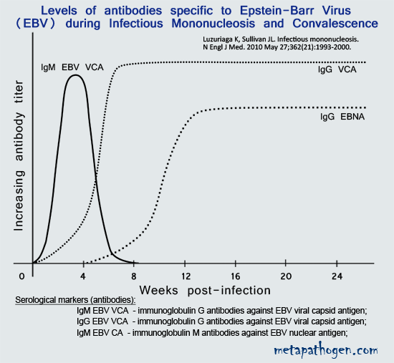

Slide 46
Complications of Epstein-Barr Virus infection
dermatologic
urologic
rheumatologic
infectious
ophthalmologic
neurologic
psychiatric
splenic
respiratory
cardiac
gastrointestinal
hepatic
renal
hematologic

Slide 47
Neurologic complications of EBV infection
Guillain-Barre syndrome
meningoencephalitis
cranial nerve palsy
optic neuritis
peripheral neuropathy
cerebellar ataxia
transverse myelitis
metamorphopsia (Alice in Wonderland)

Slide 48
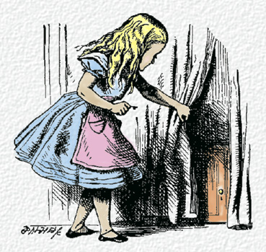

Slide 49
Treatment of mononucleosis
acyclovir has no effect on the duration or severity of clinical symptoms
insufficient evidence of a clinically relevant benefit to recommend routine use of corticosteroids
clinical experience supports corticosteroid use for severe complications, including upper airway obstruction, hemolytic anemia and thrombocytopenia

Slide 50
Treatment Guidelines: Mononucleosis
Authorized health and wellness staff may treat infectious mononucleosis as follows:
All students with a diagnosis of acute mononucleosis should be referred to the center physician for evaluation and development of a management plan. MSWR can be discussed at that time.
Screen the student for simultaneous streptococcal throat infection.
Advise the student to avoid sharing drinks, utensils, or toiletries, and to avoid exchange of bodily fluids (e.g., no kissing and no unprotected sexual behavior).
Avoid contact sports and heavy exertion for 6-8 weeks after onset of infection, until cleared by the center physician with resolution of splenomegaly.
Note: Steroids are useful in patients with complications as determined by the center physician; antiviral medications have no proven benefit.

Slide 51
Treatment Guidelines: Mononucleosis
WHEN TO REFER TO THE CENTER PHYSICIAN
If the student has difficulty breathing
If the student cannot swallow and maintain adequate
hydration
If the student’s symptoms (malaise, fatigue) worsen, and
the student is unable to attend class

Slide 52
Open Forum
https://www.surveymonkey.com/r/PM8HSJM

Slide 53
Regional Medical Specialists Contact us with policy or clinical questions
John Kulig MD MPH Region 1 Boston & Region 2 Philadelphia
Gary Strokosch MD Region 3 Atlanta & Region 5 Chicago
Drew Alexander MD Region 4 Dallas
Sara Mackenzie MD MPH Region 6 San Francisco
HIPAA compliant messages => use @jobcorps.org email address
https://www.surveymonkey.com/r/PM8HSJM

Slide 54
Monthly Teleconference
Next call: Wednesday, June 26th, 2024
Center Physician Call - June 2024 June 26, 2024, 2:00 – 3:00 PM (America/New_York) Please join my meeting from your computer, tablet or smartphone. https://meet.goto.com/604629957 You can also dial in using your phone. Access Code: 604-629-957 United States: +1 (224) 501-3412 Get the app now and be ready when your first meeting starts: https://meet.goto.com/install

