Slide 1
Job Corps Center Physician Monthly Teleconference
Wednesday, December 4th, 2024

Slide 2
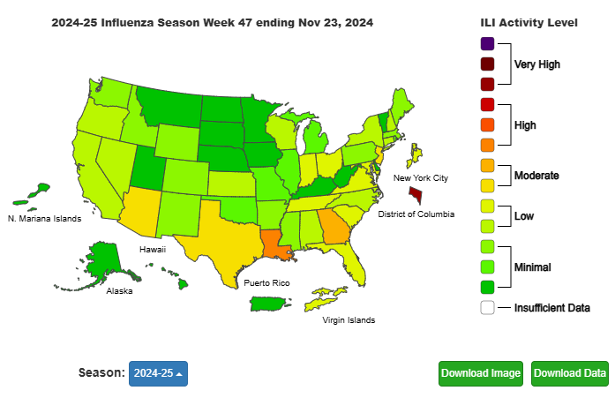

Slide 3
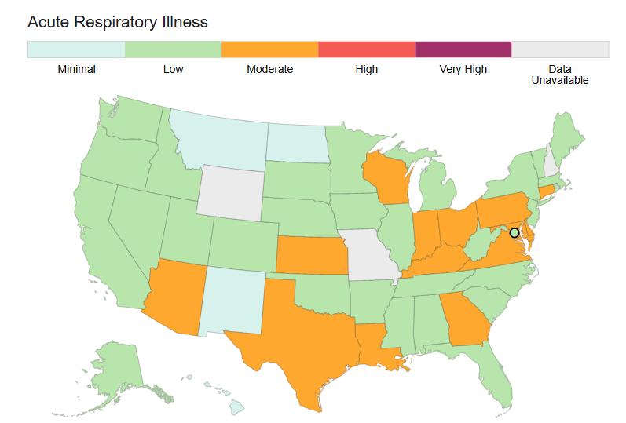

Slide 4
Early winter update
CDCs new “acute respiratory illness” metric replaces “influenza-like illness” from emergency room (ER) data
Flu season off to a slow start – hospitalizations 5X lower - ER visits for children with flu less than a third of this time last year
COVID-19 ER visits are low or minimal in nearly all states – virus in wastewater minimal
“Walking pneumonia” due to Mycoplasma increasing in children
Pertussis (“whooping cough”) cases reported weekly now exceeding the peaks from the 2014 wave CBS News

Slide 6
Measles outbreaks
Total U.S. Cases as of November 21, 2024
280
Age Under 5 years: 116 (41%) 5-19 years: 87 (31%) 20+ years: 77 (28%)
Vaccination Status Unvaccinated or Unknown: 89% One MMR dose: 7% Two MMR doses: 4%

Slide 7
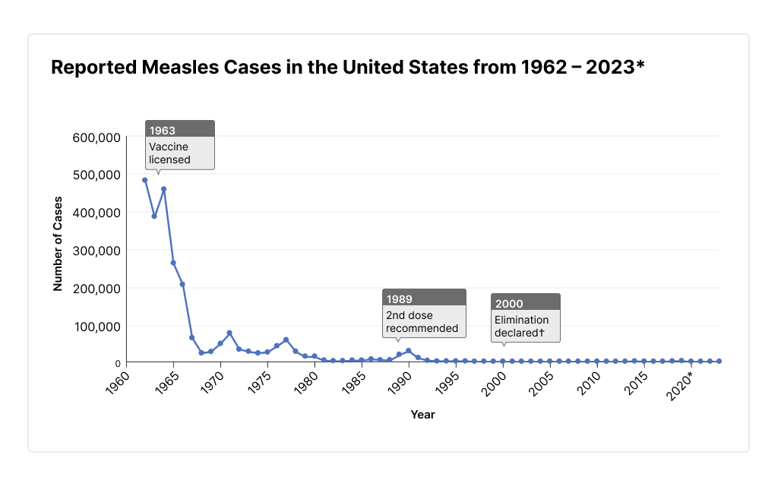

Slide 8
Screening for hepatitis C infection in Job Corps
No change in policy – no universal screening – offer screening or testing for clinical indications only.
During acute HCV infection, antibody becomes detectable at 8–11 weeks.
HCV RNA testing is recommended for the diagnosis of current HCV infection among people who might have been exposed to HCV within the past 6 months, regardless of HCV antibody result. HCV RNA becomes detectable approximately 1 – 2 weeks after infection with HCV.
Both laboratory and POC tests for HCV antibody and HCV RNA are currently available. CDC

Slide 9
Indications to screen for hepatitis C infection
People who currently or have previously injected drugs and shared needles, syringes, or other drug preparation equipment.
People with human immunodeficiency virus (HIV) infection.
People with selected medical conditions, including people who have ever received maintenance hemodialysis and persons with persistently abnormal alanine aminotransferase (ALT) levels.
Health care, emergency medical, and public safety personnel after needle sticks, sharps, or mucosal exposures to HCV-positive blood.
Infants born to people with known hepatitis C.
CDC

Slide 10
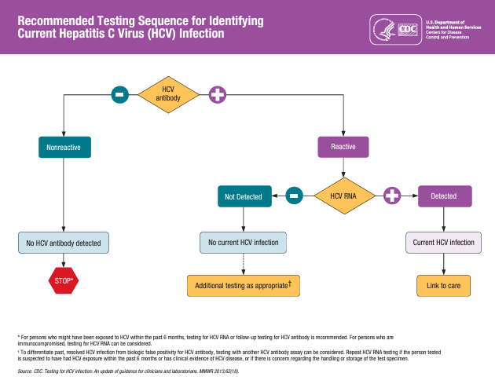

Slide 11
Case presentation
A 20 year-old male presents with two days of epigastric pain, nausea and vomiting, including two episodes of coffee ground emesis. He reports symptom relief with compulsive hot water showering several times a day. He denies fever, diarrhea, melena, hematochezia, constipation, dysuria or sick contacts. Physical examination is remarkable only for mild epigastric tenderness. A similar episode 4 months earlier led to an extensive gastroenterological evaluation, including a non-diagnostic esophagogastroduodenoscopy (EGD).

Slide 12
Cannabinoid Hyperemesis Syndrome
Diagnosis proposed after case series of patients in
Australia in 2004 who were observed to have:
“cyclic episodes of nausea, vomiting, and
abdominal pain in the setting of long term
cannabis use.”
“improvement of symptoms with hot showers and
symptom resolution with cannabis cessation”

Slide 13
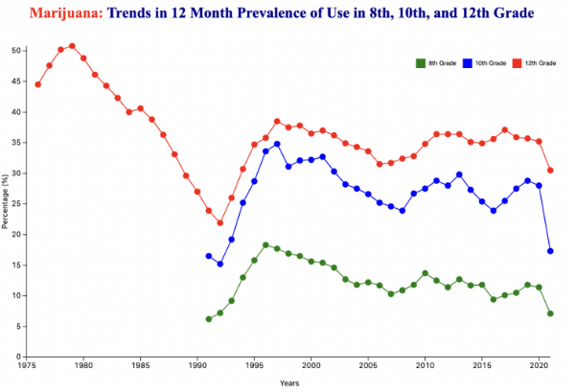
MTF

Slide 14
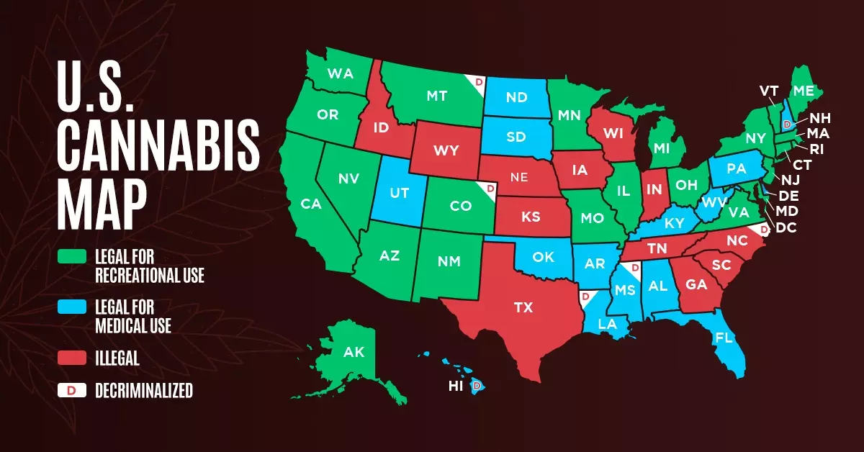

Slide 15
Mayo Clinic case series
Emesis – 100%
morning 71%
after meals 21%
during defecation 8%
Abdominal pain – 86%
Location
epigastric - 61%
periumbilical - 23%
diffuse - 5%
Character
burning - 27%
crampy - 29%
sharp - 23%
Bowel habits
normal - 67%
diarrhea - 23%
constipation - 7%
diarrhea and constipation - 2%
Relief with hot showers – 91%
Other symptoms
diaphoresis - 20%
bloating - 6%
flushing - 5%
chills - 2%
Frequency of use
most reported daily
several reported weekly
Duration of use
4 months to 27 years
32% under 12 months

Slide 16
“Scromiting” = Screaming plus vomiting

Slide 17
Proposed mechanism
Pathophysiology hypotheses:
long term alterations of hypothalamic-pituitary-adrenal (HPA) axis
autonomic instability
CB1 receptors may be involved in hypothermic effects of cannabis
impairment of physiologic thermoregulation
CB1 receptors on enteric nerves may slow gastric transit time
not supported by large case-series with normal or rapid gastric emptying times

Slide 18
Proposed diagnostic criteria
Essential for diagnosis
long term cannabis use
Major features
severe, cyclic nausea and vomiting
resolution with cannabis cessation
relief with hot showers
abdominal pain (epigastric or periumbilical)
weekly use of marijuana
Supportive features
age < 50 years
weight loss > 5 kg
morning predominance of symptoms
normal bowel habits
negative lab studies, radiographs, endoscopy
Often mistaken for cyclic vomiting syndrome

Slide 19
Treatment of cannabinoid hyperemesis syndrome
symptoms typically resolve within 24-48 hours with conservative management
oral or IV volume repletion
anti-emetics as needed
all patients followed who remained abstinent from cannabis had complete resolution of symptoms

Slide 21
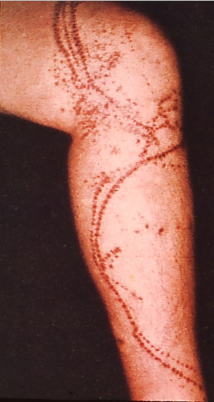
Physical diagnosis
Unknown of the month

Slide 22
Portuguese man-o-war

Slide 23
Smoking cessation
QuickStats: Percentage* of Current Cigarette Smokers† Aged ≥18 Years Who Received Advice from a Health Professional To Quit Smoking,§ by Sex and Age Group — United States, 2022
The MMWR reported that in 2022, 42.0% of current cigarette smokers aged ≥18 years received advice from a doctor, dentist, or other health professional about ways to quit smoking. The percentage of current smokers who received advice to quit smoking increased with age. Overall, and for current smokers aged 18–44 years, men were less likely to receive advice on quitting compared with women.
MMWR / June 20, 2024 / 73(24);565

Slide 24
Open Forum
https://www.surveymonkey.com/r/D8KCVC5

Slide 25
Regional Medical Specialists Contact us with policy or clinical questions
John Kulig MD MPH Region 1 Boston & Region 2 Philadelphia
Gary Strokosch MD Region 3 Atlanta & Region 5 Chicago
Drew Alexander MD Region 4 Dallas
Sara Mackenzie MD MPH Region 6 San Francisco
HIPAA compliant messages => use @jobcorps.org email address

Slide 26
Warmest wishes for a peaceful, joyous, healthy holiday season from your Humanitas Medical Specialists: Drew, Gary, John, Sara

