Slide 1
Job Corps Center Physician Monthly Teleconference
John Kulig MD MPH Region 1 Boston & Region 2 Philadelphia
Sara Mackenzie MD MPH Region 6 San Francisco
Drew Alexander MD Region 4 Dallas
Gary Strokosch MD Region 3 Atlanta & Region 5 Chicago
HIPAA compliant messages use @jobcorps.org email address
Wednesday, November 29th, 2023

Slide 2
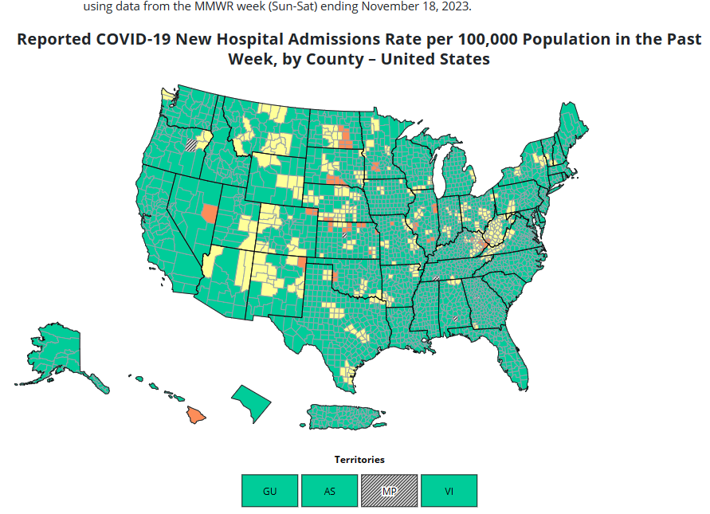
COVID-19 Hospitalization by county

Slide 3
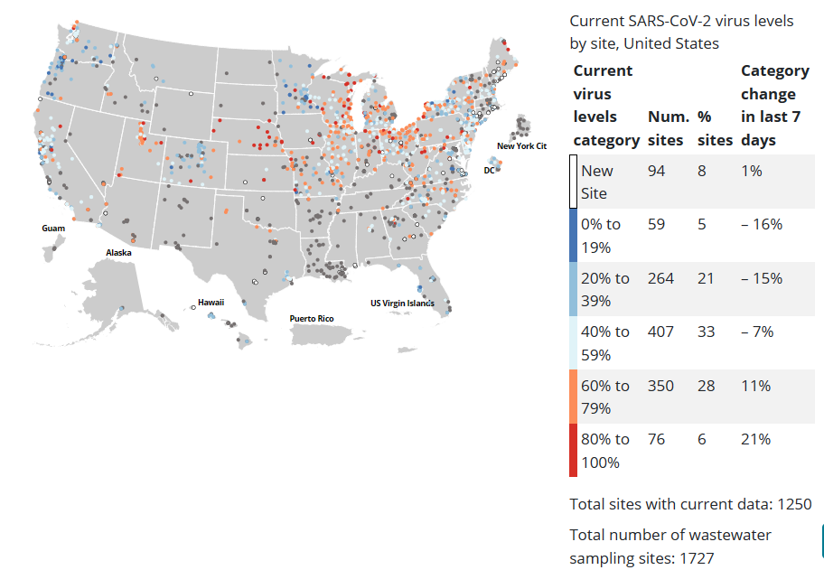
COVID-19 Wastewater surveillance map

Slide 4
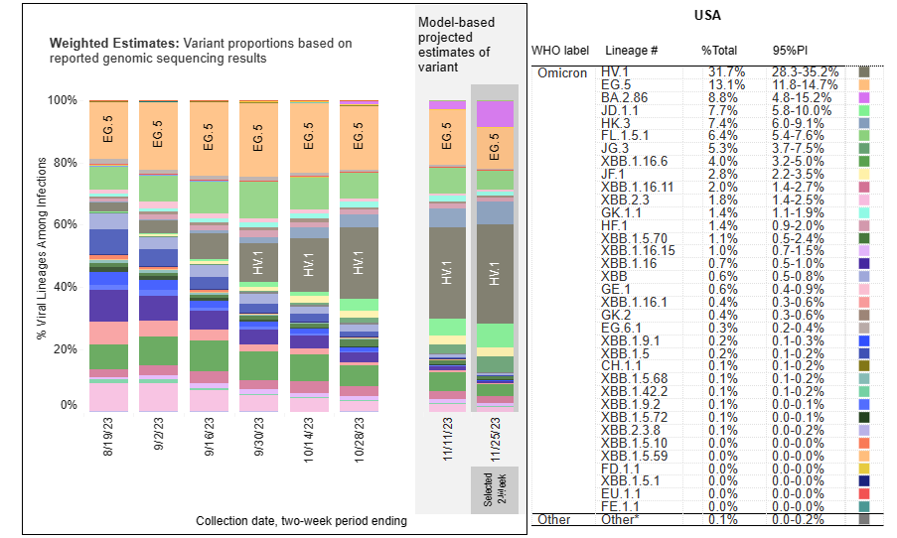
COVID-19 Variants

Slide 5
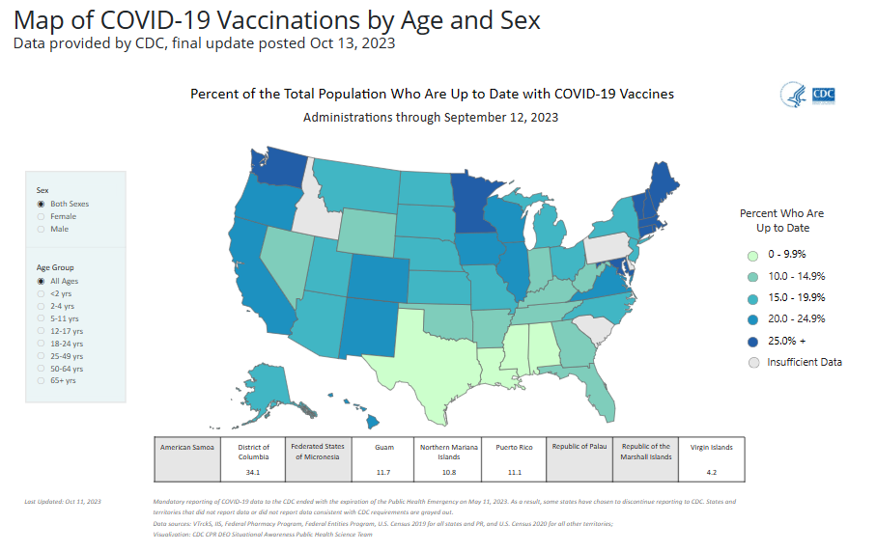
COVID-19 Vaccinations

Slide 6
Reminders
Check your Emergency Action Plans to ensure alignment
Continue to focus on maintaining full staffing
Continue to do the following:
Test for COVID-19 in students with symptoms
Isolate for 5 full days if positive, mask for 10 full days
Contact tracing – test CCEs, mask for 10 days
Consider center-wide masking if cases increasing (recommend or require)
Promote and reduce barriers to vaccination (COVID-19 and flu vaccines)

Slide 7
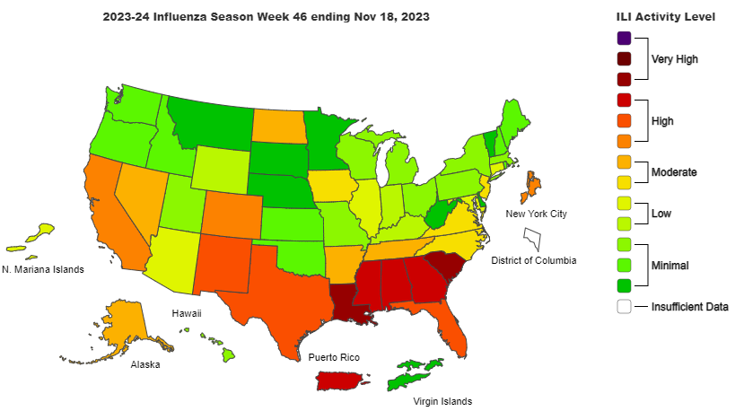

Slide 8
Influenza: Key Points
Seasonal influenza activity is increasing in most of the United States, most noticeably in the South Central, Southeast, Mountain, and West Coast regions.
Weekly flu hospital admissions continue to increase, and CDC estimates that there have been at least 1.2 million illnesses, 12,000 hospitalizations, and 740 deaths from flu so far this season.
About 80 percent of influenza viruses tested in public health laboratories and reported to CDC this season have been influenza A viruses and 20 percent have been influenza B viruses.
Flu vaccination coverage is lower among children and adults this year compared to the same time last year. About one-third of Americans report having gotten flu vaccine so far this season.
Adult flu vaccine coverage in the United States has hovered at around 50 percent of the population for years.

Slide 9
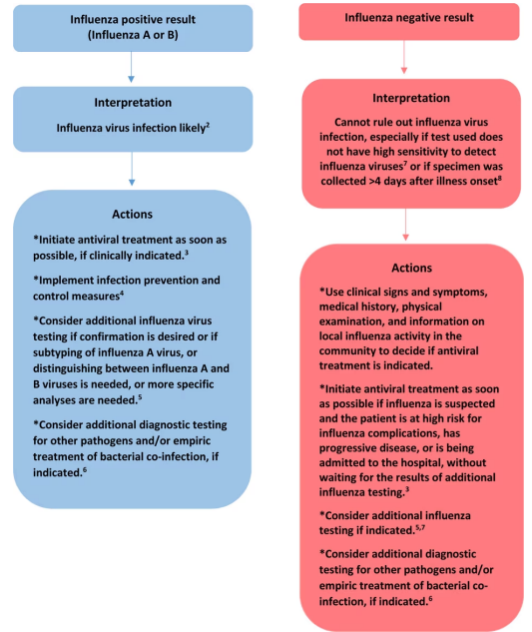
Algorithm to assist in the interpretation of influenza testing results and clinical decision-making
during periods when influenza viruses are circulating in the community
https://www.cdc.gov/flu/professionals/diagnosis/algorithm-results-not-circulating.htm

Slide 11
New Pentavalent Meningococcal Vaccine
PenbrayaTM is manufactured by Pfizer and combines the components from two existing meningococcal vaccines, Trumenba group B vaccine and Nimenrix groups A, C, W-135, and Y conjugate vaccine.
Indicated for active immunization to prevent invasive disease caused by Neisseria meningitidis serogroups A, B, C, W, and Y.
Approved for use in individuals 10 through 25 years of age.
Administered as a two-dose series given six months apart.
FDA approval on October 20, 2023 – expected availability early in 2024.

Slide 12
Nicotine replacement therapy (NRT)
NRT is indicated for students with physiologic dependence on nicotine, generally defined as smoking 10 cigarettes (1/2 pack) or more daily.
Quantifying the nicotine content of vaping vs smoking is imprecise, so questions assessing the likelihood of nicotine dependence may be useful in determining the need for NRT.
The Fagerstrom Test for Nicotine Dependence can be used to quantify the degree of dependence.
Although students ages 16 to 21 years, depending upon state law, may be prohibited from purchasing or possessing tobacco products, a clinician may prescribe NRT to students of any age.

Slide 13
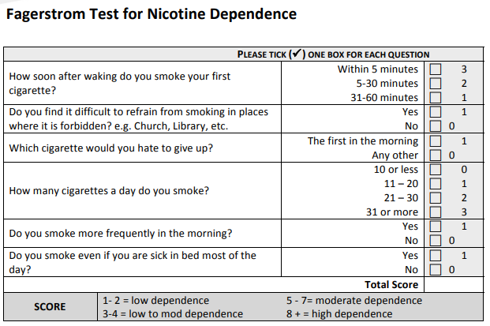

Slide 14
Alpha-gal syndrome (AGS)
Alpha-gal syndrome (AGS) is a serious, potentially life-threatening allergic condition. AGS is also called alpha-gal allergy, red meat allergy, or tick bite meat allergy.
Alpha-gal (galactose-α-1,3-galactose) is a sugar molecule found in most mammals.
Alpha-gal can be found in meat (pork, beef, rabbit, lamb, venison, etc.) and products made from mammals (including gelatin, cow’s milk, and milk products).
Alpha-gal is not found in fish, reptiles, birds, or people.

Slide 15
Alpha-gal syndrome
AGS is primarily associated with the bite of a Lone Star tick in the United States, but other kinds of ticks have not been ruled out.
A small percentage of the people who have been bitten by a Lone Star tick can develop the allergy. Both adults and children are susceptible.
Lone Star ticks do not transmit Lyme disease but can spread human Ehrlichiosis and tularemia.
Lone Star ticks are aggressive insects. Adult females typically have a white dot or “lone star” on the back.

Slide 16
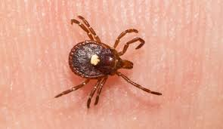
Distribution of the Lone Star Tick

Slide 17
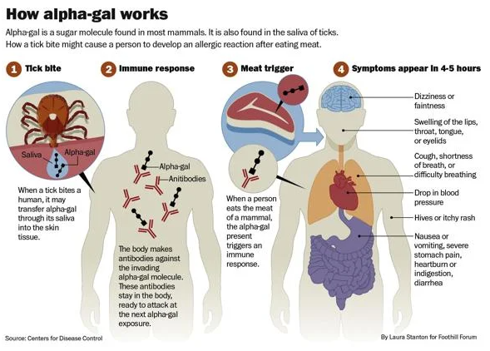

Slide 18
Symptoms of AGS
Hives or itchy rash
Nausea or vomiting
Heartburn or indigestion
Diarrhea
Cough, shortness of breath, or difficulty breathing
Drop in blood pressure
Swelling of the lips, throat, tongue, or eye lids
Dizziness or faintness
Severe stomach pain
Onset 2-6 hours after eating meat, dairy products, or gelatin
Reactions can range from mild to severe or even life-threatening anaphylaxis

Slide 19
Alpha-gal syndrome management
Referral to an allergist
Blood test for specific IgE antibodies to alpha-gal
Allergy skin testing
Stop eating mammalian meat (such as beef, pork, lamb, venison, rabbit, etc.)
Consider avoiding other foods such as cow’s milk, milk-products, and gelatin
Read food product labels carefully
Avoid tick bites – may reactivate allergic reactions
Carry an EpiPen or equivalent
Levels of IgE antibodies against alpha-gal decrease over time

Slide 20
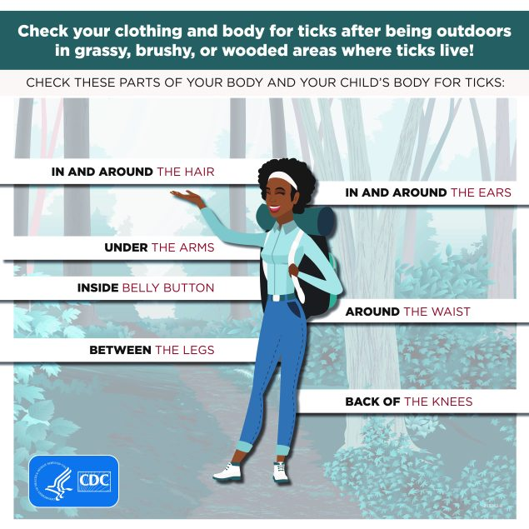

Slide 21
Syndrome of the Month
Review of common findings on physical examination suggestive of a specific syndrome that may first be suspected in the Job Corps age population
Presentation of diagnostic criteria commonly used to support the diagnosis
Indications for syndrome-specific evaluation
Indications for subspecialty referral(s), if any
Implications for career choice, if any

Slide 22
Fetal Alcohol Spectrum Disorders (FASDs)
Fetal alcohol spectrum disorders (FASDs) are a group of conditions that can occur in a person who was exposed to alcohol before birth:
Fetal Alcohol Syndrome (FAS): FAS represents the most involved end of the FASD spectrum. People with FAS have central nervous system (CNS) problems, minor facial features, and growth problems. People with FAS can have problems with learning, memory, attention span, communication, vision, or hearing.
Alcohol-Related Neurodevelopmental Disorder (ARND): People with ARND might have intellectual disabilities and problems with behavior and learning.
Alcohol-Related Birth Defects (ARBD): People with ARBD might have problems with the heart, kidneys, or bones or with hearing.
Neurobehavioral Disorder Associated with Prenatal Alcohol Exposure (ND-PAE): ND-PAE was first included as a recognized condition in the Diagnostic and Statistical Manual 5 (DSM 5) of the American Psychiatric Association (APA) in 2013. Youth with ND-PAE will have problems in three areas: (1) thinking and memory, (2) behavior problems, and (3) trouble with activities of daily living.
https://www.cdc.gov/ncbddd/fasd/facts.html

Slide 23
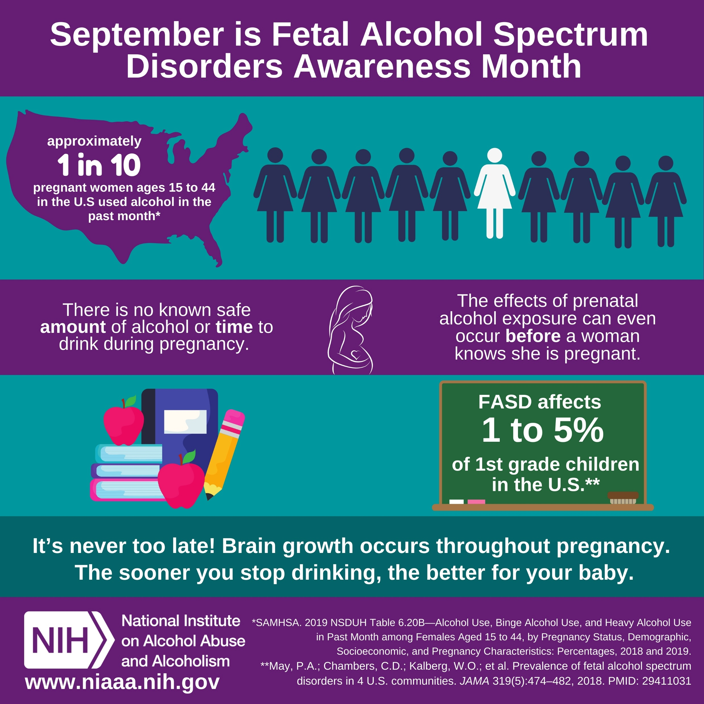

Slide 24
Signs and symptoms
Low body weight
Poor coordination
Hyperactive behavior
Difficulty with attention
Poor memory
Difficulty in school (especially
with math)
Learning disabilities
Speech and language delays
Intellectual disability or low IQ
Poor reasoning and judgment skills
Sleep and sucking problems as a baby
Vision or hearing problems
Problems with the heart, kidneys, or bones
Shorter-than-average height
Small head size
Abnormal facial features, such as a smooth ridge between the nose and upper lip (philtrum)

Slide 25
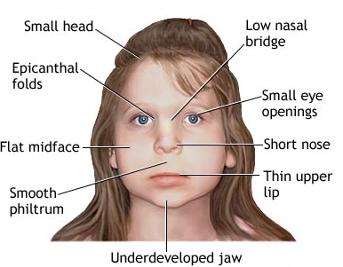
Distinctive facial features

Slide 26
Alcohol-related birth defects
Malformations and dysplasias of the heart, bone, kidney, vision, or hearing:
Short stature
Microcephaly
Congenital heart defects (50%): atrial or ventricular septal defects, aortic malformation, tricuspid and mitral valvular defects.
Cross-fused ectopia, renal hypoplasia and urethropelvic junction obstruction.
Renal functional abnormalities, including impairment in renal acidification, potassium excretion, and increased urinary excretion of zinc.
Lower bone mineral density and lean tissue mass than typically developing peers.

Slide 27
FAS in Adults
Short stature
Small head size
Thin upper lip
Reduced brain size
Problems with attention
and concentrating
Learning and memory problems
Difficulty processing emotions
Aggression and irritability
Depression
Psychosis
Anxiety
Bipolar disorder

Slide 28
Life expectancy
Canadian study in Alberta province (2003-2012):
Life expectancy at birth of people with FAS was 34 years (95% confidence interval: 31 to 37 years), which was about 42% of that of the general population.
Leading causes of death for people with FAS were “external causes” (44%), which include suicide (15%), accidents (14%), poisoning by illegal drugs or alcohol (7%), and other external causes (7%).
Other common causes of death were diseases of the nervous and respiratory systems (8% each), diseases of the digestive system (7%), congenital malformations (7%), mental and behavioral disorders (4%), and diseases of the circulatory system (4%).
“As the cause of FAS is known and preventable, more attention devoted to the prevention of FAS is urgently needed.”
J Popul Ther Clin Pharmacol Vol 23(1):e53-e59; March 9, 2016

Slide 29
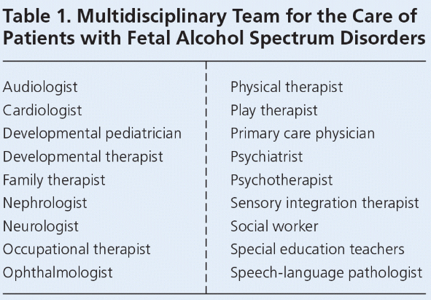

Slide 30
Open Forum
https://www.surveymonkey.com/r/9V7MR87

Slide 31
Job Corps Center Physician Monthly Teleconference Next call: Wednesday, January 24th, 2024 No December call
John Kulig MD MPH Region 1 Boston & Region 2 Philadelphia
Sara Mackenzie MD MPH Region 6 San Francisco
Drew Alexander MD Region 4 Dallas
Gary Strokosch MD Region 3 Atlanta & Region 5 Chicago
HIPAA compliant messages use @jobcorps.org email address
https://www.surveymonkey.com/r/9V7MR87

