Slide 1
Job Corps Center Physician Monthly Teleconference
John Kulig MD MPH Region 1 Boston & Region 2 Philadelphia
Sara Mackenzie MD MPH Region 6 San Francisco
Drew Alexander MD Region 4 Dallas
Gary Strokosch MD Region 3 Atlanta & Region 5 Chicago
HIPAA compliant messages use @jobcorps.org email address
Wednesday, October 25th, 2023

Slide 2
Health and Wellness Update
October 24, 2023

Slide 3
Congratulations and thank you!
Nice job to centers for implementation of the updated COVID-19 reporting requirements!
Received one SIR from center with >10% of students with confirmed COVID-19/Total OBS in past 7 days
Received totals for COVID-19 cases in staff and students and CCE counts for the past 7 days from nearly all centers

Slide 4
PIN 22-17 Updates (Errata Sheet) - Clarification
Notes:
The “may” is for isolation rooms not isolation. Confirmed covid must still isolate.

Slide 5
Frequently asked questions
Is the COVID-19 Checklist still required?
NO
Must centers still report COVID-19 Abbott ID Now Test results to MCI?
NO
However, center MUST know whether COVID-19 has been added to the state notifiable diseases list and the center MUST report to public health if COVID-19 is a notifiable disease in the state!

Slide 6
COVID-19 Antigen test supplies:
MCI will be distributing C19 Antigen Test Kits
Job Aid will be updated with the following:
“A CCE with confirmed COVID-19 within the past 90 days should be managed as follows:
30 days or less: if symptoms, test with an antigen test. If no symptoms, no action required
31-90 days: use an antigen test instead of the Abbott ID Now test at day 0 and day 6”

Slide 7
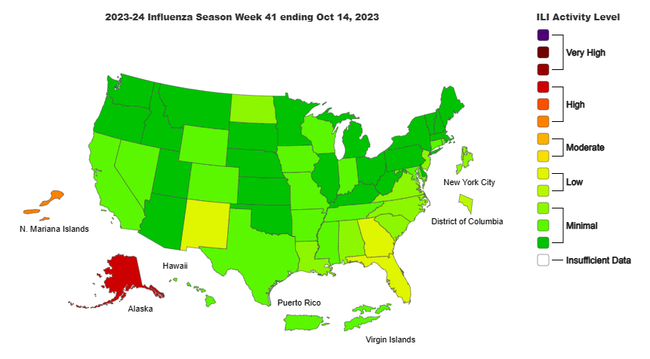

Slide 8
Influenza: Key Points
Seasonal influenza activity remains low nationally, but there are slight increases in some parts of the country.
The number of flu hospital admissions remains low.
During week 41, of the 159 viruses reported by public health laboratories, 124 (78.0%) were influenza A, and 35 (22.0%) were influenza B. Of the 99 influenza A viruses subtyped during week 41,93 (93.9%) were influenza A(H1N1), and 6 (6.1%) were A(H3N2).
CDC recommends that everyone ages 6 months and older get an annual flu vaccine, ideally by the end of October.

Slide 10
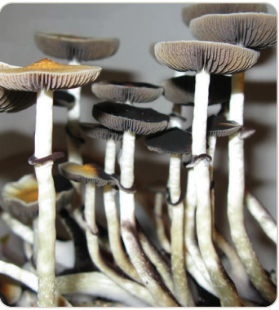
Psilocybin mushrooms
Street names: “magic mushrooms,” “shrooms”
Hallucinogen similar to LSD and PCP as well as
mescaline in peyote cactus
Oral ingestion, brewed as a tea, added to foods (chocolate) to mask bitter flavor
Physical effects, which appear within 20 minutes of ingestion and last approximately 6 hours, include nausea, vomiting, muscle weakness, drowsiness, and lack of coordination
Psychological consequences of psilocybin use include hallucinations and an inability to discern fantasy from reality. Panic reactions and psychosis can occur.
DEA

Slide 11
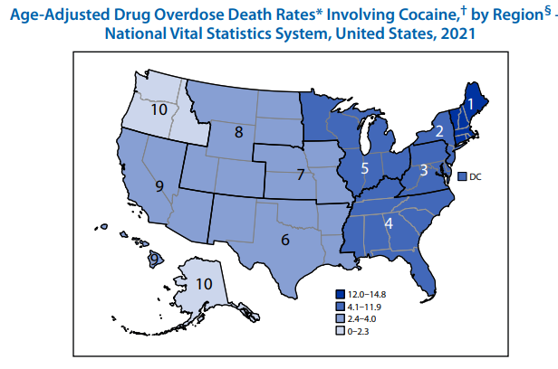
https://www.cdc.gov/nchs/nvss/deaths.htm

Slide 12
Age-Adjusted Suicide Rates, by Method of Suicide National Vital Statistics System, United States, 2001–2021
http://dx.doi.org/10.15585/mmwr.mm7239a6

Slide 13
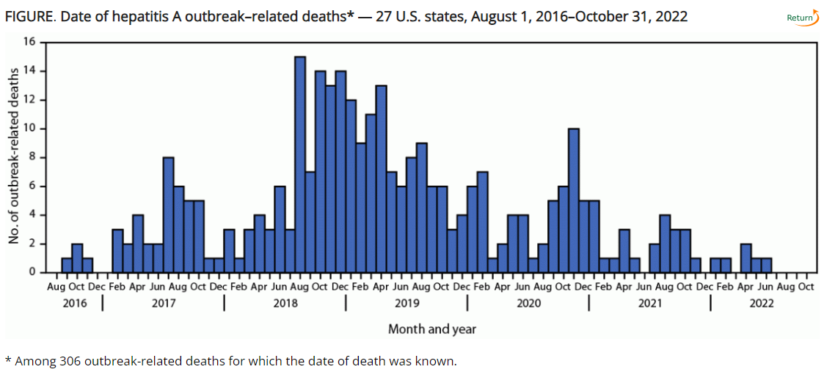
Hepatitis A mortality in community outbreaks
http://dx.doi.org/10.15585/mmwr.mm7242a1

Slide 15
Syndrome of the Month
Review of common findings on physical examination suggestive of a specific syndrome that may first be suspected in the Job Corps age population
Presentation of diagnostic criteria commonly used to support the diagnosis
Indications for syndrome-specific evaluation
Indications for subspecialty referral(s), if any
Implications for career choice, if any

Slide 16
Turner syndrome
Turner syndrome is a chromosomal condition that affects development in people who are assigned female at birth. One in 2000 to one in 2500 live female births.
About half of individuals with Turner syndrome have monosomy X which means each cell in the individual's body has only one copy of the X chromosome instead of the usual two.
Turner syndrome can also occur if one of the X chromosomes is partially missing or rearranged rather than completely absent. Mosaicism commonly occurs.
The most common feature of Turner syndrome is short stature, which becomes evident by about age 5 years.
Many affected individuals do not undergo puberty unless they receive hormone therapy, and most are unable to become pregnant naturally.
Most people with Turner syndrome have normal intelligence but may have learning disabilities.
Medline Plus NLM NIH

Slide 17
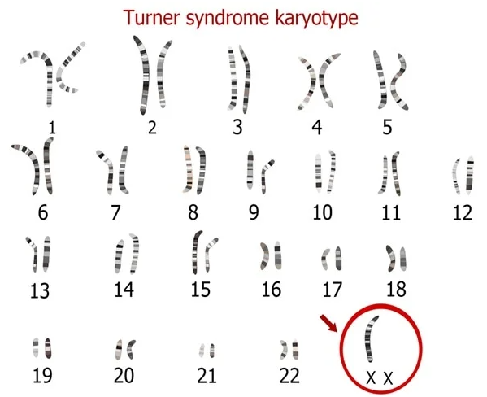
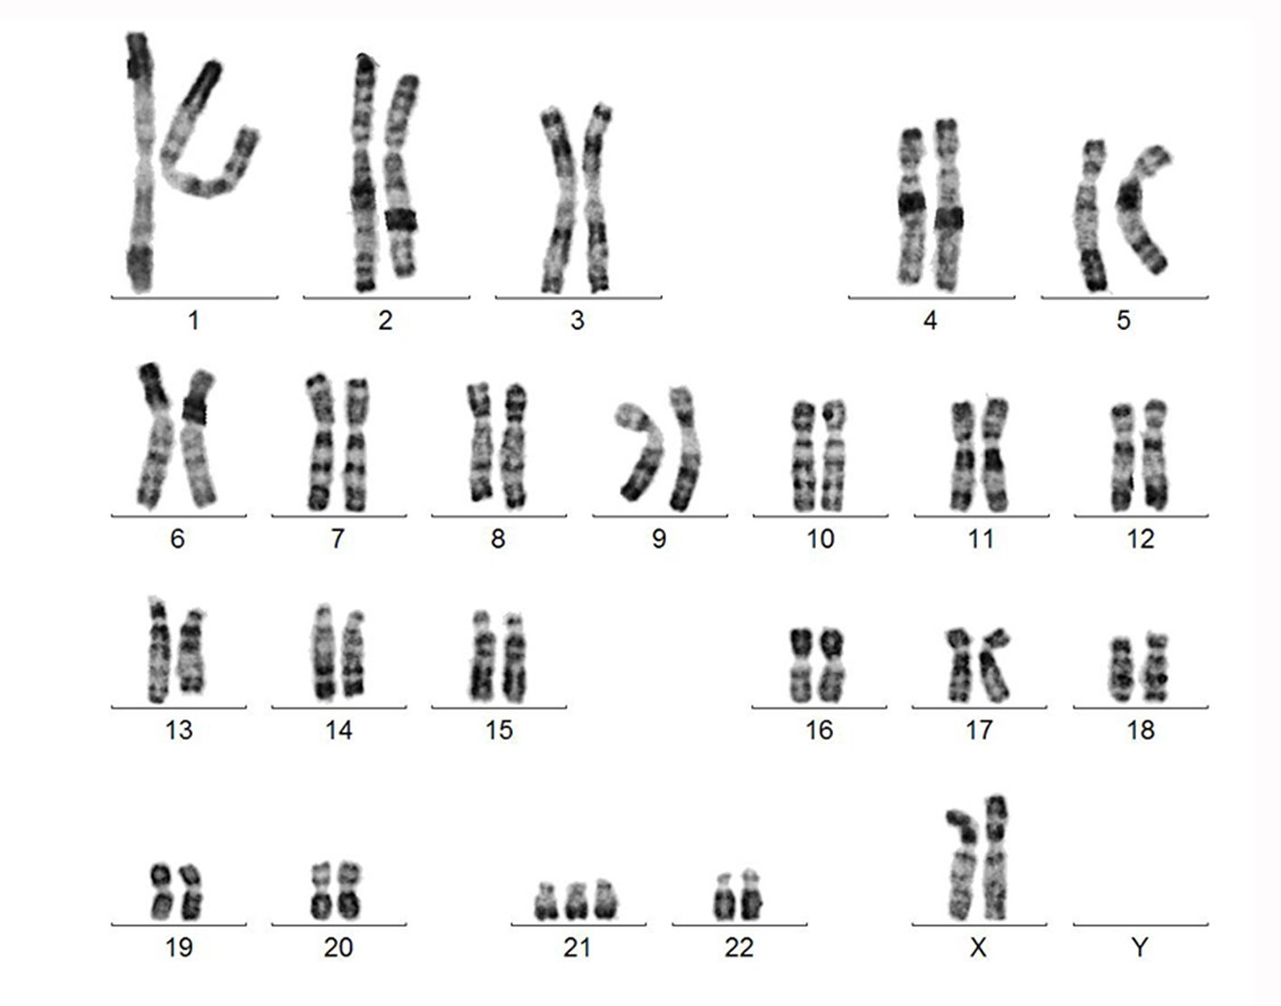
Normal female karyotype
46,XX
45,XO

Slide 18
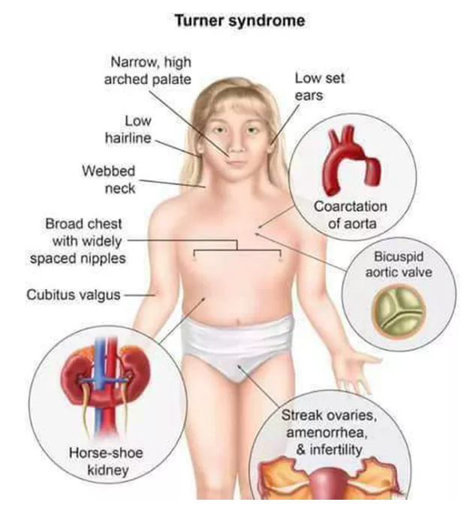
Mnemonic
C cardiac anomalies
L lymphedema
O ovarian insufficiency
W webbed neck
N nipples widely spaced
S short stature

Slide 19
Diagnostic evaluation
Karyotyping is definitive but mosaicism is common
Elevated gonadotropins – follicle stimulating hormone (FSH), luteinizing hormone (LH)
Low estradiol levels
Presence of anti-Mullerian hormone (AMH)
Renal ultrasonography
Echocardiography/cardiac MRI
Monitor for hypertension, diabetes, hypothyroidism, celiac disease,
liver disease, hearing loss, bone mineral density

Slide 20
Management
Growth hormone therapy – may gain 2 inches
Induction of puberty with hormone replacement therapy
Susbspecialist consultation and monitoring:
endocrinologist
cardiologist
gynecologist
obstetrician - IVF
geneticist
psychologist
Life expectancy with Turner Syndrome is about 13 years shorter than that of the general population

Slide 21
Open Forum
https://www.surveymonkey.com/r/LNPV5QC

Slide 22
Job Corps Center Physician Monthly Teleconference Next call: Wednesday, November 29th, 2023 No December call
John Kulig MD MPH Region 1 Boston & Region 2 Philadelphia
Sara Mackenzie MD MPH Region 6 San Francisco
Drew Alexander MD Region 4 Dallas
Gary Strokosch MD Region 3 Atlanta & Region 5 Chicago
HIPAA compliant messages use @jobcorps.org email address
https://www.surveymonkey.com/r/LNPV5QC

