Slide 1
Job Corps Center Physician Monthly Teleconference
Wednesday, October 23rd, 2024

Slide 2
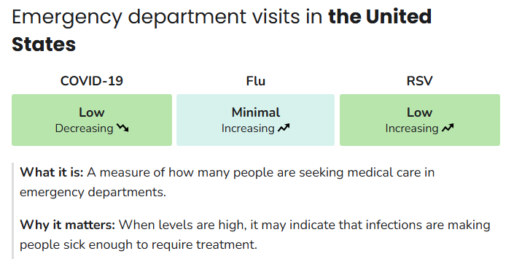
CDC Respiratory Illness:
COVID- 19 infections and ER visits decreasing
Influenza and RSV activity is increasing
Respiratory Illnesses Data Channel | Respiratory Illnesses | CDC

Slide 3
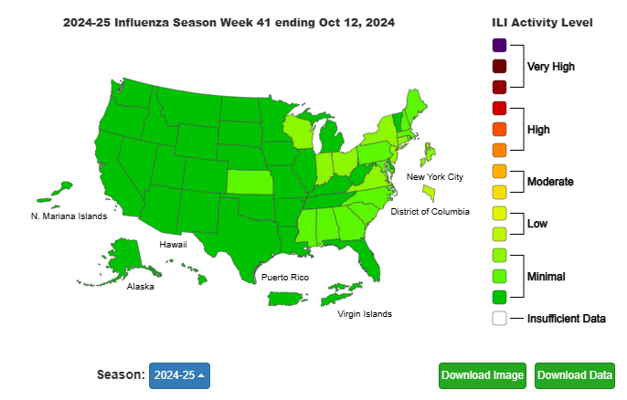
CDC Dashboard Influenza-like Illness*:
*Percent of visits to enrolled outpatient providers or ERs for fever and cough or sore throat

Slide 4
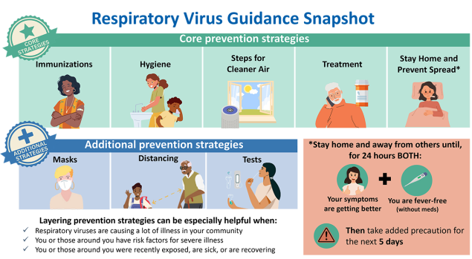
Management & Prevention of Respiratory Illness in Job Corps:
Respiratory Virus Guidance (cdc.gov)

Slide 5
CDC Guidance: Immunizations
COVID-19 vaccine
2024-2025 COVID-19 vaccine
Recommended for everyone 6 months and older
Viral strain is changing, and immunity declines over time
Seasonal Influenza vaccine
2024-2025 influenza vaccine
Recommended for everyone 6 months and older
Trivalent vaccine (3 strains)
RSV vaccine
Pregnant persons at 32-36 weeks
People 60 and older

Slide 6
CDC Vaccination Trends:
COVID-19 2024-2025 vaccine
3.7% of children
11.7% of adults 18+
27.5% of adults 65+
Influenza vaccine
22.1% of children
21.8% of adults 18+
38.2% adults 65+

Slide 7
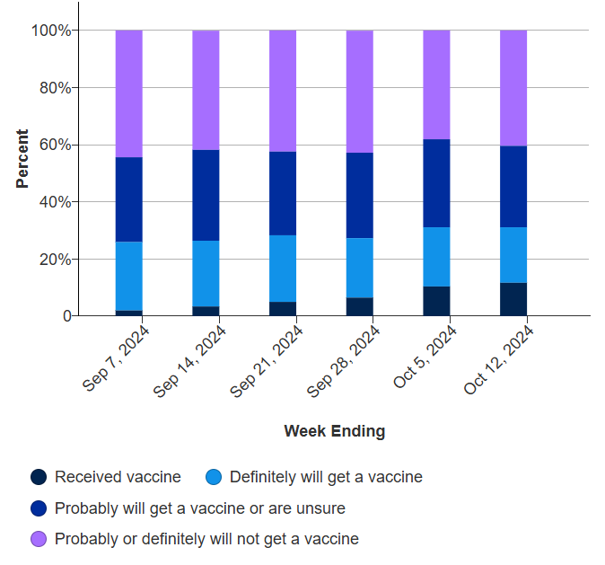
COVID-19 Vaccination Intent Adults:

Slide 8
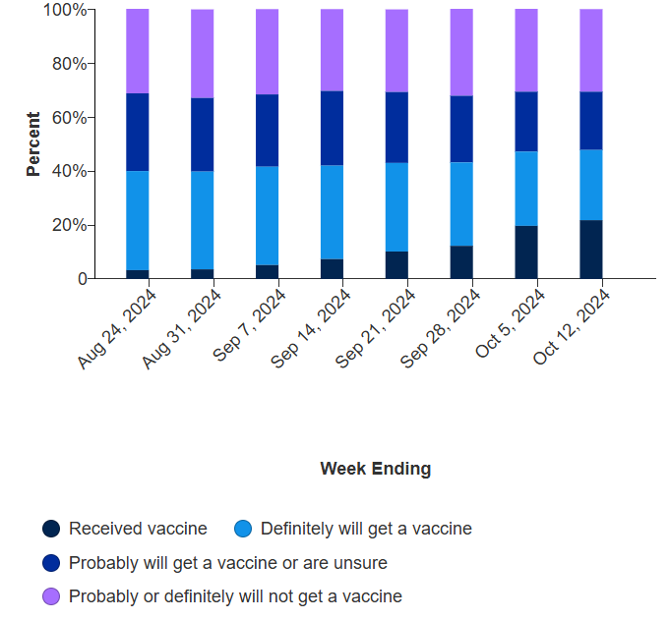
Influenza Vaccination Intent Adults:

Slide 9
CDC strategies to Increase COVID-19 vaccine confidence and uptake:
Vaccine ambassadors
Medical provider vaccine standardization
Reminder, recall
Motivational Interviewing
Workplace vaccination
Effective messages
Provider recommendation
Combat misinformation
12 COVID-19 Vaccination Strategies for Your Community | CDC

Slide 10
4 Steps for discussing vaccines:
Embrace an attitude of empathy and collaboration
Be compassionate and genuine curiosity about reasons student feels the way they do
Be sensitive to culture, family dynamics and circumstances
Ask permission to discuss vaccines
If they say no, respect and move on
If yes, go to step 3
Motivational Interview
On a scale of 0-10, how likely are you to get vaccine?
Why (x)? Why not a lower number? What would help you move higher?
Respond to questions about vaccines, health, or mental health
Talking with Patients about COVID-19 Vaccination | CDC

Slide 11
PRH 2.3 R7: Family Planning Program
Must be provided to all students on a voluntary basis. At a minimum, this program must include counseling, health promotion activities, and medical services, including birth control. The Center Director must appoint a staff member to implement and monitor this program.

Slide 12
CDC Contraceptive Use and Practice recommendations:
Personal autonomy in contraceptive decision-making
Equitable access to the full range of contraceptive methods
Offer in non-coercive manner honoring personal values, goals and reproductive autonomy
Share decision-making and person-centered approach
Remove unnecessary medical barriers to access and use
U.S. Medical Eligibility Criteria for Contraceptive Use, 2024 | MMWR

Slide 13
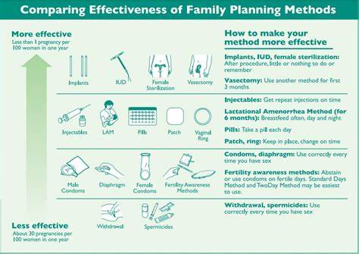
Contraceptive Efficacy:

Slide 15
Health & Wellness Entrance Requirements
PRH 2.3 R2(a)
The Health and Wellness Program must include the following components: A cursory health evaluation, laboratory testing, and a medical history within 48 hours of arrival on center. The medical history must be documented on the Job Corps Health History Form. The cursory health evaluation and medical history must be conducted by a qualified health professional designated by the Center Physician.

Slide 16
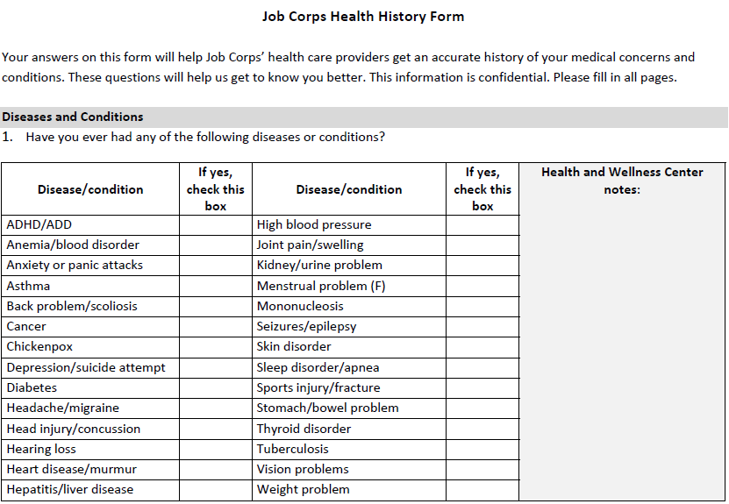

Slide 17
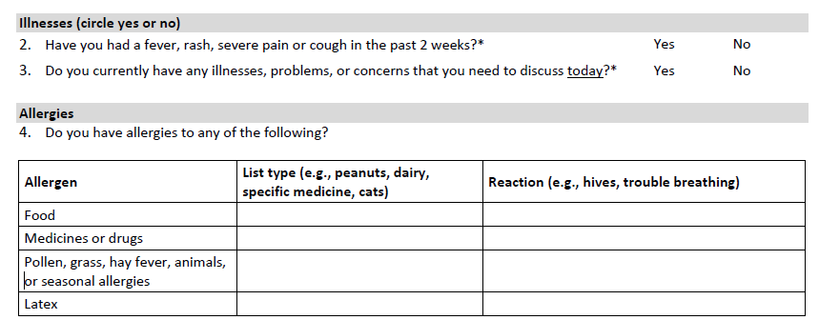

Slide 18
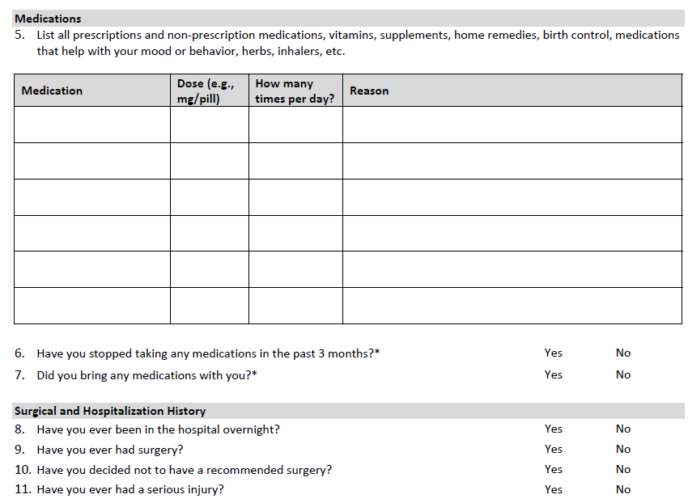

Slide 19
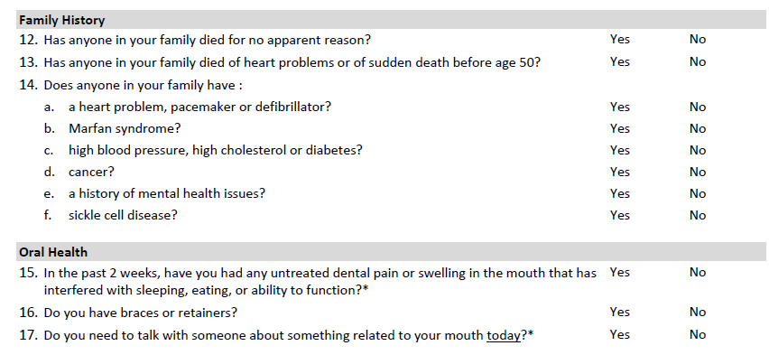

Slide 20
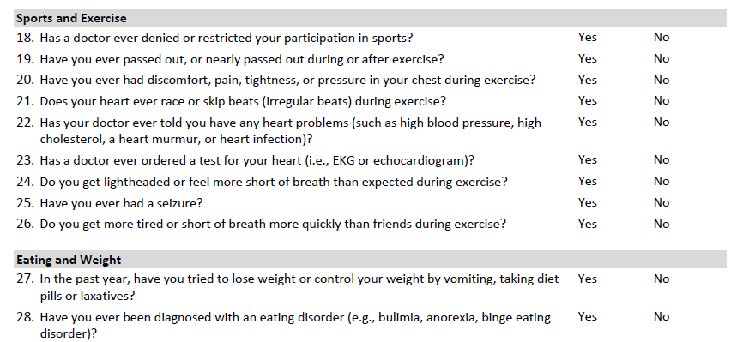

Slide 23
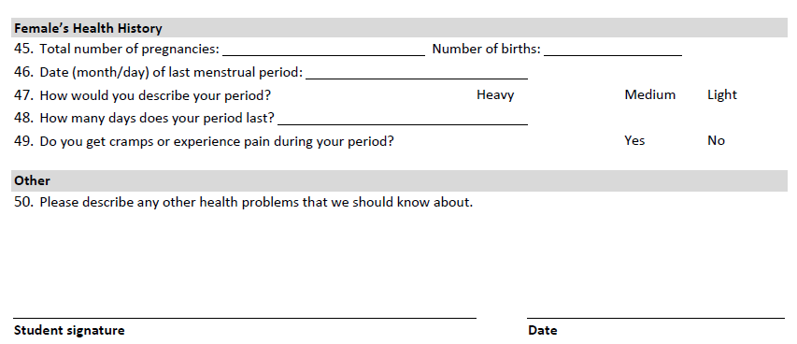

Slide 24
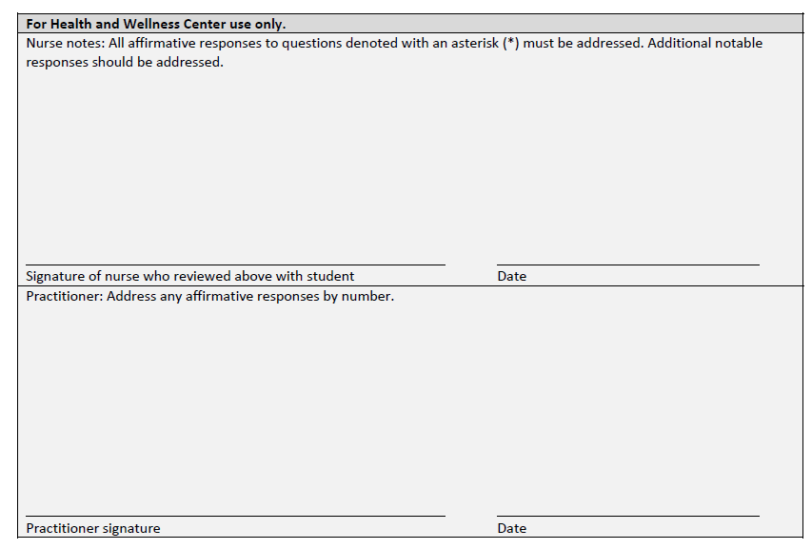

Slide 25
Health & Wellness Entrance Requirements
PRH 2.3 R2(b)
The Health and Wellness Program must include the following components: A complete entrance physical examination and a review of the medical history within 14 days. The cursory evaluation, with the exception of the required entrance laboratory testing, may be omitted if the physical examination is conducted within 72 hours of a student’s arrival on center. The physical examination must be provided by a qualified health professional and documented on the Job Corps Physical Examination Form.

Slide 26
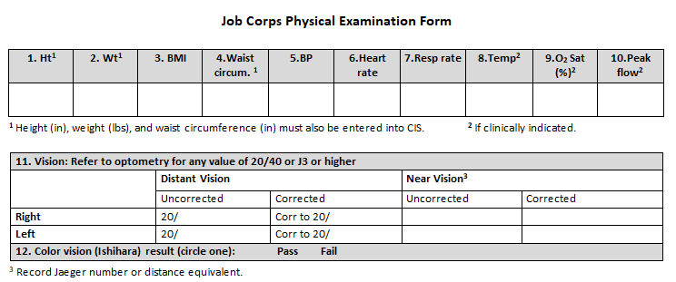

Slide 28
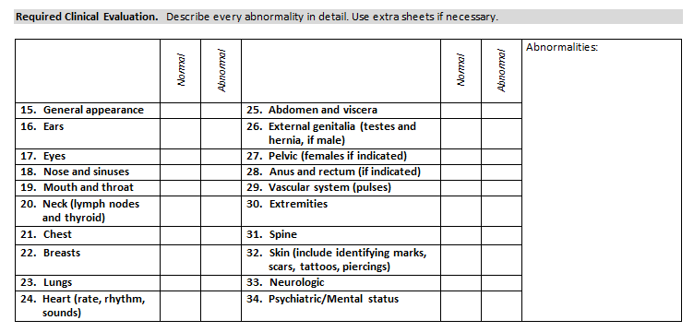

Slide 29
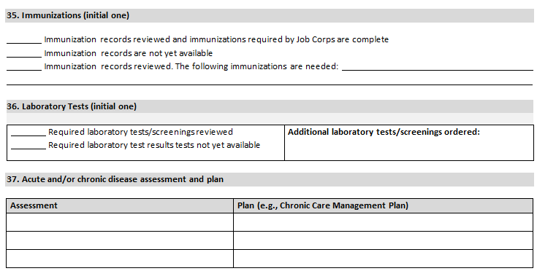

Slide 30
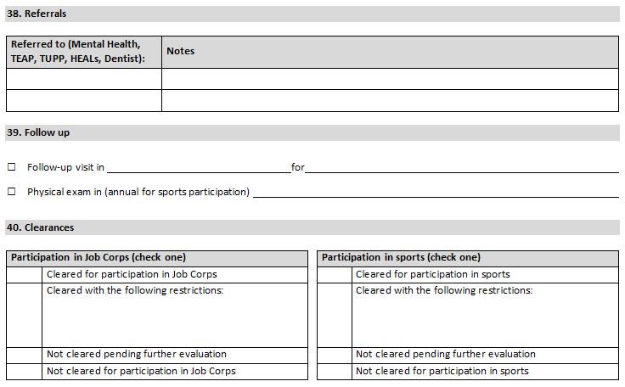

Slide 32
Case presentation
A 20 year-old obese male reports an episode of exertional chest pain that occurred while shoveling snow the previous day. The pain was substernal, graded 9/10 (“wicked bad”) in severity and radiated down his left arm. He reports “ringing” in his ears and “blacking out” for about a minute, but no syncope. Mild chest pain persists, graded 2/10. Exam reveals BMI 37.2, BP 108/60, heart rate 67, no fever, no chest wall tenderness, clear breath sounds, and normal cardiac auscultation.

Slide 33
Case presentation
A 20 year-old obese male reports an episode of exertional chest pain that occurred while shoveling snow the previous day. The pain was substernal, graded 9/10 (“wicked bad”) in severity and radiated down his left arm. He reports “ringing” in his ears and “blacking out” for about a minute, but no syncope. Mild chest pain persists, graded 2/10. Exam reveals BMI 37.2, BP 108/60, heart rate 67, no fever, no chest wall tenderness, clear breath sounds, and normal cardiac auscultation. Chest pain was positional - worse lying supine and relieved by sitting forward.

Slide 34
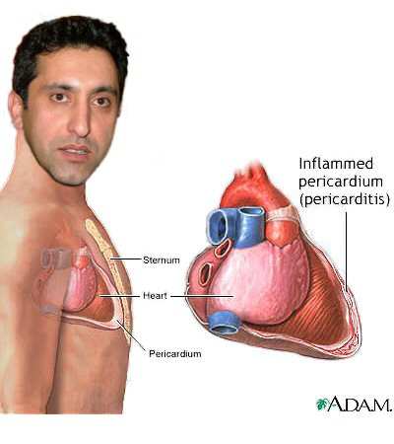
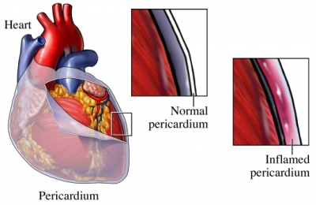

Slide 35
Pericarditis
inflammation of the pericardium, with or
without effusion
viral infection most common cause (80%-90%)
distinguish from acute coronary syndromes
and pulmonary embolism
complications include cardiac tamponade
and constrictive pericarditis

Slide 36
Pericarditis
Etiology
infection – viral, bacterial, fungal
autoimmune disorders – IBD, RA, SLE
malignancy – lymphoma, leukemia
radiation therapy
chest trauma
uremia – renal failure
medications – isoniazid, mesalamine, phenytoin

Slide 37
Pericarditis
Clinical presentation:
sudden onset of severe chest pain
may be crushing, as with ischemic cardiac pain
may be referred to the scapular ridge
exacerbated by inspiration, coughing, swallowing
worse supine – relieved upright, leaning forward
pathognomonic pericardial friction rub (33%-85%)

Slide 38
Pericarditis
Stages of electrocardiographic findings:
diffuse ST-segment elevation and
PR-segment depression
normalization of ST and PR segments
widespread T-wave inversion
normalization of T-waves

Slide 39
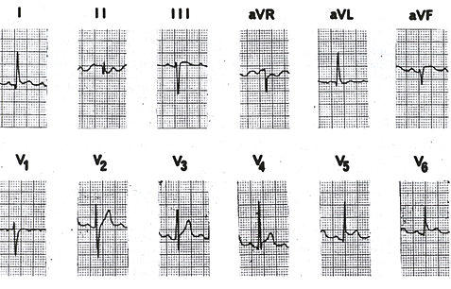

Slide 40
Pericarditis
Management:
self-limited, benign course
exercise restriction
empiric treatment with NSAIDs
corticosteroid use increases risk of recurrence
colchicine if refractory or recurrent
pericardiocentesis for cardiac tamponade

Slide 41
Invitation to submit
Do you have an unusual case presentation encountered in your practice at Job Corps?
An atypical presentation of a common medical disorder in this age group?
A typical presentation of an uncommon medical disorder in this age group?
If so, please submit a proposal for a brief 10-15 minute presentation on a future monthly call to John.Kulig@Humanitas.com

Slide 42
Upcoming webinars
Autism Spectrum Disorder
Description: The webinar will provide an overview of prevalence and diagnostic criteria for Autism Spectrum Disorder (ASD), as well as the challenges and functional limitations that students with ASD often experience at Job Corps. The information presented is designed to assist centers in identifying appropriate strategies and accommodations to support the success of students with ASD in Job Corps.
Tuesday, October 29, 2024 @ 10:00 am CT
Thursday, October 31, 2024 @ 2:00 pm CT
jobcorps.webex.com

Slide 43
Open Forum
https://www.surveymonkey.com/r/J6RNX9J

Slide 44
Regional Medical Specialists Contact us with policy or clinical questions
John Kulig MD MPH Region 1 Boston & Region 2 Philadelphia
Gary Strokosch MD Region 3 Atlanta & Region 5 Chicago
Drew Alexander MD Region 4 Dallas
Sara Mackenzie MD MPH Region 6 San Francisco
HIPAA compliant messages => use @jobcorps.org email address

Slide 45
Monthly Teleconference
Next call: Wednesday, December 4th, 2024
Center Physician Call - November/December 2024 (combined) December 4, 2024, 2:00 – 3:00 PM (America/New_York) Please join my meeting from your computer, tablet or smartphone. https://meet.goto.com/145615093 You can also dial in using your phone. Access Code: 145-615-093 United States: +1 (872) 240-3212 Get the app now and be ready when your first meeting starts: https://meet.goto.com/install

