Slide 1
Job Corps Center Physician Monthly Teleconference
John Kulig MD MPH Region 1 Boston & Region 2 Philadelphia
Sara Mackenzie MD MPH Region 6 San Francisco
Drew Alexander MD Region 4 Dallas
Gary Strokosch MD Region 3 Atlanta & Region 5 Chicago
HIPAA compliant messages use @jobcorps.org email address
Wednesday, September 27th, 2023

Slide 2
Health and Wellness COVID Update

Slide 3
COVID-19 – hospitalizations increasing
Notes:
Last week we had our first center required to mask indoors across center due to “high” covid hospital admission levels in the county. Please remember to check the Job Corps PRH web site, resources tab for the cdc hospital admissions level in your county as we expect to see this increasing over next few months.

Slide 4
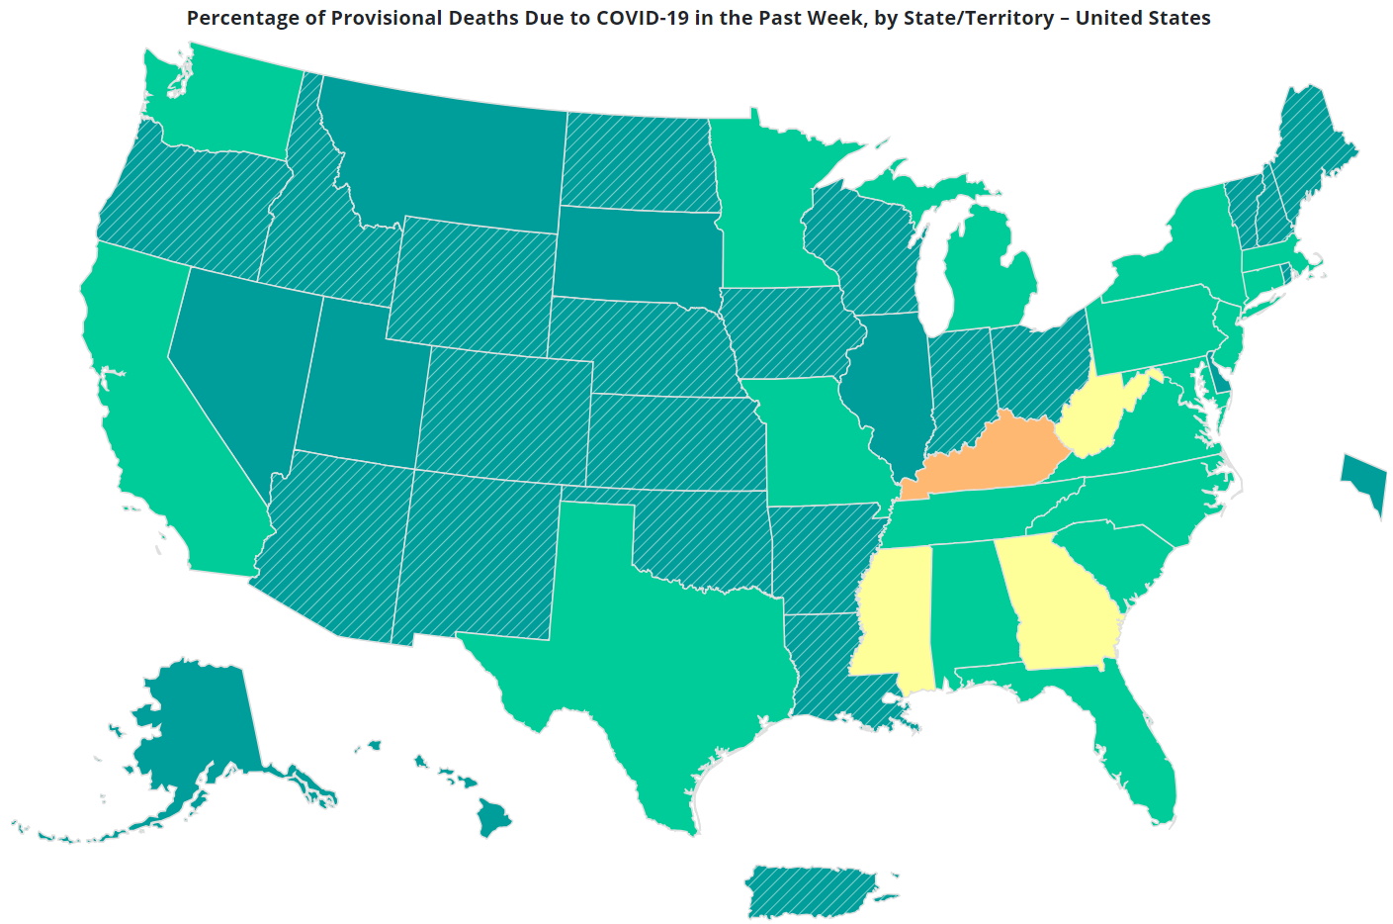

Slide 5
COVID-19 Vaccines now available and recommended
Notes:
Includes options to look for “Bridge Access Program” participant sites – provide no-cost COVID-19 vaccines for adults without health insurance or for adults whose health insurance doesn’t cover COVID-19 vaccine

Slide 6
COVID-19 Testing Supplies
Check expiration dates on testing supplies each week
Discard expired supplies
Complete weekly survey to document center supplies
If running low of Abbott ID Now testing supplies, request redistribution from Regional Office

Slide 7
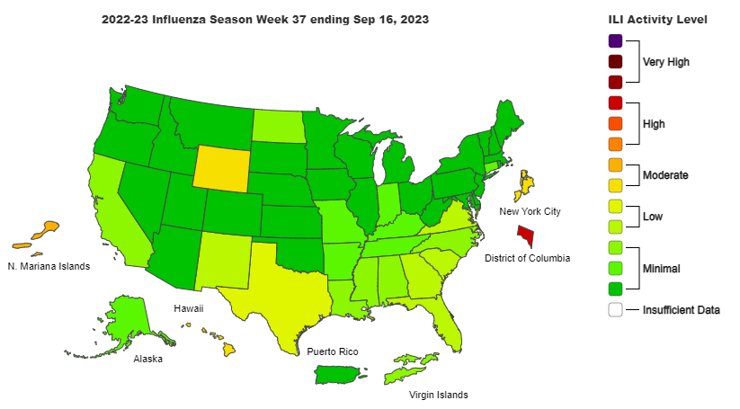

Slide 8
RSV immunization at 32-36 weeks gestation

Slide 9
Oral phenylephrine ineffective
America’s most popular oral nasal decongestant, phenylephrine, was deemed ineffective by a Food and Drug Administration panel in a unanimous 13-0 vote on September 12, 2023.
Studies in 2006 and 2009 found pseudoephedrine (PDE) to be more effective than phenylephrine (PE) in the treatment of nasal congestion, but sale of PDE was restricted to reduce its use in manufacturing illicit methamphetamine.
Decongestant nasal sprays may be more effective in reducing swelling of the nasal passages, but use should be limited to 3 days to avoid rebound congestion.

Slide 10
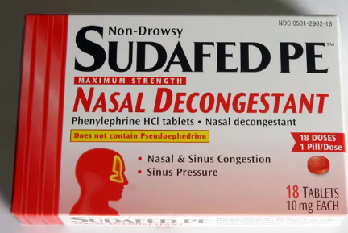
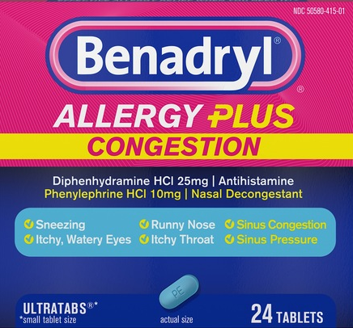

Slide 11
Generic Vyvanse
Vyvanse (lisdexamfetamine dimesylate) is a prodrug formulation of dextroamphetamine indicated for treatment of ADHD in patients age 6 years and older.
U.S. sales of Vyvanse® were approximately $5.1 billion in the 12 months ending June 30, 2023. Estimated 15% of U.S. market share for ADHD. Retail cost $450 for a 30-day supply.
As the U.S. patent for Vyvanse expired in August 2023, the FDA cleared 14 manufacturers to produce Vyvanse generics.
Soonest availability of generics estimated in late 2023 or early 2024.

Slide 12
Generic Vyvanse
Lisdexamfetamine is an inactive drug that the body breaks down into dextroamphetamine in the bloodstream.
Considered to have fewer side effects and lower potential for abuse than Adderall.
Vyvanse has a longer duration of action compared with Adderall XR – 14 hours vs 10-12 hours.
Vyvanse is also indicated for treatment of moderate to severe binge eating disorder (BED) in adults.

Slide 13
Supplement warning
Food and Drug Administration (FDA) regulations mandate that all ingredients used to manufacture dietary supplements be tested for identity and be free from reasonably anticipated contaminants.
Despite these regulations, misbranded dietary supplements are frequently found to contain potentially dangerous substances.
Tejocote (Crataegus mexicana) root, a supplement promoted online through social media for weight loss, is readily available from online retailers.
Recent DNA fingerprinting of a product labeled as containing tejocote root under the brand name Alipotec determined that the product was 100% yellow oleander (Cascabela thevetia). Yellow oleander contains the cardenolide thevetin B, which has the same clinical effects as other cardenolides, such as digoxin, and can be highly toxic.

Slide 14
*Remember as with any Natural Supplement, Individual Results may vary.

Slide 15
Syndrome of the Month
Review of common findings on physical examination suggestive of a specific syndrome that may first be suspected in the Job Corps age population
Presentation of diagnostic criteria commonly used to support the diagnosis
Indications for syndrome-specific evaluation
Indications for subspecialty referral(s), if any
Implications for career choice, if any

Slide 16
Klinefelter syndrome
most common sex chromosome disorder in males, affecting one in 660 men, approximately 64% of which remain undiagnosed throughout life
majority (90%) of cases present with a 47, XXY karyotype
phenotype may vary according to the degree of gonadal dysfunction
cardiovascular, cerebrovascular, metabolic syndrome, and other comorbidities are increased - loss of approximately 2 years in life span

Slide 17
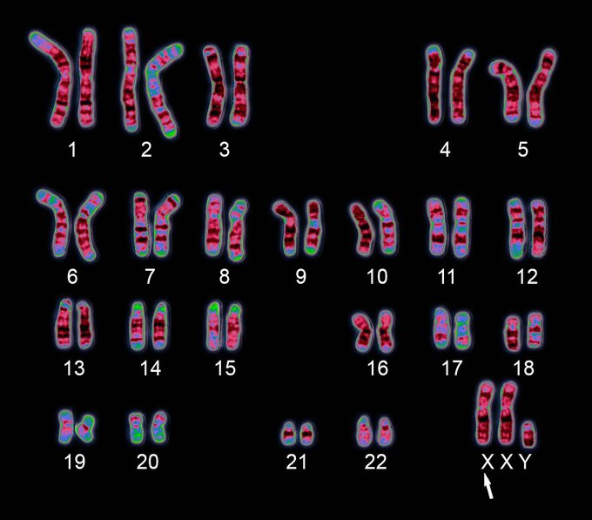
47,XXY
karyotype

Slide 18
Klinefelter syndrome
Taller than average males with longer legs and shorter torsos
Less muscle mass and strength – lack muscle control and coordination
Gynecomastia (50-75%)
Thin, sparse body hair
Female pubic hair distribution
Fat accumulation around hips, buttocks and thighs

Slide 19
Klinefelter syndrome
Normal onset of puberty, but incomplete
Small testes (99-100%), cryptorchidism
Decreased penis size (10-25%), hypospadias
Infertility (99-100%)

Slide 20
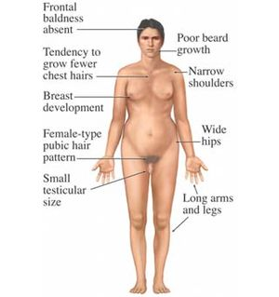
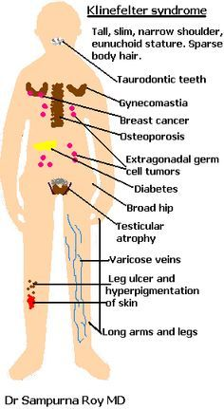

Slide 21
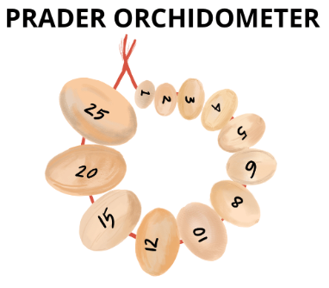
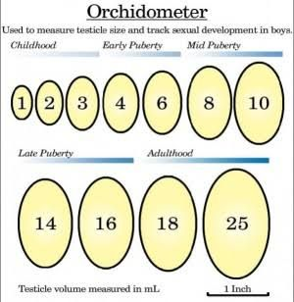
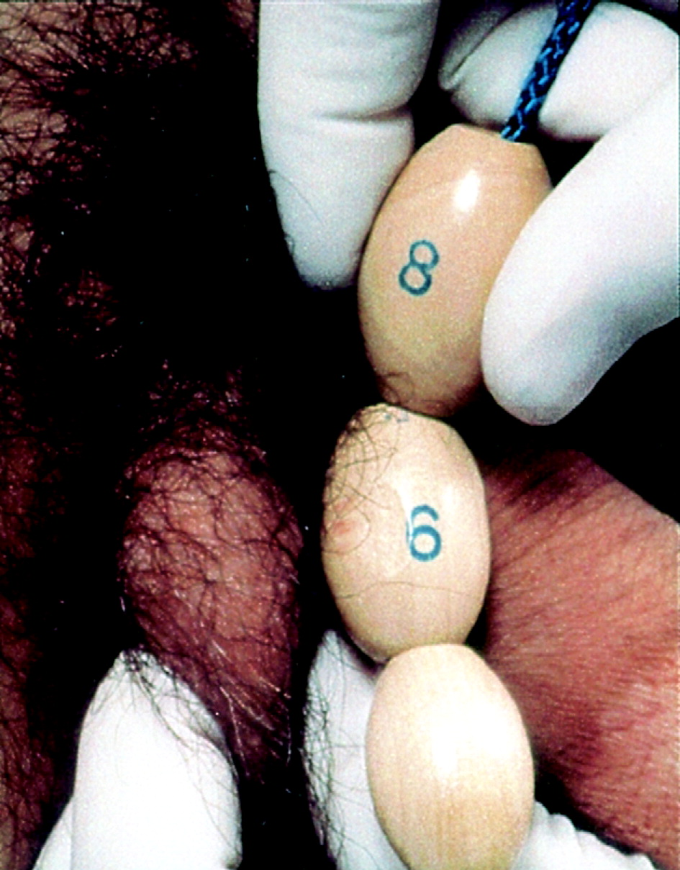

Slide 22
Klinefelter syndrome
Anxiety/depression
Attention Deficit Hyperactivity Disorder (ADHD)
Autism spectrum disorder (ASD)
Below average IQ, typically between 80-90, but many with normal IQ
Language-based learning disabilities

Slide 23
Klinefelter syndrome diagnosis
Klinefelter syndrome is usually not diagnosed until the time of puberty but may be identified before birth via prenatal screening for chromosome disorders
Definitive diagnosis by karyotype – 47,XXY
Decreased testosterone levels (65-85%)
Elevated sex hormone binding globulin (SHBG)
Elevated gonadotropins - FSH and LH (90-100%)

Slide 24
Klinefelter syndrome treatment
Testosterone replacement therapy optimally beginning at age 11-12 years – injectable preferred over oral – cholestatic liver injury/tumors – injections painful – given weekly
Advances in fertility treatment, such as sperm extraction, in vitro fertilization (IVF), and intracytoplasmic sperm insertion (ICSI), can result in conception without abnormalities or mutations of chromosomes
Monitor for comorbidity
Increased risk of DVT, breast and lung cancer, osteoporosis
Higher risk of autoimmune disorders such as diabetes

Slide 25
Paqui One Chip Challenge
Recalled by the manufacturer following the death of a Massachusetts teenager after ingesting the chip.

Slide 26
Open Forum
https://www.surveymonkey.com/r/FTM5852

Slide 27
Job Corps Center Physician Monthly Teleconference Next call: Wednesday, October 25th, 2023
John Kulig MD MPH Region 1 Boston & Region 2 Philadelphia
Sara Mackenzie MD MPH Region 6 San Francisco
Drew Alexander MD Region 4 Dallas
Gary Strokosch MD Region 3 Atlanta & Region 5 Chicago
HIPAA compliant messages use @jobcorps.org email address
https://www.surveymonkey.com/r/FTM5852

