Slide 1
Job Corps Center Physician Monthly Teleconference
Wednesday, September 25th, 2024

Slide 2
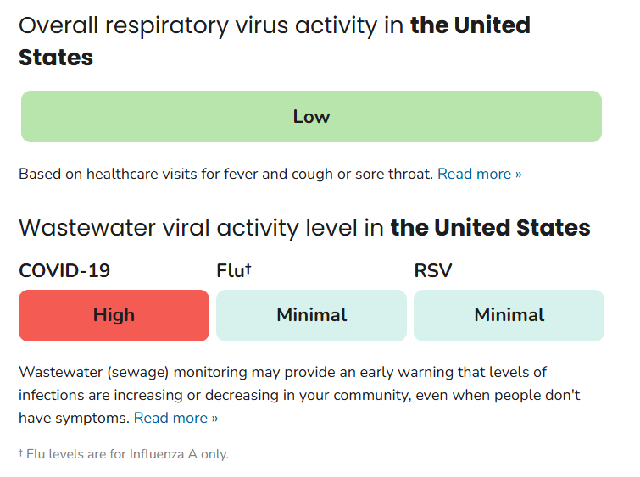
CDC Respiratory Illness:
COVID- 19 infections decreasing
Influenza and RSV activity is increasing but remains low
Respiratory Illnesses Data Channel | Respiratory Illnesses | CDC

Slide 3
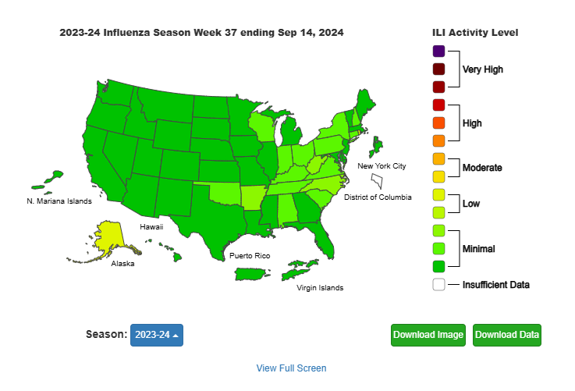
CDC Dashboard Influenza-like Illness*:
*Percent of visits to enrolled outpatient providers or ERs for fever and cough or sore throat

Slide 4
PIN 23-09 Managing Respiratory Infections & PIN 24-01 Guidance For Respiratory Illnesses 2024-2025
Reduce risk of respiratory illness spread:
Educate regarding CDC Respiratory Illness Guidance
Provide masks and education about when masking appropriate
Promote good hygiene practices
Support Access to Immunizations
Seasonal influenza and COVID-19 booster recommended for everyone 6 months and older
Centers may order, store, and administer flu and covid vaccines
Evaluate, test, and treat, as indicated.
COVID testing is no longer universally recommended
Testing for COVID-19 and influenza recommended if alters treatment or management on center

Slide 5
CDC Guidance: Immunizations
COVID-19 vaccine
2024-2025 COVID-19 vaccine
Recommended for everyone 6 months and older
Viral strain is changing, and immunity declines over time
Seasonal Influenza vaccine
2024-2025 influenza vaccine
Recommended for everyone 6 months and older
Trivalent vaccine (3 strains)

Slide 6
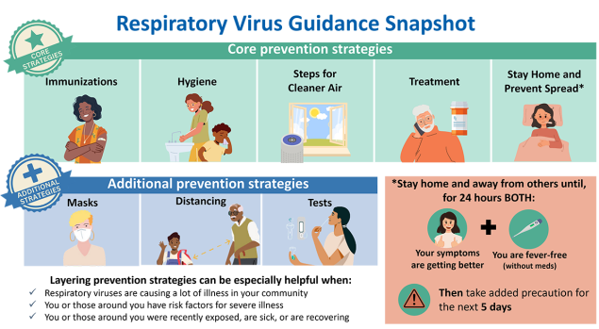
Management & Prevention of Respiratory Illness in Job Corps:
Respiratory Virus Guidance (cdc.gov)

Slide 7
U.S. Opioid Overdose Epidemic:

Slide 8
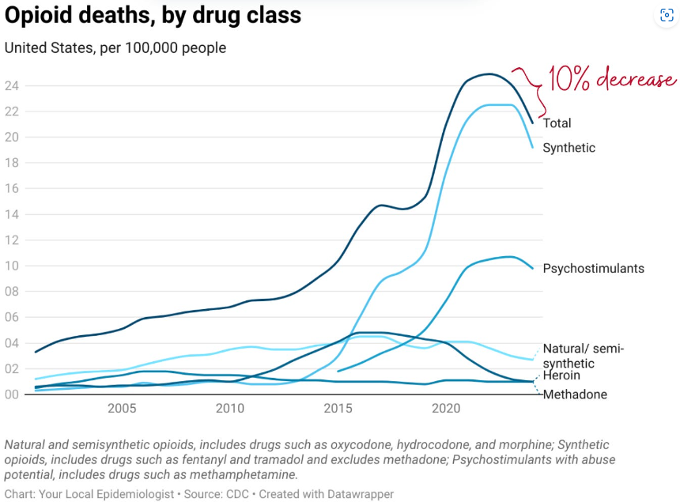
U.S. Opioid Overdose Epidemic
Your Local Epidemiologist | Katelyn Jetelina | Substack

Slide 9
CDC Opioid Overdose Prevention:
Promote and support RX awareness
Utilize prescription drug monitoring programs
Learn about dangers of illegally made fentanyl
Treat opioid use disorder
Reverse overdose
Rx Awareness | Rx Awareness | CDC Preventing Opioid Overdose | Overdose Prevention | CDC

Slide 10
Job Corps specific approaches:
Limited use of opioid-medications on center
Medication-assisted treatment (MAT)
Early identification of substance use disorder & TEAP program
Emergency Response

Slide 11
Medication Management (PRH 6.12, R6 & Prescribed Controlled Substances SOP):
Monitoring & Storage
Store all Schedule II, III, IV substances under double-lock system
Inventory and reconciliation once per week 2 staff
Purchasing
Individual prescription
No bulk stocks of Schedule II substances

Slide 12
Medication Assisted Treatment (MAT) for Opioid Addiction in JC (PIN 16-21):
MAT and disability
Under Federal law, may be eligible for reasonable accommodation
Advanced planning critical (File Review)
Availability of community services
Avoid interruption of treatment
MAT options
Methadone – cannot be kept on center
Buprenorphine/naloxone (suboxone) daily
Buprenorphine/naloxone subdermal implant (Probuphine)
Naltrexone IM (Vivitrol) monthly
Collaborative care – TEAP/CMHC/Clinician

Slide 13
Responding to Opioid Overdose in Job Corps(PIN 22-16)
Staff & student training on signs of opioid overdose & Narcan administration
Narcan readily available
Two boxes (4 doses of 4mg nasal spray) must be available at:
Health and Wellness in Grab and Go kit
Safety and Security in Grab and Go kit
Each dormitory
Recreation
Academic and trade building/areas
Transportation vehicles

Slide 14
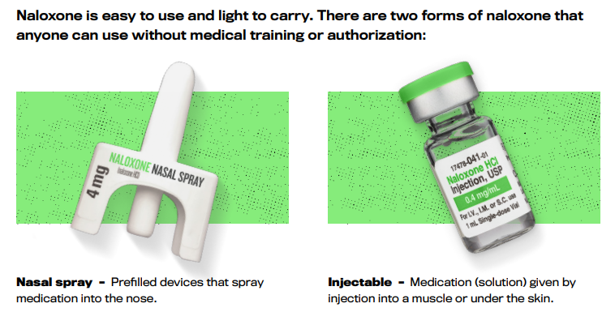
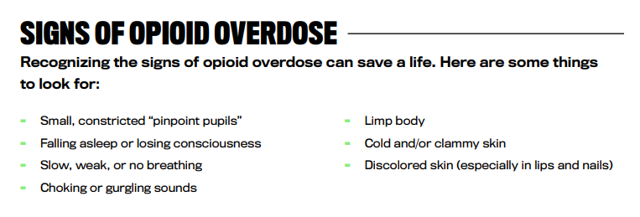
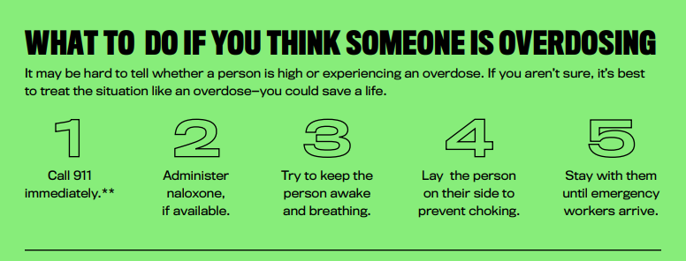
CDC resources
REVERSING OPIOID OVERDOSES WITH LIFESAVING NALOXONE (cdc.gov)

Slide 15
Entrance and Follow Up THC UDS in Job Corps:

Slide 16
Entrance THC UDS Results & Impact on Retention at 40 days:

Slide 18
New hypertension guidelines (2024)
New BP categories are:
Normal (<120 systolic and <80 mm Hg diastolic)
Elevated (120–129 systolic and <80 mm Hg diastolic)
Stage 1 hypertension (130–139 systolic or 80–89 mm Hg diastolic)
Stage 2 hypertension (≥140 systolic or ≥90 mm Hg diastolic)
Hypertensive crisis (>180 systolic and/or >120 mm Hg diastolic)
NIH/AHA

Slide 19
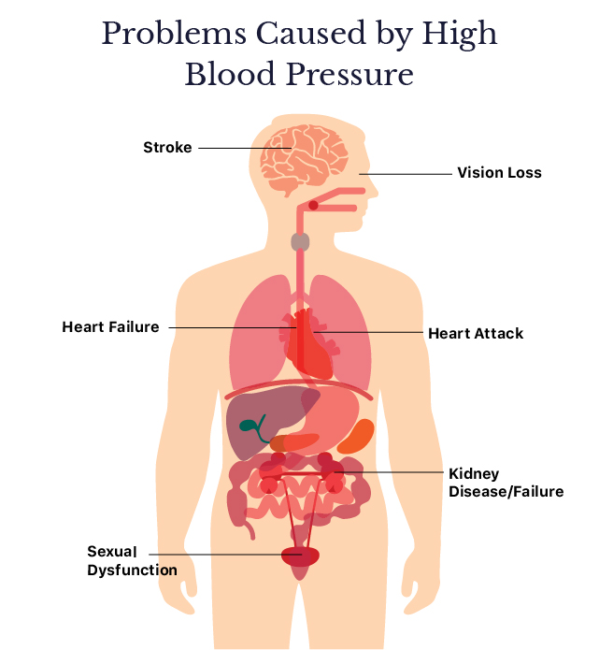

Slide 20
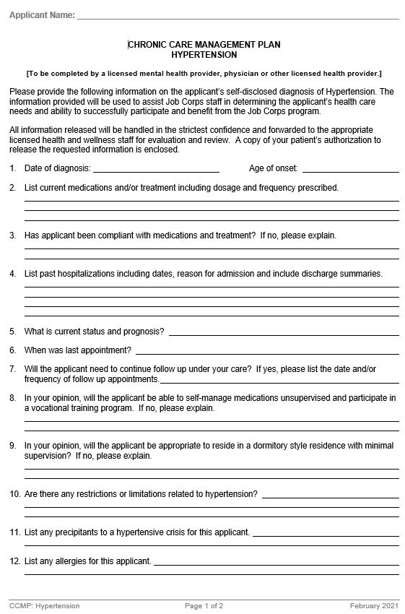
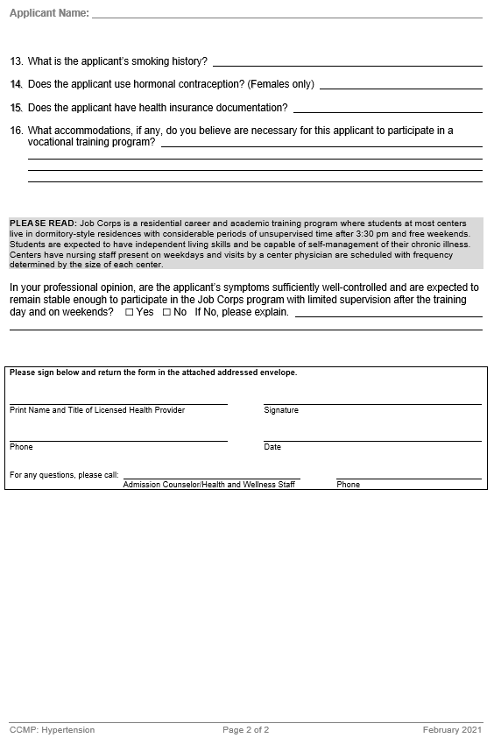

Slide 21
Evaluation of young adults
Primary hypertension, previously known as essential hypertension, has no definitive cause (90%-95% in adults).
Secondary hypertension is caused by an underlying medical condition.
Consider CBC, BUN, creatinine, electrolytes, lipid profile, hemoglobin A1c, urinalysis and microalbumin, ECG => echocardiogram if LVH present, renal ultrasound, retinopathy screening.
Consider 24 hour ambulatory BP monitoring.
Consider medication Rx with lifestyle changes for BP >140/90.

Slide 22
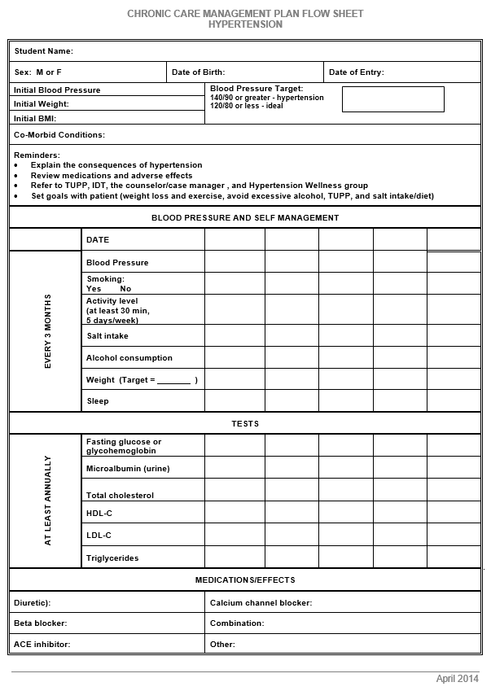
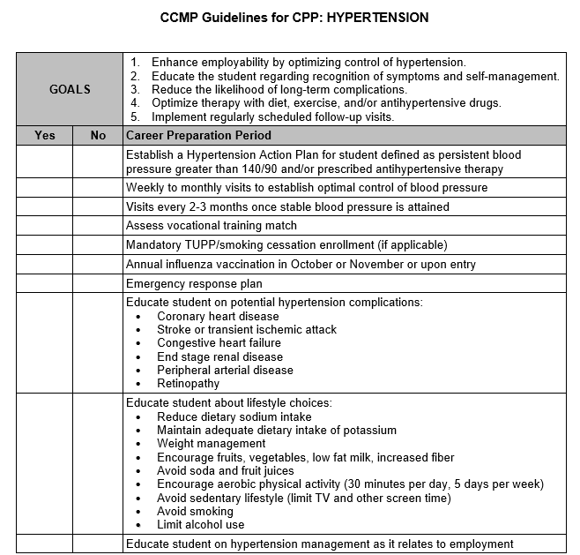

Slide 23
Case presentation
A 16 year-old male reports recent onset of frightening episodes of immobility upon awakening from sleep while lying supine. He reports being unable to move or speak for a minute or two and senses an evil presence compressing his chest. Episodes have occurred almost daily for the past week. He was recently diagnosed with panic disorder but takes no psychotropic medication.

Slide 25
Sleep paralysis
transient and generalized inability to move or speak occurring during the transition period between sleep and wakefulness
lasting one to several minutes
may be accompanied by auditory, tactile and/or visual hallucinations:
hypnagogic – upon falling asleep
hypnopompic – upon awakening
lifetime prevalence 6% in general population > 15 years – 30% to 50% in patients with narcolepsy

Slide 26
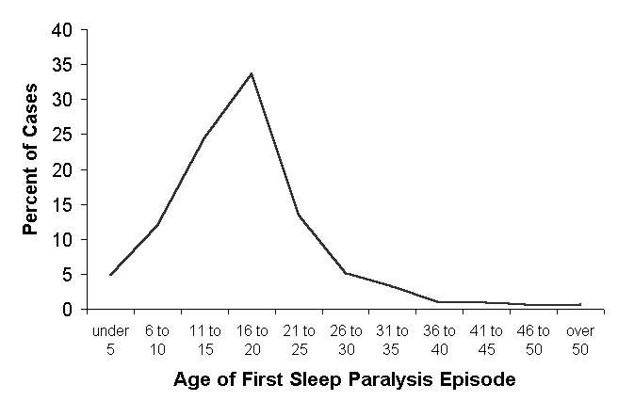

Slide 27
Sleep paralysis: Components
subjective impression of wakefulness
immobility – paralysis, restraint
visual control – eyes open and close, scanning intact
fear – terror of a presence, harm, death
feeling of a presence – watching, attacking, speaking
feeling of pressure on chest – smothering, choking
auditory hallucinations – footsteps, breathing
visual hallucinations – ghostly humanoid form
feelings of floating or being lifted up

Slide 28
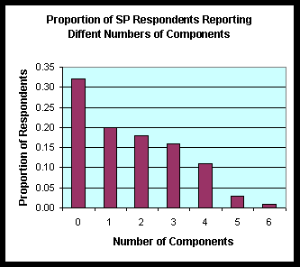

Slide 29
Sleep paralysis: Severity criteria
Severe – episodes occurring at least once per week within the previous year
Moderate - episodes occurring at least once per month but less than once per week within the previous year
Mild - episodes occurring less than once per month or last episode occurred more than one year earlier
None – no symptoms

Slide 30
Sleep paralysis: Management
adequate sleep
stress reduction
regular exercise, but not close to bedtime
regular sleep-wake schedule
sleeping on the side may help
during paralysis episodes, try moving the facial muscles and moving the eyes from one side to the other to hasten resolution
consider antidepressant drugs

Slide 31
Invitation to submit
Do you have an unusual case presentation encountered in your practice at Job Corps?
An atypical presentation of a common medical disorder in this age group?
A typical presentation of an uncommon medical disorder in this age group?
If so, please submit a proposal for a brief 10-15 minute presentation on a future monthly call to John.Kulig@Humanitas.com

Slide 32
Program Instruction Notice (PIN) 23-08: Electronic prescribing in Job Corps 1/3/2024
Each center required to “purchase and begin using e-prescribing
software.”
Submit proposal to purchase a subscription to the Regional Office and the center’s Contracting Officer’s Representative (COR).
Software options must possess Electronic Prescribing for Controlled Substances (EPCS) certification required by the DEA, meet HIPAA requirements, and be compatible with Job Corps Information Technology (IT) systems and security requirements.

Slide 33
Upcoming webinars
Autism Spectrum Disorder
Description: The webinar will provide an overview of prevalence and diagnostic criteria for Autism Spectrum Disorder (ASD), as well as the challenges and functional limitations that students with ASD often experience at Job Corps. The information presented is designed to assist centers in identifying appropriate strategies and accommodations to support the success of students with ASD in Job Corps.
Tuesday, October 29, 2024 @ 10:00 am CT
Thursday, October 31, 2024 @ 2:00 pm CT
jobcorps.webex.com

Slide 34
Open Forum
https://www.surveymonkey.com/r/5YFTLQS

Slide 35
Regional Medical Specialists Contact us with policy or clinical questions
John Kulig MD MPH Region 1 Boston & Region 2 Philadelphia
Gary Strokosch MD Region 3 Atlanta & Region 5 Chicago
Drew Alexander MD Region 4 Dallas
Sara Mackenzie MD MPH Region 6 San Francisco
HIPAA compliant messages => use @jobcorps.org email address

Slide 36
Monthly Teleconference
Next call: Wednesday, October 23rd, 2024
Center Physician Call - October 2024 Oct 23, 2024, 2:00 – 3:00 PM (America/New_York) Please join my meeting from your computer, tablet or smartphone. https://meet.goto.com/499338797 You can also dial in using your phone. Access Code: 499-338-797 United States: +1 (408) 650-3123 Get the app now and be ready when your first meeting starts: https://meet.goto.com/install

