Slide 1
Job Corps Center Physician Monthly Teleconference
Wednesday, August 28th, 2024

Slide 2
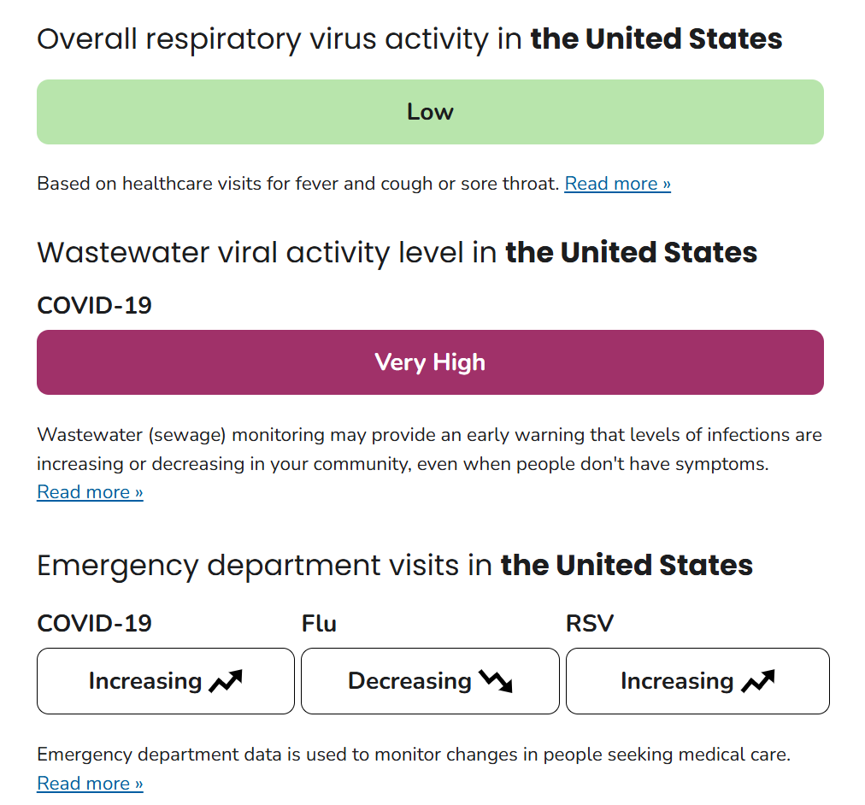
Summer Respiratory Illness:
COVID- 19 infections increasing – evolving strains
Minimal Influenza and RSV activity at present
Respiratory Illnesses Data Channel | Respiratory Illnesses | CDC

Slide 3
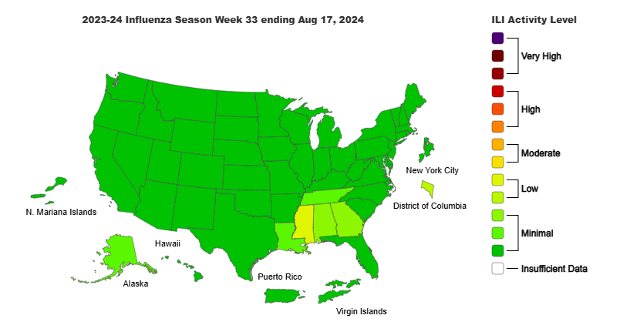
CDC Dashboard Influenza-like Illness*:
*Percent of visits to enrolled outpatient providers or ERs for fever and cough or sore throat

Slide 4
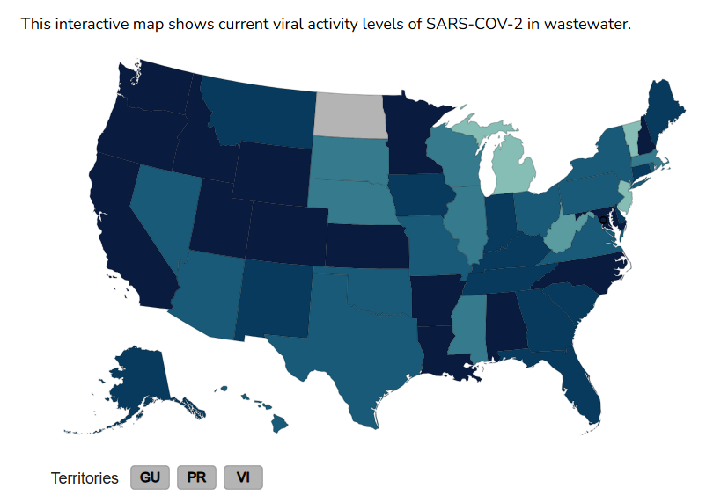
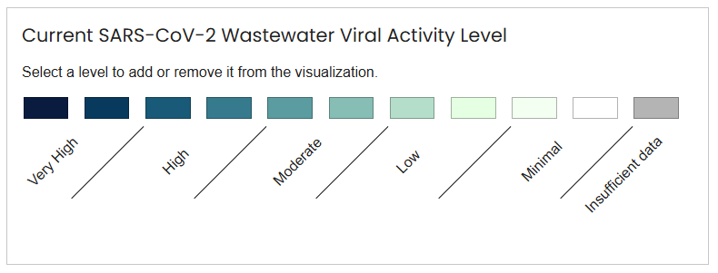
Respiratory Illness: COVID activity (waste water)

Slide 5
PIN 23-09 Managing Respiratory Infections & PIN 24-01 Guidance For Respiratory Illnesses 2024-2025
Reduce risk of respiratory illness spread:
Educate regarding CDC Respiratory Illness Guidance
Provide masks and education about when masking appropriate
Promote good hygiene practices
Support Access to Immunizations
Seasonal influenza and COVID-19 booster recommended for everyone 6 months and older
Centers may order, store, and administer flu and covid vaccines
Evaluate, test, and treat, as indicated.
COVID testing is no longer universally recommended
Testing for COVID-19 and influenza recommended if alters treatment or management on center

Slide 6
CDC Guidance: Immunizations
COVID-19 vaccine
2024-2025 COVID-19 vaccine
Recommended for everyone 6 months and older
Viral strain is changing, and immunity declines over time
Seasonal Influenza vaccine
2024-2025 influenza vaccine – to be released “soon”
Recommended for everyone 6 months and older
Trivalent vaccine (3 strains)

Slide 7
CDC Guidance: When you are sick
Stay home and away from others
Return to activities when, for at least 24 hours,:
Your symptoms are getting better AND
You have had no fever
When you return to normal activities, take extra precautions for 5 days including:
Masking, hygiene, physical distancing

Slide 8
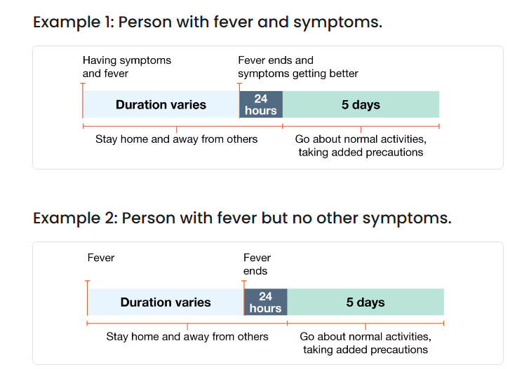

Slide 9
CDC Guidance: Testing
“Testing can provide useful information to help make prevention and treatment choices.”
If someone high risk for severe respiratory illness due to underlying health factors, testing guides treatment options (antiviral medications for influenza or COVID-19)
Testing is not required or recommended for everyone with respiratory illness

Slide 10
How is this different from requirements during the pandemic?
CDC management treats as collective of respiratory illness (not disease specific) currently
No defined isolation period – based on symptoms
No required isolation spaces
Can remain in residence hall
If a roommate is high risk for complications, might consider moving them
No required quarantine or testing for exposures

Slide 11
How is this like practices during the pandemic?
Centers should continue to look at air circulation and air quality
Centers should continue to provide education and posters about how to reduce respiratory illnesses
Centers should continue to provide access to vaccines, masks, hand washing, and health care for students.

Slide 12
How do current CDC recommended practices differ from CDC recommended practices during the pandemic?
Less proscriptive requirements – more choice
Shifts some responsibility to individuals to mask, vaccinate to protect themselves rather than emphasis on community efforts to reduce circulating viral loads through isolation and quarantine
Acknowledges that COVID is here to stay(endemic) & deaths have decreased with treatments and vaccinations now available to reduce risk.

Slide 13
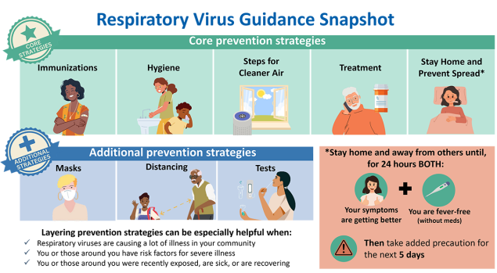
Management & Prevention of Respiratory Illness in Job Corps:
Respiratory Virus Guidance (cdc.gov)

Slide 14
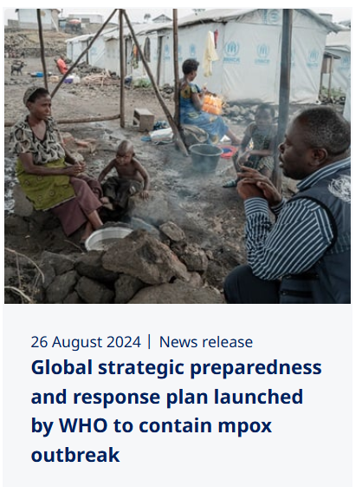
MPox:
Democratic Republic of the Congo (DRC)
27,000 cases & >1,300 deaths
More widespread than any previous outbreaks –neighboring countries
Risk to U.S. low (per CDC)
Required close or intimate contact
Vaccine preventable
2023 Outbreak in Democratic Republic of the Congo | Mpox | Poxvirus | CDC

Slide 15
Prevalence of choking/strangulation during sex

Slide 16
Sexual asphyxiation
Restricting oxygen to enhance sexual pleasure, arousal, or orgasm
Autoerotic
Hanging is a form or autoerotic asphyxiation
200-1000 people in the U.S. (mostly men) die due to oxygen deprivation, neck compression, airway obstruction
Partnered
Less described – perceived as lower risk
Choking, strangulation, “breath play”
Increasing in mainstream past 20 years
Herbenick D et al. Prevalence and characteristics of choking/strangulation during sex: Findings from a probability survey of undergraduate students. J Am Coll Health. 2023 May-Jun;71(4):1059-1073. doi: 10.1080/07448481.2021.1920599. Epub 2021 Jul 9. PMID: 34242530.

Slide 17
College student study:
2020 survey of random sample undergrads at large public Midwestern University (n=4,998)
Aims:
Establish prevalence of choking and being choked during sex
Examine demographic and situational predictors of being choked or choking
Herbenick D et al. Prevalence and characteristics of choking/strangulation during sex: Findings from a probability survey of undergraduate students. J Am Coll Health. 2023 May-Jun;71(4):1059-1073. doi: 10.1080/07448481.2021.1920599. Epub 2021 Jul 9. PMID: 34242530.

Slide 18
Results:
26.5% women and 6.6% of men and 22.3% of TGNB identified students reported being choked at most recent sexual event
Choking a partner reported by 5.7% of women, 24.8% of men and 25% of TGNB
Bisexual women reported highest prevalence of being choked (35.5%), lesbian (32.9%) heterosexual (24.5%)
Gay men more likely to report being choked (21.2%) than bisexual (14.5%) and heterosexual (5.1%)
Herbenick D et al. Prevalence and characteristics of choking/strangulation during sex: Findings from a probability survey of undergraduate students. J Am Coll Health. 2023 May-Jun;71(4):1059-1073. doi: 10.1080/07448481.2021.1920599. Epub 2021 Jul 9. PMID: 34242530.

Slide 19
Implications:
High prevalence
Potential acute and cumulative harm (loss of consciousness, breathing difficulties, stroke, death)
Consider incorporating questions about choking in sexual history
Educate about importance of sexual consent, power dynamics, communication (likes and dislikes)
Consider asking about if student presenting with symptoms reported as associated: head aches, neck pain, loss coordination, ear ringing

Slide 23
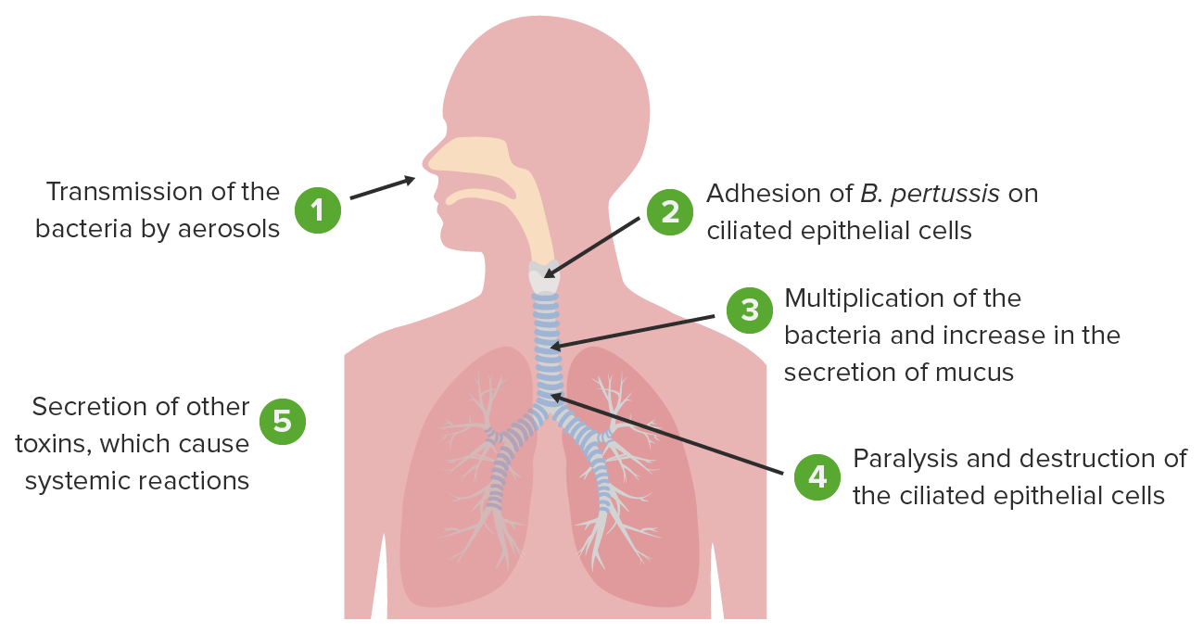

Slide 25
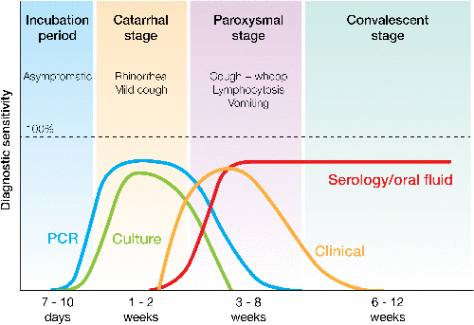

Slide 26
Pertussis Case Definition (2020)
Clinical Criteria
In the absence of a more likely diagnosis, a cough illness lasting ≥ 2 weeks, with at least one of the following signs or symptoms:
Paroxysms of coughing; OR
Inspiratory whoop; OR
Post-tussive vomiting; OR
Apnea (with or without cyanosis)
Laboratory Criteria
Confirmatory laboratory evidence:
Isolation of Bordetella pertussis from a clinical specimen
Positive Polymerase Chain Reaction (PCR) for Bordetella pertussis
Epidemiologic Linkage
Contact with a laboratory-confirmed case of pertussis

Slide 27
Pertussis in Massachusetts

Slide 28
Treatment
Antibiotic effects on the duration or severity of the disease are minimal when started in the catarrhal phase and not proven effective when started in the paroxysmal phase.
Primary goal of antibiotic treatment is to decrease the carriage and spread of disease.
Erythromycin (40 to 50 mg/kg per day, maximum 2 g per day, in 2 to 3 divided doses for 14 days) is the first-line treatment for pertussis.
Azithromycin (10 mg/kg per day on day 1 followed by 5 mg/kg on days 2 to 5) or clarithromycin (15 mg/kg per day in 2 divided doses for 14 days) are alternative treatments.

Slide 29
Prophylaxis
Giving postexposure prophylaxis to asymptomatic household contacts within 21 days of the original patient’s cough onset can prevent symptomatic infection.
Adults:
Azithromycin
500 mg in a single dose on day 1, then 250 mg per day on days 2 through 5
Erythromycin
2 g per day in four divided doses for 14 days
Clarithromycin
1 g per day in two divided doses for 7 days

Slide 30
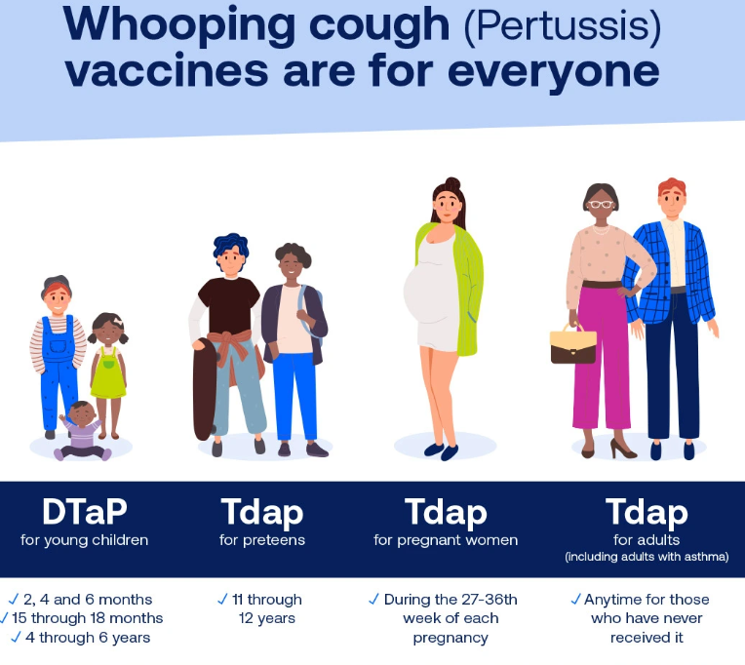

Slide 31
“You call the shots”
An interactive, web-based immunization training course
Consists of a series of modules that discuss vaccine-preventable diseases and explain the latest recommendations for vaccine use
Each module provides learning opportunities, self-test practice questions, reference and resource materials, and an extensive glossary
The course is available free of charge on the CDC Immunization Education & Training website at: http://www.cdc.gov/vaccines/ed/youcalltheshots.html

Slide 32
Distract adolescents to reduce stress and ease pain
Interact with adolescents throughout the appointment.
Use clinician-led distraction techniques (e.g., point out interesting things in the room and ask the patient to describe what they see, tell an age-appropriate story).
Use patient-led distraction techniques (e.g., games, videos, music, books).
Remind adolescents to stay focused on the distraction strategy if their attention wanders to the vaccination.
Suggest adolescents engage in slow, deep breathing or exhalation during vaccination.
Avoid telling adolescents “It won’t hurt.”

Slide 33
Administer vaccines using best practices
Select the correct needle size for adolescents (22–25-gauge 5/8–1 inch [16–25 mm] needle).
Consider using topical anesthetics on the skin upon arrival at the clinic, if requested.
Identify the injection site (preferred site: deltoid muscle in the upper arm).
Have adolescents sit upright or lie down during injection.
If sitting, ask them to:
Sit in a straight-backed chair
Rest their feet flat on the floor
Relax their forearms and place hands on their upper thighs
Relax their shoulders
When administering multiple vaccine injections to adolescents sequentially, inject the most painful vaccine last to reduce pain at the time of injection.
Administer vaccine using a rapid injection technique without aspiration.

Slide 35
Flovent
GlaxoSmithKline (GSK) discontinued the brand-name Flovent (fluticasone propionate) asthma inhalers, Flovent HFA and Flovent Diskus, on January 1, 2024.
Some insurance plans are covering generic Flovent. Others are requiring their members to switch to a different medication in the same class.
Alternate inhaled corticosteroids include beclomethasone (Qvar RediHaler), budesonide (Pulmicort Flexhaler), ciclesonide (Alvesco), and mometasone (Asmanex Twisthaler, Asmanex HFA).

Slide 36
Epinephrine nasal spray
Neffy is a needle-free nasal spray that can be used to treat severe allergic reactions, such as anaphylaxis, in adults and children who weigh at least 66 lbs.
Each dose lasts for 30 months and is administered into one nostril.
If symptoms don't improve or worsen, a second dose can be given using a new nasal spray in the same nostril after waiting five minutes.
Side effects may include nervousness, headache, tremors, sneezing, and nasal discomfort.

Slide 37
EpiPen vs Neffy
EpiPen
Autoinjector - needle
Large, bulky
Two doses
Prescription required
Retail cost $650-$700
Keep at room temperature
Shelf life 18 months
Neffy
Nasal spray – needle free
Small, compact
Two doses
Prescription required
Retail cost $199
Storage in heat or cold
Shelf life 2^{1/2} years

Slide 38
Open Forum
https://www.surveymonkey.com/r/STB5NGG

Slide 39
Regional Medical Specialists Contact us with policy or clinical questions
John Kulig MD MPH Region 1 Boston & Region 2 Philadelphia
Gary Strokosch MD Region 3 Atlanta & Region 5 Chicago
Drew Alexander MD Region 4 Dallas
Sara Mackenzie MD MPH Region 6 San Francisco
HIPAA compliant messages => use @jobcorps.org email address

Slide 40
Monthly Teleconference
Next call: Wednesday, September 25th, 2024
Center Physician Call - September 2024 Sep 25, 2024, 2:00 – 3:00 PM (America/New_York) Please join my meeting from your computer, tablet or smartphone. https://meet.goto.com/707495997 You can also dial in using your phone. Access Code: 707-495-997 United States: +1 (571) 317-3122 Get the app now and be ready when your first meeting starts: https://meet.goto.com/install

