Slide 1
Introduction to
Mental Health and Wellness Services
Career Preparation Period Presentation for Students
Part 1–Mental Health and Wellness Program and Services
Part 2–Identifying and Responding to a Mental Health Crisis

Slide 2
Objectives
Provide overview of mental health and wellness program and services.
Explain how to make a self-referral.
Teach basic skills for identifying and responding to a mental health crisis.

Slide 3
Mental Health and Wellness Program and Services
PART 1

Slide 4
Mental Health and Wellness Program
Help you learn:
To develop healthy lifestyle choices to increase your chances of completing the program, getting a job and remaining employed.
Ways to deal with stress, depression, anxiety, low self-esteem and many other things that can get in the way of being successful and employed.

Slide 5
Mental Health and Wellness Program
I am ___________________, your mental health and wellness provider and my title is Center Mental Health Consultant (CMHC).
My office is in the Health and Wellness Center and I am on center_____________________.

Slide 6
Available Services
The mental health and wellness program provides:
  Assessments
  Mental Health Promotion and Education
  Treatment
Let’s talk about each one of these so you have a clear idea of what is available to you.

Slide 7
Assessment
All students complete the Social Intake Form (SIF) with their counselor during the first couple of days.
This form helps us know some of the challenges you have faced and how we can best help you.
Your counselor or a CMHC may follow up with you after you have completed this form in order to explore ways to support you here at Job Corps.

Slide 8
When to Come Talk With Me?
If you have feelings, thoughts, or behaviors that seem to get in the way of your success, I may be able to help you figure out why.
If you have a mental health condition, I can help you determine if you need additional assistance or qualify for accommodations. Accommodations are things like extra breaks or a shortened training day to help manage mental health symptoms.

Slide 9
Mental Health Promotion and Education
I can provide:
Information and education on how to maintain good mental health, like managing stress and good sleep habits.
Information and education on mental health topics like depression, anxiety and how it impacts employability.
Opportunities for you to learn how to make healthy decisions now and once you graduate.

Slide 10
Treatment
  Short-term counseling
    We provide a limited number of individual sessions to help you learn skills and strategies on managing problems or dealing with mental health issues that may make it hard for you at Job Corps and in the workplace.
  Substance use issues
    Many times mental health issues and substance abuse go hand in hand. Along with the TEAP Specialist, I can help you understand this relationship and make healthy choices for yourself.
  Medication referrals
    Sometimes, in addition to learning new skills and strategies, medication can be helpful in managing mental health symptoms.

Slide 11
Treatment Continued
Group referrals
  On our center we have the following groups:________________________________________________________________________________________________________________________
Off-center referrals
  If needed, we can arrange for additional services off center at the local community mental health center or specialized support services.
Notes:
Why attend a group?
A group can improve the way you interact with others and you can learn and practice new behaviors. Many students are dealing with similar issues and in a group you can learn new positive behaviors together. Positive behaviors you can practice here at Job Corps and use in the workplace.

Slide 12
Treatment Continued
The mental health and wellness program also includes:
Help during a crisis
  Crises can include many things from a death in the family to thoughts of suicide. Your CMHC is trained to help you during a crisis.

Slide 13
Appointments
A couple of ways to make an appointment:
  Go to the Health and Wellness Center and request to make an appointment to see the CMHC.
  Ask your career counselor to send a referral to the CMHC for you.
  TIP: The CMHC may not be on center every day.

Slide 14

Questions?

Slide 15
Identifying and Responding to a Mental Health Crisis
Part 2
Notes:
Part 2 can be done on a different day/week during CPP

Slide 16
Introduction
Being a Job Corps student can be an exciting time of your life, and an opportunity for growth.
However, you or one of your friends may also have experiences that are difficult to manage alone. You may be coping with relationship difficulties, family problems, financial concerns, significant stress, grief or loss, or struggling with one of a variety of mental health issues.

Slide 17
Introduction
Many people have a hard time asking for help, because we assume that we should be able to handle problems on our own.
However, there are some situations where having a helping hand can be key in overcoming those problems. We can all help each other by knowing how to identify and respond to a mental health crisis.

Slide 18
Mental Health Crisis
Crisis of the Mind or Spirit
  Experiencing thoughts of suicide
  Experiencing anger, aggression, and/or the threat of violence
Let’s briefly talk about each one of these before we talk about what to do if you or someone else is having a mental health crisis.
www.MentalHealthFirstAid.org
Notes:
There are other forms of mental health crises, but we will focus on these two.

Slide 19
Thoughts of Suicide
Sometimes people experience such overwhelming emotional pain that they believe ending their life is the only way to feel better.
Most suicidal persons desperately want to live and have tried to communicate their pain to others.
Know the warning signs and take all signs of suicidal behavior seriously.
Most suicides are preventable.
www.MentalHealthFirstAid.org
Notes:
After suicide is preventable, tell students---“We know if we can help the person through their immediate pain and crisis that they will feel better"

Slide 20
Thoughts of Suicide
Warning Signs
Threatening to hurt or kill self or talking about wanting to kill self
Looking for ways to kill self
Seeking access to pills, weapons, or other means of killing self
Talking or writing about death, dying, or suicide
Expressing feelings of hopelessness, uncontrollable anxiety, rage, or revenge
Engaging in reckless or risky behaviors
Withdrawing from family and friends
Expressing a lack of purpose and meaning in life, no reason for living
Giving away personal items, changing a will
Loss of loved one, job, pet, home, independence
www.MentalHealthFirstAid.org
Notes:
The Warning Signs in Red mean DO SOMETHING NOW (to help students know when they should immediately get help)

Slide 21
Anger, Aggression
Threat of Violence
Anger is a feeling coming from how we see a situation (often as wrong, unfair) and our ability to cope.
Aggression is a behavior that is sometimes caused by anger--people may act out their angry feelings by threatening to harm others.
Anger and aggression can lead to threats of violence.
www.MentalHealthFirstAid.org

Slide 22
Threat of Violence
Warning Signs
Constantly reporting feeling disrespected
Threatens to hurt others
Withdraws from friends and feels rejected or alone
Inappropriate fascination with guns and/or weapons or other violent incidents
Depression: comments about suicide
Essays or art work that indicate extremes of hopelessness, social isolation, despair, rage, death
Talks about bringing weapons on center
http://www.apa.org/helpcenter/warning-signs.aspx#
Notes:
The Warning Signs in Red mean DO SOMETHING NOW (to help students know when they should immediately get help)
CMHC TIP: Psychologists emphasize several important principles to observe when early warning signs appear evident: (1) do no harm—early warning signs should not be used as a rationale to exclude, isolate, or punish a student; (2) understand violence and aggression within a context—there may be many antecedent factors, in the home and/or school, for students at risk of committing violent acts; (3) avoid stereotypes—it is important to be aware of false cues, including race, socioeconomic status, learning difficulties, or physical appearance; (4) view warning signs within a developmental context—know what is developmentally appropriate behavior so that supposed warning signs are not misinterpreted; (5)understand that students typically exhibit multiple warning signs—research confirms that most students at risk of aggression exhibit more than one warning sign repeatedly and with increasing intensity over time.

Slide 23
If YOU Are Experiencing a Mental Health Crisis
A few options
  Let a staff member know. This could be your counselor or any staff member you feel comfortable talking to.
  Let a friend know and ask them to get help for you.
  Come to the Health and Wellness Center & ask to speak with a staff member.
  Call/text the Job Corps Safety Hotline: 1-844-JC1-SAFE.
  Call the crisis lifeline: 1-800-273-TALK.
  If you’re off center, go to the nearest emergency room or call 911.

Slide 24
If Someone Else is Having a Mental Health Crisis
3 Steps
  Ask the Question and/or assess the safety of the situation
    See if the person is so upset that they may hurt themselves or someone else.
    If you can’t ask the question, find someone who can.
    If the situation is unsafe, do not intervene. Go and get help immediately.
  Listen and Persuade
    Let the person tell you what is going on.
    Offer hope to the person and get them to agree to get help.
  Refer for Help – Don’t Wait
    Counselor
    Health and Wellness Center
    Any staff member you feel comfortable telling
www.qprinstitute.com

Slide 25
Q = QUESTION
Ask the question!
“You know, when people are as upset as you seem to be, they sometimes wish they were dead. I’m wondering if you’re feeling that way, too?”
“You look pretty miserable, I wonder if you’re thinking about hurting yourself or someone else?”
“Do you want to hurt yourself or someone else?”
“Sometimes when people are really upset and overwhelmed they wish they were dead. Do you feel that way?”
www.qprinstitute.com
Notes:
CMHC TIP: Asking about suicide is hard for most people for many reasons. Suicide is a taboo subject and we don’t want to believe that someone would actually consider killing themselves. We feel insecure about asking if we “aren’t sure” and many of us carry around the additional fear that we will “drive someone” to suicide by “planting the idea.” There is no evidence that asking about suicide leads people to commit suicide. There is a lot of evidence that asking can save lives. Another fear is that we are often afraid to ask the question because we won’t know what to do if someone acknowledges feeling suicidal. Now we have a responsibility to get them help. Part of the purpose of this presentation is to help students feel confident that they know how to get the person help once identified. Suicide prevention is everyone’s job.

Slide 26
P = Listen and Persuade
Listen to friends who share upsetting thoughts or display troubling, harmful, or dangerous behavior, and encourage them to seek help from their residential advisor, counselor, instructor, health and wellness center, or other trusted center staff member.
“Will you go with me to talk with your counselor?”
“Would you like me to tell your counselor that you would like to talk to him or her?”
“I want to take you to the Health and Wellness Center to get more help. Will you go with me?”
www.qprinstitute.com
Notes:
CMHC TIP: The goal of listening is to better understand the individual’s situation so that you can provide hope that the problems can be overcome (that suicide or violence is not the only solution). The persuasion is about helping the person understand that there is help for their problem and you know where they can find it (persuading them to follow up with necessary resources).

Slide 27
R = Refer
Make sure the person gets help or you let someone know that they need help.
  Counselor
  Health and Wellness Center
  Center security
  Any staff member you feel comfortable with
  If you’re off center, go to the nearest emergency room or call 911.
  Call the JC Safety Hotline 1-844-JC1-SAFE.
  Call a crisis lifeline: 1-800-273-TALK.
DON’T WAIT!
www.qprinstitute.com

Slide 28
Person Doesn’t Agree to Get Help
If you are concerned someone is suicidal or may hurt someone else…
  Don’t worry about breaking trust or being disloyal.
  Don’t worry that you may not have “enough” information to call for help.
  This is not “snitching.”
  GET HELP!
You may save someone’s life.
Notes:
“It is better to have an angry friend than a dead friend.”
I would also emphasize how it is important to look out for each other (it is not snitching) because sometimes the person who is depressed and may become suicidal does not recognize they are becoming depressed since it happens gradually.

Slide 29

  24/7
  CALL
  TEXT
  CHAT
  Free, confidential mental health support.

Slide 30
Job Corps Safety Hotline
WHAT IS IT?
National, toll-free hotline for:
  JC students and staff
  Urgency-based counseling with multilingual counselors & social workers
  Problem-solving for safety and security concerns
  Available 24-7
1-844-JC1-SAFE

Slide 31
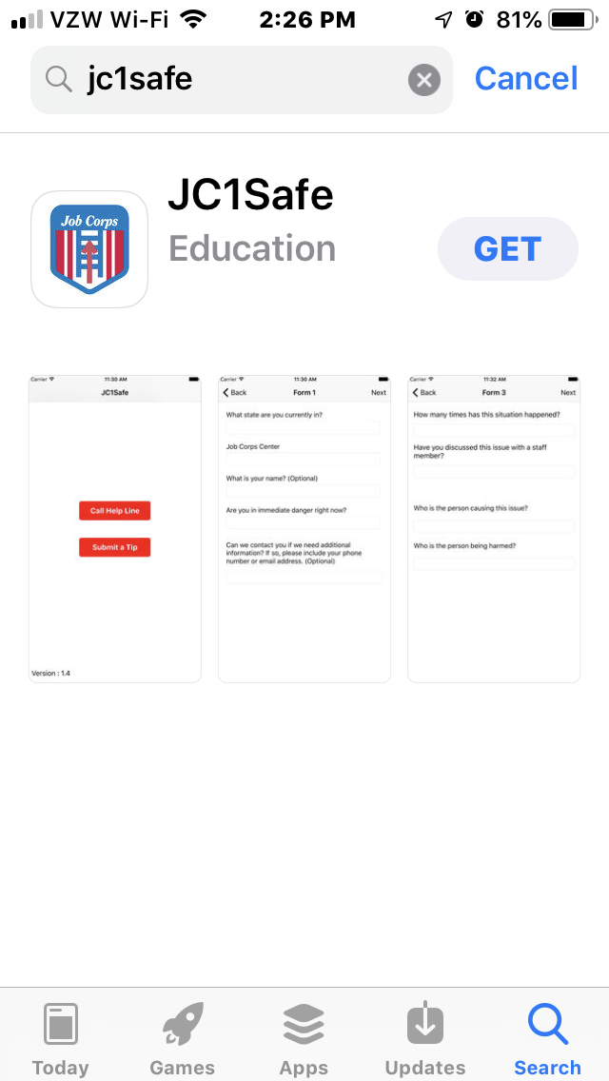
JC1 Safe App
Download the app now.
Add the Safety Hotline to your contacts:
1-844-521-7233
Take a pic of the wallet card.

Slide 32

Job Corps Safety Hotline
WHAT DO I USE IT FOR?
For yourself
For a friend or someone you know on center
Any issue or concerns related to emotional or physical safety on center

Slide 33
Job Corps Safety Hotline
HOW DO I USE IT?
Call or Text: 1-844-JC1-SAFE
  1-844-521-7233
Email: jc1safe@jobcorps.org
Online: jc1safe.jobcorps.org
Download: JC1SAFE app

Slide 34

Job Corps Safety Hotline
WHAT ELSE DO I NEED TO KNOW?
You can report anonymously (you don’t have to give your name)
Students and staff are protected against retribution, isolation or retaliation (you cannot get in trouble for calling the hotline)
Information is shared with the Center Response Team for follow-up on center as needed.

Slide 35


Help is available 24/7
National Suicide Prevention Lifeline
1-800-273-TALK (1-800-273-8255)
En Español: 1-800-628-9454
Text HOME to 741-741
Chat at suicidepreventionlifeline.org/chat/
Deaf/Hard of Hearing: 711, then 1-800-273-TALK
Notes:
You can suggest that students take a picture of this slide with their cell phones. Be sure to tell them that the there is longer wait when using the text line.

Slide 36
Scenarios
Notes:
Let’s look at each vignette and address each of the questions
Talking Point
General: Each slide has recommended warning signs embedded in the notes of the slide.

Slide 37
Responding to
Suicidal Thoughts
Morgan is an 18-year-old female who was only able to finish the 8th grade. Morgan has difficulties learning new skills and can’t seem to pass the GED. Because of what appears to be her “slowness” and her appearance, she is often teased by peers. This makes her very angry and she has started to withdraw from people and activities. She is starting to give away some personal belongings and recently told a friend that she had “had enough.”
What are the warning signs?

Slide 38
Morgan (cont’d)
Let’s assume you know Morgan, and are aware of her problems, which of the following would be the best response?
  If I had known she was angry about being “teased”, I would talk to her to see if she was alright. I would ask her if she felt suicidal. If she said yes, I would convince her to see the CMHC in the morning. I would tell her that I would go with her the next day.
  In Job Corps, students and staff are always joking with each other. That’s how we all deal with the stress. If you can’t handle the ribbing, you should probably not be at Job Corps.
  When I heard that she had “had enough”, I would immediately ask her if she was thinking of suicide. If she said yes, I would stay with her, and tell another friend to get the residential advisor. I would not leave her alone until she saw the RA or counselor.
Notes:
WARNING SIGNS: Giving away personal items; verbalizing “having had enough”; peer hazing
Option 1 was fine until the student was left alone. What was wrong with leaving the student alone until the next day?
Option 2 is a problem. Discuss why this was the wrong choice.
Option 3 is the best. When the student indicated she had enough, this was a warning sign that should receive immediate attention. You should directly ask the student about his or her suicidal thoughts. You should seek assistance for the student You should stay with the student until assistance is provided.

Slide 39
Responding to
Threat of Violence
Tarik is quiet and doesn’t seem to have many friends. He never talks in class. When he’s called on, he usually just shakes his head. While he doesn’t talk to teachers, other staff on center, or other students, Tarik seems comfortable communicating through writing and drawing. From what you’ve seen of his work, he tends to focus on dark and depressing subjects. Recently, everything you’ve seen of his has focused on death and murder of lots of people. He used to at least play cards with you, but now he is not doing that.
What are the warning signs?
Notes:
Warning Signs
Withdraws from friends and feel rejected or alone
Essays or creative work that indicate extremes of hopelessness, social isolation, despair, rage, death

Slide 40
Tarik (cont’d)
Let’s assume you know Tarik, and are aware of his problems, which of the following would be the best response?
Wait to see what happens.
Assume Tarik is just going through a rough time and ignore his writings and drawings.
Try to talk with Tarik, ask the question if he is thinking of hurting himself or someone else. Encourage Tarik to set up an appointment with the CMHC tomorrow.
Tell a staff member about your concerns immediately.
Notes:
The correct answer is: 4.
Do not want to wait to see what happens. Tarik shows many of the warning signs we discussed earlier in this module. It may be nothing, but do you really want to take that chance? If you simply encourage Tarik to set up an appointment with the CMHC, chances are he will not follow through since he is not comfortable talking to staff. Note: Take all threats seriously. Err on the side of responding to a threat. It is far better to overreact to something than to remain quiet or to wait and see what happens.

Slide 41
Finally
If you feel that any situation is unsafe, do not get involved physically. Contact center staff or, if you are off center, call 911.

Slide 42
Questions?

Slide 43
Reminder
The mental health and wellness program is here to help maintain a safe environment, to support you while in Job Corps and help prepare you for the work environment.
Again, I am ______________, your Center Mental Health Consultant (CMHC).
My office is in the Health and Wellness Center and I am on center _______________________________.

