Slide 1
INFECTION CONTROL
Job Corps Oral Health Teleconference
Brian Swann, DDS, MPH
August 15, 2024

Slide 2
CDC Guidelines for Infection Control in Dental Health Care Settings

Slide 3
Breakdown Areas
Unsafe injection practices
Failure to heat sterilize handpieces
Failure to monitor spore testing and autoclaves
Failure to clean waterlines regularly

Slide 4
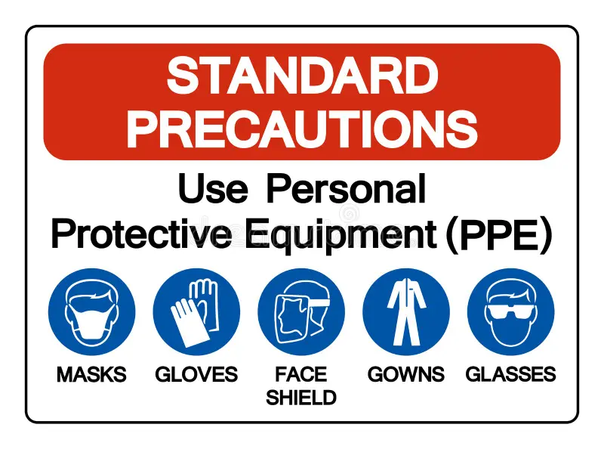
Standard Precautions
Hand Hygiene – make sure the patient can see and/or hear you washing your hands and donning your gloves
Personal protective equipment (PPE) – gloves, masks, eyewear, face shield, gowns, head cover
Clean and disinfect environment surfaces
DO NOT wash disposable gloves for reuse
Notes:
2007 Guidelines for Isolation Precautions
Infection Control in Health Care Facilities

Slide 5
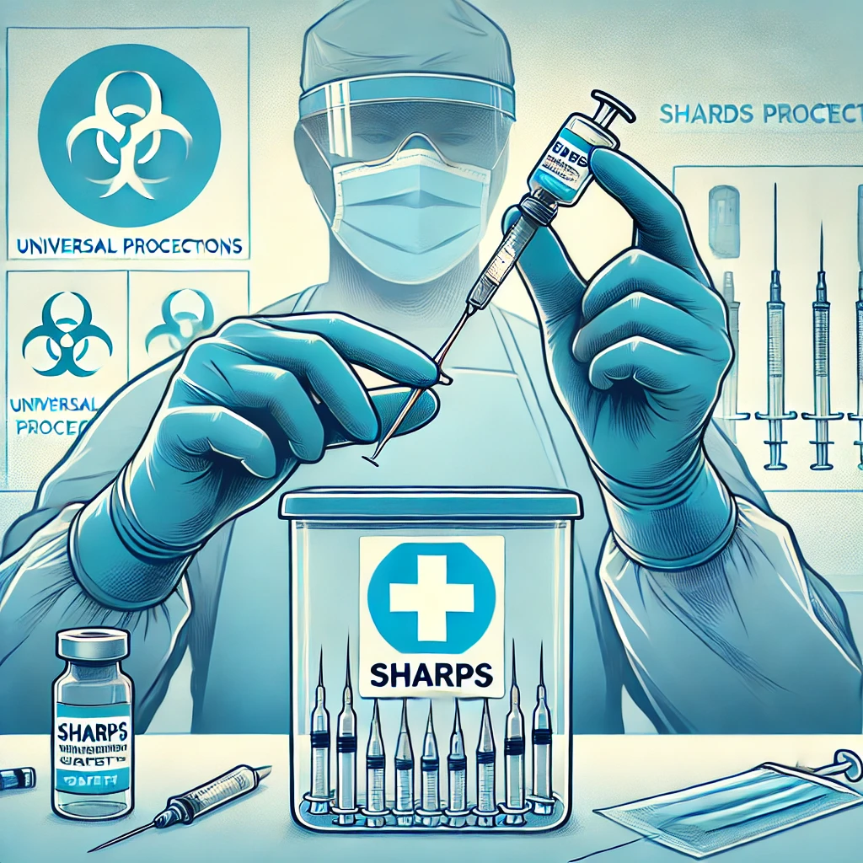
Standard Precautions – Sharps Safety
Needle stick, cuts
Risk of bloodborne pathogen transmission
Engineering to prevent or reduce injuries
Sharpe protection devices, recapping and sharps containers
Safe injections
Not using fingers to dismantle burs or scalpel
Passing instruments

Slide 6
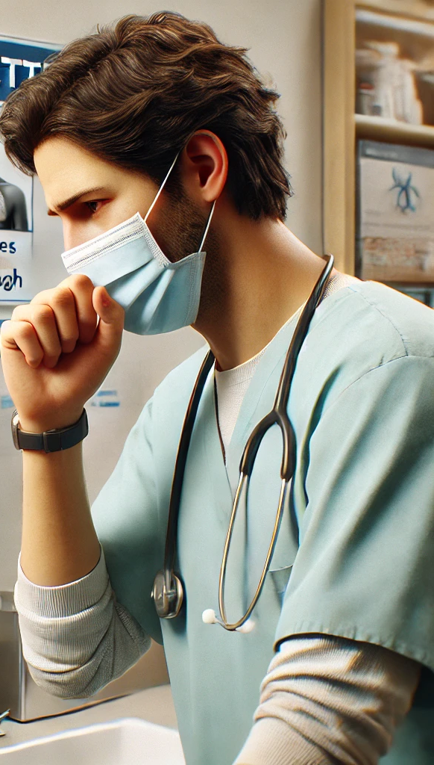
Respiratory Hygiene and Cough Etiquette
Flu season and COVID
Signs - cough, sneezing, congestion, secretions (patient) = undiagnosed transmission infections
Signage - cover mouth, use disposable tissues, mask
Hand hygiene station near waiting area
Spacing
Cultural practices (flushing, hand hygiene, blowing nose)
Notes:
2007 Guidelines for Isolation Precautions

Slide 7
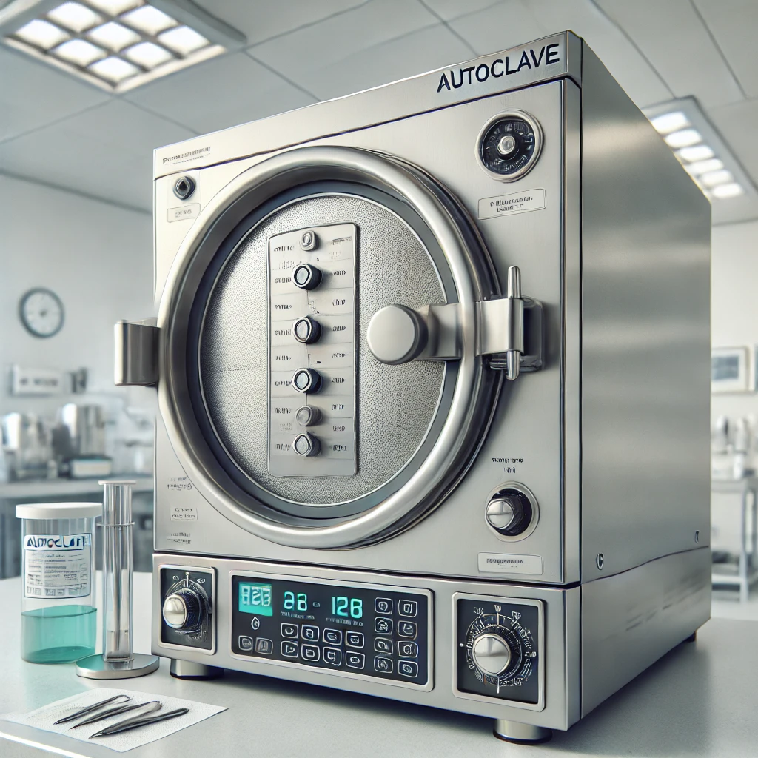
Sterilization and Disinfecting
Training
PPE
Patient Care Items
penetrate tissue (surgical and scalers)
semi critical (mouth mirrors, burs, condensers, impression trays)
handpieces and contra angles
Radiography sensors and barriers
Heat sterilization of holders

Slide 8
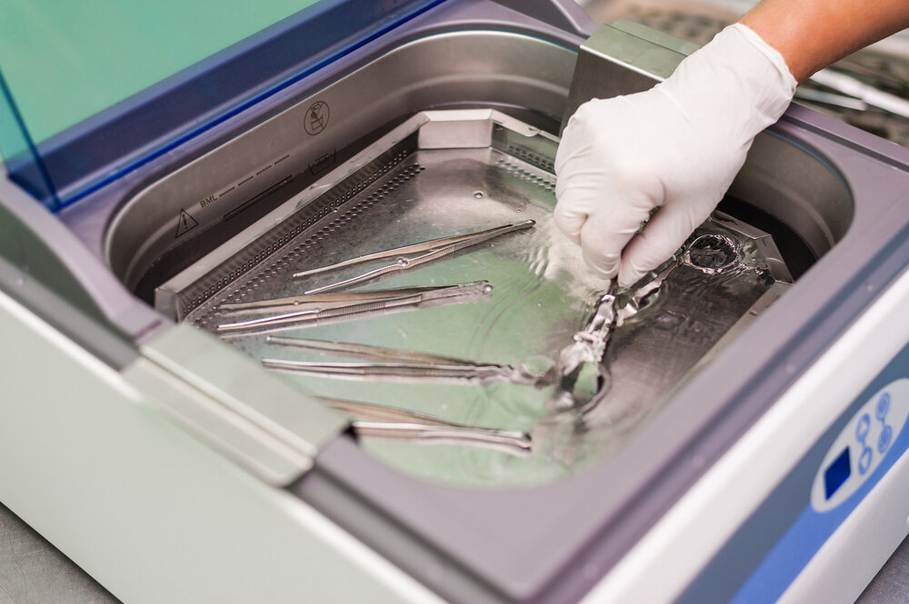
Sterilization Protocol
Ultrasonic cleaning or washer
If hand washing instruments, use heavy duty gloves
Dried and inspected, wrapped, and packaged for heat sterilization
Label packages by date and which sterilizer used

Slide 9
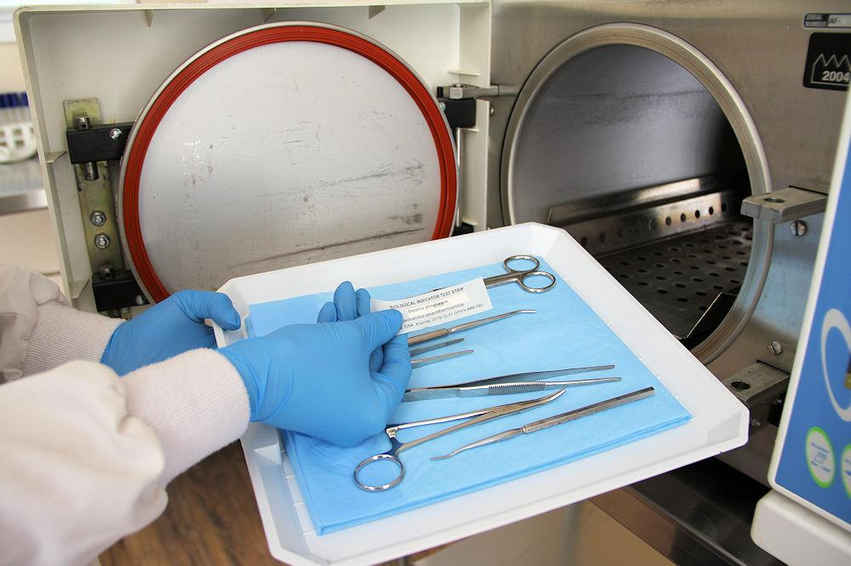
Spore Testing
Test weekly (lab)
Record results and keep in a notebook
Notes:
Guidelines for Disinfection and Sterilization in Healthcare Facilities”, 2008

Slide 10
Key Recommendations for Environmental Infection Prevention and Control in Dental Settings
Establish standard operating procedures (SOP) for routine cleaning and disinfection of environmental surfaces
Use barriers for difficult to clean areas such as light switches, computer equipment, handles
Clean and disinfect clinical contact surfaces with registered hospital disinfectant after each patient
Select EPA-registered disinfectants or detergents
Follow manufacturers instructions

Slide 11
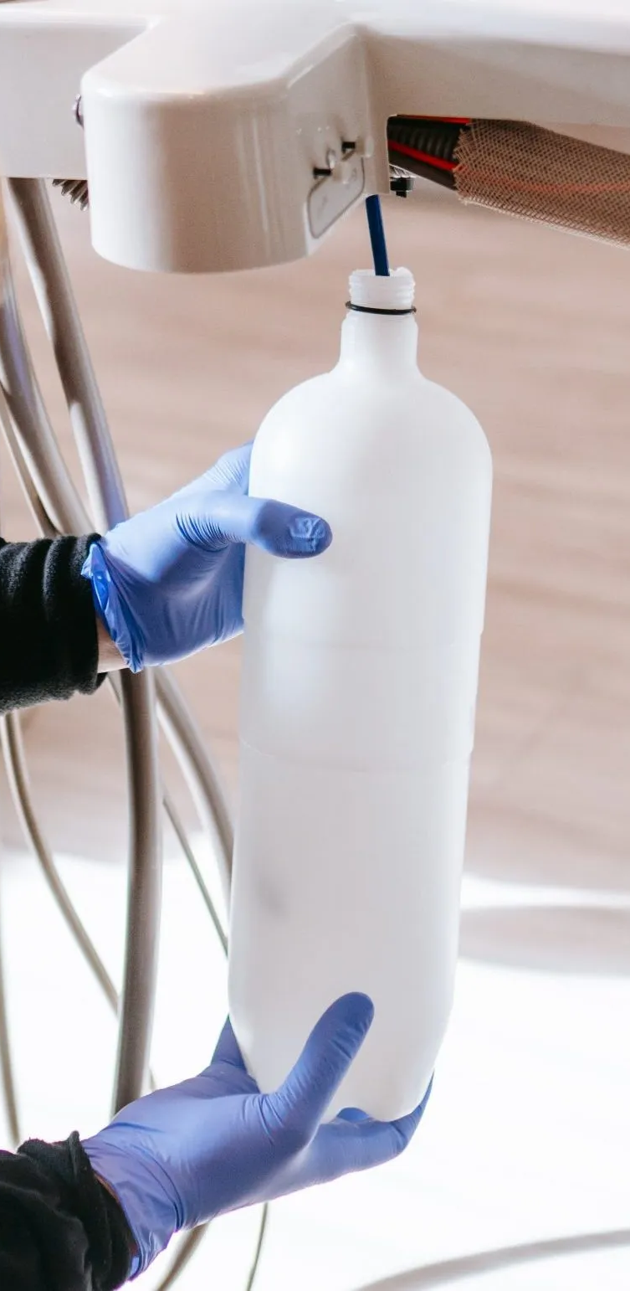
Dental Unit and Waterlines
Plastic tubing running through the units and through the handpieces promotes bacterial growth and develops biofilm.
Purge dental unit waterlines each night and whenever units are out of service to prevent stagnate water
Discharge water and air lines for minimum of 20 to 30 seconds after each patient
Monitor for damage. Be alert for signs of biofilm including musty odor, cloudiness, water particulates or clogging

Slide 12
Duties
Hygienist:
Sterilize and clean instruments (ultrasound and inspect)
Waterlines
Disinfect environmental surfaces
Disposable barriers
Dental Assistant:
Disinfect environmental surfaces
Eyewash station
Spore testing
Waterlines
Clean or change traps and filters
Disposable barriers
Sterilize and clean instruments (ultrasound and inspect)

Slide 13
Regional Oral Health Specialists
Brian Swann, DDS, MPH
Regions - 2/Philadelphia, 3/Atlanta, 4/Dallas
Swann.Brian@Jobcorps.org
Brian.Swann@humanitas.com
Mobile: 617.529.4401
Pamela Alston, DDS, MPP
Regions -1/Boston, 5/Chicago, 6/San Francisco
Alston.Pamela@Jobcorps.org
Pamela.Alston@humanitas.com
Mobile: 510.325.6005

Slide 14
Questions?

Slide 15
Post Op
• ACTIVITY: Plan to rest for the remainder of the day of surgery. Avoid strenuous activity for at least 24
hours after oozing has stopped from the surgical site. If you have had sedation or general anesthesia, you
should not drive a vehicle, operate any machinery, or make important decisions for 24 hours following
intravenous anesthesia.
• ORAL HYGIENE: Brush your teeth gently, avoiding the area where the procedure was performed. On
the day of surgery, avoid toothpaste. Starting the next day, use a smaller amount of paste than usual.
Starting the day after surgery, gentle rinsing with salt water or saline can help keep the site clean. Avoid
using a Water Flosser until your site is fully healed.
You can purchase saline at any pharmacy or make your own salt solution at home. Place one teaspoon of
salt in 1 cup of warm salt water and stir until dissolved. Allow to cool to lukewarm before using. Instead
of spitting, simply let the water fall from your mouth into the sink. Do not swallow.
• SMOKING: Smoking increases your risk of poor healing and a painful (though not dangerous)
condition known as “dry socket.” Please avoid smoking or vaping for 7 days after surgery.

Slide 16
Post Op (cont.)
• DO NOT SLEEP WITH GAUZE IN YOUR MOUTH!
• SWELLING: Swelling is expected after surgery. Ice and keeping your head elevated while sleeping can
help minimize swelling. You should expect peak swelling approximately 48 hours after surgery.
• ICE: Ice is helpful in reducing both pain and swelling. Apply ice to your face (on the side or sides
where surgery was performed) in 20-minute intervals, taking care to protect your skin from the cold with
a cloth or several layers of paper towel. Remove ice for 20-minutes before replacing. Use for 24-48
hours.
• ANTIBIOTICS: Sometimes (but not always) antibiotic medications are prescribed after oral surgery to
help prevent or treat infections. If an infection is present at the time of your consultation, you may be
prescribed an antibiotic at that time. Be sure to take the medication as prescribed and finish the entire
course. Please contact us if you are experiencing any side effects from the medications. Be sure to drink
plenty of water when taking these medications and consider a gut supplement like a probiotic (over the
counter) if you have a history of upset stomach with antibiotics in the past.

Slide 17
Post Op
ALCOHOL
The use of alcohol impairs wound healing. Please avoid for 7 days after surgery.
DIET
Make sure to stay hydrated after surgery. Avoid very hot foods and liquids while you still have numbness to avoid burning yourself. Soft foods should be consumed for the first few days after surgery. Sometimes you will be advised to follow a soft diet longer, but if not specifically instructed, you can resume a normal diet once you are feeling less sore.
Soft food examples: Yogurt, milkshakes/smoothies (no straws!), ice cream/sorbet, gelatin, pudding, applesauce, mashed potatoes, soups, scrambled eggs, overcooked pasta, etc.
Foods to avoid: Popcorn, chips, nuts, carrots, apples, etc. Crunchy foods or foods with small pieces (like rice) should be avoided until the sites are fully healed.
WHEN TO SEEK MEDICAL ATTENTION
Even if you are careful to follow the post-operative instructions, issues can arise. Please seek medical attention right away or contact your dentist / surgeon if you are experiencing:
Bleeding that does not stop with gauze and pressure
Signs of infection (fever more than 24 hours after surgery, pus, significant swelling that does not improve, etc.)
Changes in your breathing or swallowing (
Signs of allergic reaction (rash, itching, swelling, etc.)
Pain that is persistent and severe, despite taking medications as directed
Numbness that is present more than 24 hours after surgery
Not feeling back to normal within 2 weeks after surgery

Slide 18
Post Op Instructions (abbreviated version)
Post op Instructions MGH:
“Post-Operative Recommendations: Gauze may be removed to drink but should be replaced after. No need to continue biting on gauze if hemostatic after 30 mins. Replace gauze and have patient bite for 30 more mins if suture sites continue to ooze mildly after 30min of biting pressure, please replace gauze. Ensure gauze is moist, as dry gauze can stick to blood clots and dislodge them. FOR BLEEDING: 1) Continuous gauze pressure for 30-60 mins 2) If bleeding persists have patient bite on moistened tea bag for 30-60 minutes 3) Gauze pressure with Amicar soaked gauze (5cc = 1.25g) if tea bag is not effective - Pain control typically, NSAIDs/acetaminophen standing q6h are sufficient, with narcotics such as oral oxycodone for breakthrough pain. - Ice to face (20 min on / 20 min off) starting immediately post-op, for 3 days. - No straws, smoking, forceful swishing, or spitting for 7 days. - May rinse gently with Peridex (Chlorhexidine Gluconate 0.12%) BID starting on post-op day 3, for 7 days. - May rinse gently with warm salt water after meals (at least QID) starting on post-op day 3, for 7 days. -No forceful swishing or spitting; instruct patient to tip their head side to side to let the rinse roll around gently inside the mouth, then allow the rinse to passively "drool" out of mouth into sink - Pt DOES NOT need to remain NPO post-operatively. -Recommend PO liquids until local anesthesia wears off (~1-2 hours) then ADAT. - Avoid very hot foods/beverages for 3 days post-op. - Avoid hard/crunchy foods and foods with small seeds, nuts, or rice for 7 days. - Suture placed is resorbable--it should dissolve on its own in the next few days, but may take up to 1-2 weeks. There is no need to return for suture removal. The suture dissolves through a natural inflammatory process in the gingiva, which may cause some mild localized erythema and tenderness in the suture area while it is being resorbed. Mild to moderate swelling, bruising, and tenderness/pain is expected up to 72h post-op; typical peak of post-op inflammation with maximal tenderness/pain, soreness, swelling, bruising is expected on post-op day #3--patient should begin to feel resolution/down trending of tenderness and swelling in the next few days after that. If pain persists or significantly increases 1 week post-op, or if patient develops a fever, please call the office for further evaluation.”

