Slide 1
TEAP CPP Presentation
[Insert TEAP/Presenter’s name]
[TEAP Specialist/role on center]
Notes:
Note to TEAP specialist – Prior to presentation
1.) Review the PPT as there are several places you need to add your own center specific information.
2.) Develop icebreaker activities (available on website in TEAP section and the document is called, ”TEAP CPP Icebreakers." See slide 3 for more information.
3.) Many of these slides have specific information that needs to be shared with the students. On certain slides (such as slides 8-11), consider reading the slide to make sure the information is accurate as this is a new policy.
4.) Review Program Information Notice 22-16, print out or be prepare to electronically distribute the CDC’s “How and When to Use Naloxone for an Opioid Overdose.”
5.) Get the CDC 's Lifesaving Naloxone video ready to show (slide 13).

Slide 2
Job Corps’ Mission
As a national primarily residential training program. Job Corps’ mission is to attract eligible young adults, teach them the skills they need to become employable and independent, and place them in meaningful jobs, higher education, or the military.
Notes:
Consider asking students for examples of their goals and/or why they entered Job Corps.

Slide 3
Introductions
TEAP is the Trainee Employee Assistance Program
I am the TEAP specialist, and my name is [insert name]
[Insert here any other details you want to add about yourself as the TEAP specialist.]
My hours on center are: [insert]
My office is located at: [insert]
Today we are going to spend the next hour talking about the TEAP program
Notes:
Use this slide to introduce yourself and the TEAP. Emphasize that you are available to meet with any student.
After introductions – you may want to do an interactive exercise with the students as a way to increase rapport and get to know them.
Examples are available on the JC Health Support Services website and the document is entitled TEAP CPP Icebreakers.

Slide 4
What is the Overall TEAP Goal?
TEAP is a center-wide alcohol and drug prevention and education program that assists you with preventing or reducing barriers to employability.
We help students develop appropriate health and wellness practices that will enhance their ability to obtain/maintain employment.
TEAP has many components:
Prevention and education activities
Drug testing program
Relapse Prevention Program
Identify students who need support or are engaging in risky activities
Let’s talk about these pieces BUT first to be an educated consumer – you need to understand what happens to your information/drug tests results
Notes:
This is an introduction slide and the details for each component are discussed later.
Main point is that TEAP is about ways to increase each student's employability which is what Job Corps is all about.

Slide 5
TEAP and Confidentiality
We take your privacy very seriously.
Your drug/alcohol test results are only known by Health and Wellness staff.
It may be shared with other appropriate staff members who have a specific reason to need this information (This is called a “need to know” and protected by federal statutes (42 CFR Part 2 and HIPAA)).
What you tell me is kept confidential (except for exceptions, such as self-harm)
You signed Form 6-02 during the admission process which outlined how TEAP information is shared with other center staff (Form 6-02: Authorization for Use and Disclosure of Your Health Information).
Notes:
Remind students part of goal for Wellness is to help them be more informed consumers of wellness services.
Ask if they have questions as this may be new information to some students.

Slide 6
Job Corps is a Drug-Free Program
We know from experience that the use of drugs and/or alcohol makes a huge impact on a student’s ability to complete this program and to meet academic and/or career goals.
Drugs and alcohol are some of the biggest stumbling blocks for students in Job Corps. We can help you!
When you signed up, you signed a form and agreed to remain drug and alcohol free while at Job Corps.
Job Corps is an alcohol- and drug-free living and working environment.
You must abstain from all drug use (meaning federally illegal substances or mood-altering substances you do not have a legitimate prescription for) after arrival at Job Corps.
Drug testing is about workplace safety and worker health so, like other workplaces, Job Corps conducts drug testing.
Notes:
Read each bullet point out loud to students.
Ask if there are questions.
Encourage students to share what they understand this says and why it is important.

Slide 7
10 Drugs on Job Corps Drug Test
Marijuana/Cannabinoids/THC
Cocaine
Opiates (codeine, morphine, heroin)
Fentanyl
Amphetamines/methamphetamines
Phencyclidine (PCP)
Barbiturates
Benzodiazepines
Hydrocodone/hydromorphone (Vicodin)
Oxycodone/oxymorphone (percocet, oxyContin)
Notes:
Emphasize this a common panel for drug testing in the workplace.

Slide 8
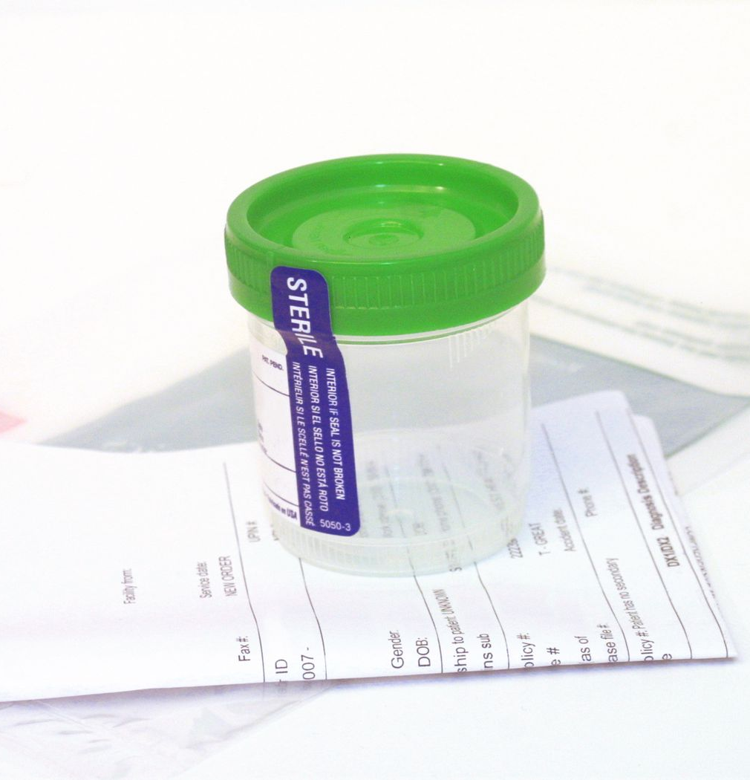
Drug Testing Information
Drug testing occurs for everyone on entry within 2 days of arrival.
If your drug test is positive on entry, then you will be retested on a follow-up test and we will talk about more on the next slide.
If you are reasonably suspected of using drugs at any time, then you will be tested on suspicion. If you test positive, you will be separated from Job Corps and removed from the campus immediately due to the program's zero-tolerance policy for drug and alcohol abuse.
Some trades at Job Corps, heavy machinery operator and CDL operator for example, participate in the Department of Transportation (DOT) random drug testing pool. If you are a trade like this, you may have random drug tests.
We have chain of custody procedures in place just like any other workplace.
Notes:
All students at Job Corps must participate in drug testing to ensure workplace safety.
Make sure you are providing this specific information listed on the slide.
Read each bullet point out loud.
Give examples of chain of custody procedures such as checking the temperature and bluing agent in toilet. Explain this is standard practice for workplace drug testing.

Slide 9
What Happens if My Entry Drug Test is Positive?
I will provide you with the results of the test as soon as I get them.
If you test negative for drugs upon entry, then congratulations and we are available if you have other questions or want to participate in voluntary services.
If you test positive for drugs upon entry, you will participate in mandatory intervention services that includes individual and group sessions as well as required recreational activities.
For your safety and the safety of others, you will be restricted from participation in certain privileges, such as driver’s education, center trips or some work-based learning assignments. The restriction may be disclosed to appropriate staff, but not the details of why the restriction is in place.
You will also be retested for drugs between your 37th and 40th days on center and provided with results by your 45th day.
If your second test (called a follow-up test) is negative, then congratulations and we are available to provide you with support through our Relapse Prevention program.
Notes:
Make sure you are providing this specific information listed on the slide.
Read each bullet point out loud.

Slide 10
What if My Follow-Up Test is Positive?
If your follow-up test is positive for drugs other than cannabis you will be separated from Job Corps and removed from the campus immediately under the zero tolerance (ZT) policy.
Refer to Exhibit 2-1 Infraction Levels Definitions and Appropriate Center Actions as needed.
Notes:
Make sure you are providing this specific information listed on the slide.
Read each point out loud.
The nine other drugs are: Cocaine, Opiates (codeine, morphine, heroin), Fentanyl, Amphetamines/methamphetamines, Phencyclidine (PCP), Barbiturates, Benzodiazepines, Hydrocodone/hydromorphone (Vicodin), and Oxycodone/oxymorphone (percocet, oxyContin).

Slide 11
Notes:
Let's go over what happen if your follow-up test is positive for cannabis. There are two pathways on this infographic and I am going to explain each side starting on the right side.
Option 1 (right side of infographic):
If you abstained from cannabis use, then the THC in your system will be significantly reduced or eliminated. It can take a long time for THC to clear from your body even if you are not using cannabis. This may cause your follow-up drug test to still be positive. In this case, you will stay in the program and be required to meet with the TEAP specialist for relapse prevention sessions.
Cannabis has what is called a half-life, which is how long the THC remains in your body. If you are not using cannabis, then after 37-40 days there will be at least a 50% decrease in the amount of THC in your body. This is considered a negative test since you have not used since you got to Job Corps. You signed a pledge when you arrived to remain drug-free and you followed through with this agreement and you followed through with the agreement. Contratulations!
Now let's look at the second option on the left side of the infographic:
We hope that all of you remain drug free after entering Job Corps, but if you decide to use cannabis then obviously the THC in your body will increase, stay the same, or will not decrease very much. Job Corps uses sophisticated drug testing that will show that you used. If this happens, then the THC in your body will reflect the drug use. If your follow-up test does not show the 50% or greater decrease required, then you will be separated from Job Corps and removed from the campus immediately under the zero tolerance (ZT) policy. You can appeal this decision to the regional office or you may reapply to Job Corps after a year. But if you decide to reapply, your entry drug test MUST BE negative or you will be separated and not have another chance for training at Job Corps.

Slide 12
Job Corps Alcohol Use Policies
Alcohol is prohibited on center.
If you return to center and show signs you have been drinking alcohol, then you will have a breathalyzer test.
If the test is positive, then you will be monitored until it is safe for you to return to residential living.
You will also be referred TEAP.
You could also be terminated for Job Corps depending on the circumstances.
Alcohol has negative effects on employment as well and we will talk more about this during your time at Job Corps.
Notes:
For the last bullet point – give examples such as:
•Alcohol and other drug impairment increases workplace accidents (by 3.5 times).
•Alcohol and drug misuse increases likelihood an employee misses eight or more workdays annually.
•50% of workmen compensation claims are alcohol/drug use-related
•Substance use contributes to lowering productivity (by 33 percent)
See https://nida.nih.gov/

Slide 13
General Opioid and Overdose Prevention Education
Opioid use and overdoses is a serious problem, and the United States is experiencing an increase in drug overdose deaths.
Narcan saves lives.
Narcan must be administered within minutes to stop an overdose.
We are going to watch a training video called Lifesaving Naloxone (cdc.gov).
I am [handing out/emailing] a copy of the CDC’s “How and When to Use Naloxone for an Opioid Overdose."
Notes:
After watching the video – ask them to discuss what they saw and ask if there are questions.

Slide 14
Center Specific Narcan Information
I want to talk about where Narcan is located on our center. [Lists locations and a best practice is to provide a map of the locations].
Narcan is safe and should be given if there is any possibility of an opioid overdose.
If Narcan is mistakenly given, nothing bad will happen.
[Insert information about our state’s Good Samaritan or Medical Amnesty Laws (if applicable), which protect the person administering life-saving measures from legal ramifications.]
[Insert procedure on how to alert staff in an emergency.]
Notes:
See JOB CORPS PROGRAM INSTRUCTION NOTICE NO. 22-16 for more information.

Slide 15
Prevention and Education
We will be having several center-wide education and prevention activities available that are for ALL students. [Give examples of past activities and do a ‘preview of coming attractions’ by talking about what is scheduled for TEAP activities. (e.g., Red Ribbon Week; Drug and Alcohol Fact Week; Substance Abuse Awareness Month).]
Encourage students to get involved.
We also have a (HEALs) program that promotes healthy eating and active lifestyles for everyone (but especially those in TEAP). I can help you get involved in this program
Notes:
Give examples of recent Prevention Education activities that you have done on center. Show pictures or handouts as a way to increase their interest.

Slide 16
National Data and Emerging Trends
Discuss emerging trends regarding drug use
[Add information about national trends from SAMHSA Annual Drug Use Survey]
Notes:
I want to talk about some other trends and important information regarding alcohol and drugs such as….
There is a lot of information on-line that you can google and read about.

Slide 17
TEAP is Here to Help You
See me if you want to talk about anything alcohol or drug-related.
We have voluntary activities, and we can develop a plan that works for you [introduce relapse prevention].
We can help you get access to self-help groups, either on-line or off-center.
I have a weekly relapse prevention group you can attend [edit if different].
We have peer mentors who are volunteers to support you who have been through TEAP and I can connect you with another student [edit if different].
If you are struggling with not using drugs and can’t focus on your training, then we may assist you to get more help than Job Corps can provide. This is called a Medical Separation with Reinstatement Rights (MSWR).
Notes:
Discuss how Relapse Prevention (RP) is a blanket terms that includes lots of ways to support students and strategies to reduce relapse for people trying to remain abstinent. Given examples of RP activities on your center. These may include RP group, on-line or off center attendance at self-help, peer mentors, continued attendance in intervention groups, and individual meetings with you.
Emphasize this is supportive and available to everyone.

Slide 18
Tobacco Use and Prevention Program (TUPP)
I want to talk about the TUPP or Job Corps tobacco use policies. I am the TUPP coordinator [or identify who that person is].
Vapes are not allowed because the cartridges could contain drugs.
At our center, tobacco [is or is not] allowed. Here is where you can use tobacco if you are 18 years old [or insert what your state law is].
If you violate the tobacco policy and receive a negative incident report, then you will be required to meet with me/TUPP coordinator.
Please contact me if you want support.
If you are a minor (under the age of 18) and use tobacco, then you are required to meet with me/TUPP coordinator.
The Wellness Center can help you obtain nicotine replacement products.
We have a state-wide helpline which is [insert info].
Notes:
If you are not in charge of TUPP – consider asking the TUPP coordinator to present this part of the presentation.
Discuss that the workplace restrictions on tobacco use are similar to what Job Corps does.

Slide 19
Summary
I want to remind you:
My name is [insert].
My hours are [insert].
My office is located in [insert].
Let me know how I can help you be successful at Job Corps.
Notes:
Keep it upbeat and positive.

Slide 20
Notes:
Here is the opportunity to final questions and end on an upbeat note by talking about something exciting coming up for the students.

