Slide 1
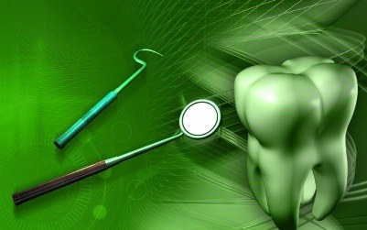
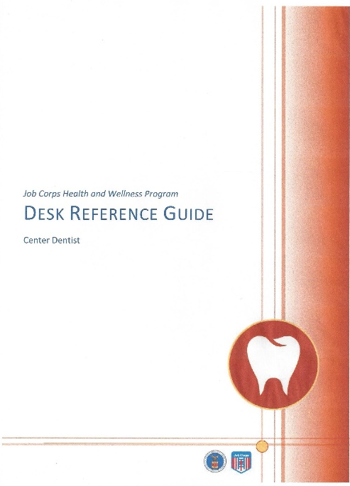
Navigating
the Center Dentist
Desk Reference Guide
(DRG)
Pamela Alston, DDS, MPP
Lead Oral Specialist
November 20, 2014
Notes:
I am pleased to have this opportunity to speak to you about the Center Dentist Desk Reference Guide which I will refer to from now on as the DRG. As you know PRH sections 6.10 through 6.12, including the Oral Health and Wellness Program (OHWP), were revised in September 2013 but the Center Dentist DRG was not revised at the same time. So, Oral Health and Wellness Programs labored under an outdated DRG. It is good news that the DRG was updated this month and now it provides guidance for meeting the compliance and quality requirements of the PRH.
Of course, Oral Health and Wellness personnel emailed, texted and called Dr. Kevin Avery and me in the interim with questions. Oral Health and Wellness personnel asked questions during the monthly teleconference calls and the minutes contained the answers that were given during the teleconference calls. But these were only interim measures. Nothing beats having a contemporary that is based on the current PRH.
The DRG does not contain requirements that are not in the PRH. It is strictly guidance in how to achieve good outcomes and have a quality program as you meet the compliance requirements of the PRH. It interprets the PRH, if you will.
For example, the PRH says that students can elect to have the oral examination. It does not specify how they consent to the oral examination and it does not give a timeframe for students to get it when they consent to it. But a PRH quality indicator for the Oral Health and Wellness Program and other programs in PRH 6.10 specifies that students’ health will be maintained or improved. With only 3 hours per 100 students, this is a challenging quality indicator. The DRG draws on best practices as documented in ROCA reports and spells out how to make it an elective rather than mandatory exam for the students.
There are aspects of the Oral Health and Wellness Program where you will find no guidance. These are usually areas where clinical judgment is necessary such as in the dental materials to use in restoring caries teeth or areas where the budget is involved.
At any rate, there are 23 pages of guidance excluding the title page, introduction and overview. I hope you will find them helpful.

Slide 2
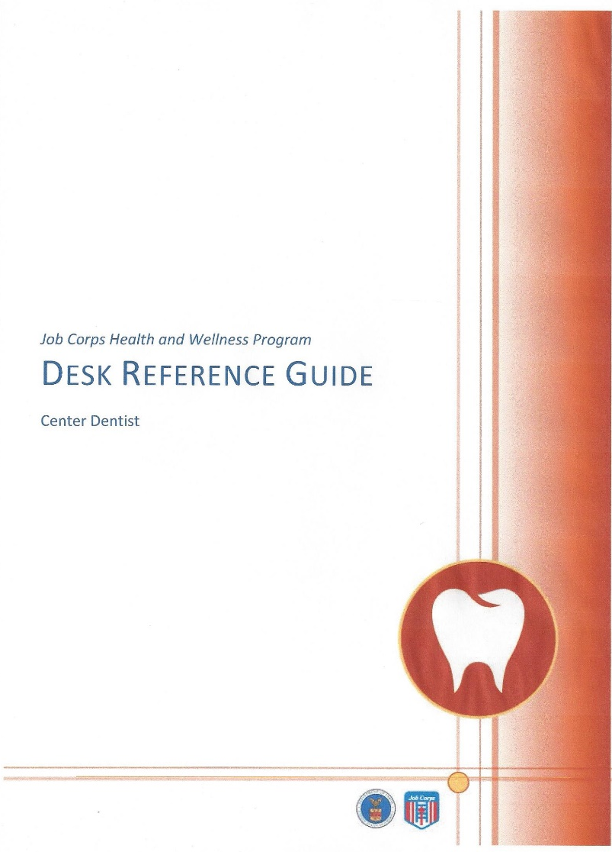
Webinar Overview
Webinar will end at 1 PM ET
Formal presentation
Question and answer period
Notes:
I arranged for today’s teleconference call to have a webinar format so that I could go orient you to the DRG and show you how to navigate it. As with the timeframe for the regular monthly teleconferences, the webinar is an hour long. The first part will be a formal slide presentation that you should follow along with your copy of the DRG. Dr. Kevin Avery and I will have live microphones but you will be on mute until the end of the formal presentation. When it is opened to questions and answers, you can either write your questions and comments or you may verbally ask questions to Dr. Avery and me. We have a lot of material to cover so this arrangement will be allow us to cover the material.

Slide 3
Webinar Objectives
OHW personnel will be familiar with the organization of the DRG
OHW personnel will know how to navigate the DRG to find answers
OHW personnel will know how to navigate the HW website to find documents
Notes:
We expect that by the end of the webinar you will be familiar with the organization of the DRG. The DRG was revised to be updated and user friendly. While the PRH is streamlined, the DRG provides detailed guidance in how to meet the PRH requirements and quality indicators. We incorporated answers to frequently asked questions. Although it is called the Center Dentist DRG, all members of the OHW team and the health and wellness manager can benefit from the DRG as a reference.
There are plenty of links to the the HW website where you can find documents that will help you have a compliant and quality OHWP. The Job Corps Health and Wellness website now has public facing which means that you can access all of the forms and documents in the Center Dentist DRG on the Job Corps Health and Wellness website by clicking on the website address in the introduction on the web version from any computer anywhere.

Slide 4
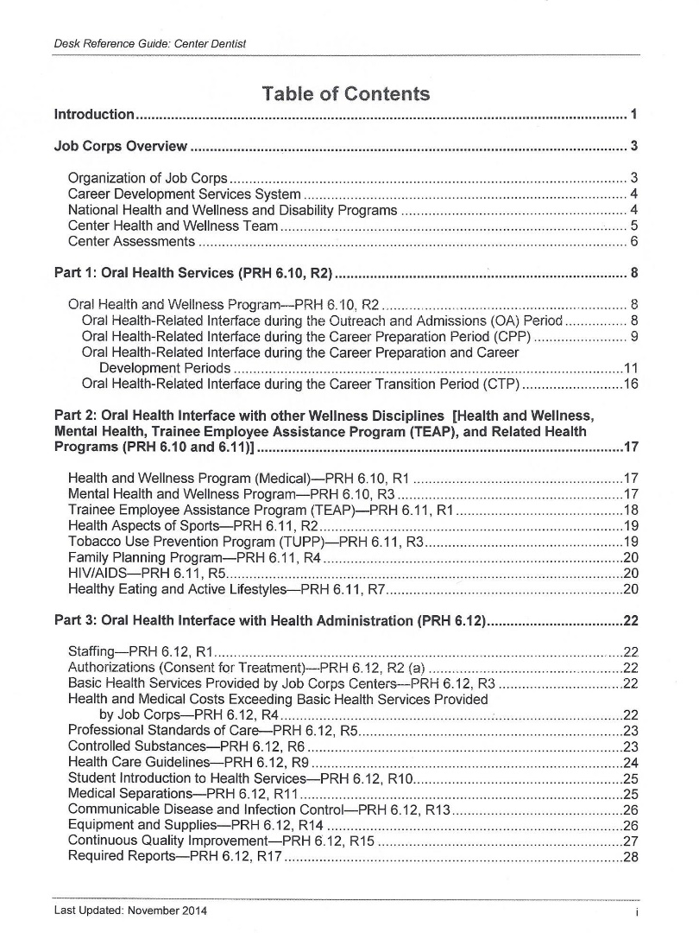
Table of Contents
Introduction
Tips for new dentists
Location of policies and procedures
Notes:
The DRG begins with a Table of Contents that is organized by topics that correspond to the PRH after a brief introduction and detailed overview. New dentists will find the introduction particularly helpful. It contains tips to get new dentists oriented to and functioning in their new position. It describes where the policies and procedures for center Health and Wellness programs are defined and clarified.

Slide 5
Table of Contents
Overview
CDSS
Nat’l Office and contractors’ roles
Center Health and Wellness Team
Center Dentist role
Center Assessments
“Regardless of the contractual or employee status of the
members of the OHW team, the Center Dentist provides
the direct and general supervision of the dental hygienist
and the dental assistant pursuant to the applicable state
dental practice act.”—Page 6
Notes:
The Job Corps overview describes that Job Corps Career Development Services System or CDSS which is a system for equipping students with everything they need to enter and stay employed in a competitive labor market.
There is a section in the introduction about the roles of the National Office, Health Support Contractor and Accommodation Support Contractor to guide the Health and Wellness and Disability Programs.
There is also a section in the Introduction about the composition and roles of the Center Health and Wellness Team.
The DRG states, “Regardless of the contractual or employee status of the members of the the OHW team the Center Dentist provides the direct and general supervision of the dental hygienist and dental assistant pursuant to the applicable state dental practice act.” So, it very important that center dentists be well-acquainted with the DRG.
It is also important to know that the Center Director has the final administrative decision-making authority on all matters concerning students and staff.
Center assessments including Regional Office Center Assessments are described. You can click on the link in the Center Assessments section to go to the Center Dentist Pre-ROCA Questionnaire and other ROCA tools. The assessors use the Job Corps Program Assessment Guide to standardize the assessment. In the center assessments section, you can see a description of the program ratings as described in the Program Assessment Guide. They range from unsatisfactory to exceptional.

Slide 6
Be familiar with the PRH and DRG so you don’t mislead Derrick.
Notes:
A PRH and DRG are necessary just so Derrick gets more than a tooth brush if he goes to Job Corps.

Slide 7
Career Development Services System
Outreach & Admissions Period (OAP)
Career Preparation Period (CPP)
Career Transition Period (CTP)
Career Development Period (CDP)
CDSS periods are described on Page 4.
Notes:
The first part of the DRG is organized along the periods of the Career Development Services System through which students progress, first as applicants and finally as graduates. The types and extent of oral health interfaces with them in each period are described. Some of the oral health interfaces involve the center dentist and others just involve other center or contract personnel.

Slide 8
PRH OHWP Components
dental readiness inspection
(b)
Early detection, diagnosis, dental hygiene, prevention/education (a)
elective oral exam (c)
Oral Health &
Wellness Program
PRH-6.10 (R2)
Agreement for students with braces
(f)
scope of basic oral care
(d)
Referral for other oral conditions
(e)
Quality indicators too
Notes:
During CDSS, the students interface with the oral health and wellness program when they seek early detection and diagnosis or when they receive the dental readiness inspections, elective oral exams, basic oral care, referrals for other oral health conditions, or when furnishing documentation that they have an agreement for braces.

Slide 9
OAP Oral-Health Interfaces
Outreach & Admissions Period (OAP)
JC Health Questionnaire
Applicant file review
Notes:
Part 1: Oral Health Services of the DRG describes oral health-related interfaces during the Outreach & Admissions Period. During the OAP, the Admissions counselors are gathering information from the applicants about their oral health status and their oral health needs and how and whom evaluates the information. The health and wellness manager may call on your expertise to evaluate the oral health information in the applicant file and assess if the students’ needs can be met within the scope of basic oral care. The DRG provides guidance on how the applicant file review is done and how it is documented.

Slide 10
CPP Oral-Health Interfaces
Health History PRH 6.10 (R1) a
Dental Readiness Inspection PRH 6.10, R2 (b)
Career Preparation Period (CPP)
Notes:
There are several oral health-related interfaces during the Career Preparation Period. Students complete the health history. There is link to it in the DRG. The DRG describes what alert questions are and how the center nurse follows up to affirmative answers to alert questions. The PRH says that students are entitled to emerIt describes your responsibility for evaluating new students with serious oral health conditions and how they are managed until they see you. The DRG also describes the DRI, who may delegate it and under what circumstances, how it is performed, and where it is documented. There is a link to the dental readiness inspection checklist that can be used to make sure the inspector is properly trained to perform it if the inspector is not the center dentist. There is a link to a pain rating scale that can be used when the student complains of oral pain. There is a link to a generic oral health fact sheet that can be customized to the center. It is a best practice to to the students some information about oral health information that may help them make a decision regarding receiving the oral examination. There is a link to the JC Physical Examination form where the results of the dental readiness inspection are documented.

Slide 11
CPP-CDP Oral-Health Interfaces
Health History PRH 6.10 (R1) a
Dental Readiness Inspection PRH 6.10, R2 (b)
Oral Examination
Basic Oral Care
Referrals to specialists
Medical Separations with Reinstatement
Emergent & Urgent Oral Health Care
Students with Orthodontics Appliances
Oral disease prevention, ed, management
Career Preparation Period (CPP)
Career Development Period (CDP)
Notes:
Because there is no time frame for the oral examination, it can be completed during the CPP or CDP. The oral examination record is accompanied by instructions. There is a link in the DRG to download them. The DRG provides guidance on how to perform the oral examination and how to assign the priority classification. There is a link to the Priority Classification System.
Because a caries risk assessment is part of the oral examination, there is a link in that section for downloading a dental habits questionnaire and caries risk assessment form.
There is no guidance in how long the oral examination should take.
Basic oral care is defined under basic health responsibilities in the PRH. It is elective as the PRH states and there is guidance in the DRG for how students elect to have it. There is a link to the Oral Health Treatment Consent/Refusal form in the DRG.
There are no productivity guidelines but OHW staff are expected to work productively. There is no guidance on quadrant dentistry but the expectation is stated in the DRG that the center dentists will follow the priority classification system and will work efficiently in order to maximize the number of students who receive oral health care.
In the treatment section, there is guidance on what to do when students have basic oral care conditions that require treatment by a specialist or oral health conditions require care that exceeds basic oral health care.
The DRG provides guidance on how to deal with oral health emergent or urgent conditions and how students are managed when the dentist is not available.
The DRG provides guidance regarding Oral Disease Prevention, Education, and Management. There is guidance on the delivery of oral hygiene instruction, group oral health education, and oral health promotion activities based upon centers’ best practices. I have not found best practices with regard to caries risk assessments.

Slide 12
CTP Oral-Health Interfaces
Copy of oral health treatment plan
Local community dental resources
Career Transition Period (CTP)
Notes:
The DRG describes the Career Transition Period and provides guidance in how center dentists can help students who are transitioning from Job Corps.

Slide 13
Oral Health Interface with Other Wellness Disciplines
Health and Wellness Program
Mental Health and Wellness Program
Trainee Employee Assistance Program
Health Aspects of Sports
Tobacco Use Prevention Program
Family Planning Program
HIV/AIDS Program
Healthy Eating and Active Lifestyles
Notes:
The center dentist interfaces with other Wellness disciplines. The thrust of teach of the other Wellness disciplines is highlighted in the DRG. The Health and Wellness Program interfaces appear in other sections of the DRG. The only one that did not fit anywhere else is the interface with HW over students on medications that have xerostomic effects. There is a link to the Xerostomia Chronic Care Management Plan. The Mental Health and Wellness Program thrust is described but there are no examples of oral health interfaces. The DRG describes guidance in collaborations with TEAP. Encouraging students to acquire and wear mouth guards during contact sports is recommended in the Health Aspects of Sports section of the DRG.
Guidance for the Tobacco Use Prevention Program includes collaboration on education about tobacco use, incentive for students who stop tobacco use, and referrals to TUPP.
Guidance on Family Planning includes provision of oral health services to pregnant students.
Guidance on HIV/AIDS includes special outreach as necessary to students with HIV/AIDS.
There is guidance on how to support the Healthy Easting and Active Lifestyles thrust. There are links to the HEALs website and to Oral Health and Wellness specific guidance.
I look forward to sharing center dentist best practices in the next revision of the DRG so please share your interfaces with other Wellness programs interfaces. They will be regarded as notable positives and strengths in ROCA reports. They can help elevate or justify your ROCA rating.

Slide 14
Oral-Health Interface the Health Administration
Staffing
Authorizations (consent for treatment)
Basic health services provided by JCCs
Health and medical costs exceeding basic health services
Health Care Guidelines
Notes:
There are links to Exhibit 6-5, Center Health Services Staffing Requirements and the ETA 6-53 Health Questionnaire. The health questionnaire contains consent for oral health care services including the exam and basic/routine health care that applicants or their guardians sign before they enter Job Corps but according to the PRH the oral exam and basic/routine health care is elective. So, technically students can refuse an oral exam and basic oral care. There is guidance in the Oral Health-related interface during the Career Preparation and Career Development Period regarding how to obtain consent for the elective oral exam and elective basic oral care.
There is guidance on the center dentists’ role students have oral health needs that are very costly or beyond the basic health services. You are not required to seek pro bono services but if you are aware of resources, you are encouraged to make the connections.
Professional standards of care are a broad area. They are too broad to be delineated in the PRH and even in the DRG. The guidance in short is to follow accepted professional standards of care in compliance with state law when providing health services and treating illnesses and injuries.
Center dentists are advised to make sure the Wellness Center has copies of current dental licenses, DEA registrations and professional liability insurance. The DRG also provides guidance on student health record documentation. There is a link to The Essentials of Job Corps Health and Wellness Charting.
The DRG provides guidance on responsibilities regarding Health Care Guidelines and a link where the Health Care Guidelines are located. Of course, each center needs to maintain current health care guidelines and you are responsible for approving or changing the content of the oral health care guidelines and signing them on an annual basis.

Slide 15
Oral-Health Interface the Health Administration—continued
Medical Separations—PRH 6.12, R12
Communicable Disease and Infection Control—PRH 6.12, R13
Equipment and Supplies—PRH 6.12, R14
Continuous quality improvement
Required reports
Notes:
In this part, Medical Separations are fully discussed but the guidance to center dentists is in other sections. Communicable disease and Infection Control are a broad area. Infection control is relevant to the oral health and wellness program. There is guidance on universal precautions, disinfection and sterilization, and spore testing. The CDC website is listed for reference.
There is guidance on equipment and supplies provides guidance to oral health personnel on discarding outdated supplies, preventive equipment maintenance, x-ray machine testing to make sure it is calibrated, making sure eyewash stations are equipped and checked regularly, and dental radiography systems.
There is guidance on continuous quality improvement.
The only required statistic is the number of oral examinations completed monthly because that statistic is reported on the mandatory Health Services Utilization Report.

Slide 16
Part 4: Additional Requirements
Wellness Education—PRH 3.17, R1
Standard/Center Operating Procedures—PRH 5.1, R3
Management and Reporting of Significant Incidents—PRH 5.5
Environmental Hazards/Hazard Communication—PRH 5.16, R6
Notes:
There are additional PRH requirements that you should be aware of not necessarily because you are required to meet them but because they relate to the Oral Health and Wellness Program or to Oral Health Personnel as employees. Take Wellness Education, for example. Oral Health is one of the topics covered. Maybe you can be a resource to the instructor for educational content. Some centers have a standard or center operating procedure for the Oral Health and Wellness Program. If so, be familiar with it and make sure the Oral Health and Wellness Program practices follow the SOP or COP. If it doesn’t submit edits. Some Oral Health and Wellness Program practices benefit from SOPs like spore-testing and handling a failed spore test. If you have a SOP or COP, it would be a best practice because it is not required.
There is guidance on the reporting of Significant Incidents. You are not responsible for completing them but if it is an oral health related significant incident you may be requested to give input to the report. You should be aware of Job Corps Centers’ responsibilities regarding environmental hazards and your responsibility regarding material data sheets. In another section of the DRG is guidance about minimum staff qualifications. Job Corps requires staff training for employees. Check with your Job Corps Center but it usually does not include subcontractors. There is guidance on the sending centers’ responsibilities when a student transfers. There is information about the Disability Program but no guidance regarding how to accommodate dental treatment needs of students with disabilities. The only guidance is to consult with the Disability Coordinator which each center is requested to have.

Slide 17
Part 4: Additional Requirements
Minimum Staff Qualifications
Required Staff Training
Student Enrollments, Transfers and Separations
Disability Program
Notes:
In another section of the DRG is guidance about minimum staff qualifications. Job Corps requires staff training for employees. Check with your Job Corps Center but it usually does not include subcontractors. There is guidance on the sending centers’ responsibilities when a student transfers. There is information about the Disability Program but no guidance regarding how to accommodate dental treatment needs of students with disabilities. The only guidance is to consult with the Disability Coordinator which each center is requested to have.

Slide 18
Frequently Asked Questions

Slide 19
Sorry but Siri can’t find answers to your OHWP program-related questions either.

Slide 20
FAQ
A new enrollee came in today. There was no waiver in the chart but the student reports her grandma is going to fax it to us. She says her grandmother is paying to transport her from the JCC to her hometown 4 hours monthly. What should happen?
DRG Guidance - Page 15 Obtain the signed agreement for the cost of continued treatment & transportation ASAP. File in the SHR. Obtain the signed agreement for compliance. Ascertain that the appointments will not exceed authorized leave limits.
Notes:
Pam- is this for orthodontics? It doesn’t specify in the question.

Slide 21
FAQ
I have found information on the OSHA website stating that personal radiation monitoring for each individual with potential to be exposed to high amounts on ionizing radiation should be in place. Do you know if either or both of these should be enforced at our center?
No DRG guidance—Check to see if there a state requirement for personal radiation monitoring. If so, furnish proof of the requirement to the HWM.
Notes:
In another section of the DRG is guidance about minimum staff qualifications. Job Corps requires staff training for employees. Check with your Job Corps Center but it usually does not include subcontractors. There is guidance on the sending centers’ responsibilities when a student transfers. There is information about the Disability Program but no guidance regarding how to accommodate dental treatment needs of students with disabilities. The only guidance is to consult with the Disability Coordinator which each center is requested to have.

Slide 22
FAQ
An applicant checked ‘yes’ for dental problems/pain & wrote “wisdom teeth erupting, my dentist recommends extraction.” Should the extractions be handled prior to arriving on enter, after arrival but with a MSWR, or is the center obligated to handle it financially?
DRG Guidance—Pages 9, 13—Some wisdom teeth may be manage nonsurgically. Extractions of pathological teeth are basic oral care. They may be extracted by the center dentist. The center may refer the students to an oral surgeon but must assume the cost. A MSWR may be appropriate when the extraction costs are exceptional. The center dentist should assist in the applicant file review.

Slide 23
FAQ
What do we do if a student transferring for advanced training has refused dental treatment from the beginning. The form asks if all dental treatment has been completed in the last 6 months but nothing was done. How do we proceed with that? Do we just sign them off?
DRG Guidance–Page 30–The sending center is not required to ensure that students have a certain priority classification. The center is required to provide a legible summary note on the student’s current state at least 2 weeks prior to the student’s arrival.

Slide 24
FAQ
The majority of Job Corps students meet the eligibility criteria for Medicaid. Can the center process and collect all third party payments?
DRG guidance – Page 12-13 Center operators are responsible fore providing and paying for basic oral care. Oral health conditions that require advance oral care are not paid by Job Corps.

Slide 25
FAQ
Is it acceptable for a center to offer whitening to help students appear more presentable for job interviews before they leave the program?
No DRG guidance

Slide 26
FAQ
Is it okay for nurses to use an over-the-counter temporary dental repair to use on students with dental emergencies as deemed appropriate?
DRG Guidance–Pages 23, 24 Oral health care guidelines and personal authorizations for health staff are signed by the center dentist. All personnel should follow accepted professional standards of care and subject to state laws.

Slide 27
FAQ
What if a student declines voluntary oral health exam and later has a dental emergency and potentially needs referral to community facility? Will the referral be made based on the dental readiness inspection or should the student be seen by the center dentist first before a referral?
DRG Guidance—Page 14, 11—Job Corps is required to have a 24-hour emergency care system. Students who decline the elective oral exam may rescind their refusal at any time. After hours, the center follows the Standing (Center or Department) Operating Procedure.

Slide 28
FAQ
What are the restorative materials for Job Corps students?
No DRG Guidance
See page 13

Slide 29
FAQ
Does Job Corps require productivity data?
DRG guidance – Page 28
The PRH has no productivity requirements and does not require any productivity reports.

Slide 30
FAQ
Is the signed ETA 6-53 sufficient consent for the oral exam and basic oral care?
DRG guidance–Page 12
The ETA 6-53 is signed by applicants. There should be documentation that students have the opportunity to consent to or decline oral health services.

