Slide 1
Sugar and Acid Double Trouble
Teresa Santana, DDS
Center Dentist San Jose Job Corps

Slide 2
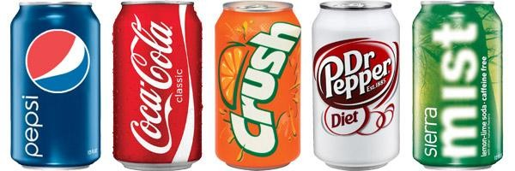
Trendy drinks are causing a generation of young people to experience decay and loss of tooth enamel unprecedented in modern times.
Overconsumption of sugar-laden, acidic drinks, such as boxed juice, sport drinks and soft drinks, is reversing more than 50 years of public health gains realized through preventive measures like fluoridated water and dental sealants.
Notes:
Source: http://www.scottetroutdds.com/general/soda-pop-teeth-cigarettes-lungs

Slide 3
“Soda is to teeth as cigarettes are to lungs.”
From their early years into young adulthood, young people are drinking increasing quantities of these sugary, acidic drinks from morning until night.
They consume fruit juice at breakfast, soda at lunch and sport drinks or flavored sweet tea or coffee after school.
During the past generation, milk intakes have decreased while soda and 100 percent juice intakes have increased.
Heavy soda consumption has also been linked to other health complications including diabetes, obesity and osteoporosis.
Notes:
Quote by unknown dentist.

Slide 4
Hard Facts About Soft Drinks
A bottle of soda pop in the 50's was 6.5 ounces. Today, a 12-ounce can is standard and a 20-ounce bottle is common.
Larger container sizes mean more calories, more sugar and more acid in a single serving. A 64-ounce "Big Cup" has more than five cans of soda pop in a single serving!
There is no nutritional value in soft drinks. In regular soda all of the calories come from sugar.
One-fifth of all one- and two-year-old children drink soda.
Today, teens drink three times more soda pop than 20 years ago, often replacing milk.
Soft drink companies pay high schools and middle schools big bucks to offer their products.
Sealants only protect tooth chewing surfaces. Soda decay tends to occur where sealants can't reach.
Notes:
Harnack L, Stang J, Story M. Soft drink consumption among US children and adolescents: Nutritional consequences. Journal of the American Dietetic Association 1999;99:436-444. Gleason P, Suitor C. Childrens diets in the mid 1990s: Dietary intake and its relationship with school meal participation. Alexandria, VA: US Department of Agriculture, Food and Nutrition Service, Office of Analysis, Nutrition and Evaluation;2001. Brimacombe C. The effect of extensive consumption of soda pop on the permanent dentition: A case report. Northwest Dentistry 2001;80:23-25.

Slide 5
Sugar and Acid Dental Damage
The patient shown below drank 5 or 6 sodas a day and had poor home care. The result was decay in multiple teeth.
Source: http://www.drchristophermorris.com/services/cosmetic/
Notes:
Reference: http://www.drchristophermorris.com/services/cosmetic/

Slide 6
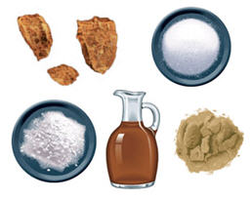
Sugar
The sugar content in soft drinks, whether it is sucrose, high fructose corn syrup or glucose is astounding and inflicts the same damage on teeth.
Most people would find it difficult to crunch on 11 to 13 teaspoons of sugar in one sitting. Yet that is what we do with every regular soda.
In regular soda all of the calories come from sugar.
Notes:
Photo: http://www.benefits-of-honey.com/images/sugar_types.jpg

Slide 7
How much sugar is in it?
Coca Cola
12 oz can: 39 g 20 oz bottle: 65 g 1 liter bottle: 108 g
pH 2.4
Source: http://www.sugarstacks.com/beverages.htm

Slide 8
Mountain Dew:
40% more caffeine and 15% more sugar than Coke
20 oz bottle: 77 g 1 liter bottle: 124 g
pH: 3.3
Source: http://www.sugarstacks.com/beverages.htm

Slide 9
Vitamin Water: Vitamin? Really?
8 oz serving: 13 g 20 oz bottle:33 g
Source: http://www.sugarstacks.com/beverages.htm

Slide 10
How soda attacks teeth
Dental decay is by definition the demineralization of tooth structure by acids caused by bacterial fermentation of dietary sugars.
In other words: Sugar in soda combines with bacteria in the mouth to form acid, which attacks the teeth by causing decay.
Whether regular or diet, soda contains its own acid, which also can damage teeth by causing dental erosion.
Each attack lasts about 20 minutes and starts over with every sip of soda taken.
Frequency of drinking is more important than amount of drink, because each sip renews the acid attack.
Notes:
In other words drinking 1 can of soda in one sitting with a meal, does less damage than sipping the same can for a prolong period of time.
Is not a single episode of drinking an acidic drink that causes erosion and decay, is the repeated and/or prolonged use of it that does the damage.

Slide 11
Acids Cause Dental Erosion
Dental erosion is the chemical removal of minerals from the tooth structure. It is irreversible.
Minerals are dissolved from the tooth structure by acids that are NOT produced by bacteria.
A pH lower than 5.5 starts demineralizing and dissolving enamel.
Immature enamel in kids and teens is most susceptible to damage and decay, because is more porous, chalky and easily penetrated and dissolved by acids.
Notes:
Immature enamel is a lot more porous
The warmer the drink the greater the amount of available acid hence more erosion.
Source: Lussi A, Jaeggi T, Zero D. The role of diet in the aetiology of dental erosion. Caries Res. 2004;38 Suppl 1:34-44.
Imfeld T. Dental erosion: definition, classification and links. Eur J Oral Sci. 1996;104 (2[Pt 2]):151-155.

Slide 12
Sugar and pH of common drinks
Test by Dr. John Ruby, University of Alabama, Birmingham School of Dentistry, 2007 Minnesota Dental Association: Sip All Day, Get Decay.
Notes:
The lower the pH, the stronger the acid. Battery Acid is not a drink, is used only for comparison purposes.
Coffee 2.4-3.3 Orange Juice 3.4

Slide 13
Soft Drink Acid Damage
Source: http://www.vanguarddentalgroup.com/smile-gallery/
Notes:
Notice the pattern of white dull stains: decalcification
And then brown cavitated areas: decay
After the decalcified enamel area turns soft, it will start “peeling” away, making it more susceptible to decay.

Slide 14
Other acid sources:
Sodas and juices are not the only source of dietary acid.
Patients may suffer from acid reflux or bulimia.
Vomiting due to alcohol abuse.
Eating many servings of acidic fruit or vegetables.
Lemon or orange slices sucking habit, if with salt damage is worse.
Condiments, sauces heavily used in some households.
Chewable vitamin C.
Meth, ectasy, cocaine or other recreational drug use.
Dry mouth due to low salivary flow.
Notes:
Cultural and geographical factors come into play here.
Our Job Corp Center has a lemon tree and our students routinely pick them and eat them.
Dry mouth syndrom or due to medication is not very common among our Job Corp population

Slide 15
Soda Mouth
Source: http://www.johngoodmandds.net/blog/2013/10/09/health-effects-from-drinking-soda-112632
Notes:
Source: http://www.johngoodmandds.net/blog/2013/10/09/health-effects-from-drinking-soda-112632

Slide 16
How to Identify Acid Exposure
Health care professionals can screen for excessive acid exposure by visually inspecting teeth for some simple clues. Decay affects the smooth surfaces of teeth, and in the beginning is signaled by a white area known as “decalcification.” A dull appearance plus a white decalcified area indicates excessive acid exposure, the precursor to decay.
A more advanced stage of acid damage involves losing enamel. Dentin is darker than enamel and more sensitive. Those who swish acidic drinks also exhibit worn lingual surfaces and thin or broken anterior teeth and loss of enamel in the premolar and molar area.
In adults, decay on the incisal edges of upper or lower teeth indicates an acidic environment and perhaps a dry mouth.
Dental erosion can be misdiagnosed as dental caries, is important to diagnose the correct etiology so that the correct treatment plan and prevention protocol can be developed.

Slide 17
This patient had a history of drinking five to six bottles of an acidic carbonated
beverage a day, leading to combined dental erosion–caries.
Source: http://cdeworld.com/courses/4554-Dental_Erosion:Prevention_and_Treatment#

Slide 18
Decalcification
Notes:
Acid erosion around braces. Seen in a photo POST braces removal.

Slide 19
Info for Health Care Professionals
Talk to your patients about consumption of bad drinks.
Rule out GERD and bulimia.
Ask how many sports drinks and soft drinks and how much juice or other low-pH drinks the patient consumes per week, and in what serving size.
Ask whether the patient consumes the drink slowly over time. Does he or she make the drink last all morning, afternoon or through the entire day or game?
Notes:
Note if the patient charts metions any antiacid medication.

Slide 20
Diet soda can have same effect on teeth as meth
Source: Dr. Mohamed Bassiouny
http://www.ncbi.nlm.nih.gov/pubmed/23454320
Notes:
Both patients in the pictures in addition to their respective addictions had very poor oral hygiene.
Similar to citric acid, ingredients used in preparing methamphetamine can include extremely corrosive materials such as battery acid, lantern fuel, drain cleaner.
Crack Cocaine is highly acidic as well.

Slide 21
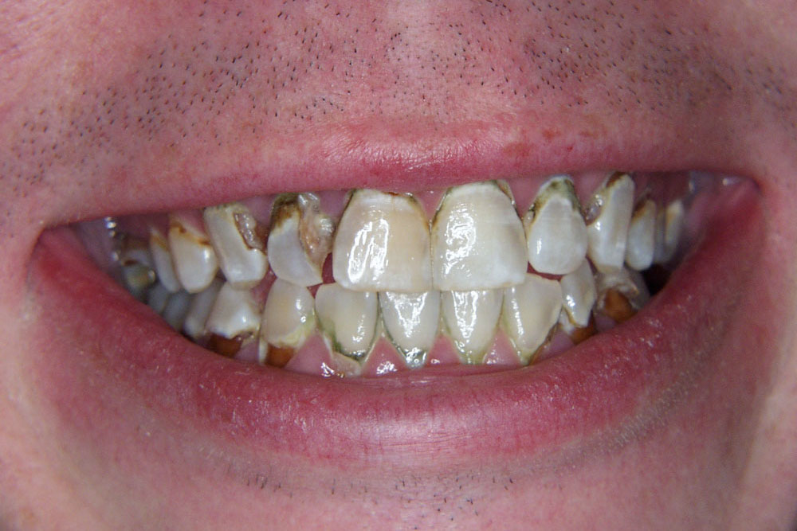
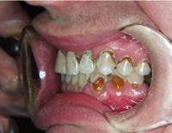
Patient consumed one to two liters of Mountain Dew a day. In addition to doing the Dew, he smoked almost a pack of cigarettes a day.
Source: http://www.bocaratoncosmeticdentist.com/smile-restoration/full-mouth-reconstruction-soda-pop-damage/

Slide 22
Excessive daily soda pop intake caused characteristic tooth decay around gums.
Source: http://kimhenrydental.wordpress.com/category/dental-facts

Slide 23
Health care professionals should advise patients to:
Limit acidic drinks, stay hydrated the right way with WATER. Sugar and caffeine laden drinks speed up dehydration.
Use a straw to draw acidic liquid away from the teeth.
Never drink acidic drinks when a dry mouth is present. Saliva protects the teeth, if little saliva is present the acid damage is greatest.
Drink water to rehydrate and return the mouth to a neutral pH.
Chew sugarless gum with Xylitol to help restore a neutral pH.
Wait one hour to brush after drinking a sports drink or soft drink to allow enamel to re-harden after an acid attack.
Notes:
Most sugar free gum out there contains xylitol, we pass it out as sample to our pts at SJJCC.
Sports drinks are promoted for athletes by coaches. When they consume a sports drink in a dehydrated state, the acid hits the enamel without the benefit of the natural salivary proteins to protect the enamel. Natural saliva protects the teeth from acidic drinks. When there is little or no saliva acid does its’ greatest damage.

Slide 24
Advice patients to do not:
Sip for extended periods of time. Advice to throw away the cap to prevent ongoing sipping.
Drink soda shortly before bedtime.
Brush right after a meal or drink.
Substitute soft drinks, sports drinks or fruit juice for a meal.

Slide 25
Recommend
Consuming two or more servings of dairy foods.
Limiting the intake of 100 percent juice to 6oz a day.
Restricting other sugared beverages to occasional use, no more than 12oz a day.
This doesn’t mean a person should never drink soda. In fact, drinking it in moderation may represent no harm at all. However, substituting sugary, acidic carbonated beverages for water or intake of caloric food could be problematic in the long run.

Slide 26
Dental team should advice to:
Chew sugarless gum.
Visit the dentist regularly.
Brush and floss daily using a a fluoride toothpaste.
Drink fluoridated water.
Prescribe additional fluoride, rinse or prescription toothpastes.
Prescribe a casein phosphopeptide-amorphous calcium phosphate complex (CPP-ACP) to remineralize the enamel, as MI Paste.
Read the labels for sugar content.
Notes:
Rx such as: Mi Paste, Gel-Kam, rx fluoride gel.
Calcium and Fluoride alter the solubility of enamel, in other words, it makes the enamel stronger.

Slide 27
Source: http://www.examiner.com/article/soda-mouth-a-dental-disaster-just-like-meth

Slide 28
Statements by the American Beverage Association 2014
The beverage industry provides multiple beverage options to meet our bodies' hydration needs, such as bottled water, 100 percent juice, sports drinks, ready-to-drink teas and soft drinks. In fact, water is the predominant ingredient in carbonated soft drinks. Regular soft drinks are made up of 90 percent water and diet soft drinks with zero calories are 99 percent water.
Adults and children can consume a wide variety of fluids each day, including water, milk, juice, tea, sports drinks and soft drinks to meet their hydration needs. For all the appeal beverages generate from a taste standpoint, it's easy to forget they exist for an essential reason.
Source: http://www.ameribev.org/nutrition-science/hydration/

Slide 29
© 2014 American Beverage Association
Do soft drink beverages contribute to poor dental health?
You cannot single out one food or beverage as causing dental caries or erosion considering so many factors determine individual dental health. These include the types of food consumed, the length of time foods are retained in the mouth and the level of oral hygiene and access to professional dental care. For instance, sticky foods that tend to stay in the mouth longer and/or cling to teeth can be a significant source of dental cavities. In contrast, liquids that contain sugar, such as soft drinks or sweetened beverages, clear the mouth quickly.
Source: http://www.ameribev.org/nutrition-science/oral-health/qas/
Notes:
http://www.ameribev.org/nutrition-science/oral-health/qas/

Slide 30
© 2014 American Beverage Association
Do sports drinks impact teeth enamel more than other drinks?
There is no single cause of dental erosion, and there are numerous factors that can contribute to it besides various foods and beverages. A person’s susceptibility to dental erosion varies depending on a person's behavior, lifestyle, diet and genetic make-up. General dental health has improved due to many factors, including better oral hygiene, water fluoridation and frequent dental check-ups.
The facts demonstrate that there are multiple causes of dental erosion and many protective factors that can help prevent or minimize it. It is irresponsible to blame foods, beverages or any other single factor for enamel loss and tooth decay.
Source: http://www.ameribev.org/nutrition-science/oral-health/qas/

Slide 31
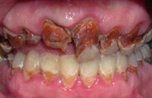
Mountain Dew Enamel Erosion
A male patient in his late 20's. Excessive consumption of the popular Mountain Dew beverage has caused considerable damage to the surfaces and structures of his upper teeth. Damage to the lower teeth is limited to enamel surfaces.
Source: http://www.rochesternewyorkcosmeticmakeoverdentistry.com/replace_tooth_enamel.html
Notes:
Mountain Dew Enamel Erosion
Paul Sussman, DMD

Slide 32
Resources
Minessota Dental Association http://www.sipallday.org
Indiana Dental Associtaion http://drinksdestroyteeth.org
http://www.ncbi.nlm.nih.gov/pubmed/23454320
http://www.huffingtonpost.com/2013/05/28/diet-soda-teeth-similar-to-meth-photos_n_3348158.html
http://www.colgate.com/app/CP/US/EN/OC/Information/Articles/Oral-and-Dental-Health-Basics/Oral-Hygiene/Oral-Hygiene-Basics/article/Soda-or-Pop-Its-Teeth-Trouble-by-Any-Name.cvsp
http://www.scottetroutdds.com/general/soda-pop-teeth-cigarettes-lungs
http://www.powerofsour.com
http://www.ncbi.nlm.nih.gov/pmc/articles/PMC2516950/pdf/nihms50629.pdf

